Slide 1



The International TESOL Conference 2025
5th – 6th August, 2025 HUFLIT University
English Learning on Demand: Exploring the Convenience of AI Tutors
Authors:
Nguyen Dang Khoa (UEH)
Thuy Ngoc Le (UEH)
Hong Sam Le (Diplomatic Vietnam of Vietnam)
HUFLIT University, August 5th - 6th, 2025

Slide 2


PRESENTATION OUTLINE
1
2
3
INTRODUCTION
METHODOLOGY
DISCUSSION AND CONCLUSIONS

Slide 3

ABSTRACT
  AI-powered apps increasingly used in English education.
  Research gap: limited study of perceived convenience (CON) in developing countries (e.g., Vietnam).
  Aim: explore how perceived convenience affects learner attitude and adoption.
METHOD
KEY FINDINGS
  Based on Technology Acceptance Model (TAM)
  Added perceived convenience as key factor.
  Quantitative survey (n=255 Vietnamese respondents).
  Analysis: PLS-SEM (SmartPLS 4.1).
  Perceived convenience → strongly improves user attitude.
  Positive attitude → higher adoption of AI-powered English learning apps.
CONTRIBUTIONS
KEYWORDS
  Helps service providers & policymakers understand AI’s role in English learning.
  Raises awareness of AI’s importance in education.
AI; Perceived Convenience (CON); TAM; AI-powered English learning applications.

Slide 4

INTRODUCTION
  Since COVID‑19, online English learning in Vietnam increased sharply.
  Shift brought challenges:
    Need for learner self‑direction & responsibility (Peng et al., 2023).
    Lower focus & engagement (Aristovnik et al., 2020).
    Inequalities between public & private learners; missing social aspects → more stress (Kuhfeld et al., 2021).
  Educators explore tools like video recording & AI to boost motivation & learning outcomes (Bradley, 2017).
AI IN ENGLISH EDUCATION
THEORETICAL FRAMEWORK
  Global studies show AI tools (Google Home, Alexa, NovoLearning) improve:
    TOEIC scores, English proficiency, learner attitudes (Obari et al., 2020; Arini et al., 2022)
  In Vietnam:
    Grade 11 learners & high school pupils report positive attitudes & openness to AI (Dan et al., 2024; Quyet & Minh, 2024).
    Call for balanced frameworks & training.
  Many studies added perceived convenience (CON) into TAM:
    Influences continued use of WLAN, RFID, mobile payment, tourism apps.
  This study extends TAM with CON, drawing on the SOR model perspective.
Research question
What is the relationship between perceived ease of use, perceived usefulness, perceived convenience, and usage attitude on English learners’ continuous intention to use AI tools?

Slide 5
02.METHODOLOGY
2.1 Sampling
  Online survey via Google Form.
  Collected over 3 weeks → 255 valid responses.
  Gender:
    58.9% male → slightly higher than national average (49.9:51.1).
  Age groups:
    31.4% → 18–30 years old.
    29.1% → 31–40 years old.
  Occupations:
    Trade & manufacturing: 35.5%.
    Service sector: 23.4%.
  Younger people & males showed higher participation willingness.
Research framework
  Based on extended TAM model.
  Includes:
    Perceived usefulness.
    Perceived ease of use.
    Perceived convenience
    → Affecting attitude toward using.
    → Leading to intention to use AI in English learning.

Slide 6
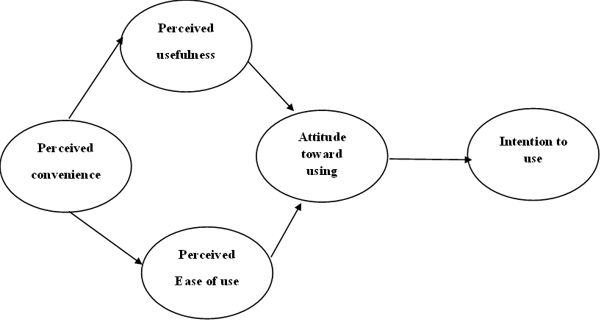
Fig.1. Research framework
Source: Authors’ own synthesis

Slide 7
02.METHODOLOGY
2.2. Measures & Results
KEY FINDINGS
MODEL INSIGHTS
  Measurement Approach:
Scales adapted from established studies (e.g., Munoz-Levia et al., 2017; Childers et al., 2001) using 5-point Likert. Translation followed back-translation for validity.
  Analysis Method:
PLS-SEM (SmartPLS v4.1) was used for reliability, validity, and hypothesis testing. One item (PU1) was dropped due to low factor loading.
  Significant Positive Relationships:
    Attitude → Intention to Use (β = 0.772, p = 0.000).
    Perceived Convenience → Attitude / PEU / PU.
    Perceived Ease of Use → Attitude / PU.
  Non-significant Relationship:
    Perceived Usefulness → Attitude (p = 0.133).
IMPLICATIONS
CONCLUSION
  Perceived Convenience is the strongest influencer, highlighting the value of time-saving and ease in AI tool usage.
  Ease of Use contributes to positive attitudes and perceived usefulness.
  Perceived Usefulness, though indirectly influential, is less critical in shaping learner attitude.
Designers should prioritize convenience, usability, and personalized experience to drive adoption of AI tools in English learning.

Slide 8
TABLE 1. MEASUREMENT VARIABLES AND PATH COEFFICIENTS

Slide 9
TABLE 1. MEASUREMENT VARIABLES AND PATH COEFFICIENTS

Slide 10
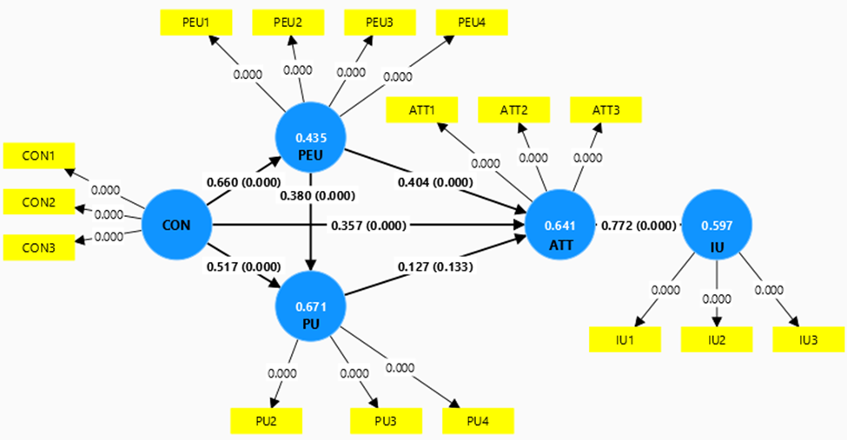
Fig.2. The structural model analysis using Bootstrapping
Source: Authors’ own synthesis

Slide 11
Table 2. Analysis results
Source: Authors’ own synthesis

Slide 12

03. DISCUSSIONS AND CONCLUSIONS
THEORETICAL CONTRIBUTIONS
  Extended TAM by adding perceived convenience (CON).
  Found CON significantly affects:
    Attitude
    Perceived ease of use
    Perceived usefulness
  Shows emotional & motivational factors (e.g., convenience, ease) are critical in AI tool acceptance.
PRACTICAL IMPLICATIONS
  Developers: focus on accessibility, flexibility, mobile use, quick navigation & personalization.
  Educators & marketers: highlight ease, engagement & comfort, not just test scores.
  Emotional appeal can be stronger than cognitive utility for some learners.
KEY INSIGHTS / CONCLUSIONS
  Perceived convenience & ease of use shape positive attitudes & intentions.
  Perceived usefulness alone may not be enough.
  Design AI tools to be functional and emotionally supportive → better learner adoption.

Slide 13
The International TESOL Conference 2025
5th – 6th August, 2025 HUFLIT University
THANK YOU FOR LISTENING!
HUFLIT University, August 5th - 6th, 2025

