Slide 1
SUPPORTING ENGLISH LANGUAGE LEARNING THROUGH AI: INSIGHTS FROM STUDENTS AND INSTRUCTORS IN A VIETNAMESE UNIVERSITY
Hoa Pham & Cương Nguyễn
Nha Trang University

Slide 2
Table of contents
01
02
03
04
05
06
Introduction
Theoretical Framework
Method
You can describe the topic of the section her
You can describe the topic of the section here
You can describe the topic of the section here
Findings and Discussion
Conclusion
Q&A
You can describe the topic of the section here
You can describe the topic of the section here
You can describe the topic of the section here

Slide 3
01
INTRODUCTION

Slide 4
The Rise of AI in Higher Education
* AI reshapes teaching and learning
– From lecture-based delivery to multimodal, interactive learning
– Students use video content, simulations, and AI-powered tools
• Widespread AI adoption among students and teachers
– 86% of students use AI for academic purposes (DEC, 2024)
– Common tools: ChatGPT, Grammarly, Copilot
– 76% of English teachers use AI tools for planning and materials (Edmett et al., 2024)
• AI as a pedagogical agent
– Supports writing, idea generation, revision, and feedback
– Enables adaptive, personalized learning experiences

Slide 5
Pedagogical Implications and Theoretical Grounding
• Opportunities and challenges
– Benefits: Scaffolding, feedback, personalized support
– Risks: Overreliance, lack of critical thinking, ethical concerns
– 68% of students want more guidance on responsible AI use
• Theoretical foundations
– Constructivist Theory: Learning through active engagement (Bruner, 1996)
– Sociocultural Theory & ZPD: Guided support bridges learning gaps (Vygotsky, 1978)
– Teacher Beliefs (Borg, 2003): Influence AI adoption and instructional design
• Purpose of the study
– Explore how students and instructors use and perceive AI in English language learning; Identify pedagogical opportunities, tensions, and areas for curriculum and professional development

Slide 6
02
Literature Review & Theoretical Framework

Slide 7
Constructivist Learning & ZPD – How Learning Happens
What is Constructivist Theory?
Learners build their own understanding by exploring, solving problems, and reflecting on experience (Bruner, 1996; Schunk, 2020).
In language learning, this means doing meaningful tasks, not just memorizing rules.
How AI Supports This:
AI tools can adjust content difficulty, offer real-time hints, and prompt students to think critically.
Example: An AI reading tool changes text difficulty based on student comprehension.
What is ZPD (Zone of Proximal Development)?
From Vygotsky (1978): The ZPD is the space between what a learner can do alone and what they can do with help.
AI can act like a tutor—offering just enough support to help learners grow.

Slide 8
AI as a Learning Partner – Social & Cognitive Scaffolding
Learning is social:
Vygotsky emphasized that we learn best through interactions with others.
Now, AI tools also play this role by guiding learners step by step.
Examples of AI Scaffolding:
Chatbots: Help students practice conversations or grammar.
Peer review platforms: Let students give feedback to each other, supported by AI-generated suggestions.
Essay tools: Encourage revision by pointing out unclear or weak sections.
Why it matters?
These tools create chances for reflection, collaboration, and deeper understanding.
AI doesn’t replace teachers or peers—it adds another layer of support, especially outside class time.

Slide 9
Teachers’ Beliefs Shape AI Use in the Classroom
Why do teachers’ beliefs matter?
Teachers don’t just follow rules—they make instructional decisions based on what they believe about teaching, learning, and technology (Borg, 2003).
Beliefs determine whether AI is seen as a tool for growth or a threat to learning.
Two common teacher views:
Optimistic: AI offers personalized feedback and increases student autonomy.
Cautious: Concerns about cheating, over-reliance, or loss of original thinking.
Experience changes beliefs
Teachers become more open to AI when they see real improvements in student outcomes.
But fears around privacy, bias, and ethics remain common (Asterhan & Schwarz, 2023).
Local Contexts Matter: In Southeast Asia, factors like digital access, institutional support, and culture also shape how AI is used in teaching.

Slide 10
AI in Foreign Language Teaching (FLT)
AI tools support all 4 skills:
Speaking: speech recognition, fluency coaches, chatbots
Writing: Grammarly, translation, scaffolding, coherence
Reading/Vocab: adaptive texts, AI games
Listening: chatbot conversations, real-time simulations
Boosts learner autonomy, confidence, and critical thinking.
Risks: uncritical reliance, lack of cultural fit, and errors without teacher mediation.

Slide 11
Research Gaps & Study Focus
Most research overlooks student-instructor interplay in AI-rich environments.
This study explores:
Student AI usage: tasks and behavioral patterns
Instructor beliefs: impact of experience on AI integration
Interplay: how both groups shape AI-enhanced English learning
Aims to guide curriculum design and teacher training using constructivist and sociocultural principles.

Slide 12
03
METHOD

Slide 13
Method – Overview
Quantitative, cross-sectional survey design (Creswell & Creswell, 2018).
• Goal: Investigate AI usage by students and beliefs of English instructors.
• Participants: 186 English-majored students, 32 full-time instructors.
• Data collection: Online surveys analyzed using R (R Core Team, 2024).

Slide 14
Method – Instruments & Validity
Two instruments (students & instructors) using 4-point Likert scales.
• Student survey: AI use frequency, purpose, and benefits.
• Instructor survey: Beliefs, concerns, and ZPD-aligned practices.
• Validity reviewed by TESOL experts; Cronbach’s α > .70 for all scales (Table 1)
Most valued function: AI for error detection and correction
– Mean = 3.38; 53% of students strongly agreed
Second-highest rated use: AI tools help explain concepts/tasks (Mean = 3.27)
Lowest-rated item: AI helps improve critical thinking
– Mean = 2.64, with a negative skew (-0.38); 34% of students were disagreed or strongly disagreed.
Students appreciate AI for practical support (e.g., grammar help and explanations) but are less convinced about its role in developing higher-order thinking skills like critical thinking.

Slide 15
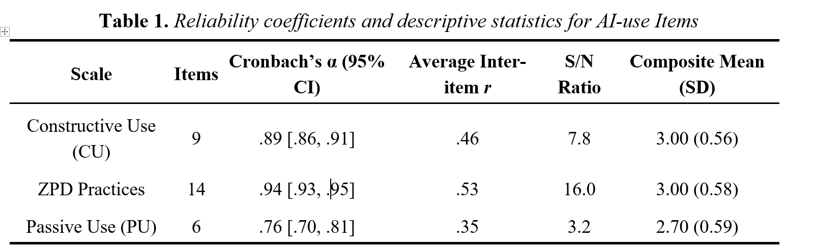

Slide 16
04
FINDINGS AND DISCUSSION

Slide 17
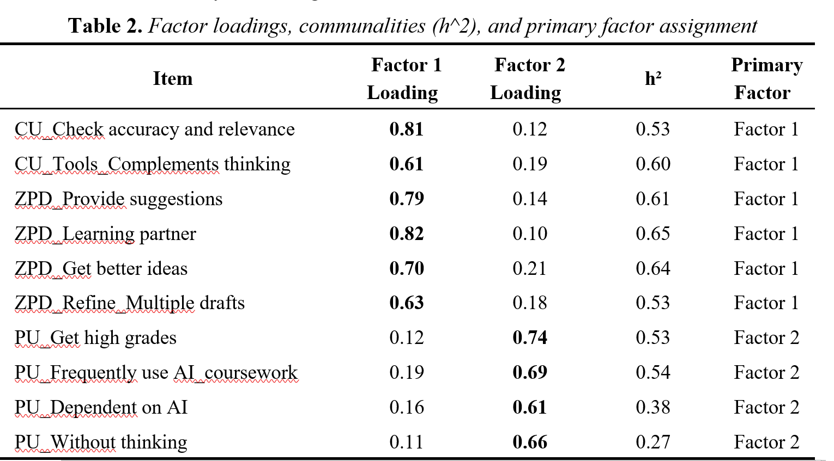

Slide 18
Purpose and Use of Exploratory Factor Analysis (EFA)
Why EFA?
➤ EFA was used to uncover underlying dimensions (or "factors") in student AI use behavior without imposing a predefined structure.
➤ Helps determine how different survey items cluster together, revealing patterns in how students interact with AI.
Model Fit and Results:
➤ Two-factor model explained 50% of total variance
– Factor 1: 32% | Factor 2: 18%
➤ Good model fit confirmed by key statistics:
– RMSEA = 0.073 | TLI = 0.869 | RMSR = 0.05

Slide 19
Identified AI-Use Factors Among Students
Factor 1: Collaborative/Metacognitive Use
➤ Students use AI for idea generation, multiple drafts, formative feedback
➤ Reflects constructivist and sociocultural learning (Bruner, Vygotsky)
➤ AI as a scaffold for higher-order thinking
Factor 2: Instrumental/Performance-Oriented Use
➤ Focused on grades, convenience, and quick task completion
➤ Indicates surface-level engagement with minimal cognitive effort
➤ Reflects pressure of performance-driven learning environments
Students use AI both as a cognitive learning partner and a performance tool
Moderate correlation between the two factors (r = 0.63)
➤ Some students blend both approaches
Highlights need for critical guidance to prevent over-reliance and promote meaningful learning (Popenici & Kerr, 2017)

Slide 20
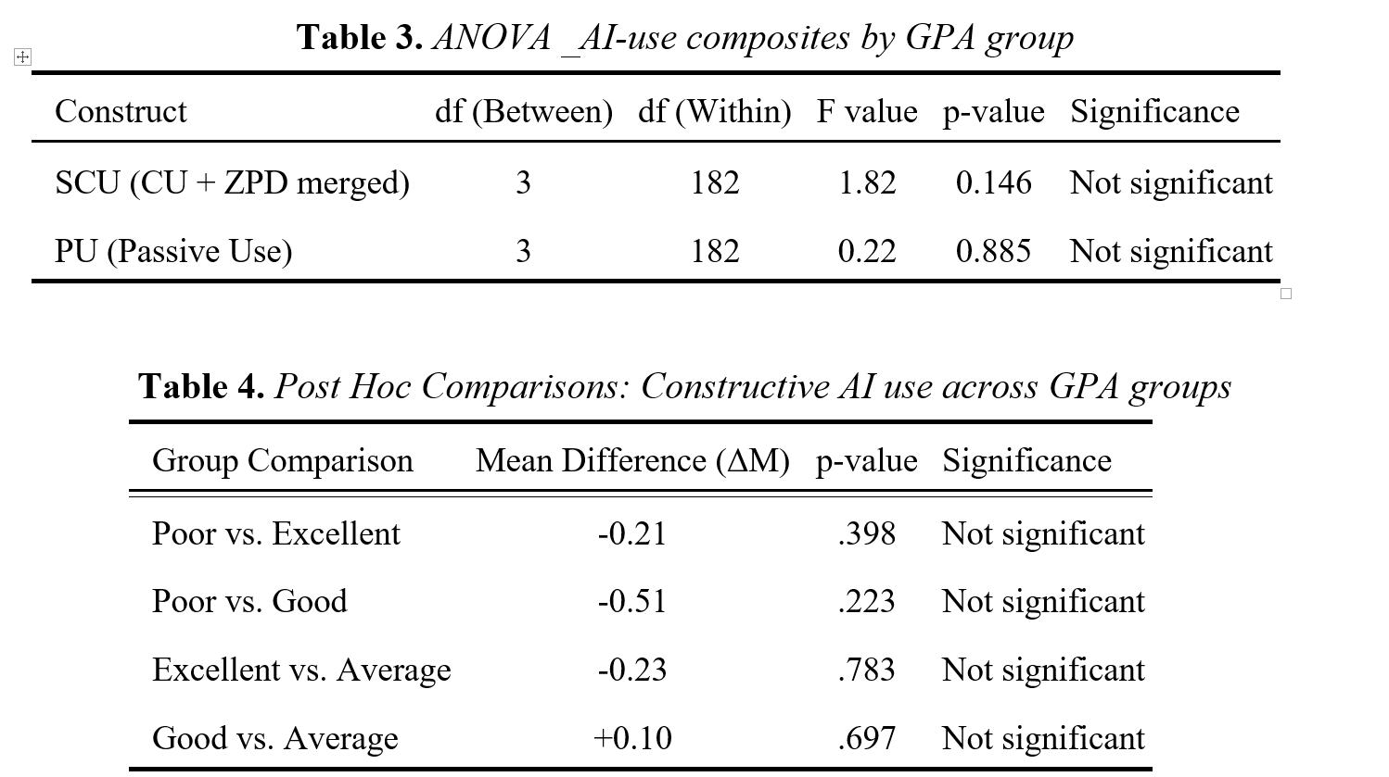

Slide 21
Discussion
No significant GPA-based differences in AI usage patterns
➤ High-, mid-, and low-GPA students reported similar levels of AI engagement
➤ Slight trend: Students with lower GPAs had marginally lower Constructive Use scores (ΔM = –0.21), but not statistically meaningful
Challenge to assumptions
➤ Contradicts the belief that high-achieving students use AI more strategically
➤ Suggests AI is often used similarly regardless of academic standing
Need for pedagogical scaffolding
➤ Mere frequency or enjoyment of AI tools does not guarantee learning gains
➤ Highlights the need for intentional guidance to foster critical and reflective AI use

Slide 22
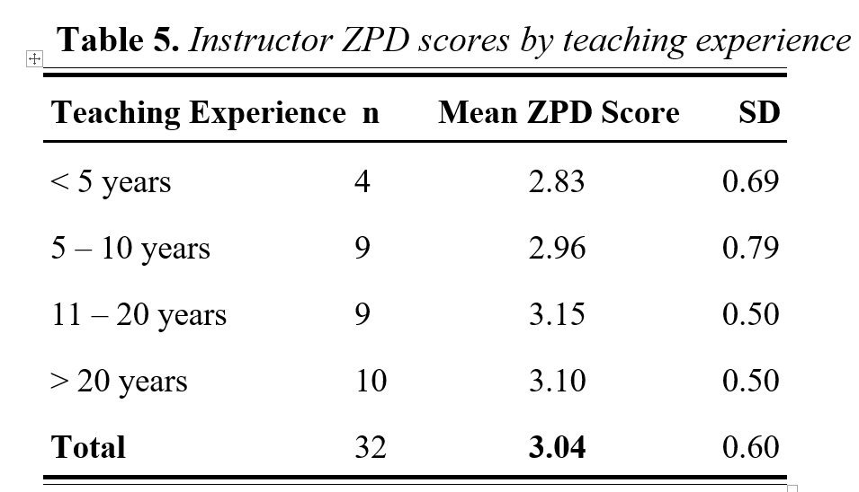
Teacher’s survey: ZPD-aligned practices
Overall mean ZPD score = 3.04 (on a 4-point scale).
➤ Indicates moderately high commitment to using AI for scaffolding instruction
➤ Supports Vygotsky’s sociocultural theory: learning occurs within guided support zones (ZPD)
Most instructor scores fell between 2.4 and 3.6, showing consistent pedagogical intentions
Experienced teachers are more confident in student-centered, differentiated strategies

Slide 23
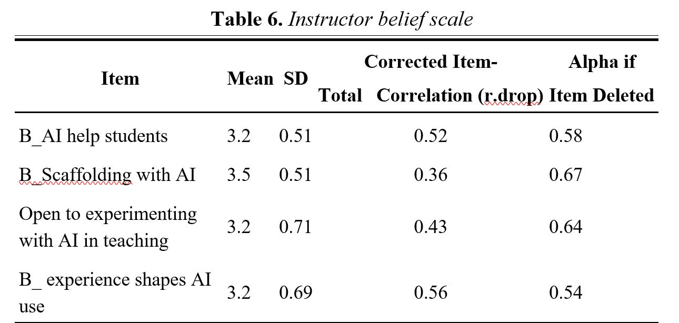
Teacher’s survey: Belief about AI
Overall belief level:
➤ Mean belief score = 3.29 (SD = 0.44)
➤ Indicates generally positive attitudes toward using AI in instruction
Item-total correlations ranged from 0.36 to 0.56, confirming each item added value
➤ Results reflect agreement with AI’s usefulness, but also suggest some caution or variability in conviction
➤ Aligns with prior research linking positive tech beliefs to teacher self-efficacy and openness (Ertmer & Ottenbreit-Leftwich, 2010)

Slide 24
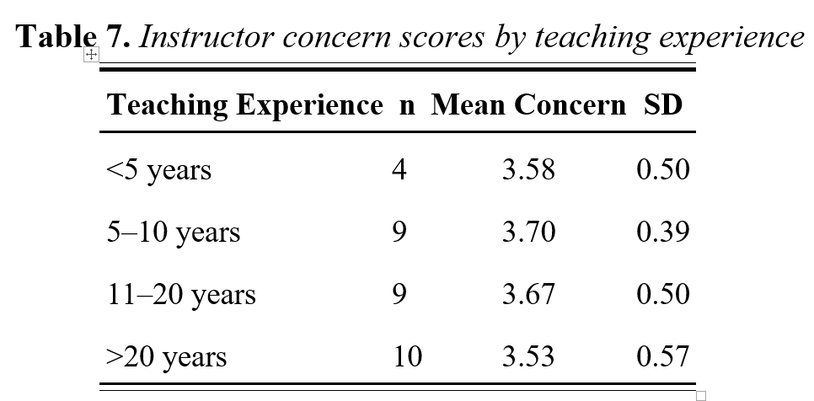
Concerns about AI
High average concern level
➤ Mean = 3.62, SD = 0.48
➤ Indicates widespread instructor apprehension about AI’s educational impact
Top concerns
➤ AI misuse
➤ Decline in student critical thinking
➤ Need for more professional development
Highest alignment with worry-related items, showing concerns are personally relevant and consistent among instructors (Selwyn, 2019)

Slide 25
Triangulation Findings: Alignment & Divergence
Both students and instructors show moderate–high engagement with ZPD-based practices.
Divergence: Beliefs vs. Use Orientation
Instructors have positive beliefs about AI (M = 3.29), but:
Students often use AI instrumentally for grades/performance, not deep learning.
Instructors express high concerns (M = 3.62), especially about:
Reduced critical thinking (echoed in student ratings: M = 2.64 for AI aiding critical thinking)
Highlights a misalignment between:
Instructors’ intended pedagogical goals
Students’ transactional behaviors
Experience vs. Democratized Use
Instructors with more experience report slightly higher ZPD-aligned practice (not statistically significant)
Students’ AI use does not differ by GPA → suggests:
AI is widely accessible and equally used, regardless of academic standing

Slide 26
Conclusions
Students = enthusiastic adopters
Teachers = cautiously optimistic
AI integration must be pedagogically intentional, not just about access or usage frequency.
Instructors should:
Design AI-supported tasks that encourage reflection, iteration, and deeper thinking
Guide students to use AI as a collaborative cognitive tool, not a shortcut
Limitations
Student sample skewed toward first-year students
Small instructor sample (N = 32) limits generalizability
Self-report data only — no direct assessment of learning outcomes

Slide 27
Thank You
Q&A

