Slide 1





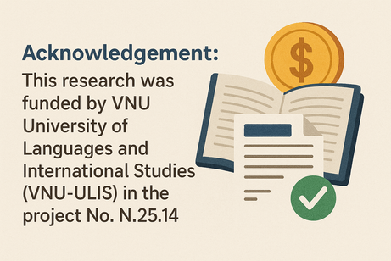
AI
By: Dr. Chu Thanh Vân;
Hoàng Nguyễn Thu Trang
At an English Language Teacher Education Institution (2020-2025)
2025

Slide 2
Introduction
The application of AI at an English Language teacher education institution
(Chan’s (2023: 13) AI ecological education framework)
  Management
2. Operation
3. Pedagogy
  Academic misconduct & ethical dilemmas
  AI governance
  AI attribution guidelines
  Equity in AI technologies
  AI Implementation monitoring and evaluation
  AI literacy training for teachers, staff, and students
  Rethinking assessments
  Encouraging a balanced approach to AI adoption
  Preparing students for the AI-driven workplace
  Developing students’ holistic competencies

Slide 3


1. Senior management
1.1. Academic Misconduct and Ethical Concerns
📌 Identifying and preventing misuse of generative AI:
🛠️ Turn it in, reference checking (Journal paper)
📌 Developing guidelines and strategies: in progress
📌 Identifying ethical dilemmas: Council on Academic Integrity
📌 Familiarizing students with ethical issues.

Slide 4


1. Senior management
1.2 AI Governance
📌 Transparency in AI use decisions: Guidelines on assessment
📌 Data privacy and security:
Portal - personal academic result reports
📌 Ethical issues like bias and stereotypes: Editing boards Critical thinking course, Critical discourse analysis course (linguistic programmes)

Slide 5
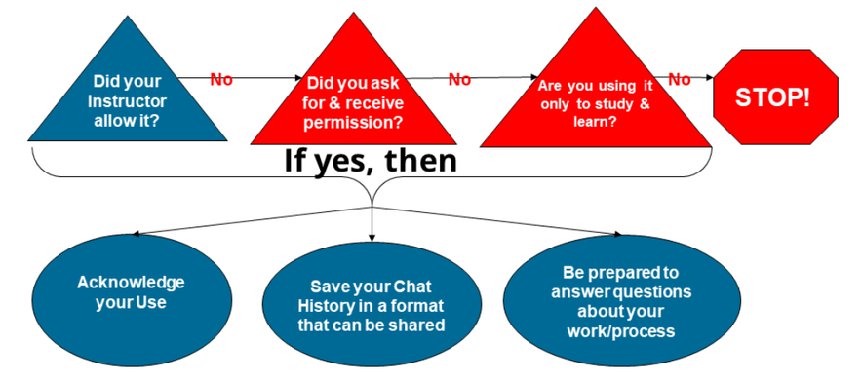
1. Senior management)
1.3 AI Attribution Guidelines
• Promote academic integrity in AI use: upcoming, E.g. UC San Diego
• Develop guidelines for the contribution of generative AI to student work. (Chan, 2023)
https://academicintegrity.ucsd.edu/excel-integrity/gen-ai/ai-in-education.html

Slide 6
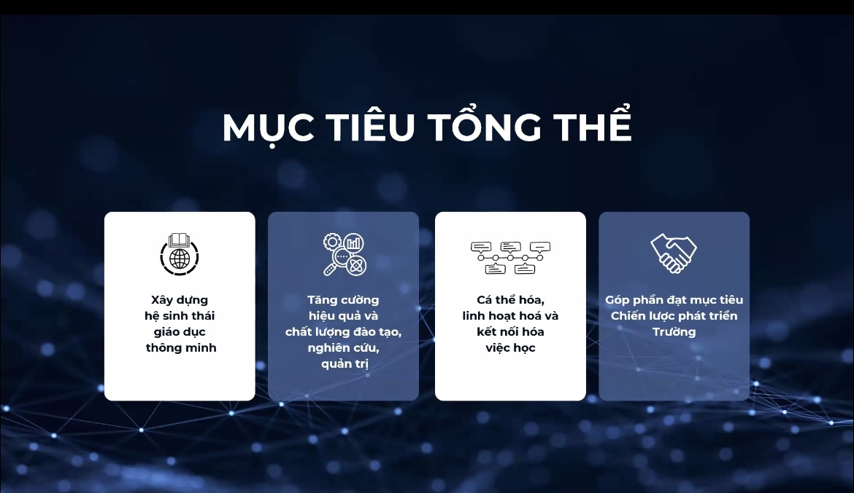
1. Senior management
1.4 Equity in AI Technologies
📌Digital transformation plan 2025-2030:
Providing resources and support for all
📌2025 plan: research on AI application & training:
Ensuring student access and training to AI tools

Slide 7
1. Senior management
1.4 Equity in AI Technologies:
🎯 DIGITAL TRANSFORMATION INITIATIVES (2025–2030)
📅 April 21, 2025
Dissemination of the Digital Transformation Plan (2025–2030)
📅 May 27, 2025
School-Level Implementation Conference
Implementing the Digital Transformation Plan at:
* Foreign Language Specialized High School
* Foreign Language Secondary School

Slide 8
2. Operation
(teaching and learning and IT staff)
2.1 AI Implementation Monitoring and Evaluation
9
8
studies on AI applications in ESL teaching and assessment 2023-6/2025
action research studies, including students’ feedback

Slide 9
2. Operation
(teaching and learning and IT staff)
2.1 AI literacy training for teachers, staff & students
8 webinars & 1 international + 1 national conferences & 3 seminars on AI to enhance staff confidence and competences
Students’ contest: Creating with AI => Teach students AI technology usage and critique
Provide ethics education, AI benefits, use, limitations, and evaluation capabilities

Slide 10
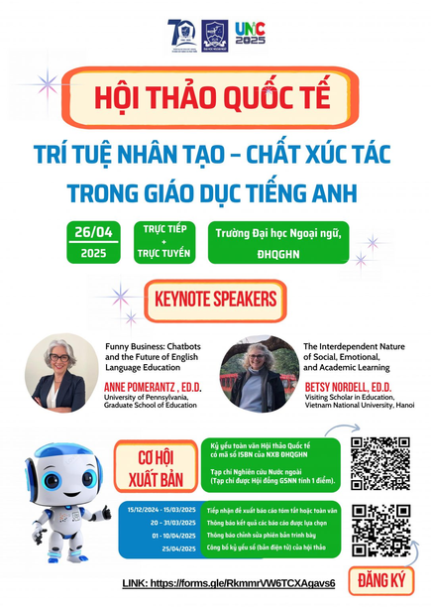

2. Management & Operation
2.1.1 Equity in AI Technologies: Conferences
📅 April 26, 2025
🌍 International Conference “AI as a Catalyst for English Language Education”
📅 March 10 – May 2025
💻 Weekly Webinars Series: Experience Sharing: AI in Teaching & Training
👨‍🏫 For: School leaders, teachers, and staff
📌 Goal: Practical insights & peer learning
📅 September 27, 2025
🗣️ International Conference “Artificial Intelligence and the Future of Translation and Interpretation”

Slide 11
2.1.2 AI TRAINING INITIATIVES
IN EDUCATION & ADMINISTRATION
📅 May 10, 2023
🧠 Training Workshop: “Application of AI in Teaching, Learning, Testing & Evaluation of Foreign Languages”
👩‍🏫 For: University lecturers
📌 Focus: AI-powered pedagogy & assessment tools
📅 December 11, 2023
🎓 Closing Ceremony: AI in Teaching and Assessing English
🤝 Co-organized by:
* University of Foreign Languages, VNU Hanoi
* People’s Police Academy
📌 Highlight: Integration of AI in English education for law enforcement
📅 April 24, 2025
🏛️ Training Session: “AI in Party, Mass Organization & University Administration”
🎯 Audience: Administrative staff & political organizations
📌 Focus: Improving governance and operations with AI tools

Slide 12
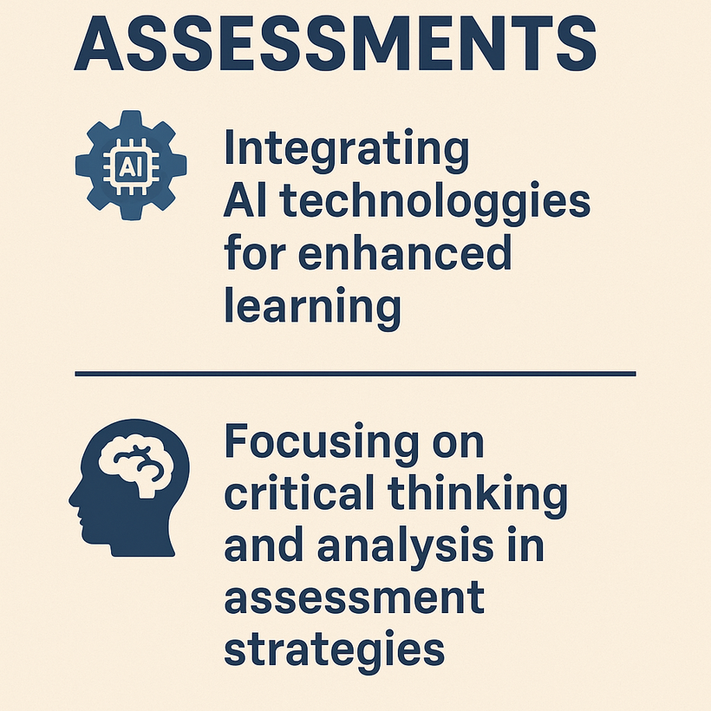
3. Pedagogy
📚 3 Studies on the effectiveness of AI feedback tools
📚 A research proposal on standardising the assessment of text with AI assistance

Slide 13
3. Pedagogy
3.2 A balanced approach to AI adoption
📚 3 Studies on the teachers’ experience with AI, integrating AI, and effects of AI on students’ products
📌 Recognize the benefits and limitations of generative AI:
📌 Avoid over-reliance on AI:
📌 Use AI as a complementary tool

Slide 14
3. Pedagogy
3.3 Preparing students for the AI-driven workplace
🎯 Teaching responsible AI usage.
• Developing AI curriculum.
• Familiarizing students with AI tools for university studies and future workplaces.
📚 3 Studies on the effectiveness of AI feedback tools
🎯 Focusing on critical thinking and analysis in assessment strategies:
📚 A research proposal on standardising assessment of text with AI assistance

Slide 15

Discussion:
Pedagogy & Operation
1
Conducting longitudinal experiments
Developing students’ holistic competencies
2
📌 Critical thinking for effective AI use
📌 Teamwork & leadership competencies impeded by AI

Slide 16
Discussion: Management
1
Ecological policy on AI applications
Ethical principles
2

Slide 17
Conclusion
Application of AI at this English teacher institution
1
2
Determined managers
Proactive practitioners
3
Eager learners
Well-informed policy planning: rich in theory & practice

Slide 18

Suggestions: AI management
3 dimention guidlines:
1
Education serving
2
Teaching
3
Learning

Slide 19
References
Chan, C.K.Y. (2023). A comprehensive AI policy education framework for university teaching and learning. International Journal of Educational: Technology in Higher Education, 20:38. Longitudinal experiments
Dexe, J., & Franke, U. (2020). Nordic lights? National AI policies for doing well by doing good. Journal of Cyber Policy, 5(3), 332–349. https://doi.org/10.1080/23738871.2020.1856160
Federspiel, F., Mitchell, R., Asokan, A., Umana, C., & McCoy, D. (2023). Threats by artificial intelligence to human health and human existence. BMJ Global Health, 8(5), e010435. https://doi.org/10.1136/bmjgh-2022-010435
Floridi, L. (2021). A Unified Framework of Five Principles for AI in Society. In Ethics, Governance, and Policies in Artificial Intelligence (Vol. 144, pp. 5–17). Springer International Publishing AG. https://doi.org/10.1007/978-3-030-81907-1_2
Greiman, V. A. (2021). Human rights and artificial intelligence: A universal challenge. Journal of Information Warfare, 20(1), 50–62.
Hogenhout, L. (2021). A Framework for Ethical AI at the United Nations. https://doi.org/10.48550/arxiv.2104.12547
IMDA & PDPC (2020). Model Artificial Intelligence Governance Framework. Retrieved from https://www.pdpc.gov.sg/-/media/files/pdpc/pdf-files/resource-for-organisati on/ai/sgmodelaigovframework2.pdf
McKinsey Consultant. (2023). What is generative AI? [Article]. Retrieved February 12, 2023, from https://www.mckinsey.com/featured-insights/mckinsey-explainers/what-is-generative-ai
Renda, A. (2020). Europe: Toward a Policy Framework for Trustworthy AI. In M. D. Dubber, F. Pasquale, & S. Das (Eds.), The Oxford Handbook of Ethics of AI (pp. 650–666). Oxford Academic. https://doi.org/10.1093/oxfordhb/9780190067397.013.4

Slide 20
Thank you.

