Slide 1








Exploring the Opportunities and Challenges of Using AI in TESOL Assessment and Feedback at Vietnam Aviation Academy
By Phan Tú Trinh and Đỗ Thị Thanh Trúc
AI in Aviation English
Enhance Assessment
Overcome Integration Challenges
Improve Feedback
Address Aviation Needs

Slide 2









Presentation Outline
Introduction
Literature Review
Methods
Results
Discussion
Conclusion

Slide 3
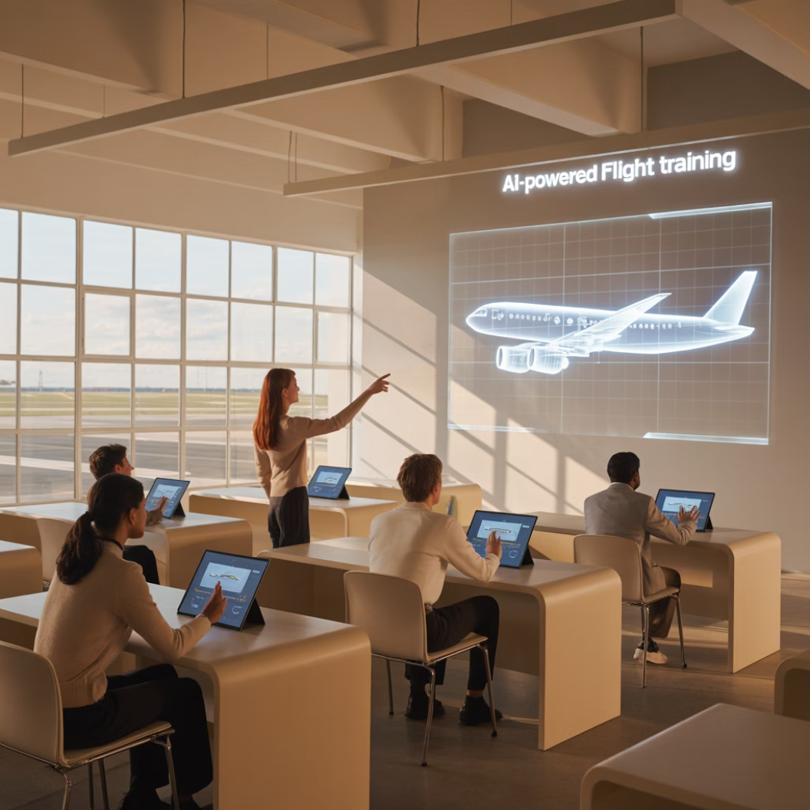
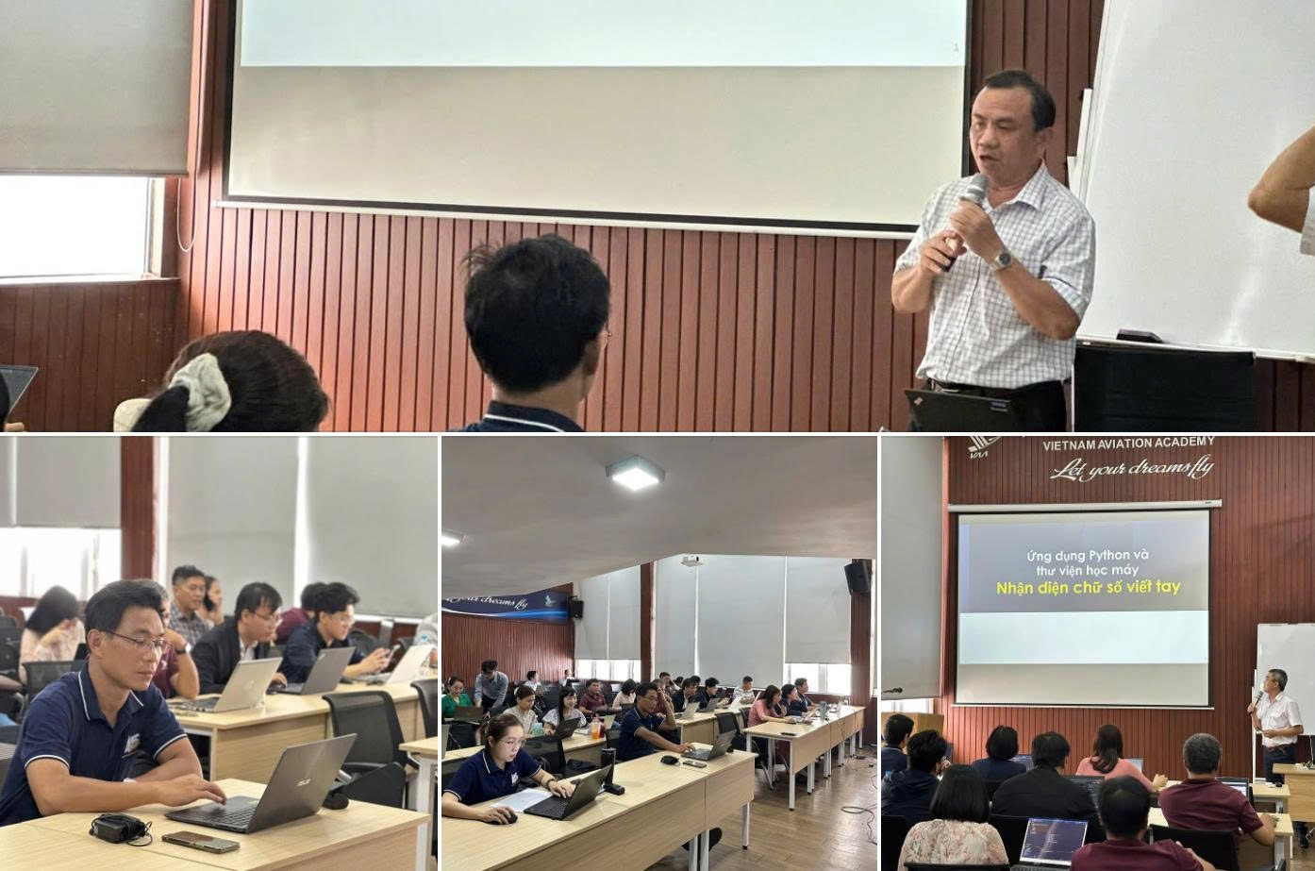
Introduction
AI in Education
- AI is transforming education, offering personalized learning and significantly enhancing TESOL assessment, feedback, and engagement.
- Pedagogical and implementation challenges
AI at Vietnam Aviation Academy (VAA)
- English proficiency is crucial
- Since 2024, VAA has launched AI-focused training for teachers.
Research Focus
- Investigates current AI use in TESOL assessment and feedback at VAA
- Examining its benefits, challenges, and conditions for successful implementation.
- Aims to understand how to integrate AI responsibly and effectively into education.

Slide 4





Research Questions
How do TESOL lecturers and students at VAA perceive the integration of AI tools in assessment and feedback?
What perceived opportunities are associated with the use of AI in TESOL assessment and feedback at VAA?
What challenges and concerns do TESOL lecturers and students face when using AI for assessment and feedback purposes?
What support mechanisms do TESOL lecturers at VAA recommend for effective AI integration in assessment and feedback?

Slide 5










Literature Review
AI in Language Assessment and Feedback
Automated Writing Evaluation
Speech Recognition Tools
Intelligent Tutoring Systems
Opportunities of AI Integration in TESOL
Enhanced Writing Skills
Increased Accessibility
Efficient Feedback
Challenges in Integrating AI into TESOL

Slide 6






Challenges in Integrating AI into TESOL
Pedagogical Limitations
Cultural & Linguistic Constraints
AI often focuses on surface-level accuracy, missing deeper communicative aspects like critical thinking and cultural nuances.
AI struggles with idioms, cultural references, and non-standard English, leading to inaccurate feedback.
Infrastructure & Resource Gaps
Teacher Readiness
Implementation requires robust digital infrastructure, stable internet, and institutional investment, which are not universally available.
Teachers often lack familiarity with AI tools and their pedagogical uses, necessitating extensive professional development.

Slide 7



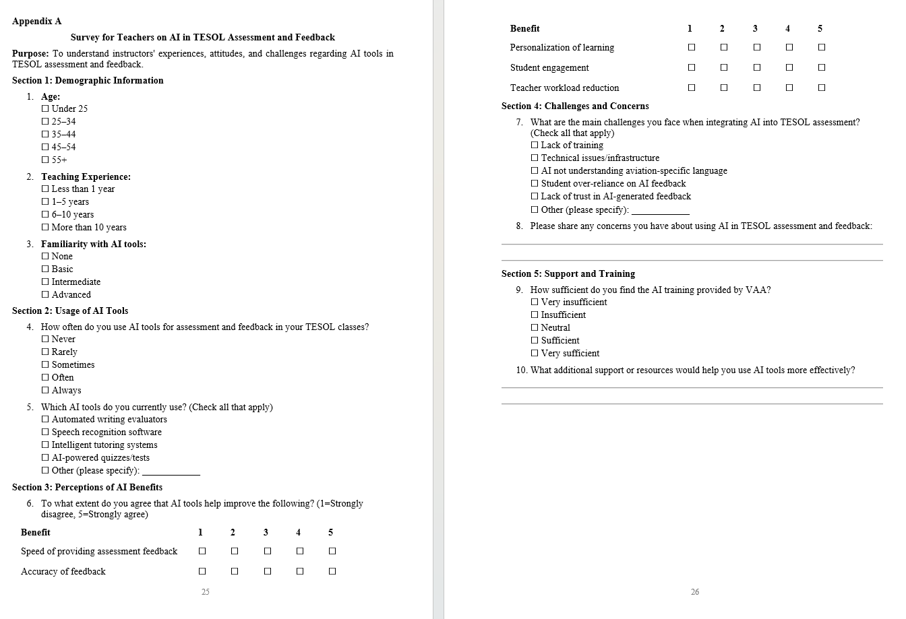
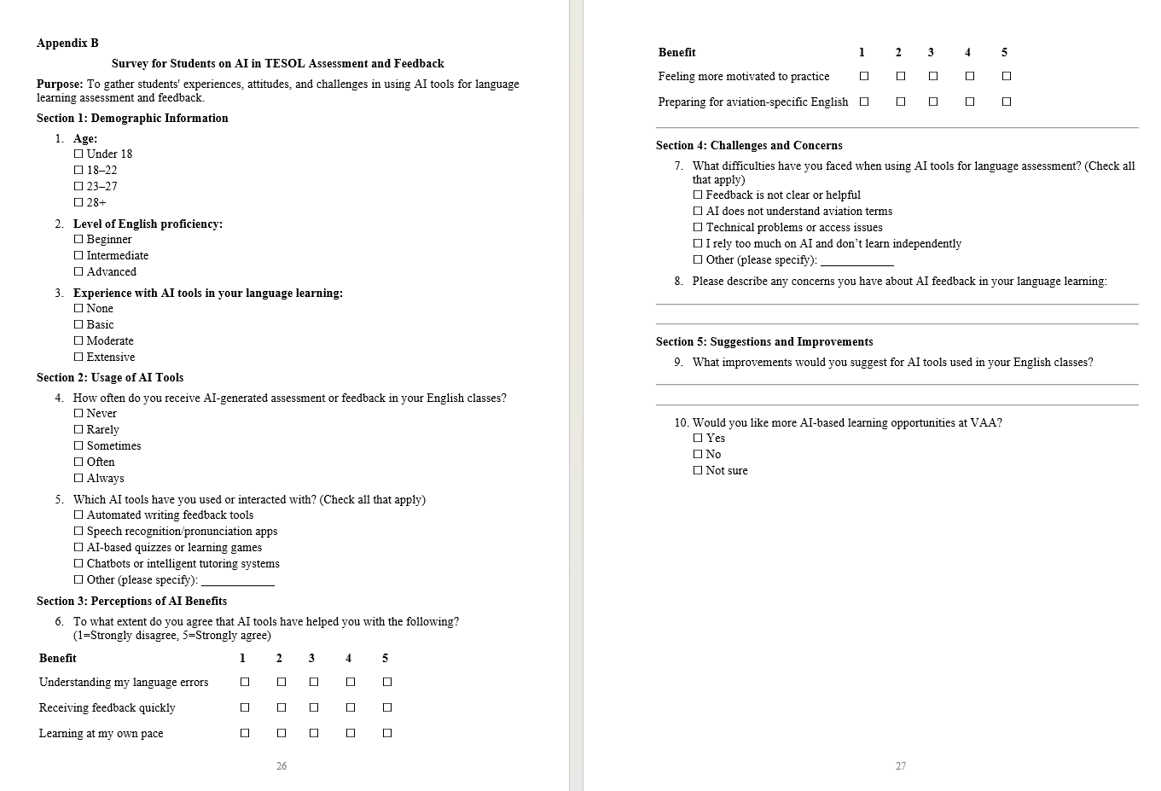
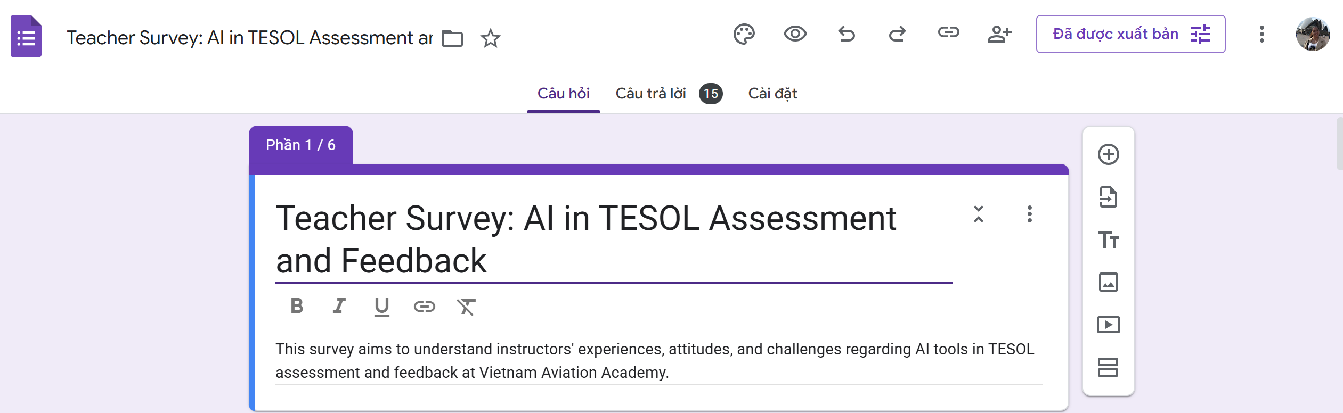
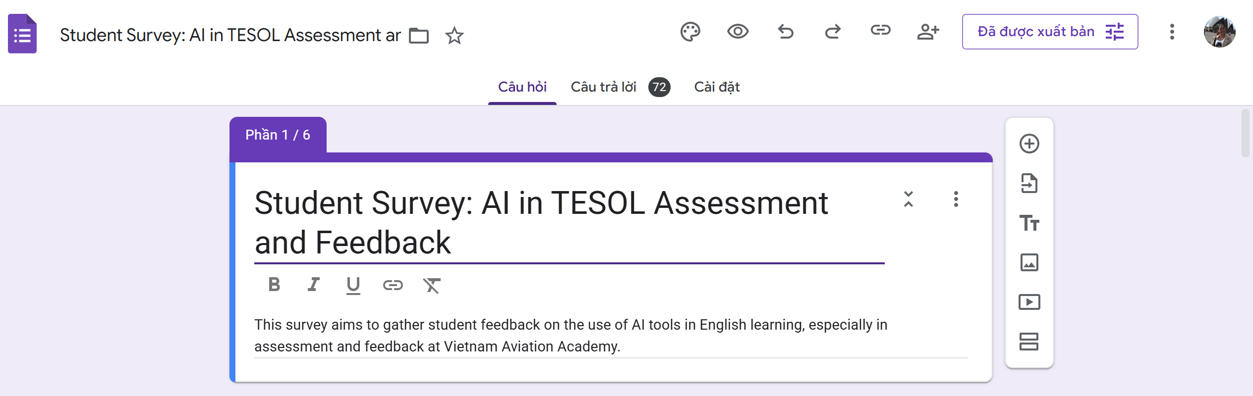


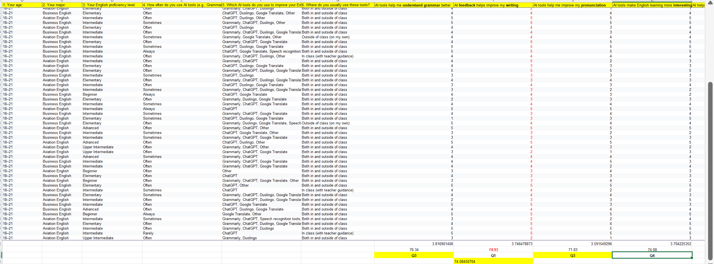
Methodology
Research Design
Participants & Setting
Data Collection
A qualitative case study approach
14 instructors and 71 students from Vietnam Aviation Academy (VAA)
Methods included semi-structured interviews with instructors and students
Data Analysis
Ethical Considerations
Thematic analysis and focus group data related to AI opportunities and challenges.
Informed consent, participant anonymity, confidentiality, and institutional approval were ensured throughout the study.

Slide 8

Results
1. Perceptions of AI Integration in TESOL Assessment and Feedback
Lecturer Perspectives
Majority report frequent use of AI-based tools
High satisfaction with feedback speed (4.5/5)
Agreement that AI reduces workload (4.3/5)
Mixed opinions on accuracy and personalization
Student Perspectives
Vast majority use AI tools like ChatGPT, Grammarly
High ratings for grammar improvement (4/5)
Benefits noted in writing, pronunciation, motivation
Teacher Approval %
Student Approval %
70-80% concerned about over-reliance on AI
Percentage of respondents rating benefits 4 or 5 out of 5

Slide 9



2 Opportunities of Using AI in TESOL Assessment and Feedback
Improved Feedback Speed & Efficiency
Enhanced Student Autonomy & Confidence
Personalized Learning & Motivation
AI tools provide immediate, personalized feedback, significantly reducing grading time for educators and allowing them to focus on higher-order teaching.
Students use AI tools for self-directed practice before submission, reducing anxiety and promoting a sense of independence in their learning.
AI adapts feedback to individual proficiency levels, improving accuracy, increasing student engagement, and motivating learning.
Notes:
This slide is a blank canvas, so I can use it to highlight a key point or transition to the next section.
I will use this slide to pause and emphasize a critical takeaway from the previous content.
This blank slide provides a moment of visual rest for the audience before diving into the next topic.
I will use this blank slide to allow the audience to reflect on what we've covered so far and prepare for what's to come.

Slide 10
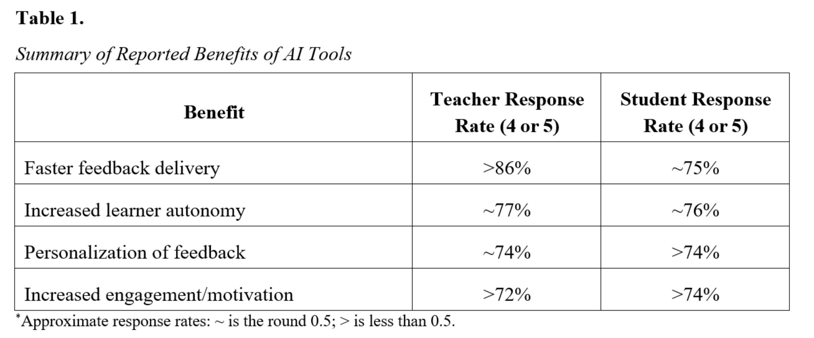
2 Opportunities of Using AI in TESOL Assessment and Feedback

Slide 11




3. Key Challenges Identified
Inadequate Contextual Understanding
Over-Reliance on AI
Technical Barriers
"It's easier to use AI for entertainment than for learning... I rely on it too much even in class or at home." - Student
Issues include paid subscriptions, unstable internet connectivity, and device compatibility problems, especially during in-class AI usage.
"Sometimes the AI marks aviation terminology as incorrect, it doesn't understand our field." - Instructor with 6-10 years experience
Students often accept AI-generated feedback without question, potentially limiting critical thinking.
AI feedback often fails to grasp aviation-related contexts or nuances in specialized vocabulary.

Slide 12








4. Support Mechanisms Needed
Practical Training
Needs Analysis
AI Tool Selection
Domain Customization
Implementation & Review
42.9%
70%
Instructors who found AI training at VAA "insufficient"
Students concerned about over-reliance on AI tools

Slide 13
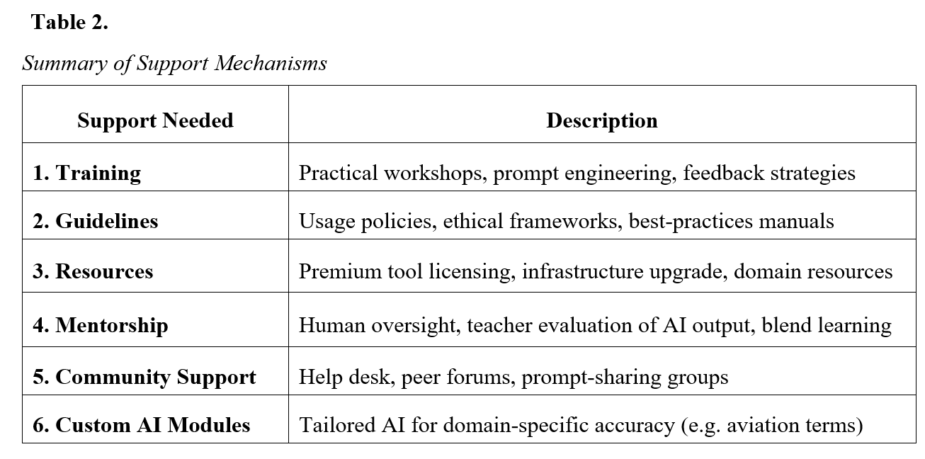
4. Support Mechanisms Needed

Slide 14






Discussion
Alignment with Global Research
Challenges in Specialized Contexts
Pedagogical &Institutional Needs
AI at VAA boosts feedback, autonomy, and personalization.
Aviation English reveals a gap in generic AI.
Generic AI struggles with Aviation English terms.
Over-reliance risks shallow learning, not critical thinking.
Teacher readiness and strong infrastructure are crucial.
AI should support - not replace - human instruction in TESOL.
Need for Context-Aware AI Tools
Contributions to Education
Need for AI trained on aviation data to give accurate, context - aware feedback - supporting customizable AI research.
This study highlights AI’s role in Vietnamese higher education - balancing innovation, strategy, and learner-centered approaches.

Slide 15




Conclusion
Opportunities Realized
Challenges Addressed
Strategic Integration
AI enhances TESOL with faster feedback, greater autonomy, and personalized learning—aligning with global trends.
Aviation English needs AI with better context, less reliance risk, and stronger infrastructure—demanding tailored solutions.
Effective AI at VAA needs smart integration, teacher training, and learner focus—supporting, not replacing, human teaching.

Slide 16

Thank You!
We appreciate your attention and the opportunity to present at the TESOL International Conference 2025.
For further inquiries, please feel free to reach out.

