Slide 1
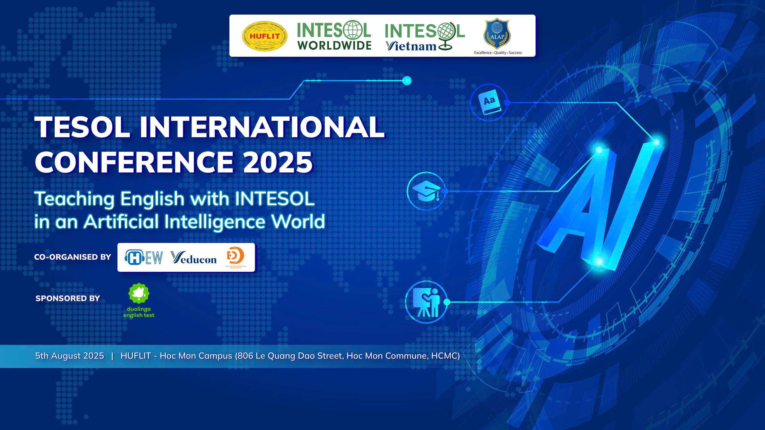

Slide 2



Home
Video
About Us
Artificial Intelligence and Critical Thinking in Language Learning: A Study of HUFLIT Students
Presenter: Nguyễn Minh Tuấn
01

Slide 3

Table of content
Home
Video
About Us
Introduction
Literature review
Methodology
Results
Discussion
Conclusion
Reference
02

Slide 4

INTRODUCTION
Home
Video
About Us
Critical thinking helps students:
  Understand and evaluate information
  Solve problems
  Make informed decisions
Advantages of AI in learning
  Personalized learning (matches student’s style and speed)
  Real-time feedback
  Helps make lessons more engaging and effective
HUFLIT with AI
  Critical Thinking in the AI Era
  AI-Powered Learning events
03

Slide 5
INTRODUCTION
Video
Home
About Us
Research questions:
What are HUFLIT students’ perceptions of critical thinking in language acquisition?
How do HUFLIT students perceive the benefits of AI tools in supporting or enhancing their critical thinking skills during language learning?
What drawbacks do HUFLIT students identify when using AI tools to develop critical thinking in language acquisition?
03

Slide 6


LITERATURE REVIEW
Home
Video
About Us
AI in Education
  Personalized lessons based on student needs
  Quick feedback for improvement
  Real-life problem-solving promotes deeper thinking (Holmes et al., 2019; Luckin et al., 2016)
Critical Thinking in Education
  Helps students analyze, evaluate, and make decisions (Papathanasiou et al., 2014; Chen, 2020)
  Judging the reliability of sources (Brookfield, 1987; Pithers & Soden, 2000)
  Scientific-style thinking: question, test, conclude (Schafersman, 1991)
04

Slide 7
LITERATURE REVIEW
Home
Video
About Us
Previous Research
  AI adapts to student levels and gives personalized feedback
  Helps learners reflect on grammar, structure, and meaning (Holmes et al., 2019; Luckin et al., 2016)
  Over-reliance weakens independent thinking (Carr, 2020)
  Quick answers reduce deep thinking and analysis (Selwyn, 2022)
Conclusion from LR
  AI can support learning if used actively and reflectively
  Passive or careless use can weaken critical language skills
04

Slide 8

METHODOLOGY
Home
Video
About Us
1. Participants
  240 English-major students at HUFLIT
  8% of HUFLIT’s English-major students
  25% first-year, 62% second-year, 13% third-year
2. Data Collection
  Qualitative approach using a questionnaire
  8 closed-ended, 2 open-ended
  Based on previous research (Papathanasiou et al., 2014; Chen, 2020), adapted to HUFLIT context
3. Data Analysis
  Google Forms
  4 weeks
  Responses grouped by themes
05

Slide 9
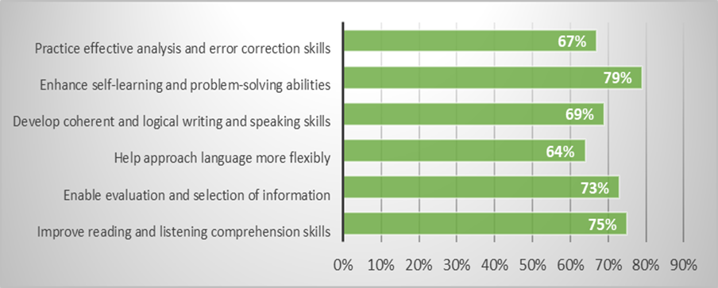
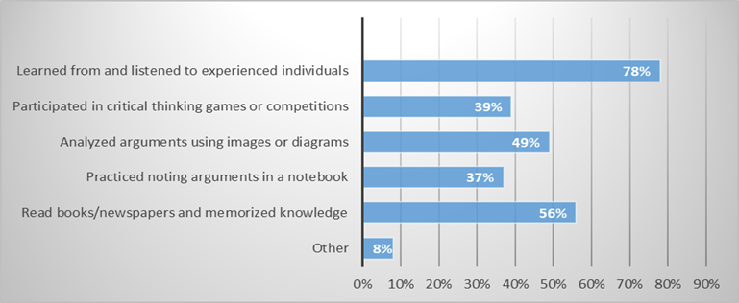
RESULTS
Home
Video
About Us
The students’ perceptions of critical thinking without AI
The importance of critical thinking in language learning
Ways to practice critical thinking without using AI
05

Slide 10
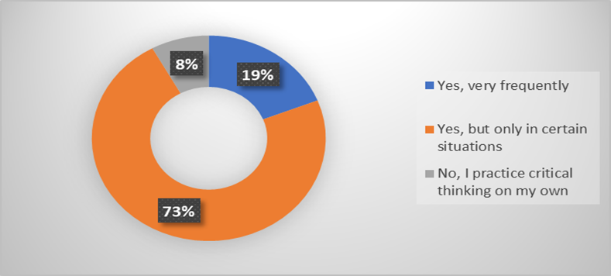
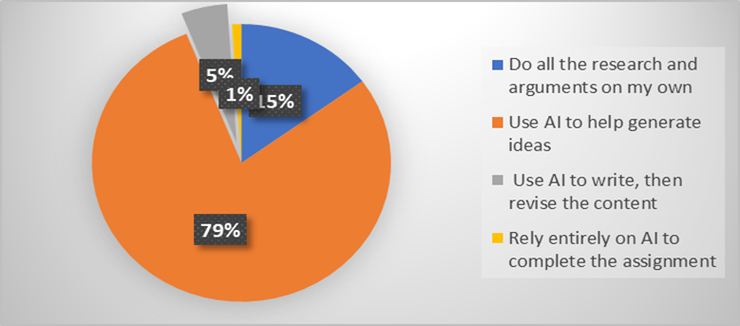
RESULTS
Home
Video
About Us
2. The impacts of AI on students’ critical thinking in language acquisition
The frequency of using AI to support critical thinking
The measurement of using AI to complete writing
05

Slide 11
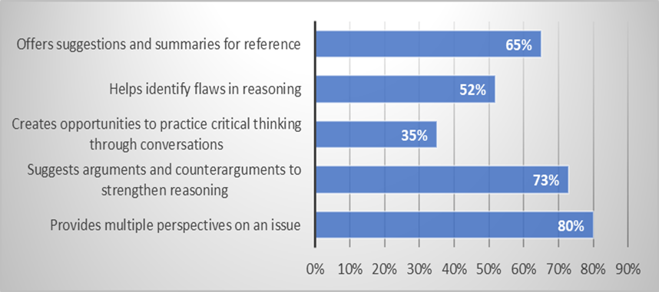
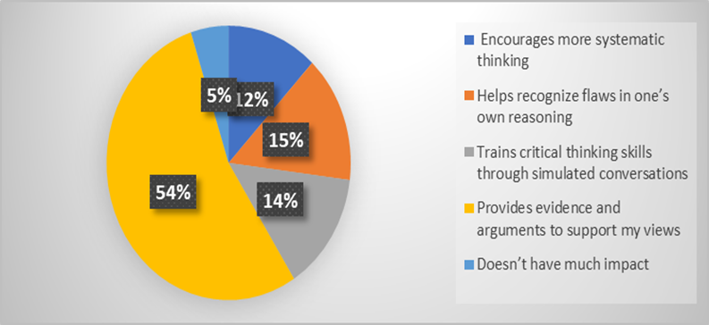
RESULTS
Home
Video
About Us
2. The impacts of AI on students’ critical thinking in language acquisition
The advantages of using AI in developing critical thinking skills
The benefits of using AI in enhancing critical thinking skills
05

Slide 12
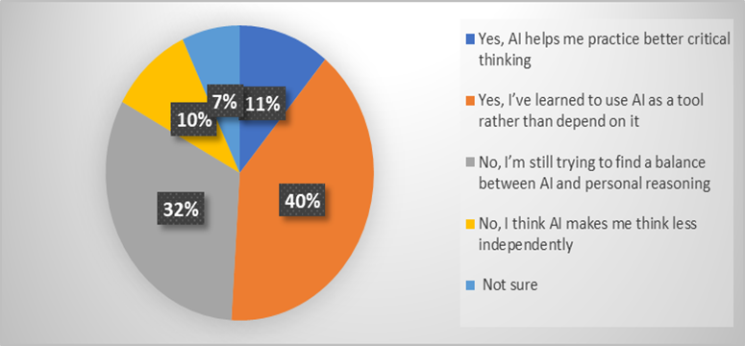
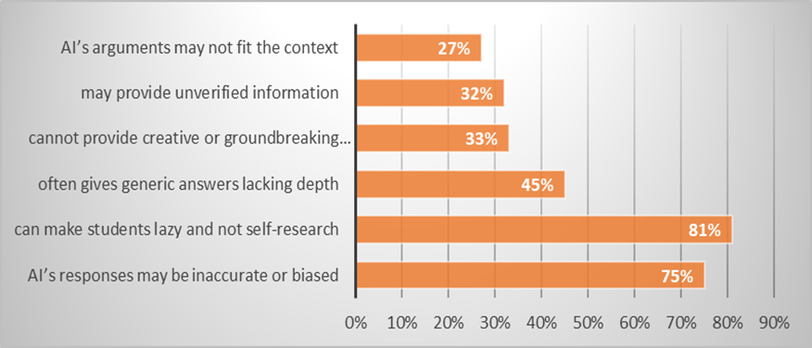
RESULTS
Home
Video
About Us
2. The impacts of AI on students’ critical thinking in language acquisition
Students’ level of independence when using AI
The challenges of using AI on students’ critical thinking skills
05

Slide 13
RESULTS
Home
Video
About Us
3. Students’ views on whether AI can replace human critical thinking
AI replaces human critical thinking skills in the future. | % | Because AI… | %
Yes | 18% | processes information quickly | 31%
 |  | has access to a lot of knowledge | 22%
 |  | has more logical and fair thinking | 20%
 |  | supports complex problem-solving | 13%
 |  | others | 14%
No | 82% | cannot feel emotions or ethics | 48%
 |  | lacks human creativity | 21%
 |  | does not understand context deeply | 11%
 |  | relies on existing information | 11%
 |  | others | 8%
05

Slide 14


DISCUSSION
Home
Video
About Us
Results’ explanation
  AI can support critical thinking
  Students’ responsibility
  Limitations of AI
  Student Independence with AI
Recommendations
  Encourage balanced use of AI — support, not replace thinking
  Improve students’ digital literacy
  Promote active learning and reflective thinking with AI tools
08

Slide 15

CONCLUSION
Home
Video
About Us
Students know critical thinking helps
Before AI, they practiced it through
Many students believe AI helps them
More future research should:
  Explore active, reflective use of AI
  Help students think critically with technology—not instead of it
09

Slide 16

REFERENCE
Alam, A. (2022). Employing adaptive learning and intelligent tutoring robots for virtual classrooms and smart campuses: Reforming Education in the age of Artificial Intelligence. In Lecture notes in electrical engineering (pp. 395–406). https://doi.org/10.1007/978-981-19-2980-9_32
Bishop, C.M. 2006. Pattern Recognition and Machine Learning. Springer.
Brookfield, S. (1987). Developing critical thinkers. Milton Keyes: Open University Press.
Carr, N. (2020). The Shallows: What the Internet is Doing to Our Brains. New York, NY: W. W. Norton and Company.
Chen, L., Chen, P., & Lin, Z. (2020). Artificial Intelligence in Education: A Review. IEEE Access, 8, 75264–75278. https://doi.org/10.1109/ACCESS.2020.2988510
Fischer, F., Kollar, I., Stegmann, K., & Wecker, C. (2013). Toward a script Theory of Guidance in Computer-Supported Collaborative Learning. Educational Psychologist, 48(1), 56–66. https://doi.org/10.1080/00461520.2012.748005
Holmes, W., Maya, B., & Fadel, C. (2019). Artificial Intelligence in Education Promises and Implications for Teaching. In Journal of Computer Assisted Learning (Vol. 14, Issue 4).
Johnson, M., & Smith, K. (2021). Traditional Education in the Digital Age: Perceptions of Educators. Educational Technology & Society, 24(3), 152-168.
Jurafsky, D., Martin, J.H. 2023. Speech and Language Processing (3rd ed.). Prentice Hall.
Kamalov, F., Calonge, D. S., & Gurrib, I. (2023). New era of Artificial intelligence in Education: Towards a sustainable Multifaceted Revolution. Sustainability, 15(16), 12451. https://doi.org/10.3390/su151612451
Khan, Z. A., Adnan, J., & Raza, S. A. (2023). Cognitive Learning Theory and Development: Higher Education Case Study. Education, 13.
Luckin, R., Holmes, W., Griffiths, M., & Forcier, L. B. (2016). Intelligence-Unleashed-Publication.
Minsky, M. 1985. The Society of Mind. New York: Simon and Schuster.
Nilsson, N. 1998). Artificial Intelligence: A New Synthesis. Morgan Kaufmann.
Papathanasiou, I., Kleisiaris, C., Fradelos, E., Kakou, K., & Kourkouta, L. (2014). Critical Thinking: the development of an essential skill for nursing students. Acta Informatica Medica, 22(4), 283. https://doi.org/10.5455/aim.2014.22.283-286
Paul, R. W. (1985). Bloom’s taxonomy and critical thinking intervention. Educational Leadership, 42(8), 36–39.
Pithers, R. T., & Soden, R. (2000). Critical thinking in education: A review. Educational Research, 42, 237–249.
Quinn, S., Hogan, M., Dwyer, C., Finn, P., & Fogarty, E. (2020). Development and Validation of the Student-Educator Negotiated Critical Thinking
10

Slide 17
REFERENCE
Quinn, S., Hogan, M., Dwyer, C., Finn, P., & Fogarty, E. (2020). Development and Validation of the Student-Educator Negotiated Critical Thinking Dispositions Scale (SENCTDS). Thinking Skills and Creativity, 38, 100710. https://doi.org/10.1016/j.tsc.2020.100710
Russell, S., Norvig, P. 2020. Artificial Intelligence: A Modern Approach (4th ed.). Pearson.
Schafersman. (1991). An introduction to critical thinking. Retrieved March 16, 2010 from: www.freeenquiry/criticalthinking.html
Selwyn, N. (2022). The future of AI and education: Some cautionary notes. European Journal of Education, 57(4), 620–631. https://doi.org/10.1111/ejed.12532
Shanta, S., & Wells, J. G. (2020). T/E design based learning: assessing student critical thinking and problem solving abilities. International Journal of Technology and Design Education, 32(1), 267–285. https://doi.org/10.1007/s10798-020-09608-8
Solon, T. (2003). Teaching critical thinking: The more, the better! The Community College Enterprise, 9(2), 25-38.
Williamson, B., Bayne, S., & Shay, S. (2020). The datafication of teaching in Higher Education: critical issues and perspectives. Teaching in Higher Education, 25(4), 351–365. https://doi.org/10.1080/13562517.2020.1748811
Zawacki-Richter, O., Marín, V.I., Bond, M., Gouverneur, F. 2019. Systematic review of research on artificial intelligence applications in higher education. International Journal of Educational Technology in Higher Education, 16(1), 1-27.
10

Slide 18



Thank You
15

