Slide 1


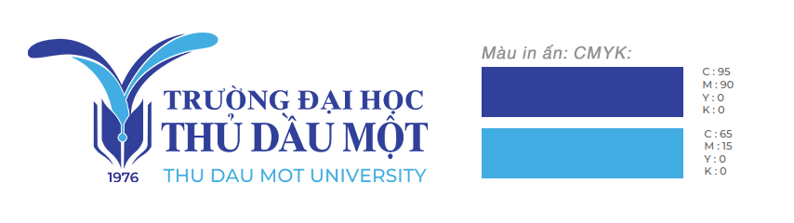

Thu Dau Mot University
Institute of Foreign Languages Training
AI Tools in English Writing Development: Benefits and Challenges for Non-English Major Students at Thu Dau Mot University
Hồ Trung Hậu, Lê Thị Mỹ Duyên,
Hoàng Đoàn Gia Hân, Lê Hoàng Khánh Đoan,
Trịnh Hồng Thúy, Nguyễn Thị Ngọc Ánh
Date: August 5th, 2025
Time: 07:30 – 16:00 (Asia/Ho_Chi_Minh Timezone)
Venue: HUFLIT University (Hoc Mon campus), 806 Le Quang Dao, My Hoa 3 Hamlet, Tan Xuan Commune, Hoc Mon district, Ho Chi Minh City, Vietnam.

Slide 2
Table of contents
1. Introduction
4. Results
2. Literature Review
5. Conclusion
3. Methodology

Slide 3

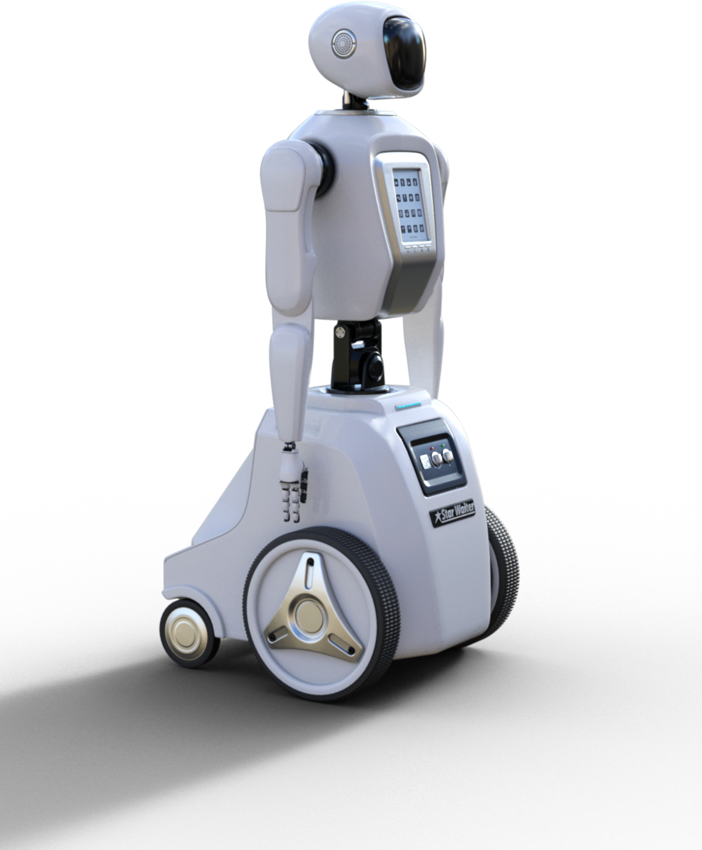
  Introduction

Slide 4
1.1.Background to the Study
  Rapid AI development → strong impact on academic writing.
  Common tools: ChatGPT, Grammarly, Quillbot, Gemini.
  Benefits: grammar correction, vocabulary expansion, and idea suggestion.
  Challenges: plagiarism, reduced creativity, ethical concerns.
  Need to explore AI use among non-English majors – often lack proper guidance.

Slide 5
1.2. Research Questions
1. How do non-English majors perceive the benefits of using AI tools to develop English writing skills?
2. What disadvantages do non-English majors encounter when using AI tools to develop English writing skills?

Slide 6

1.3. Significance of the Study
Study contributions:
-Highlights the dual role of AI in education.
-Promotes ethical, balanced AI use in writing.
-Supports teachers, students, and policymakers in AI integration.
-Contributes to broader debates on AI in higher education.

Slide 7

2. Literature Review
2.1 The role of AI in education
  Like other sectors, the education sector has undergone significant transformation through the implementation of AI and education (Yeruva, 2023).
  Educational systems are integrating AI tools to enhance the learning experience for students, thereby increasing their engagement in learning. (Alneyadi et al., 2023).

Slide 8
2. Literature Review
2.2 Advantages of AI tools in writing
  Faiz et al. (2023) empirically confirmed these advancements, finding that AI-aided writing had 37% fewer grammatical errors and significantly richer word choice than human-only compositions.
  Research by Kang and Yi (2023) and Li et al. (2024) highlights how next-generation platforms strengthen literacy skills by blending visual, auditory, and interactive features with standard writing methods.
  Luckin et al. (2016) found that adaptive, student-specific learning not only accelerates comprehension but also increases engagement by delivering inclusive and interactive educational content.

Slide 9
2. Literature Review
2.3. Disadvantages of AI tools in writing
  A study by Wang (2024) found that students perceived ChatGPT's output as unoriginal and lacking creative depth.
  Overuse of these tools could encourage shallow interaction with writing activities, possibly weakening essential cognitive skills such as critical analysis, creative reasoning, and original expression (Grimes & Warschauer, 2023).
  Marzuki’s (2023) research supports the idea of not relying too heavily on AI-generated feedback at the expense of human feedback, suggesting that over-reliance on AI can weaken collaborative learning dynamics and limit students' overall development growth.

Slide 10
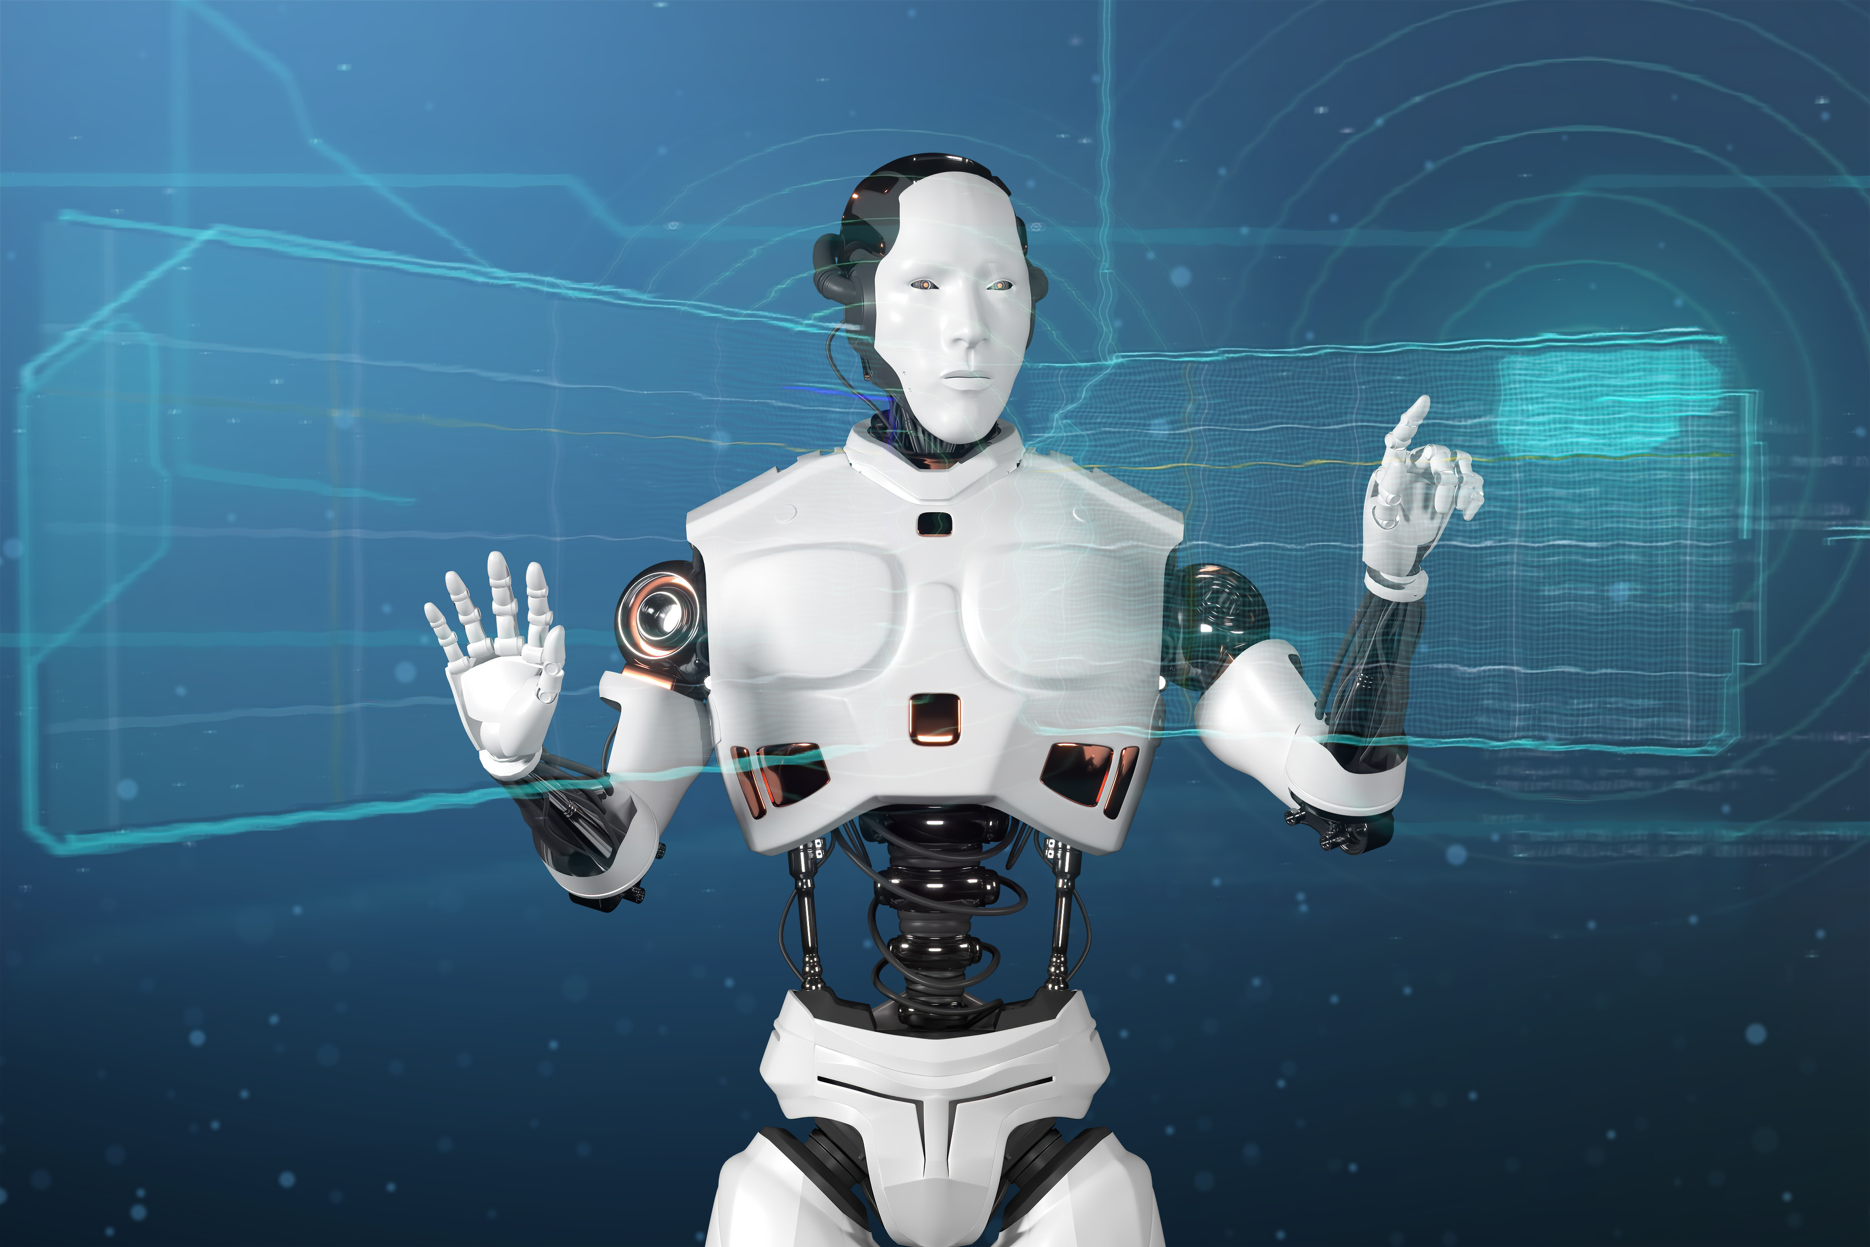
3. Methodology
Methodology Overview
Research Design: Mixed-methods (Creswell, 2014): quantitative + qualitative methods.
Participants: Non-English major students (Level 4–6 English courses) at Thu Dau Mot University.
Sampling: Voluntary response & convenience sampling.
Data Collection:
  Survey: 108 students
  Interviews: 6 students (in-depth follow-up)

Slide 11
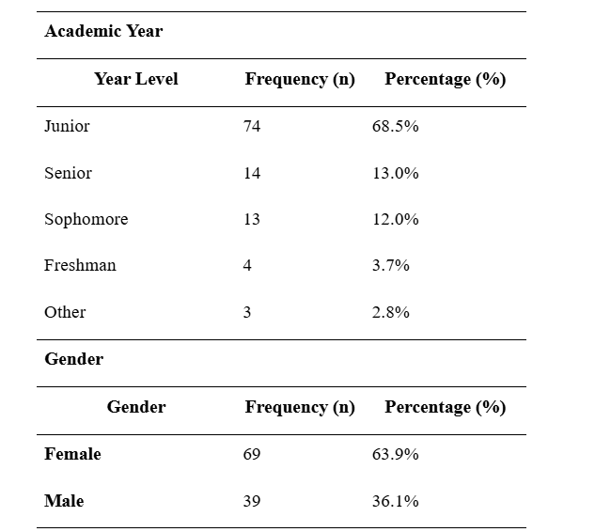
3. Methodology
Participant Demographics
  Most were junior students
  Female participants made up the majority
  May reflect course enrollment or interest level

Slide 12

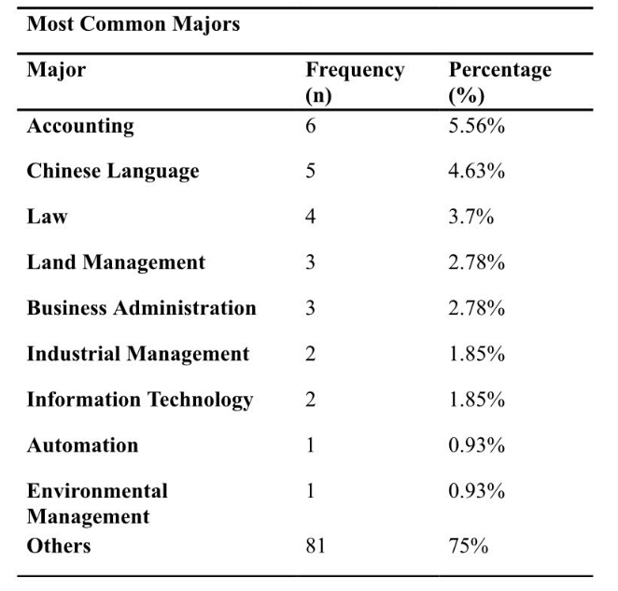
3. Methodology
Academic Majors
  Wide range of non-English majors
  Most common: Accounting, Chinese, Law
  75% came from other majors → high diversity
  Shows English writing is important across all fields

Slide 13

3. Methodology
Research Instruments
🔹 Survey Questionnaire
  Distributed via Google Forms (in Vietnamese)
  3 Sections:
  Demographic information
  Advantages of AI tools in writing
  Disadvantages of AI tools in writing
🔹 Semi-Structured Interviews
  Conducted in Vietnamese (~1 hour each)
  Focused on students’ experiences & perceptions
  Recorded and transcribed for analysis

Slide 14
3. Methodology
Data Analysis Methods
Quantitative Analysis
  Used means, standard deviations, and percentages
  Results displayed in tables for clarity
Qualitative Analysis
  Audio recorded and transcribed verbatim
  Thematic analysis used:
  Coded independently by 4 researchers
  Reviewed for consensus
  Recurring patterns grouped into broader themes
  Member-checking for data accuracy and trustworthiness

Slide 15
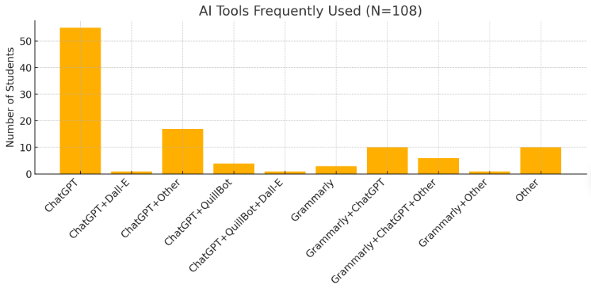
4. Results

Slide 16
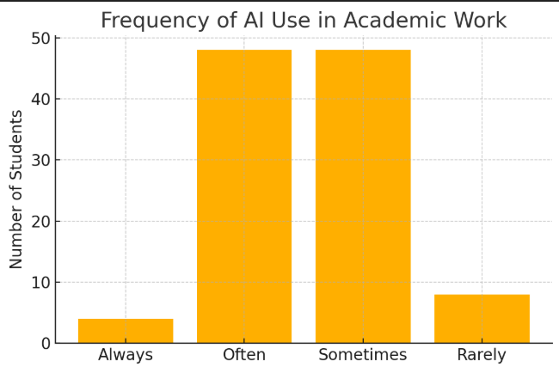
4. Results

Slide 17
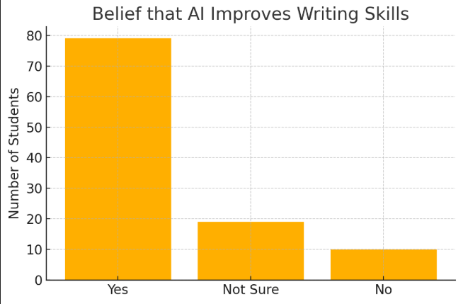
4. Results

Slide 18
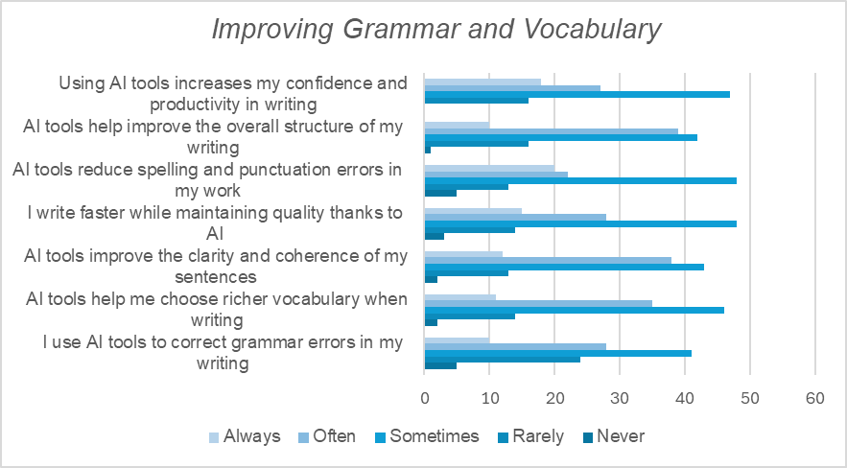
Advantages of AI tools in writing

Slide 19
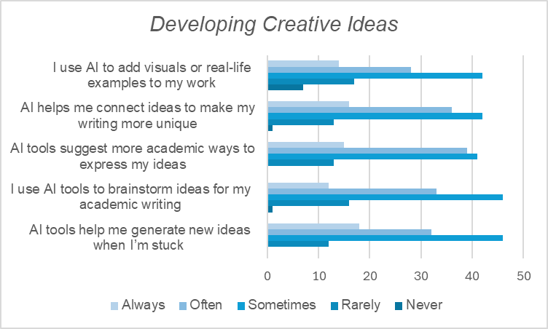
Advantages of AI tools in writing

Slide 20
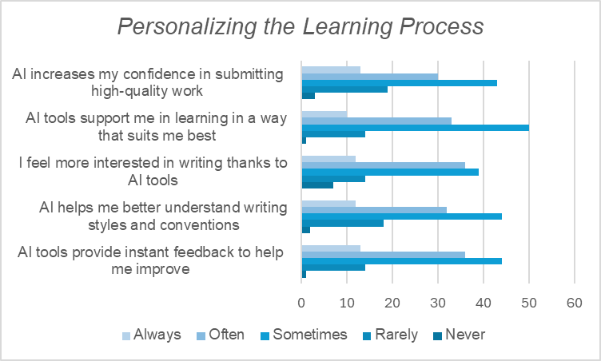
Advantages of AI tools in writing

Slide 21
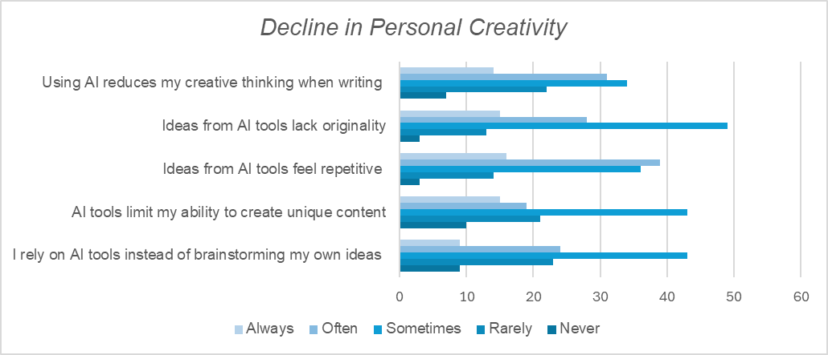
Disadvantages of AI tools in writing

Slide 22
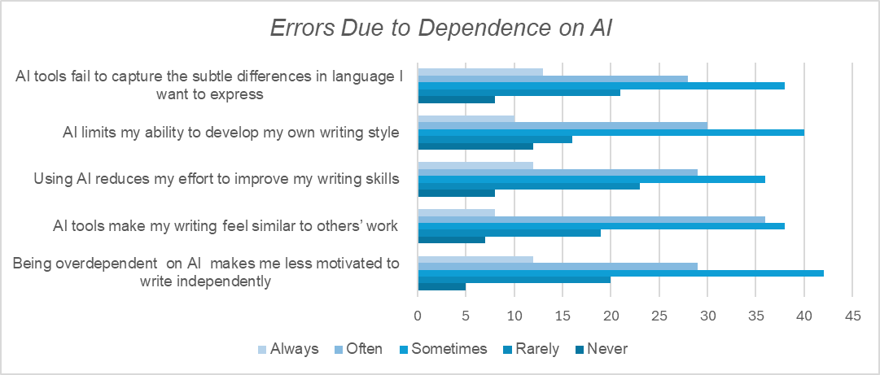
Disadvantages of AI tools in writing

Slide 23
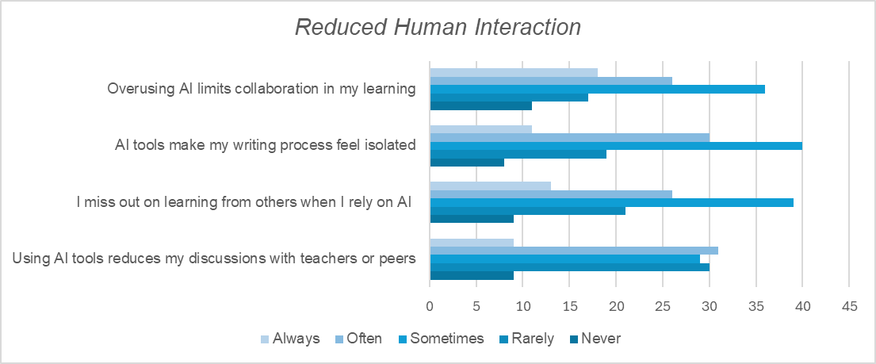
Disadvantages of AI tools in writing

Slide 24

5. Conclusion
Summary of Main Findings
AI Tools
Enhancing Academic Writing
Potential Drawbacks
  Technical Improvement
  Creativity Boost
  Personalized Learning
  Diminished Creativity
  Reduced Critical Thinking
  Social Isolation
=> balanced AI integration.

Slide 25

Limitations
  Limited Generalizability
  Reliance on Self-Reported Perceptions
  Rapid Evolution of AI

Slide 26
Future Directions
  Broader Scope
  Mixed-Methods Approach
  Longitudinal Studies
  Discipline-Specific Insights

Slide 27
Recomendations
Lecturers
Students
Policymakers
  Promote Responsible Use
  Integrate into Curriculum
  Foster Critical Evaluation
  Use as a Learning Aid
  Prioritize Independent Writing
  Understand AI Limitations.
  Verify Content
  Attend Workshops
  Discipline-Specific Guidelines
  Invest in Resources
  Support Training

Slide 28
References
Abu-Al-Aish, A. (2023). The Effect of Using a Smart E-Learning App on the Academic Achievement of Eighth-Grade Students. Science and Technology Education, 19(4).
Dobrin, S. I. (2023). AI and writing. Broadview Press.
Grimes, M., & Warschauer, M. (2023). The False Promise of ChatGPT: How Overreliance on AI Undermines Learning. Computers & Education, 104(1), 45–62.
Kang, J., & Yi, Y. (2023). Beyond ChatGPT: Multimodal generative AI for L2 writers. Journal of Second Language Writing.
Lee, Y.-J., Davis, R. O., & Lee, S. O. (2024). University students’ perceptions of artificial intelligence-based tools for English writing courses. Online Journal of Communication and Media Technologies, 14(1).
Li, B., Wang, C., Bonk, C., & Kou, X. (2024). Exploring inventions in self-directed language learning with generative AI: Implementations and perspectives of YouTube content creators. TechTrends. https://doi.org/10.1007/s11528-024-00960-3
Luckin, R. (2016). Intelligence unleashed: An argument for AI in education. Pearson
Marzuki, Widiati, U., Rusdin, D., Darwin, & Indrawati, I. (2023). The impact of AI writing tools on the content and organization of students’ writing: EFL teachers’ perspective. Cogent Education, 10(2).
Wang, C. (2024). Exploring Students’ Generative AI-Assisted Writing Processes: Perceptions and Experiences from Native and Nonnative English Speakers. Technology Knowledge and Learning.
Yeruva, Ajay Reddy. (2023). Providing A Personalized Healthcare Service To The Patients Using AIOPs Monitoring. Eduvest-Journal of Universal Studies, 3(2), 327–334.

Slide 29

Thank You

