Slide 1
TRƯỜNG ĐẠI HỌC NGOẠI NGỮ - TIN HỌC TP. HỒ CHÍ MINH
HO CHI MINH CITY UNIVERSITY OF FOREIGN LANGUAGES - INFORMATION TECHNOLOGY
AN INVESTIGATION INTO UNIVERSITY STUDENTS’ AI COMPETENCY IN ENGLISH LANGUAGE LEARNING
Presenter: Võ Thị Bích Phương
www.huflit.edu.vn

Slide 2
Table of content
01
02
03
INTRODUCTION
LITERATURE REVIEW
METHODOLOGY
04
05
FINDINGS & DISCUSSION
CONCLUSION & RECOMMENDATIONS

Slide 3
INTRODUCTION
AI competency
AI tools usage in language education
AI in education
Digital transformation

Slide 4
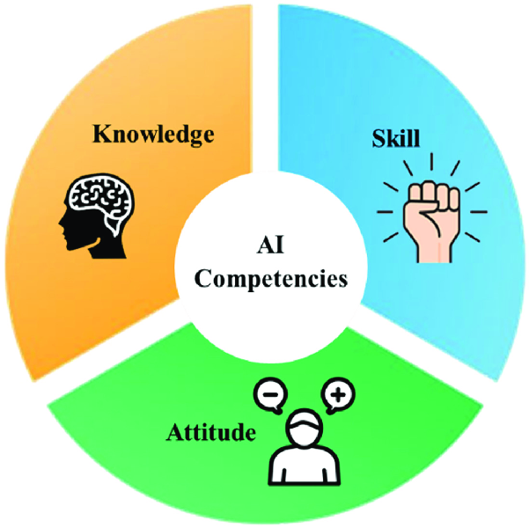
RESEARCH QUESTIONS
1. What AI tools are students using for English language learning tasks?
2. What are the students’ perceptions of the usefulness of AI in English language leaning?
3. How competent are they in applying these tools effectively?

Slide 5
THE ROLE OF AI IN EDUCATION
AI is transforming education (Luckin et al., 2016)
Personalized learning pathways
Real-time feedback for language skill development
Learner autonomy and motivation

Slide 6
COMMON AI TOOLS IN LANGUAGE LEARNING
ChatGPT acts as a virtual tutor, supporting natural conversation, goal setting, and grammar explanations (Kasneci et al., 2023).
Grammarly enhances grammar, cohesion, and writing fluency; reduces anxiety; fosters autonomy (Ebadi & Rahimi, 2019; Tambunan et al., 2022).
Quillbot supports paraphrasing, grammar correction, and vocabulary improvement, boosting motivation and accuracy (Rahimi & Fathi, 2022; Amanda et al., 2023).
Google Translate assists with vocabulary building and sentence formation through fast, accurate AI-powered translations (Castilho et al., 2018).

Slide 7
AI COMPETENCY FRAMEWORK
HUMAN-CENTERED MINDSET
Human agency
Human accountability
Citizenship in the era of AI
ETHICS OF AI
Embodied ethics
Safe and responsible use
Ethics by design
AI COMPETENCY
AI SYSTEM DESIGN
Problem scoping
Architecture design
Iteration and feedback loops
AI TECHNIQUES AND APPLICATIONS
AI foundations
Applications skills
Creating AI tools
AI COMPETENCY FRAMEWORK FOR STUDENTS (UNESCO, 2024)

Slide 8
AI definitions & its key concepts
KNOWLEDGE
AI apps & limitations
Data sources, bias & ethical challenges
Proficiency in using AI tools
SKILLS
ENGLISH LANGUAGE LEARNING
AI COMPETENCY
Evaluating AI-generated content
Problem-solving
Positive engagement with AI tools
ATTITUDE
Ethical considerations
Advocating for responsible AI use
Conceptual framework of AI Competency in language learning (UNESCO, 2024) and Ng et al. (2024)

Slide 9
METHODOLOGY
Convenience sampling method
Faculty of Foreign Languages at HUFLIT
128 students
4 classes
Advanced English skills
Quantitative
Questionnaires
31 items – Likert scale, multiple responses & subjective tests
Questionnaire delivered via Moodle
Descriptive statistics, Paired-samples T-test
Pedagogical settings
Participants
Study design
Data collection & analysis

Slide 10
FINDING 1 – PATTERNS OF AI TOOLS
Tools | Number | Percentage
Grammarly | 96 | 75.0%
ChatGPT | 112 | 87.5%
Duolingo | 54 | 42.2%
Google Translate | 104 | 81.3%
Text-to-Speech | 30 | 23.4%

Slide 15
DISCUSSION 1
Students’ AI competency
High competency across all four areas: knowledge, skills, ethics, and attitudes
Ethical awareness topped the list – students understand responsible AI use
Students are confident and motivated using tools like Grammarly, ChatGPT, Google Translate
Cognitive understanding was the weakest – many lack insight into how AI actually works
Pedagogy must go beyond usage: promote AI literacy, critical thinking, and ethical decision-making
DISCUSSION 2
DISCUSSION 3
DISCUSSION 4

Slide 16
Patterns of AI Tool Usage Among Students
ChatGPT & Google Translate: Most frequently used – valued for immediacy and flexibility
Duolingo & Text-to-Speech: Underused – seen as less spontaneous or overly assistive
ChatGPT & Google Translate benefits:
Instant feedback
Grammar explanations
Support across writing and speaking tasks
Duolingo: Requires structured practice → less appealing for quick help
Text-to-Speech apps: Still perceived as passive aids, not active learning tools
Students prefer tools with speed, ease, and multi-functionality
DISCUSSION 1
DISCUSSION 2
DISCUSSION 3
DISCUSSION 4

Slide 17
DISCUSSION 1
Uneven Use of AI Tools for Speaking and Listening Skills
Most students preferred AI tools for writing & translation tasks
Listening & speaking tools were less trusted or used
Text-based tools (e.g., ChatGPT, Grammarly) valued for visible, instant output
These tools felt easier & more intuitive than voice-based apps
Tools like ELSA Speak & Text-to-Speech were underused
Students may lack awareness or technical confidence with oral-skill tools
DISCUSSION 2
DISCUSSION 3
DISCUSSION 4

Slide 18
DISCUSSION 1
Gap Between Self-Rated and Actual AI Competency
Students overrated their AI competency compared to their actual performance on knowledge-based assessments.
Frequent use ≠ deep understanding.
Students may be technically familiar with tools but lack:
Knowledge of AI mechanisms
Awareness of tool limitations and biases
Understanding of ethical and privacy implications
DISCUSSION 2
DISCUSSION 3
DISCUSSION 4

Slide 19
CONCLUSION & IMPLICATIONS
Misjudged AI Competency
AI Competency
Embed AI foundations, algorithm awareness, and ethical topics (e.g., privacy, bias) in curricula; Compare AI outputs, analyze tool limitations, and justify usage decisions.
AI literacy should include conceptual knowledge, ethical awareness, and critical evaluation skills
01
04
02
Skills-Based Disparities
Patterns of AI Tool Use
03
Instruction should integrate oral-AI tools in class and address student hesitancy or misconceptions
Teachers should guide students in selecting and combining tools for balanced development, especially in listening and pronunciation.

Slide 20
LIMITATIONS
Self-reported data can overestimate abilities; test-based data included for balance.
Findings may have limited cross-cultural generalizability.
No direct analysis of teacher roles, curriculum design, or peer collaboration.
Did not measure language improvement outcomes from AI use.
Future research should use longitudinal, mixed-method designs to explore the effects of AI tool use in different learning environments.

Slide 21
THANK YOU FOR LISTENING!

