Slide 1

The AI Revolution in TESOL
Teaching, Learning, and Innovation:
The Ethical Dimensions of AI in Education
Vickie Miller
Founder, Catalyzing Learning Services/
INTESOL Worldwide Senior Trainer
August 5-6, 2025
z

Slide 2


Catalyzinglearningservices.com
Alan Turing
credited with breaking the ‘Enigma’ code
History

Slide 3
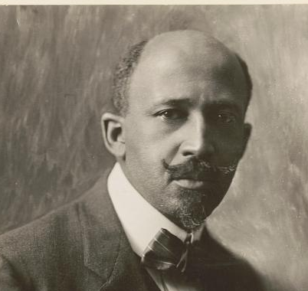

Catalyzinglearningservices.com
W.E.B DuBois
Ida B. Wells-Barnett
History

Slide 4

Catalyzinglearningservices.com
History
City and Rural Population
Value of Land Owned by Georgia Negroes
Proportion of Freeman and Slaves Among American Negroes
Source: W.E.B. Du Bois, 1900; Monroe-White, T., & Lecy, J. (2023). The Wells-Du Bois Protocol for Machine Learning Bias: Building Critical Quantitative Foundations for Third Sector Scholarship. Voluntas (Manchester, England), 34(1), 170–184. https://doi.org/10.1007/s11266-022-00479-2

Slide 5

Source: Wake County, North Carolina Register of Deeds Marriage Registry

Slide 6
“The ultimate measure of a man is not where he stands in moments of comfort and convenience, but where he stands at times of challenge and controversy”
-Dr. Martin Luther King, Jr.

Slide 7
Catalyzinglearningservices.com
Moment: A concept of time – either a brief or exact period of time.
“She paused to savor the special moment before stepping onto the stage.”
Definition 1

Slide 8
Catalyzinglearningservices.com
Moment: A concept of importance or significance.
“That fleeting moment held immense significance for the future of the project.”
Definition 2

Slide 9
Why does it matter?
1.5 Billion Learners
Source: The British Council

Slide 10
What are the ethical considerations in using
AI in TESOL Education?

Slide 11
Catalyzinglearningservices.com
Key points from the literature on the ethical considerations in AI and TESOL education
Suggestions for potentially addressing these ethical concerns
Areas of further research
Introduction

Slide 12
Methodology

Slide 13

Catalyzinglearningservices.com
A literature search was conducted using multiple academic databases, including Google Scholar, ERIC, JSTOR, and ResearchGate.
The search employed a combination of keywords and phrases such as "AI in education," "ethical considerations in AI," "TESOL and AI," "AI ethics for educators," and "language teaching and technology."
The search was limited to peer-reviewed articles and books published within the last ten years to ensure the relevance and currency of the findings.
Source: Unsplash | İrfan Simsar (2018)
Methodology

Slide 14
24,680 Total
8,630 Peer reviewed
659 Ethics & AI
39 Somewhat related
8 Directly related

Slide 15
Findings

Slide 16
Equity and access concerns
Results
Source:

Slide 17
Quote
Use of AI to maintain systemic discriminatory practices
Cultural sensitivity
Results
“Without examining the structure of the information economy and its relation to inequality, distributive interventions cannot transform the problem of digital inequality, nor can they create nonmaterial social goods such as empowerment and opportunity for marginalized people” (Stratton, 2021, p.50).
Source: Stratton, 2021, p.50)

Slide 18
Discussion and Questions for Future Research

Slide 19
Catalyzinglearningservices.com
Awareness
Training and professional development for TESOL educators
Opportunities to Impact Ethical Challenges

Slide 20
Catalyzinglearningservices.com
How does algorithmic bias manifest in AI-powered TESOL platforms?
What are the primary sources of algorithmic bias in TESOL AI systems?
How can algorithm auditing be applied to mitigate bias in TESOL AI systems?
Call to Action

Slide 21

Call to Action

Slide 22
Catalyzinglearningservices.com
Thoughtful design and supervision of AI systems to reduce the replication of historical biases and inequities
Consideration for the impact of digital gaps that may exist
Parlay knowledge and position to education and rais awareness around AI and accessibility
Call to Action

Slide 23


Slide 24


Follow Us
Thank you!
www.catalyzinglearningservices.com

