Slide 1



Panda English Center
AI IN ACADEMIC WRITING: A COMPARATIVE STUDY ON THE EFFECTIVENESS OF CHATGPT ASSISTANCE AND STUDENTS’ PERCEPTIONS AMONG UNIVERSITY LEARNERS.
Trang Nguyen, An Pham, Ly Nguyen, Phuong Pham

Slide 2
RESEARCH INTRODUCTION
  TESOL alumni at EDC, IELTS teacher at Panda English Center (Hanoi)
  Research: "AI in Academic Writing: Comparing the Effectiveness of ChatGPT Assistance and Student Perceptions"
  Reason: ChatGPT is increasingly used in education; IELTS learners at Panda use it without clear guidance
  Aim: Explore the actual effectiveness of ChatGPT and how students perceive it
01

Slide 3
LITERATURE REVIEW
Technology Acceptance Model (Davis, 1989)
TAM suggests that two key factors shape whether users accept a new technology:
    Perceived Usefulness – does it help improve performance?
    Perceived Ease of Use – is it simple to use?
02

Slide 4
METHODOLOGY
MIXED-METHODS APPROACH
Participants | 15 IELTS learners
Phase 1 | Collect ChatGPT-assisted writing samples
Phase 2 | Google form survey
03

Slide 5
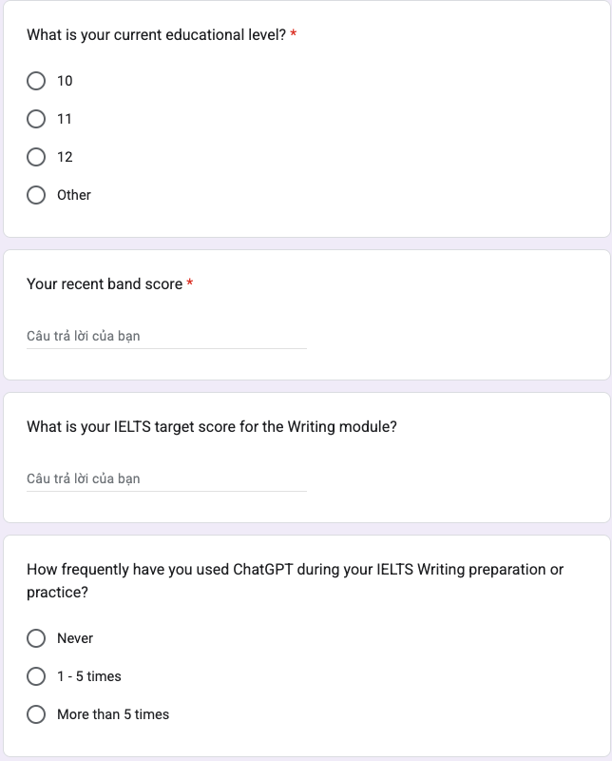
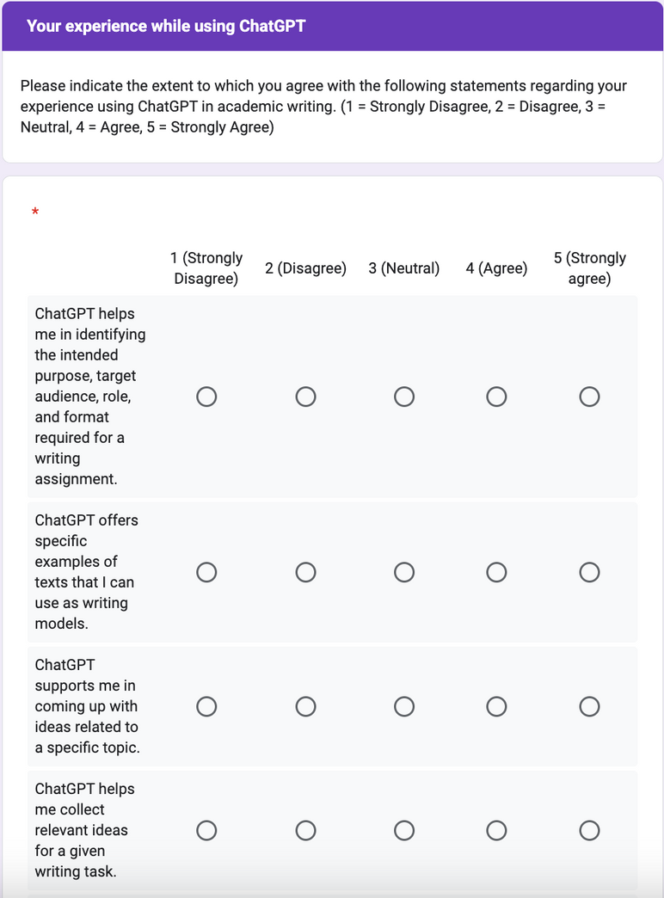
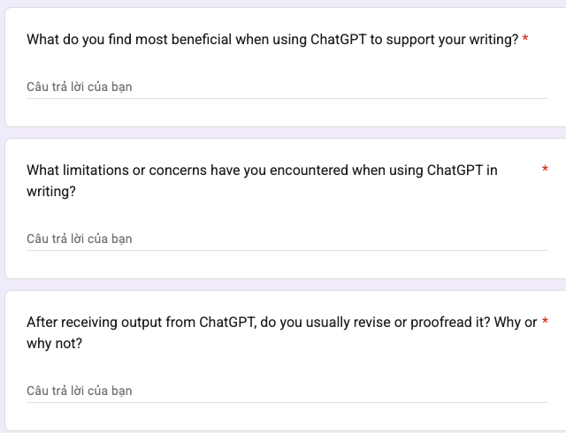
ABOUT GOOGLE FORM SURVEY
Basic information: Band scores, education level
Questions based on TAM-Likert scales
Open-ended questions
04

Slide 6
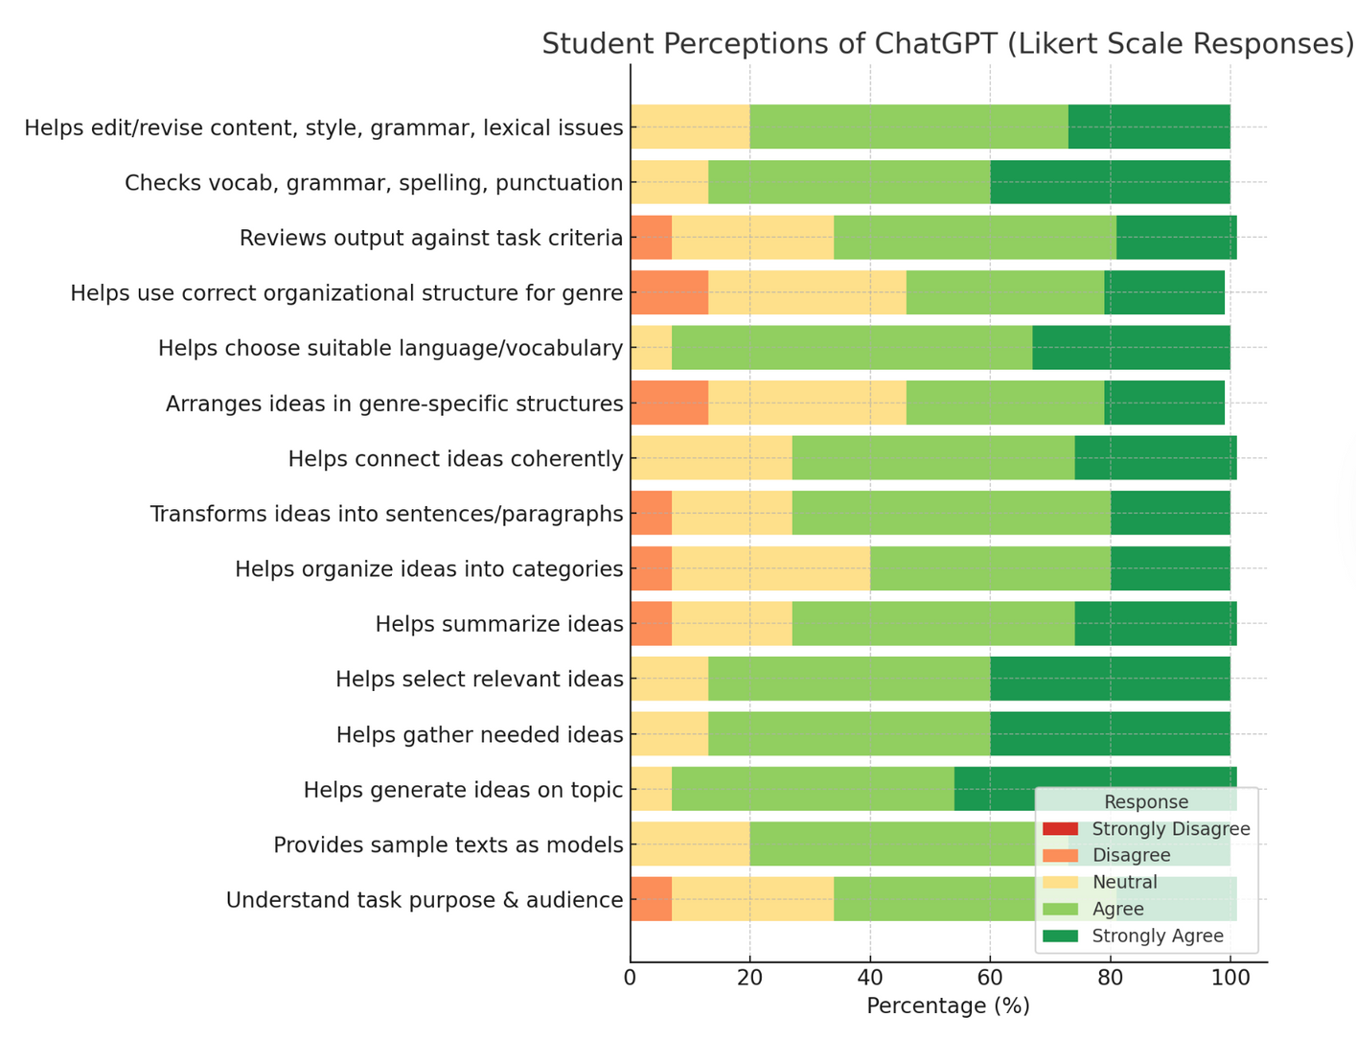
Key findings
  Helpful for brainstorming, organizing ideas, and improving vocabulary.
  Fast & convenient.
  Concerns: over-reliance, less critical thinking.
  Better prompts are needed.
05

Slide 7
Meaning & pedagogy
Using ChatGPT as a support tool, not a replacement
Learning to prompt and think critically
Teaching AI literacy to keep independent thinking
06

Slide 8
Conclusion & recommendation
  Need to teach AI literacy: how to prompt or keep independent thinking
  Combine AI tools with student autonomy for best results
  ChatGPT supports IELTS writing, especially for ideas & vocabulary
  But risk of over-reliance if not used critically
07

Slide 9
THANK YOU

