Slide 1

How IELTS Teachers Integrate ChatGPT in Developing Students’ Writing Skills: Potential and Limitations
Presented by Tran Thanh Luat
& Nguyen Thi Kim Hue

Slide 2
OVERVIEW
1
Background & Rationale
2
Research Aim & Questions
3
4
Methodology
Key Findings
5
Conclusion

Slide 3
01
Background & Rationale
ChatGPT is gaining attention in language education, especially in writing feedback.
Recognized as an assistant for easing teachers’ workload and giving consistent feedback.

Slide 4

01
Background & Rationale
RESEARCH GAP:
Limited research on ChatGPT’s feedback use in IELTS writing, especially from teachers’ perspectives.
This study uses a qualitative approach to explore both the potential and limitations of ChatGPT in this context.

Slide 5
Research Aim & Questions
02
1. To explore how IELTS teachers use ChatGPT to provide writing feedback and examine their perceptions of its benefits and limitations.
2. Research Questions:
What aspects of students’ writing do teachers use ChatGPT for?
What are the benefits and limitations of ChatGPT in IELTS writing feedback?

Slide 6


METHODOLOGY
03
Population: Post-graduate students enrolled in the Master of Education (TESOL) program.
Research settings: Ho Chi Minh City Open University (HCMCOU).

Slide 7
METHODOLOGY
03
Qualitative approach using structured interviews.
Participants: 10 IELTS teachers from Open University (TESOL Master’s program).
Data Analysis: Thematic analysis (Braun & Clarke, 2006).

Slide 8
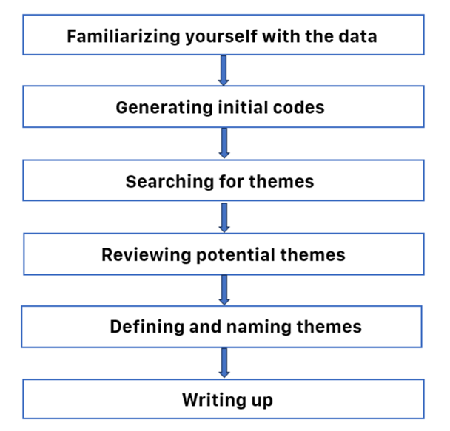
METHODOLOGY
03
Data Analysis: Thematic analysis (Braun & Clarke, 2006).

Slide 9
KEY FINDINGS
04
ASPECTS OF STUDENTS’ ESSAYS THAT TEACHERS COMMONLY USE CHATGPT TO ASSIST WITH
Grammar correction
Vocabulary and word choice
Sentence structure and idea development
Scoring and Feedback Based on Criteria

Slide 10
KEY FINDINGS
04
BENEFITS OF CHATGPT IN GENERATING IELTS WRITING FEEDBACK
Time Efficiency
Accuracy and Error Detection
Detailed and Helpful Feedback
Idea and Structure Support
“I think that ChatGPT gives the opportunity to save time for teachers so they can have time to do other important things.”

Slide 11
KEY FINDINGS
04
BENEFITS OF CHATGPT IN GENERATING IELTS WRITING FEEDBACK
Time Efficiency
Accuracy and Error Detection
Detailed and Helpful Feedback
Idea and Structure Support
“It can increase the accuracy of students’ writing essays because teachers may miss some errors while grading a wide range of essays.”

Slide 12
KEY FINDINGS
04
BENEFITS OF CHATGPT IN GENERATING IELTS WRITING FEEDBACK
Time Efficiency
Accuracy and Error Detection
Detailed and Helpful Feedback
Idea and Structure Support
“ChatGPT not only provides helpful feedback but it also gives some useful recommendations to improve the essays”.

Slide 13
KEY FINDINGS
04
BENEFITS OF CHATGPT IN GENERATING IELTS WRITING FEEDBACK
Time Efficiency
Accuracy and Error Detection
Detailed and Helpful Feedback
Idea and Structure Support
“ChatGPT can suggest many ideas and structures to help reduce burdens on teachers.”

Slide 14
KEY FINDINGS
04
LIMITATIONS OF CHATGPT IN GENERATING IELTS WRITING FEEDBACK
Overreliance and Misuse
Lack of Personalization
Lack of consistency
“...teachers may lose their creativity and it can also deteriorate their grading skills”.

Slide 15
KEY FINDINGS
04
LIMITATIONS OF CHATGPT IN GENERATING IELTS WRITING FEEDBACK
Overreliance and Misuse
Lack of Personalization
Lack of consistency
“It lacks personalization... just marks their essays based on a general rubric.”

Slide 16
KEY FINDINGS
04
LIMITATIONS OF CHATGPT IN GENERATING IELTS WRITING FEEDBACK
Overreliance and Misuse
Lack of Personalization
Lack of consistency
“Sometimes, there is still misinformation that can be misleading to students if teachers do not check carefully.”

Slide 17
CONCLUSION
05
ChatGPT can be a useful tool, but Human empathy and personalization are irreplaceable.
Encourage further research with larger, diverse samples and long-term studies.

Slide 18
THANKS FOR LISTENING

