Slide 1

TRƯỜNG ĐẠI HỌC NGOẠI NGỮ - TIN HỌC TP. HỒ CHÍ MINH
HO CHI MINH CITY UNIVERSITY OF FOREIGN LANGUAGES - INFORMATION TECHNOLOGY
Promoting Students’ Morphological Competence in English for Medical Purposes (EMP) Courses through AI-Driven Gamification
Nguyen Huu Ngoc
Nguyen Tat Thanh University
www.huflit.edu.vn

Slide 2
OUTLINE
01
02
03
04
INTRODUCTION
LITERATURE REVIEW
METHODOLOGY
FINDINGS AND CONCLUSION

Slide 3

INTRODUCTION
English for Medical Purposes (EMP) has grown in popularity in recent years, reflecting the growing needs for medical professionals to communicate effectively in English in clinical settings (Hutchinson & Waters, 1993; Georgy, 2023)
English medical terms are often difficult for learners due to their Latin and Greek origins (Hastürkoğlu, 2020).
Mastering medical morphology—prefixes, roots, and suffixes—is essential for improving learners’ ability to decode, understand, and retain complex terminology (Nguyen Le & Miller, 2020; Oseki & Marantz, 2020; Hastürkoğlu, 2020).
=> Need for innovative methods to promote students’ retention of morphology in Medical English

Slide 4
INTRODUCTION
AI-powered platforms offer real-time, adaptive, and personalized feedback that enhances vocabulary acquisition (Alenezi, 2023; Abbes et al., 2024).
Gamification—using elements like points, badges, and leaderboards—has proven effective in boosting learners’ motivation and engagement (Deterding et al., 2011; Salehi et al., 2023; Chugh & Turnbull, 2023).
However, the combined application of AI and gamification to enhance morphological learning in EMP remains underexplored.
=> This study was conducted to investigate the effects of the use of AI-driven games on promoting students’ morphological competence in learning medical terminology in EMP courses.

Slide 5
RESEARCH AIMS
- Investigate the effects of AI-driven gamification on students’ morphological competence;
- Explore students' perceptions of AI gamified learning in EMP courses.

Slide 6
RESEARCH QUESTIONS
1. How does AI-driven gamification enhance medical students’ morphological competence in EMP courses?
2. What are medical students' perceptions towards the use of AI-driven gamification in their EMP courses?

Slide 7
LITERATURE REVIEW
Definition of AI-Driven Gamification
AI-driven gamification refers to the integration of AI technologies with gamified strategies to personalize and enhance learning experiences.
Gamification involves the use of game mechanics (e.g., points, challenges) to engage learners (Kapp, 2012; Zichermann & Cunningham, 2011; Werbach & Hunter, 2012), while AI refines this experience by adapting content and feedback based on learner data (Macewski, 2023; Centrical, 2023; Chou, 2023).

Slide 8
LITERATURE REVIEW
Features of AI-Driven Gamification
AI-driven gamification offers personalized, real-time, and engaging learning by combining:
Personalization through adaptive algorithms (Costa et al., 2024; Abbes et al., 2024)
Immediate feedback based on learner performance (Ng et al., 2024; Spinify, 2024)
Content generation in quizzes and assessments (Abbes et al., 2024)
Motivational game mechanics like badges and leaderboards (Jaramillo-Mediavilla et al., 2024; Costa et al., 2024)
Scaffolding with intelligent hints and adaptive pathways (Jiang et al., 2025; Ng et al., 2024)

Slide 9
LITERATURE REVIEW
The use of Quizizz in learning vocabulary
Basma & Nadera (2021) found that Quizizz increased enthusiasm and reduced anxiety in vocabulary learning.
Ismail & Mohammad (2019) concluded that real-time quizzes helped maintain attention and improved learner retention.
Aljaloud et al. (2019) observed that gamified quizzes enhanced classroom dynamics by encouraging participation and fostering a sense of achievement.

Slide 10
LITERATURE REVIEW
Morphological Competence in EMP
Morphological competence in EMP is the ability to analyze medical terms by understanding their prefixes, roots, and suffixes—mostly derived from Latin and Greek (Nguyen Le & Miller, 2020; Chabner, 2017).
This skill aids vocabulary acquisition, comprehension of medical texts, and confident use of technical terms in academic and clinical contexts (López-Medina & García-Sánchez, 2022; Nguyen & Tran, 2023; Alshammari & Alqarni, 2023).

Slide 11
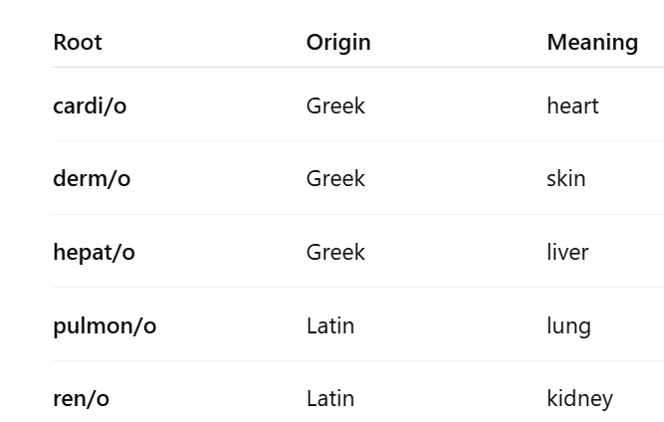
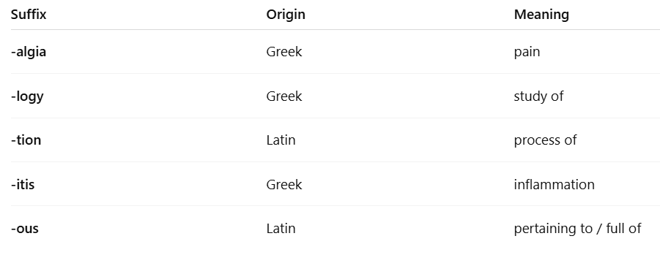
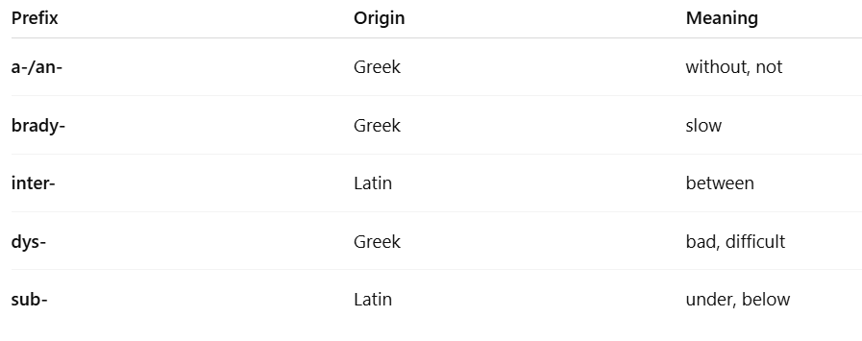
Examples of Components of Medical Terms

Slide 12
METHODOLOGY
Nguyen Tat Thanh University, Medicine department (District 4, HCMC).
Convenience sampling: two sophomore classes (age range: 18–22) in the first semester of 2024–2025.
+ Experimental group (N=42)
+ Control group (N=41)
Quasi-experimental design

Slide 13
METHODOLOGY
1. Tests:
Pre-test: Administered to both groups at course start to assess baseline morphological knowledge.
Post-test: Same format as pre-test, given after 3 months to measure morphological competence.
2. Semi-structured interviews: 8 volunteer students from the experimental group after post-tests.

Slide 14
INTERVENTION
- Experimental group: textbook + AI gamification (Quizizz)
- Control group: textbook + traditional lecture
- Duration: One semester (3 months)

Slide 15
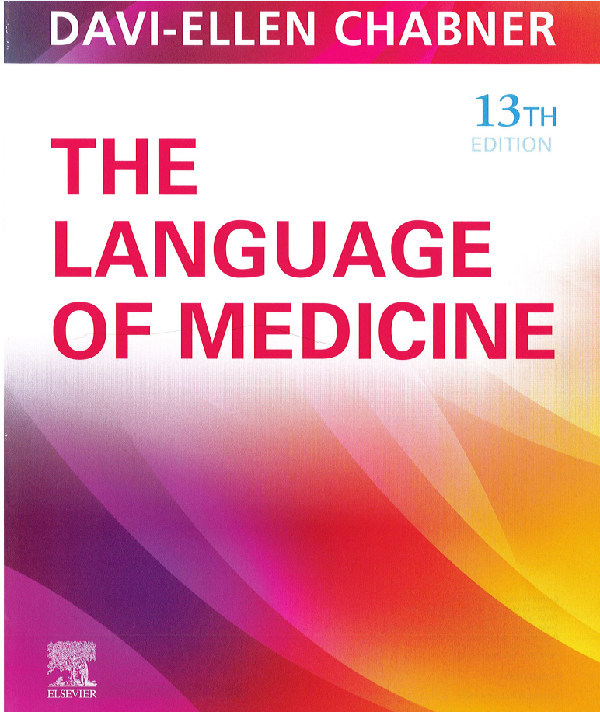
TEXTBOOK

Slide 16
Body system
Cardiovascular System
Respiratory System
Endocrine system
Musculoskeletal system

Slide 17
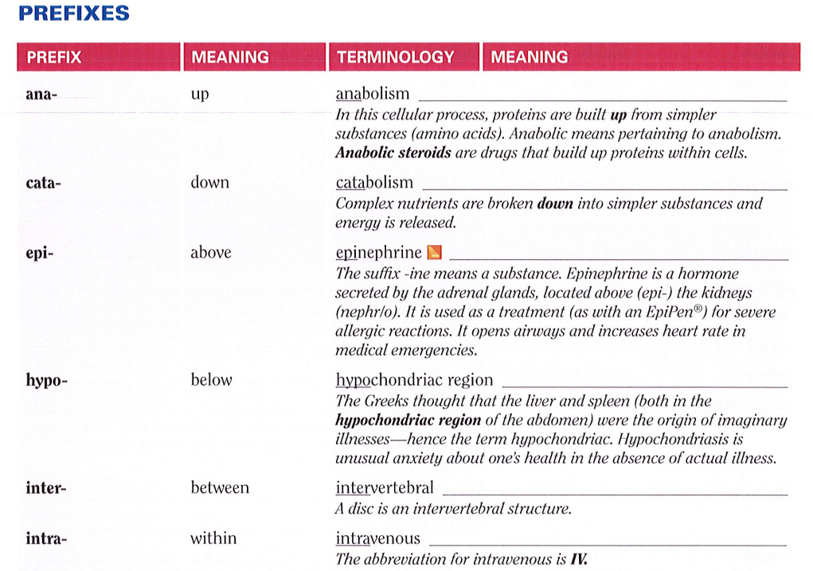
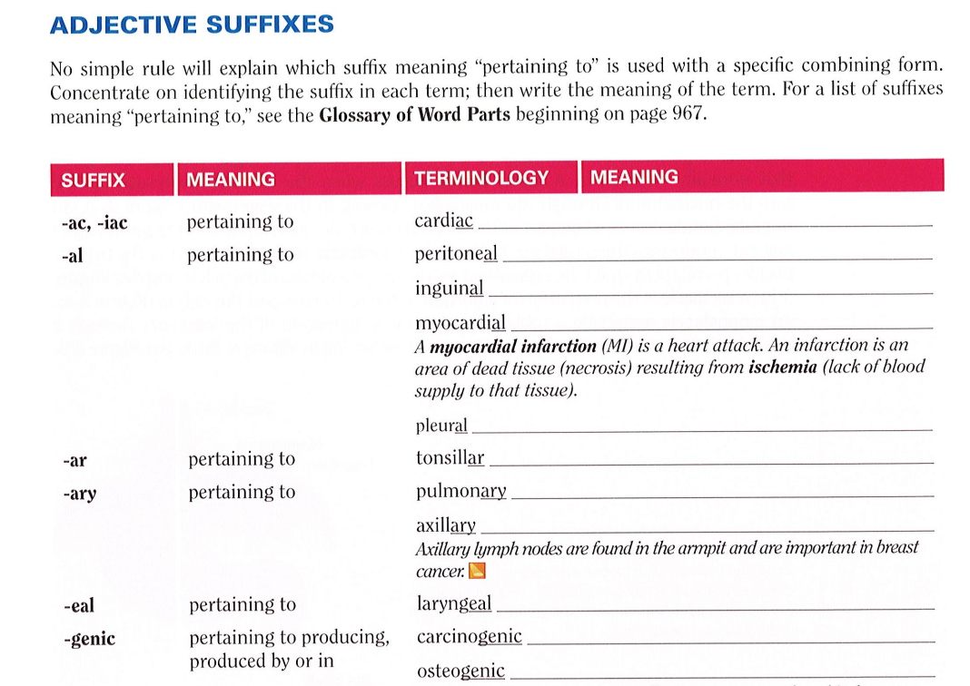
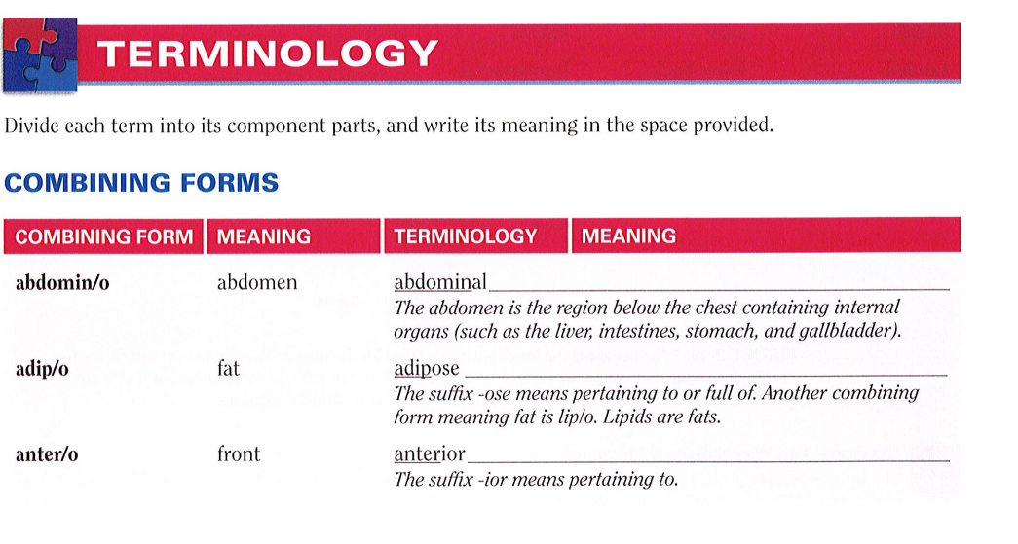

Slide 18
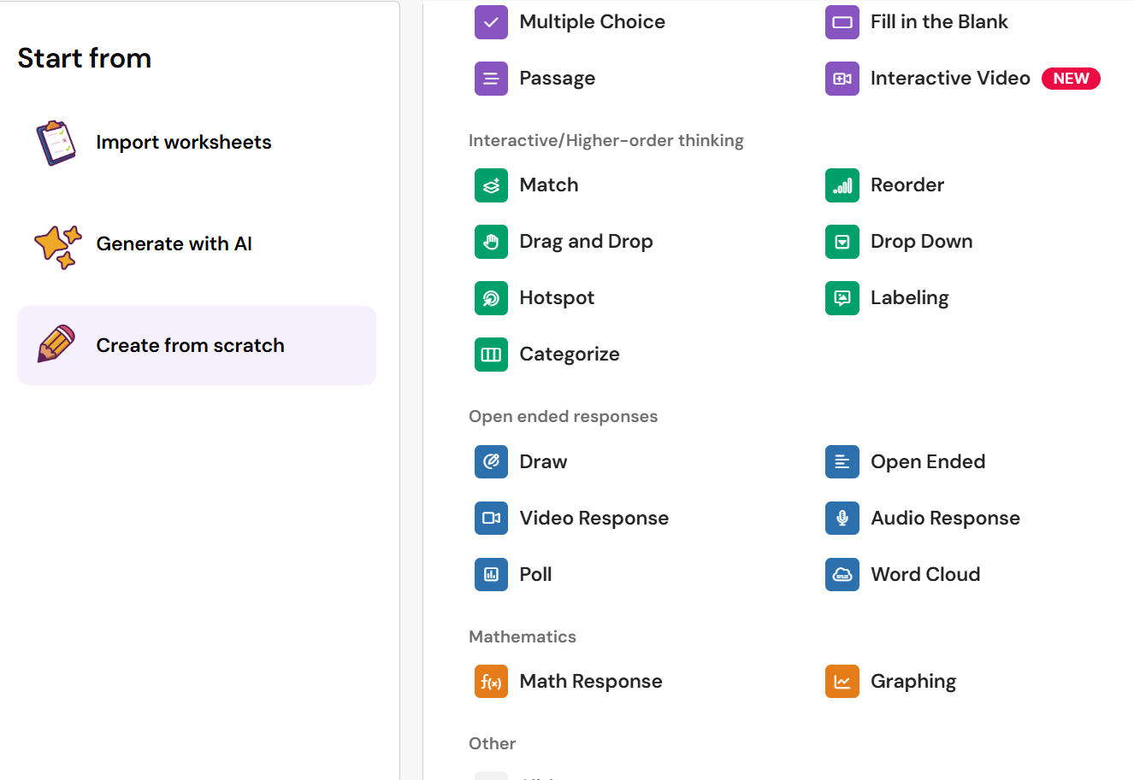
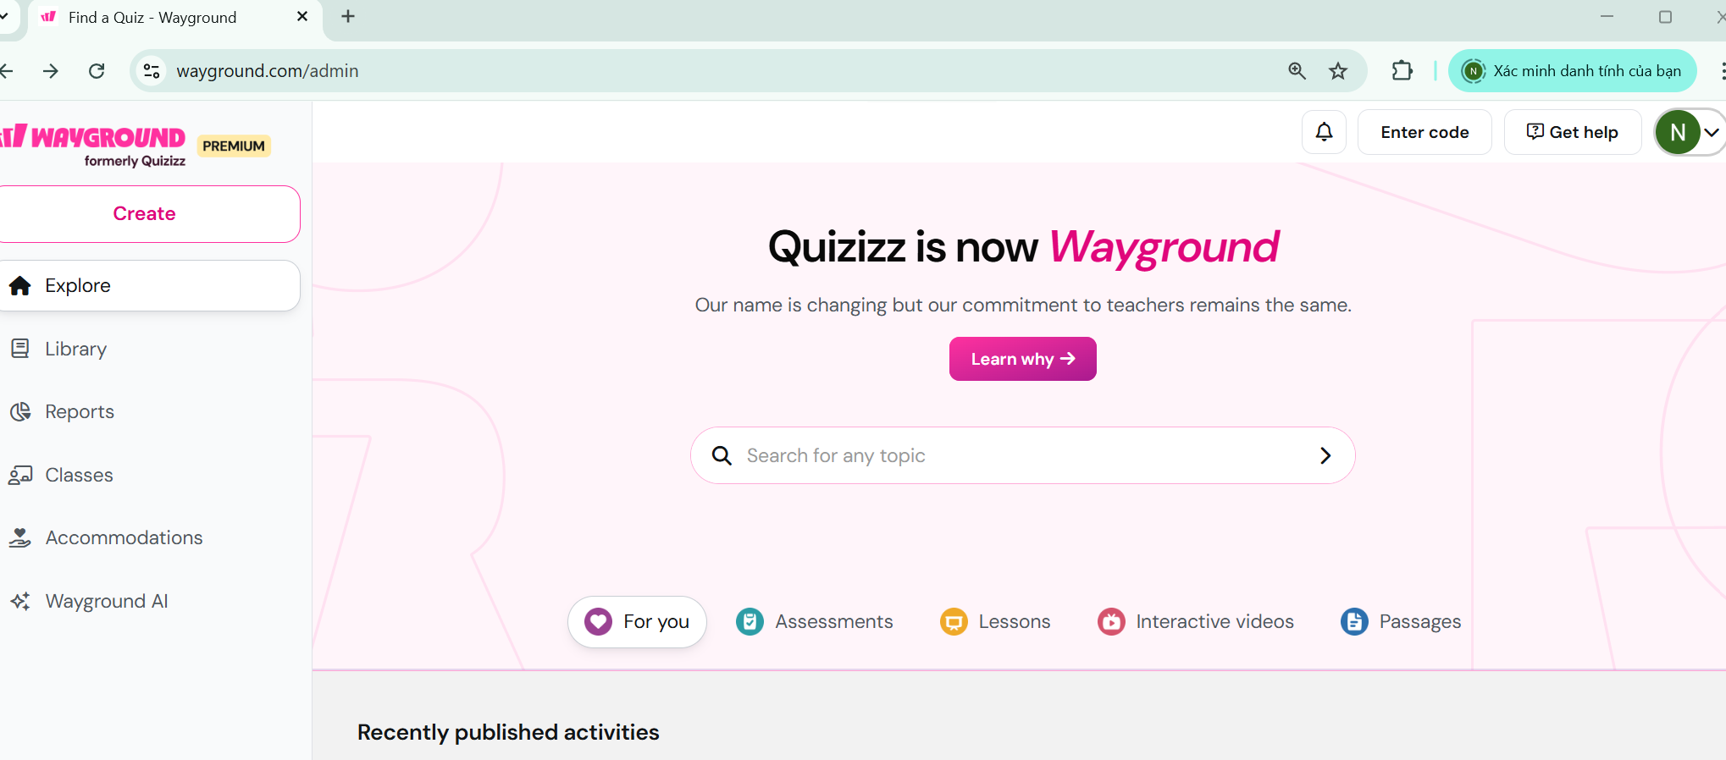

Slide 19
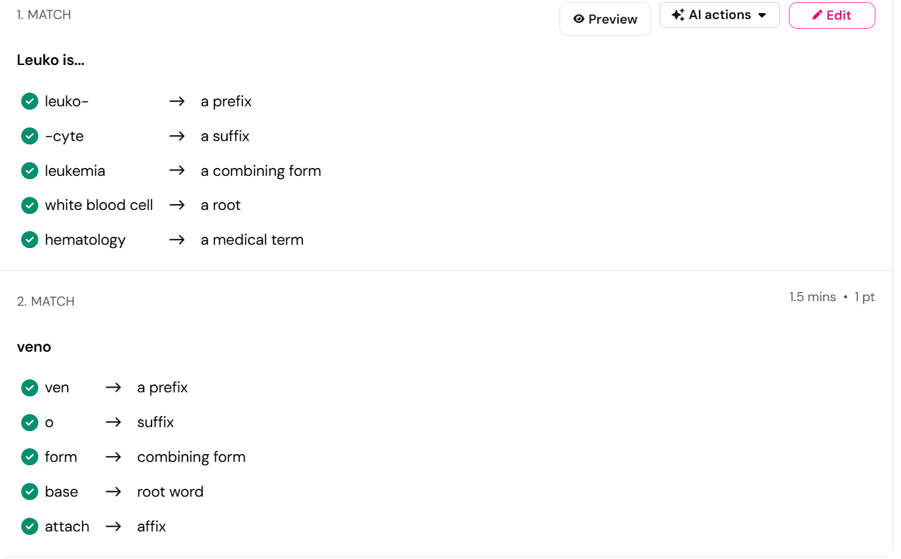
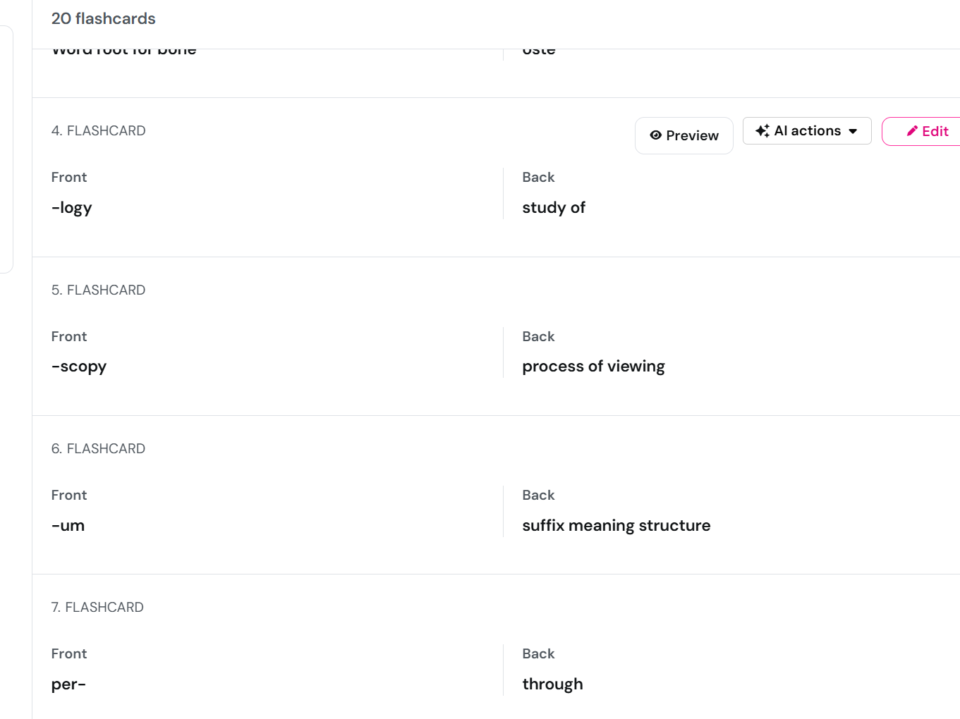
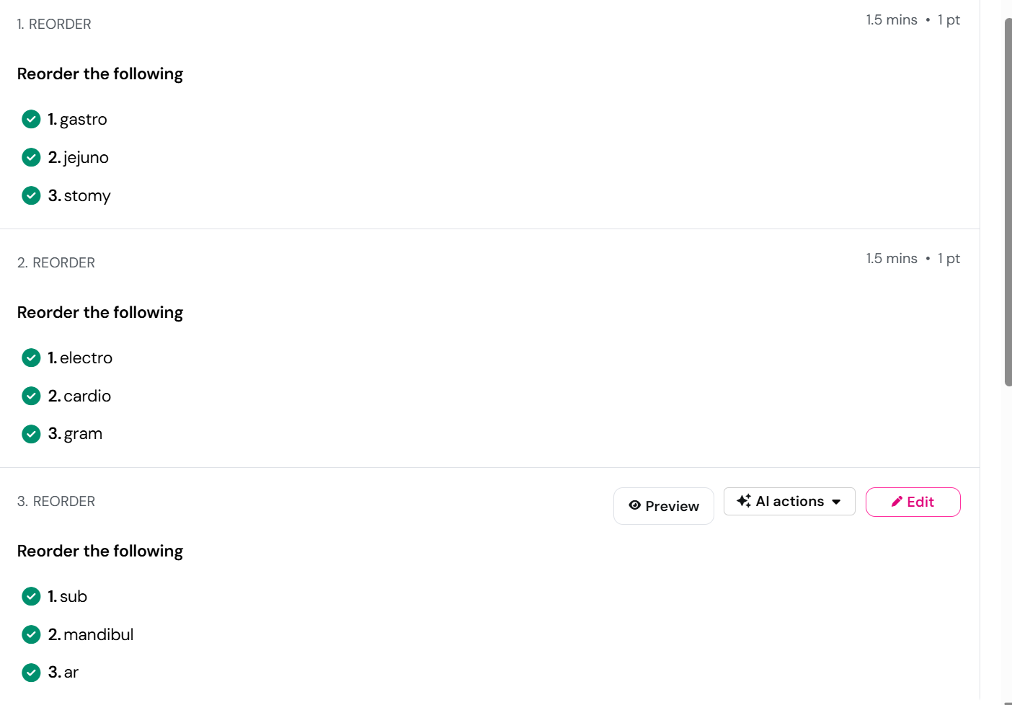
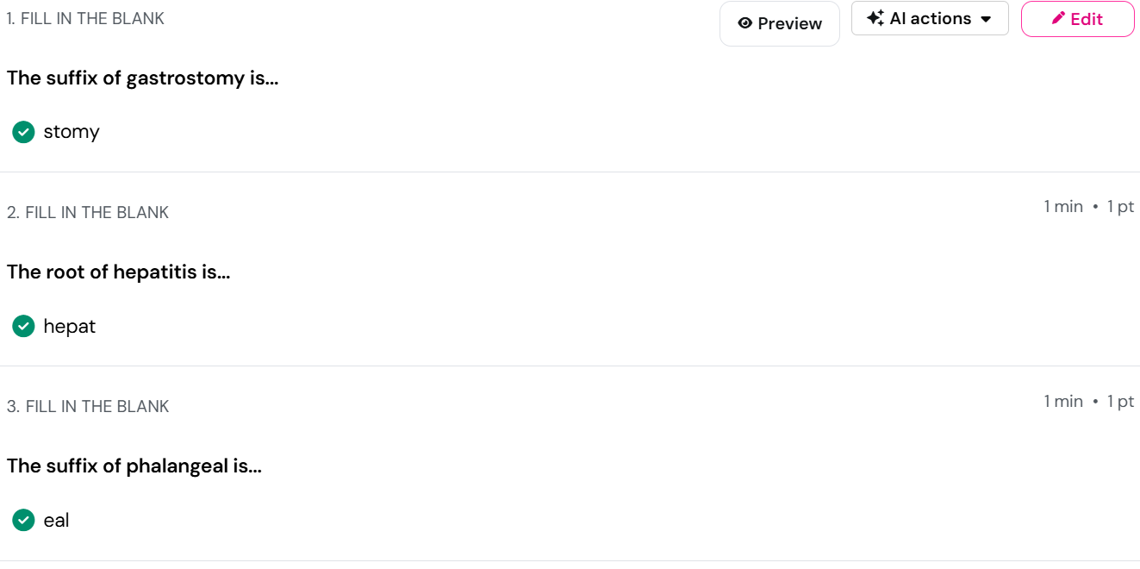
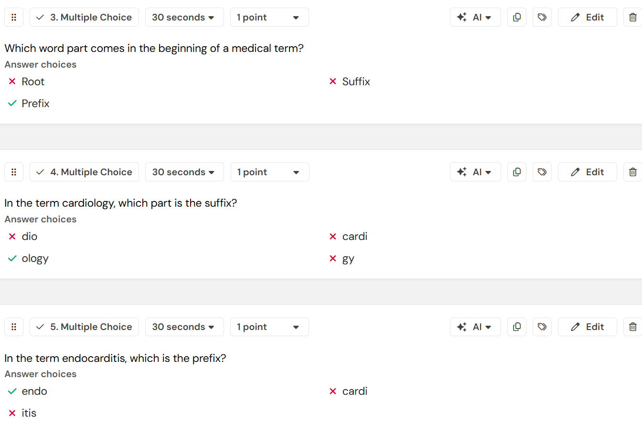
INTERVENTION

Slide 20
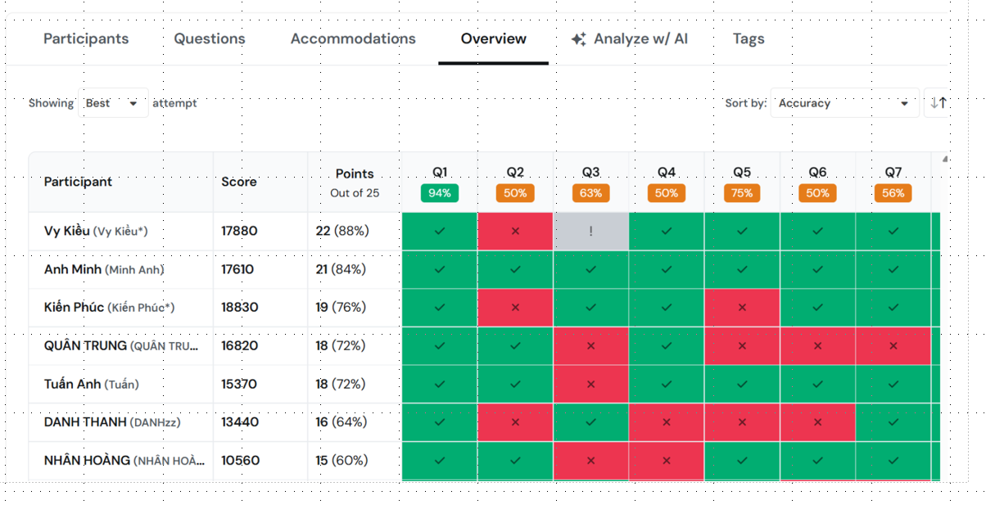

Slide 21
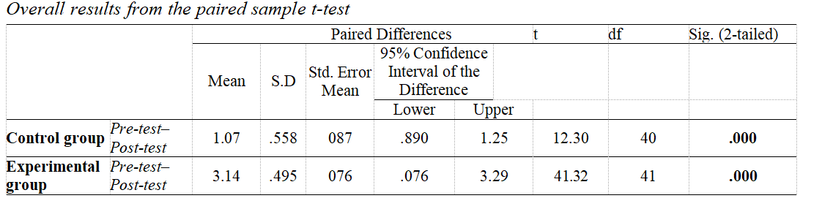
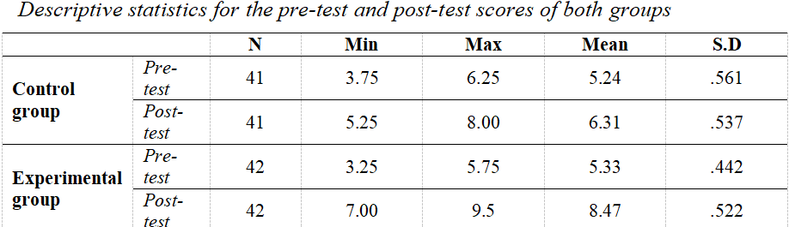
FINDINGS

Slide 22
FINDINGS - Qualitative data
1. Increased Engagement and Motivation
Students felt more engaged and motivated thanks to the fun, enjoyable, and game-like nature of AI-driven gamification.
2. Multi-Sensory Stimulation
Visual effects, soundtracks, and movement in the platform made learning more dynamic and stimulating.
3. High Interactivity and Social Collaboration
Game-based tasks encouraged both individual and group interaction, promoting social learning through competition and teamwork.
4. Improved Retention of Medical Morphology
Repeated exposure to prefixes, roots, and suffixes across different games supported deeper learning and memory retention.
5. Immediate and Supportive Feedback
AI platforms provided instant feedback that helped students recognize and correct mistakes without fear or embarrassment.

Slide 23
DISCUSSION
This study supports earlier research (Hsu et al., 2023; Nguyen & Tran, 2023; Qiao et al., 2023; Ouanes, 2024) on the positive impact of AI-powered gamification on vocabulary acquisition and engagement. It also introduces new insights:
+ Statistically significant improvement in students’ morphological competence in EMP (M = 3.14, p < .001)
+ Emerging themes from qualitative data:
Personalized and flexible review
Real-time feedback reduces anxiety
Game-based collaboration fosters social connection
Homework through AI-driven gamification allowed students to learn at their own pace, reducing pressure and increasing autonomy.

Slide 24
PEDAGOGICAL IMPLICATIONS
Incorporating AI-driven games into EMP courses to support learning of medical morphology and terminology
Leveraging feedback features to enhance student confidence and motivation
Using self-paced gamified homework to reinforce learning and promote a positive emotional climate.
Guiding curriculum innovation with data-driven feedback from AI games.

Slide 25
LIMITATIONS
The short duration limited examination of long-term learning outcomes.
The study focused solely on students’ perspectives, excluding teachers’ views.
Findings may not be generalizable to other EMP contexts or institutions.

Slide 26
RECOMMENDATIONS
Future research should extend the intervention period to assess long-term retention.
Studies should include teachers’ perspectives to explore implementation challenges.
Replicating the study in diverse EMP settings is recommended.
Further research can examine the effects of AI-driven gamification on other EMP skills.

Slide 27

THANK YOU FOR YOUR LISTENING!

