Slide 1





AI-enhanced needs analysis and ESP syllabus design for hotel receptionists in Vietnam
Presenter: Phuong Trinh Nguyen
Authors: Phuong Trinh Nguyen, Quoc Toan Vo, Thi Kim Thanh Nguyen, Thi Ngoc Anh Truong
Tuesday,05 August, 2025

Slide 2






Meet the Research Team
Quoc Toan Vo
Project Lead - Lecturer
Thai Binh Duong University
Phuong Trinh Nguyen
Presenter - EFL Instructor
WESET English Center
Thi Ngoc Anh Truong
EFL Teacher
Dong Hoa Secondary School
Thi Kim Thanh Nguyen
Lecturer
Nguyen Tat Thanh University

Slide 3

Agenda Overview
01
Introduction & Context
04
Key Findings
02
Literature Review
05
Proposed ESP Syllabus
03
Research Methods
06
Conclusion

Slide 4
01
Introduction & Context

Slide 5

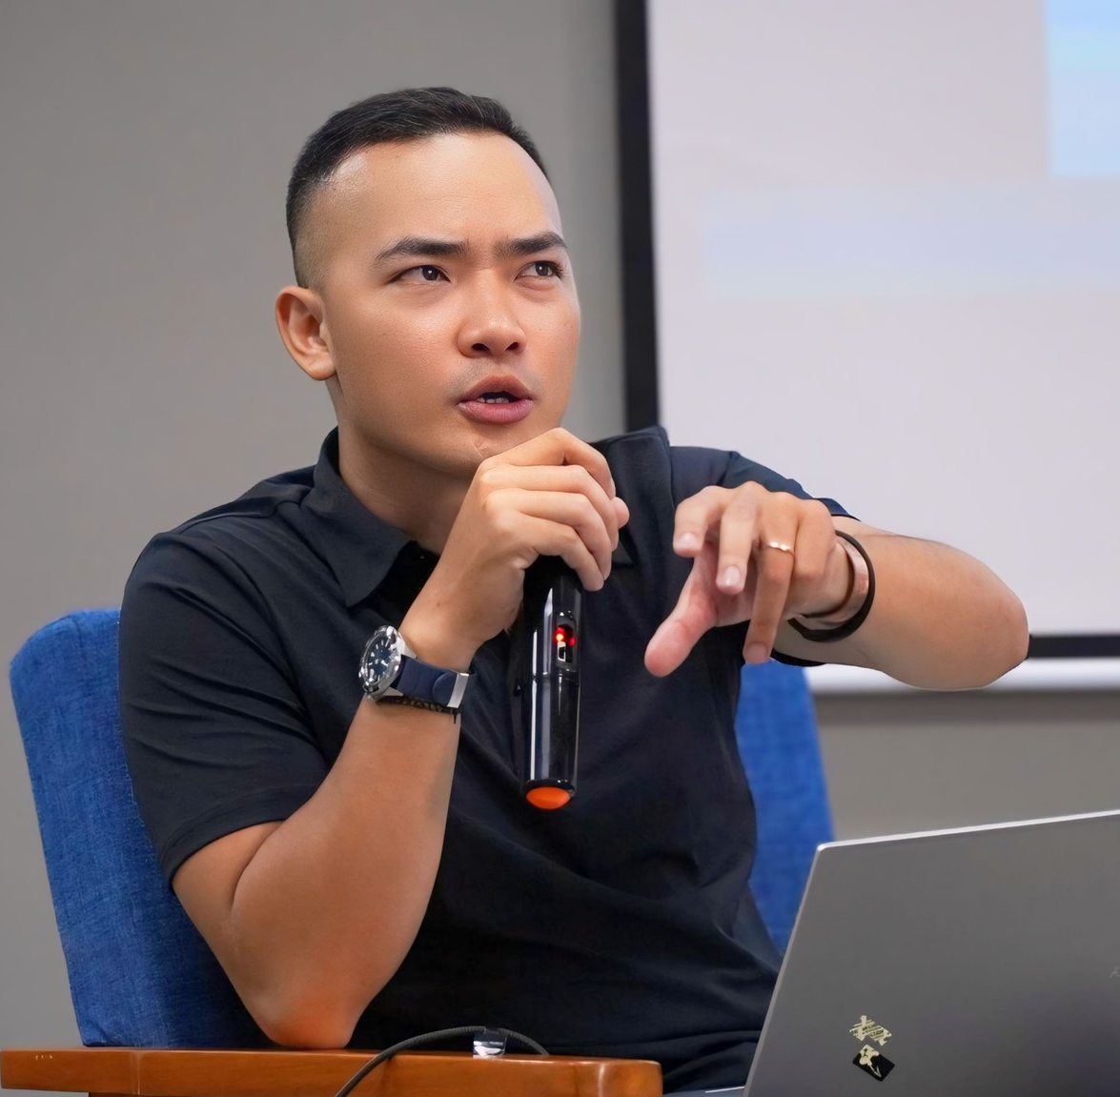

Mr. Toan Vo
Research team leader
5 years working directly in the hospitality industry (front-desk receptionist, front office manager)
currently, full-time educator, university lecturer, ESP instructor at many city hotels and resorts in Nha Trang city
→ gain permission to conduct research at Regalia Gold hotel

Slide 6

Regalia Gold Hotel
A city hotel located in Nha Trang city
ESP Training course to be provided to new entrants, sponsored by the hotel
Varying English background (lower to inter)

Slide 7

Why focus on receptionist?
🌐 Vietnam’s tourism boom
🛎️ Hotel receptionists are brand ambassadors
🎯 General English is not enough
📞 Core skills needed

Slide 8



Current Training - What’s missing?
What’s Needed: “How to say ‘Let me fix this for you’ to a guest
What’s taught: “Present Perfect Tense”

Slide 9

Research Questions:
1st goal: What do learners actually need to say and do in English to succeed in their job?
Traditional ESP (books, chalkboard)
AI-Enhanced
(chatbots, simulations)
2nd goal: how AI can serve as a bridge—addressing key limitations in ESP training:
Can it support instructors who lack industry background?
Can it generate authentic, dynamic scenarios for learners to practice?
And can it scale personalized feedback for learners with varying levels and needs?

Slide 10
02
Literature Review

Slide 11


Key Literature in ESP, Needs Analysis & AI
ESP in Hospitality: Hutchinson & Waters (1987)
Needs Analysis - The heart of ESP: Hyland (2006), Brown (1995), West (1994), (Brunton, 2009; Masoumpanah & Tahririan, 2013).
AI in language training – Opportunity or Overhype?: Alhumaidan & Alghamdi (2023)
goal – directed & needs-based → serve the actual, everyday demands of the job
Listening and speaking are often the most used and least supported skills
Many training programs skip the step of asking learners and stakeholders what they actually need
Generate authentic conversation scenarios for roleplays
Provide personalized feedback
Allow for self-paced learning
Notes:
In the hospitality industry, receptionists aren’t just using English — they’re using it to solve problems, provide comfort, and build trust. That’s where ESP comes in: targeted English that reflects the actual communicative functions of the job.
Needs Analysis helps us stop designing "guesswork" syllabi. It ensures that what’s taught matches what’s needed — especially in high-stakes, real-time communication like hospitality.
AI doesn’t just automate — it individualizes. It helps us train dozens of receptionists with simulations, feedback, and personalization that would otherwise take hours of one-on-one time.

Slide 12
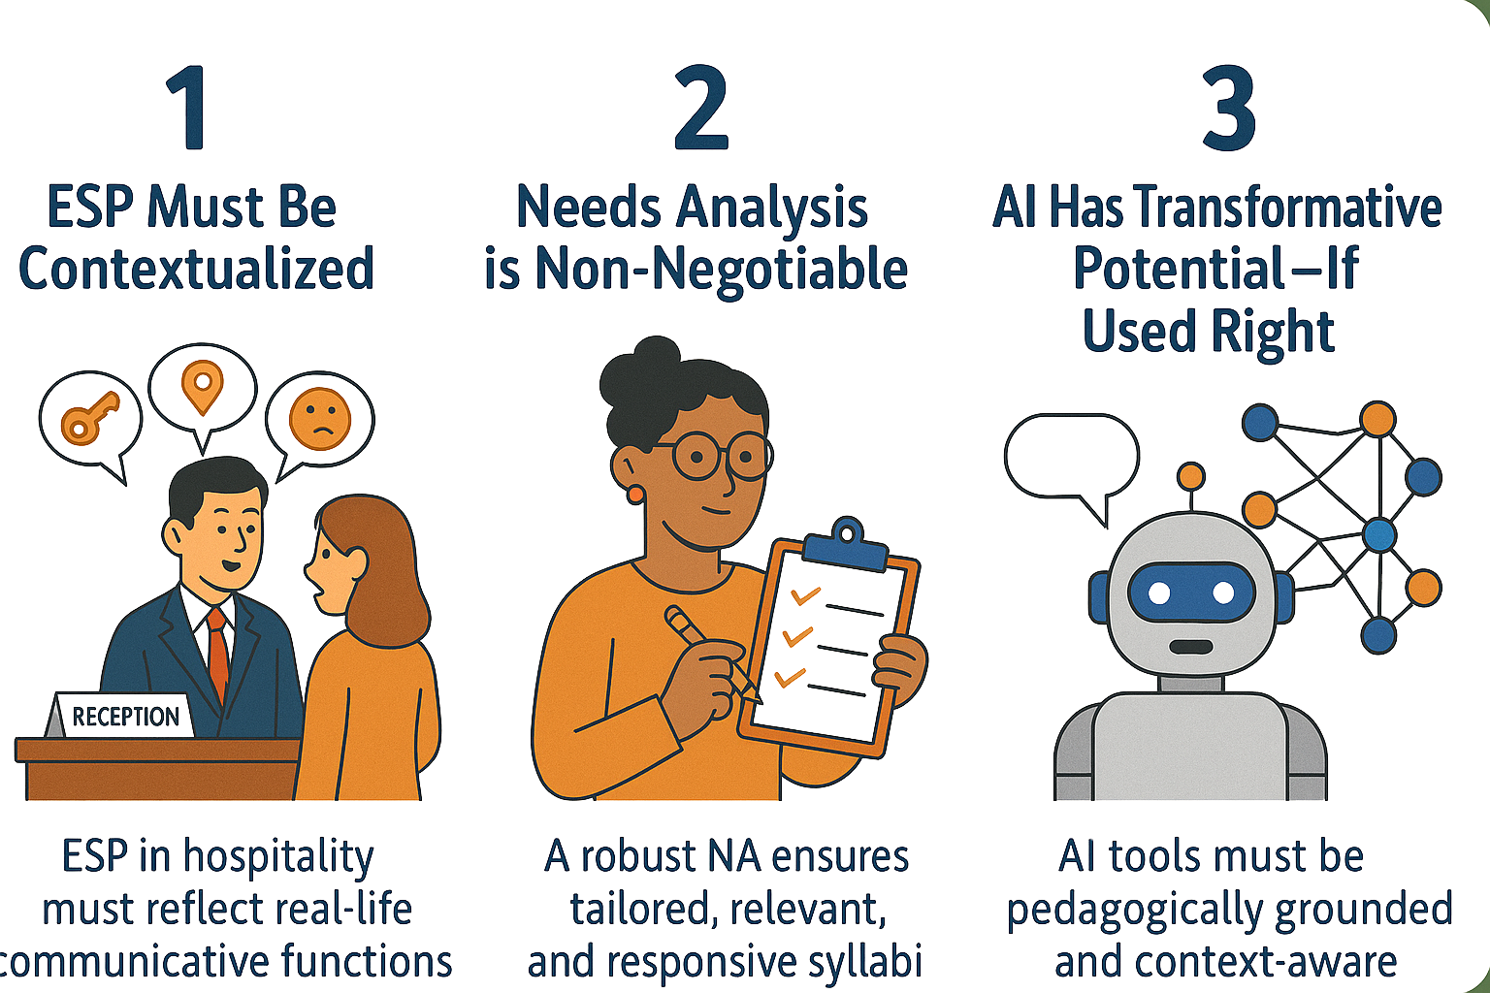
What the Literature Tells Us — and Why It Matters?

Slide 13
03
Research Methodology

Slide 14
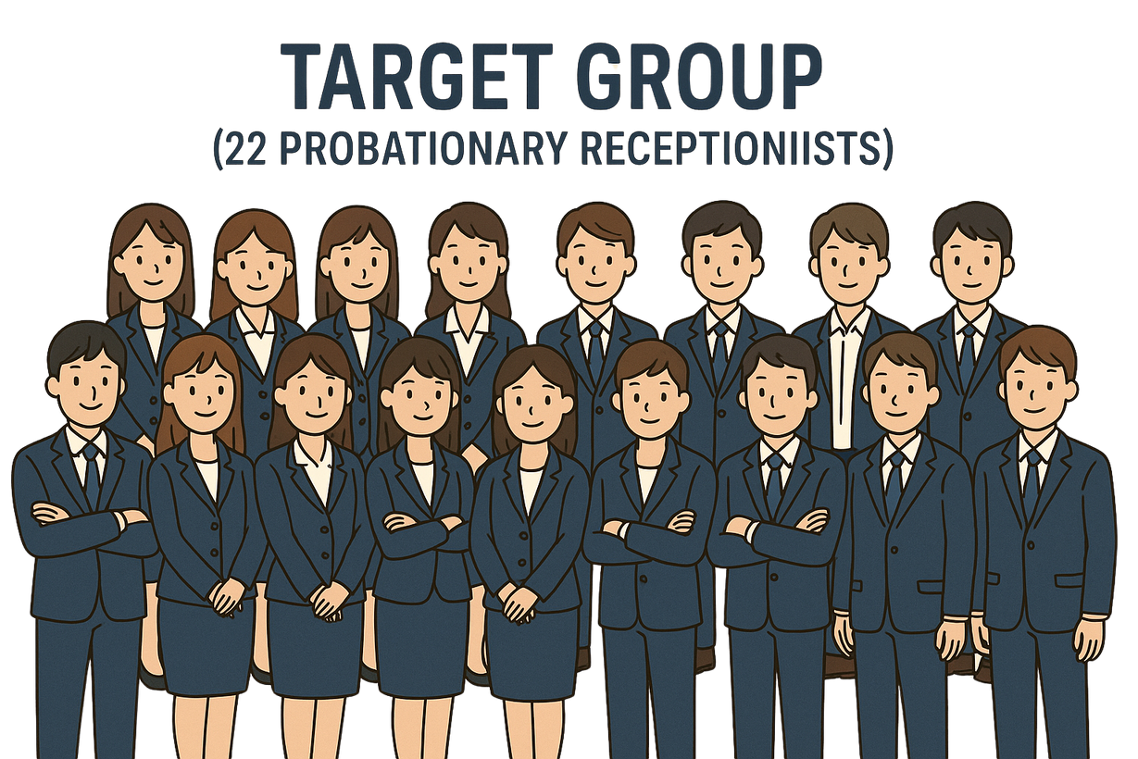
Target Group
(22 Probationary Receptionists)
  University graduates
  Mostly A2–B1+ CEFR
  60% no English certificate
  Stronger in speaking/listening, weaker in reading/writing
  Almost no experience in ESP Training
10 males - 12 females
Aged 22-35

Slide 15
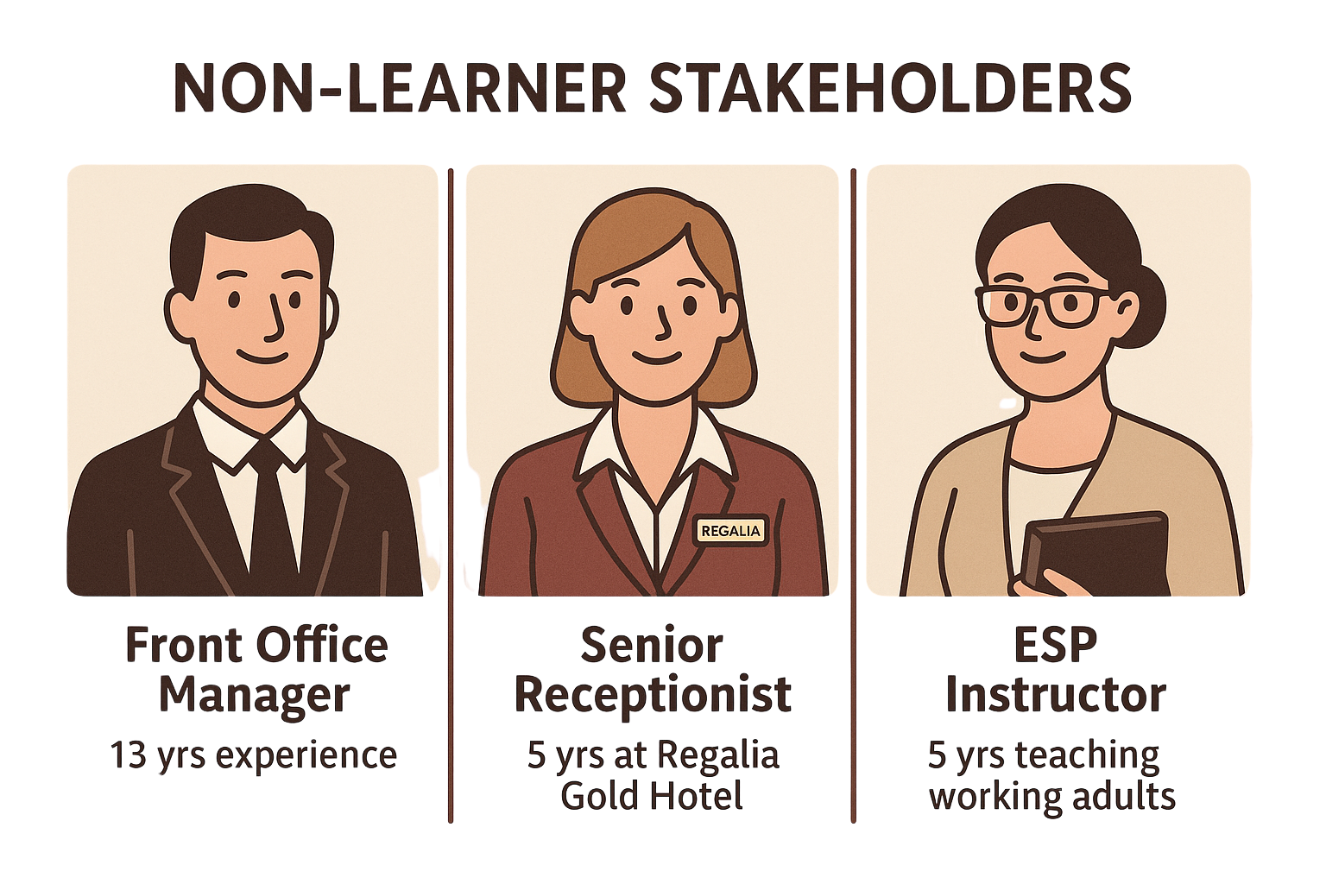
Non-learner stakeholders
need more competent staff
➯ higher level of service
need more competent staff
➯ higher level of service & professionalism
want to equip students with communicative skills
➯ effectively perform within their role

Slide 16

Data Collection Process
English skills
Class logistics
ESP experience
Main concerns
Preferences
AI literacy/exposure & preferences
Survey
- New entrants
- Receptionists
Needs Analysis
Interview
for Hotel Receptionists
English skills
Class logistics
Difficulties
Expectations
ESP experience
Realistic views on AI use in training
- Front Office Manager
- Senior Receptionist
- ESP Instructor
Observation
On-site observation

Slide 17
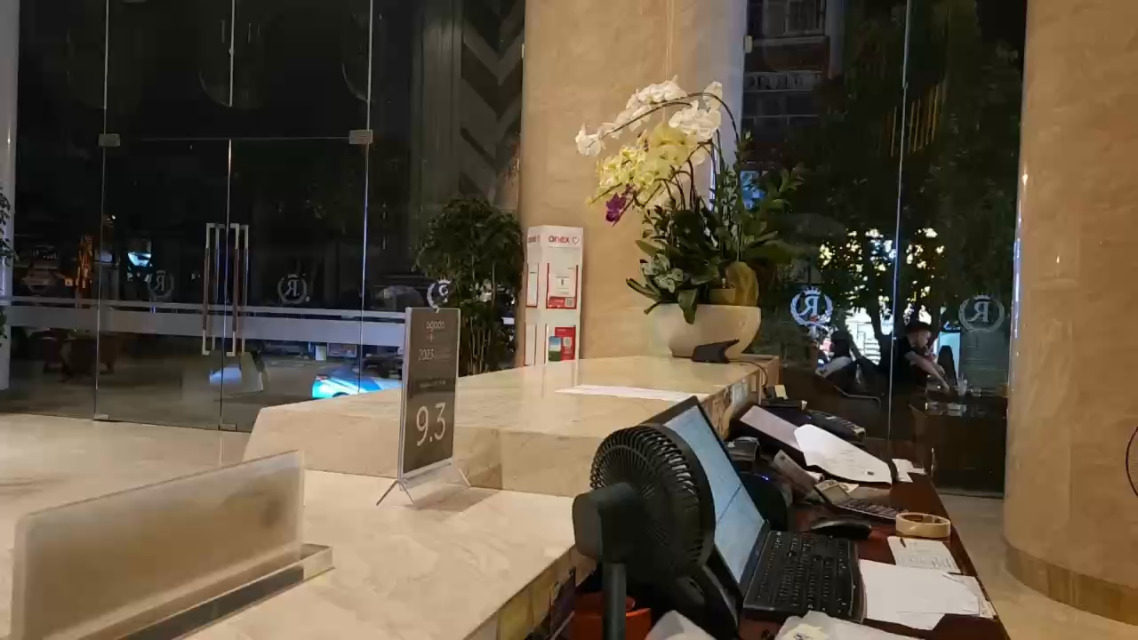
Site observation video

Slide 18
04
Key Findings

Slide 19
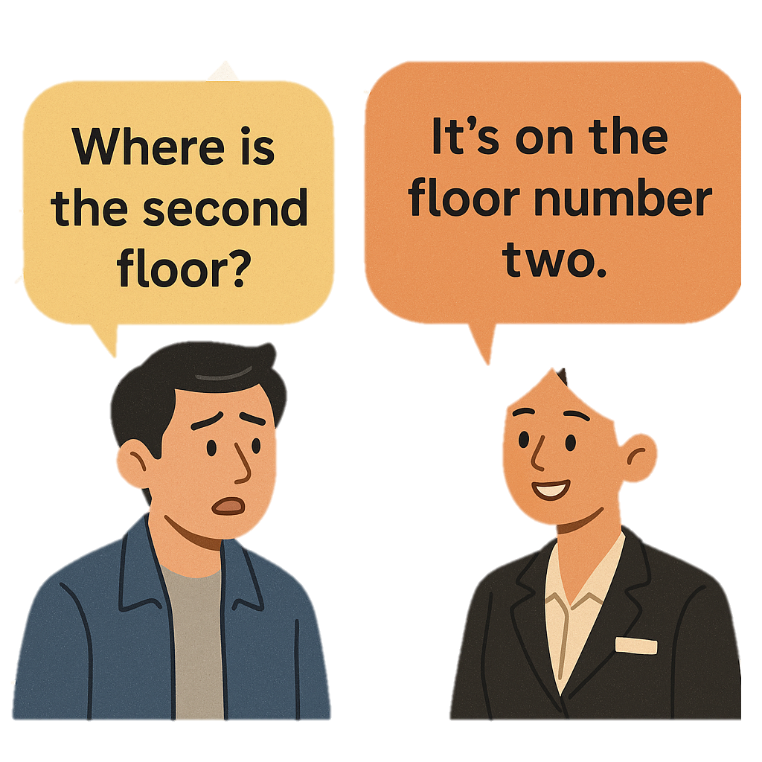
1. Priority Language Skills:
Speaking and Listening are the most critical skills. Receptionists are constantly required to:
Listen carefully to various accents
Speak clearly and diplomatically in real time
Respond to unexpected situations on the spot

Slide 20
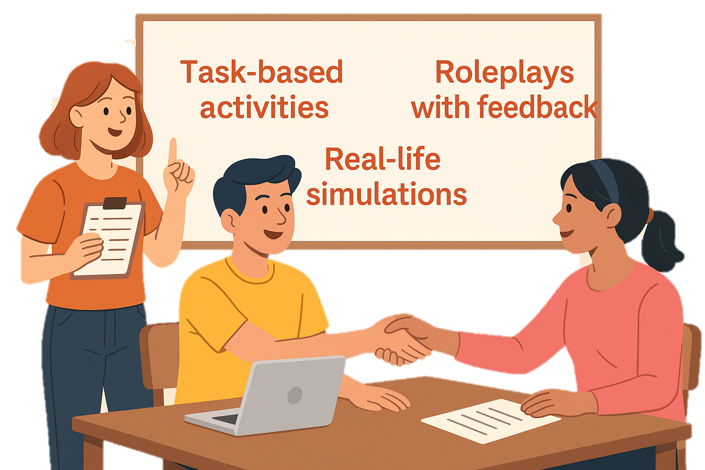
2. Preferred Learning Methods

Slide 21
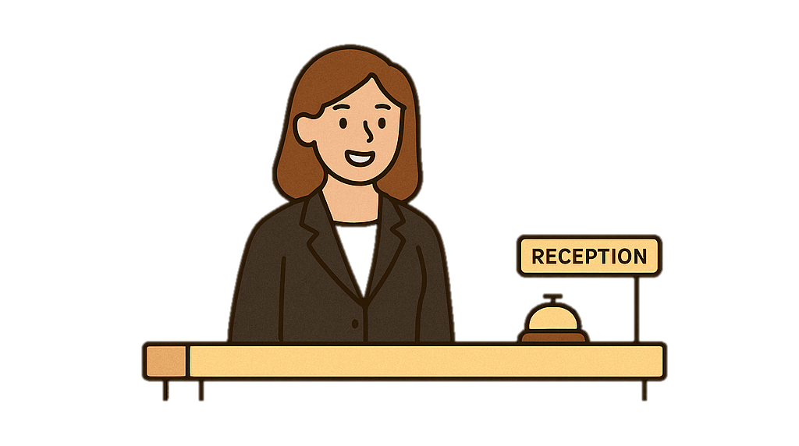
3. Core Communicative Functions
Check-in/check-out
Handling complaints
Giving directions
Making small talk
Answering phone calls professionally

Slide 22
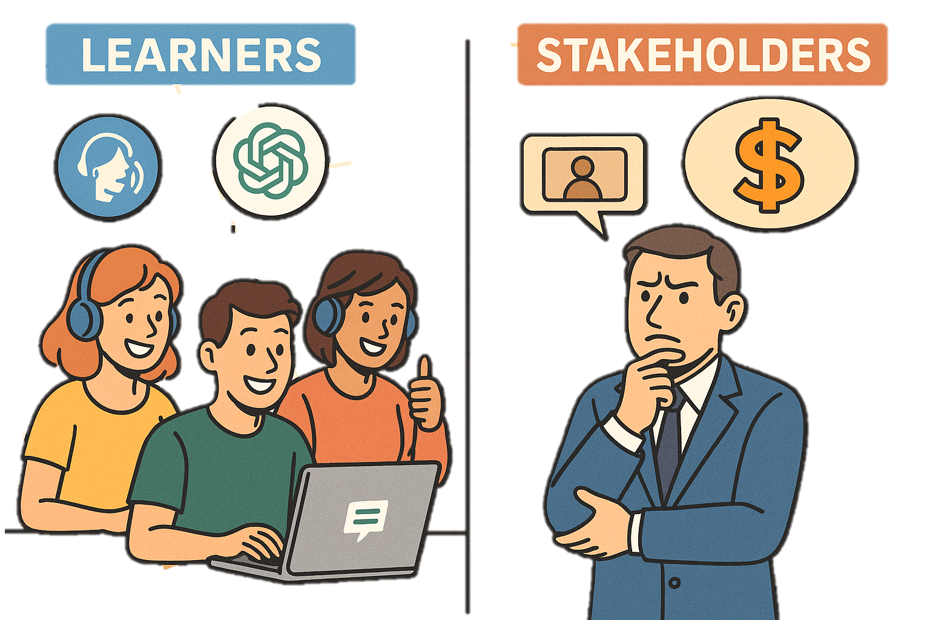
4. AI: Curiosity meets Caution

Slide 23
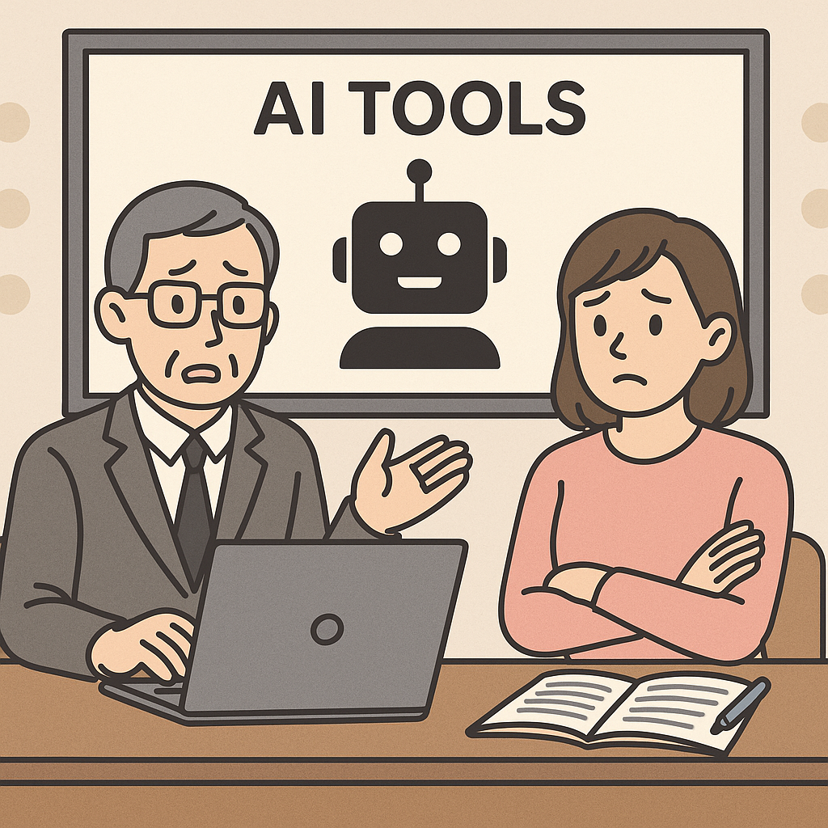
4. AI: Curiosity meets Caution

Slide 24
5. Constraints on all sides
Learners | Instructors / Stakeholders
Limited time due to shift work | Low budget, high expectations
Limited tech access (e.g., no laptops) | Lack of training in AI tools
Low digital literacy for some staff | Desire for plug-and-play syllabus formats

Slide 25
05
Syllabus Design & AI Integration

Slide 26
What guided the syllabus?
Task-based learning
Flexible delivery
Low-tech friendly

Slide 27
Course Structure Overview:
The course runs for 10 weeks, with 2 sessions per week, each lasting 90 minutes.
Each week focuses on one real-life hotel interaction, such as:
Week 1: Check-in procedures
Week 4: Giving directions
Week 6: Handling guest complaints
Week 9: Phone etiquette

Slide 28
Suggested AI Tools
AI Tool | Function | Why This Tool?
Chat GPT (Free) | Practice check-in dialogues, handle complaints | Flexible prompt-based practice, easy access
ELSA Speak (Freemium) | Pronunciation feedback, fluency scoring | Great for pronunciation-heavy tasks
YouTube (Guided Search) | Watch model receptionist interactions | Input enhancement for lower-level learners
Google Docs + ChatGPT | Draft emails, confirmation messages | Personalized writing support

Slide 29
06
Conclusion

Slide 30
What we found?
A needs-driven, communicative ESP syllabus is essential for hotel receptionists in Vietnam.
Learners want practical, task-based instruction, not school-style grammar drills.
AI tools, when used strategically, can bridge gaps in exposure, personalization, and confidence-building.
But … without institutional support, many of these innovations may never reach the learners who need them most.

Slide 31
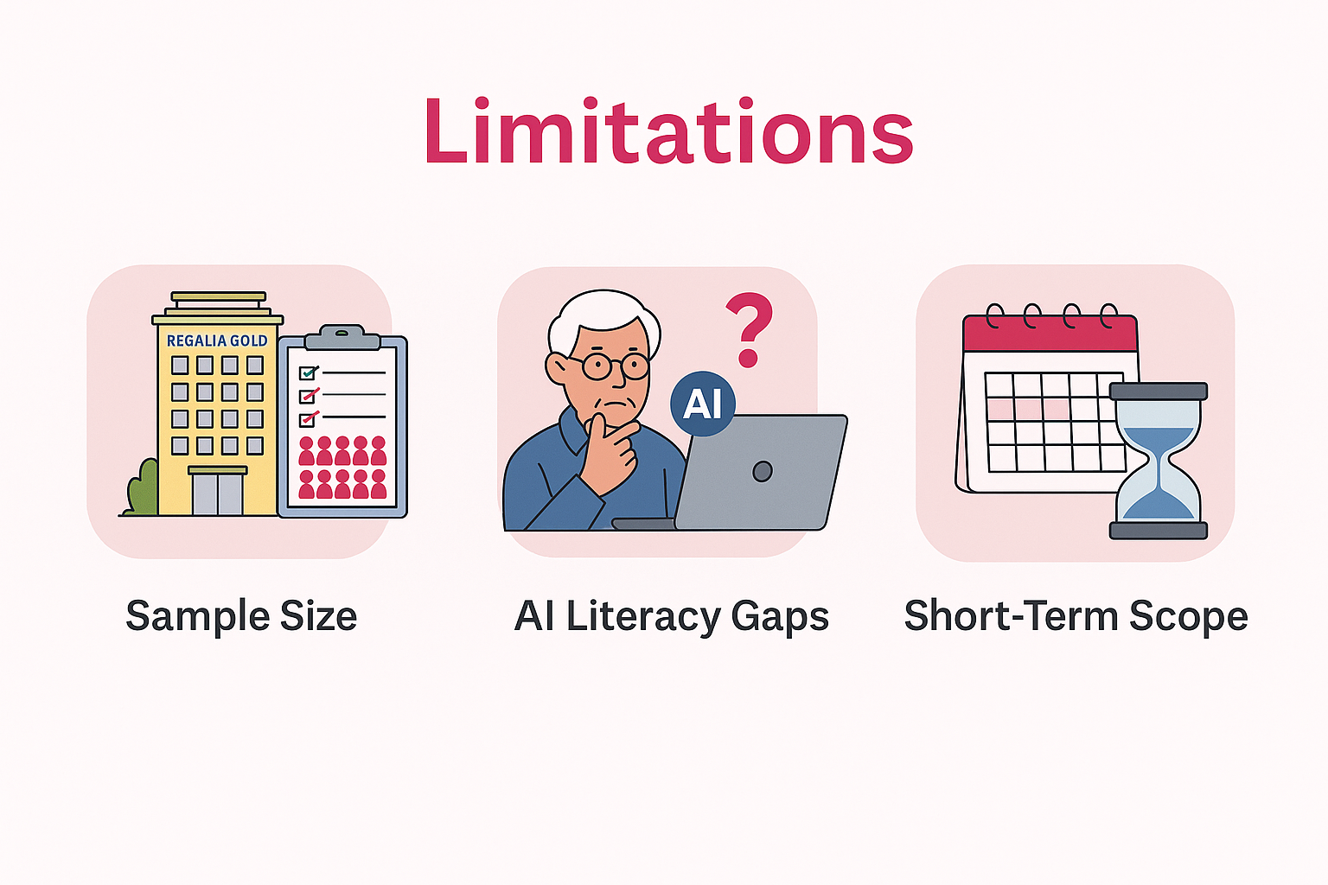

Slide 32
Thank You
“What do receptionists really need to say and do in English—and how can we help them do it better?”

