Slide 1

HO CHI MINH CITY UNIVERSITY OF FOREIGN LANGUAGES - INFORMATION TECHNOLOGY
EVALUATING THE EFFECTIVENESS OF THE ENGLISH LANGUAGE TRAINING PROGRAM AT HUFLIT:
AN OUTCOME-BASED STUDY USING PROGRAM LEARNING OUTCOMES
(PLOS) AND THE CEFR
Presenter: Tran Trung Hieu,
English lecturer of the Faculty of Foreign Languages (HUFLIT University)
www.huflit.edu.vn

Slide 2
TABLE OF CONTENT
01
02
03
Background
Research framework
Research design
04
05
06
Key findings
Discussion
Implications
www.huflit.edu.vn

Slide 3
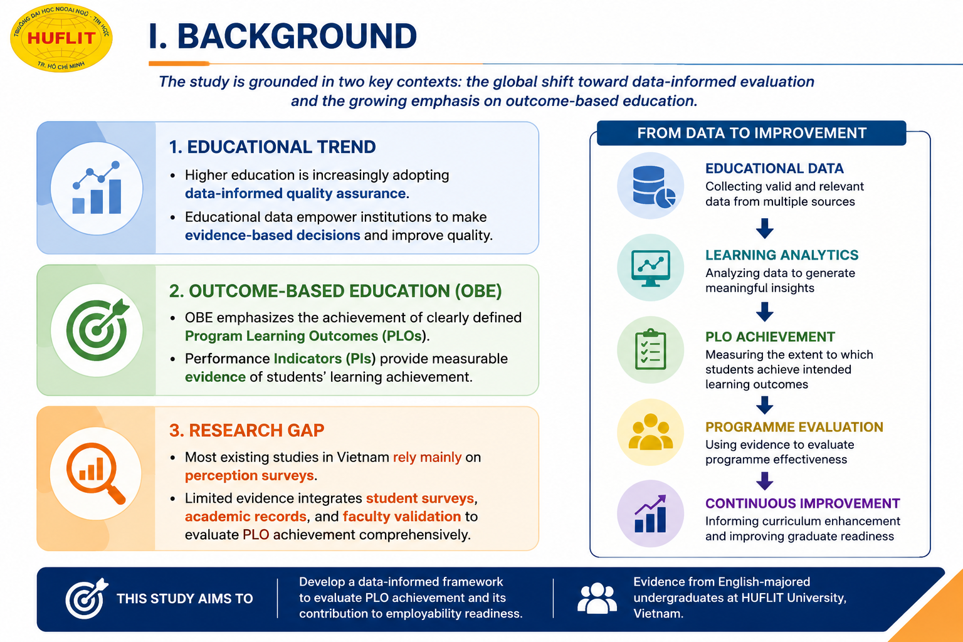
www.huflit.edu.vn

Slide 4
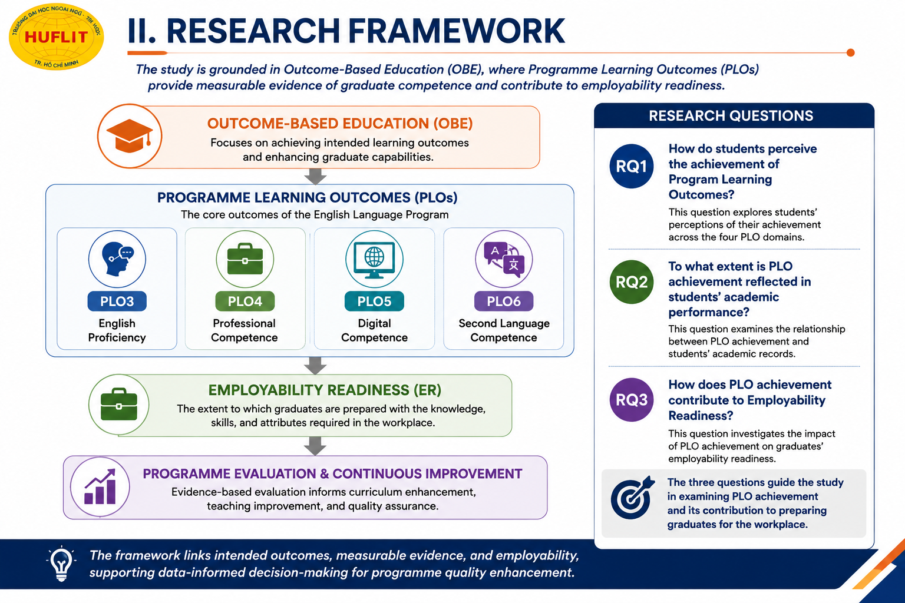
www.huflit.edu.vn

Slide 5
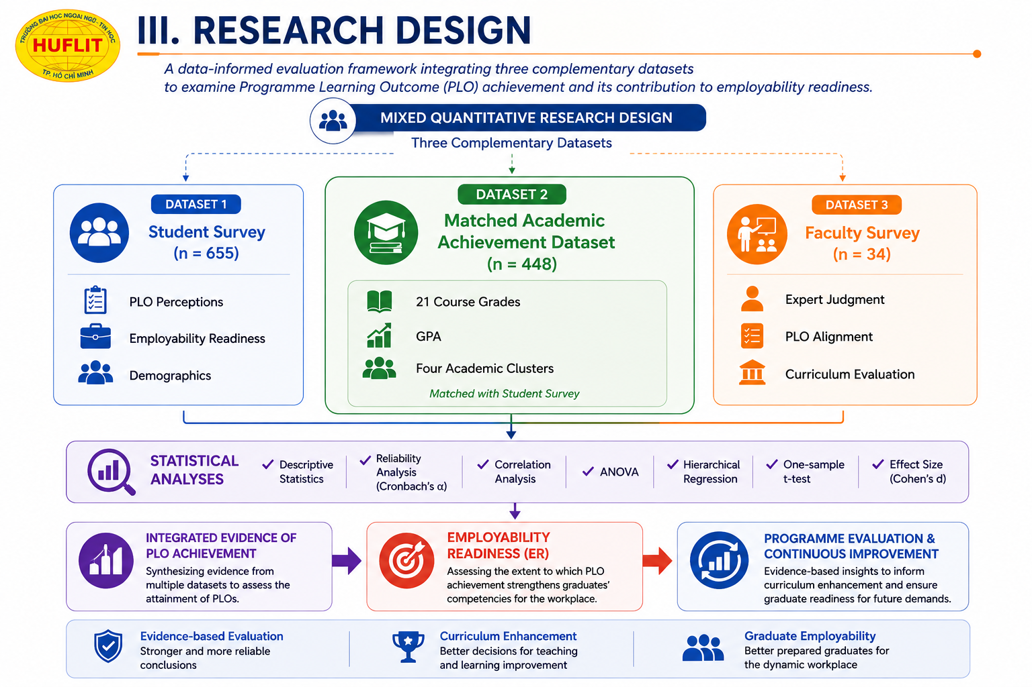
www.huflit.edu.vn

Slide 6
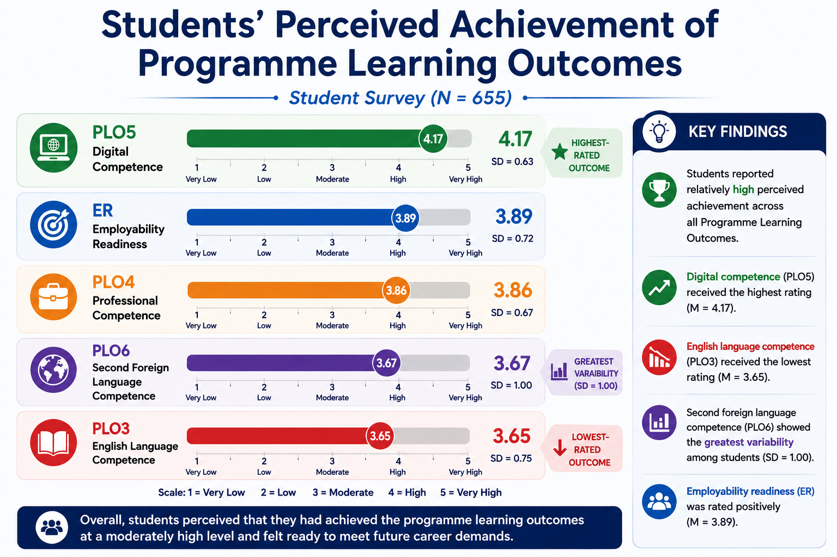
4. KEY FINDINGS (1)
www.huflit.edu.vn

Slide 7
KEY FINDINGS (1)
NOTE.
Overall, students perceived that they had achieved the programme learning outcomes at a relatively high level. Digital competence emerged as the strongest outcome, whereas English language competence received the lowest rating. Interestingly, second foreign language competence exhibited the greatest variation across students. Overall, students also reported a positive level of employability readiness.
www.huflit.edu.vn

Slide 8
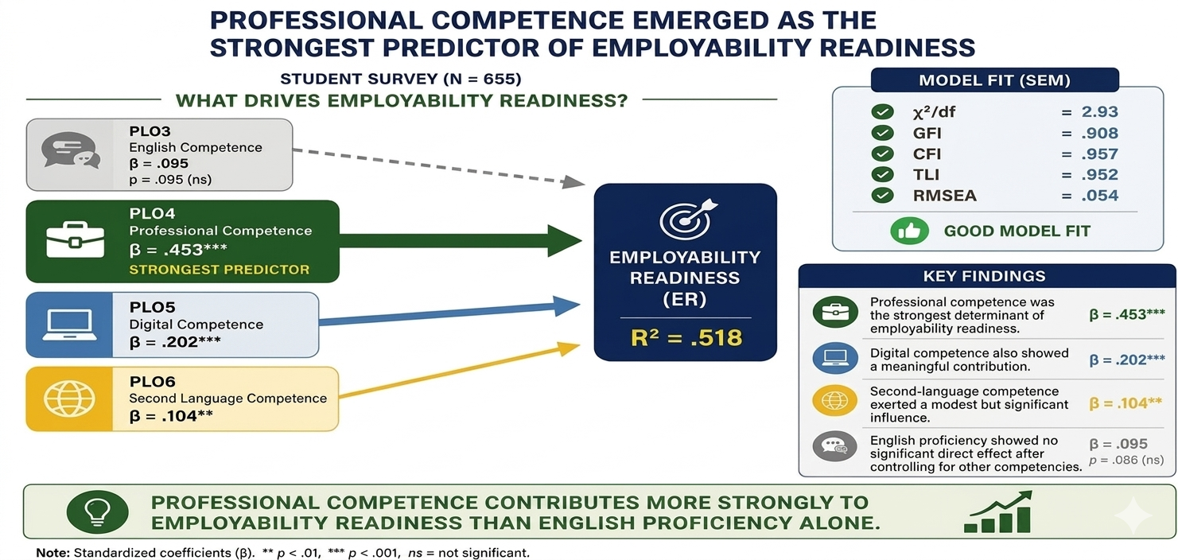
4. KEY FINDINGS (2)
www.huflit.edu.vn

Slide 9
KEY FINDINGS (2)
NOTE.
The SEM framework demonstrated a very good model fit, which showed that Chi-square over d-f was two point nine three, while the C-F-I and T-L-I were point nine five seven and point nine five two, respectively. Along with an R-M-S-E-A of point zero five four. The model explains over 51% of the variance in students' Employability Readiness, with an R-squared of point five one eight.
Crucially, Professional Competence (PLO4) emerged as the strongest predictor of career readiness, yielding a standardized Beta of point four five three, which is highly significant at the point zero zero one level.
Digital Competence (PLO5) and Second Language Competence (PLO6) also showed meaningful positive influences, with Betas of point two zero two and point one zero four respectively.
General English Proficiency (PLO3) showed no statistically significant direct effect once other core competencies were controlled.
.
.
www.huflit.edu.vn

Slide 10
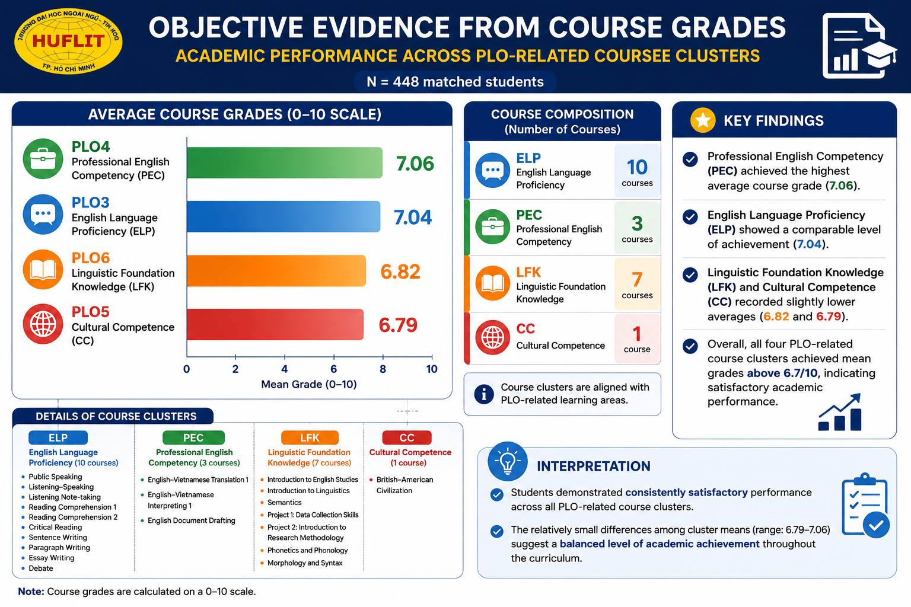
4. KEY FINDINGS (3)
www.huflit.edu.vn

Slide 11
KEY FINDINGS (3)
NOTE
This slide presents the objective evidence from students' academic performance, based on course grades from 448 matched students.
The results showed that PEC re corded the highest average course grade at 7.06, followed closely by ELP at 7.04. LFK and CC achieved slightly lower, but still satisfactory, averages of 6.82 and 6.79.
Overall, all four PLO-related course clusters obtained mean grades above 6.7 out of 10, indicating consistent academic achievement across the curriculum.
These objective results provide additional evidence supporting the overall quality of PLO attainment
.
.
.
.
www.huflit.edu.vn

Slide 12
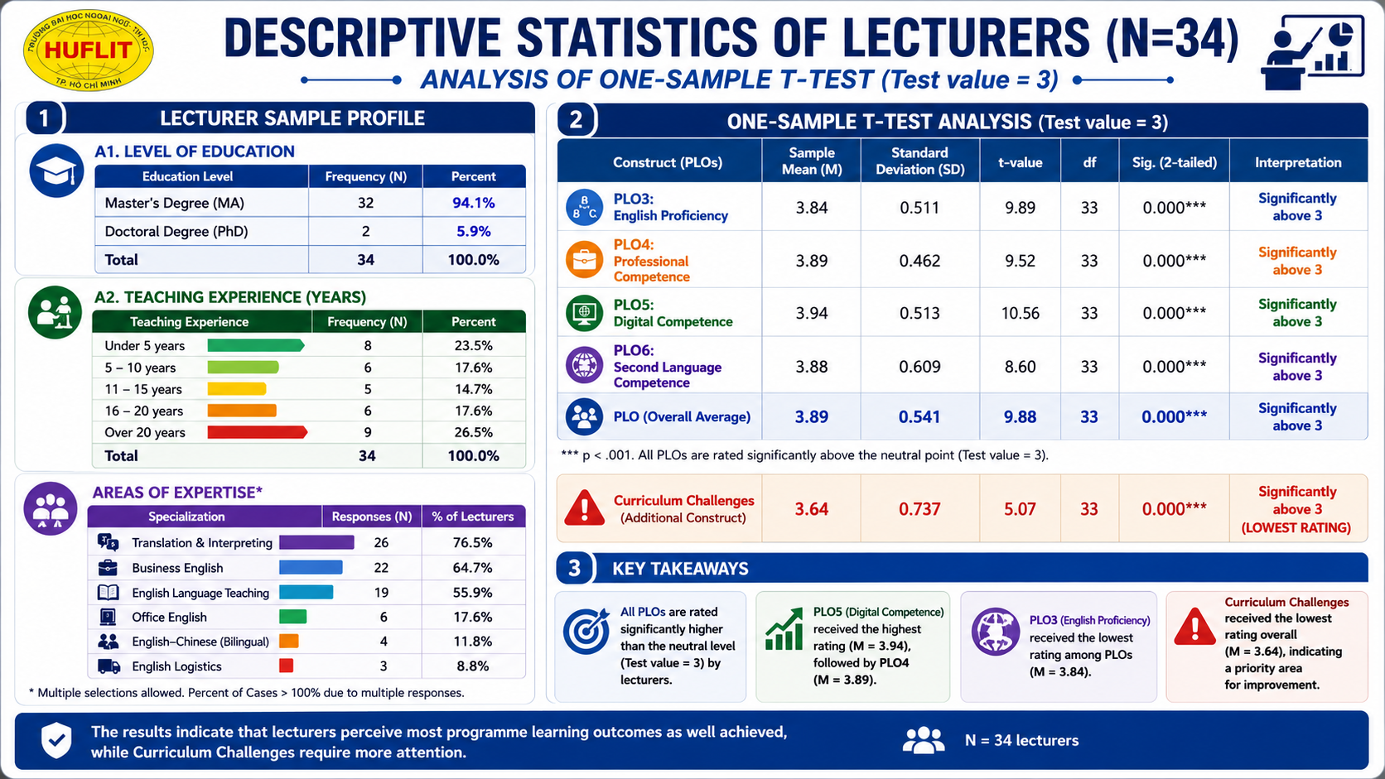
4. KEY FINDINGS (4)
www.huflit.edu.vn

Slide 13
KEY FINDINGS (4)
NOTE
First, all measurement constructs demonstrated good internal consistency, with Cronbach's Alpha values ranging from 0.803 to 0.916, confirming that the questionnaire was highly reliable.
Second, the One-Sample t-test showed that the mean scores of all four PLOs were significantly higher than the neutral benchmark of 3, with p-values below .001. Among them, PLO5 received the highest evaluation with a mean of 3.94, while PLO3 received the lowest, although it was still positively rated at 3.84.
Finally, lecturers identified Curriculum Challenges as the lowest-rated construct, with a mean of 3.64. Although this score was still significantly above the benchmark, it suggests that curriculum-related issues remain the main area requiring further improvement.
Overall, the faculty data independently confirmed the positive achievement of the PLOs while highlighting curriculum enhancement as the key priority for future development
.
.
.
www.huflit.edu.vn

Slide 14
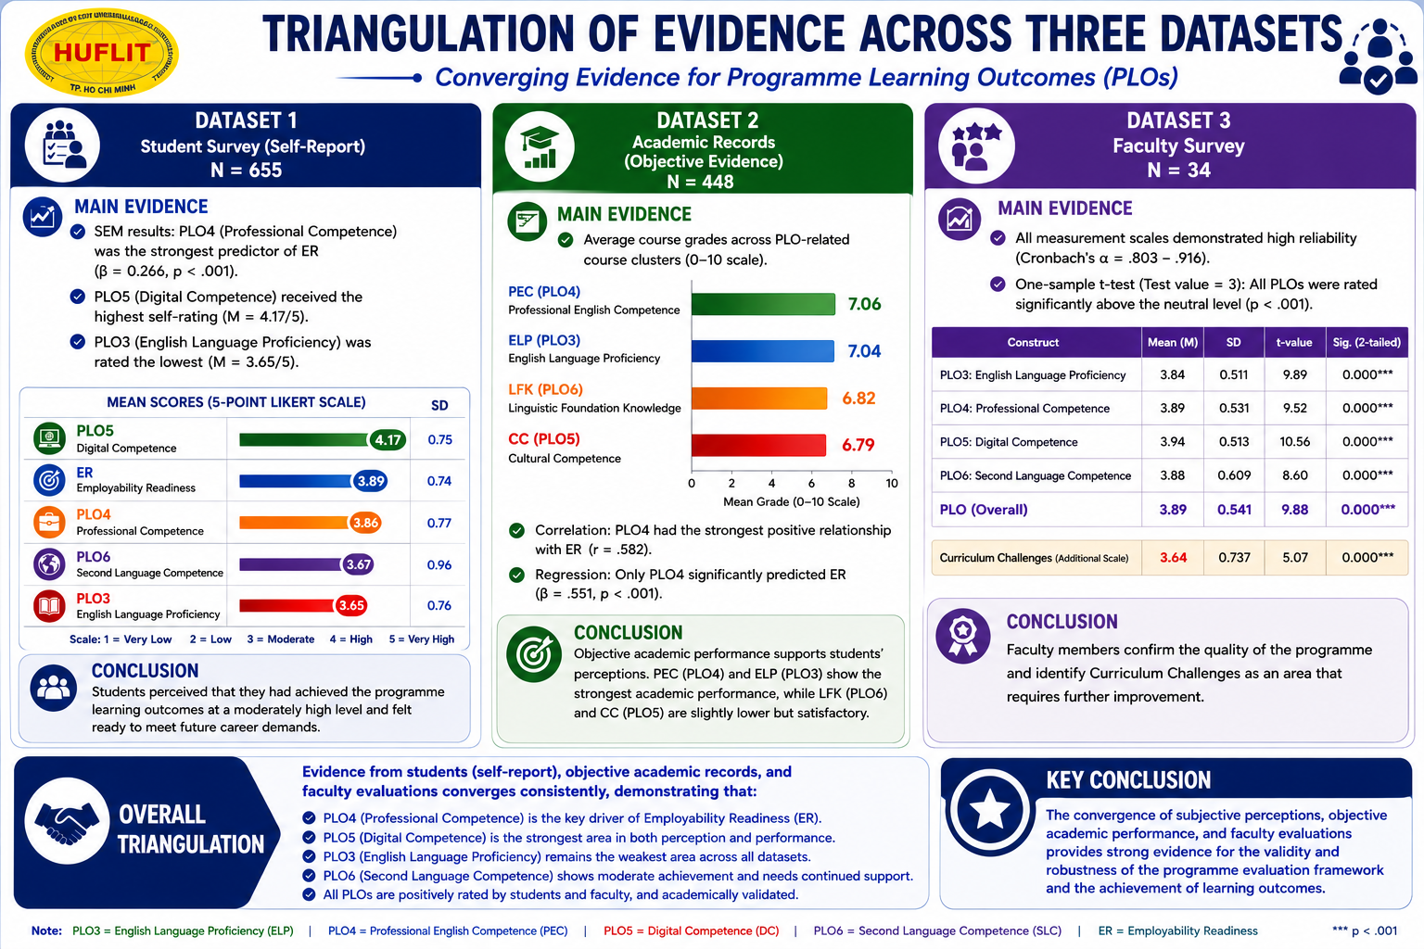
4. KEY FINDINGS (5)
www.huflit.edu.vn

Slide 15
KEY FINDINGS (5)
NOTE
First, PLO5 consistently emerged as the strongest learning outcome. It received the highest ratings from students, the highest academic performance in course grades, and the highest evaluation from lecturers.
Second, PLO3 was consistently identified as the weakest outcome across all three datasets. Although students and lecturers still rated it positively, both subjective and objective evidence indicated that it remains the area requiring the greatest improvement.
Third, ER was significantly predicted by PLO4, while lecturers also rated professional competence highly, demonstrating its important contribution to graduates' career readiness.
Taken together, the consistency among students' perceptions, objective academic evidence, and faculty evaluations provides strong triangulated evidence for the validity, reliability, and robustness of the PLOs evaluation framework.
Therefore, the findings support both the credibility of the evaluation model and the effectiveness of the current programme, while also identifying English language proficiency as the key priority for continuous improvement.
.
.
www.huflit.edu.vn

Slide 16
V. DISCUSSION (1)
1. INTERPRETATION OF THE FINDINGS
The first important finding is the remarkable consistency across the three independent datasets.
Although each dataset represents a different source of evidence—including students' self-perceptions, actual academic performance, and faculty evaluations—they all revealed the same overall pattern.
PLO5 emerged as the strongest programme outcome across all datasets, while PLO4 also demonstrated consistently strong professional competence. In contrast, PLO3 remained the weakest outcome regardless of the data source. Meanwhile, PLO6 showed a moderate level of achievement.
This convergence provided strong triangulated evidence that the programme evaluation is both valid and reliable, as different sources independently reached highly consistent conclusions about students' learning outcomes.
www.huflit.edu.vn

Slide 17
V. DISCUSSION (2)
2. EXPLAINING THE OBSERVED PLO PATTERNS
The differences among PLOs can largely be explained by the curriculum design itself.
First, PLO5 consistently achieved the highest performance because digital competence is integrated throughout almost every course. Students frequently use Moodle, Google Workspace, AI tools, and various digital platforms, allowing them to develop these competencies continuously.
In contrast, PLO3 remained the weakest area because English language proficiency, particularly productive skills such as speaking and writing, requires long-term practice and authentic communication opportunities. These competencies naturally develop more slowly than digital skills.
PLO4 demonstrated relatively stable performance because professional competencies are systematically embedded across multiple specialized courses, providing students with repeated opportunities to practice discipline-specific knowledge and skills.
Finally, PLO6 reached only a moderate level because the second foreign language occupies fewer credits and receives substantially less instructional time than English-major courses. Consequently, students had fewer opportunities to achieve higher levels of proficiency.
Overall, these findings suggest that the observed differences across PLOs are closely associated with curriculum emphasis and learning opportunities rather than random variation.
.
www.huflit.edu.vn

Slide 18
V. DISCUSSION (3)
3. THEORETICAL AND PRACTICAL IMPLICATIONS
Beyond explaining the findings, this study also contributes to both theory and educational practice.
From a theoretical perspective, the results provide empirical support for Outcome-Based Education by demonstrating that students' learning outcomes are meaningfully associated with their employability readiness. More importantly, the study shows that triangulating student perceptions, academic performance, and teacher evaluations produces a more comprehensive and trustworthy assessment of PLO achievement.
From a practical perspective, the findings suggest several priorities for curriculum improvement. First, greater emphasis should be placed on strengthening English language proficiency, particularly productive communication skills. Second, the university should continue reinforcing digital competence, which consistently emerged as the strongest learning outcome. Third, more learning opportunities should be provided for second-language development. Finally, future curriculum evaluation should rely on multiple sources of evidence rather than student surveys alone to support continuous quality improvement.
.
www.huflit.edu.vn

Slide 19
VI. RECOMMENDATIONS (1)
1. RECOMMENDATIONS FOR THE ENGLISH LANGUAGE PROGRAM
Based on these findings, three curriculum priorities are recommended. First, greater attention should be given to strengthening English language proficiency, particularly productive communication skills such as speaking, academic writing, and critical reading.
Second, the current emphasis on digital competence should be maintained because it consistently demonstrated the strongest performance across all datasets.
Finally, more opportunities should be created to improve second-language competence through increased exposure, bilingual activities, and international learning experiences. These improvements would help create a more balanced development across all PLOs.
www.huflit.edu.vn

Slide 20
VI. RECOMMENDATIONS (2)
2. RECOMMENDATIONS FOR TEACHING AND LEARNING
The findings also suggest several implications for teaching practice. Student-centered approaches such as project-based learning and collaborative learning should be expanded to strengthen communication and problem-solving skills.
Digital technologies, including AI-assisted learning and Moodle-supported activities, should continue to be integrated into instruction.
In terms of assessment, universities should combine direct evidence, such as course performance, with indirect evidence from student and teacher feedback to obtain a more comprehensive evaluation of learning outcomes.
www.huflit.edu.vn

Slide 21
VI. RECOMMENDATIONS (3)
3. RECOMMENDATIONS FOR FUTURE RESEARCH
Finally, several directions are suggested for future research.
Similar studies should be conducted across multiple universities with larger and more diverse samples to improve generalizability.
Longitudinal research would also provide valuable evidence by tracking students' development and employability after graduation.
In addition, future studies should incorporate the perspectives of employers, alumni, and industry partners to further validate the alignment between PLOs and workplace expectations.
www.huflit.edu.vn

Slide 22
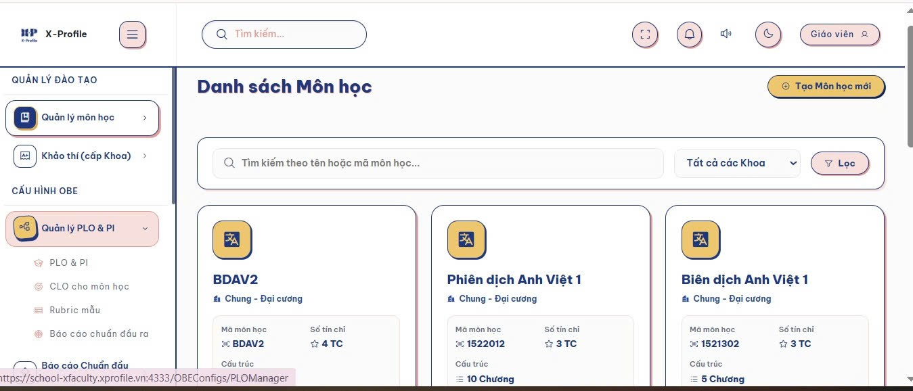
VI. RECOMMENDATIONS (4)
4. PRACTICAL APPLICATION OF THE RESEARCH
From Research Findings to Continuous Quality Improvement
www.huflit.edu.vn

Slide 23

VI. RECOMMENDATIONS (5)
www.huflit.edu.vn

Slide 24
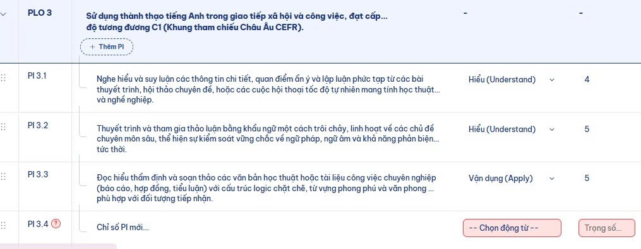
VI. RECOMMENDATIONS (6)
www.huflit.edu.vn

Slide 25
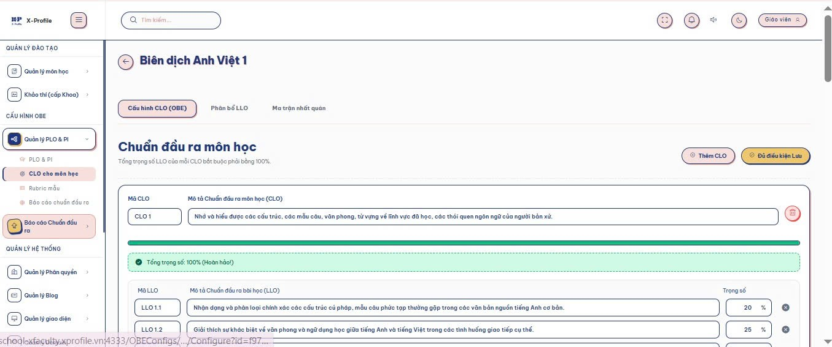
VI. RECOMMENDATIONS (7)
www.huflit.edu.vn

Slide 26
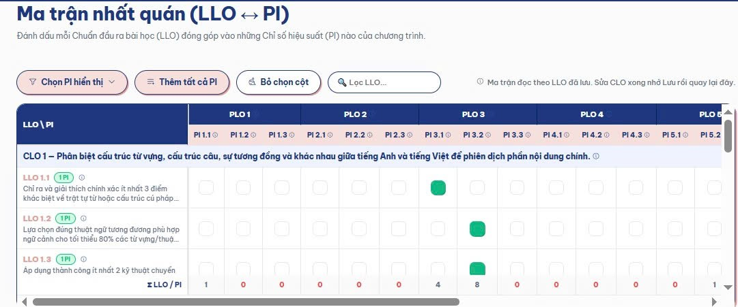
VI. RECOMMENDATIONS (8)
www.huflit.edu.vn

Slide 27
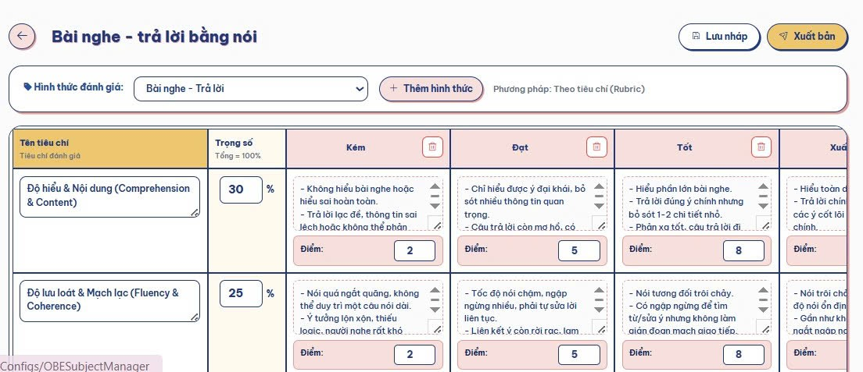
VI. RECOMMENDATIONS (9)
www.huflit.edu.vn

Slide 28
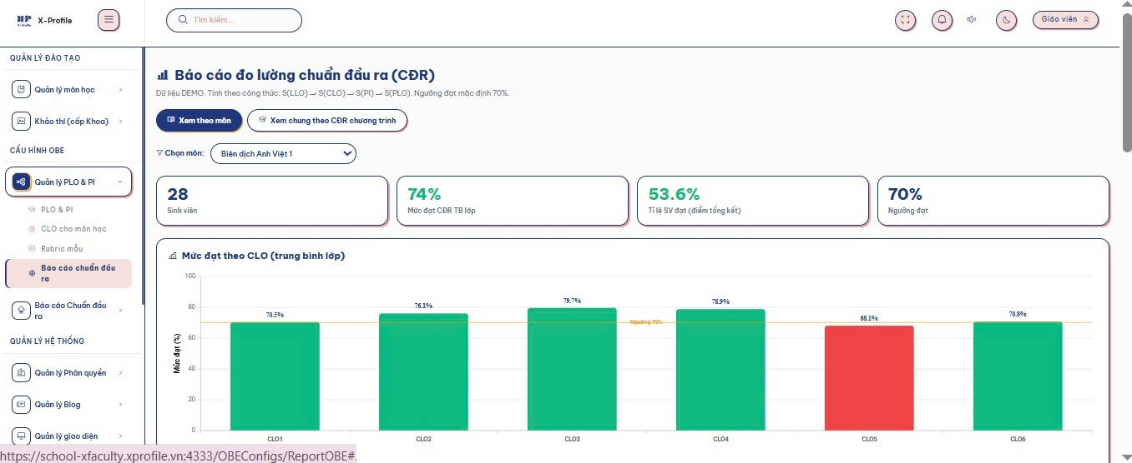
VI. RECOMMENDATIONS (10)
www.huflit.edu.vn

Slide 29
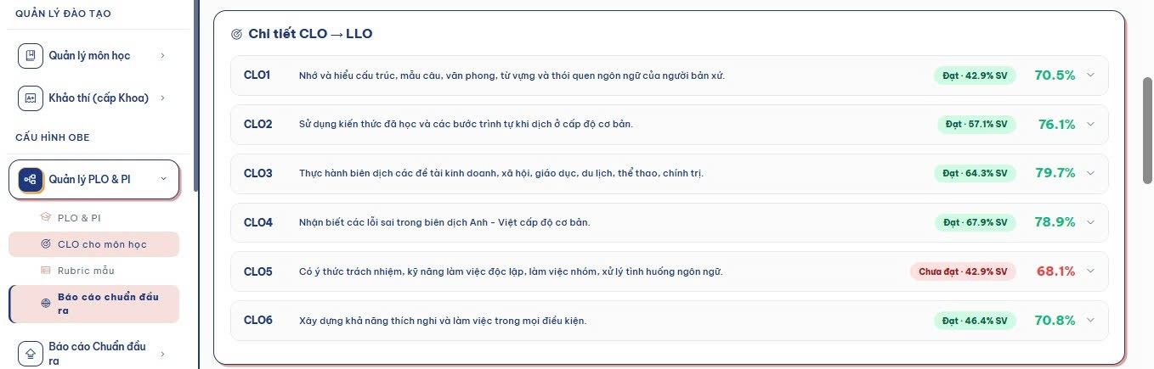
VI. RECOMMENDATIONS (11)
www.huflit.edu.vn

Slide 30
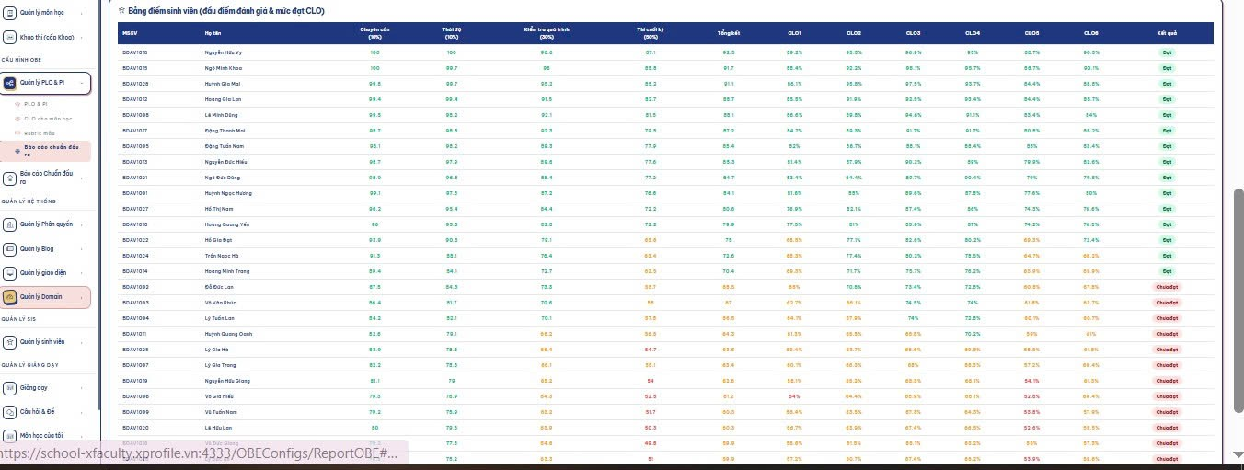
VI. RECOMMENDATIONS (12)
www.huflit.edu.vn

Slide 31
HO CHI MINH CITY UNIVERSITY OF FOREIGN LANGUAGES - INFORMATION TECHNOLOGY
EVALUATING THE EFFECTIVENESS OF THE ENGLISH LANGUAGE TRAINING PROGRAM AT HUFLIT:
AN OUTCOME-BASED STUDY USING PROGRAM LEARNING OUTCOMES
(PLOS) AND THE CEFR
Q & A
www.huflit.edu.vn

