Slide 1





Ho Chi Minh University of Foreign Languages and Information Technology
Transinterpretation Pedagogy and Application of Artificial Intelligence for better motivation: Empirical Evidence from TMT Exercises
Presented by: Nguyen Duc Chau
www.HUFLIT.edu.vn

Slide 2



Presented by: Nguyen Duc Chau
HUFLIT | 2026
Overview
1.
Introduction
4
Discussion
2.
Literature review
5.
Summary
3.
Methodology
6.
Recommendation
www.HUFLIT.edu.vn

Slide 3
  INTRODUCTION
Theories and Methods of Transinterpretation (TMT)
  emphasize grammatical structure, lexical precision, and contextual sensitivity.
  cultivate analytical reasoning, structural sensitivity, stylistic judgment, the employment of linguistic use.
  bridge linguistic competence and professional practice.
HUFLIT | 2026

Slide 4


Within HUFLIT context:
The rapid proliferation of free access to AI tools
  Diminished students’ instrintric motivation
  Weaken structural awareness
Threatens the pedagogical core of translation studies
Excessive reliance on AI tools
HUFLIT | 2026
Notes:
Many learners increasingly perceive translation as a mechanical process reducible to prompt input. This perception threatens the pedagogical core of translation studies, which traditionally cultivates analytical reasoning, structural sensitivity, and especially, stylistic judgment, and especially, the employment of linguistic use.

Slide 5



Research objectives
To investigate students’ motivation, engagement, and perceived learning outcomes when using AI-assisted translation tasks
To develop a structured instructional framework that combines AI generation with instructor editorial intervention
To evaluate how pedagogical integration enhances structural awareness and transinterpretative competence in Vietnamese EFL contexts.
HUFLIT | 2026

Slide 6

Research questions:
How can AI be systematically integrated into structural translation pedagogy to improve learning motivation and linguistic competence without undermining academic rigor?
Research limitations:
Limited to a single institutional context
Rely on self-reported data
HUFLIT | 2026
Notes:
This is just a pilot study with a very humble number of participants, not satisfy the norm of a standard research; therefore, its conclusions may be not true when referring to the same subjects on a larger scale or applied in other institutions.

Slide 7
The goal of my study:
to identify the drawbacks of the traditional transinterpretation theory teaching procedures in HUFLIT for modifications to upgrade teaching techniques for the aforementioned subject,
to provide empirical evidence on student perceptions of AI use in TMT exercises,
to propose a replicable instructional design model for AI-assisted structural translation

Slide 8


HUFLIT | 2026
  Literature review
www.HUFLIT.edu.vn

Slide 9

HUFLIT | 2026
AI in language education
incorporated as both a learning aid and an instructional support tool (Beatty, 2013; Chapelle, 2001)
improve grammatical accuracy, lexical variety, and fluency (Kukulska-Hulme et al., 2021)
allows students to engage in iterative revision processes, increasing time-on-task and learner autonomy (Li, 2022)

Slide 10

Presented by: Nguyen Duc Chau
HUFLIT | 2026
AI in academic writing pedagogy
generate linguistically coherent prose
assist with grammar correction, paraphrasing, and structural organization
function as a drafting assistant (Kasneci et al., 2023)

Slide 11

Presented by: Nguyen Duc Chau
HUFLIT | 2026
AI drawbacks:
Does not possess semantic intentionality or communicative awareness
Weaken learners’ critical thinking, rhetorical awareness, and authorial voice
Raise concerns regarding plagiarism, authorship ambiguity, and academic
Integrity (Bender et al., 2021)

Slide 12


Structural translation
focuses on controlled manipulation of syntactic and grammatical forms including:
Inversion
Modality shifts
Cleft constructions
Nominalization
Participle clauses
HUFLIT | 2026

Slide 13
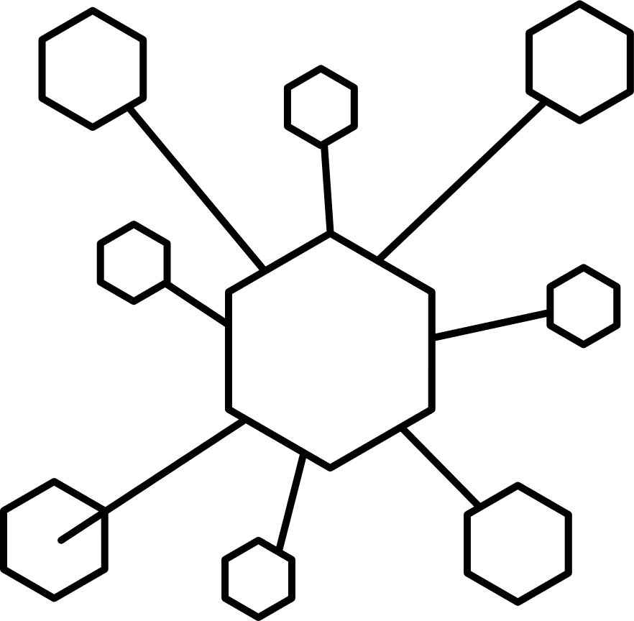
HUFLIT | 2026
Theoretical framework
Social constructivist theory in TMT
Knowledge is constructed through interaction, dialogue, and shared problem-solving (Sweller et al., 2019)
AI-supported classrooms, technology can function as a mediational tool that stimulates discussion, comparison, and collaborative evaluation (Paas et al., 2003)
Fosters deeper engagement with linguistic form and meaning,

Slide 14
HUFLIT | 2026
Research gaps
Research on AI-assisted structural translation and transinterpretation remains limited
Few studies empirically examine how editorial intervention and task design mediate the relationship between AI use and learner motivation

Slide 15


Presented by: Nguyen Duc Chau
HUFLIT | 2026
  III.Methodology
www.HUFLIT.edu.vn

Slide 16

Presented by: Nguyen Duc Chau
HUFLIT | 2026
Research design
Quantitative survey
Qualitative analysis of AI-assisted exercise
Research participants
68 undergraduate students in TMT-related courses

Slide 17
This study aims to examine how artificial intelligence can be pedagogically integrated into transinterpretation instruction to enhance student motivation, engagement, and structural competence.
It seeks to propose and empirically validate an AI-assisted instructional framework that balances automated generation with instructor editorial intervention in Vietnamese EFL tertiary contexts.

Slide 18



HUFLIT | 2026
  Discussion
www.HUFLIT.edu.vn

Slide 19
HUFLIT | 2026
Students’ Active Participation in AI-Facilitated TMT Activities
AI integration generally encourages student involvement in TMT tasks
AI appears as a facilitative tool that lowers engagement barriers, not an independent driver

Slide 20
HUFLIT | 2026
First of all, some examples below may help clarify the theme.
Exercise 1 (week 2)
Translate the following text into Vietnamese.
Analyze the text into phrases/clauses.
Tell the function of each unit.

Slide 21
HUFLIT | 2026
Use Present Perfect tense and Past Perfect tense to translate the following text into English.
Analyze text styles and formality styles of the text.
Tell the function of each unit.

Slide 22
HUFLIT | 2026
Hắn đã tháp tùng nhóm phái đoàn điều tra của LHQ dưới vỏ bọc đại diện 1 tập đoàn dệt may đến Sydney phục vụ công tác nghiên cứu hoá chất được 3 tuần, nhưng theo nguồn tin của t́ình báo địa phương thì phần lớn thời gian của hắn lại dành cho việc la cà, bù khú tại các sòng bạc và quán rượu, không phải cho nghiên cứu công nghiệp vải sợi gì cả. Cấp trên hắn rất hoang mang không hiểu đây là chiến thuật đối phó phản gián hay là chiêu trò thể hiện tâm lý?

Slide 23

HUFLIT | 2026
Peer Collaboration During AI-Based TMT Tasks
Individualized interaction is prioritized unless collaboration is explicitly stated
Highlights the need to design activities that require discussion, comparison, and joint decision-making aligning with translation pedagogy

Slide 24

Presented by: Nguyen Duc Chau
HUFLIT | 2026
Students’ Inquiry and Clarification of AI Outputs
AI outputs frequently prompt verification, questioning, and comparison with human judgment
AI serves as a stimulus for analytical thinking rather than a shortcut to ready-made answers

Slide 25
Presented by: Nguyen Duc Chau
HUFLIT | 2026
Perceived Improvement in Working with TMT Exercises Through AI Engagement
AI contributes positively to students’ learning processes, assisting them in approaching complex structures and lexical choices
AI functions most effectively as a supportive scaffold rather than a substitute for structured instruction

Slide 26


Presented by: Nguyen Duc Chau
HUFLIT | 2026
  Summary
AI integration generally encourages student involvement in transinterpretation tasks
AI functions most productively as a cognitive scaffold
The need for a balanced model that preserves academic rigor & technological innovation.

Slide 27


Presented by: Nguyen Duc Chau
HUFLIT | 2026
  Recommendations

Slide 28

Presented by: Nguyen Duc Chau
HUFLIT | 2026
For instructors
Design structured, cognitively demanding tasks that require analysis, justification, and revision of AI outputs
For researchers
Further investigate AI-assisted translation pedagogy through longitudinal, experimental, and cross-institutional studies

Slide 29

Presented by: Nguyen Duc Chau
HUFLIT | 2026
For instructors
Develop clear policies that balance AI integration with academic integrity, aligning classroom innovation with assessment standards
Investm in professional development, AI literacy training, and curriculum redesign
For students
Critically evaluate, question, and revise AI-generated translations

Slide 30
HUFLIT | 2026
THANK YOU

