Slide 1


Ho Chi Minh University of Foreign Languages and Information Technology
Transinterpretation Pedagogy and Application of Artificial Intelligence for better motivation: Empirical Evidence from TMT Exercises
Presented by: Nguyen Duc Chau
www.HUFLIT.edu.vn

Slide 2

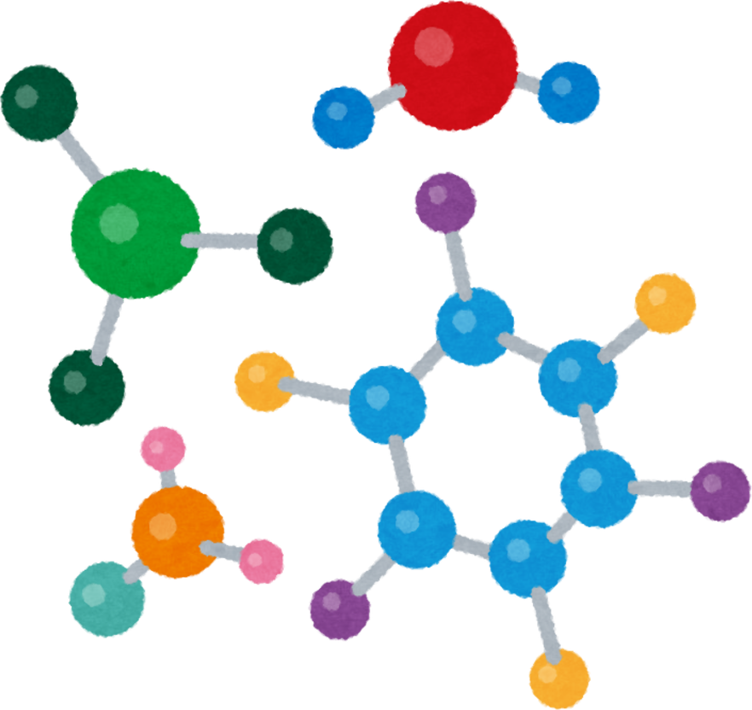

Presented by: Nguyen Duc Chau
HUFLIT | 2026
Overview
1.
Introduction
4
Discussion
2.
Literature review
5.
Summary
3.
Methodology
6.
Recommendation
www.HUFLIT.edu.vn

Slide 3
  INTRODUCTION
Theories and Methods of Transinterpretation (TMT)
  analyze grammatical structure, lexical precision, and contextual sensitivity.
  cultivate analytical reasoning, structural sensitivity, stylistic judgment, the employment of linguistic use.
  bridge linguistic competence and professional practice.
HUFLIT | 2026
Notes:
-Covering grammatical structures; explaining lexical precision (keep: giữ, bảo tồn); contextual sensitivity (transposition)

Slide 4
- Google needs a populated market like China for its development plan.
-Kế hoạch phát triển của Google cần có 1 thị trường đông dân như Trung Quốc.
-Google cần có 1 thị trường đông dân như Trung Quốc để triển khai kế hoạch kinh doanh.
-1 thị trường to lớn như Trung Quốc là vùng đất màu mỡ để Google triển khai kế hoạch kinh doanh táo bạo của mình.

Slide 5

Within HUFLIT context:
The rapid proliferation of free access to AI tools
  Diminished students’ instrintric motivation
  Weaken structural awareness
Threatens the pedagogical core of translation studies
Excessive reliance on AI tools
HUFLIT | 2026
Notes:
Many learners increasingly perceive translation as a mechanical process reducible to prompt input. This perception threatens the pedagogical core of translation studies, which traditionally cultivates analytical reasoning, structural sensitivity, and especially, stylistic judgment, and especially, the employment of linguistic use.

Slide 6


Research objectives
To investigate students’ motivation, engagement, and perceived learning outcomes when using AI-assisted translation tasks
To develop a structured instructional framework that combines AI generation with instructor editorial intervention
To evaluate how pedagogical integration enhances structural awareness and transinterpretative competence in Vietnamese EFL contexts.
HUFLIT | 2026

Slide 7
The goal of my study:
to identify the drawbacks of the traditional transinterpretation theory teaching procedures in HUFLIT for modifications to upgrade teaching techniques for the aforementioned subject,
to provide empirical evidence on student perceptions of AI use in TMT exercises,
to propose a replicable instructional design model for AI-assisted structural translation

Slide 8
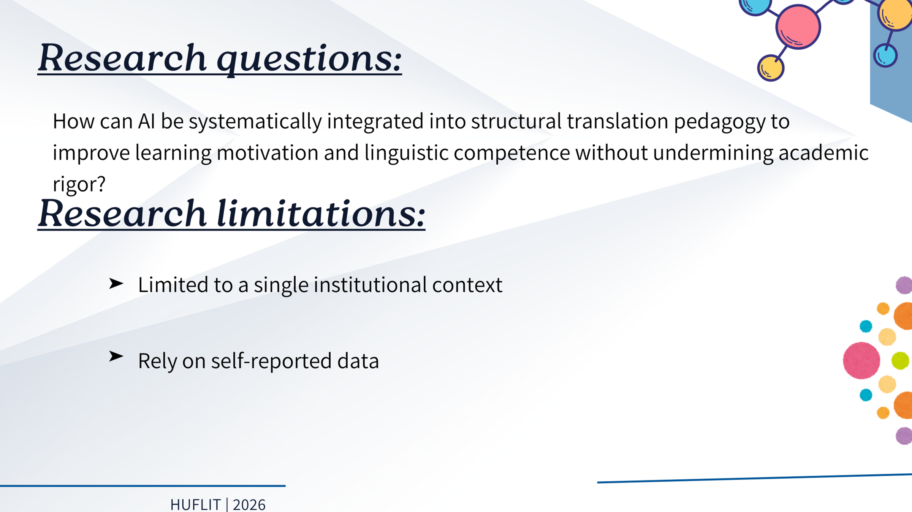

Slide 9
Significance of the Study
-to identify the drawbacks of the traditional transinterpretation theory teaching procedures in HUFLIT for modifications to upgrade teaching techniques for the aforementioned subject,
- to provide empirical evidence on student perceptions of AI use in TMT exercises, to propose a replicable instructional design model for AI-assisted structural translation,
-to meet the proposed learning outcomes in improving students’ motivation and real competence in the subject, a requirement in the job market, also one of the biggest flaws for Vietnamese job seekers,
-to help students gain better results, to steer them closer to the norms of the real-life transinterpretation,
-and to meet the innovation demand from the institution.

Slide 10

HUFLIT | 2026
  Literature review
www.HUFLIT.edu.vn

Slide 11
HUFLIT | 2026
AI in language education
incorporated as both a learning aid and an instructional support tool (Beatty, 2013; Chapelle, 2001)
improve grammatical accuracy, lexical variety, and fluency (Kukulska-Hulme et al., 2021)
allows students to engage in iterative revision processes, increasing time-on-task and learner autonomy (Li, 2022)

Slide 12

Presented by: Nguyen Duc Chau
HUFLIT | 2026
AI in academic writing pedagogy
generate linguistically coherent prose
assist with grammar correction, paraphrasing, and structural organization
function as a drafting assistant (Kasneci et al., 2023)

Slide 13
Presented by: Nguyen Duc Chau
HUFLIT | 2026
AI drawbacks:
Does not possess semantic intentionality or communicative awareness
Weaken/Eradicate learners’ critical thinking, rhetorical awareness, and authorial voice
Raise concerns regarding plagiarism, authorship ambiguity, and academic
Integrity (Bender et al., 2021)

Slide 14
Structural translation
focuses on controlled manipulation of syntactic and grammatical forms including:
Inversion
Modality shifts
Cleft constructions
Nominalization
Participle clauses
HUFLIT | 2026

Slide 15
Action-focused: We need to investigate how AI affects student learning.
Nominalized version: An investigation into the effects of AI on student learning is necessary.

Slide 16
HUFLIT | 2026
Theoretical framework
Social constructivist theory in TMT
Knowledge is constructed through interaction, dialogue, and shared problem-solving (Sweller et al., 2019)
AI-supported classrooms, technology can function as a mediational tool that stimulates discussion, comparison, and collaborative evaluation (Paas et al., 2003)
Fosters deeper engagement with linguistic form and meaning,

Slide 17
However, scholars consistently emphasize that AI does not possess semantic intentionality or communicative awareness.
Its outputs are generated probabilistically rather than interpretively, relying on statistical patterns rather than contextual understanding (Bender et al., 2021).

Slide 18
HUFLIT | 2026
Research gaps
Research on AI-assisted structural translation and transinterpretation remains limited
Few studies empirically examine how editorial intervention and task design mediate the relationship between AI use and learner motivation in TMT

Slide 19

HUFLIT | 2026
  III.Methodology
www.HUFLIT.edu.vn

Slide 20

HUFLIT | 2026
Research design
Quantitative survey
Research participants
(N=79) undergraduate students in TMT courses

Slide 21
This study aims to examine how artificial intelligence can be pedagogically integrated into transinterpretation instruction to enhance student motivation, engagement, and structural competence.
It seeks to propose and empirically validate an AI-assisted instructional framework that balances automated generation with instructor editorial intervention in Vietnamese EFL tertiary contexts.

Slide 22
Instrument Validation and Statistical Treatment
To evaluate the psychometric soundness, internal consistency and structural validity were evaluated using IBM SPSS Statistics (v26.0). Data were accurately mapped onto the expected components of Translation Learning Motivation and Pedagogical Efficacy.

Slide 23
DATA ANALYSIS
Descriptive Statistical Analysis of Student Perceptions
Rank | Variable | N | Mean (M) | Std. Error (SE) | Std. Deviation (SD) | Predominant Response Trend
1 | Q1 | 79 | 1.20 | .046 | .404 | Strongest Consensus (Strongly Agree)
2 | Q5 | 79 | 1.25 | .052 | .466 | Highly Favorable
3 | Q10 | 79 | 1.25 | .052 | .466 | Highly Favorable
4 | Q4 | 79 | 1.57 | .084 | .746 | Favorable to Highly Favorable
5 | Q2 | 79 | 1.63 | .089 | .787 | Favorable
6 | Q3 | 79 | 1.67 | .088 | .780 | Favorable
7 | Q9 | 79 | 1.71 | .090 | .803 | Favorable
8 | Q8 | 79 | 1.75 | .101 | .898 | Favorable
9 | Q6 | 79 | 1.82 | .098 | .874 | Favorable (Moderate Variance)
10 | Q7 | 79 | 4.67 | .071 | .635 | Strong Disagreement (Negatively Worded)

Slide 24
Distribution and Frequency Analysis
High-Consensus Positive Indicators (Agreement > 95%)
Q1: Exhibited an absolute positive consensus with 100% of participants responding favorably (79.7% Strongly Agree, 20.3% Agree; M = 1.20, SD = .404). This represents the most robust benchmark within the dataset.
Q5 & Q10: Shared identical distribution properties, yielding a cumulative agreement rate of 98.7% (75.9% Strongly Agree, 22.8% Agree; M = 1.25, SD = .466). Only a nominal 1.3% of respondents remained neutral.

Slide 25
To improve construct validity and internal consistency, the questionnaire items were classified into four theoretically related scales rather than being analyzed as a single construct.
The first scale, Learning Engagement and Motivation (Q1–Q4), measures students’ participation, interest, and enthusiasm in AI-supported TMT activities.
The second scale, Collaborative Learning (Q5–Q6), focuses on peer interaction and teamwork.

Slide 26
The third scale, AI Satisfaction and Evaluation (Q7–Q8), examines students’ satisfaction with AI outputs and their critical evaluation of AI-generated content.
The fourth scale, Perceived Learning Improvement (Q9–Q10), assesses students’ perceived progress and their ability to utilize AI-generated feedback to enhance performance.

Slide 27
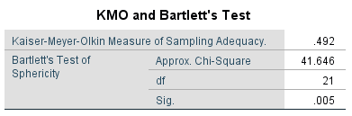

Slide 28
The Bartlett's test of sphericity was statistically significant (\chi^2(21) = 41.65, p = .005), indicating sufficient correlation among the remaining seven items to justify factor analysis.
The KMO measure of sampling adequacy was .492; while slightly below the traditional .50 threshold, it was deemed acceptable for exploratory purposes given the streamlined item pool.

Slide 29
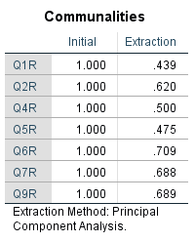

Slide 30
The communalities ranged from a low of .439 (Q1R) to a high of .709 (Q6R). Because all items exceeded the standard threshold of .40, it is confirmed that every retained item shares sufficient variance with the extracted components, justifying their inclusion in the final model and ensuring the structural integrity of the scale.

Slide 31
the Varimax-rotated component matrix presents an optimized, elegant 3-factor solution. The complete absence of cross-loadings confirms that the items are conceptually distinct and map onto separate dimensions cleanly.

Slide 32
Critical Inquiry and Constructivist Metacognition (Q7 & Q8)
For RQ2, the highest positive margins in the entire dataset emerged within the critical inquiry indices. An overwhelming 63.2% of students explicitly reported seeking external verification and critically cross-examining machine-generated outputs.
This provides within the context of Social Constructivism, that the AI system serves as an interactive "more knowledgeable other" or an automated foil.

Slide 33


HUFLIT | 2026
  Discussion
www.HUFLIT.edu.vn

Slide 34
HUFLIT | 2026
Students’ Active Participation in AI-Facilitated TMT Activities
AI integration generally encourages student involvement in TMT tasks
AI appears as a facilitative tool that lowers engagement barriers, not an independent driver

Slide 35
HUFLIT | 2026
First of all, some examples below may help clarify the theme.
Exercise 1 (week 2)
Translate the following text into Vietnamese.
Analyze the text into phrases/clauses.
Tell the function of each unit.

Slide 36
HUFLIT | 2026
Use Present Perfect tense and Past Perfect tense to translate the following text into English.
Analyze text styles and formality styles of the text.
Tell the function of each unit.

Slide 37
HUFLIT | 2026
Hắn đã tháp tùng nhóm phái đoàn điều tra của LHQ dưới vỏ bọc đại diện 1 tập đoàn dệt may đến Sydney phục vụ công tác nghiên cứu hoá chất được 3 tuần, nhưng theo nguồn tin của t́ình báo địa phương thì phần lớn thời gian của hắn lại dành cho việc la cà, bù khú tại các sòng bạc và quán rượu, không phải cho nghiên cứu công nghiệp vải sợi gì cả. Cấp trên hắn rất hoang mang không hiểu đây là chiến thuật đối phó phản gián hay là chiêu trò thể hiện tâm lý?

Slide 38
HUFLIT | 2026
Peer Collaboration During AI-Based TMT Tasks
Individualized interaction is prioritized unless collaboration is explicitly stated
Highlights the need to design activities that require discussion, comparison, and joint decision-making aligning with translation pedagogy

Slide 39
Presented by: Nguyen Duc Chau
HUFLIT | 2026
Students’ Inquiry and Clarification of AI Outputs
AI outputs frequently prompt verification, questioning, and comparison with human judgment
AI serves as a stimulus for analytical thinking rather than a shortcut to ready-made answers

Slide 40
Presented by: Nguyen Duc Chau
HUFLIT | 2026
Perceived Improvement in Working with TMT Exercises Through AI Engagement
AI contributes positively to students’ learning processes, assisting them in approaching complex structures and lexical choices
AI functions most effectively as a supportive scaffold rather than a substitute for structured instruction

Slide 41

Presented by: Nguyen Duc Chau
HUFLIT | 2026
  Pedagogical Implications and Summary
Instead, the data reveals a high-consensus, technologically literate cohort capable of balancing enthusiastic adoption with rigorous quality control.
To maximize the value of these findings, translation instructors must shift away from defensive, restrictive policies and embrace AI-assisted workflows.

Slide 42


Presented by: Nguyen Duc Chau
HUFLIT | 2026
  Recommendations

Slide 43

Presented by: Nguyen Duc Chau
HUFLIT | 2026
For instructors
Design structured, cognitively demanding tasks that require analysis, justification, and revision of AI outputs
For researchers
Further investigate AI-assisted translation pedagogy through longitudinal, experimental, and cross-institutional studies

Slide 44
Presented by: Nguyen Duc Chau
HUFLIT | 2026
For instructors
Develop clear policies that balance AI integration with academic integrity, aligning classroom innovation with assessment standards
Invest in professional development, AI literacy training, and curriculum redesign
For students
Critically evaluate, question, and revise AI-generated translations

Slide 45
HUFLIT | 2026
THANK YOU

