Slide 1

HUFLIT INTESOL International Conference 2026
Translation-majored Students’ ChatGPT Usage Pattern and Translation Self- Efficacy
Author: Ms NGO, Quan (International Univeristy - Vietnam National University HCM)
Co-author: Ms NGUYEN, Chau (International University - Vietnam National University HCM)
Affiliation: International University - VNU HCM, Ho Chi Minh City, Vietnam
Date: August 07, 2026

Slide 2
Contents:
01
02
03
Introduction
Literature Review
Methodology
04
05
Results & Discussions
Conclusions

Slide 3
INTRODUCTION
01

Slide 4
01
Background of the study
Rapid adoption of Generative AI in translation education
ChatGPT supports translation tasks across different stages
Benefits:
Faster information retrieval
Translation assistance
Revision support
Challenges:
AI overreliance
Reduced learner autonomy
Translation Self-Efficacy (TSE) influences translation performance
Limited evidence on the relationship between ChatGPT usage patterns and TSE
Research Gap
How do different ways of using ChatGPT influence students' translation self-efficacy?

Slide 5
01
Purpose and significance of the study
Purpose
Significance
Explore students' ChatGPT usage patterns
Examine differences in Translation Self-Efficacy
Investigate the relationship between AI use and TSE
Theoretical
Extend research on AI-assisted translation
Practical
Inform AI integration in translation education
Promote effective AI use

Slide 6
01
Research questions
1.
2.
To what extent do levels of translating self-efficacy differ across students with different ChatGPT usage?
How do students use ChatGPT in translation practice?

Slide 7
LITERATURE REVIEW
02

Slide 8
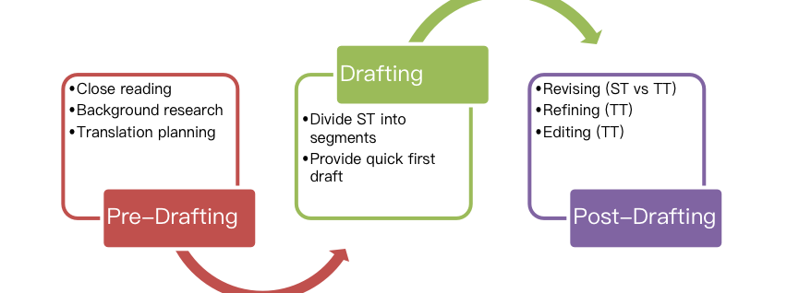
02
Theoretical framework
(Bandura, 1997) Self-belief in translation ability ↓ TSE-C (Yang et al., 2021) Internal Competence Psycho-physiological Competence External Competence | Borg (2018) Pre-Drafting Drafting Fine-tuning Polishing Proofreading ↓ | (Rowland, 2023) Human-led ↓ Human–AI Collaboration ↓ AI-led
Translation Self-Efficacy
Translation Process
Human-AI Continuum

Slide 9
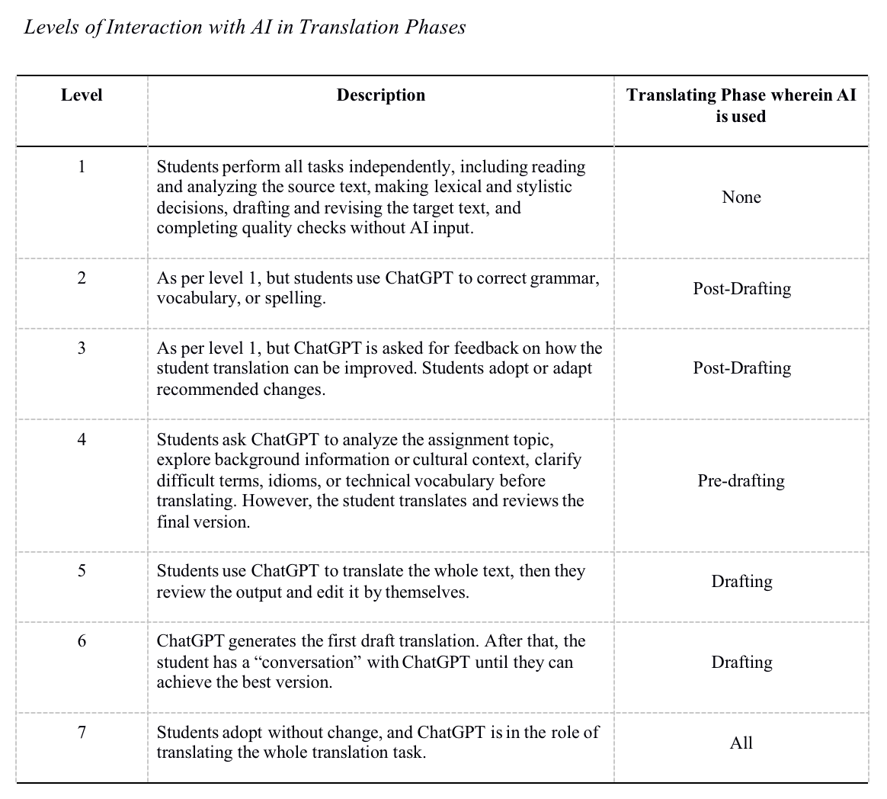
02
CONCEPTUAL FRAMEWORK
Combination of The Rowland’s (2023) Human-AI continuum and Borg’s (2018) translating process
Seven levels were adopted to represent different patterns of students’ ChatGPT usage: from 1 to 7

Slide 10
METHODOLOGY
03

Slide 11
03
Research Design | Quantitative research Cross-sectional survey
Participants | 53 English-major students

Slide 12
03
Research Design | Quantitative research design
Participants | 53 English-major students
Instruments for data collection | The modified questionnaire based on Rowland’s model (2023) & Yang et al., (2021)
Section 1 Demographic Information
Section 2 ChatGPT Usage Pattern Pre-Drafting Drafting Post-Drafting
Section 3 TSE-C Scale 12 items Three dimensions Internal Psycho-physiological External

Slide 13
03
Research Design | Quantitative research design
Participants | 53 English-major students
Instruments for data collection | The modified questionnaire based on Rowland’s model (2023) & Yang et al., (2021)
Data analysis | Online survey questionnaire via Google Forms
Transfer data to Jamovi
Run descriptive analysis
Shapiro-Wilk
Levene’s test
Welch’s ANOVA
Games-Howell

Slide 14
RESULTS & DISCUSSION
04

Slide 15
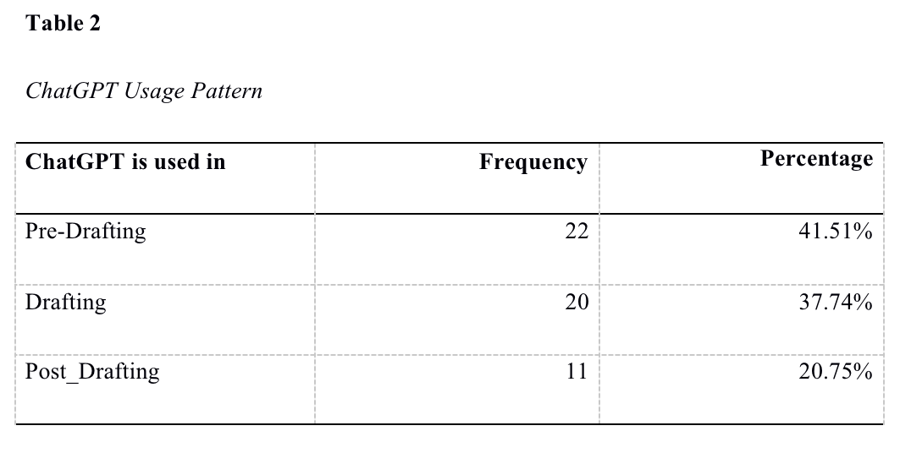
Research question 1: ChatGPT Usage

Slide 16
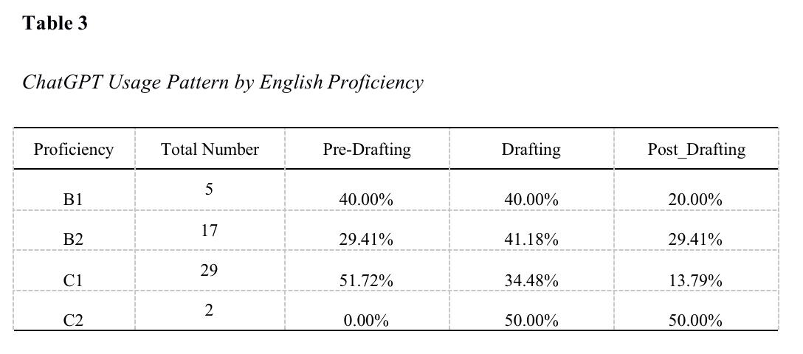
Research question 1: ChatGPT Usage

Slide 17
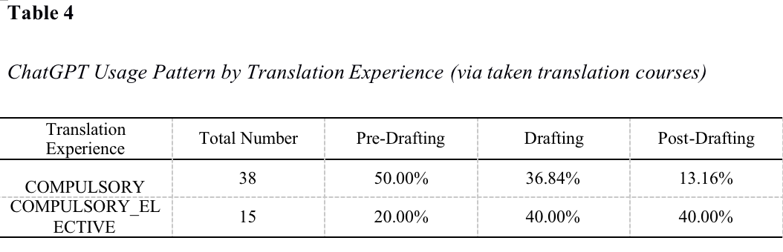
Research question 1: ChatGPT Usage

Slide 18
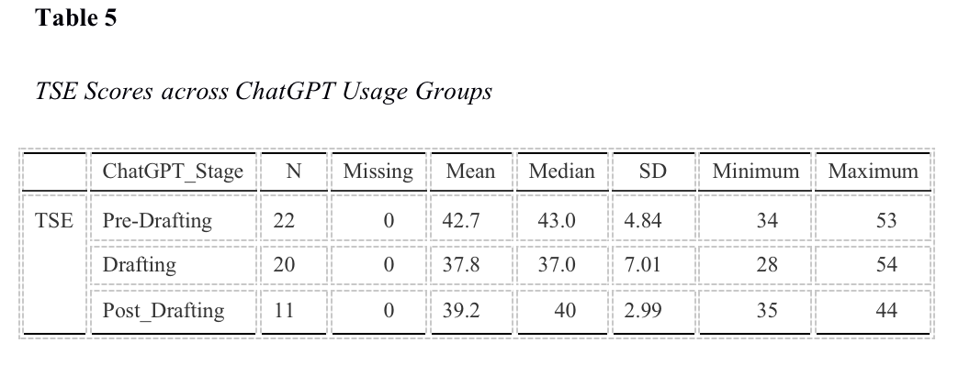
04
RQ2: TSE levels with different ChatGPT usage?
Pre-Drafting demonstrated the strongest confidence levels
Drafting and Post-Drafting users displayed more varied response patterns
=> In general, positive perceptions dominated across all groups, suggesting that students generally felt capable of performing translation tasks

Slide 19
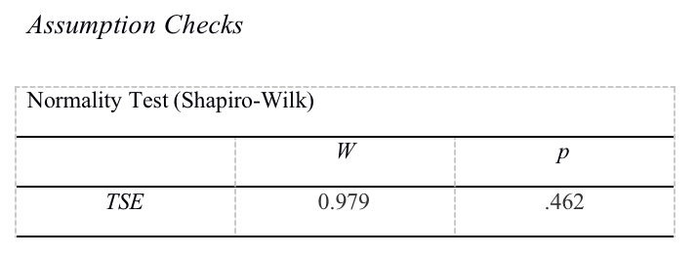
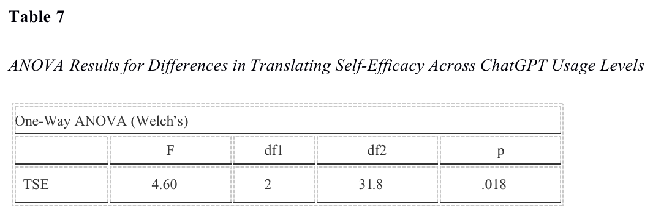
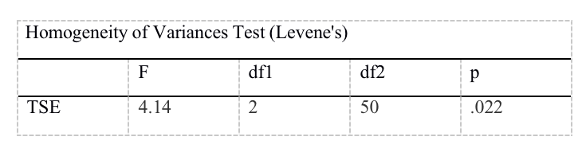
04
RQ2: TSE levels with different ChatGPT usage?
Differences in translating self-efficacy levels are associated with different levels of students’ use of ChatGPT.
statistically significant difference in translating self-efficacy levels between the groups using ChatGPT (p = .018)

Slide 20
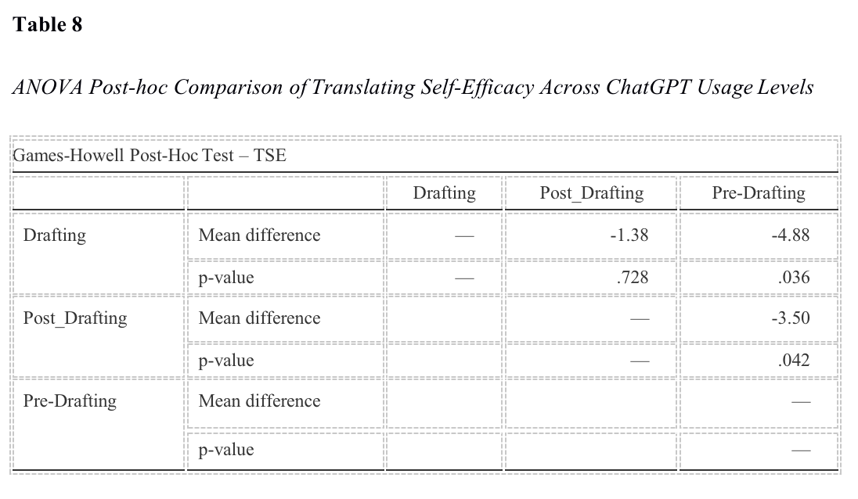
Research question 2: TSE levels associated with different ChatGPT usage

Slide 21
CONCLUSIONS
05

Slide 22
05
Implications
Encourage selective AI use
Maintain student autonomy
Teacher
01
AI literacy training
Prompt engineering
AI evaluation
Ethical AI use
Universities
02
Students
Use AI as support
Preserve independent decision-making
03

Slide 23
05
Limitations & Recommendations
Limitations
Recommendations
Larger and more diverse samples
Small sample size
Multiple universities
Single institution
Mixed-methods research
Longitudinal studies
Self-reported questionnaire
Investigate other AI tools

Slide 24
Q&A SECTION

Slide 25
THANK YOU!

Slide 26
REFERENCES:
Abdel Latif, M. M., & Alhamad, M. M. (2025). Translation and interpreting self-efficacy: A review of published measures. Frontiers in Psychology, 16. https://doi.org/10.3389/fpsyg.2025.1632366
Bandura, A. (1995). Self-efficacy in Changing Societies. University Press.
Bandura, A. (1997). Self-efficacy: The exercise of control (Vol. 11). Freeman.
Bhati, K., & Sethy, T. (2022). Self-efficacy: Theory to educational practice. The International Journal of Indian Psychology, 10(1), 1123-1128. DOI: 10.25215/1001.112
Bolaños-Medina, A., & Núñez, J. L. (2018). A preliminary scale for assessing translators’ self-efficacy. Across Languages and Cultures, 19(1), 53–78. DOI:10.1556/084.2018.19.1.3
Borg, C. (2018). The phases of the translation process: Are they always three? In Junior College Multi-Disciplinary Conference: Research, Practice and Collaboration—Breaking Barriers (pp. 79–92). University of Malta. https://www.um.edu.mt/library/oar/handle/123456789/38130
Brahmana, C. R., Sofyan, R., & Mono, U. (2025). Evaluating the strengths and limitations of CHATGPT-generated translations in academic post-editing workflows. Language Literacy: Journal of Linguistics, Literature, and Language Teaching, 9(1), 135–151. https://doi.org/10.30743/ll.v9i1.10551
Brown, Tom & Mann, Benjamin & Ryder, Nick & Subbiah, Melanie & Kaplan, Jared & Dhariwal, Prafulla & Neelakantan, Arvind & Shyam, Pranav & Sastry, Girish & Askell, Amanda & Agarwal, Sandhini & Herbert-Voss, Ariel & Krueger, Gretchen & Henighan, Tom & Child, Rewon & Ramesh, Aditya & Ziegler, Daniel & Wu, Jeffrey & Winter, Clemens & Amodei, Dario. (2020). Language Models are Few-Shot Learners. https://doi.org/10.48550/arXiv.2005.14165
Dinh, C. T. (2025). EFL students’ perspectives on chatgpt in translation: Exploring AI assistance, motivation, and learning outcomes. Electronic Journal of E-Learning, 23(2), 99–116. https://doi.org/10.34190/ejel.23.2.4006

Slide 27
REFERENCES:
Kaiyi, D. (2025). Research on post-editing strategies for Chinese-english translation based on Chatgpt. Lecture Notes on Language and Literature, 8(4). https://doi.org/10.23977/langl.2025.080419
Konttinen, K. (2021). A self-efficacy scale for measuring student progress in Translation Company simulations. Across Languages and Cultures, 22(1), 64–81. https://doi.org/10.1556/084.2021.00004
Liu, C., & Yu, C. (2019). Understanding students’ motivation in translation learning: A case study from the self-concept perspective. Asian-Pacific Journal of Second and Foreign Language Education, 4(1). https://doi.org/10.1186/s40862-019-0066-6
Ma, Y. (2024). The impacts and challenges of CHATGPT on translation teaching in universities. Journal of Education, Humanities and Social Sciences, 38, 155–161. https://doi.org/10.54097/fjp9tb72
Mossop, B. (2000). The workplace procedures of professional translators. In A. Chesterman, N. Gallardo San Salvador, & Y. Gambier (Eds.), Translation in context: Selected papers from the EST Congress, Granada 1998 (pp. 39–48). John Benjamins. https://doi.org/10.1075/btl.39.07mos
Ngo, T.T.A. (2023) The Perception by University Students of the Use of ChatGPT in Education. International Journal of Emerging Technologies in Learning (iJET), 18, 4-19. https://doi.org/10.3991/ijet.v18i17.39019
Nguyen, H. (2024). Integrating ChatGPT in Translation Learning.In Annual SEAAIR Conference Proceedings, 4, 602-611. https://www.researchgate.net/publication/391425619_Integrating_ChatGPT_in_Translation_Learning
Nguyen, T. N. N., Tran, T. T., Nguyen, N. H. A., Lam, H. P., Nguyen, H. M. S., & Tran, N. A. T. (2025). The benefits and challenges of AI translation tools in translation education at the tertiary level: A systematic review. International Journal of TESOL & Education, 5(2), 132–148. https://doi.org/10.54855/ijte.25527.

Slide 28
REFERENCES:
OpenAI (2023). ChatGPT (Mar 14 Version) [Large Language Model]. https://chat.openai.com/chat
Pym, A. (2014). Translation skill-sets in a machine-translation age. Meta, 58(3), 487–503. https://doi.org/10.7202/1025047ar
Rowland, D. R. (2023). A conceptual framework for discussing the human-AI writing continuum. ResearchGate. https://doi.org/10.13140/RG.2.2.36445.59361
Stansfield, C. W., Scott, M. L., & Kenyon, D. M. (1992). The measurement of translation ability. The Modern Language Journal, 76(4), 455. https://www.researchgate.net/publication/263588437_The_Measurement_of_Translation_Ability
Wang, L., Lyu, C., Ji, T., Zhang, Z., Yu, D., Shi, S., & Tu, Z. (2023). Document-level machine translation with large language models. In H. Bouamor, J. Pino, & K. Bali (Eds.), Proceedings of the 2023 Conference on Empirical Methods in Natural Language Processing (pp. 16646–16661). Association for Computational Linguistics. https://doi.org/10.18653/v1/2023.emnlp-main.1036
Worthington, R. L., & Whittaker, T. A. (2006). Scale Development Research: A Content Analysis and Recommendations for Best Practices. The Counseling Psychologist, 34(6), 806–838. DOI: 10.1177/0011000006288127
Yang, C., Chen, J., Hou, S., Wider, W., & Yi, W. L. (2025). How AI Benefits Student Translators: An Exploratory Study on the Impact of ChatGPT Feedback on Translation Proficiency. Forum for Linguistic Studies, 7(10), 526–541. https://doi.org/10.30564/fls.v7i10.11080
Yang, Y., Cao, X., & Huo, X. (2021). The Psychometric Properties of Translating Self-Efficacy Belief: Perspectives from Chinese learners of translation. Frontiers in Psychology, 12. https://doi.org/10.3389/fpsyg.2021.642566
Yuan, Y., Wu, J., & Wu, Y. (2024). The influence of translation majors’ self-efficacy on their interpreting ability and coping strategies under the guidance of gile’s model. Advances in Social Science, Education and Humanities Research, 420–435. https://share.google/vHPJvKMBBZxPtdnyF
Zhang, L., & Xu, J. (2025). The paradox of self-efficacy and technological dependence: Unraveling generative AI’s impact on University Students’ task completion. The Internet and Higher Education, 65, 100978. https://doi.org/10.1016/j.iheduc.2024.100978

