Slide 1



ACTIVITY THEORY (AT) AS A LENS FOR EXAMINING TEACHERS’ ENACTMENT OF THE COMPETENCY – BASED ENGLISH
TEACHING CURRICULUM (CBETC)
Presented by: Thanh Vinh Chau (Ph.D student)
Ho Chi Minh City Open University, Vietnam
Notes:
Good morning, everyone. Thank you for attending this presentation. My name is Thanh Vinh Chau, and I am a Ph.D. student at Ho Chi Minh City Open University, Vietnam.
Today, I will present our research paper entitled "Theory as a lens through which to examine teachers' implementation of competency-based English teaching programs”. This paper is one part of the literature review for my dissertation.

Slide 2


INTRODUCTION
Global shift to competency-based education
➢ Global education is shifting from content-based to competency-based learning (OECD, 2018).
➢ The focus is on learners' ability to apply knowledge in authentic contexts rather than memorizing content (OECD, 2018)..
➢ Vietnam's 2018 General Education Curriculum adopts competency development as its core orientation (OECD, 2018)..
➢ English teaching is designed to develop communicative competence, requiring a shift in teaching objectives (OECD, 2018)..
Competency-based English teaching curriculum (CBETC) represents a fundamental pedagogical transformation rather than a simple curriculum revision.
Notes:
Around the world, Global education is shifting from content-based to competency-based learning (OECD, 2018). Instead of emphasizing the memorization of the knowledge content, the focus is now on learners' ability to apply what they know in authentic situations.
Following this global trend, Vietnam introduced the 2018 General Education Curriculum, which places competency development at the center of teaching and learning. Therefore, in English education nowadays, the English teaching curriculum is designed to develop students' communicative competence. Moreover, English teaching is expected to move beyond knowledge transmission and focus on helping students use English effectively in real-life contexts.

Slide 3

INTRODUCTION
The complexity of curriculum enactment
➢ Teachers do not simply implement curriculum; they interpret, adapt, and reconstruct it in practice (Spillane et al., 2002).
➢ Curriculum enactment is shaped by interactions between: professional beliefs, school culture, assessment policies, and resources (Priestley et al., 2015).
➢ It is a dynamic and context-dependent professional process rather than rigid policy compliance.
Curriculum enactment is socially situated and continuously negotiated in classroom practice.
Notes:
Although the competency-based curriculum provides a clear policy direction, translating English teaching curriculum into classroom practice is far from straightforward. The reason is that teachers do not simply implement the curriculum as written. Instead, they interpret, adapt, and reconstruct it according to their own teaching contexts.
Moreover, this process is influenced by many interacting factors, including teachers' beliefs, school culture, assessment policies, examination pressure, available resources, and professional collaboration. Therefore, curriculum enactment is a dynamic and context-dependent process rather than a straightforward act of policy implementation. As the result, this complexity is the key reason why understanding teachers' enactment has become an important research focus.

Slide 4







INTRODUCTION
Need for a comprehensive analytical lens
Why Activity Theory?
Systemic Perspective
Drivers of Change
Traditional approaches often examine only teachers' cognition or curriculum implementation.
AT examines the full system: Subject (teachers), Object (competency teaching), Tools, Rules, Community, and Division of Labor (Vygotsky, 1987; Engeström, 2009)
AT also explains how contradictions within the activity system become vital drivers of change and professional development (Engeström, 2009).
Activity Theory captures both individual agency and contextual influences on curriculum enactment.
Notes:
As I mentioned in the previous slide, curriculum enactment is influenced by many interacting factors. So, looking only at teachers' individual cognition is not enough. We need a broader framework that helps us understand both teachers and the context in which they teach English.
This is why Activity Theory is a suitable framework. First, it provides a more comprehensive perspective by considering not only what teachers do in the classroom, but also the wider context that influences their teaching. Second, it views teaching as an activity system comprising several interconnected elements, including teachers, tools, rules, the community, and the division of labor. Most importantly, Activity Theory helps explain how the interactions and even the contradictions among these elements shape teachers' classroom practices and lead to educational change.

Slide 5

INTRODUCTION
Purpose of the paper
Examine the theoretical foundations of AT: Delve into the core sociocultural roots of Activity Theory.
Apply an Analytical Lens: Explain how AT serves as a structured lens for investigating teachers' enactment of the Competency-Based Curriculum.
Discuss Implications: Provide theoretical and practical implications for curriculum development and teacher professional development.
Curriculum AT offers a comprehensive framework for understand how teachers enact CBTEC in real classroom contexts.
Notes:
Based on the analysis above, I found that the role of AT theory in CBETC implementation is very important and still not fully explored, so I conducted a research paper on it.
Actually, this paper has three main objectives. First, it reviews the theoretical foundations of Activity Theory. Second, it examines how Activity Theory can be used as an analytical lens to investigate teachers' enactment of the CBETC. Finally, it provides theoretical and practical implications for curriculum development and teacher professional development.

Slide 6

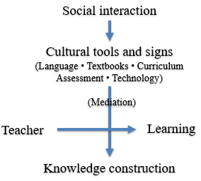


LITERATURE REVIEW
Overview of AT: Sociocultural foundations
Social Interaction: Learning is socially situated process: Knowledge develops through continuous social interaction.
Human action is mediated: Language, symbols, tools, (Vygotsky, 1978).
Tools transform thinking: Cultural tools influence both the action and the individual.
Education as a activity system: Curriculum, textbook, assessment, and classroom interaction mediate teaching and learning.
Human cognition is mediated by cultural tools within social contexts (Vygotsky, 1978)
Notes:
As mentioned in the previous sections, this paper focuses on the study of AT theory. Evidence shows that AT theory is a complex system, and it comprises four different versions.
First, AT is rooted in Vygotsky’s sociocultural theory by , which views learning as a socially situated process rather than an individual cognitive activity. Moreover, Vygotsky argued that human actions are always mediated by cultural tools such language, symbols, tools. These tools not only support teaching and learning but also shape how teachers think and act. Therefore, in educational contexts, AT can be understood as a social activity system where teachers and students collaboratively construct knowledge through interaction.

Slide 7

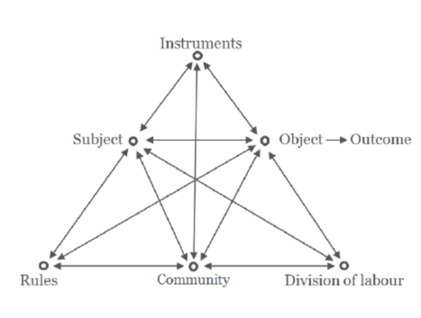
LITERATURE REVIEW
Overview of AT: 1st and 2nd generations
Engeström (1987) Expanded Activity System
First Generation (Vygotsky): Focus on Mediated Action. The introduction of cultural tools mediating between the subject and object.
Second Generation (Engeström): Expands to the Expanded Activity System (Engeström, 1987). Activity → Action → Operation.
The Object gives motive to the entire system, linking individual action inextricably to the broader social context.
Human 1st and 2nd = individual action + Social context.
Notes:
Second, Building on the concept of Sociocultural foundations. Vygotsky explained that human activity has three levels: activity, action, and operation. He also argued that every activity is directed toward an object, and this object gives people both motivation and purpose. This idea became the first version of AT.
Based on this foundation, Engeström developed the second generation of AT. As you can see in this diagram, he expanded the model by adding three new elements: Rules, Community, and Division of Labor, alongside Subject, Object, and Instruments or Tools.
This is an important development because it moves the focus from an individual teacher to the wider social and institutional context. That's why Activity Theory is a useful framework for understanding how teachers enact a competency-based curriculum.
1. Vygotsky → 3 levels: activity – action – operation + Object gives motivation and purpose. 2. Engeström → thêm 3 elements: Rules – Community – Division of Labor. 3. Significance → từ individual → social context → phù hợp nghiên cứu teachers' enactment of CBETC.

Slide 8
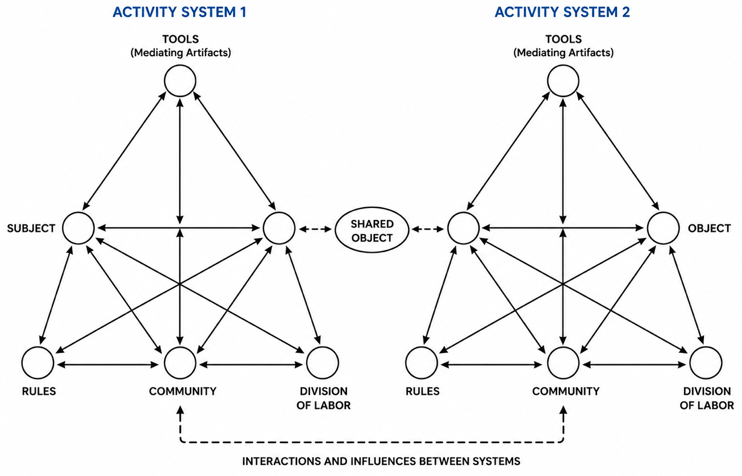
LITERATURE REVIEW
Overview of AT: 3rd generations
Human Teachers enact curriculum through continuous adaption, negotiation, and transformation rather than simple implementation.
Notes:
Finally, Engeström also proposed the third generation of AT.
Unlike the second generation, it doesn't look at just one activity system. Instead, it examines how multiple activity systems interact with each other.
In curriculum reform, this means that teachers' enactment is influenced not only by teachers themselves, but also by the interaction between policy, schools, and classroom practice.
Another important idea is expansive learning. It suggests that change happens when people identify and resolve contradictions within or between activity systems.
So, curriculum enactment is not a fixed process. It is a continuous process of adaptation, negotiation, and professional learning.
1.Third generation → multiple activity systems. 2. Interaction → policy – school – classroom. 3.Expansive learning → resolve contradictions. 4. Conclusion → adaptation – negotiation – professional learning.

Slide 9

LITERATURE REVIEW
Applying AT to teachers enactments’ of CBETC Conceptualizing CBETC enactment as an activity system
Human CBETC enactment is shaped by the interaction of individual, social, and institutional factors.
Notes:
Now, let's see how AT can be applied to understand CBETC enactment.
Many previous studies have shown that AT is a useful framework for this purpose. The first reason is that it views curriculum enactment as an activity system.
As shown in the figure, the subject is the English teacher, who interprets and implements the curriculum in the classroom. The object is to develop students' communicative competence.
Teachers' work is also mediated by different tools, such as textbooks, curriculum guidelines, technology, and teaching strategies.
Besides that, their teaching is influenced by rules, such as assessment policies and school regulations; by the community, including students, colleagues, school leaders, and parents; and by the division of labor within the school.
So, Activity Theory helps us understand that curriculum enactment is not only about what teachers do individually. Instead, it is the result of continuous interactions among pedagogical, social, and institutional factors.
1. Transition: Now, let's see how AT can be applied...2. Activity system 3. Subject → English teachers. 4. Object → Communicative competence. 5. Tools → textbook, technology, strategies. 6. Rules – Community – Division of Labor6. Conclusion → not individual, but interaction of many factors

Slide 10




LITERATURE REVIEW
Applying AT to teachers enactments’ of CBETC
Mediations and interaction within the activity system
Tools → Practice
Rules ↔ Object
Community & Labor
Curriculum, textbooks, technology, and pedagogy mediate classroom practice. Teachers interpret rather than simply implement (Spillane et al., 2002).
Examination pressure and rigid school regulations may shift the focus from communicative competence to grammar-oriented teaching (Chau & Tran, 2025a)
Professional collaboration and leadership support facilitate curriculum enactment, while weak coordination constrains implementation (Priestley et al., 2015)
Curriculum enactment is a dynamic process shaped by the interaction of tools, rules, community, and teachers' agency—not by policy alone (Engeström, 1987; Spillane et al., 2002; Priestley et al., 2015).
Notes:
Another important point is that all the elements in the activity system are connected. They don't work independently.
First, tools such as textbooks or technology help teachers make instructional decisions. However, teachers do not simply follow the policy. They actively interpret and adapt it to their own teaching context.
At the same time, rules, especially examination pressure, often shift the focus from developing communicative competence to teaching grammar for exams.
Finally, support from colleagues and school leaders also plays an important role. The more support teachers receive, the more effectively they can enact the curriculum.
So, teacher agency is not only about individual ability. It is also shaped by the school and the wider educational context.
1. Everything is connected. 2. Tools → help teachers → teachers interpret, not just implement. 3. Rules → exam pressure → grammar instead of communication. 4. Community → colleagues + leaders → support enactment. 5. Conclusion → teacher agency depends on the context.

Slide 11

LITERATURE REVIEW
Applying AT to teachers enactments’ of CBETC
Contradictions and tensions in CBETC enactment
Contradiction | Activity Theory Interpretation
Assessment vs. Competency Goals | Object ↔ Rules: Grammar-oriented examinations conflict with the goal of developing communicative competence (Engeström, 2009; Chau & Tran, 2025a).
Innovative Pedagogy vs. School Context | Tools ↔ Rules/Community: Communicative teaching is constrained by large classes, limited time, and insufficient resources (Engeström, 2009).
Teacher Beliefs vs. Established Practices | Internal Contradiction: Teachers value communicative teaching but revert to traditional habits under exam and workload pressures (Leontiev, 1978).
Contradictions are not barriers—they are opportunities for transforming teachers' practices and improving CBETC implementation (Engeström, 2009).
Notes:
Another important contribution of AT is the concept of contradictions.
In AT, contradictions are not simply problems. Instead, they are seen as drivers of change and development.
In the context of CBETC, there are three main contradictions.
First, the curriculum aims to develop students' communicative competence, but examinations still focus mainly on grammar. This creates a mismatch between the object and the rules of the activity system.
Second, teachers are encouraged to use communicative and innovative teaching methods. However, in reality, they often face challenges such as large classes, limited time, and insufficient resources.
Third, many teachers believe in communicative language teaching, but traditional teaching practices still remain because of exam pressure and established routines.
So, Activity Theory helps us see these contradictions not as barriers, but as opportunities for teachers to improve their practices and strengthen the implementation of the competency-based curriculum.
Contradictions = opportunities, not problems. Three contradictions: Curriculum ↔ Exams (communication vs. grammar)
Innovation ↔ Reality (large classes, time, resources)
Beliefs ↔ Practice (teachers believe, but old habits remain)
Conclusion: Contradictions → change → better CBETC.

Slide 12
LITERATURE REVIEW
Applying AT to teachers enactments’ of CBETC
Expansive possibilities and transformation
Expansive Learning (Engeström, 2009)
● Contradictions → Opportunities for innovation
● Reflection on tensions stimulates new teaching and assessment practices.
Conditions for Sustainable CBETC
● Professional reflection & collaboration
● Flexible assessment policies
● Supportive school leadership
● Professional Learning Communities (PLCs)
Activity Theory explains practice and guides systemic educational change (Engeström, 2001, 2009; Spillane et al., 2002).
Notes:
Finally, Activity Theory also opens up possibilities for change and transformation.
According to Engeström, contradictions should not be seen as problems. Instead, they are opportunities for innovation and improvement.
When teachers work together and reflect on the tensions between curriculum goals, assessment, and classroom realities, they can develop more effective teaching practices.
However, meaningful change cannot happen through teachers' efforts alone. It also requires supportive conditions, such as professional collaboration, flexible assessment policies, supportive school leadership, and professional learning communities.
In conclusion, Activity Theory not only helps us understand how teachers enact the competency-based curriculum, but also provides a framework for achieving broader and more sustainable educational change.
1. Transformation → change is possible. 2. Contradictions ≠ problems → opportunities. 3. Teachers reflect together → better practices. 4. Need support → collaboration, assessment, leadership, PLCs. 5. Conclusion → understand enactment and guide educational change.

Slide 13




RESEARCH METHODOLOGY
Research Design
Data Sources
Analytical Process
Structured as a theoretical analysis (conceptual paper) utilizing broad literature synthesis and deep interpretive analysis.
Primary data drawn from Activity Theory literature, curriculum studies, and Vietnam's General Education Curriculum.
Clarified core CBETC concepts, mapped AT components to context, and analyzed underlying contradictions influencing practice.
AT provides an analytical lens linking teachers' classroom practices with institutional, cultural, and social contexts.
Notes:
Now, let me briefly introduce the research methodology.
This study is a theoretical analysis, not an empirical study.
To conduct the analysis, we reviewed and synthesized the key literature on competency-based English teaching, curriculum enactment, and Activity Theory, and Vietnam's General Education Curriculum.
The analysis was carried out in three steps.
First, we clarified the key concepts of CBETC and curriculum enactment.
Second, we mapped the components of Activity Theory to the Vietnamese EFL context.
Finally, we identified the major contradictions that influence teachers' curriculum enactment.
Overall, this approach shows that Activity Theory provides a comprehensive framework for understanding curriculum implementation within its broader social and institutional context.
1. Theoretical analysis → not empirical. 2. Literature reviewed → CBETC + Curriculum Enactment + Activity Theory. 3. Three steps: Clarify concepts; Map AT to Vietnamese EFL; Identify contradictions. 4. Conclusion → AT is a comprehensive analytical framework.

Slide 14




RESULTS
Theoretical implications
Systemic Perspective
Policy–Practice Gap
Context & Mediation
➢ Curriculum enactment as a social activity system, not isolated teacher actions.
➢ Integrates subject–object–tools–rules–community (Engeström, 2009).
➢ Reveals contradictions underlying CBETC implementation.
➢ Contradictions become opportunities for expansive learning (Engeström, 2009).
➢ Teachers' practices are mediated by social, cultural, and institutional contexts.
➢ Grounded in Sociocultural Theory (Vygotsky, 1978).
AT provides a comprehensive framework for understanding and explaining teachers' enactment of CBETC.
Notes:
Now, I'd like to present the main theoretical findings of this study.
After analyzing the literature, we identified three main theoretical implications of Activity Theory for understanding the enactment of the competency-based English teaching curriculum.
First, Activity Theory views curriculum enactment as a social activity system, where teachers' practices are shaped by the interaction among teachers, tools, rules, the community, and shared goals.
Second, it helps explain why there is often a gap between curriculum policy and classroom practice. Instead of seeing this gap as a failure, Activity Theory views it as an opportunity for learning and improvement.
Third, it reminds us that teachers' classroom practices are always influenced by social, cultural, and institutional contexts.
Overall, these findings show that Activity Theory provides a comprehensive framework for understanding how teachers enact the competency-based English teaching curriculum.
1. Transition: Now, I'd like to present the main theoretical findings...2. First: Activity system → teachers + tools + rules + community + goals. 3. Second: Policy–practice gap → opportunity for learning, not failure. 4. Third: Context matters → social, cultural, institutional. 5. Conclusion: AT = comprehensive framework.

Slide 15




RESULTS
Practical implications
Curriculum Developers
School Leaders
Teacher Development
➢ Align curriculum, pedagogy, and assessment.
➢ Reduce contradictions between competency goals and testing rules (Chau & Tran, 2025a).
➢ Foster professional learning communities (PLCs),
➢ Encourage localized innovation, and actively strengthen teacher agency (Priestley et al., 2015).
➢ Promote reflective, system-oriented learning.
➢ Utilize systemic contradictions for expansive learning (Engeström, 2009).
Successful CBETC enactment requires coordinated changes across curriculum, school leadership, and teacher professional learning.
Notes:
Now, let's look at what this framework means in practice.
Our analysis suggests that AT offers several practical implications for curriculum reform.
First, for curriculum developers, it is important to ensure better alignment between curriculum goals, teaching methods, and assessment. This can help reduce contradictions during curriculum implementation.
Second, for school leaders, providing a supportive environment and encouraging professional learning communities can strengthen teacher collaboration and teacher agency.
Finally, teacher professional development should focus not only on teaching new techniques, but also on helping teachers reflect on their own practice and understand the wider system in which they work.
By identifying and addressing contradictions, teachers can continue learning, improve their classroom practice, and implement the competency-based curriculum more effectively.
1. Transition: Now, I'd like to move on to the findings...2. First: Curriculum developers → align goals – teaching – assessment. 3. Second: School leaders → support + professional learning communities. 4. Third: Teachers → reflection, not just techniques. 5. Conclusion: Address contradictions → better curriculum implementation.

Slide 16







RESULTS
Future research directions
Empirical Validation
Instrument Development
Theoretical Integration
➢ Conduct rigorous mixed-methods and longitudinal case studies.
➢ Examine exactly how these activity systems evolve.
➢ Develop and validate new questionnaires to accurately measure teacher beliefs, practices, systemic impetus, and hindrances (Chau & Tran, 2025b).
➢ Combine AT with modern frameworks of Teacher Agency and Ecological Perspectives (Priestley et al., 2015).
➢ Gain a more comprehensive understanding of curriculum enactment.
Future research should strengthen empirical evidence and expand the theoretical application of AT in CBETC.
Notes:
Finally, I'd like to suggest some directions for future research.
Although Activity Theory provides a strong theoretical framework, more empirical studies are still needed to examine how it works in real classroom settings.
Future research could use mixed-methods or longitudinal case studies to explore how activity systems change over time.
Another important direction is to develop and validate research instruments that measure key factors, such as teachers' beliefs, practices, impetus, and hindrances.
Finally, combining Activity Theory with other perspectives, such as Teacher Agency and ecological approaches, may provide a more complete understanding of curriculum enactment in different educational contexts.
These directions can help strengthen future research and support the more effective implementation of competency-based English teaching.
More empirical research.
Mixed-methods + longitudinal studies.
Develop questionnaires (beliefs – practices – impetus – hindrances).
Combine AT with Teacher Agency and ecological approaches.

Slide 17


DISCUSSION
Why activity theory?
Contradictions Drive Change
Evidence from Language Education
➢ Curriculum enactment is shaped by systemic contradictions, not teacher deficits.
➢ Example: Competency-oriented goals ↔ Knowledge-based examinations (Engeström, 2009).
Innovation is mediated by interactions among: Tools, institutional expectations, and teaching practices (Blin & Appel, 2011).
Curriculum enactment is a socially situated and context-dependent process.
Notes:
Now, let's discuss what these findings actually mean. Based on our findings, we can conclude that Activity Theory is a highly suitable framework for understanding and supporting the enactment of the competency-based English teaching curriculum.
One key finding is that Activity Theory explains curriculum enactment through systemic contradictions, rather than simply blaming individual teachers.
For example, in the Vietnamese context, there is a clear contradiction between competency-based curriculum goals and an examination system that still focuses mainly on linguistic knowledge.
This finding is also consistent with previous research, which shows that educational innovation is shaped by the interaction among teaching tools, institutional expectations, and classroom practice.
So, curriculum enactment should be understood as a socially situated process, influenced by multiple contextual factors rather than by teachers alone.
1. Transition: Now, I'd like to move on to the discussion. 2. Main message: AT is a suitable framework for CBETC. 3. Key finding: Systemic contradictions, not teacher limitations. 4. Example: Competency goals ↔ Knowledge-based exams. 5. Conclusion: Curriculum enactment is shaped by the wider context.

Slide 18

DISCUSSION
Beyond teacher beliefs
Beyond Individual Cognition
Implications for Curriculum Reform
Teacher beliefs matter, but they are mediated by: Rules, community, resources, and assessment (Borg, 2003; Fives & Gill, 2015).
Successful CBETC requires alignment among: Curriculum objectives, assessment, school leadership, professional collaboration, and classroom realities (Priestley et al., 2015; Chau & Tran, 2025b, 2026)..
Curriculum reform succeeds when teachers and the wider educational system develop together.
Notes:
Another important point is that Activity Theory gives us a broader perspective than approaches that focus only on teachers' beliefs.
Of course, teachers' beliefs are important. However, those beliefs are also influenced by many other factors, such as school rules, professional communities, available resources, and assessment systems.
This means that successful curriculum reform cannot depend on teachers alone. It also requires alignment between curriculum goals, assessment, school leadership, and professional collaboration.
In this sense, teachers should be seen as active participants within a larger educational system, rather than working in isolation.
So, the successful implementation of the competency-based curriculum depends not only on teachers' professional capacity, but also on a supportive school environment and coordinated educational reform.
1. AT gives a broader perspective. 2. Beliefs matter, but they are influenced by context. 3. Need alignment → curriculum, assessment, leadership, collaboration. 4. Teachers are active participants in a larger system. 5. Conclusion: Success depends on teachers + supportive system.

Slide 19
CONCLUSION
AT provides a systemic lens for understanding teachers' enactment of CBETC.
.
Curriculum enactment is a dynamic, socially situated process, shaped by interactions among subjects, tools, rules, community, and objectives.
Sustainable curriculum reform requires alignment among curriculum, assessment, school context, and teacher practice.
Understanding curriculum enactment requires understanding the activity system in which teachers work.
Notes:
To conclude, this paper shows that Activity Theory is a powerful framework for understanding teachers' enactment of the competency-based English teaching curriculum.
Instead of viewing curriculum implementation as a simple, linear process, Activity Theory helps us understand it as a dynamic process, shaped by the interaction among teachers, tools, rules, the community, and shared goals.
This also means that successful curriculum reform depends not only on teachers' professional competence, but also on assessment, school culture, institutional support, and classroom conditions.
Overall, we believe that Activity Theory provides both a valuable framework for future research and a practical guide for supporting sustainable curriculum reform.

Slide 20
Thank you for your attention

