Slide 1

THE EFFECTS OF
WORDWALL GAMIFIED EXERCISES
ON STUDENT ENGAGEMENT AND GRAMMAR ACHIEVEMENT
Nguyen Thi Nhat Thao, Bui Thi Ngoc Oanh, Truc Quynh Nguyen

Slide 2


Slide 3


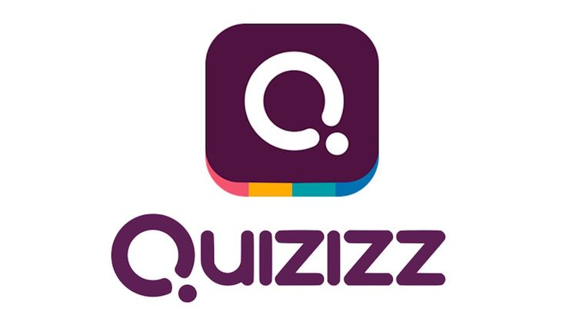
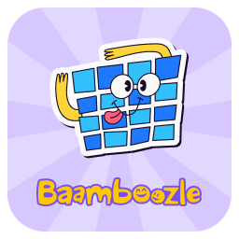

Using technology in language teaching and learning have gained popularity over the past decade.
The use of gamification through gamified learning platforms, such as Kahoot!, Quizizz, Wordwall, and Duolingo, has received considerable attention from educators and researchers.
It is because these online platforms featuring points, badges, leaderboards, and rewards provide several benefits in educational settings and contexts.

Slide 4
Reported benefits of gamification in education
It is used to improve students’ English language skills and abilities, have positive effects on students’ attitudes and emotional response (Zhang & Hasim, 2023)
Huang, Hew, and Lo (2019) reported that gamification enhances students' participation in flipped learning environments. Their study found that learners exposed to gamified activities were more likely to complete both pre-class and post-class tasks, which ultimately contributed to improved academic performance and higher test scores.
Kim et al. (2018) argued that gamification is an effective instructional approach that enables students to monitor their learning progress, foster collaboration, and improve both learning performance and academic achievement.

Slide 5
Why grammar should be taught with technology
The study by Tores Celi et al. (2023) reported that gamified English grammar instruction led to a remarkable improvement in students' achievement.
Students in the gamified group achieved significantly better grammar performance and lower grammar error rates than those receiving conventional instruction (Lin et al., 2020).
The use of Wordwall positively impacted students’ grammar achievement (Sulianto et al., 2025)

Slide 6
Research questions
To what extent does the use of gamified grammar learning on Wordwall improve grammar learning outcomes among non-majored English students?
How does the engagement level of non-majored English students differ when using Wordwall?
Is there a relationship between students engagement and their grammar achievement?

Slide 7


Slide 8

This research used quantitative data that was collected from 65 students in A2 General English course.
The study lasted 10 weeks and the teacher used traditional methods to teach grammar in 6 units in Roadmap A2 textbook.
Students practiced grammar knowledge through gamified exercises on Wordwall platform.
Students must take 4 tests including pretest, two period tests and post test.
All tests were paper-based to make sure that students did not use their smartphone to find answers.
The tests were multiple-choice questions (pre-test and post-test: 30 questions; period tests: 20 questions)
After 10 weeks, participants were required to complete an online questionnaire using the scale of the engagement developed by Whitton (2010 and 2011). The questionnaire included 18 items measured by 5-Likert scale (Strongly disagree to Strongly agree).

Slide 9
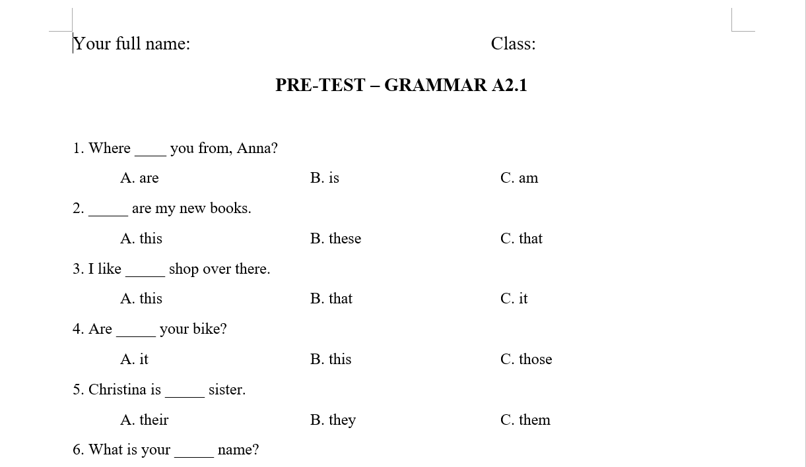
PRE - TEST

Slide 10
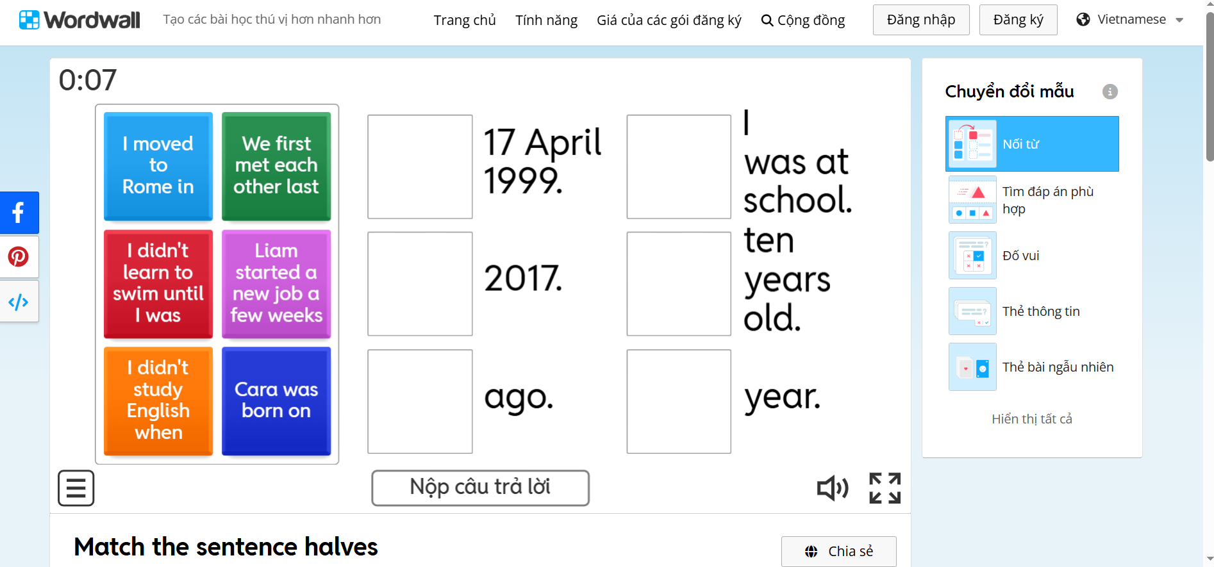
A gamified exercise for Past Simple Tense

Slide 11
Items | Items
1 | I wanted to complete the activity.
2 | I found the activity frustrating.
3 | I felt that I could achieve the goal of the activity.
4 | I knew what I had to do to complete the activity.
5 | I found the activity boring.
6 | It wasn’t clear what I could and couldn’t do.
7 | It was clear what I could learn from the activity
8 | I felt absorbed in the activity.
9 | The activity was pointless.
Items | Items
10 | I was not interested in exploring the options available.
11 | I did not care how the activity ended.
12 | I felt that time passed quickly.
13 | I found the activity satisfying.
14 | The activity did not let me do what I wanted.
15 | I was unable to tell what effect my actions had on me.
16 | I did not enjoy the activity.
17 | Feedback I received was useful.
18 | I found it easy to get started.

Slide 12


Slide 13
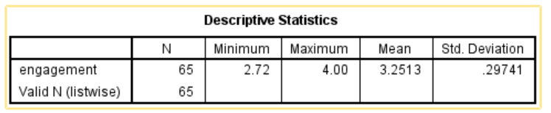
Students’ engagement
The descriptive statistics indicated that students demonstrated a relatively high level of interest in learning grammar through gamification (M = 3.25, SD = 0.30). Based on the five-point Likert scale, this corresponds to an interest level of approximately 81.3%, suggesting that participants generally expressed positive attitudes toward the learning activities.

Slide 14
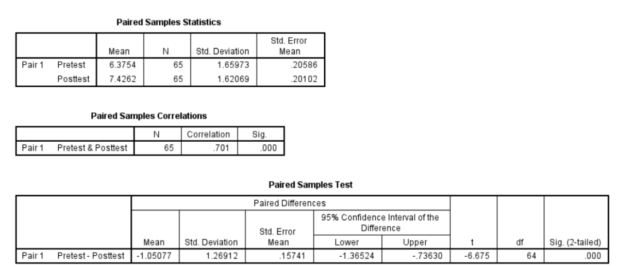

Slide 15
2. Students’ grammar achievement
A paired-samples t-test was conducted to examine whether students' grammar performance improved following the intervention. The results showed that the mean posttest score (M = 7.43, SD = 1.62) was significantly higher than the mean pretest score (M = 6.38, SD = 1.66), t(64) = −6.68, p < .001. The mean increase in scores was 1.05 points, with a 95% confidence interval ranging from 0.74 to 1.37. These findings indicate that the intervention significantly improved students' grammar achievement. The correlation between pretest and posttest scores was strong (r = .701, p < .001), suggesting that students' relative performance remained consistent over time while their overall achievement improved.

Slide 16
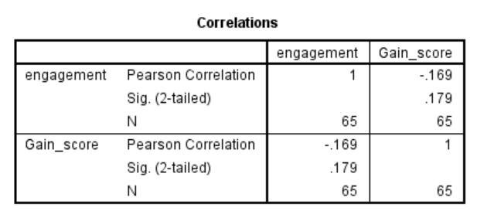
3. Relationship between engagement and grammar outcomes
A Pearson correlation analysis was conducted to examine the relationship between students' engagement and their grammar gain scores. The results indicated a weak negative correlation between engagement and grammar gain scores; however, the relationship was not statistically significant, r(63) = −.169, p = .179. Therefore, the findings suggest that students' engagement was not significantly associated with improvements in grammar achievement.

Slide 17
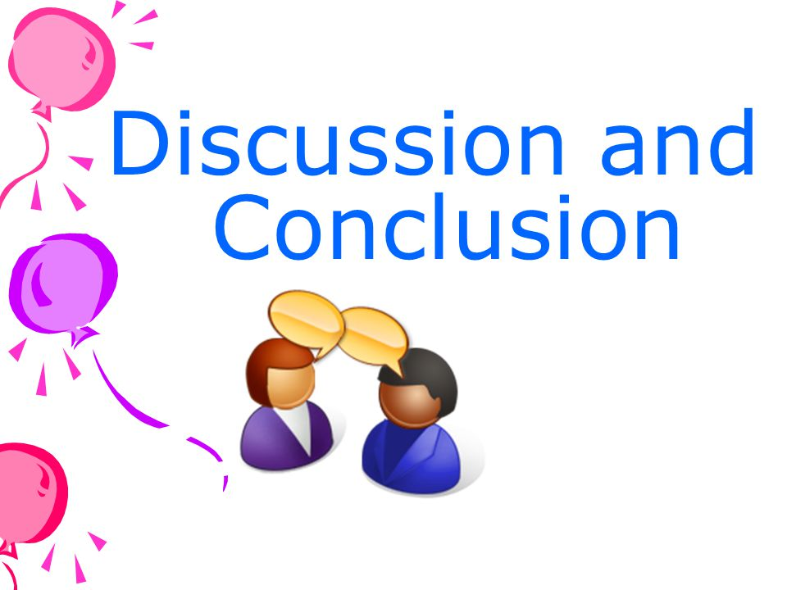

Slide 18
The findings revealed that students' grammar achievement improved significantly after the implementation of gamified learning activities. This finding is consistent with a previous research suggesting that gamification generally has positive effects on learners’ language achievement, motivation, and classroom participation (Zhang and Hasim, 2023).
The findings revealed that students' grammar achievement improved significantly after the implementation of gamified learning activities. Chen and Liang (2022) argued that gamification enhances study engagement by increasing learners' enjoyment and self-efficacy, both of which encourage active participation in learning activities.
However, the Pearson correlation analysis revealed no statistically significant relationship between students' engagement and grammar gain scores (r = −.169, p = .179). Gang and Hong (2022) found that behavioral engagement significantly contributed to language achievement and even mediated the relationship between learners' emotions and academic performance.

Slide 19
References
Zhang S. , Hasim Z. Gamification in EFL/ESL instruction: A systematic review of empirical research. Front Psychol. 2023 Jan 5;13:1030790. doi: 10.3389/fpsyg.2022.1030790. PMID: 36687912; PMCID: PMC9849815.
Whitton, N., 2010. Learning with digital games: a practical guide to engaging students in higher education. The open and flexible learning series. New York: Routledge.
Whitton, N., 2011. Game Engagement Theory and Adult Learning. Simulation & Gaming, 42(5), pp.596–609. https://doi.org/10.1177/1046878110378587.
Chen J and Liang M (2022) Play hard, study hard? The influence of gamification on students’ study engagement. Front. Psychol. 13:994700. doi: 10.3389/fpsyg.2022.994700

Slide 20
5. Feng, E. and Hong, G. (2022) Engagement Mediates the Relationship Between Emotion and Achievement of Chinese EFL Learners. Front. Psychol. 13:895594. doi: 10.3389/fpsyg.2022.895594
6. Huang, B., Hew, K.F. and Lo, C.K., 2019. Investigating the effects of gamification enhanced flipped learning on undergraduate students’ behavioral and cognitive engagement. Interactive Learning Environments, 27(8), pp.1106–1126. https://doi.org/10.1080/10494820.2018.1495653.
7. Kim, S., Song, K., Lockee, B., and Burton, J. (2018). Gamification in learning and education. Springer International Publishing AG 2018, 39-47
8. Torres Celi, Y. A., Ramón Rodríguez, B. L., & Criollo Vargas, M. I. (2023). Gamification on learning English grammar by using technology. In Libro Redlic (Chap. 6). Redlic Libros. https://doi.org/10.58995/lb.redlic.9.111
9. Lin, C.-J., Hwang, G.-J., Fu, Q.-K., & Cao, Y.-H. (2020). Facilitating EFL students' English grammar learning performance and behaviors: A contextual gaming approach. Computers & Education, 152, 103876. https://doi.org/10.1016/j.compedu.2020.103876

Slide 21
10. Sulianto, Y. D., Agustina, E., & Rahayu, E. M. (2025). Gamified digital learning with Wordwall: An experimental study on grammar achievement. IDEAS: Journal on English Language Teaching and Learning, Linguistics and Literature, 13(2), 3880–3893. https://doi.org/10.24256/ideas.v13i2.6453

