Slide 1


UNIVERSITY STUDENTS’ ATTITUDE AND INTENTIONS TOWARDS THE USE OF CHATGPT AND CANVA IN A PROJECT-BASED LEARNING ACTIVITY
Vi Le Bao | Ho Chi Minh City University of Foreign Languages and Information Technology (HUFLIT)

Slide 2

The AI Education Gap
AI Is Reshaping Education
Personalized learning, enhanced creativity, and intelligent content generation are now part of the academic landscape.
A Research Blind Spot
Studies on AI in language skills are abundant—but specialized disciplines like marketing and business communication remain largely understudied.
The Central Question
How do students actually adopt AI tools in real-world academic projects?

Slide 3

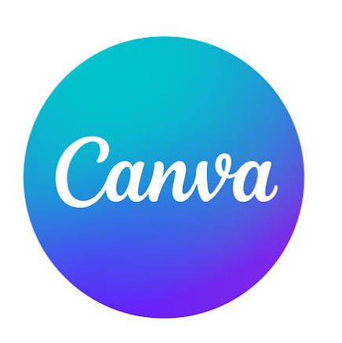



Two Tools, One Mission
ChatGPT
Canva
Together
Text-based generative AI for brainstorming, drafting, and content creation—a versatile writing partner for academic projects.
Imagery-based AI for visual design and professional templates—enabling polished presentations and social media assets with ease.
A complete toolkit for modern marketing and business communication, combining language and visual intelligence.

Slide 4
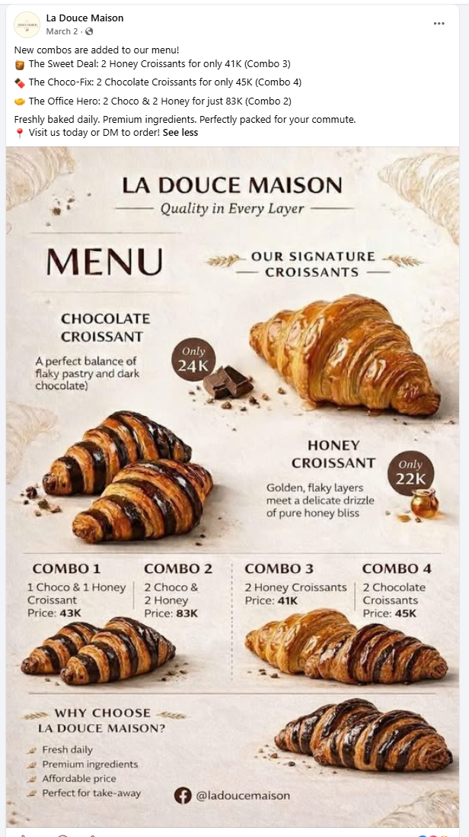


Slide 5
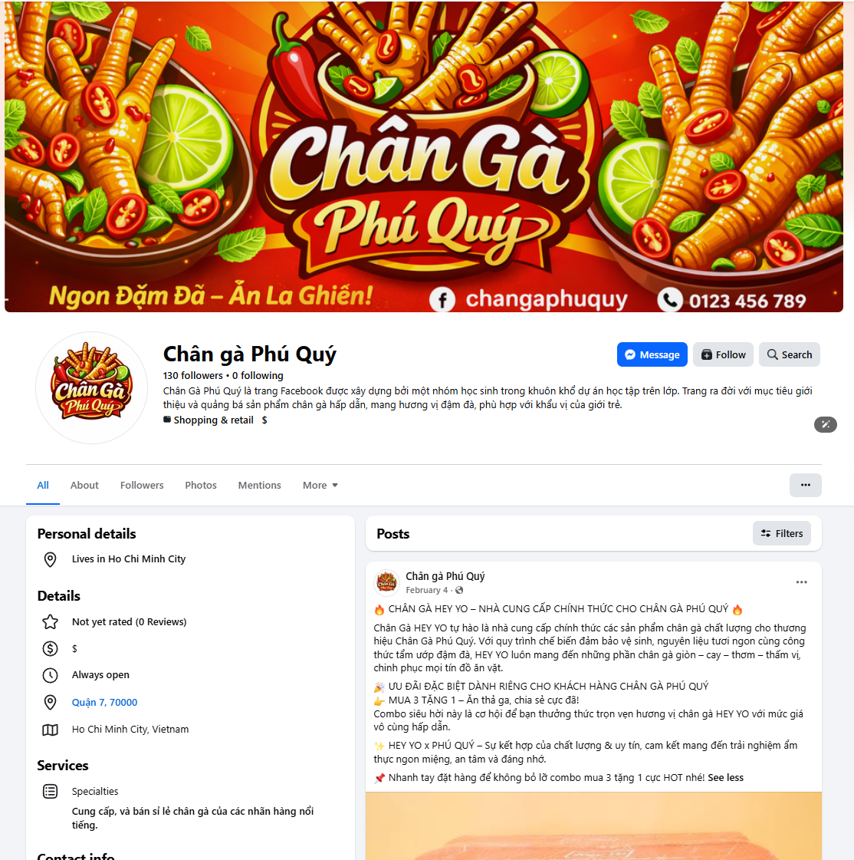
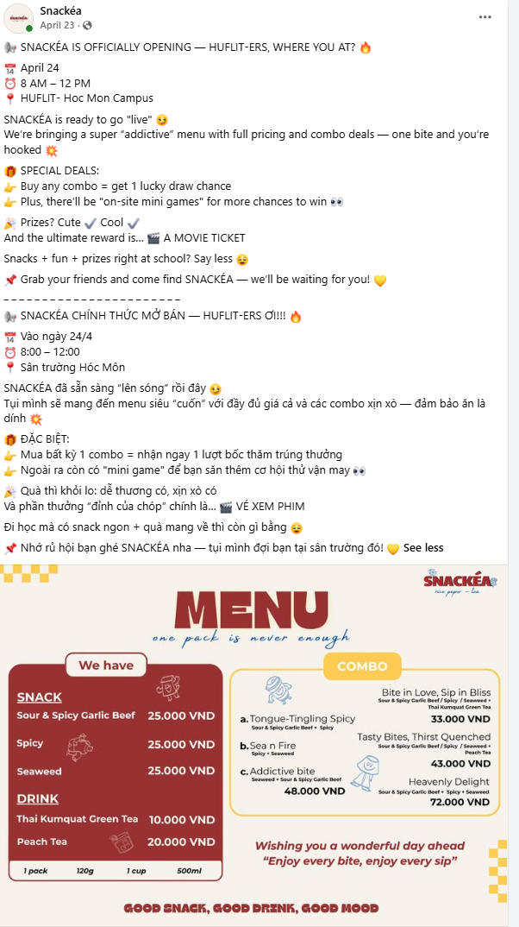

Slide 6

Research Questions
RQ 1
What are students' attitudes toward ChatGPT and Canva when used in project-based learning contexts?
RQ 2
Will students intend to use these tools for similar academic or professional projects in the future?

Slide 7
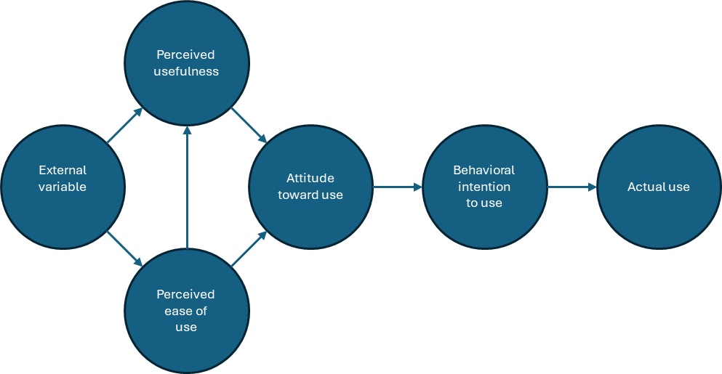
Technology Acceptance Model (TAM)
TAM model (Davis, 1989)
Foundation
Davis's TAM (1989) predicts technology adoption through perceived
usefulness and ease of use.
Notes:
Technology Acceptance Model (TAM)) , it has not been able to fully explain all the things that affect users' acceptance of technological systems because it does not clearly include antecedent or external variables that influence PEOU and PU (Dishaw & Strong, 1999).

Slide 8
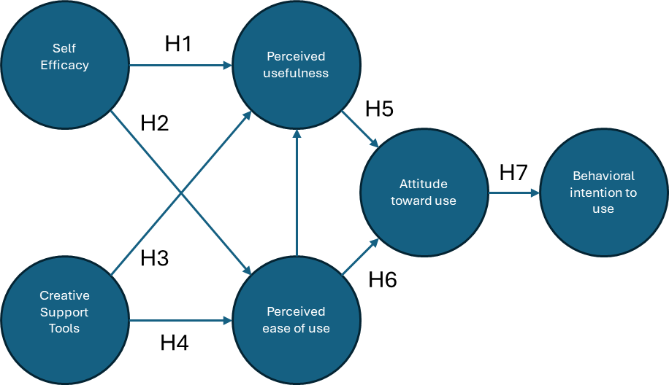
Extended Technology Acceptance Model (TAM)
Innovation
This study extends the model by
adding self-efficacy and creativity
support as external drivers of adoption.
Outcome Measures
Student attitude and behavioral
intention to use ChatGPT and
Canva.
Proposed Theoretical Framework
Notes:
Technology Acceptance Model (TAM))

Slide 9
Hypothesis Testing
H1: SE has a positive effect on PU when employing ChatGPT and Canva.
H2: SE has a positive effect on PEOU when employing ChatGPT and Canva.
H3: Creativity support tools (CSTs) have a positive effect on Perceived Usefulness (PU).
H4: Creativity support tools (CSTs) have a positive effect on Perceived Ease of Use (PEOU).
H5: Perceived usefulness (PU) has a positive effect on students’ attitude (Att) toward the use of ChatGPT and Canva.
H6: Perceived ease of use (PEOU) has a positive effect on students’ attitude (Att) towards ChatGPT and Canva use
H7: Students’ attitude (Att) toward ChatGPT and Canva use has a positive effect on students’ behavioral intention (BI) for actual use.
Proposed Theoretical Framework

Slide 10

Methodology
📋 Task
Research Design
👥 Participants
12-week “Sale Skills" course — groups promoted products on social media using ChatGPT and Canva
Quantitative
Survey: 5-point Likert scale (20 items)
136 out of 150 Business English majors at HUFLIT
B1-B2 (CEFR).
📊 Analysis
PLS-SEM structural equation modeling via SmartPLS 3.0
Notes:
Common European Framework of Reference for Languages (CEFR).

Slide 11
Data Analysis
evaluate the reliability and validity of the constructs
Measurement Model
Structural Model
Hypothesis Confirmation
represents the proposed relationships between variables and evaluates the model's explanatory and predictive power
validate the proposed relationships between the variables in the proposed model
Notes:
the measurement model focuses on the quality of the data and the accuracy of the constructs

Slide 12
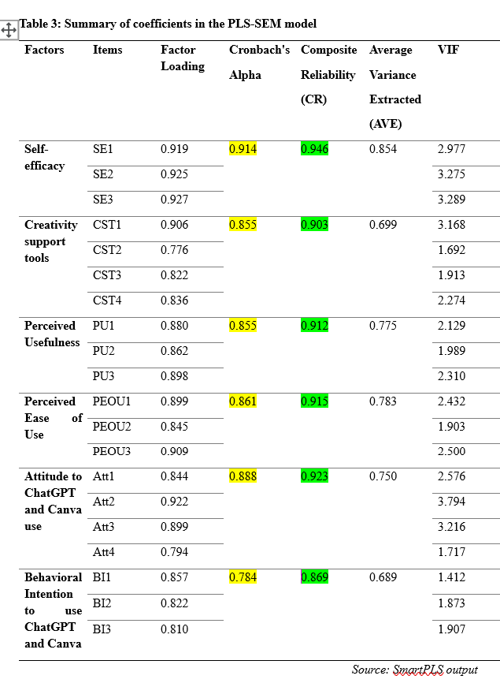
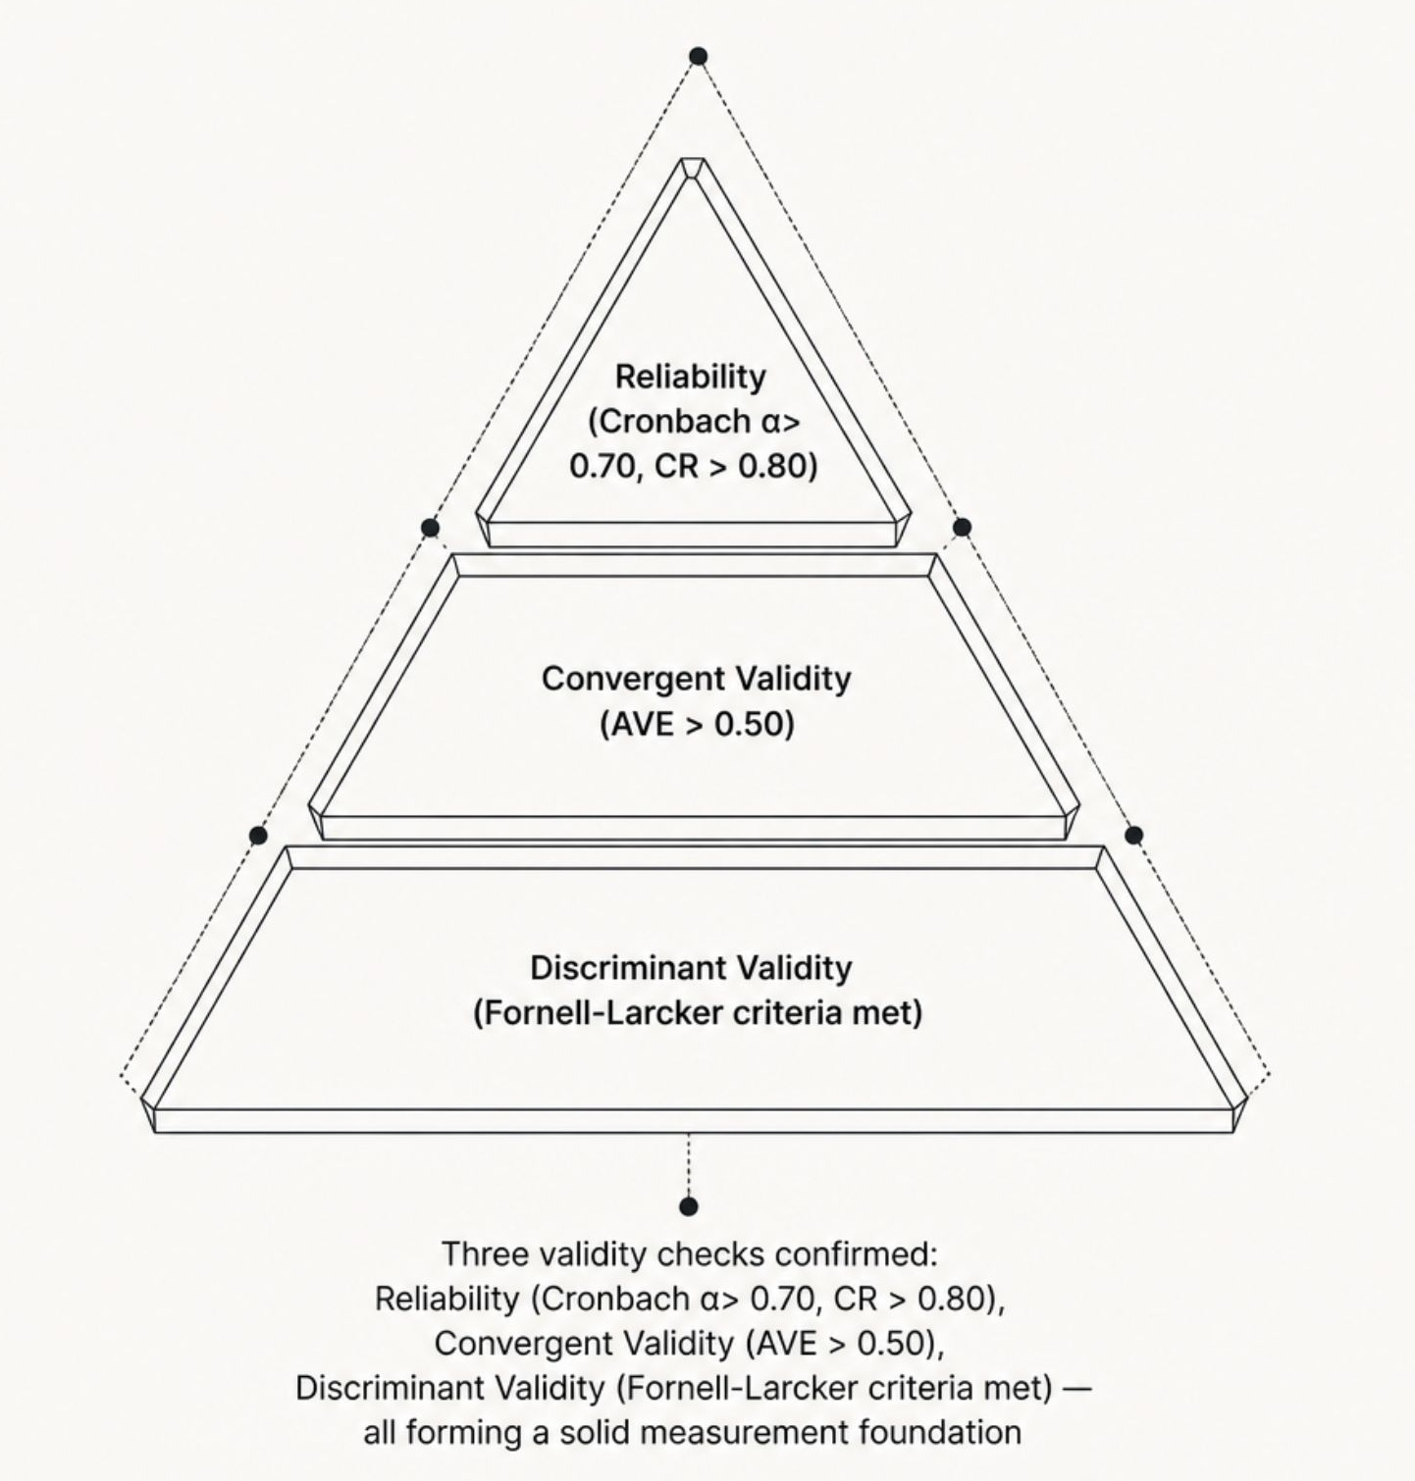
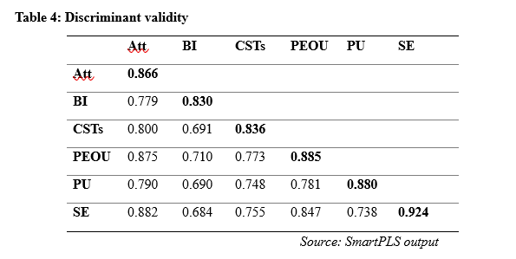
Key Findings - Measurement Model
Notes:
The reliability or consistency of a scale or questionnaire was initially evaluated using Cronbach’s Alpha (CA). Hair et al. (2016, 2017) assert that a Cronbach's alpha (CA) value of 0.70 or above signifies good reliability, whereas values over 0.80 reflect qualified reliability.
the convergent reliability (CR) value for each construct was greater than 0.8 ->bring robustness and reliability to the measurement model, which supports the consistency of the constructs.
convergent validity, as denoted through the Average Variance Extracted (AVE). This value must surpass 0.50 to demonstrate that each construct accounts forover half of the variance of their respective indicators (Hair et al., 2017).
In this study, all of the component AVE values were greater than the required cut-off, varying between 0.689 (Behavioral Intention) and 0.854 (Self-efficacy), thereby confirming that the constructs sufficiently capture the variance of their respective indicators, thus affirming convergent validity within the measurement
model.
Hair et al. (2017) emphasized the importance of highlighting the diagonal values which reflects the square root of the Average Variance Extracted (AVE) for each construct. Especially, the square root of the AVE on the diagonal values should be higher than the off-diagonal values for each pair.

Slide 13
Measurement Model: Validity Confirmed
Reliability
All constructs exceeded accepted thresholds:
Cronbach’s α > 0.70 and CR > 0.80,
confirming internal consistency.
Validity
Convergent Validity: AVE values > 0.50.
  Discriminant Validity: Fornell-Larcker criteria confirmed constructs are empirically distinct.
Notes:
The reliability or consistency of a scale or questionnaire was initially evaluated using Cronbach’s Alpha (CA). Hair et al. (2016, 2017) assert that a Cronbach's alpha (CA) value of 0.70 or above signifies good reliability, whereas values over 0.80 reflect qualified reliability
Convergent Validity: AVE values > 0.50, indicating that each latent variable explains sufficient variance in its indicators.
Fornell-Larcker criteria confirmed that each construct is empirically distinct from the others.

Slide 14

Structural Model
Model Fit (SRMR):
  The SRMR value is 0.090, which falls within the acceptable range (< 0.10), indicating a good fit between the observed data and the predicted model.
Explanatory Power (R² Adjusted):
  Attitude (0.791) & PEOU (0.755): Demonstrated strong explanatory power.
  Perceived Usefulness (0.623) & Behavioral Intention (0.604): Fell within the moderate range.
Predictive Relevance (Q²):
  High relevance for Attitude (0.582) and PEOU (0.583).
  Medium relevance for PU (0.477) and BI (0.378).
Key Path Analysis (β):
  Strongest Relationship: Attitude → Behavioral Intention (β=0.779).
  Perceived Ease of Use (β=0.660) had a much more significant impact on Attitude than Perceived Usefulness (β=0.275).
  Self-Efficacy showed a stronger influence on PEOU (β=0.612) than on PU (β=0.403)

Slide 15
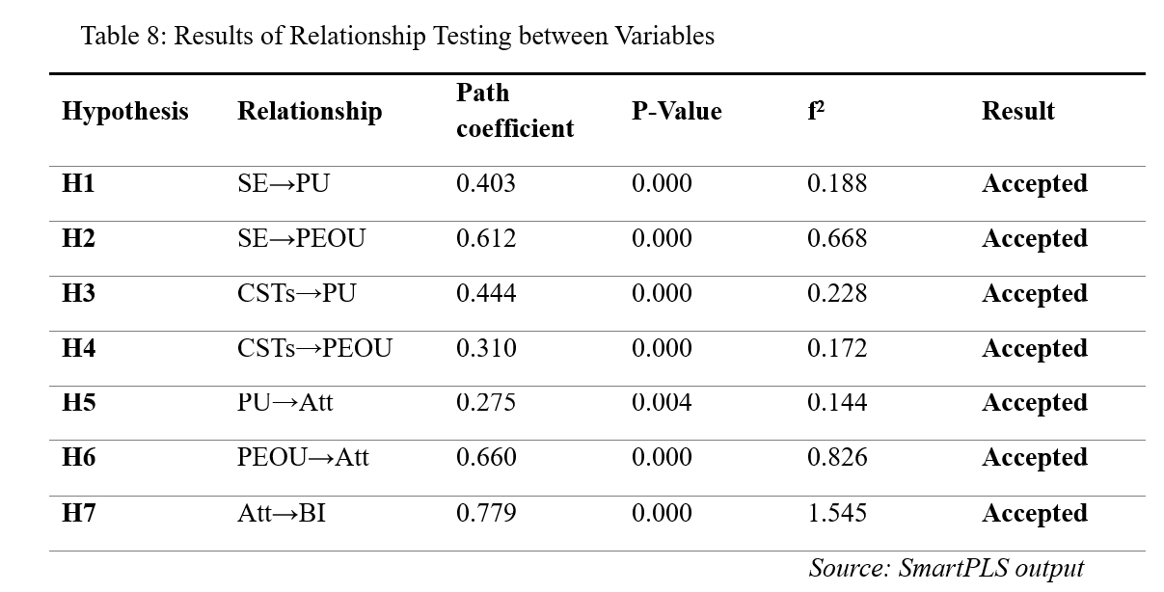
Hypotheses Testing (Path Analysis)
Notes:
Perceived Ease of Use (PEOU)
To test the strength and direction of relationships between latent variables

Slide 16
Hypotheses Testing (Path Analysis)
External Factors:
  Self-Efficacy (SE) significantly impacted PEOU (β = 0.612) and PU (β = 0.403).
  Creativity Support (CSTs) significantly impacted PU (β = 0.444) and PEOU (β = 0.310).
Core TAM Relationships:
  PEOU → Attitude (β = 0.660): Stronger impact than PU.
  PU → Attitude (β = 0.275): Positive but less significant than ease of use
Notes:
Perceived Ease of Use (PEOU)
To test the strength and direction of relationships between latent variables

Slide 17

The Ease-of-Use Advantage
User-Friendliness: Students prioritize simplicity (Canva’s drag-and-drop, ChatGPT’s natural language) over sheer utility.
Creativity Boost: AI tools function as "creative collaborators," helping students brainstorm slogans and design professional marketing content quickly
Notes:
Students prioritize simplicity over raw functionality. Canva's drag-and-drop interface and ChatGPT's natural language interaction trump feature complexity.

Slide 18
Hypotheses Testing (Path Analysis)
The "Golden" Path to Future Use
Attitude → Behavioral Intention (β = 0.779): The strongest relationship in the model.
Conclusion: If students enjoy the tools and find them easy to use, they are highly likely to integrate them into future academic and professional routines

Slide 19

Actionable Implications
For Educators
Design authentic, collaborative PBL tasks that mirror real-world business environments, giving students meaningful context for AI tool use.
For Institutions
Provide training and workshops specifically aimed at building student confidence and self-efficacy with AI tools.
For Curriculum Design
Systematically integrate AI tools across courses to prepare students for the demands of a digitized professional workforce.

Slide 20
Limitations & Future Research
Sample: Limited to one university and one specific course (Business English/Marketing).
Methodology: Primarily quantitative; future studies should use mixed methods (interviews) to gain deeper insights.
Scope: Only focused on ChatGPT and Canva; other emerging AI tools should be explored

Slide 21
Conclusion
Students have positive attitudes and strong intentions to continue using AI
Integrating AI in PBL fosters engagement, skill development, and productivity
Building confidence and ensuring ease of use are the keys to successful AI adoption in higher education

Slide 22


Slide 23


