Slide 1
From Motivational Self to Language Practice
A Mixed-Methods Study of Out-of-Class English Engagement
Among Vietnamese English Majors
Hoa Pham & Cuong Nguyen
Notes:
Good morning/afternoon. This presentation examines why English-major students use English beyond the classroom, and why that engagement takes some forms more readily than others.

Slide 2
Introduction: Why look beyond the classroom?
English as capital
Access to knowledge, careers, mobility
Future selves
Who learners want / feel they ought to become
Out-of-class use
Academic • Social • Habitual
English-major students encounter English as a subject, a professional resource, and a socially valued skill.
Out-of-class engagement extends learning beyond formal instruction—but it is not a single, uniform behavior.
The study asks how perceived value and future-oriented motivation relate to different forms of English engagement.
RQs: (1) To what extent do PLC and L2 self-guides predict engagement? (2) How do relationships differ across Academic, Habitual, and Social Use? (3) How do students experience and interpret engagement?
2
Notes:
English is not only a subject. It is also a form of capital that can provide access to knowledge, employment, and mobility. Students also develop future-oriented images of themselves as English users. The study examines how these factors relate to different forms of out-of-class engagement.

Slide 3
Theoretical frameworks
Bourdieu's linguistic capital + Dörnyei's L2 Motivational Self System
PERCEIVED LINGUISTIC CAPITAL
Why is English worth investing in?
FUTURE SELF-GUIDES
Who do I want to become?
Who do I feel I should become?
OUT-OF-CLASS ENGAGEMENT
Academic • Habitual • Social
Perceived value → Future-oriented motivation → Language practice
Key proposition: contextual affordances may shape how motivation is enacted.
3
Notes:
The framework integrates Bourdieu's linguistic capital and Dörnyei's L2 Motivational Self System. Perceived value helps explain why English is worth investing in; future self-guides help explain how value connects to future-oriented motivation. The study then examines Academic, Habitual, and Social Use, while considering contextual affordances.

Slide 4
Method: explanatory sequential mixed-methods design
QUANTITATIVE
QUALITATIVE
INTEGRATION
N = 328
n = 8
Triangulation
Survey • CFA • 3 parallel SEMs
Follow-up interviews • thematic analysis
Explain • elaborate • contextualize
Six constructs measured on 5-point Likert scales; 24 items.
Qualitative participants: 3 first-year + 5 second-year students; pseudonyms used.
Qualitative findings were used to explain, elaborate, and contextualize quantitative patterns.
4
Notes:
The quantitative phase involved 328 English majors and used CFA and three parallel SEMs. Eight students then participated in follow-up interviews. The qualitative phase was designed to explain and contextualize the quantitative findings.

Slide 5
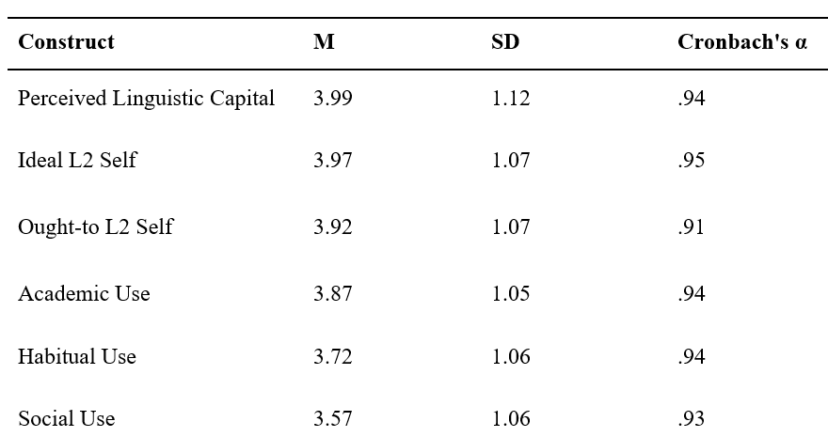
Quantitative findings 1: Students value English—and use it most academically
Table 3. Means and Standard Deviations for the Study Constructs
[INSERT TABLE 3 HERE]
3.99 / 3.97 / 3.92
High PLC + strong future self-guides
3.87 → 3.72 → 3.57
Academic > Habitual > Social Use
Finding: motivation is high, but engagement is uneven.
Discussion: students can often initiate Academic and Habitual Use independently; Social Use requires more than motivation.
5
Notes:
Table 3 shows high perceived linguistic capital and strong future self-guides. Yet engagement is uneven: Academic Use is highest, followed by Habitual and Social Use. Strong motivation does not translate equally into all forms of engagement.

Slide 6
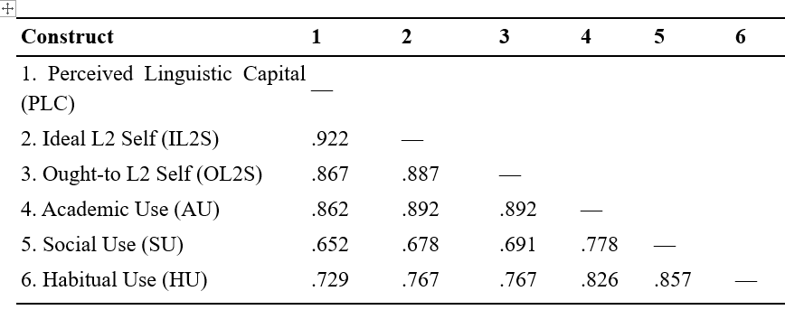
Quantitative findings 2: Motivational constructs are tightly interconnected
Table 4. Correlation Matrix
r = .922
PLC ↔ Ideal L2 Self
r = .862
PLC ↔ Academic Use
r = .892
IL2S / OL2S ↔ Academic Use
Discussion: perceived value and future selves appear to form an interconnected motivational system.
6
Notes:
Table 4 shows very strong positive relationships among perceived linguistic capital and the two future self-guides. The motivational variables also show stronger associations with Academic Use than with Social Use. Perceived value and future selves appear closely interconnected.

Slide 7
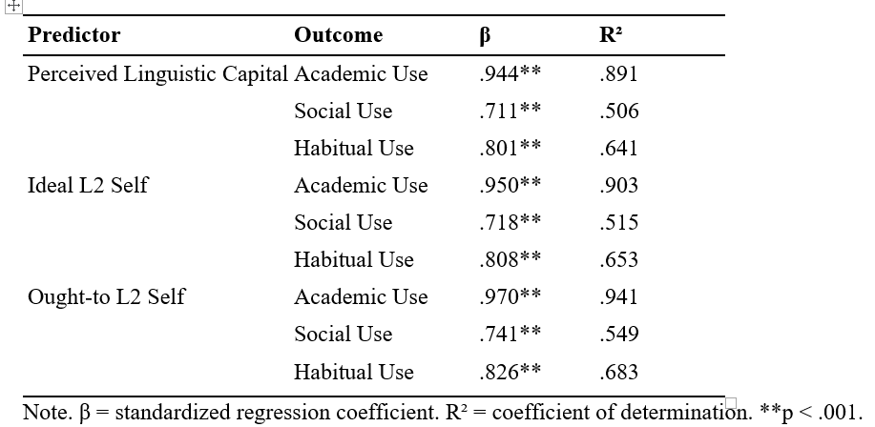
Quantitative findings 3: The strongest effects were on Academic Use
Table 7. Structural Path Coefficients and Explained Variance
[INSERT TABLE 7 HERE]
β = .944–.970
Academic Use
β = .801–.826
Habitual Use
β = .711–.741
Social Use
Discussion: motivational orientations predict all three forms—but not with equal strength.
7
Notes:
Table 7 shows that all three motivational constructs predicted all three forms of engagement, but Academic Use consistently showed the strongest coefficients, followed by Habitual Use and then Social Use.

Slide 8
Quantitative findings 4: The Ought-to L2 Self was the strongest predictor
A notable finding that deserves interpretation
β = .970
OL2S → Academic Use
β = .826
OL2S → Habitual Use
β = .741
OL2S → Social Use
Finding: OL2S was the strongest predictor across all three engagement dimensions.
Contrast: previous research often identifies the Ideal L2 Self as the stronger motivational predictor.
Possible explanation: English majors may experience English as closely tied to career expectations, employability, and professional competence.
When accompanied by family support and tangible opportunities, 'ought-to' expectations may become personally meaningful future goals.
8
Notes:
The Ought-to L2 Self was the strongest predictor across all three forms of engagement. This differs from research in which the Ideal L2 Self tends to be stronger. One possible explanation is contextual: English majors may experience English as closely tied to career expectations and employability. These expectations may become meaningful future goals when accompanied by support and opportunities.

Slide 9
Quantitative discussion: Motivation does not determine one form of engagement
ACADEMIC USE
Purposeful, self-initiated
Information + professional knowledge
HABITUAL USE
Embedded in everyday routines
Digital media + online searching
SOCIAL USE
More context-dependent
Interaction + confidence + opportunities
Motivation matters—but contextual affordances help determine how motivation is enacted.
9
Notes:
Taken together, the quantitative findings suggest that motivation is important but does not determine a single form of engagement. Academic Use can be initiated independently; Habitual Use becomes embedded in digital routines; Social Use depends more on opportunities for interaction.

Slide 10
Qualitative findings 1: How students develop perceived linguistic capital
Family encouragement and investment create early recognition of English's value.
Language centers and prior learning experiences reinforce the importance of English proficiency.
English-language media and digital exposure normalize English as a resource for information and entertainment.
Students increasingly connect English with educational access, professional competence, and future opportunities.
VALUE
English as educational + professional capital
INVESTMENT
Using English to access other valued resources
LINK
Value becomes connected to future selves
10
Notes:
The interviews show how perceived linguistic capital develops through family encouragement, learning experiences, and exposure to English media. Students value English not only as a language but for what it gives them access to: information, professional knowledge, careers, and international opportunities.

Slide 11
Qualitative findings 2: Students enact English in different ways
ACADEMIC USE
Professional knowledge
Information searching
IELTS / career preparation
HABITUAL USE
YouTube and media
Podcasts / entertainment
Routine online searching
SOCIAL USE
Interaction with foreigners
Online communities
Less frequent with Vietnamese peers
Academic + Habitual Use can be self-initiated; Social Use depends more on interactional affordances.
11
Notes:
The interviews closely explain the quantitative differences. Academic Use included professional knowledge and career preparation. Habitual Use involved YouTube, podcasts, entertainment, and routine online searching. Social Use was less frequent and often involved foreigners or online communities rather than Vietnamese classmates. The distinction is agency and context: students can initiate Academic and Habitual Use, whereas Social Use requires access to interaction.

Slide 12
Qualitative findings 3: Future English selves—and an integrated interpretation
1. VALUE
PLC explains why English matters.
Students imagined futures
as English teachers, translators,
tour guides, and other internationally
oriented professionals.
Family expectations could function
as meaningful support rather than simple pressure.
2. FUTURE
Self-guides connect value to possible identities.
3. PRACTICE
Affordances shape how motivation becomes action.
12
Notes:
The qualitative findings help explain the strong role of the Ought-to L2 Self. Students imagined futures as teachers, translators, tour guides, and other internationally oriented professionals. External expectations were not necessarily coercive. With family support and tangible opportunities, they could become meaningful future aspirations. Integrating both phases: perceived linguistic capital explains why English matters; future self-guides connect value to identities; contextual affordances shape how motivation becomes practice.

Slide 13
Implications, conclusion, and future research
PEDAGOGICAL IMPLICATION
CONCLUSION + FUTURE RESEARCH
Design assignments that require English-language information searches and professional resources.
Create authentic interaction: interviews, international students, language exchange, online communities.
Provide low-stakes opportunities for Social Use and reflect on out-of-class experiences.
Goal: create affordances through which existing motivation can be enacted.
PLC and future self-guides jointly underpin out-of-class engagement.
OL2S was particularly salient in this Vietnamese English-major context.
Academic and Habitual Use are easier to initiate independently; Social Use is more affordance-dependent.
Future: multi-site and longitudinal studies; examine how structured opportunities influence Social Use.
From seeing English as valuable → imagining an English-using future → actually using English: students need both motivation and opportunities.
13
Notes:
The pedagogical message is not simply to motivate students more. Students in this study were already highly motivated and valued English. The challenge is to create affordances through which motivation can be enacted. Future research should examine multiple institutions and disciplines, use longitudinal designs, and investigate whether structured opportunities can increase Social Use. The final message is: students need both motivation and opportunities.

