Slide 1

INVESTIGATING ENGLISH-MAJOR UNDERGRADUATES’ READINESS FOR AI-SUPPORTED ACADEMIC WRITING: A MULTIDIMENSIONAL PERSPECTIVE
Tran Phuong Anh & Ngo Thi Thu Hien

Slide 2
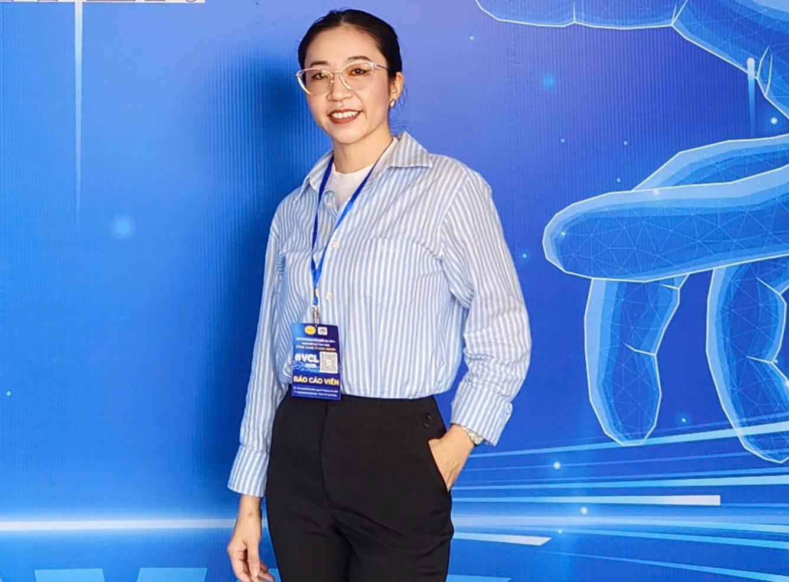
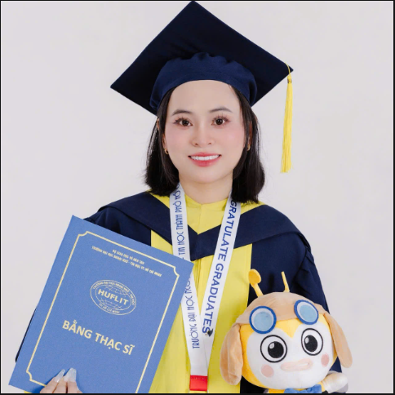
BIONOTE
Mrs Tran Phuong Anh
Master of English Language Studies
English teacher & independent researcher
Ho Chi Minh City, Vietnam
Email: phuonganh.tr1089@gmail.com
Mrs Ngo Thi Thu Hien
Master of English Language Studies
English teacher & independent researcher
Ho Chi Minh City, Vietnam
Email: friendship200561@gmail.com

Slide 3
Why this study?
Artificial Intelligence (AI) is changing academic writing.
Generative AI (ChatGPT, Gemini, Claude)
Most studies focus on:
✔ The use of artificial intelligence (AI)
in academic writing.
✔ The single aspect of AI application,
such as the level of technological
competence or perceptions.
Students increasingly use AI for academic writing
Universities are asking: "Are they actually ready to use AI responsibly and effectively ?“

Slide 4
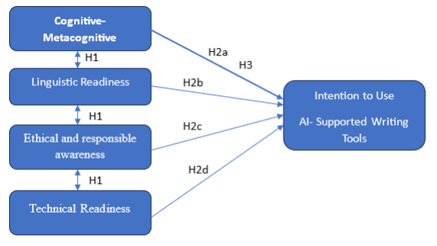
RESEARCH FRAMEWORK
RESEARCH QUESTIONS:
RQ1. How ready are students to use AI in academic writing?
RQ2. What are the relationships between readiness dimensions and intention to use AI in academic writing?
RQ3. Which dimensions predict intention to use AI in academic writing?

Slide 5
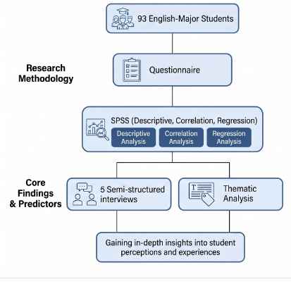
METHODOLOGY
    The mixed-method approach:
    A structured questionnaire included 29 items measured on a five-point Likert scale.
    Five semi-structured interviews included 7 key questions.
    Cronbach’s alpha coefficients indicated acceptable reliability across the scales, with Cronbach’s alpha values exceeding the threshold (α > .70) for most dimensions.
1
2

Slide 6
QUANTITATIVE FINDINGS
Finding | Result
Highest readiness | Cognitive-metacognitive (M = 4.17)
Strongest correlation with intention | Technology Enablers (r = .635)
Strongest predictor of intention | Technology Enablers (β = .404)
Explained variance | R² = .48
Technology Enablers, not Cognitive Readiness, emerged as the strongest predictor of intention to use AI.

Slide 7
QUALITATIVE FINDINGS
What did students actually tell us?
Upper-intermediate students | Intermediate students
✔ Question AI ✔ Verify information ✔ Preserve writing style ✔ Set personal benchmarks “The principle I always apply is that AI provides the foundation for my work. I just need to step up and build the pillars and roof myself to complete my part.” | ✔ Grammar correction ✔ Greater dependence ✔ Concern about writing without AI “Sometimes, I feel like I'm becoming too dependent on this AI. And without it, I don't know how long it would take me to achieve my target score.”
English proficiency shaped how students interacted with AI.

Slide 8
DISCUSSION
What does this mean?
Technology Enablers
"I WANT to use AI"
Cognitive Readiness
"I KNOW HOW to use AI"
Technology encourages adoption.
Metacognition regulates use.
Ethics guides responsible AI practices.
Ethical Awareness
"I KNOW WHEN to stop"

Slide 9
IMPLICATIONS FUTURE RESEARCH
1
Theory
Technology may drive adoption
Metacognition supports responsible use
Larger and more diverse samples
Longitudinal studies
Experimental AI-writing interventions
2
Teaching
Guided AI use, not unrestricted AI use
AI comparison and evaluation tasks
Reflection and AI Use Declarations

Slide 10


THANK YOU
Questions & Discussion

