Slide 1
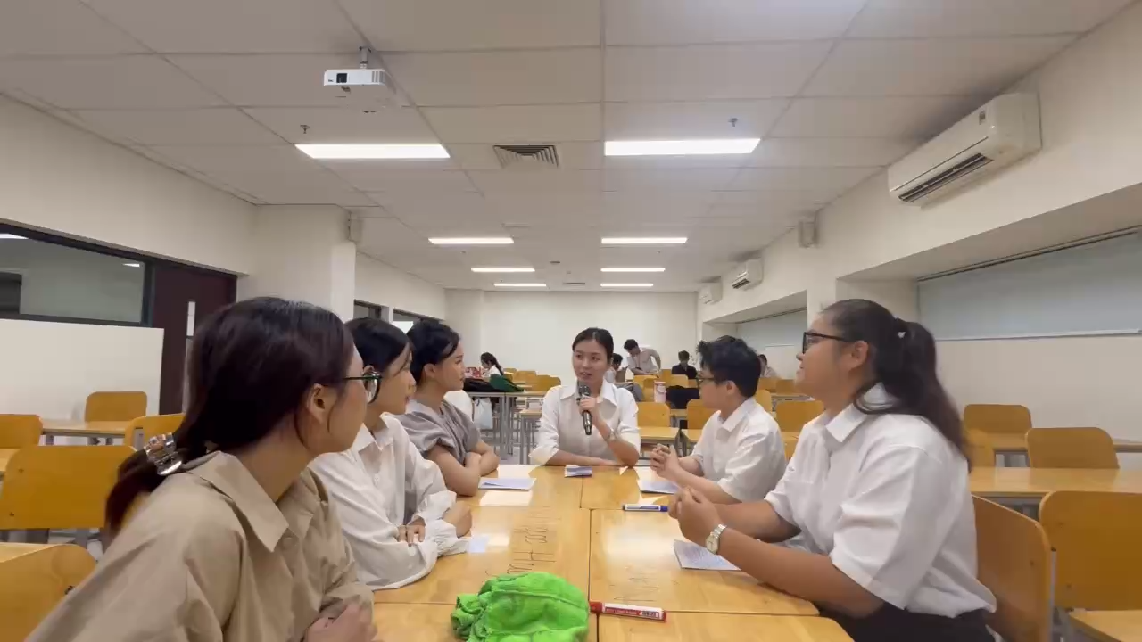
A problem-solving meeting

Slide 2
Application of AI in Teaching and Learning Business English at HUFLIT: strengths, weaknesses, and solutions
Ms Nguyen Thi Bach Yen
Faculty of Foreign Languages, HUFLIT
Customer Service– Business English
Mixed-Methods Study with 420 students

Slide 3
Table of content
Introduction
Literature Review
Methodology
Findings
Discussion
Conclusion

Slide 4
Research Problems & Purposes
Problems
-Academic program: condensed from four years to three and a half. -The academic calendar: expanded from two semesters to three per year.
-Course overload, leaving students with little time to absorb knowledge, reflect critically, or engage meaningfully with the material.
Purposes
-Evaluate AI’s roles as a cognitive assistant and a motivational force .
-Identify AI’s strengths & weaknesses.
-Offer practical, ethical solutions.

Slide 5
Research Questions
1. To what extent can artificial intelligence support lecturers and students in the Business English major?
2. How useful and effective is the application of artificial intelligence in teaching and learning the Customer Service course?

Slide 6

Literature Review
Devasena (2024): the development of artificial intelligence is not only a significant illustration of how science and technology can advance social change but also a useful tool for teaching and English.
Rukiati et al. (2023): comparing their pronunciation, intonation, and fluency to native speakers, AI can provide instant feedback and suggestions for improvement. Moreover, as virtual language tutors, AI can take part in interactive talks with students.
Fitria (2021): Language literacy and digital literacy are a neat combination to improve global competence.
Shimbergenova (2026): AI tools yield optimal outcomes when teachers actively mediate their use by selecting appropriate tasks, interpreting automated feedback, and linking digital activities to broader learning objectives. Without such pedagogical intervention, AI applications may encourage surface-level learning focused on error correction rather than conceptual understanding.

Slide 7
Methodology
1. Mixed-methods (qualitative + quantitative)
2. Participants: 420 students in 6 Customer Service classes
3. Instruments:
• Observations (12 sessions)
• Interviews (10 students)
• Surveys (Google Forms)
4. Duration: 12-week term

Slide 8
Procedure
1. Preparation Phase:
- AI tools training (ChatGPT, Gemini, Grammarly, ELSA)
2. Implementation Phase:
- AI-integrated tasks (role-plays’ scripts, problem-solving solutions)
3. Data Collection Phase:
- Observations, interviews, surveys

Slide 9
Observation Findings
- High engagement: 4.6/5
- AI used for brainstorming, scripts writing, problem-solving solutions, editing, pronunciation
- Teacher facilitation was key
- Challenges: copy-paste habits, internet issues
→ AI fosters a dynamic and efficient learning environment for those possessing low competence of language.

Slide 10
Interview Findings
Benefits
•Improvements in speaking skills
• Higher motivation
Concerns
•Lack of contextual sensitivity in business-specific situations
•Need Teacher-guided use of AI

Slide 11
Survey Findings
- 85.9% found AI useful/very useful
- Uses:
• Idea generation (75.7%)
• Dialogue writing (71.2%)
- Frequency:
• Often (40.5%)
• Sometimes (43.2%)

Slide 12
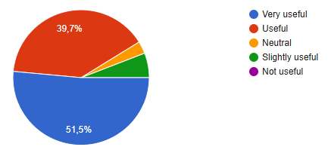
Figure 1
The usefulness of AI tools in Business English learning

Slide 13
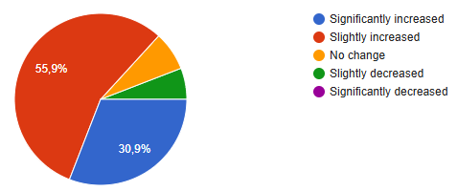
Figure 2
Students’ engagement and motivation changes when using AI tools in learning

Slide 14
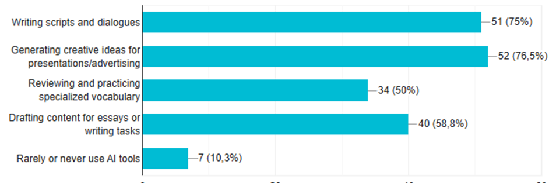
Figure 3
Types of learning activities students use AI for learning

Slide 15
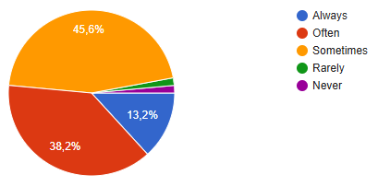
Figure 4
Students rely on AI tools when completing assignments or preparing lessons

Slide 16
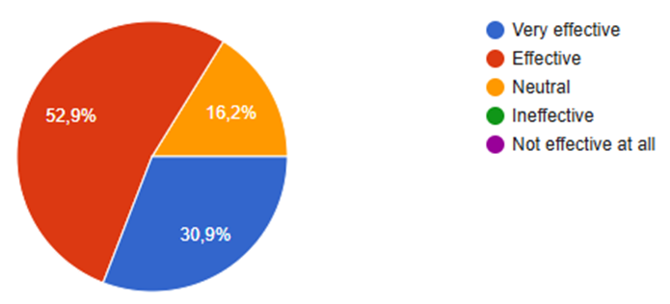
Figure 5
The overall effectiveness of integrating AI into the Customer Service course

Slide 17
Discussion
- AI boosts engagement, autonomy, and creativity
- Teachers play a critical guidance role
- Risks: over-reliance, digital literacy gaps
- AI augments, not replaces, instruction

Slide 18
Recommendations
- Use AI in task-based, collaborative learning
- Provide AI literacy training
- Establish ethical AI use guidelines
- Scaffold AI use to develop critical thinking
→ combining the traditional pedagogical practices and the advantages of AI to get the target.

Slide 19
Conclusion
- AI enhances ESP learning in Customer Service course
- Thoughtful use promotes autonomy and proficiency
- Teachers remain essential facilitators
- Focus on ethics, training, reflection

Slide 20
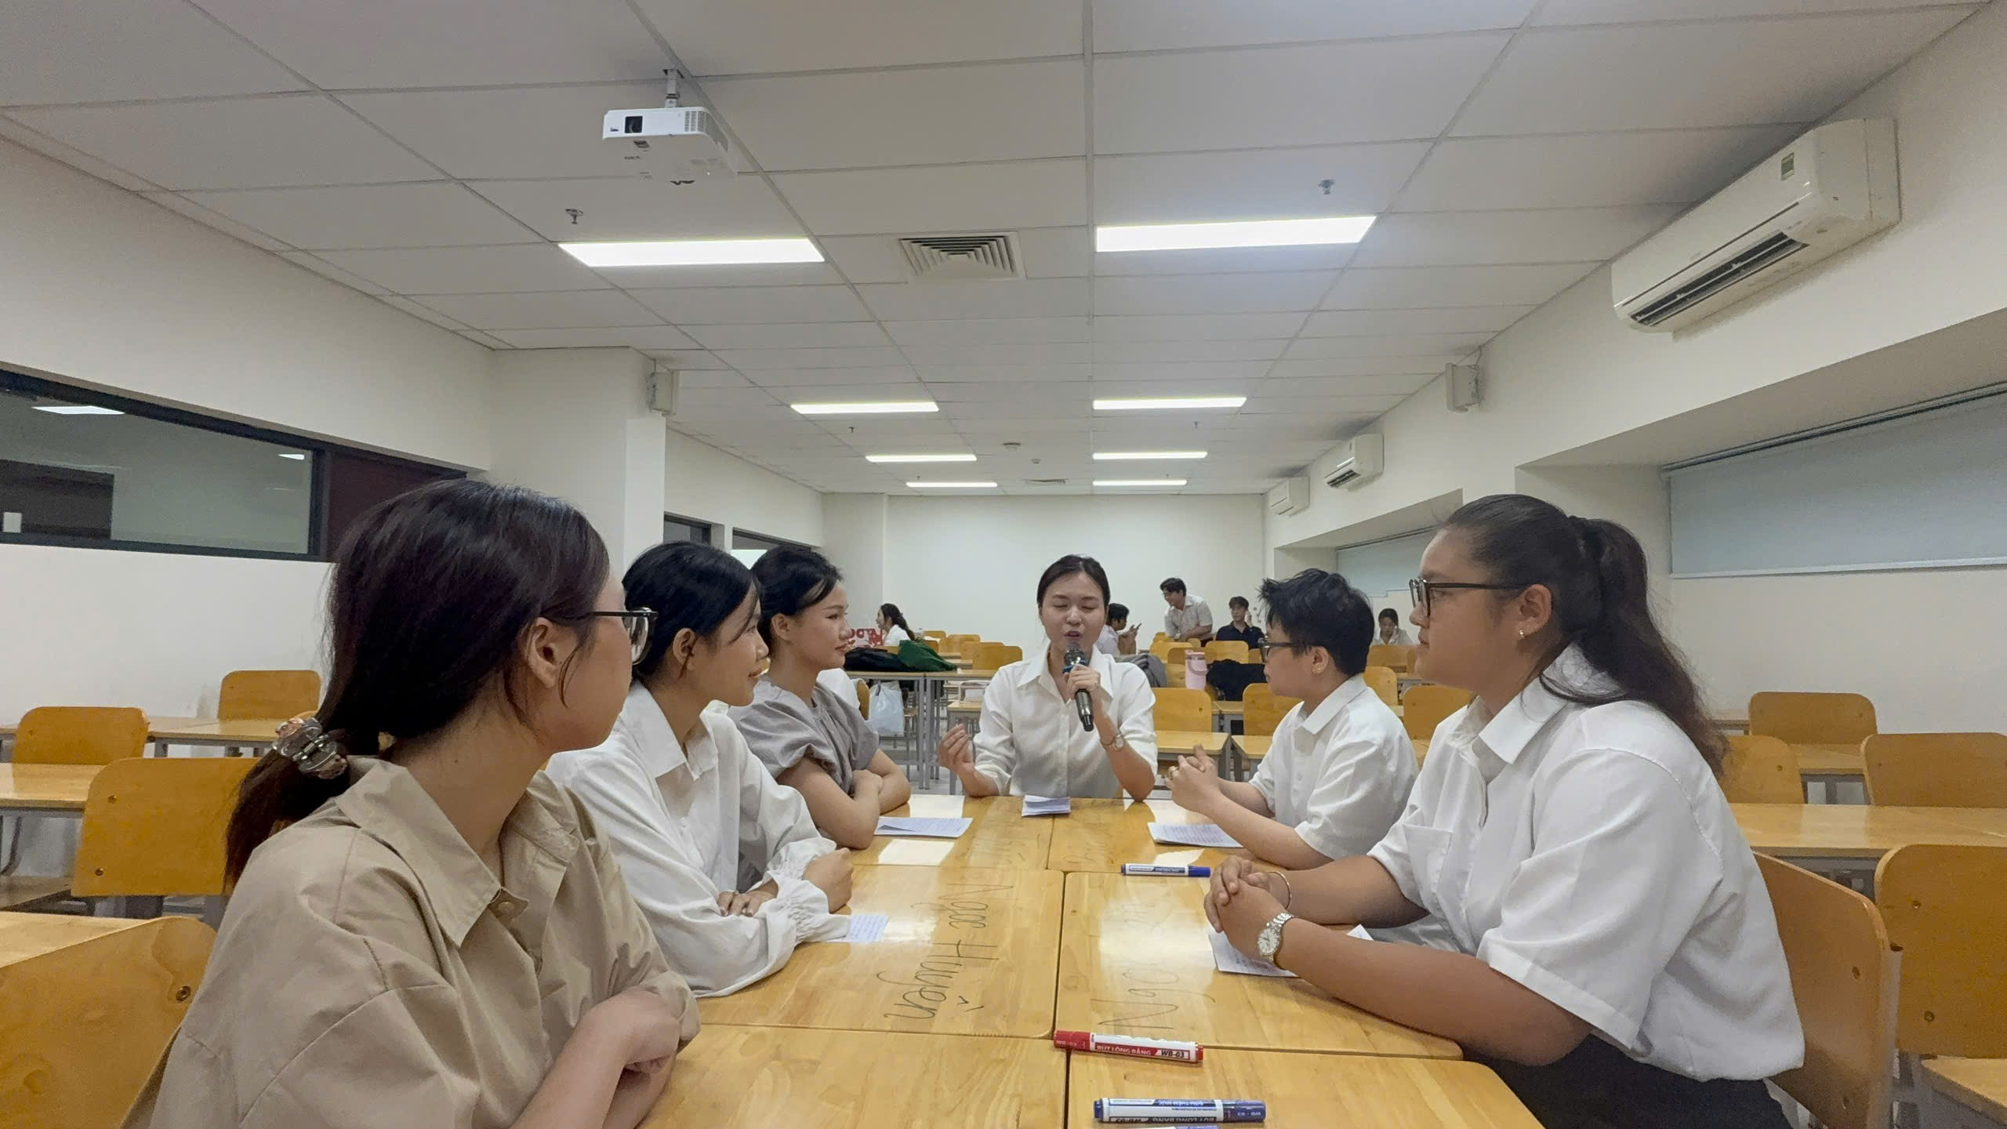
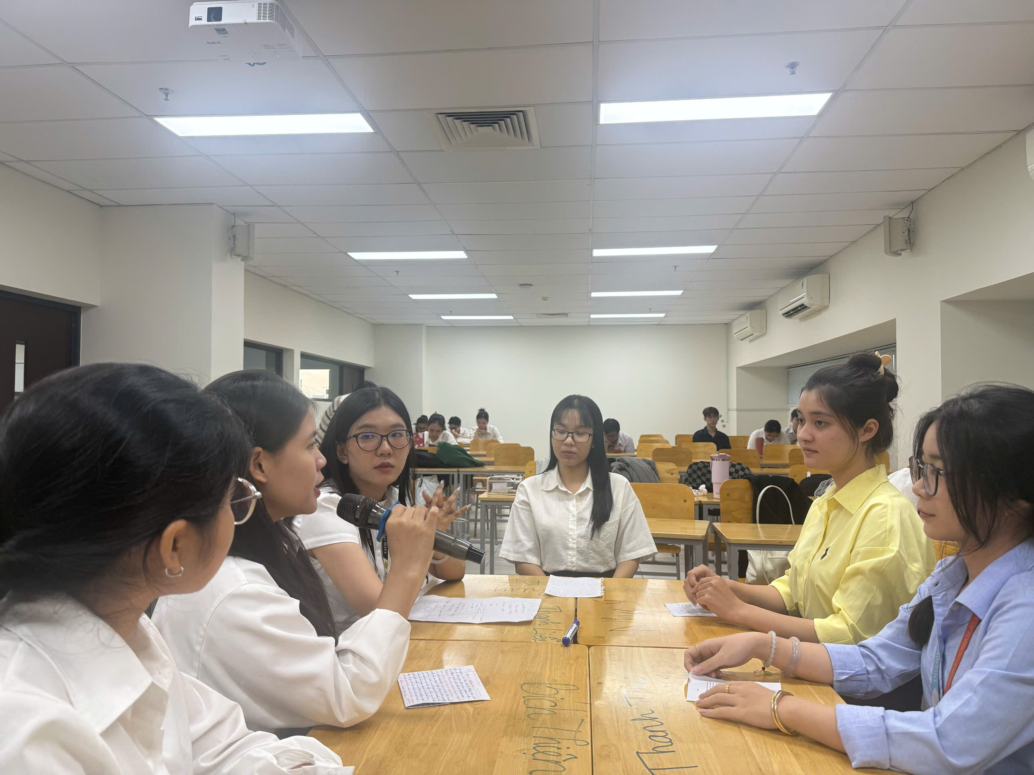
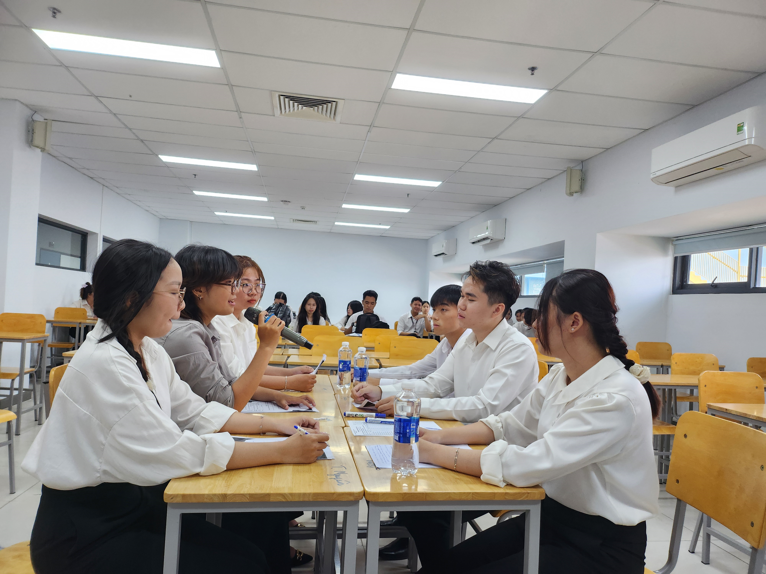

Customer Service: role-play

Slide 21
Application of AI in Teaching and Learning Business English at HUFLIT: strengths, weaknesses, and solutions
THANK YOU FOR YOUR LISTENING!
QUESTIONS & ANSWERS
Ms. Nguyen Thi Bach Yen
Faculty of Foreign Languages, HUFLIT
Customer Service – Business English
Mixed-Methods Study with 420 students

