Slide 1

Examining The Factors Affecting The Employment of ChatGPT in Translation Among English Majors at HUFLIT as Vietnamese Education Transitions From EFL To ESL Orientation
Presenter: Lê Thị Thu Hường
Faculty of Foreign Languages
HUFLIT

Slide 2
TABLE OF CONTENTS
1
INTRODUCTION
2
LITERATURE REVIEW
3
METHODOLOGY
4
FINDINGS & DISCUSSION
5
CONCLUSION
6
REFERENCES

Slide 3

I.
INTRODUCTION

Slide 4

I. Introduction
1.1. Background of the study:
AI -> transform conventional teaching and learning methods
  Teachers: facilitate their teaching process and increase their teaching efficiency (Ghimire et al., 2024)
  Learners: maximize their learning capacity, undertake self-study, or implement research on linguistic issues (Ghimire et al., 2024).

Slide 5
I. Introduction
1.1. Background of the study:
AI tool use in translation: ↑
ChatGPT = a linguistic storehouse & ↑ precision & speed of translation process (Ren, 2025).
Vietnam’s policy shift: EFL – ESL orientation by 2035 (Kiet, 2025)

Slide 6

1.2. Research Gap:
Most studies ⇒ indirect effects of Perceived Usefulness, Perceived Ease Of Use, Motivation, and Social Influence on ChatGPT adoption in translation through a mediator (behavioral intention)
⇒ Direct impact of these factors on the actual employment of ChatGPT in translation in higher education settings: under-researched.

Slide 7

1.3. Research Objectives & Questions
Research objectives:
Investigate the determinants behind English majors’ actual employment of ChatGPT in assisting them in translation courses in a Vietnamese tertiary education institution, specifically in the ESL-transitioned context.

Slide 8
1.3. Research Objectives & Questions
B. Research questions:
  What are the factors influencing English-majored students at HUFLIT to adopt ChatGPT in their translation courses?
  What skills can be explicitly taught to English-majored students as ChatGPT is formally integrated into translation courses?
  What kinds of pedagogical instructions or strategies could be incorporated into translation teaching when ChatGPT becomes a formal tool for teaching and learning English?

Slide 9
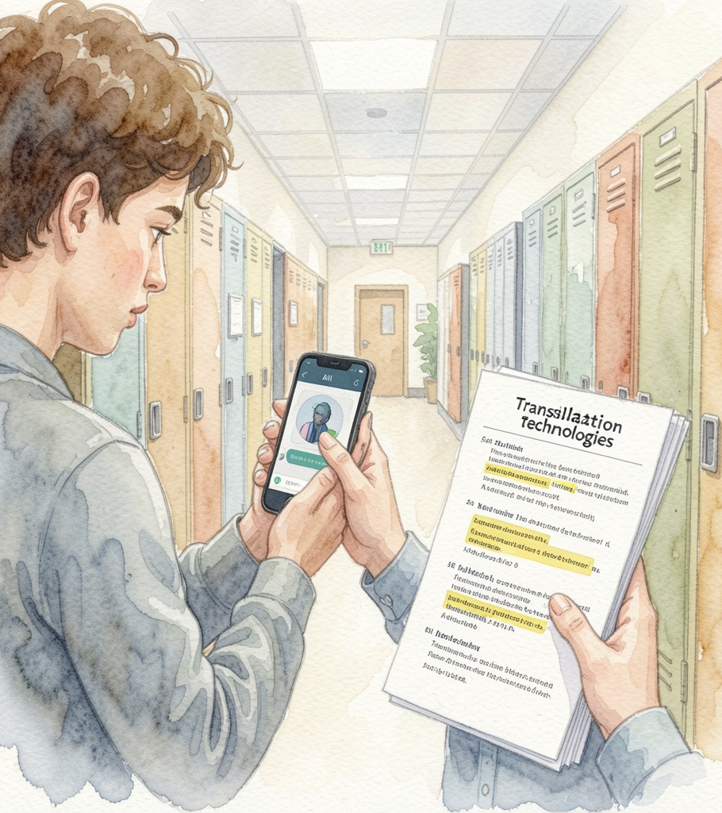
II.
LITERATURE REVIEW

Slide 10

2.1. The use of AI in language education:
2.1.1. The benefits of using AI in language education:
customization
content adaptation
provision of detailed analysis of feedback
Source: Gutiérrez, 2023; Pokrivcakova, 2019; Semerikov et al., 2021; Tafazoli, 2024; Zhu & Wang, 2025

Slide 11
2.1. The use of AI in language education:
2.1.1. The benefits of using AI in language education:
production of human-like conversations and texts
offering language practice opportunities
engagement enhancement
↑ in learner autonomy
Source: Abdallah et al., 2025; Ali et al., 2023; Aljabr & Al-Ahdal, 2024; Ferreiro-Santamaria (2024); Gutiérrez, 2023.

Slide 12

2.1. The use of AI in language education:
2.1.2. The drawbacks of using AI in language education:
inaccurate information
biases & excessive reliance
hindrance to Ts’ specialized knowledge development
↓ in Ss’ critical thinking & social skills
↑ in academic integrity violation
Source: Abdallah et al., 2025; Ferreiro-Santamaria, 2024; Gutiérrez, 2023; Li et al., 2024; Vinola et al., 2025

Slide 13
2.2. The adoption of ChatGPT in translation:
2.2.1. Translation:
Ismail & Syahruzah (2017)
Source language
(Meaning of written texts)
Target language
⇒ A change in forms, meaning & style (Fitria, 2018)
“accuracy, clarity, naturalness” (Akil, 2011, p. 2)

Slide 14
2.2. The adoption of ChatGPT in translation:
2.2.2. The advantages of adopting ChatGPT in translation:
Generating translations of high degrees of accuracy, pertinence, authenticity, speed with no cost (Roza & Zulhirawati, 2023; Vinola et al., 2025).
Time efficiency in proofreading (Vinola et al., 2025).
Provision of texts appropriate in terms of styles based on the given prompts (Vinola et al., 2025).
Brilliant capabilities of structural conformity (Badah et al., 2026).

Slide 15
2.2. The adoption of ChatGPT in translation:
2.2.3. The disadvantages of adopting ChatGPT in translation:
Ability to translate idioms, cultural subtleties (Manapbayeva et al., 2024; Mohsan & Durr-e-Nayab, 2024; Rousan et al., 2025)
Retention of style, emotional & cultural integrity of the source language (Manapbayeva et al., 2024)
Ability to translate figurative texts (Manapbayeva et al., 2024)
Inaccurate translation of euphemisms
(Albalawi & Abdul-Ghafour (2026) )
Overdependency & reduced translation skills (Vinola et al., 2025)

Slide 16

2.3. Theoretical Frameworks (TAM, UTAUT, SDT)
1. Technology Acceptance Model (TAM) Theory
2. Self-Determination Theory (SDT)
3. Unified Theory of Acceptance and Use of Technology (UTAUT)

Slide 17
2.3. Theoretical Frameworks (TAM, UTAUT, SDT)
2.3.1. Technology Acceptance Model (TAM) Theory
Perceived Usefulness (PU)
Attitude towards technological use
Behavioral intention of its employment
Actual Use
(AU)
Perceived Ease Of Use (PEOU)
Fred Davis (1989)

Slide 18
2.3. Theoretical Frameworks (TAM, UTAUT, SDT)
2.3.1. Technology Acceptance Model (TAM) Theory
Perceived Usefulness (PU)
Behavioral intention of its employment
Actual Use
(AU)
Perceived Ease Of Use (PEOU)
Fred Davis (1989)

Slide 19
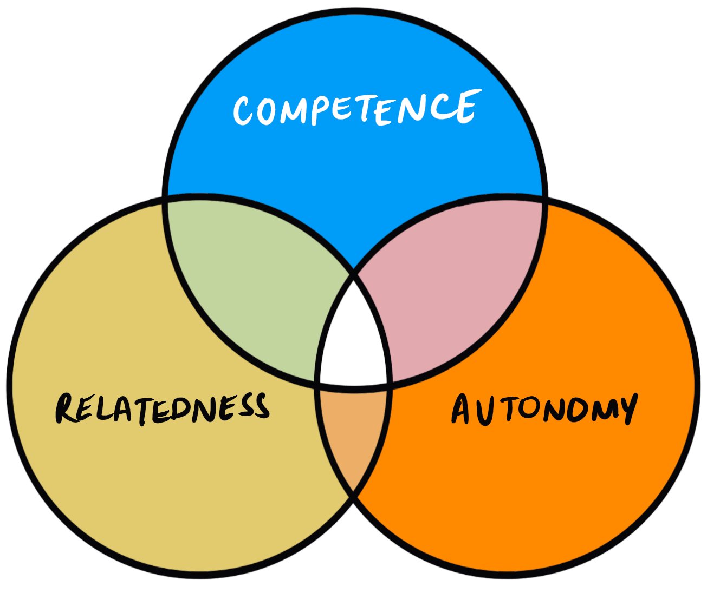
2.3. Theoretical Frameworks (TAM, UTAUT, SDT)
2.3.2. Self-Determination Theory (SDT)
Proposed by Deci and Ryan (1985)
Examining the relationship between people’s motivation and their character traits (L.M. Jeno et al., 2017).

Slide 20

2.3. Theoretical Frameworks (TAM, UTAUT, SDT)
2.3.2. Self-Determination Theory (SDT)
Internal sense of delight & pleasure
INTRINSIC MOTIVATION
EXTRINSIC MOTIVATION
Behaviors to gain specific outcomes

Slide 21
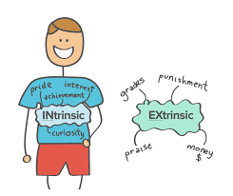
2.3. Theoretical Frameworks (TAM, UTAUT, SDT)
2.3.2. Self-Determination Theory (SDT)

Slide 22
2.3. Theoretical Frameworks (TAM, UTAUT, SDT)
2.3.3. Unified Theory of Acceptance and Use of Technology (UTAUT)
formulated by Venkatesh et al. (2003)
explains 4 principal constructs behind individuals’ acceptance & employment of a particular technology
Performance Expectancy
Individuals’ acceptance & employment of technology
Effort Expectancy
Social Influence
Facilitating Conditions

Slide 23

Key Constructs
Perceived Usefulness (PU)
Perceived Ease Of Use (PEOU)
Intrinsic Motivation (IM)
Extrinsic Motivation (EM)
Social Influence (SI)
⇒ Direct predictors of actual use

Slide 24
2.4. Hypotheses
H1: Perceived Usefulness (PU) positively impacts English majors’ actual use of ChatGPT (AU) in translation.
H2: Perceived Ease Of Use (PEOU) positively impacts English majors’ actual use of ChatGPT (AU) in translation.
H3: Intrinsic motivation (IM) positively impacts English majors’ actual use of ChatGPT (AU) in translation.

Slide 25
2.4. Hypotheses
H4: Extrinsic motivation (EM) positively impacts English majors’ actual use of ChatGPT (AU) in translation.
H5: Social influence (SI) positively impacts English majors’ actual use of ChatGPT (AU) in translation.

Slide 26
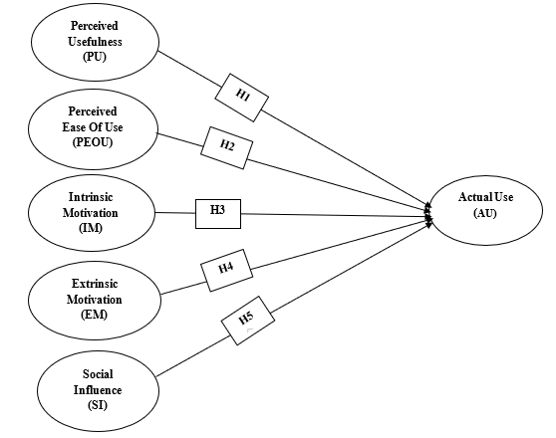
2.5. Conceptual Framework
Figure 1
Proposed research model
(Source: Researcher’s proposal)

Slide 27

III.
METHODOLOGY

Slide 28

3.1. Participants
138 sophomores and juniors
Various majors
Taking a compulsory course in Translation 1
Majors | Number | Percentage
Translation – Interpretation | 15 | 10.9%
Business English | 44 | 31.8%
English Pedagogy | 59 | 42.8%
English for Office Administration | 3 | 2.2%
English for Logistics | 4 | 2.9%
English - Chinese Bilingualism | 13 | 9.4%
Table 1
Participants’ demographic information

Slide 29

3.2. Instruments
Questionnaire:
19 items
five-point Likert scale
divided into diverse themes
Structured interviews: 8 students & 4 lecturers
2 questions for students
4 questions for lecturers
.

Slide 30

3.3. Procedures
Questionnaire:
drafted on Google Forms
distributed online via Zalo groups
Interviews:
conducted online
lasted ∼ 15-20 mins

Slide 31

3.4. Data analysis
Questionnaire:
transferred to csv file
coded & cleaned (data)
analyzed 131 valid responses using SMART-PLS 3.0 software program
Interviews:
transcribed
analyzed using thematic analysis

Slide 32

IV.
RESULTS & DISCUSSION

Slide 33
AVE > 0.5 ⇒ each construct achieves good convergent validity
4.1. Survey Results
4.1.1. Measurement model validation:
Scale Reliability & Validity Testing:
 | Cronbach's Alpha | rho_A | Composite Reliability | Average Variance Extracted (AVE)
AU | 0.818 | 0.818 | 0.916 | 0.846
EM | 0.796 | 0.809 | 0.880 | 0.711
IM | 0.830 | 0.840 | 0.887 | 0.664
PEOU | 0.798 | 0.803 | 0.868 | 0.623
PU | 0.853 | 0.875 | 0.900 | 0.692
SI | 0.773 | 0.780 | 0.867 | 0.685
Table 2
Summary of coefficients in the PLS-SEM model
CR > 0.8 ⇒ good internal consistency
CA > 0.7 ⇒ achieve reliability

Slide 34
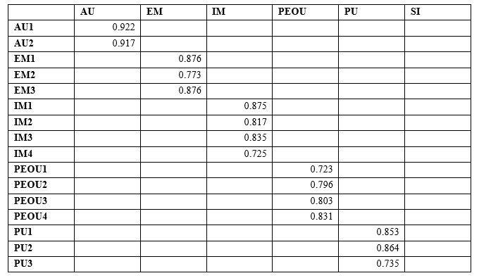
4.1. Survey Results
4.1.1. Measurement model validation:
Scale Reliability & Validity Testing:
Table 3
Outer loadings

Slide 35
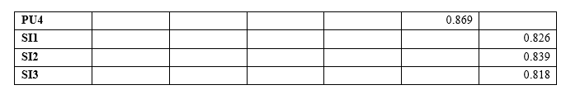
4.1. Survey Results
4.1.1. Measurement model validation:
Scale Reliability & Validity Testing:
Table 3
Outer loadings
Outler loading > 0.7 ⇒ indicators achieve reliability

Slide 36
4.1. Survey Results
4.1.1. Measurement model validation:
Scale Reliability & Validity Testing:
 | AU | EM | IM | PEOU | PU | SI
AU | 0.920
EM | 0.663 | 0.843
IM | 0.706 | 0.689 | 0.815
PEOU | 0.436 | 0.574 | 0.586 | 0.789
PU | 0.551 | 0.555 | 0.615 | 0.531 | 0.832
SI | 0.614 | 0.594 | 0.661 | 0.518 | 0.442 | 0.828
Table 4
Discriminant validity (HTMT) according to the Fornell-Larcker Criterion
Square root of AVE (bold & diagonal) > correlations that are not diagonal ⇒ achieve discriminant validity

Slide 37
4.1. Survey Results
4.1.1. Measurement model validation:
Scale Reliability & Validity Testing:
 | AU | EM | IM | PEOU | PU | SI
AU
EM | 0.817
IM | 0.853 | 0.845
PEOU | 0.533 | 0.711 | 0.720
PU | 0.643 | 0.670 | 0.716 | 0.623
SI | 0.759 | 0.732 | 0.802 | 0.645 | 0.518
Table 5
Discriminant validity (HTMT) according to the Heterotrait-Monotrait Ratio
HTMT indices for most factors < 0.85
meet distinction standard
IM = 0.853 < 0.9 ⇒ acceptable

Slide 38
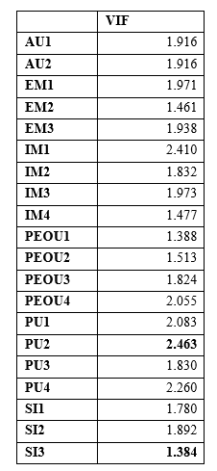
4.1. Survey Results
4.1.2. Structural model assessment:
Multicollinearity Test:
0.2 < VIF < 5 (Hair et al., 2017)
No multicollinearity issues
Table 6
Variance Inflation Factor (VIF)

Slide 39
4.1. Survey Results
4.1.2. Structural model assessment:
R and R2 Validation:
Moderate explanatory power
 | R Square | R Square Adjusted
AU | 0.594 | 0.577
Table 7
R and R2 Validation
 | AU | EM | IM | PEOU | PU | SI
AU
EM | 0.088
IM | 0.111
PEOU | 0.019
PU | 0.030
SI | 0.056
IM (0.111) ⇒ a medium effect
PEOU (0.019) ⇒ a practically negligible impact (index < 0.02)
Table 8
f² Validation

Slide 40
4.1. Survey Results
4.1.2. Structural model assessment:
Model Fit Validation:
 | Saturated Model | Estimated Model
SRMR | 0.083 | 0.083
d_ULS | 1.438 | 1.438
d_G | 0.638 | 0.638
Chi-Square | 492.021 | 492.021
NFI | 0.701 | 0.701
SRMR = 0.083 ⇒ 0.08 but < 0.1
⇒ an acceptable level of model fit.
Table 9
Model Fit Validation

Slide 41
4.1. Survey Results
4.1.2. Structural model assessment:
Q² Coefficient:
The model has a medium level of forecast accuracy
 | SSO | SSE | Q² (=1-SSE/SSO)
AU | 262.000 | 137.631 | 0.475
EM | 393.000 | 393.000
IM | 524.000 | 524.000
PEOU | 524.000 | 524.000
PU | 524.000 | 524.000
SI | 393.000 | 393.000
Table 10
Q² Coefficient

Slide 42
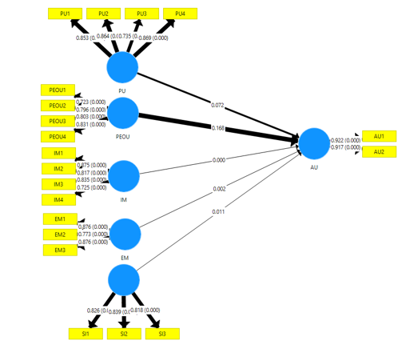
4.1. Survey Results
4.1.3. Research Model Testing & Hypothesis Validation:
Figure 2
Estimated model results using SMART PLS-SEM

Slide 43
4.1.Survey Results
4.1.3. Research Model Testing & Hypothesis Validation:
Hypotheses | Relationships | P Values | Results
H1 | PU -> AU | 0.080 | Rejected
H2 | PEOU -> AU | 0.192 | Rejected
H3 | IM -> AU | 0.000 | Accepted
H4 | EM -> AU | 0.002 | Accepted
H5 | SI -> AU | 0.007 | Accepted
Table 11
Results of hypotheses testing
P value < 0.05 ⇒ hypotheses accepted
P value >= 0.05 ⇒ hypotheses refuted

Slide 44

4.2. Interview Results
4.2.1. INTERVIEWS WITH STUDENTS
Theme 1: The consolidation of linguistic knowledge and skills in translation courses
Theme 2: The necessity of equipping students with higher-order thinking skills
Theme 3: The significance of post-editing competencies in translation courses in ESL-oriented context

Slide 45
4.2. Interview Results
4.2.1. INTERVIEWS WITH STUDENTS
Theme 1: The consolidation of linguistic knowledge and skills in translation courses
Evaluate precision & suitability of grammar & vocabulary use
Assess meaning accuracy in target language
“I think students need critical thinking and language knowledge. They should not rely on ChatGPT completely. Instead, they need to check whether the translation is correct and suitable for the context. For example, ChatGPT might translate a word correctly, but the meaning may not fit the situation, so students need to change it.”

Slide 46
4.2. Interview Results
4.2.1. INTERVIEWS WITH STUDENTS
Theme 2: The necessity of equipping students with higher-order thinking skills (HOTS)
Training HOTS: critical thinking, evaluation, reasoning, comparison, researching, and independent thinking skills
Identify areas of improvement
Make better-informed decisions in translation
“In addition, they should have critical thinking skills and the ability to search for and compare information from different sources in order to produce the best possible translation. For example, when translating the word “hoa đào,” ChatGPT may translate it as “peach blossom.” However, in some contexts such as Japanese culture, the correct translation should be “cherry blossom” (sakura). Therefore, students need to check the cultural context and compare different sources before deciding which translation is the most appropriate.”

Slide 47
4.2. Interview Results
4.2.1. INTERVIEWS WITH STUDENTS
Theme 3: The significance of post-editing competencies in translation courses in ESL-oriented context
“change”
“adjust”
“check”
“edit”
“refine”
“spot errors”
Post-editing competency
prompt engineering

Slide 48
4.2. Interview Results
4.2.2. INTERVIEWS WITH LECTURERS
Theme 1: Making transformations or adaptations to translation teaching.
Mindset change & Role switching
Acceptance of ChatGPT
Guidance on appropriate use of ChatGPT
“My point of view is that in the current AI boom, instructors cannot and should not prohibit students from using ChatGPT to support their learning. Instead of prohibiting them, instructors should allow them, especially those studying Translation, to use apps they find necessary and effective for their learning.”

Slide 49
4.2. Interview Results
4.2.2. INTERVIEWS WITH LECTURERS
Theme 1: Making transformations or adaptations to translation teaching.
Mindset change & Role switching
Knowledge providers ⇒ Facilitators
“Instead of focusing only on traditional translation methods, I now integrate AI into classroom activities. For example, I ask students to compare their own translations with ChatGPT’s output, then analyze differences in accuracy, tone, and cultural appropriateness. This has shifted my role from being the sole provider of answers to more of a facilitator who guides students in critical evaluation.”

Slide 50
4.2. Interview Results
4.2.2. INTERVIEWS WITH LECTURERS
Theme 1: Making transformations or adaptations to translation teaching.
Mindset change & Role switching
Providing lexical items, structures, collocations
Linguistic scaffolders & monitors
Monitoring Ss’ understanding & engagement

Slide 51
4.2. Interview Results
4.2.2. INTERVIEWS WITH LECTURERS
Theme 1: Making transformations or adaptations to translation teaching.
Mindset change & Role switching
Prioritize problem-solving & reflection exercises
Make adaptations to translation teaching
Make use of blended teaching approach

Slide 52
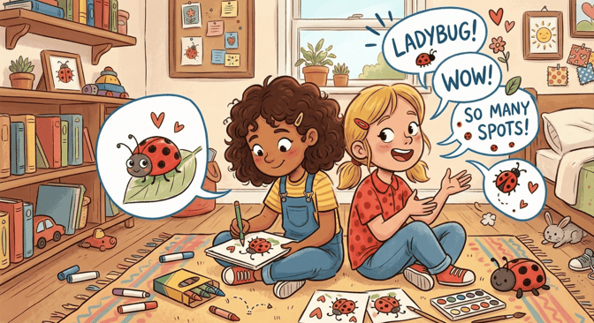
4.2. Interview Results
4.2.2. INTERVIEWS WITH LECTURERS
Designing more translation activities ⇒ ↑ interactivity, focus on meaning & context, & fostering students’ critical translation & comprehension skills
Games ⇒ ↑ Memorization of new vocab & grammar & ↑ interaction

Slide 53

4.2. Interview Results
4.2.2. INTERVIEWS WITH LECTURERS
Designing more translation activities ⇒ ↑ interactivity, focus on meaning & context, & fostering students’ critical translation & comprehension skills
comparison, error analysis, reflection journals, and collaborative or group-based projects.
“One useful activity is comparison tasks, where students translate a text themselves and then compare it with ChatGPT’s version, discussing differences in accuracy, tone, and cultural meaning. Another strategy is error analysis, where students identify mistakes in AI translations, such as idioms or technical terms, and propose better alternatives. Teachers can also design collaborative projects, asking groups to refine ChatGPT’s draft into a polished translation, which encourages teamwork and critical thinking. Additionally, reflection journals can be used, where students record how they used AI, what they learned, and how they improved the translation. These activities help students see AI as a supportive tool, while still developing their own judgment and translation skills.”

Slide 54
4.2. Interview Results
4.2.2. INTERVIEWS WITH LECTURERS
Designing more translation activities ⇒ ↑ interactivity, focus on meaning & context, & fostering students’ critical translation & comprehension skills
“… Lessons should not only focus on structures but the core meaning of sentences, and they should have a more focus on style of translation, which I think can differentiate human and machine’s use of language and structures.”
more activities devoted to sentence meaning and register rather than grammatical structure

Slide 55

4.2. Interview Results
4.2.2. INTERVIEWS WITH LECTURERS
Designing more translation activities ⇒ ↑ interactivity, focus on meaning & context, & fostering students’ critical translation & comprehension skills
more activities devoted to linguistic knowledge building, comprehension, & translation skills

Slide 56
4.2. Interview Results
4.2.2. INTERVIEWS WITH LECTURERS
Theme 2: Skills that students of translation courses should be equipped with.
Foundational skills: lower-order thinking & translation skills
Higher-order thinking skills
Enhanced awareness of contextual and cultural nuances

Slide 57
4.2. Interview Results
4.2.2. INTERVIEWS WITH LECTURERS
Theme 2: Skills that students of translation courses should be equipped with.
Post-editing competence
Crafting prompts

Slide 58
4.2. Interview Results
4.2.2. INTERVIEWS WITH LECTURERS
Theme 3: The types of pedagogical instructions or strategies that could be incorporated into translation teaching when ChatGPT becomes a formal tool for teaching and learning English.
Acceptance of ChatGPT as a supportive tool
Pedagogical instructions on ChatGPT adoption
Restrictions on ChatGPT use in tests & assessment
Instructions on more effective prompt writing

Slide 59
4.2. Interview Results
4.2.2. INTERVIEWS WITH LECTURERS
Theme 3: The types of pedagogical instructions or strategies that could be incorporated into translation teaching when ChatGPT becomes a formal tool for teaching and learning English.
Responsible use of ChatGPT
Instructions on ethical use of ChatGPT
Aware of biases & other sensitive issues
“In the middle of the course, I train my students how to use AI tools effectively and discuss with them about ethical issues. Specially, they need to evaluate the AI translation and be responsible for their final translation version.”

Slide 60
4.2. Interview Results
4.2.2. INTERVIEWS WITH LECTURERS
Theme 3: The types of pedagogical instructions or strategies that could be incorporated into translation teaching when ChatGPT becomes a formal tool for teaching and learning English.
Active & critical engagement in translation tasks
Instructions on development of learner autonomy
Involvement in decision-making process
Utilizing translation skills & methods ⇒ produce multiple translations

Slide 61
DISCUSSION
RQ1: What are the factors influencing English-majored students at HUFLIT to adopt ChatGPT in their translation courses?
Greatest contributory factors to HUFLIT Ss’ adoption of ChatGPT
Intrinsic Motivation (IM)
Extrinsic Motivation (EM)
Social Influence (SI)
In consistent with findings of Ren (2025)

Slide 62
DISCUSSION
RQ1: What are the factors influencing English-majored students at HUFLIT to adopt ChatGPT in their translation courses?
Other factors contributing to HUFLIT Ss’ adoption of ChatGPT
Perceived Usefulness (PU): little impact on Actual Use (AU)
Perceived Ease Of Use (PEOU): no significant impact on Actual Use (AU)

Slide 63
DISCUSSION
RQ2: What skills can be explicitly taught to English-majored students as ChatGPT is formally integrated into translation courses?
Linguistic competency
Higher-order thinking skills
Post-editing competence
Lower-order thinking skills
Translation skills
Both students & lecturers
Matches translation competence model & metacognitive theory
Lecturers

Slide 64
DISCUSSION
RQ3: What kinds of pedagogical instructions or strategies could be incorporated into translation teaching when ChatGPT becomes a formal tool for teaching and learning English?
Guidance on appropriate & effective use of ChatGPT
Promotion of learner autonomy & accountability of ChatGPT adoption
Mindset change & role shifting
Lesson adaptations
Incorporation of more interactivity-boosting activities

Slide 65

IMPLICATIONS
Educators
Scaffolders/ facilitators
Group-based projects
Student-centered/ peer-supported activities
Lesson design nurturing students’ fundamental linguistic knowledge, translation skills, higher-order thinking skills, and post-editing competence

Slide 66
IMPLICATIONS
Curriculum design
Enhancing motivational factors among students
Integrating separate modules on higher-order thinking skills and post-editing competency

Slide 67

Topic: The factors influencing English-majors’ employment of ChatGPT in translation
Findings:
PU, PEOU, IM, EM, SI ⇒ varying effects on ChatGPT adoption in translation courses.
Suggestions for lecturers in guidance on ChatGPT use, role switching, & lesson design.

Slide 68
REFERENCES
Abdallah, N., Katmah, R., Khalaf, K., & Jelinek, H. F. (2025). Systematic review of ChatGPT in higher education: Navigating impact on learning, wellbeing, and collaboration. Social Sciences & Humanities Open, 101866, 1-14. https://doi.org/10.1016/j.ssaho.2025.101866
Akil, M. (2011). The Quality Of Indonesian - English Translation By English Department Students Of Higher Learning Institutions In Makassar. Linguistika: Buletin Ilmiah Program Magister Linguistik Universitas Udayana, 18(1), 1-14.
Albalawi, A. F., & Abdul-Ghafour, A.-Q. K. (2026). An investigation into human vs AI English translations of Qur’anic euphemisms. Social Sciences & Humanities Open, 13(102249), 1-10. https://doi.org/10.1016/j.ssaho.2025.102249
Alghamdy, R. Z. (2024). English Teachers’ Practice of Classroom Discourse in Light of Zone of Proximal Development Theory and Scaffolding Techniques. Journal of Language Teaching and Research, 15(1), 46-54. https://doi.org/10.17507/jltr.1501.06
Ali, J. K., Shamsan, M. A., & Hezam, T. A. (2023). Impact of ChatGPT on Learning Motivation: Teachers and Students' Voices. Journal of English Studies in Arabia Felix, 2(1), 41-49. doi: 10.56540/jesaf.v2i1.51
Aljabr, F. S., & Al-Ahdal, A. A. (2024). Ethical and pedagogical implications of AI in language education: An empirical study at Ha'il University. Acta Psychologica, 251(104605), 1-8. https://doi.org/10.1016/j.actpsy.2024.104605

Slide 69
REFERENCES
Al-kfairy, M. (2024). Factors Impacting the Adoption and Acceptance of ChatGPT in Educational Settings: A Narrative Review of Empirical Studies. Applied System Innovation, 7(110). https://doi.org/10.3390/asi7060110
Almansour, N. (2024). Investigating Factors Influencing EFL Learners’ Behavioral Intentions to Adopt ChatGPT for Language Learning. Journal of Language Teaching and Research, 15(6), 1910-1918. https://doi.org/10.17507/jltr.1506.16
Almogren, A. S., Al-Rahmi, W. M., & Dahri, N. A. (2024). Exploring factors influencing the acceptance of ChatGPT in higher education: A smart education perspective. Heliyon, 10(11), 1-19. https://doi.org/10.1016/j.heliyon.2024.e31887
Alotaibi, H. M., Sonbul, S. S., & El-Dakhs, D. A. (2025). Factors influencing the acceptance and use of ChatGPT among English as a foreign language learners in Saudi Arabia. Humanities & Social Sciences Communications, 12(628), 1-13. https://doi.org/10.1057/s41599-025-04945-2
Amin, M. Y. (2023). AI and Chat GPT in Language Teaching: Enhancing EFL Classroom Support and Transforming Assessment Techniques. International Journal of Higher Education, 4(4), 1-15. https://doi.org/10.33422/ijhep.v4i4.554
Annamalai, N., Eltahir, M. E., Zyoud, S. H., Soundrarajan, D., Zakarneh, B., & Salhi, N. R. (2023). Exploring English language learning via Chabot: A case study from a self determination theory perspective. Computers and Education: Artificial Intelligence, 1-8. https://doi.org/10.1016/j.caeai.2023.100148

Slide 70
REFERENCES
Badah, A. M., Khalaf, C. N., & Dwaikat, F. J. (2026). The usage of artificial intelligence in legal translation: Bridging the gap between law and language. Ampersand: An Interdisciplinary Journal of Applied Linguistics, 16, 1-10. https://doi.org/10.1016/j.amper.2025.100248
Daskalakis, S., & Mantas, J. (2008). Evaluating the impact of a service-oriented framework for healthcare interoperability. Studies in Health Technology and Informatics, 136, 285.
Deci, E. L., & Ryan, R. M. (1985). Intrinsic motivation and self-determination in human behavior, New York: Plenum.
Diep, C. M., & Dang, H. M. (2025). Exploring Factors Influencing the Adoption of ChatGPT as a Supportive Tool in EFL Lesson Creation. AsiaCALL Online Journal, 16(1), 111–139. https://doi.org/10.54855/acoj.251616
Dong, L., Liu, M., & Yang, F. (2022). The Relationship Between Foreign Language Classroom Anxiety, Enjoyment, and Expectancy-Value Motivation and Their Predictive Effects on Chinese High School Students’ Self-Rated Foreign Language Proficiency. Frontiers in Psychology, 13, 1-13. doi: 10.3389/fpsyg.2022.860603
Fatoni, A. U., & Surani, D. (2022). UTAUT: An Analysis of Online Learning Media in English Class During Covid-19 Pandemic. In Proceedings of the 4th Social and Humanities Research Symposium (SoRes 2021. doi:10.2991/assehr.k.220407.122

Slide 71
REFERENCES
Ferreiro-Santamaria, G. (2024). Exploring the Role of ChatGPT in English Teaching Within Higher Education Settings. International Journal of Trends and Developments in Education, 4(1), 44-58. doi:10.5281/zenodo.11204781
Fitria, T. N. (2018). Translation Techniques Found In English To Indonesian Abstract Translation Of Journal Edunomika 2018. ELITE Journal, 5(2), 145-160.
G. C., S. B., Bhandari, P., Gurung, S. K., Srivastava, E., Ojha, D., & Dhungana, B. R. (2024). Examining the role of social influence, learning value and habit on students’ intention to use ChatGPT: the moderating effect of information accuracy in the UTAUT2 model. Cogent Education, 11(1), 1-24. https://doi.org/10.1080/2331186X.2024.2403287
Ghimire, P. R., Neupane, D. B., & Dahal, N. (2024). Generative AI and AI Tools in English Language Teaching and Learning: An. English Language Teaching PERSPECTIVES, IX(1-2), 30-40.
Gutiérrez, L. M. (2023). Artificial Intelligence in Language Education: Navigating the Potential and Challenges of Chatbots and NLP. Research Studies in English Language Teaching and Learning (RSELTL), 1(3), 180- 191. https://doi.org/10.62583/rseltl.v1i3.44
Hadalgekar, M. S., & Desai, D. N. (2025). Role of Perceived Ease of Use and Perceived Usefulness in Adoption of Mobile Computing Technology. International Journal of Social Science and Human Research, 8(6), 4458-4462. doi: 10.47191/ijsshr/v8-i6-58

Slide 72
REFERENCES
Hair, J. F., Hult, G. T. M., Ringle, C. M. & Sarstedt, M. (2017). A primer on partial least squares structural equation modeling (2nd Ed.). Thousand Oaks, CA: Sage
Hair, J.F., Hult, G.T.M., Ringle, C.M. & Sarstedt, M. (2016). A primer on partial least squares structural equation modeling (PLS-SEM). Thousand Oaks, CA: Sage.
Harryanto., Muchran, M., & Ahmar, A. S. (2018). Application of TAM model to the use of information technology. arXiv. https://api.semanticscholar.org/CorpusID:59523621
Henseler, J., Ringle, C. M., & Sarstedt, M. (2012). Using partial least squares path modeling in international advertising research: Basic concepts and recent issues. In S. Okazaki (Ed.), Handbook of research in international advertising (pp. 252–276). Edward Elgar Publishing.
Henseler, J., & Sarstedt, M. (2013). Goodness-of-fit indices for partial least squares path modeling. Computational statistics, 28(2), 565-580. doi: 10.1007/s00180-012-0317-1
Höck, M., & Ringle, C. M. (2010). Local strategic networks in the software industry: an empirical analysis of the value continuum. International Journal of Knowledge Management Studies, 4(2), 132-151.
Hu, L.-t., & Bentler, P. M. (1998). Fit indices in covariance structure modeling: Sensitivity to underparameterized model misspecification, Psychological Methods, 3(4), 424-453. https://doi.org/10.1037/1082-989X.3.4.424

Slide 73
REFERENCES
Ismail, H., & Syahruzah, J. K. (2017). Improving the Students’ Reading Skill through Translation Method. Journal of English Education (JEE), 2(2), 124-131. doi:10.31327/jee.v2i2.405
Jeno, L. M., Raaheim, A., Kristensen, S. M., & Daniel, K. (2017). The Relative Effect of Team-Based Learning on Motivation and Learning: A Self-Determination Theory Perspective. Life Sciences Education, 16(4), 1-12. doi:10.1187/cbe.17-03-0055
Jukiewicz, M., & Wyrwa, M. (2026). Can ChatGPT Replace the Teacher in Assessment? A Review of Research on the Use of Large Language Models in Grading and Providing Feedback. Appl. Sci., 16(680). https://doi.org/10.3390/app16020680
Kartini, M. M., Santosa, M. H., & Indrayani, L. (2025). Students’ Acceptance and Enjoyment of ChatGPT in English Language Learning. Journal of Educational Study (JoES), 5(2), 171-186. https://doi.org/10.36663/joes.v5i2.1100
Kiet, A. (2025, November 4). English to be Vietnam’s second language by 2035. Hanoi Times. https://hanoitimes.vn/english-to-be-vietnam-s-second-language-by-2035.893519.html
Lai, P. (2017). The Literature Review Of Technology Adoption Models And Theories For The Novelty Technology. Journal of Information Systems and Technology Management, 14(1), 21-38. doi: 10.4301/S1807-17752017000100002
Lee, M. S. (2015). Implementing the Sociocultural Theory While Teaching ESL. SPACE: Student Perspectives About Civic Engagement, 1(1), 28-35. Retrieved from https://digitalcommons.nl.edu/space/vol1/iss1/6

Slide 74
REFERENCES
Li, M., Enkhtur, A., Cheng, F., & Yamamoto, B. A. (2024). Ethical implications of ChatGPT in higher education: A scoping review. Journal of Interdisciplinary Studies in Education, 13(1), 55-69. doi: 10.32674/jise.v1
Li, X., Lin, B., Zhao, W., Jin, Q., Lin, T., & Li, Z. (2025). Research and Practice of ChatGPT-Assisted Instructional Design for University Teachers. International Journal of New Developments in Education, 7(3), 18-24. doi: 10.25236/IJNDE.2025.070304
Manapbayeva, Z., Zaurbekova, G., Ayazbekova, K., Kazezova, A., & Pirmanova, K. (2024). AI in Literary Translation: ChatGPT-4 vs. Professional Human Translation of Abai’s Poem ‘Spring’. Procedia Computer Science 251, 526–531. doi:10.1016/j.procs.2024.11.143
Mohsan, M., & Durr-e-Nayab, D. (2024). Estimating and Comparing Translation Skills: A Comparative Study of ChatGPT and Human Translation. Journal of Development and Social Sciences, 5(3), 75-86. https://doi.org/10.47205/jdss.2024(5-III)08
Moqbel, M. S., & Al-Kadi, A. M. (2023). Foreign Language Learning Assessment in the Age of ChatGPT: A Theoretical Account. Journal of English Studies in Arabia Felix, 2(1), 71–84. doi: 10.56540/jesaf.v2i1.62
Muntasir, M., & Akbar, I. (2023). Revisiting the Significance of ZDP and Scaffolding in English Language Teaching. Journal of English Language Teaching Linguistics and Literature, 3(1), 40-45. https://doi.org/10.47766/jetlee.v3i1.1276

Slide 75
REFERENCES
Nunnally, J. C., & Bernstein, I. H. (1994). Psychometric theory. (3rd ed.). McGraw-Hill.
Pokrivcakova, S. (2019). Preparing teachers for the application of AI-powered technologies in foreign language education. Journal of Language and Cultural Education, 7(3), 135-153. https://doi.org/10.2478/jolace-2019-0025
Posner, G. J., Strike, K. A., Hewson, P. W., & Gertzog, W. A. (1982). Accommodation of a scientific conception: towards a theory of conceptual change. Science Education, 66, 211-227. https://doi.org/10.1002/sce.3730660207
Qu, K., & Wu, X. (2024). ChatGPT as a CALL tool in language education: A study of hedonic motivation adoption models in English learning environments. Education and Information Technologies, 29, 19471–19503. https://doi.org/10.1007/s10639-024-12598-y
Ren, X. (2024). Modeling college EFL teachers' intentions to conduct academic research: Integrating theory of planned behavior with self-determination theory. PLoS ONE, 19(8), 1-18. https://doi.org/10.1371/journal.pone.0307704
Ren, X. (2025). We want but we can’t: measuring EFL translation majors’ intention to use ChatGPT in their translation practice. Humanities And Social Sciences Communications, 12(256), 1-11. https://doi.org/10.1057/s41599-025-04604-6
Ringle, C.M., Sarstedt, M., Schlittgen, R., & Taylor, C.R. (2013), 'PLS path modeling and evolutionary segmentation', Journal of Business Research, 66(9), 1318-1324. https://doi.org/10.1016/j.jbusres.2012.02.031
Rousan, R. A., Jaradat, R., & Malkawi, M. (2025). ChatGPT translation vs. human translation: an examination of a literary text. Cogent Social Sciences, 11(1), 1-21. https://doi.org/10.1080/23311886.20

Slide 76
REFERENCES
Roza, V., & Zulhirawati. (2023). Higher Students’ Perception of Using Chat GPT in Translating English Texts. Bukittinggi International Conference on Education, 1, pp. 64-73. https://dx.doi.org/10.30983/biced.v1i1.278
Rubić, I., & Matijević, D. (2019). Autonomy and Motivation: A Self-Determination Theory Perspective on ESP Motivation . The Journal Of Teaching English For Specific And Academic Purposes, 7(2), 147-158. https://doi.org/10.22190/JTESAP1902147R
Salamah, D. (2021). Translation Competence and Translator Training: A Review. International Journal of Linguistics, Literature and Translation, 4(3), 276-291. doi:10.32996/ijllt.2021.4.3.29
Sarmiento-Campos, N.-V., Lázaro-Guillermo, J. C., Silvera-Alarcón, E.-N., Cuellar-Quispe, S., Huamán-Romaní, Y.-L., Apaza, O. A., & Sorkheh, A. (2022). A Look at Vygotsky’s Sociocultural Theory (SCT): The Effectiveness of Scaffolding Method on EFL Learners’ Speaking Achievement. Education Research International, 1-12. https://doi.org/10.1155/2022/3514892
Semerikov, S. O., Striuk, A. M., & Shalatska, H. M. (2021). AI-assisted language education: critical review. Educational Dimension, 4, 1-7.
Sharp, J. H. (2007). Development, Extension, and Application: A Review of the Technology Acceptance Model. Information Systems Education Journal, 5(9), 1-11. https://isedj.org/5/9/

Slide 77
REFERENCES
Tafazoli, D. (2024). Exploring the potential of generative AI in democratizing English language education. Computers and Education: Artificial Intelligence, 7, 1-11. https://doi.org/10.1016/j.caeai.2024.100275
Venkatesh, V., Morris, M. G., Davis, G. B., & Davis, F. D. (2003). User acceptance of information technology: Toward a unified view. MIS Quarterly, 27(3), 425-478.
Venkatesh, V., Thong, J. Y., & Xu, X. (2016). Unified Theory of Acceptance and Use of Technology: A Synthesis and the Road Ahead. Journal of the Association for Information Systems, 17(5), 328-376. https://doi.org/10.17705/1jais.00428
Vietnam’s smart shift in education. (2025, October Monday). Retrieved from Tuổi trẻ news: https://news.tuoitre.vn/vietnams-smart-shift-in-education-103251020143536157.htm
Vinola, V., Supriusman, & Syarfi, M. (2025). Perceptions of Students on the Use of ChatGPT as a Translation Tool. Lectura: Jurnal Pendidikan, 16(2), 394-405. https://doi.org/10.31849/283kr275
Vygotsky, L. S. (1978). Interaction between learning and development. In Mind in society: The development of higher psychological processes (pp. 79–91). Harvard University Press.
Wigfield, A., & Eccles, J. S. (2000). Expectancy–Value Theory of Achievement Motivation. Contemporary Educational Psychology, 25(1), 68–81. doi: 10.1006/ceps.1999.1015

Slide 78
REFERENCES
Wilss, W. (1996). Knowledge and skills in translator behavior. Amsterdam/Philadelphia: John Benjamins Publishing Co. https://doi.org/10.1075/btl.15
Yanqun, Z. (2015). The Concept and Instruction of Metacognition in Translation Competence Development. International Forum of Teaching and Studies, 11(1-2), 69-78.
Yavuz, F., Çelik, Ö., & Çelik, G. Y. (2025). Utilizing large language models for EFL essay grading: An examination of reliability and validity in rubric-based assessments. British Journal of Educational Technology, 56, 150–166.
Zhu, M., & Wang, C. (2025). A systematic review of research on AI in language education: Current status and future implications. Language Learning & Technology, 29(1), 1-29. Retrieved from https://hdl.handle.net/10125/73606

Slide 79


