Slide 1

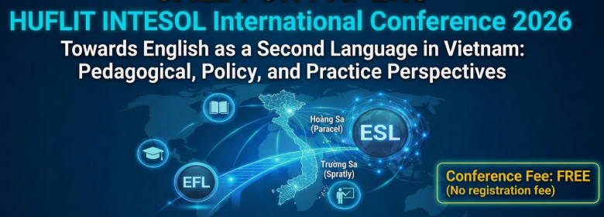
07th August 2026, HUFLIT - HUFLIT University, Ho Chi Minh city, Vietnam

Slide 2
Developing Intercultural Pragmatic Competence for Real Life Interaction through Role-Play: Teaching the Speech Act of Requests in Vietnamese English Communication Classes in the Transition from EFL-Oriented to ESL-Oriented Pedagogy
Presenter: Nguyễn Hoàng Vương Anh
Institution: Ho Chi Minh City University of
Foreign Languages and Information Technology

Slide 3
INTRODUCTION
Background
Effective English communication requires grammatical accuracy and pragmatic competence.
Vietnamese EFL classrooms mainly emphasize grammar and vocabulary.
Students have limited opportunities to develop contextually appropriate communication.

Slide 4
INTRODUCTION
Research Gap
Previous studies have confirmed the benefits of role-play.
Limited evidence on how interaction-based role-play:
improves request performance,
develops request strategies & mitigating devices,
supports the transition from EFL to ESL-oriented communicative learning.
Aim:
To explore how role-play develops intercultural pragmatic competence in performing requests.

Slide 5
INTRODUCTION
Purpose & Research question
Research Purpose
To investigate how interaction-based role-play enhances Vietnamese university students':
pragmatic appropriateness in requests,
use of request strategies and mitigating devices,
intercultural pragmatic competence.

Slide 6
INTRODUCTION
Purpose & Research question
Research Questions
To what extent does role-play improve students' pragmatic appropriateness when making requests?
How do students develop their request strategies and use of mitigating devices through role-play?
How do students perceive the role of role-play in promoting more ESL-oriented communicative practices?
Examine the effectiveness of role-play from the perspectives of performance, development, and perception

Slide 7
PRESENTATION OUTLINE
Introduction
Literature Review
Methodology
Results
Discussion
Conclusion

Slide 8
LITERATURE REVIEW
Effective communication requires both linguistic accuracy and appropriate language use (Hymes, 1972).
It integrates grammatical, sociocultural, and contextual knowledge (Bachman, 1990).
Pragmatic Competence

Slide 9
LITERATURE REVIEW
Examines how L2 learners develop and use pragmatic competence in real communication (Kasper & Schmidt, 1996).
Interlanguage Pragmatics

Slide 10
LITERATURE REVIEW
Communication across cultures requires negotiating meaning rather than relying solely on linguistic knowledge (Kecskés, 2014).
Learners should develop intercultural awareness to communicate appropriately (Byram, 2011).
Intercultural Pragmatics

Slide 11
LITERATURE REVIEW
Requests are face-threatening acts influenced by power, social distance, and degree of imposition (Brown & Levinson, 1987).
Requests as Speech Acts

Slide 12
LITERATURE REVIEW
Explicit instruction enhances learners' pragmatic awareness (DeKeyser, 2007).
Interaction and collaboration facilitate pragmatic development (Vygotsky, 1978).
Theoretical Perspectives

Slide 13
LITERATURE REVIEW
Empirical studies by Takahashi (2010) and Taguchi (2015):
role-play activities provide meaningful opportunities for learners to practice request strategies and improve their pragmatic performance.
→ interaction-based role-play serves as the pedagogical foundation for the present study.
Theoretical Perspectives

Slide 14
Research Setting & Participants
Research Setting
Ho Chi Minh City University of Foreign Languages and Information Technology
First-year compulsory English Communication course
Interactive learning:
  Role-play
  Group discussions
  Situational simulations
Participants
41 first-year students
Convenience sampling
Typical Vietnamese EFL communication classroom

Slide 15
Data Analysis
Mixed qualitative & quantitative analysis
Increased validity through triangulation
Data Source | Analysis Method
WDCT | Blum-Kulka & Olshtain's Framework
Role-play | Pragmatic Discourse Analysis
Questionnaire | Descriptive Statistics
Observation Notes | Qualitative Support & Triangulation

Slide 16
RESULTS
Findings from the WDCT
Learners' Realization of Request Strategies
Findings from the Role-Play Recordings
Learners' Pragmatic Performance in Real-Time Interaction
Findings from the Questionnaire
Learners' Pragmatic Perceptions and Evaluation of Role-Play

Slide 17
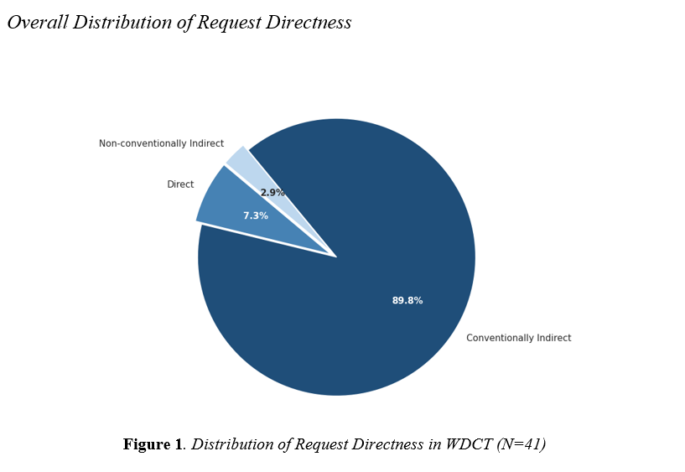
RESULTS
Findings from the WDCT
Learners' Realization of Request Strategies

Slide 18
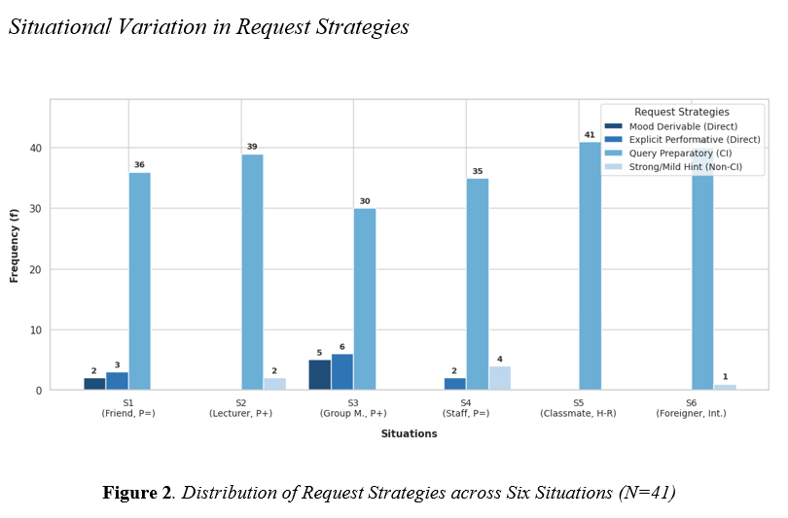
RESULTS
Findings from the WDCT
Learners' Realization of Request Strategies

Slide 19
RESULTS
Findings from the WDCT
Learners' Realization of Request Strategies

Slide 20
RESULTS
Findings from the Role-Play Recordings
Learners' Pragmatic Performance in Real-Time Interaction
Students became more direct in real-time interactions.
Evidence of L1 pragmatic transfer.
Difficulty handling spontaneous communication.

Slide 21
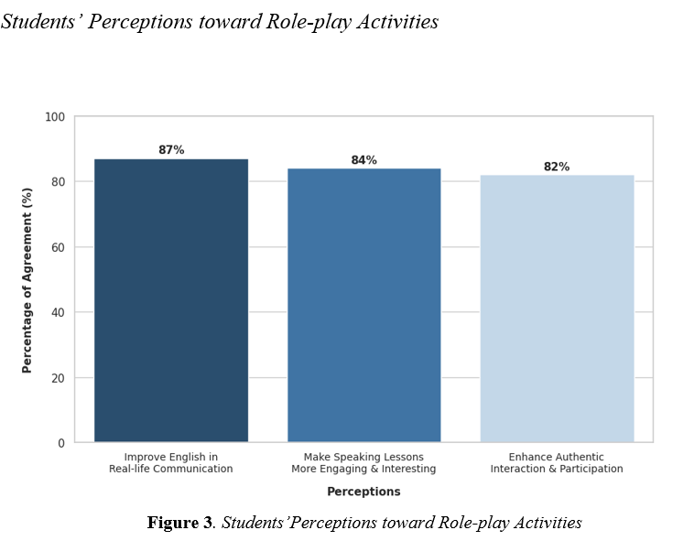
RESULTS
Findings from the Questionnaire
Learners' Pragmatic Perceptions and Evaluation of Role-Play

Slide 22
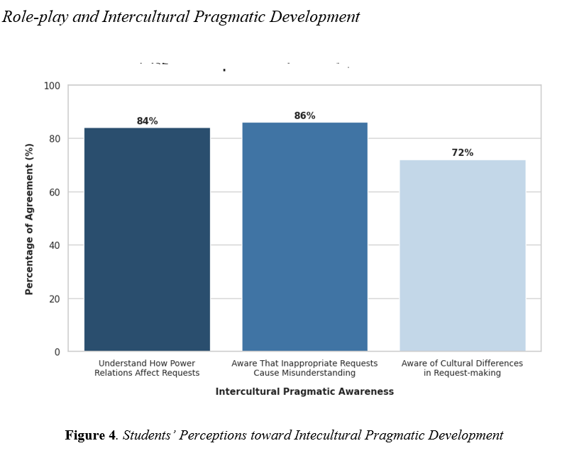
RESULTS
Findings from the Questionnaire
Learners' Pragmatic Perceptions and Evaluation of Role-Play

Slide 23
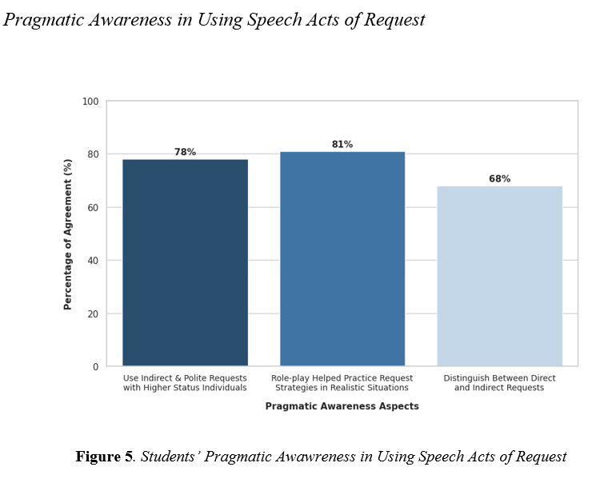
RESULTS
Findings from the Questionnaire
Learners' Pragmatic Perceptions and Evaluation of Role-Play

Slide 24
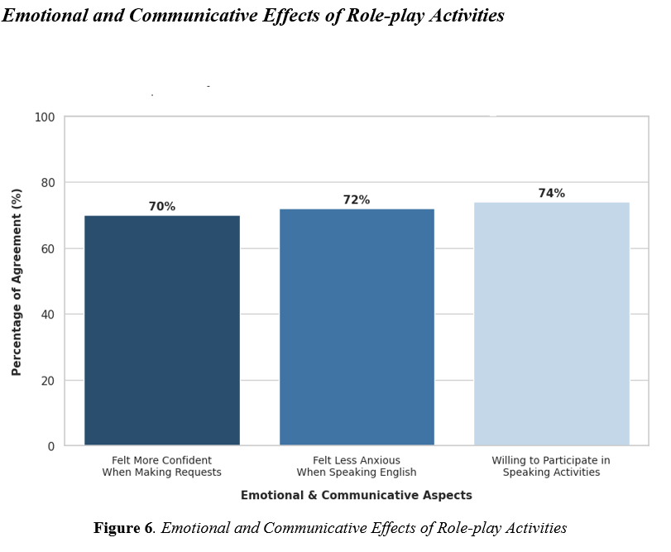
RESULTS
Findings from the Questionnaire
Learners' Pragmatic Perceptions and Evaluation of Role-Play

Slide 25
DISCUSSION
Research question 1: To what extent does the integration of role-play activities improve students’ pragmatic appropriateness in performing the speech act of requests?
Increased awareness of politeness and contextual appropriateness.
Improved use of indirect request strategies.
Challenges remained in real-time interaction.

Slide 26
DISCUSSION
Research question 2: How do students develop request strategies and use of mitigating devices during role-play activities?
Students developed indirect request strategies.
Their use of mitigating devices remained limited.

Slide 27
DISCUSSION
Research question 3: How do students perceive the role of role-play in supporting the shift toward more ESL-oriented communicative practices?
Communication-Oriented Learning
Increased Classroom Engagement
Enhanced Intercultural Awareness
Remaining Emotional Challenges

Slide 28
CONCLUSION
Politeness awareness, but limited pragmatic flexibility.
Role-play bridges knowledge and real-world communication.
AI and innovative approaches offer promising directions.

Slide 29
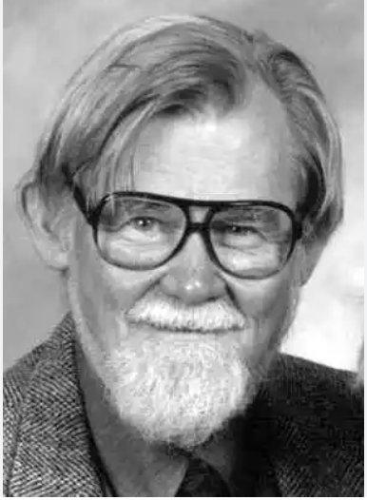
CONCLUSION
“There are rules of use without which the rules of grammar would be useless.' Thank you for your attention.”
(Dell Hymes, 1972)

Slide 30

THANKS FOR LISTENING!

Slide 31
References
Austin, J. L. (1962). How to do things with words. Clarendon Press.
Bachman, L. F. (1990). Fundamental considerations in language testing. Oxford University Press.
Bardovi-Harlig, K. (2013). Developing L2 pragmatics. Language Learning, 63(Suppl. 1), 68–86.
Bardovi-Harlig, K., & Dörnyei, Z. (1998). Do language learners recognize pragmatic violations? Pragmatic versus grammatical awareness in instructed L2 learning. TESOL Quarterly, 32(2), 233–259.
Blum-Kulka, S., House, J., & Kasper, G. (Eds.). (1989). Cross-cultural pragmatics: Requests and apologies. Ablex.

Slide 32
References
Brown, P., & Levinson, S. C. (1987). Politeness: Some universals in language usage. Cambridge University Press.
Byram, M. (2011). Conceptualizing intercultural (communicative) competence and intercultural citizenship. In J. Jackson (Ed.),
The Routledge handbook of language and intercultural communication (pp. 85–97). Routledge.
Canale, M., & Swain, M. (1980). Theoretical bases of communicative approaches to second language teaching and testing. Applied Linguistics, 1(1), 1–47. https://doi.org/10.1093/applin/1.1.1
Crystal, D. (2003). English as a global language (2nd ed.). Cambridge University Press.
DeKeyser, R. M. (2007). Practice in a second language: Perspectives from applied linguistics and cognitive psychology. Cambridge University Press.
Dong, X. (2009). Requests in academic settings in English, Russian and Chinese [Doctoral dissertation, The Ohio State University]. ProQuest Dissertations & Theses Global.
Ellis, R. (2003). The study of second language acquisition. Oxford University Press.

Slide 33
References
Han, S. (2005). The interlanguage pragmatic development of the speech act of requests by Korean non-native speakers of English in an ESL setting (Publication No. AAI3165689) [Doctoral dissertation, University of Pennsylvania]. ProQuest Dissertations & Theses Global.
Hymes, D. (1972). On communicative competence. In J. B. Pride & J. Holmes (Eds.), Sociolinguistics: Selected readings (pp. 269–293). Penguin Books.
Ishihara, N. (2010). Teaching pragmatics in the classroom. In K. R. Rose & G. Kasper (Eds.), Pragmatics in language teaching (pp. 101–124). Cambridge University Press.
Ishihara, N., & Cohen, A. D. (2010). Teaching and learning pragmatics: Where language and culture meet. Pearson Education.
Kachru, B. B. (1982). The other tongue: English across cultures. University of Illinois Press.
Kádár, D. Z., & Haugh, M. (2013). Understanding politeness. Cambridge University Press.
Kasper, G., & Dahl, M. (1991). Research methods in interlanguage pragmatics. Studies in Second Language Acquisition, 13(2), 215–247.
Kasper, G., & Rose, K. R. (2002). Pragmatic development in a second language. Blackwell.
Kasper, G., & Schmidt, R. (1996). Developmental issues in interlanguage pragmatics. Studies in Second Language Acquisition, 18(2), 149–169.

Slide 34
References
Kecskés, I. (2014). Intercultural pragmatics. Oxford University Press.
Kecskés, I. (2016). Cross-cultural and intercultural pragmatics. In Y. Huang (Ed.), The Oxford handbook of pragmatics (pp. 1–16). Oxford University Press.
Leech, G. N. (1983). Principles of pragmatics. Longman.
Liddicoat, A. J. (2022). Intercultural mediation in language learning. In I. Kecskes (Ed.), The Cambridge handbook of intercultural pragmatics (pp. 815–835). Cambridge University Press. https://doi.org/10.1017/9781108884303.032
McConachy, T. (2018). Developing intercultural perspectives on language use: Exploring pragmatics and culture in foreign language learning. Multilingual Matters.
McConachy, T. (2022). Pragmatic awareness in intercultural language learning. In I. Kecskes (Ed.), The Cambridge handbook of intercultural pragmatics (pp. 766–787). Cambridge University Press.
Ogiermann, E. (2009). Politeness and indirectness across cultures: A comparison of English, German, Polish and Russian requests. Journal of Politeness Research, 5(2), 189–216.
Rose, K. R. (2005). On the effects of instruction in second language pragmatics. System, 33(3), 385–399.
Schauer, G. A. (2006). Pragmatic awareness in ESL and EFL contexts: Contrast and development. Language Learning, 56(2), 269–318.
Searle, J. R. (1979). Expression and meaning: Studies in the theory of speech acts. Cambridge University Press.
Spencer-Oatey, H. (2008). Face, (im)politeness and rapport. In H. Spencer-Oatey (Ed.), Culturally speaking: Culture, communication and politeness theory (2nd ed., pp. 11–47). Continuum.
Taguchi, N. (2015). Instructed pragmatics at a glance: Where instructional studies were, are, and should be going. Language Teaching, 48(1), 1–50.
Taguchi, N., & Roever, C. (2017). Second language pragmatics. Oxford University Press.
Takahashi, S. (2010). Instructional effects on request strategies in Japanese EFL learners. Language Learning, 60(1), 1–33.
Thomas, J. (1983). Cross-cultural pragmatic failure. Applied Linguistics, 4(2), 91–112. https://doi.org/10.1093/applin/4.2.91
Vygotsky, L. S. (1978). Mind in society: The development of higher psychological processes. Harvard University Press.

