Slide 1
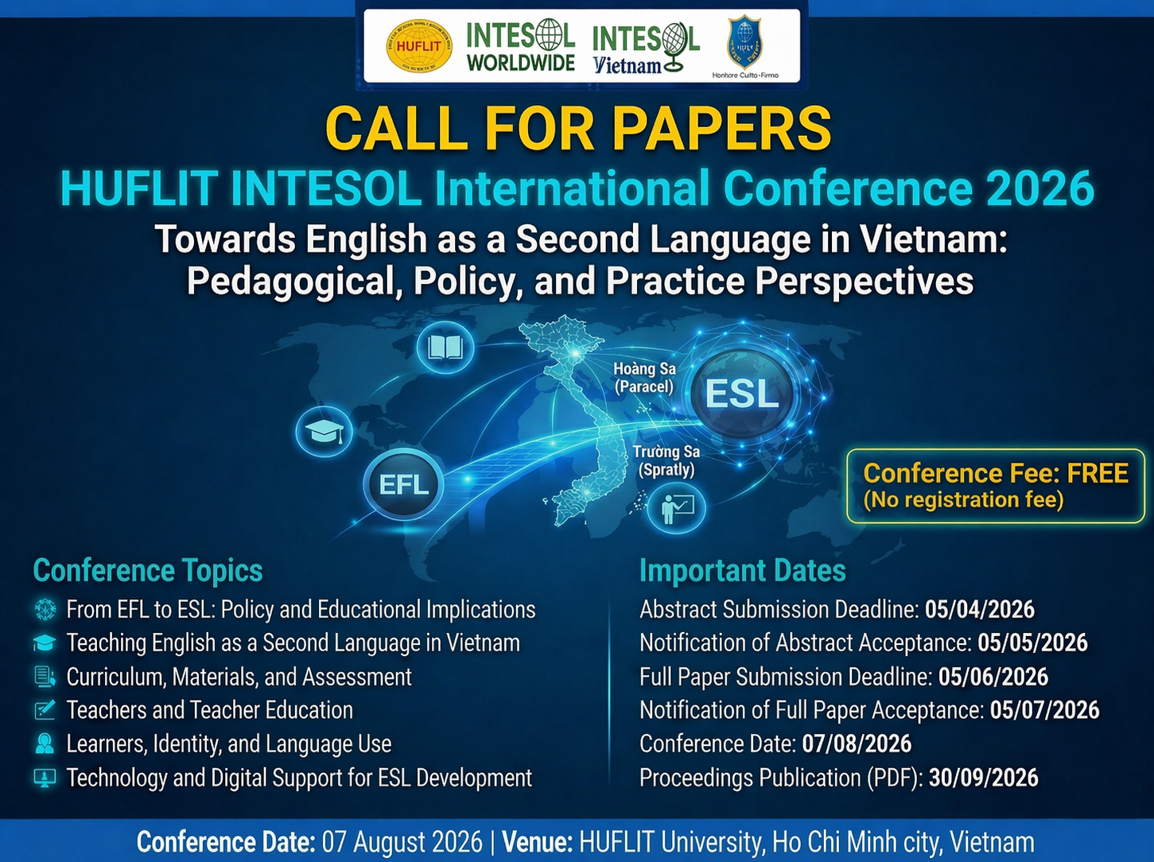
A Literature Review of Appraisal Theory in Language Education: Research Developments and Implications for ESL Teaching
Phan Tuan Ly, PhD.
Hoang Ngoc Thanh Truc, PhD. Candidate
Pham Thi Thuy Dung, PhD. Candidate

Slide 2
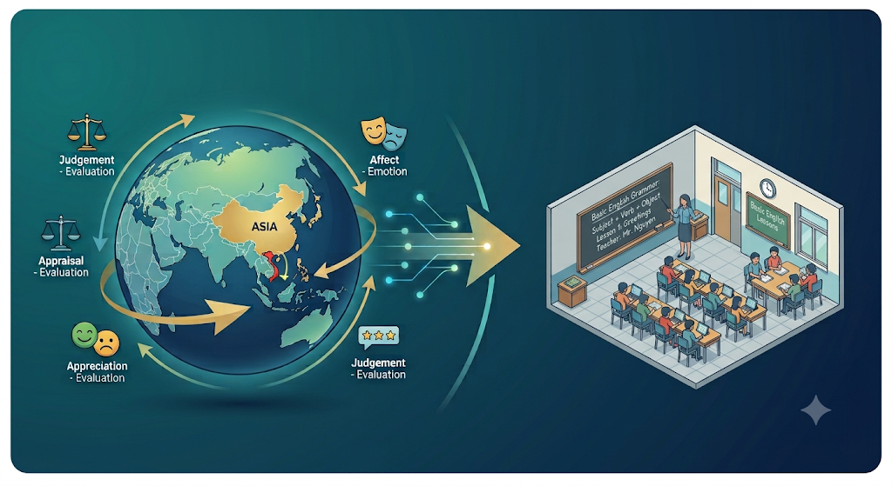

To map the global research landscape of Appraisal Theory over the last two decades
Discuss its specific potential for modernizing English teaching in Vietnam

Slide 3
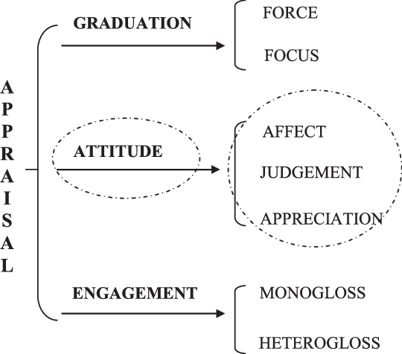

Appraisal theory
I was thrilled because the brilliant chef served a breathtaking meal.
Martin & White (2005)

Slide 4




Research methodology
48 English-language articles
from Scopus database (2006–2026)
“appraisal” and “systemic functional”
(social sciences, arts, and humanities)

Slide 5

Global Publication Trends

Slide 6
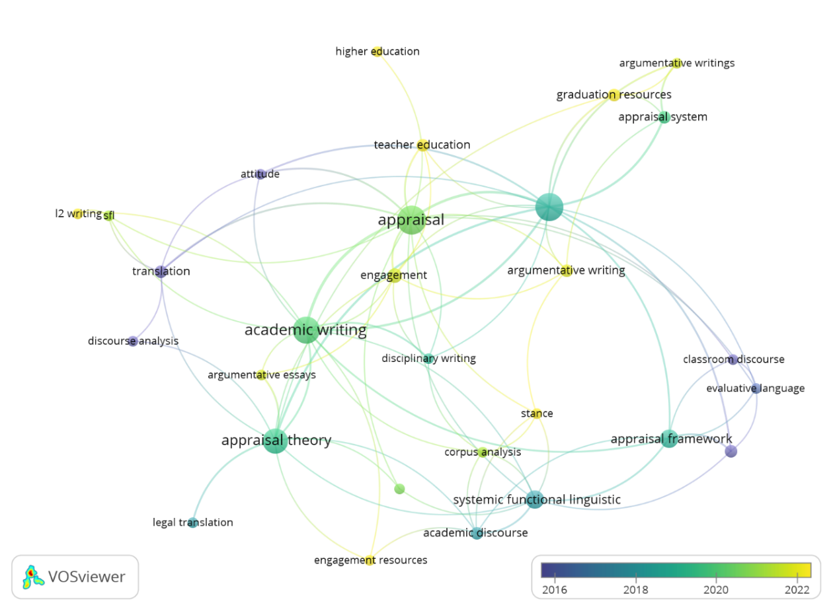
Recent trends
1
Appraisal theory is an analytical framework to support teacher education, extending to instructional contexts at both undergraduate and postgraduate levels
1
2
The cluster reflects research on teaching academic writing, where discourse analysis is treated as a foundational tool for explaining and guiding text production.
2
3
This cluster represents a line of inquiry centered on analyzing texts for specific discourse purposes, particularly argumentative essays and legal translation..
3

Slide 7
Recent trends
6
Cluster 4 emphasizes investigating interpersonal relations in academic texts and connecting such insights to discipline-specific writing practices.
4
This cluster suggests growing interest in analyzing classroom discourse and evaluative language in educational settings.
5
5
This cluster concerns the analysis of graduation in texts intended for argumentative writing.
6
4

Slide 8
Recent trends
Recent studies have largely focused on leveraging appraisal resources, particularly engagement and graduation, to address core issues closely related to writing instruction at the university level.

Slide 9
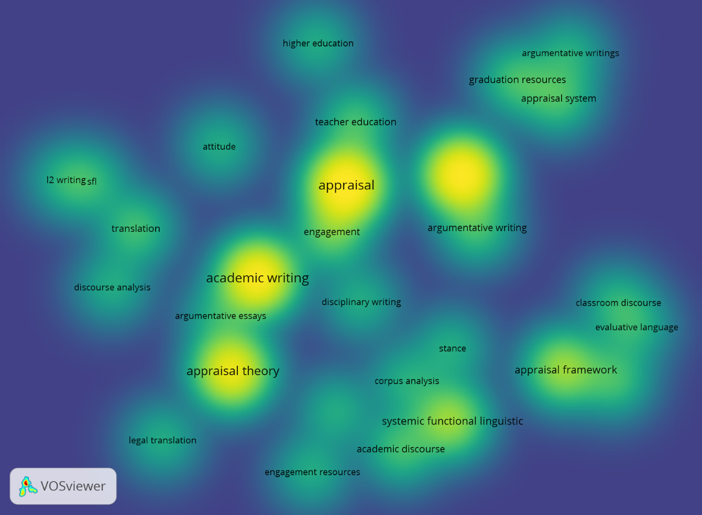
Recent trends
Scholars prioritize using appraisal theory to explain and analyze linguistic phenomena related to the construction of academic texts, while also using such insights to inform the design of teaching and learning activities aligned with writing objectives.

Slide 10



Feasibility in the Vietnamese ESL Context
Powerful clarifications to the Attitude system have been proposed based on group discussion data from graduate students in both English and Vietnamese.
(Ngo and Unsworth, 2015)
Instructions in Appraisal Theory helps students manage professional and persuasive academic voice.
(Vo and Viet, 2025)
The expression of attitudes between native English speakers and Vietnamese learners who use English as second language are different.
(Chung and Crosthwaite, 2026)
.
The awareness of 450 students and 12 teachers about the use of Google Translate has been explored.
(Ngan and Le, 2025)

Slide 11
Feasibility in the Vietnamese ESL Context
move beyond direct expressions to more subtle, persuasive academic tones
analyze spoken discourse and evaluate perceptions of educational technology, such as Google Translate

Slide 12

A Literature Review of Appraisal Theory in
Language Education: Research Developments and Implications for ESL Teaching
Phan Tuan Ly, PhD.
Hoang Ngoc Thanh Truc, PhD. Candidate
Pham Thi Thuy Dung, PhD. Candidate

