Slide 1
Exploring the Effectiveness of Quizizz in Improving Vocabulary Learning of EFL Freshmen Students at HUFLIT
A Research Presentation on Gamified Vocabulary Learning
Presented By:
Lê Thy Phương Thảo
HUFLIT
August 2026

Slide 2

Introduction
The Importance of English Vocabulary

Slide 3
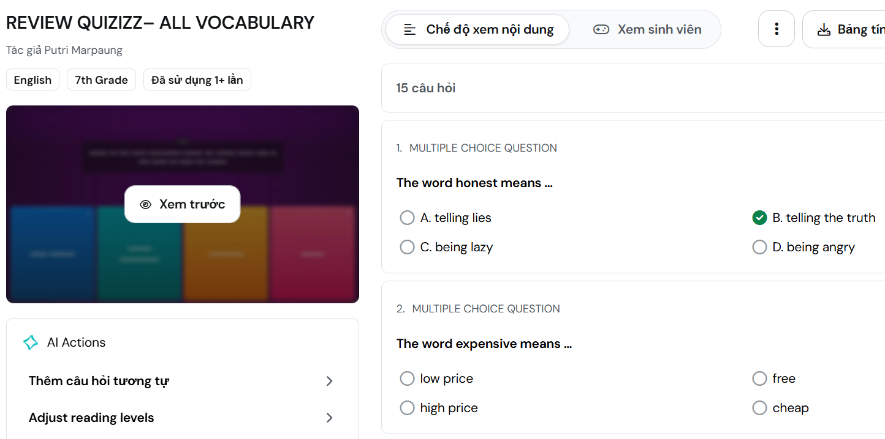

Slide 4
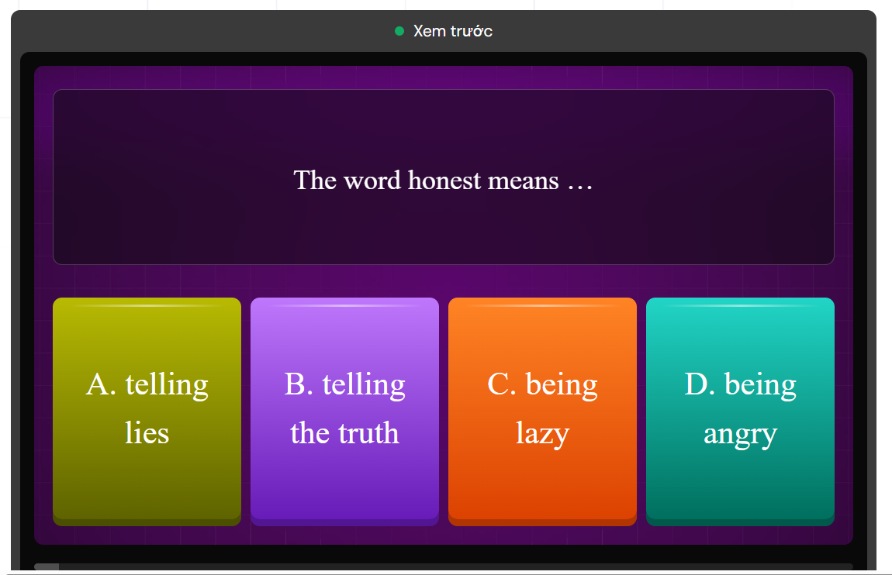

Slide 5




Challenges in Traditional Vocabulary Learning
Conventional vocabulary teaching methods present significant obstacles for EFL learners. Students often struggle with motivation, retention, and passive classroom environments — highlighting the urgent need for more engaging and interactive approaches to language instruction.
Lack of student motivation
Low retention rates
Passive learning environments
Need for engaging, interactive approaches

Slide 6
Research Question & Objectives
  Evaluate Effectiveness
Research Question: How does Quizizz contribute to the vocabulary learning of EFL freshmen students at HUFLIT?
Objectives:
evaluate the role of Quizizz as a gamified learning tool in enhancing vocabulary acquisition, engagement, and motivation among first-year EFL students
identify key challenges and areas for further improvement.

Slide 7

Brief Literature Review
Gamification in Language Learning
1
Quizizz: Evidence and Limitations
2
Gamified learning approaches have been widely shown to improve student engagement and retention in language acquisition contexts.
Research consistently demonstrates that game-based elements — such as points, leaderboards, and immediate feedback — motivate learners and promote active participation, leading to stronger vocabulary retention compared to traditional methods.
Quizizz has been widely adopted as an interactive tool for vocabulary learning in EFL classrooms, with studies reporting positive impacts on motivation, participation, and word retention.
However, existing literature also notes limitations, including limited content variety, repetitive question formats, and occasional technical issues that may hinder consistent learning outcomes.

Slide 8



Methodology
This study employs a mixed-methods approach combining quantitative and qualitative data to comprehensively assess the effectiveness of Quizizz in improving vocabulary learning among EFL freshmen at HUFLIT. Data was collected via an online questionnaire using Google Forms during March – April 2026.
Mixed-
methods:
quantitative + qualitative
100 EFL freshmen at HUFLIT
Online questionnaire via Google Forms
Timeline: March – April 2026

Slide 9
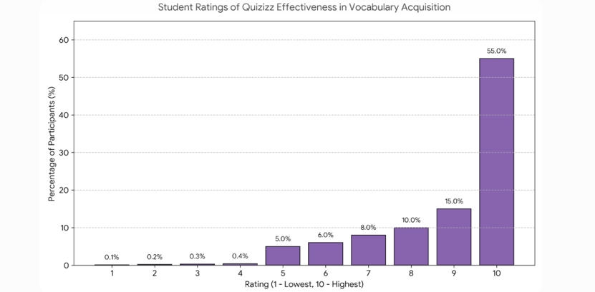
Effectiveness Ratings of Quizizz
The findings suggest that Quizizz is well received by students and is perceived as enhancing vocabulary acquisition through its engaging and interactive learning environment..

Slide 10
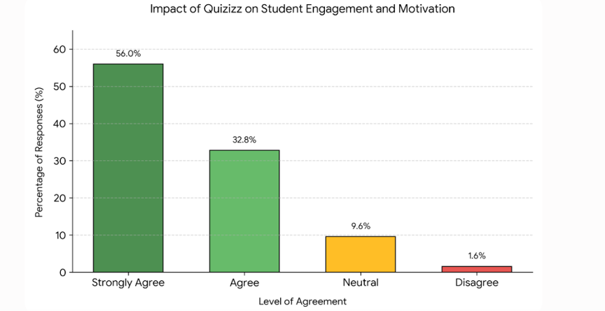
Student Engagement
with Quizizz
The results suggest that Quizizz plays a significant role in increasing students' motivation and active participation in vocabulary learning by providing an interactive and enjoyable learning experience.

Slide 11
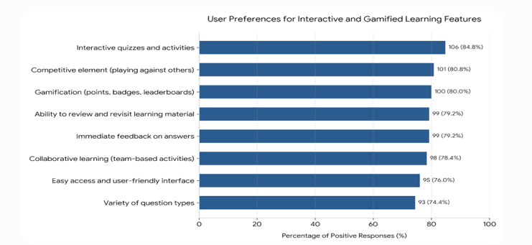
Student Engagement
with Quizizz
The findings demonstrate that students highly appreciate interactive, competitive, and gamified features, suggesting that these elements play a significant role in enhancing engagement, motivation, and the overall effectiveness of vocabulary learning through Quizizz.

Slide 12
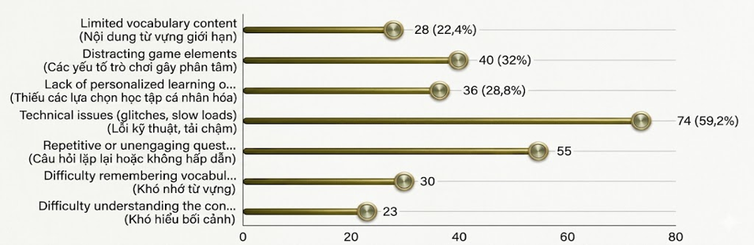
Student Engagement
with Quizizz
The horizontal bar chart details various challenges and drawbacks encountered by users, detailing both the frequency and percentage of responses for each category

Slide 13
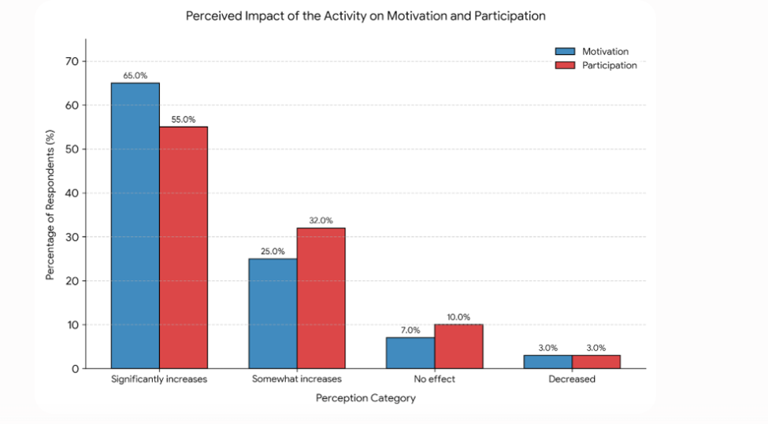
Student Engagement
with Quizizz
The findings suggest that Quizizz is an effective instructional tool for fostering student engagement by increasing both learners' motivation and active participation in vocabulary learning activities.

Slide 14

Impact on Motivation
and Participation
The majority of students reported a significant increase in motivation after using Quizizz regularly in vocabulary learning activities.
"Quizizz made me actually look forward to vocabulary practice — it felt like a game, not a test." — EFL Freshman, HUFLIT
• Increased willingness to participate in class activities
• Students initiated more self-study using the platform
• Higher engagement observed during quiz sessions
• Peer competition encouraged consistent preparation
Overall, Quizizz fostered a more positive and proactive attitude toward vocabulary learning among EFL freshmen at HUFLIT.

Slide 15

Discussion
Quizizz's gamified features effectively boost student engagement and vocabulary retention among EFL freshmen at HUFLIT.
High satisfaction rates are strongly linked to the platform's interactive quizzes and competitive elements, which motivate active participation.
Challenges identified — including technical issues and repetitive content — suggest a clear need for content variety and platform improvements.
Overall results align with prior literature on the benefits of gamification in language learning environments.
Results confirm gamification as a powerful driver of vocabulary acquisition and learner motivation

Slide 16




Recommendations for Future Practice
Based on the findings of this study, the following recommendations are proposed to optimize the use of Quizizz in EFL vocabulary learning and to address the challenges identified by students at HUFLIT.
Integrate multimedia content for richer learning
Diversify question formats to reduce repetition
Incorporate personalized learning paths for student differences
Conduct follow-up assessments to measure long-term retention

Slide 17

Conclusion
Quizizz significantly enhances EFL freshmen's vocabulary learning at HUFLIT, demonstrating the power of gamified tools in modern language education.
Gamification features and immediate feedback are identified as key success factors driving high student engagement and vocabulary retention.
Addressing technical challenges and diversifying question content will further optimize learning outcomes for future implementation.
These findings encourage broader adoption of technology-enhanced language teaching approaches across EFL contexts.

Slide 18
References
Abdulaal, M. A. A. (2019). Polysemes and synonym language stock: Linguistic evidence from English to Arabic translation. Nile Valley Journal of Human, Social and Educational Studies and Research, 23(23), 1-32. https://doi.org/10.21608/jwadi.2019.85114
Abrams, S. S., & Walsh, S. (2014). Gamified vocabulary: Online resources and enriched language learning. Journal of Adolescent & Adult Literacy, 58(1), 49- 58. https://doi.org/10.1002/jaal.315
Afzal, N. (2019). A study on vocabulary-learning problems encountered by BA English majors at the university level of education. Arab World English Journal, 10(3), 81– 98. https://doi.org/10.24093/awej/vol10no3.6
Afzal, N. (2019). A Study on vocabulary-learning problems encountered by BA English majors at the university level of education. Arab World English Journal, 10 (3)81 98. https://doi.org/10.24093/awej/vol10no3.6
Amalia, D. F. (2020). Quizizz website as an online assessment for English teaching and learning: Students’ perspectives. Journal of English Language Teaching, 7(1), 1-8. http://ojs.ikipmataram.ac.id/index.php/joelt
Bal, S. (2018). Using Quizizz.com to enhance pre-intermediate vocabulary knowledge. International Journal of Language Academy, 6(3), 295-303. Boyinbode, O. (2018). Development of a gamification-based English vocabulary mobile learning system. International Journal of Computer Science and Mobile Computing, 7(8), 183–191.
Bury, B. (2017). Testing goes mobile - Web 2.0 formative assessment tools. Conference
Proceedings. ICT for Language Learning (10th Ed.), 87-91. Çevikbaş, G. (2019). The impact of Quizizz on the vocabulary development and motivation of Turkish EFL learners (Master's thesis). Bahçeşehir University, Graduate School of Educational Sciences.
Dewi, K. S., Myartawan, I. P. N. W., Swari, N. K. T. A., & Sugihartini, N. (2020). Quizizz effect
on students’ grammar mastery in higher EFL classroom-based mobile assisted language
learning (MALL). Language and Education Journal Undiksha, 3(1), 15-24.
Conclusion

Slide 19

Thank
You!

