Slide 1

Notes:
Good morning/afternoon everyone.
Thank you very much for joining my presentation today.
My presentation is entitled "Vietnamese Students' Readiness for English as a Second Language: The Role of AI-Supported Learning Environments."
This study explores how AI-supported learning environments influence Vietnamese university students' readiness to use English beyond the classroom, particularly through student engagement.

Slide 2
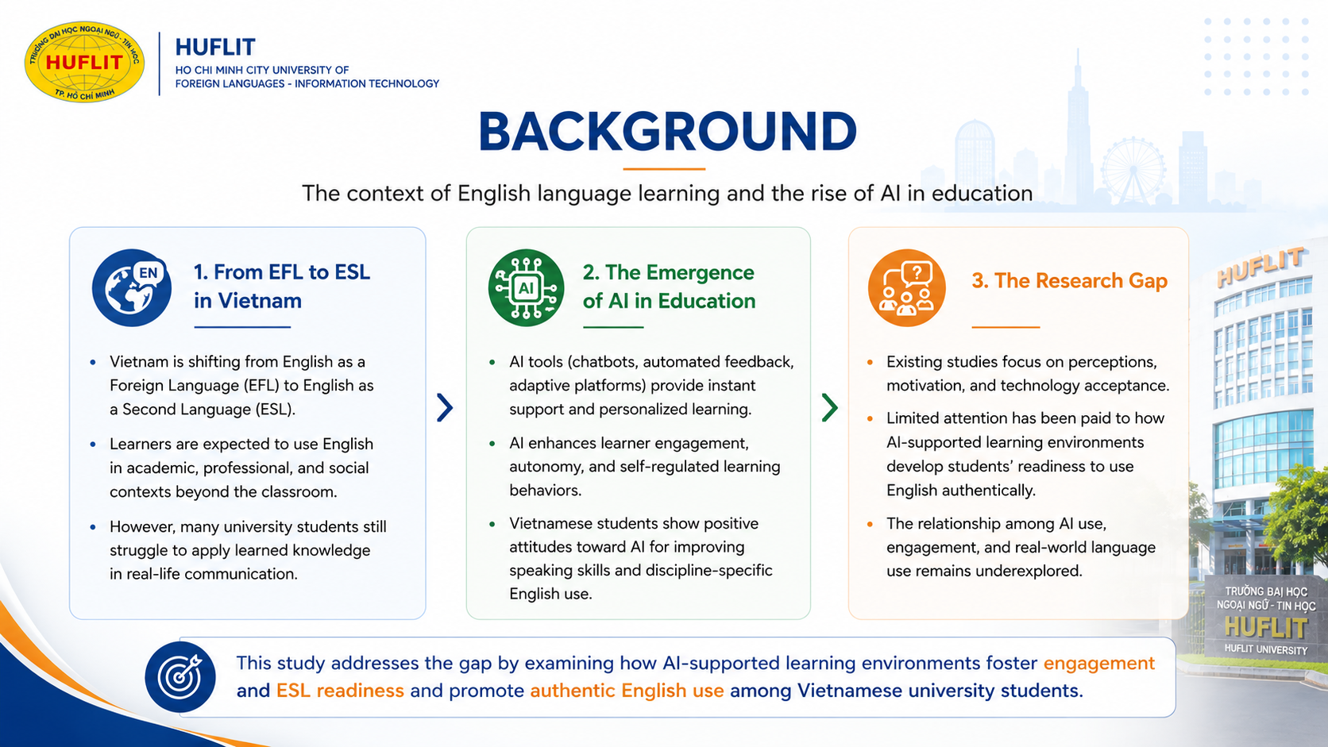
Notes:
In recent years, Vietnam has gradually shifted from an EFL context, where English is mainly learned for classroom purposes, to a more ESL-oriented context, where English is expected to be used in academic, professional, and social settings.
At the same time, AI tools such as ChatGPT, Grammarly, and other intelligent learning platforms have become increasingly popular among university students.
Although these technologies provide learners with greater access to English learning, many students still struggle to communicate confidently in authentic situations.
Therefore, this raises an important question:
Can AI really prepare students for real-world English use?

Slide 3
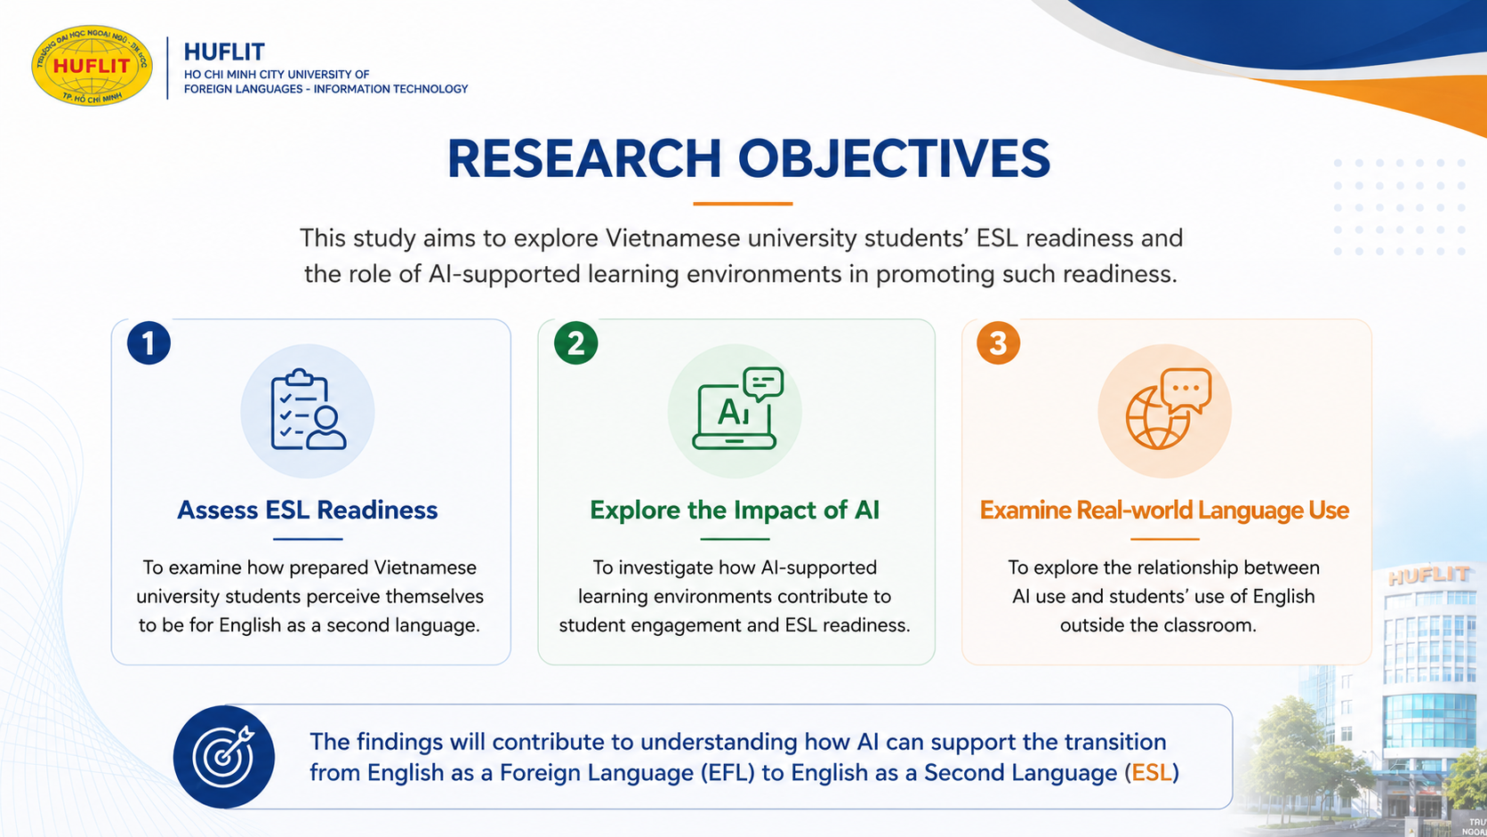
Notes:
Based on this context, this study had three objectives.
First, to examine Vietnamese university students' readiness for English as a Second Language.
Second, to investigate how AI-supported learning environments contribute to student engagement and ESL readiness.
Finally, to explore the relationship between AI use and students' English use outside the classroom.
Ultimately, this study aims to better understand how AI can support Vietnam's transition from EFL to ESL.

Slide 4
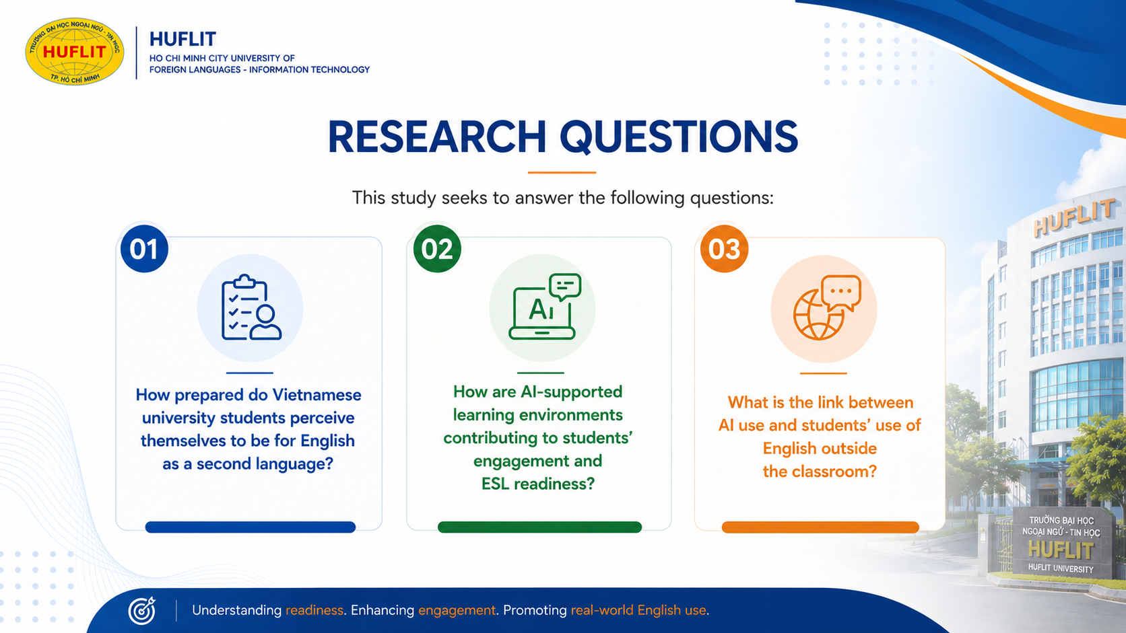
Notes:
These objectives were translated into three research questions.
The first asks about students' perceived ESL readiness.
The second investigates the contribution of AI-supported learning environments to engagement and readiness.
The third explores whether AI use is associated with English use beyond the classroom.
Together, these questions guided both the quantitative and qualitative phases of the stu

Slide 5
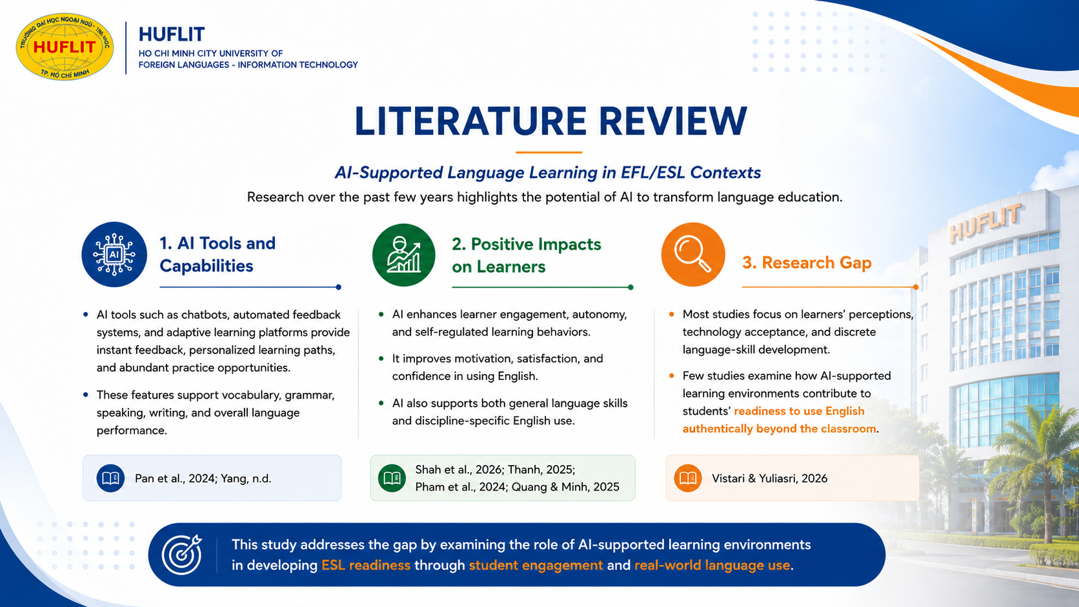
Notes:
Previous studies consistently show that AI has great potential in language education.
AI tools provide instant feedback, personalized learning opportunities, and flexible practice.
Many studies also report positive outcomes such as increased motivation, learner autonomy, engagement, and confidence.
However, most previous research has focused on students' perceptions, technology acceptance, or individual language skills.
Much less attention has been given to whether AI actually prepares learners for authentic English communication.
Therefore, more research is needed to examine AI beyond simple technology adoption.

Slide 6
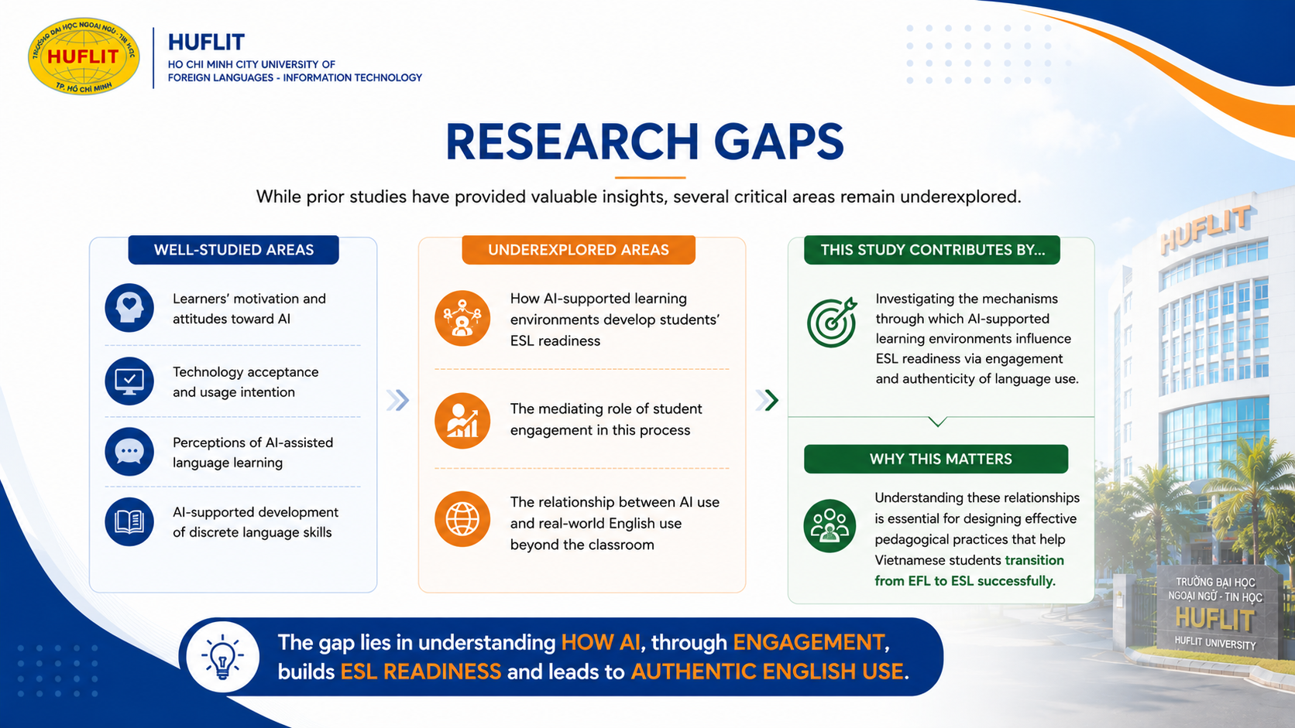
Notes:
Based on the literature review, three major research gaps were identified.
First, we still know very little about how AI develops students' overall ESL readiness.
Second, the mediating role of student engagement has rarely been examined.
Finally, the relationship between AI use and real-world English use remains underexplored.
This study attempts to fill these gaps by proposing engagement as the mechanism connecting AI and authentic language use.

Slide 7
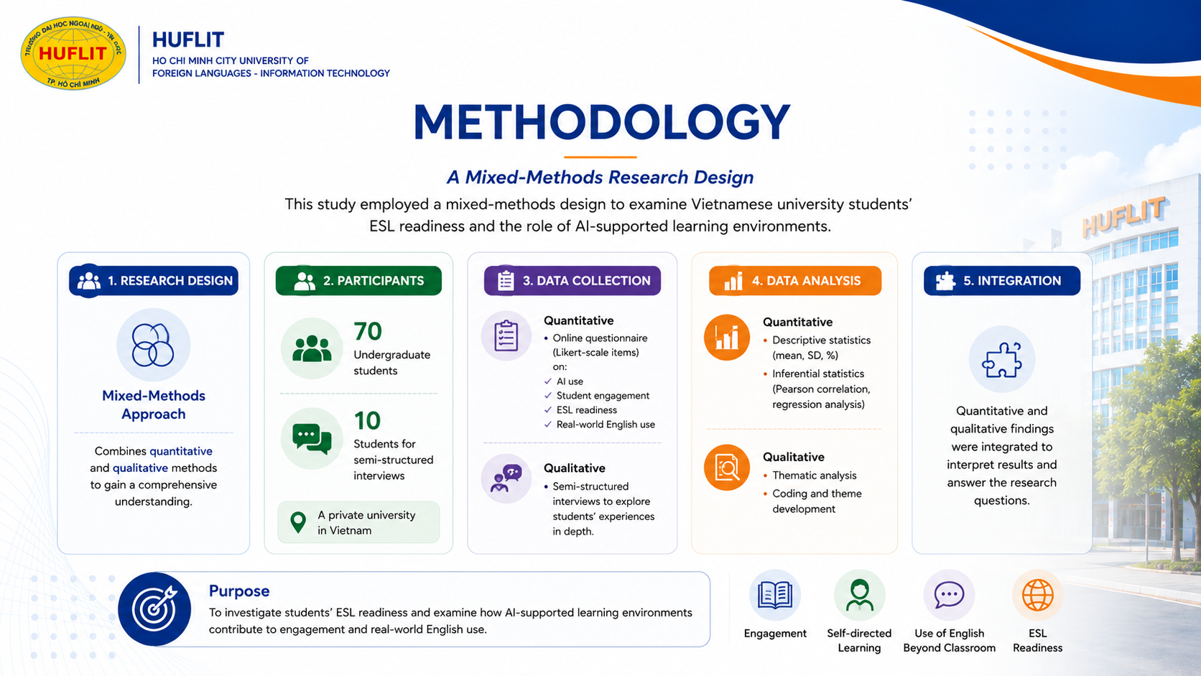
Notes:
To answer the research questions, this study adopted a mixed-methods design.
The quantitative phase involved 70 undergraduate students from a Vietnamese private university.
In addition, ten students participated in semi-structured interviews to provide deeper insights.
Data were collected using questionnaires and interviews.
Quantitative data were analyzed using descriptive statistics and Pearson correlation, while qualitative data were analyzed through thematic analysis.
Combining these two approaches allowed both statistical evidence and deeper explanations of students' experiences.

Slide 8
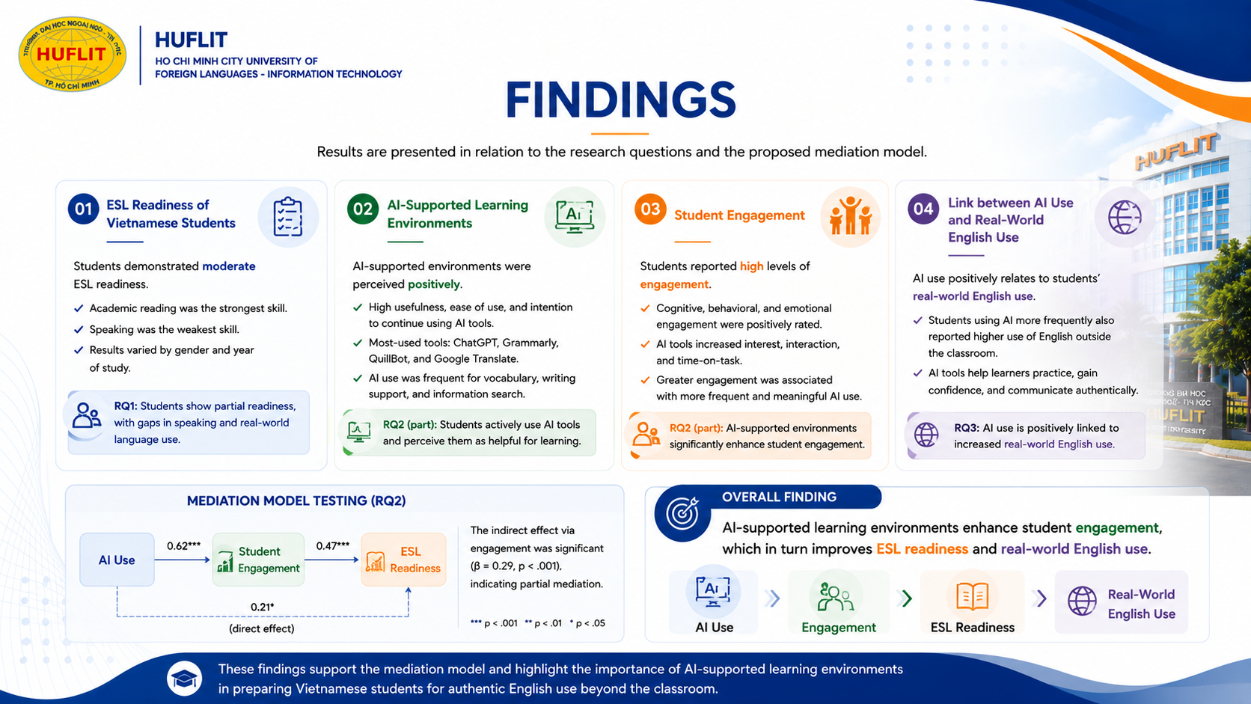
Notes:
The findings reveal several interesting results.
First, students reported relatively high levels of AI use and engagement.
However, their ESL readiness and especially their real-world English use remained only moderate.
Correlation analysis showed that AI was positively associated with engagement.
More importantly, engagement demonstrated the strongest relationship with ESL readiness.
The qualitative findings further explain these results.
Students mainly used AI as a cognitive support tool for vocabulary, grammar, writing, and assignment completion.
AI also reduced anxiety and increased confidence.
However, many students admitted relying too much on AI-generated responses and lacking confidence during real face-to-face communication.
Overall, AI alone is not enough.
What really matters is whether AI encourages meaningful learner engagement.

Slide 9
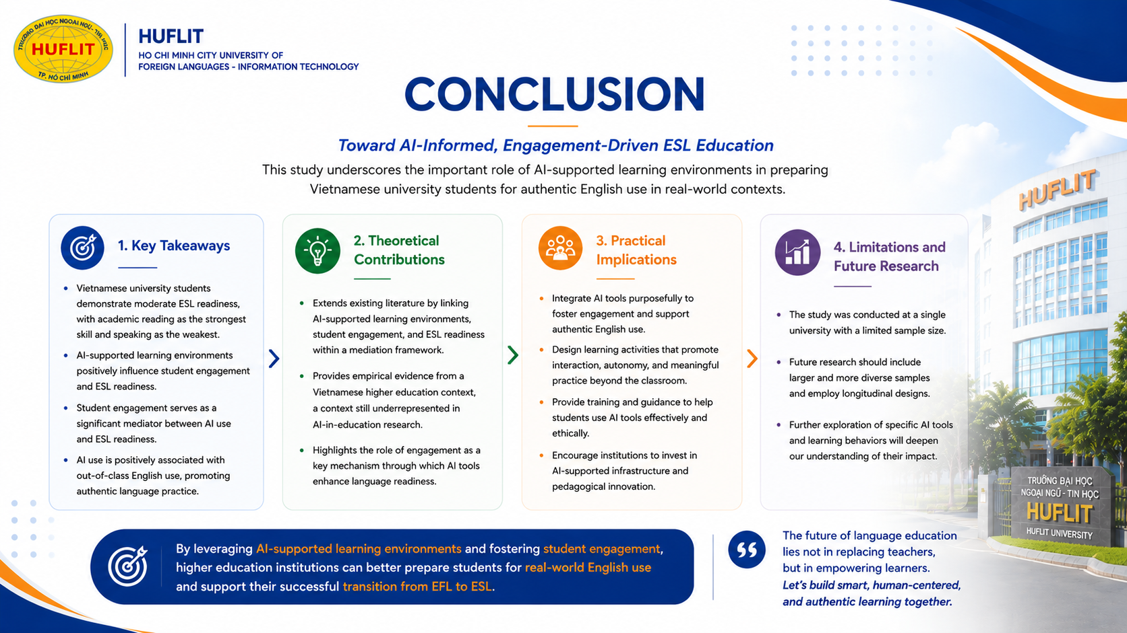
Notes:
In conclusion, this study suggests that AI-supported learning environments positively influence student engagement.
Student engagement, in turn, promotes ESL readiness and eventually supports real-world English use.
Therefore, engagement acts as an important mediating mechanism rather than simply being another learning outcome.
From a pedagogical perspective, teachers should not use AI merely as a tool for completing assignments.
Instead, AI should be integrated into communicative activities such as discussions, presentations, role plays, and collaborative tasks.
In this way, AI becomes a facilitator of authentic language learning rather than a replacement for communication.
Thank you very much for your listening.
I sincerely appreciate your time, and I would be happy to answer any questions or discuss the study further.
Thank you.

