Slide 1
HUFLIT INTESOL INTERNATIONAL CONFERENCE 2026
Aviation English Majors' Perceptions
of the Use of AI-Based Language Learning Tools for Self-Regulated English Speaking Practice
Nguyễn Thị Nguyệt Ánh & Nguyễn Thị Ngọc Quý
Faculty of Foreign Languages, Vietnam Aviation Academy
7 August 2026 • HUFLIT University, Ho Chi Minh City, Vietnam

Slide 2
Why This Study?
✈
English is the standard language of aviation communication
between crew, passengers, and ground staff.
18/120
Despite 18 of 120 curriculum credits on listening & speaking, many students still struggle: limited vocabulary, pronunciation, anxiety, lack of personalized corrective feedback.
AI
Students are increasingly turning to AI tools to practice speaking on their own
but their real experiences remain underexplored.
2

Slide 3
Research Gap & Purpose
Existing research covers AI in General English learning, or in Writing skills,
but perceptions of AI for self-regulated SPEAKING practice remain scarce.
RESEARCH QUESTION
“What are VAA Aviation English students' perceptions regarding the benefits and limitations of using AI-based tools within a self-regulated speaking context?”
Goal: to give students concrete, tool-by-tool insight - not just “AI is helpful.”
3

Slide 4
Methodology
Quantitative, descriptive survey design
161
29
SPSS
Participants
Survey Items
Analysis
AE students at VAA,
175 respondents (100% response rate)
convenience sampling
Descriptive statistics, reported as percentages, using SPSS v.20
3 background questions
26 items across 10 themes (benefits & limitations)
4

Slide 5
Which AI Tools Are EA Students Actually Using?
61.5%
of participants have practiced with AI tools for OVER 6 MONTHS
→ Long-term, experienced users, not first impressions.
Note: popularity here does not equal performance - see Slide 11.
5

Slide 6
Perceived Benefits
1
Google Assistant: 94.4% agree it identifies weak areas, customizes lessons to learner needs
Personalization
2
ELSA Speak: 94.6% agree it gives real-time feedback
Immediate Feedback
3
Accessibility
Google Assistant: 100% agree it is accessible
Google Assistant & Copilot: 83.3% agree they offer stimulating activities
Google Assistant: 88.9% agree it encourages regular practice
4
Engagement
5
Copilot: 96.7% agree it helps monitor their own progress
Self-Regulated Learning
6

Slide 7





Perceived Benefits
Self-Regulated Learning Support
Personalization
Immediate Feedback
Identifying weaknesses
Customizing lessons
Offering real-time feedback
Pinpointing errors
Setting speaking goals
Planning learning schedules
Monitoring progress
TOP PERFORMER
TOP PERFORMER
TOP PERFORMER
Google Assistant
94.4%
ELSA Speak
94.6%
Copilot
96.7%
7

Slide 8
Perceived Limitations
1
Data Dependency
Copilot: 73.3% say its examples lack originality, and sound formulaic.
2
Illusory Understanding
Google Assistant: 94.4% say it lacks real emotional understanding
3
Cultural Sensitivity
83.3% (Google Assistant), 72.2% (Gemini) say they struggle with Vietnamese idioms
4
Feedback Accuracy
~67-70% say ChatGPT / Copilot give overly general explanations
5
Technical Issues
Google Assistant: 83.3% say they encounter crashes or freezes during long practice sessions
8

Slide 9







Perceived Limitations
Illusory Understanding
Cultural sensitivity
Technical issues
Erroneous, inappropriate responses
Unconscious, unemotional reactions
Contextually inapplicable responses
Lack of diversity
Western, male-centered cultural bias
Unnatural idiomatic, colloquial phrasing
Compatibility problems
Internet problems
Crashes, freezing
Google Assistant
83.3%
Google Assistant
94.4%
Google Assistant
83.3%
Duolingo
77.6%
Google Assistant
83.3%
Gemini
72.2%
ELSA Speak
75%
9

Slide 10
Popularity Doesn't Equal Performance
MOST USED
TOP PERFORMERS
1. ChatGPT - 64%
1. Google Assistant
2. Duolingo - 47.2%
2. Copilot
3. ELSA Speak - 34.8%
3. ELSA Speak
As students gain experience, they diversify - moving from general-purpose chat tools toward specialized diagnostic assistants for structural & phonological accuracy.
10

Slide 11
Conclusion
01
AI tools genuinely help
Boosting motivation & engagement via personalization, real-time feedback, low-anxiety practice.
02
Accessibility & affordability matter most
Promoting satisfaction, especially for financially constrained students.
03
No single tool is flawless
The most effective tools often carry the most notable risks => selection must be strategic.
11

Slide 12
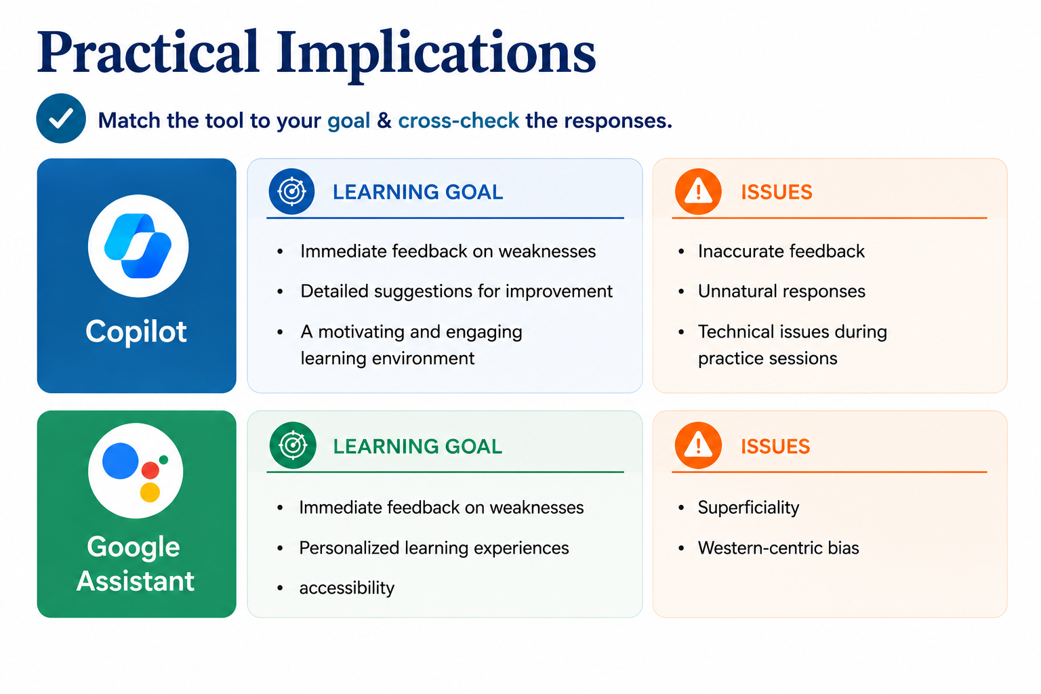
12

Slide 13
Limitations & Future Research
STUDY LIMITATIONS
FUTURE DIRECTIONS
Adopt a mixed-methods approach
Investigate why popularity ≠ perceived effectiveness
Expand samples across multiple institutions
Quantitative survey only (no follow-up interviews)
Convenience sampling from one institution
Did not explore tool-specific user experiences
13

Slide 14
Thank You For Listening
Nguyễn Thị Nguyệt Ánh & Nguyễn Thị Ngọc Quý
Vietnam Aviation Academy • anhntn@vaa.edu.vn

