Slide 1

HUFLIT · 2026
Leveraging Generative AI to Address Vietnamese EFL Learners’ Challenges in English Literature
A Close Reading and Rubric-Based Assessment Framework for Third-Year University Students
EFL Education
Generative AI
Close Reading
Rubric-Based Assessment
Presented by Nguyễn Thị Thư Hiên

Slide 2

ROADMAP
Presentation Outline
01
Background & Problem Statement
05
Post-Pilot Evaluation Results
02
Research Objectives & Questions
06
Key Findings & Discussion
03
Methodology
07
Conclusions & Implications
04
Needs Analysis Findings
HUFLIT · 2026
2

Slide 3



BACKGROUND
Background & Problem Statement
Linguistic Complexity
Cultural Unfamiliarity
Procedural Uncertainty
Archaic vocabulary, stylistics, and complex syntax pose higher demands than communicative texts (Paran, 2008)
English literature is central to university EFL programmes in Vietnam
Historical & social contexts (esp. Victorian era) create interpretive barriers for L2 readers (Lazar, 1993; Brantmeier, 2005)
Third-year students (B2–C1) struggle transitioning from comprehension to literary interpretation
EFL learners lack structured approaches to literary analysis and rubric-based assessment (Rosenblatt, 1994; Panadero & Jonsson, 2013)
Shift from textual comprehension to aesthetic analysis is demanding
HUFLIT · 2026
3

Slide 4
OBJECTIVES & QUESTIONS
Research Objectives & Questions
OBJECTIVES
1
2
3
Examine challenges faced by 3rd-year Vietnamese EFL students in English literature
Develop a ChatGPT-assisted framework to support literary analysis tasks
Assess students’ attitudes toward the proposed framework
RESEARCH QUESTIONS
RQ1
RQ2
RQ3
What challenges do 3rd-year Vietnamese EFL students face in English literature?
How do students perceive the ChatGPT-integrated framework in supporting literary analysis tasks?
What are students’ attitudes toward the framework in terms of helpfulness, confidence, and engagement?
HUFLIT · 2026
4

Slide 5



METHODOLOGY
Methodology
INSTRUMENTS
RESEARCH DESIGN & PARTICIPANTS
Survey 1: Needs Analysis (pre-pilot)
Exploratory mixed-methods design
Likert scale + open-ended questions
N = 122 third-year undergraduates, HUFLIT
Survey 2: Post-Pilot Feedback
B2 (84.4%) and C1 (15.6%) proficiency
Framework usefulness, confidence, preferences
Text: Jane Eyre (Charlotte Brontë)
HUFLIT · 2026
5

Slide 6






METHODOLOGY
5 Phases of Investigation
1
2
3
4
5
Needs Analysis
Framework Design
Pilot Study
Post-Pilot Survey
Data Analysis
HUFLIT · 2026
6

Slide 7
METHODOLOGY
The 8-Step ChatGPT-Assisted Framework
AI assists. Students think. Teachers guide.
STEP 1
STEP 2
STEP 3
STEP 4
First Reading
Vocabulary & Context
Literary Device Identification
Independent Writing (Draft)
AI-Free
AI-Free
AI-Assisted
AI-Assisted
AI-Free
STEP 5
STEP 6
STEP 7
STEP 8
Peer Discussion
Revised Writing
AI-Assisted Reflection
Final Synthesis & Self-Evaluation
AI-Free
AI-Free
AI-Free
AI-Free
AI-Free
AI-Assisted
Steps 2, 3 & 7 use teacher-designed prompt templates
HUFLIT · 2026
7

Slide 8
PROMPT TEMPLATE
Step 1: First reading (individual/ no AI)
Teacher does | Students do
Assigns a passage (Ch. 23-Jane and Rochester in the garden in Thornfield) Tells students: "Read silently. Don't look anything up now." Teacher may show an image of a Victorian era manor house | Read the passage for comprehension, underlining words/sentences that puzzle Answer in 2-3 sentences: "What do I understand so far? What puzzles me?"

Slide 9
PROMPT TEMPLATE
Step 2: AI-assisted vocabulary & context (individual/ AI allowed)
Teacher does | Students do
Hand out a prompt template that was pre-made, such as the following: "I am an EFL student reading Jane Eyre (1847). Please define for me the following words/phrases and provide cultural/historical background, when appropriate: (word list)" Ensure students use ONLY the template | Use prompt template to paste words to ChatGPT Note down definitions/contexts in personal vocabulary log NOTHING ELSE. No asking ChatGPT for summary or analysis now

Slide 10
PROMPT TEMPLATE
Step 3: AI-assisted literary device identification (paired/ AI allowed)
Teacher does | Students do
Hand out another prompt template, such as: "This is a passage from Jane Eyre. Can you tell me whether there are literary devices and, if so, briefly explain their effect? (paste passage) Conduct a short class-wide discussion, such as: "What devices did ChatGPT find?" "Do any pairs feel the AI misidentified literary devices here? Why do you say so?" "What device stands out to you most in this passage - and why?" | Work in pairs to submit the passage to ChatGPT Compare the AI's findings against your first observations in Step 1 Highlight literary devices in your copy of the text

Slide 11
PROMPT TEMPLATE
Step 4: Independent analysis (individual/ no AI)
Teacher does | Students do
Collect phones/laptops or move to the 'AI free zone' Hand out writing prompt such as the following: "Please choose ONE literary device found in the previous step. Now, in your own words, explain why Brontë used it and its effect." (This is an important assessment point; the teacher observes student thinking.) | Write a paragraph about it independently (no AI or partner) (60 to 80 words) The purpose is to generate learning data about their independent capacity

Slide 12
PROMPT TEMLATE
Step 5: Peer discussion (paired/ small group/no AI)
Teacher does | Students do
Conduct structured pair-share: "Now share your paragraph with your partner. Do you agree?" | Read each other's paragraphs from Step 4 Give feedback verbally to each other "I think Brontë used this device because…" "My partner identified…which I didn't notice…" etc. Identify 1 thing you'd like to improve

Slide 13
PROMPT TEMPLATE
Step 6: Revised independent writing (individual/ no AI)
Teacher does | Students do
Allow time for students to revise their Step 4 paragraph in light of peer feedback Explain that THIS is their work now; it shows progress. | Now write a new version independently (60 to 80 words) The difference between Step 4 and Step 6 IS the outcome

Slide 14
PROMPT TEMPLATE
Step 7: AI-assisted reflection & extension (individual/ AI allowed)
Teacher does | Students do
Hand out another template prompt: "This is the draft of my analysis paragraph about Jane Eyre. Can you help me improve my paragraph? Specifically, (a) suggest a way to strengthen my argument and (b) another topic I can investigate." | Paste your Step 6 paragraph to ChatGPT Get suggestions from ChatGPT and reflect in writing about whether you agree What did the AI say? Do I agree? Will I use it?

Slide 15
PROMPT TEMPLATE
Step 8: Final synthesis (individual/ no AI)
Teacher does | Students do
Assign an end-of-unit essay/journal writing prompt (to be done independently) Example: "Discuss how Brontë uses imagery and symbolism to reveal Jane's emotions. In particular, describe the effect of these literary devices used together on Jane's views on love and identity." | Do the assignment: Write the final paragraph independently (no AI)(70 to 90 words) Apply the rubric to self-assess your paragraph before submission, scoring each of the five criteria and writing one sentence to justify each score Propose one revision idea for any criterion where your score is low

Slide 16

NEEDS ANALYSIS
Needs Analysis: Participant Profile
122
84.4%
15.6%
75.4%
Participants
B2 Level
C1 Level
Found it Hard
3rd-year undergraduates
at HUFLIT
Upper-Intermediate
(n = 103)
Advanced
(n = 19)
"Difficult" or
"Very Difficult"
OVERALL EXPERIENCE WITH LITERATURE COURSES
29.5% (n=36)
Very Difficult
Difficult
45.9% (n=56)
Neutral
17.2% (n=21)
Manageable
7.4% (n=9)
Easy
0%
HUFLIT · 2026
8

Slide 17
NEEDS ANALYSIS
Needs Analysis: Self-Reported Difficulties
Survey 1, Section B: 5-point Likert scale (1 = Strongly Disagree, 5 = Strongly Agree)
B1
Archaic vocabulary & complex sentence structures
Linguistic
M=4.31
B4
Approaching close reading tasks systematically
Text Analysis
M=4.23
B2
Cultural references (historical events, social norms)
Cultural
M=4.18
B3
Identifying literary devices (metaphor, symbolism, irony)
Text Analysis
M=4.09
B5
Uncertainty about assessment criteria
Text Analysis
M=4.05
B6
Writing analytical responses in English
Linguistic
M=3.97
Three major challenge areas confirmed: Linguistic · Cultural · Procedural (Text Analysis)
HUFLIT · 2026
9

Slide 18
NEEDS ANALYSIS
Prior AI Use & Attitudes Toward ChatGPT
PRIOR AI EXPERIENCE (D1)
ATTITUDES TOWARD CHATGPT (D3–D5)
Comfortable using ChatGPT if guided by teacher
M=4.27
Regularly
13.1%
D5
Sometimes
40.2%
M=3.81
ChatGPT can help me understand difficult texts
D3
Once or Twice
31.1%
Can rely on ChatGPT’s explanations academically
M=3.12
Never
15.6%
D4
84.4% had prior AI experience · Students most willing to use ChatGPT under teacher guidance (M=4.27) but cautious about full reliance (M=3.12)
HUFLIT · 2026
10

Slide 19
POST-PILOT EVALUATION
Post-Pilot: Framework Usefulness (Section E)
All items rated above M = 4.00 (threshold for positive evaluation); N = 122
E4
Rubric clearly explained assessment criteria
M=4.51
E1
ChatGPT helped understand vocabulary & language
M=4.42
E2
ChatGPT helped understand cultural/historical context
M=4.36
F3
Would recommend this course format to others
M=4.45
E3
ChatGPT-assisted close reading improved text analysis
M=4.28
E5
Rubric helped realize strengths & weaknesses
M=4.33
E6
AI-integrated lessons more helpful than traditional
M=4.17
HUFLIT · 2026
11

Slide 20

POST-PILOT EVALUATION
Activity Preferences & Confidence Gains
Most Valued Activities (F1 — up to 2 selections)
Guided close reading with AI prompts
59.8%
ChatGPT for cultural/historical context
45.1%
Rubric-based self-assessment
42.6%
ChatGPT for vocabulary & language
34.4%
Peer discussions after AI activities
18%
HUFLIT · 2026
12

Slide 21

POST-PILOT EVALUATION
Activity Preferences & Confidence Gains
Post-Pilot Confidence in Close Reading (G1)
40.2%
48.4%
11.5%
0%
Much more
confident
Somewhat more
confident
No change
Less confident
88.5% reported increased confidence after the pilot
HUFLIT · 2026
13

Slide 22

DISCUSSION
Needs ↔ Solutions: Cross-Survey Alignment
Descriptive comparison showing framework alignment with identified difficulty areas
Difficulty (Survey 1)
Framework Step
Usefulness (Survey 2)
B1 Archaic vocabulary
M = 4.31
Step 2: Vocabulary &
Context Inquiry (AI)
E1 Vocabulary help
M = 4.42
B2 Cultural references
M = 4.18
Step 2: Cultural/historical
context via ChatGPT (AI)
E2 Cultural context
M = 4.36
B4 Systematic close reading
M = 4.23
Steps 1–8: Structured
8-step sequence
E3 Text analysis
M = 4.28
B5 Assessment uncertainty
M = 4.05
Step 8: Rubric-based
self-assessment (AI-free)
E4 Rubric clarity
M = 4.51
HUFLIT · 2026
14

Slide 23

DISCUSSION
Student Voice: Qualitative Evidence
Representative open-ended responses from post-pilot survey (Table 8)
Linguistic & Cultural Access
Step 2
Procedural Clarity
Steps 1–8
"It helps me understand difficult text more easy. ChatGPT also explain vocabulary and culture background clearly."
"Having a step-by-step process helped make it from overwhelming to manageable."
Critical AI Literacy
Step 7
Confidence & Engagement
Steps 1–8
"I did not agree with all ChatGPT suggestions because some ideas did not match my interpretation of the text."
"Before, I think literature was very difficult. But after these lessons, I feel more confident because I know how to read and analyze better now."
HUFLIT · 2026
15

Slide 24
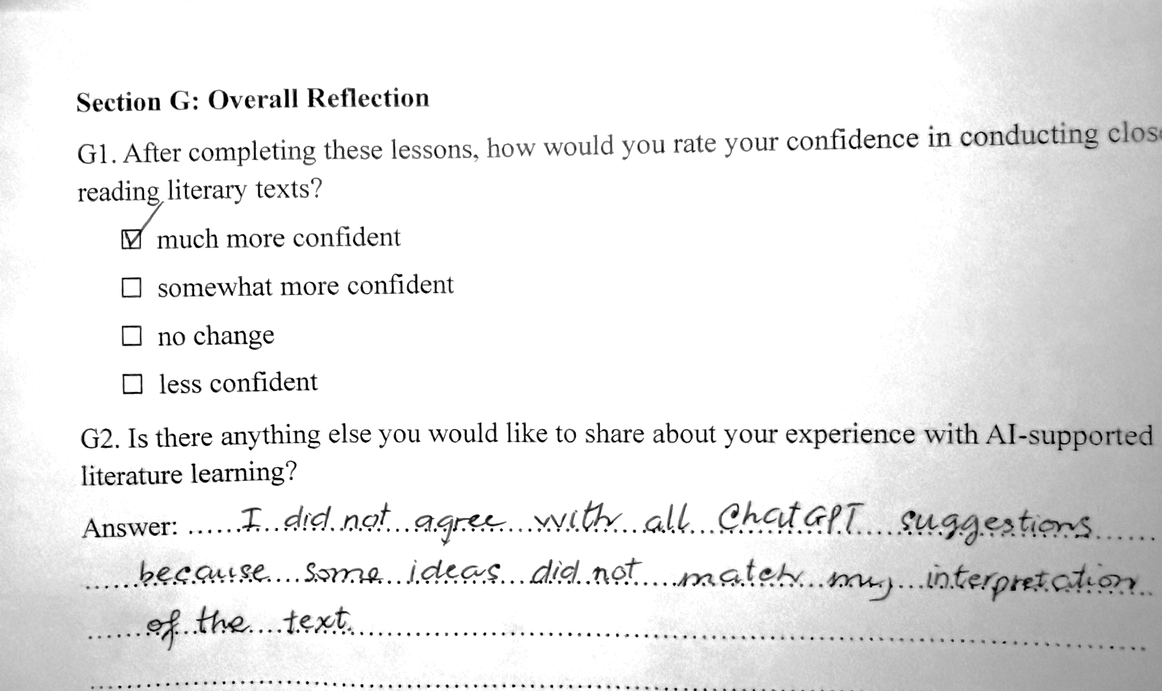

Slide 25
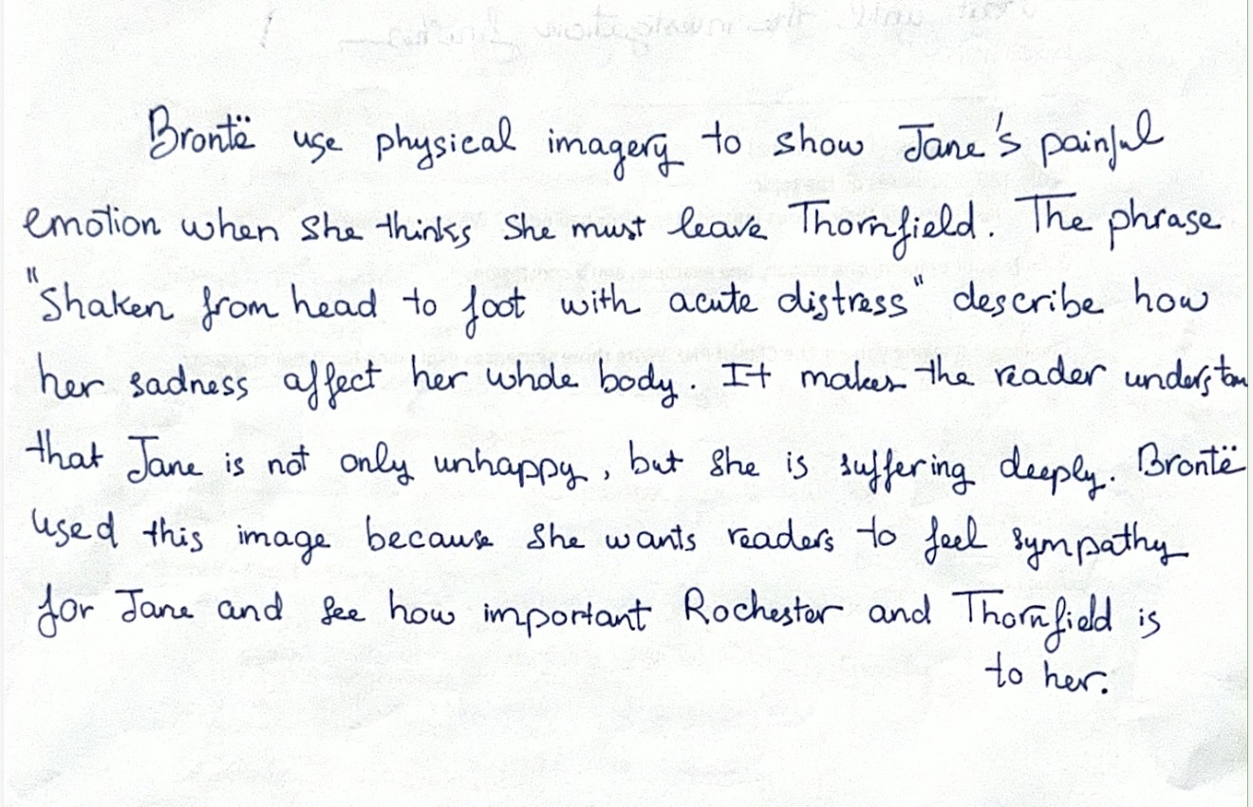

Slide 26


DISCUSSION
Critical AI Literacy: Step 7 Findings
WHAT STEP 7 INVOLVES
60.7%
Students receive ChatGPT-generated feedback on their analytical paragraph
They must accept OR reject each suggestion in writing
of participants (n=74) mentioned Step 7 in free responses
Justification required for each decision made
Initially difficult → Later seen as highly beneficial
Develops selective, evaluative engagement with AI output
Reduces passive AI dependence (Teng, 2024; Nguyen et al., 2025)
HUFLIT · 2026
16

Slide 27



CONCLUSIONS
Conclusions & Contributions
Key Findings
RQ1 Challenges
RQ2 Usefulness
RQ3 Attitudes
Three confirmed difficulty areas:
linguistic (B1; M=4.31)
cultural (B2; M=4.18)
procedural (B4; M=4.23)
All post-pilot usefulness items exceeded M=4.00;
rubric clarity highest rated (E4; M=4.51)
step-by-step structure valued
88.5% reported increased confidence;
perceived reduction in reading and assessment anxiety
HUFLIT · 2026
17

Slide 28
CONCLUSIONS
Conclusions & Contributions
Theoretical & Pedagogical Contributions
Applies Vygotsky’s (1978) ZPD and Rosenblatt’s (1994) transactional theory to AI-mediated EFL literary instruction
1
_ First empirical framework combining structured AI scaffolding + domain-specific rubric for EFL literary close reading
_ Evidence-informed classroom tool: 8 steps, prompt templates, & 5-criteria analytical rubric - adaptable to other literary texts
2
3
HUFLIT · 2026
18

Slide 29

CONCLUSIONS
Limitations & Directions for Future Research
LIMITATIONS
FUTURE RESEARCH
Single institution (HUFLIT) - limited generalizability
Multi-institutional replication across Vietnamese & regional EFL contexts
Descriptive statistics only - no inferential testing
Paired-samples t-tests / Wilcoxon tests with pre/post writing scores
Self-report measures - potential response bias
Long-term critical AI literacy development
No pre/post writing performance scores
Teachers’ perspectives on framework implementation
Limited to Jane Eyre passages
Framework adaptation to other literary texts & genres
Implications: Teachers · Curriculum Designers · EFL Policy Makers in Vietnam
AI embedded in structured pedagogy can support - not replace - independent literary analysis
HUFLIT · 2026
19

Slide 30
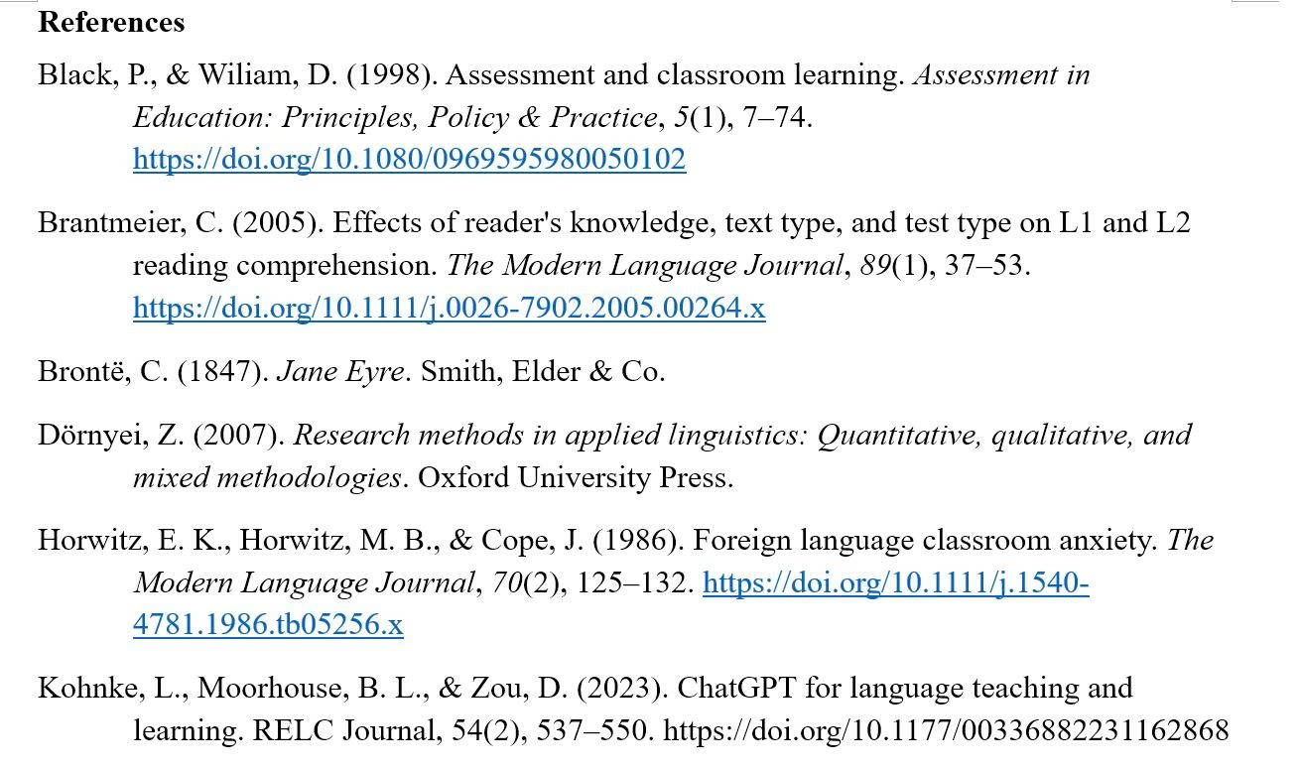
REFERENCES · 1 OF 4
References
HUFLIT · 2026
21

Slide 31
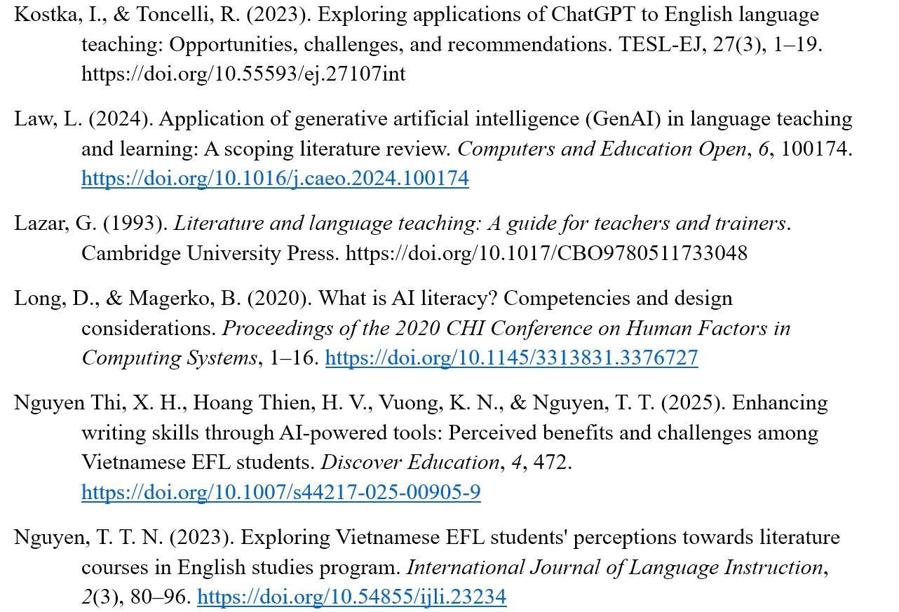
REFERENCES · 2 OF 4
References
HUFLIT · 2026
22

Slide 32
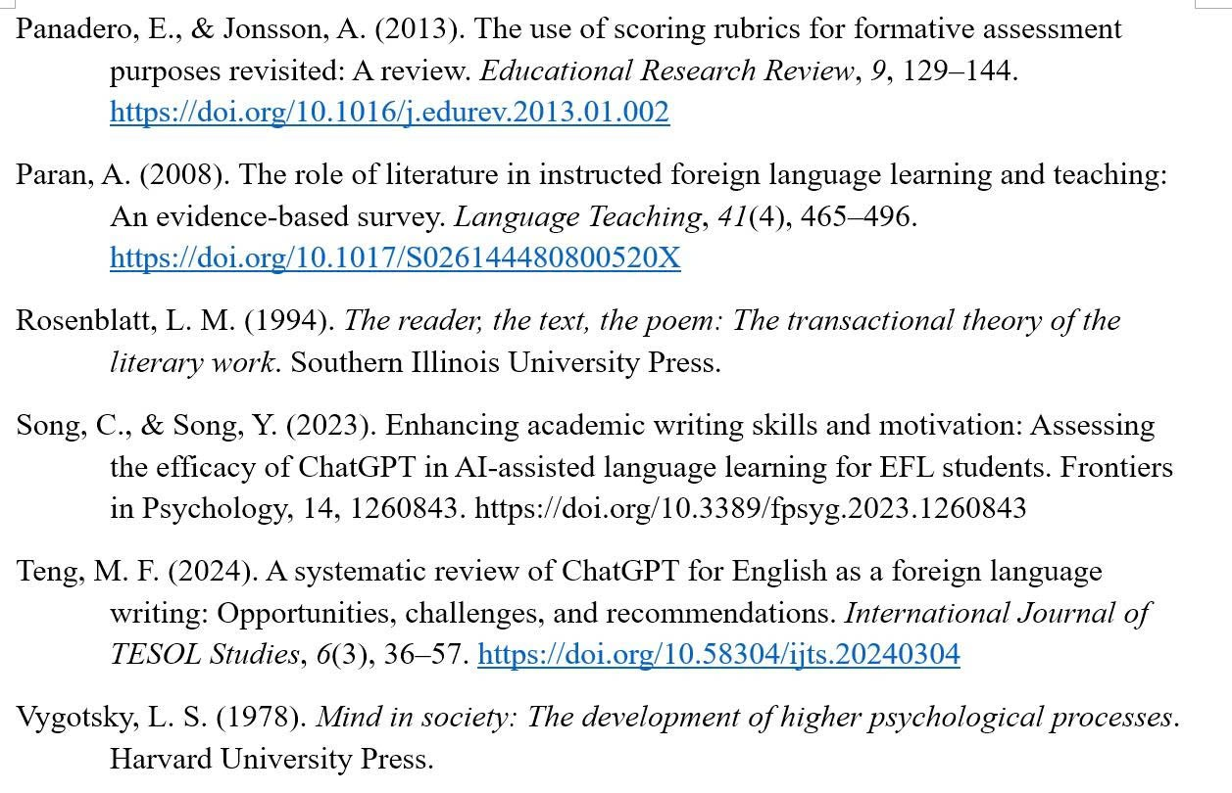
REFERENCES · 3 OF 4
References
HUFLIT · 2026
23

Slide 33
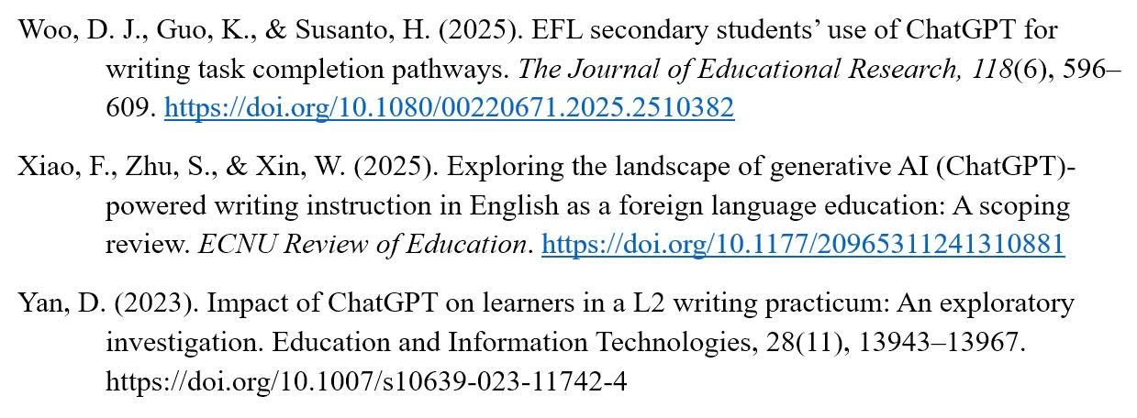
REFERENCES · 4 OF 4
References
HUFLIT · 2026
24

Slide 34

Thank You
Questions & Discussion
Nguyễn Thị Thư Hiên
hienntt@huflit.edu.vn
Ho Chi Minh City University of Foreign Languages and Information Technology (HUFLIT)
KEY TAKEAWAY
A structured 8-step ChatGPT-assisted framework with alternating AI/AI-free activities and rubric-based assessment can meaningfully support Vietnamese EFL learners in English literature - increasing confidence, reducing anxiety, and fostering critical AI literacy.
HUFLIT · 2026
20

