Slide 1

Notes:
Good afternoon, everyone. My name is Tran Le Khanh Phuong. Today, I will present our study on integrating ClassDojo into warm-up activities to support EFL learners’ writing performance at a Vietnamese language center.

Slide 2

Notes:
The presentation has five parts: background, research questions, methodology, findings, and conclusion.

Slide 3

Notes:
Let me begin with the background of the study.
Writing is demanding because learners must generate ideas, organize content, retrieve vocabulary, and use grammar accurately. These demands are especially difficult for lower-proficiency learners, who may also feel anxious or lack confidence.
Therefore, this study focuses on the pre-writing stage and examines whether warm-up activities can better prepare learners before they begin writing.

Slide 4

Notes:
Based on this background, I will now introduce the research gap.
Gamification is widely used to improve engagement and motivation. ClassDojo is also common in classrooms, but it is usually used for behavior management or general participation.
Few studies have examined its use in a specific instructional stage, especially the warm-up stage before writing. In this study, ClassDojo was not treated as a direct writing tool, but as indirect support for engagement and writing readiness.

Slide 5
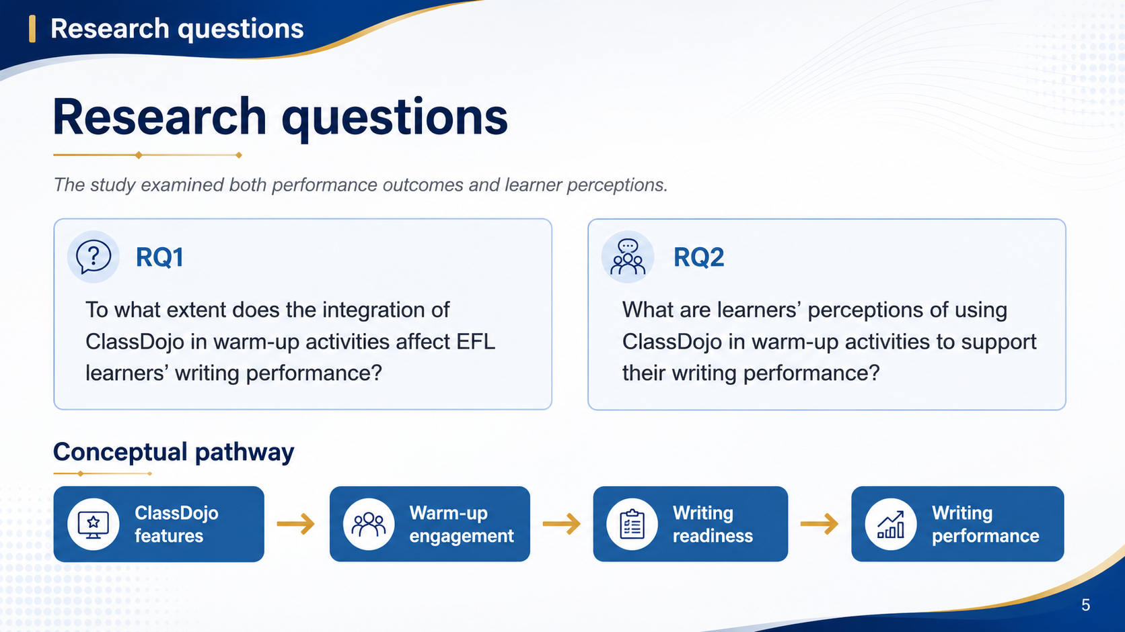
Notes:
To address this gap, the study examined two research questions.
First, to what extent did ClassDojo-supported warm-ups affect learners’ writing performance?
Second, how did learners perceive these activities?
Writing performance was measured through a pre-test, post-test, and delayed post-test. Learner perceptions were examined through a questionnaire and interviews.

Slide 6
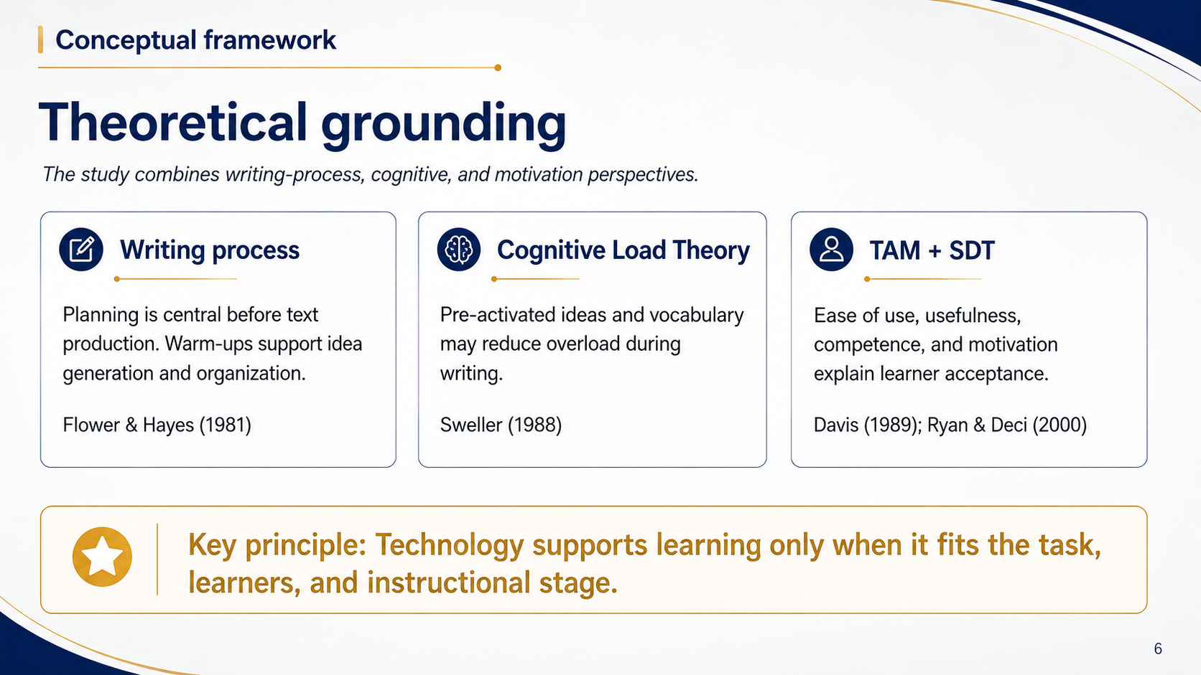
Notes:
Now, I will briefly explain the theoretical grounding.
The study was informed by three perspectives.
The writing-process model highlights planning before drafting. Cognitive Load Theory suggests that activating ideas and vocabulary may reduce pressure during writing. Finally, the Technology Acceptance Model and Self-Determination Theory help explain learners’ perceptions of usefulness, ease of use, and motivation.
Overall, technology is effective only when it fits the task, learners, and instructional stage.

Slide 7
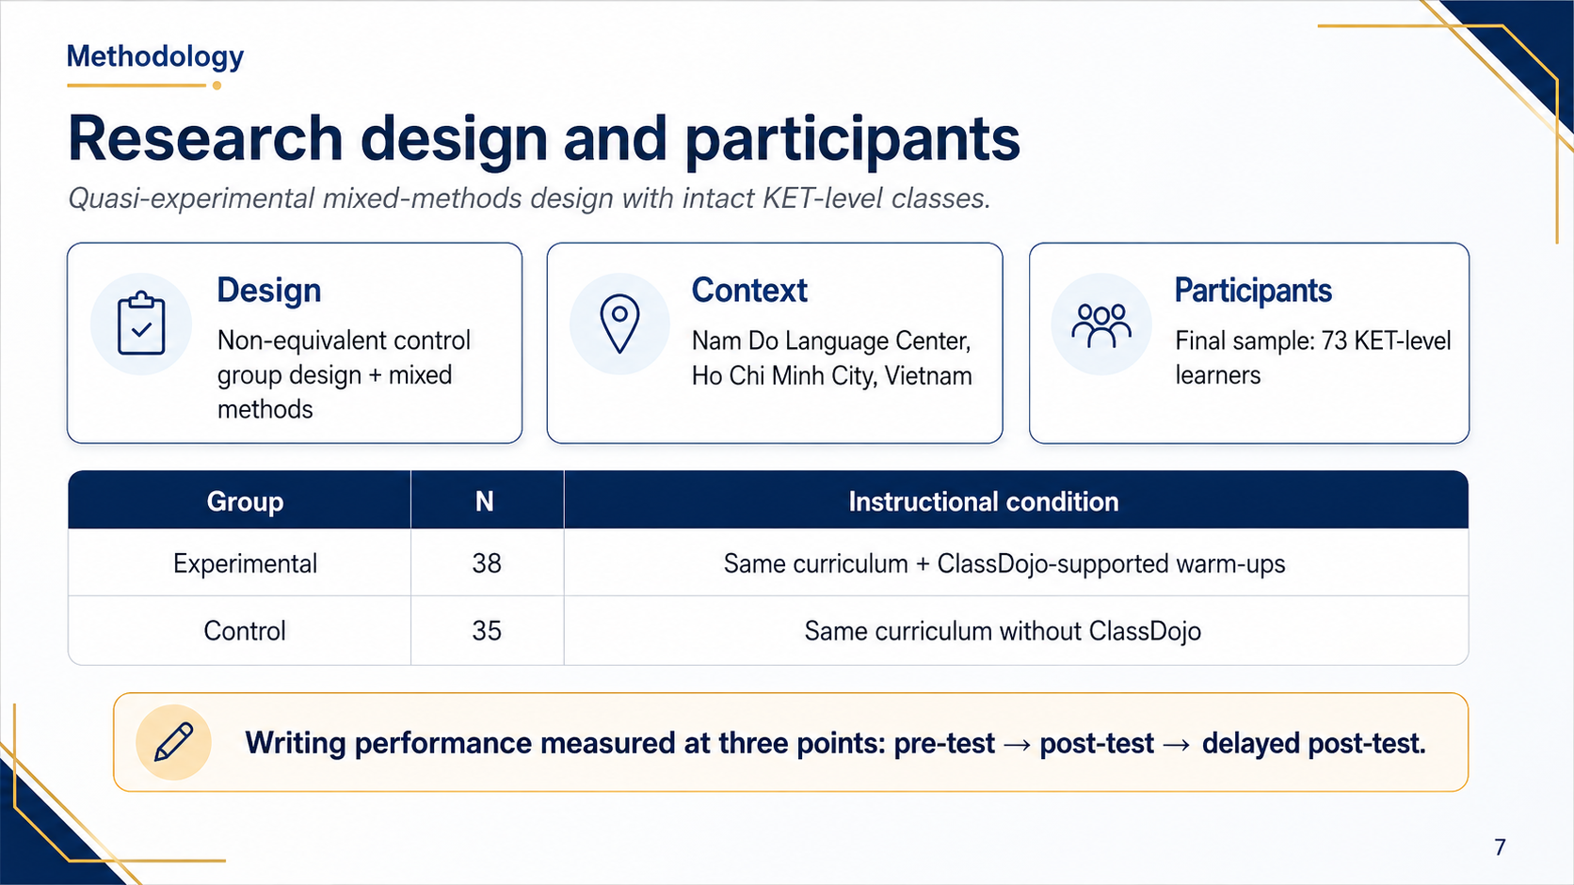
Notes:
Let me move to the methodology.
This study used a quasi-experimental mixed-methods design with intact classes. It was conducted at Nam Do Language Center in Ho Chi Minh City.
After incomplete cases were removed, the final sample included 73 KET-level learners: 38 in the experimental group and 35 in the control group.
Both groups followed the same curriculum, but only the experimental group used ClassDojo-supported warm-ups.

Slide 8
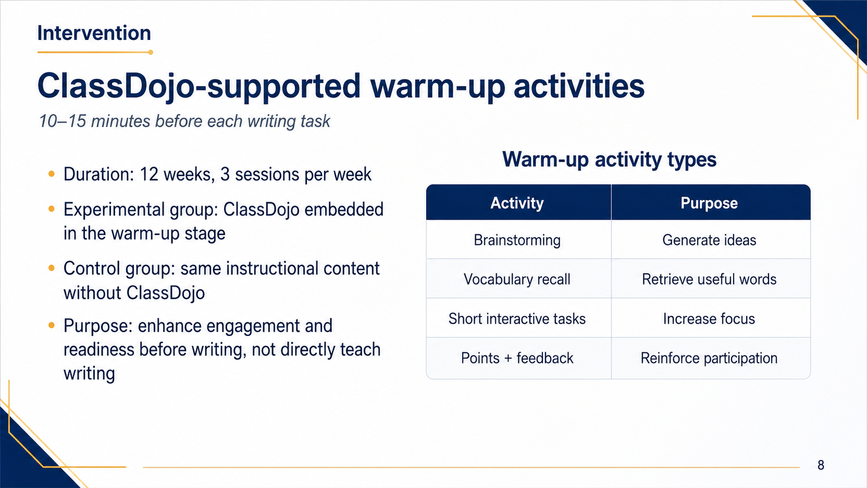
Notes:
Regarding the intervention, it lasted twelve weeks, with three writing lessons per week.
Before each writing task, the experimental group completed a ten- to fifteen-minute warm-up. Activities included brainstorming, vocabulary recall, and short interactive tasks. ClassDojo provided points and immediate feedback to reinforce participation.
The purpose was not to teach writing directly, but to help learners become more focused, involved, and ready to write.

Slide 9

Notes:
To evaluate the intervention, three instruments were used.
First, learners completed three Cambridge A2 Key-aligned writing tests. Two raters scored the scripts using Content, Organization, and Language. Inter-rater reliability was strong, ranging from .861 to .916.
Second, the experimental group completed a bilingual questionnaire. Third, ten learners participated in semi-structured interviews.
The quantitative and qualitative findings were then compared for a fuller interpretation.

Slide 10
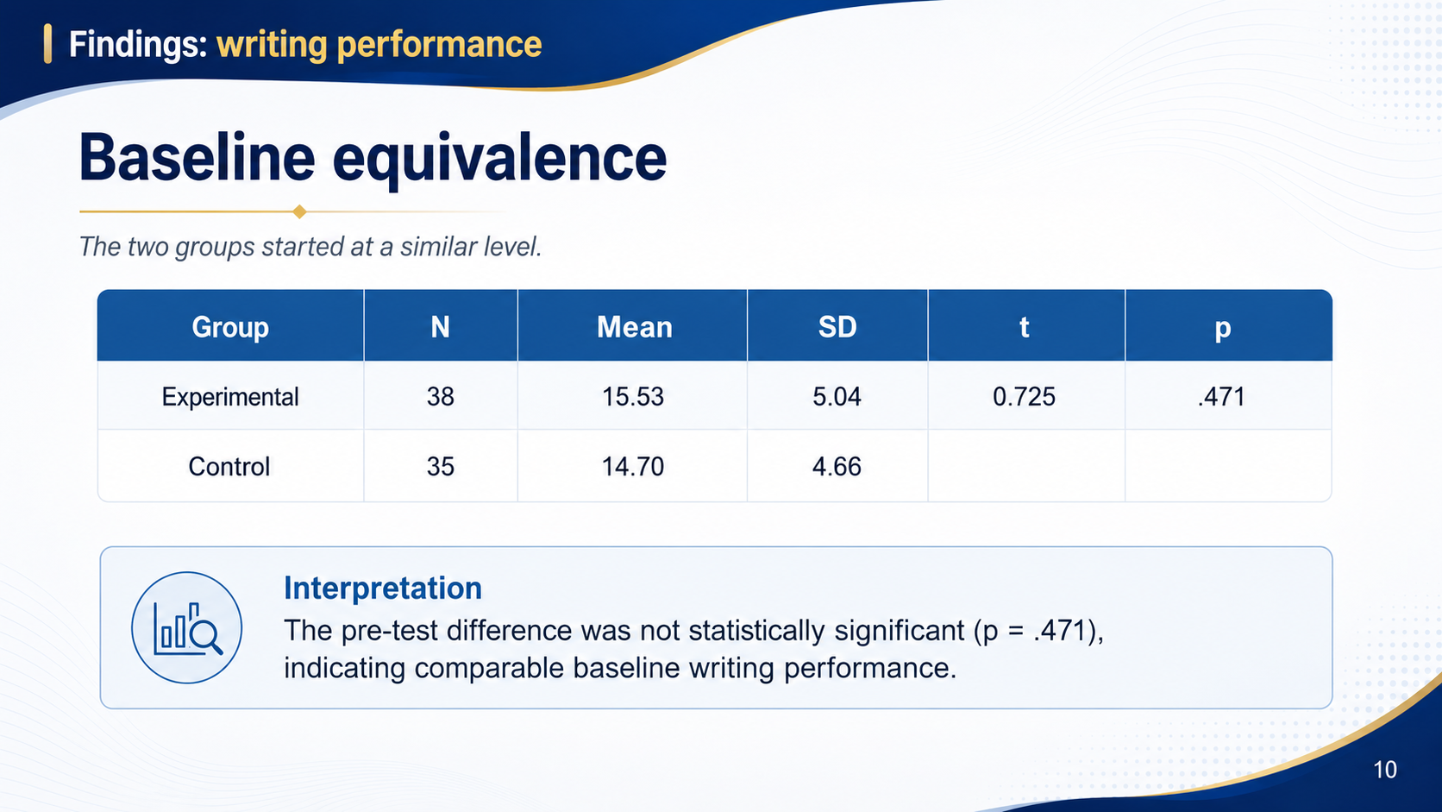
Notes:
I will now move to the main findings. First, the two groups were compared at the pre-test.
The experimental group had a mean score of 15.53, while the control group scored 14.70. The difference was not statistically significant, with $p=.471$.
Therefore, the two groups had comparable writing performance at the beginning of the study.

Slide 11
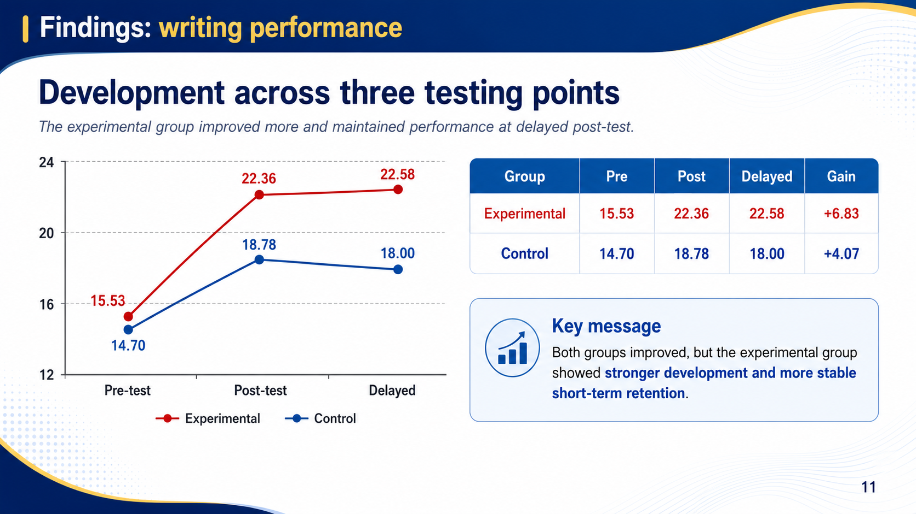
Notes:
After confirming baseline equivalence, we examined learners’ development across the three tests.
Both groups improved after instruction, but the experimental group improved more.
Its mean score increased from 15.53 to 22.36 and remained stable at 22.58 in the delayed post-test.
The control group increased from 14.70 to 18.78, but then decreased slightly to 18.00.
This pattern suggests stronger immediate improvement and more stable short-term retention in the experimental group.

Slide 12
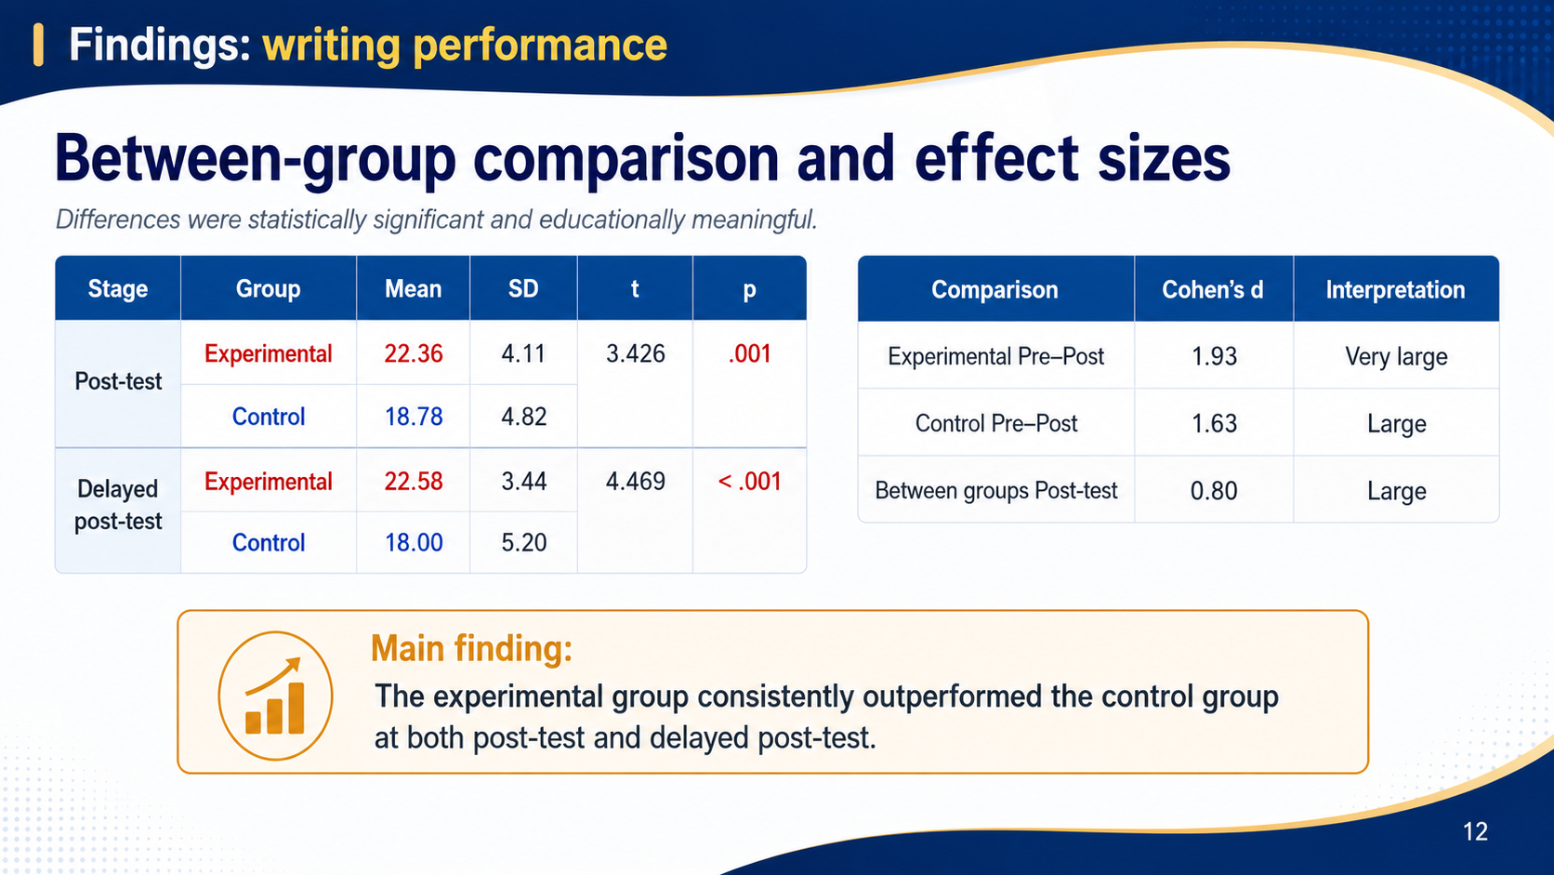
Notes:
To examine these differences more closely, the two groups were compared statistically.
The between-group differences were statistically significant at both testing points: $p=.001$at the post-test and $p<.001$at the delayed post-test.
The experimental group also showed a very large pre–post effect size, with Cohen’s $d=1.93$. The between-group post-test effect size was $d=.80$, which is considered large.
Therefore, the results were both statistically significant and educationally meaningful.

Slide 13
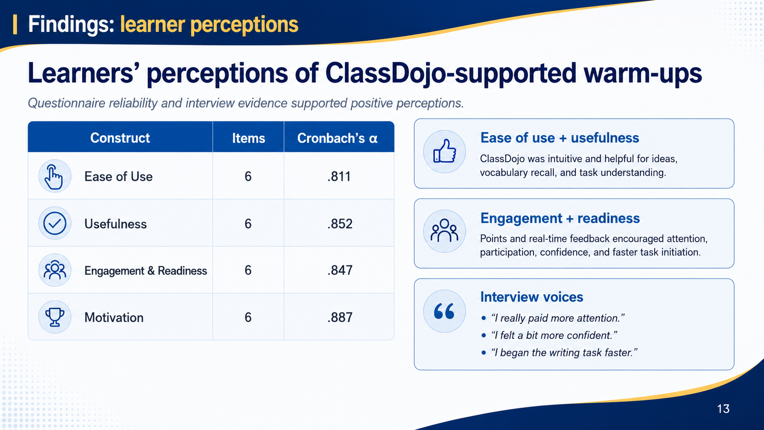
Notes:
In addition to writing performance, the study also examined learner perceptions.
Learners’ perceptions were generally positive.
Questionnaire reliability was acceptable across all constructs, with Cronbach’s alpha values ranging from .811 to .887.
Learners reported that ClassDojo was easy to use and useful for recalling vocabulary, generating ideas, and understanding writing tasks. Interview responses also showed that points and immediate feedback increased attention, confidence, participation, and readiness to begin writing.

Slide 14
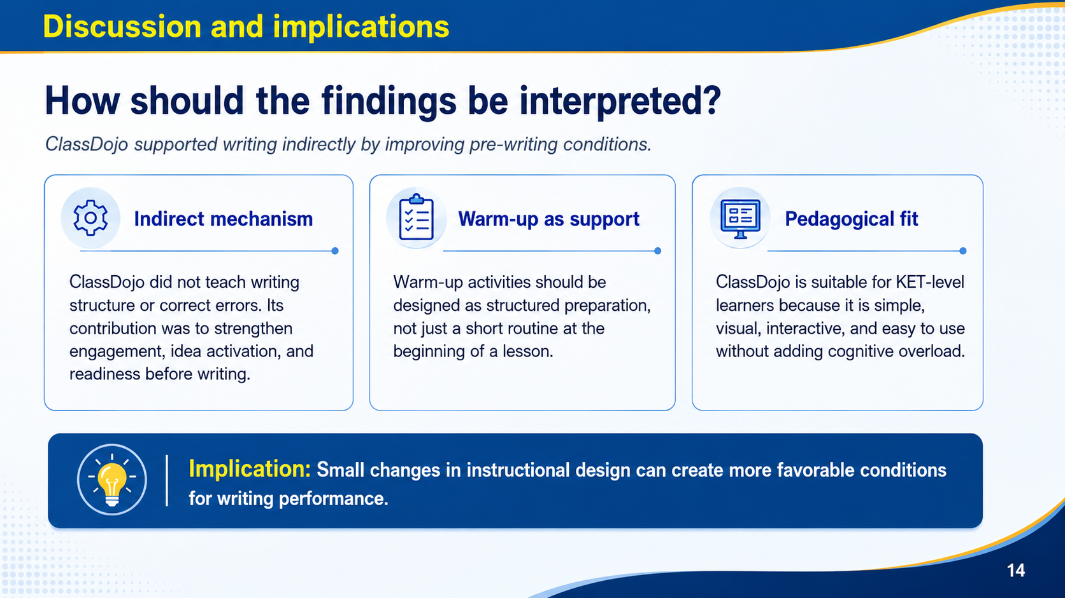
Notes:
Based on these findings, the results should be interpreted as an indirect effect.
ClassDojo did not teach grammar, writing structure, or accuracy directly. Instead, it improved the conditions before writing by making warm-ups more interactive, visible, and rewarding.
Pedagogically, warm-ups should be designed as purposeful preparation rather than routine opening activities. Even a short warm-up can activate ideas, reduce hesitation, and improve writing readiness.

Slide 15
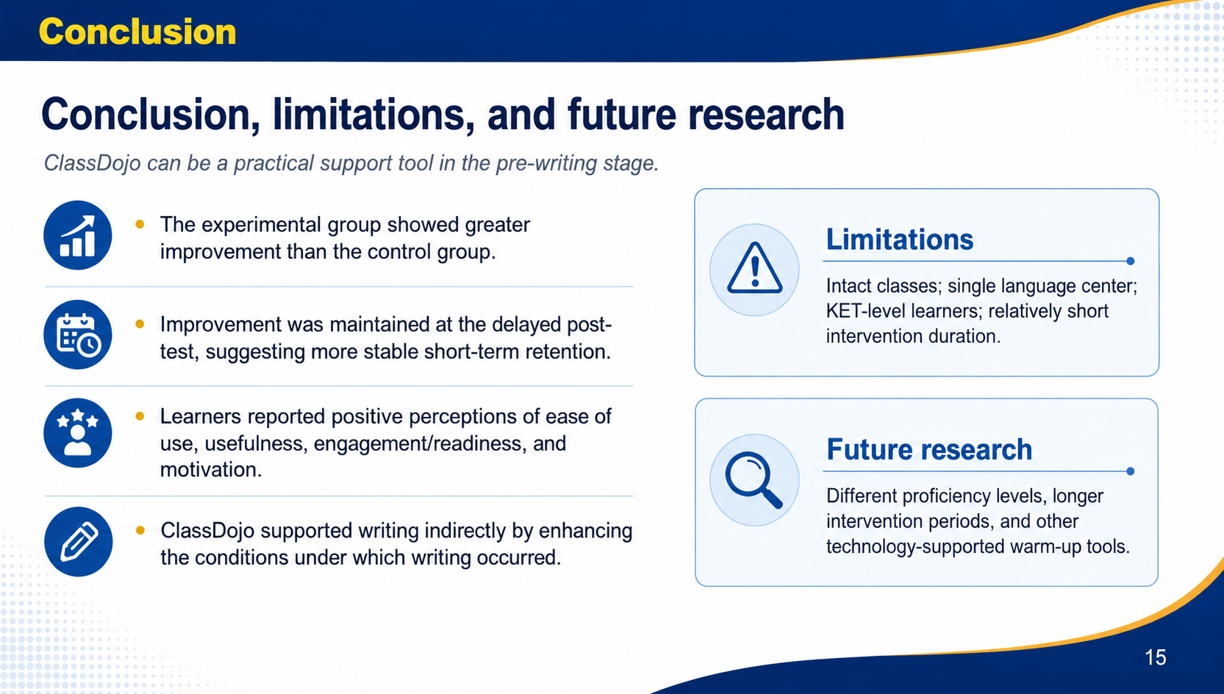
Notes:
Finally, I would like to conclude the presentation.
In conclusion, the experimental group showed greater and more stable improvement than the control group. Learners also reported positive perceptions of the ClassDojo-supported warm-ups.
The main conclusion is that ClassDojo can support writing indirectly by improving pre-writing conditions.
However, the study was limited to intact KET-level classes at one language center over twelve weeks. Future research should examine other proficiency levels, longer interventions, and different digital warm-up tools.

Slide 16

Notes:
Thank you for your attention. I would be happy to answer any questions.

Slide 17


