Slide 1


A QUASI-EXPERIMENTAL STUDY · VIETNAMESE EFL CONTEXT
Exploring the Effects of AI-Mediated Low-Stakes Practice on Speaking Anxiety in Vietnamese EFL Classrooms
Lê Minh Hằng
Faculty of Foreign Languages, Ton Duc Thang University
Ho Chi Minh City, Vietnam · leminhhang@tdtu.edu.vn

Slide 2
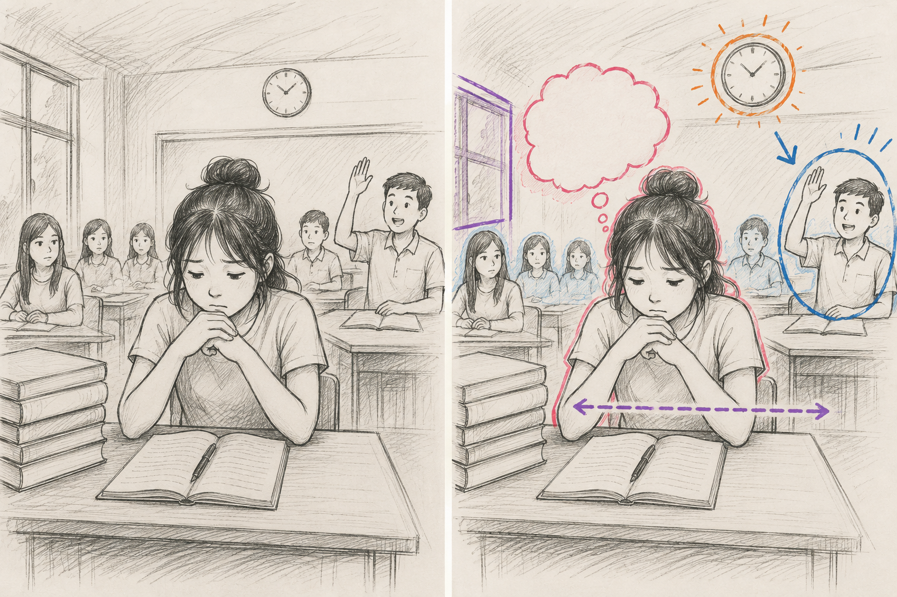

Slide 3






OVERVIEW
01 Introduction
02 Literature & Framework
03 Methodology
04 Results
05 Discussion
06 Limitations & Conclusion
2
Notes:
Good morning, everyone. Thank you for being here. My name is Le Minh Hang, from Ton Duc Thang University in Ho Chi Minh City. Before we dive in, let me give you a quick roadmap of where we are going. We will start with the problem that motivated this study, then move through the literature and framework, the method, the results, and finally what it all means. So let's begin with the problem itself.

Slide 4
Knowing the language, yet silent in class
1. INTRODUCTION
Speaking is the most anxiety-provoking skill in foreign-language learning
(Horwitz et al., 1986; Young, 1991).
In Vietnamese classrooms, large classes, exam-driven curricula, and face-preserving Confucian norms compound the problem
(Bao, 2013; Truong & Ho, 2022).
THREE COMPONENTS OF
SPEAKING ANXIETY (FLA)
Communication Apprehension
Fear of real-time, audience-present speaking
Fear of Negative Evaluation
Worry about judgment — most tied to reticence
3–4 of 40–50
Test Anxiety
students typically volunteer to speak — the rest rely on rehearsed scripts or avoid eye contact.
Stress linked to formal assessment
3
Notes:
Here is the puzzle that started everything. In our speaking classrooms, we often see students who know the grammar and read very well on paper. But the moment we ask them to speak, they go quiet. As the numbers on the right show, in a class of forty to fifty, typically only three or four students volunteer to speak. Speaking is the most anxiety-provoking skill, and in Vietnam large classes, exam pressure, and a culture of face-saving make it even harder. Now, this anxiety is not just one single feeling. It has three parts, shown on the right. Keep these three in mind, because they come back later. So if the problem is this well known, what does the research actually say?

Slide 5

1. INTRODUCTION
A documented problem — but no Vietnamese evidence
EVIDENCE EXISTS ELSEWHERE — NOT IN VIETNAM
Iran
Fathi et al. (2024) · n=40 · ↑ speaking skills
0
China
Zhang et al. (2024) · n=99 · ↓ anxiety
China
Chen et al. (2025) · n=71 · 8 wks · ↓ anxiety
results in Scopus, Web of Science & ERIC for AI × speaking anxiety × Vietnam (Jan 2025 search)
Indonesia
Fathi et al. (2025) · n=75 · ↓ anxiety
THREE PERSISTENT GAPS ① affective mechanisms beyond total scores ② Vietnamese / ASEAN learners ③ FLA sub-component effects
4
Notes:
This is where it gets interesting. The problem is documented all around the region. We see strong studies from Iran, China, and Indonesia, all showing that AI practice can reduce anxiety. But here is the gap, the big zero on the left: when we searched the major databases for this topic in Vietnam, we found nothing. Zero studies. On top of that, three gaps remain across the whole field, listed at the bottom. So that gap is exactly what this study set out to fill. And it led us to three clear research questions.

Slide 6
1. INTRODUCTION
Research Questions:
Does AI-mediated low-stakes practice reduce foreign-language speaking anxiety — total and by sub-component?
RQ1
What are its effects on oral performance, measured by an analytic speaking rubric?
RQ2
How do experimental-group students perceive AI practice in reducing anxiety and building confidence?
RQ3
5
Notes:
So, to address that gap, we asked three questions. First, does AI practice actually reduce speaking anxiety, both overall and by those three components I mentioned earlier? Second, does it improve real speaking performance? And third, how do the students themselves experience it? Each question maps onto one part of our results, so we will return to RQ1, RQ2, and RQ3 in turn. But before the results, let me briefly explain why we expected AI to help in the first place.

Slide 7
2. LITERATURE & THEORETICAL FRAMEWORK
Affective Filter
Desirable Difficulties
Skill Acquisition
Krashen (1982)
Bjork & Bjork (2011)
DeKeyser (2007)
Anxiety blocks comprehensible input; lowering it aids acquisition.
Optimal learning needs challenge — without threat.
Repeated practice builds procedural, automatized knowledge.
HOW AI LOWERS THE FILTER
↓ Fear of Negative Evaluation
↓ Communication Apprehension
≈ Test Anxiety
Non-judgmental interlocutor; no peer audience
Private, repeatable practice removes live pressure
Not tied to formal assessment — less affected
6
Notes:
To understand why this should work, we lean on three well-established ideas. Krashen's affective filter says anxiety blocks learning, so lowering it helps. Bjork and Bjork remind us that good learning needs challenge, but without threat. And DeKeyser shows that repeated practice builds automatic, fluent speech. Put simply, as the dark strip at the bottom shows, AI lowers the fear of being judged and the pressure of a live audience, but it does not touch test anxiety, because there is no test. Remember this prediction, it matters a lot later. With that foundation in place, let me walk you through how we actually tested it.

Slide 8
3. METHODOLOGY
Quasi-experimental, pretest–posttest design
64
6
B1+
100%
second-year
English majors
weeks of
intervention
CEFR level
(placement test)
completion
(no withdrawals)
Experimental (n = 32)
Control (n = 32)
Same 2-hr class + 3 × 30-min/week AI voice sessions (ChatGPT, GPT-4o voice mode). 24 F / 8 M.
Same class + ~90 min/week conventional prep (monologues, prompts, vocab logs). 22 F / 10 M.
INSTRUMENTS: 20-item FLCAS-adapted anxiety scale (α = .89)
. Analytic speaking rubric, 5 dims / 25 pts (ICC = .91)
. 12 semi-structured interviews (κ = .81)
7
Notes:
Here is how the study was built. We worked with sixty-four second-year English majors, split into two equal groups of thirty-two. Both groups had the same teacher, the same lessons, over six weeks. The only difference, shown in the two colored boxes, is that the experimental group added AI voice practice, while the control group did conventional preparation. We measured anxiety with a validated FLCAS-based scale, scored speaking with a rubric, and interviewed twelve students. And importantly, nobody dropped out. Now, let me show you exactly what that AI practice looked like week by week.

Slide 9


INTERVENTION DESIGN
Six weeks of scaffolded AI speaking practice
WEEKS 1–2
WEEKS 3–4
WEEKS 5–6
1
2
3
Guided Role-Plays
Semi-Guided Talk
Open Discussion
Structured scenarios with scripted prompts and vocabulary support
Topic-based conversations with minimal structural support
Self-selected topics simulating naturalistic interaction
87% mean compliance (range 72–97%)
Self-report logs verified against conversation screenshots. Both groups taught by the same instructor with identical lesson plans.
8
Notes:
The AI practice was not random chatting; it was carefully scaffolded. In weeks one and two, students did guided role-plays with scripts. In weeks three and four, the support was reduced. And in weeks five and six, they had open, free conversations. As you can see, the structure gradually hands control over to the learner. Compliance was high, at eighty-seven percent, and we checked it with screenshots. So, with the method clear, let's get to the part you have been waiting for, the results. We will start with anxiety, which is RQ1.

Slide 10
4. RESULTS · RQ1
Total speaking anxiety: a large drop in the AI group
TABLE 1 · Total Speaking Anxiety (range 20–100)
Group | Pre M | Post M | Diff. | d [95% CI]
Exp. (n=32) | 72.41 | 58.63 | −13.78 | 1.38 [0.98, 1.78]
Ctrl. (n=32) | 71.88 | 69.22 | −2.66 | 0.26 [−0.13, 0.65]
Group × Time interaction
F(1, 62) = 31.56, p < .001, η²p = .34
Exp. group fell 13.78 points (d = 1.38, large); control's 2.66-point change was non-significant. ANCOVA confirmed the effect held.
→ Overall anxiety fell — but which kind of anxiety?
9
Notes:
This is our first and central result. Look at the chart. The gold bars are before, the coral bars are after. The experimental group, on the left, dropped sharply, almost fourteen points. The control group barely moved. In plain terms, the effect size was very large, d equals one point three eight. The statistics in the box confirm this is a real, strong effect, not chance. So overall anxiety fell. But the more interesting question is, which kind of anxiety fell? Let me break it down.

Slide 11
4. RESULTS · RQ1
The novel finding: anxiety drops differ by sub-component
Fear of Negative Evaluation
FNE
−5.94 pts · d = 1.47
Largest effect — AI removes the evaluative audience
Communication Apprehension
CA
−6.22 pts · d = 1.29
Private, repeatable practice removes live pressure
Test Anxiety
TA
−1.62 pts · d = 0.44
Non-significant interaction (p = .169) — not assessment-tied
Lower anxiety is good —
but did speaking actually improve?
10
Notes:
This next slide is, for me, the heart of the contribution. Remember the three components from the very beginning? Here is what happened to each. Fear of negative evaluation dropped the most. Communication apprehension dropped a lot too. But test anxiety barely changed, and that change was not significant. And notice, this is exactly what the theory predicted earlier. AI removes the audience and the judgment, but not the test. The pattern fits perfectly. So anxiety went down. But did that translate into better speaking? That is RQ2.

Slide 12
4. RESULTS · RQ2
Oral performance: gains concentrated in fluency & interaction
TOTAL SCORE (/25)
+3.69 Exp.
14.72 → 18.41 d = 1.20 vs control +1.35 (d = 0.40)
Significant gains fluency (p<.01), interaction (p<.01), vocabulary (p<.05)
Not significant pronunciation (p=.083), grammar (p=.114)
11
Notes:
Lower anxiety is good, but does it help students actually speak better? Yes, and here is where. The experimental group gained almost four points overall, a large effect. But look closely at the chart: the biggest gains were in fluency and interaction, in teal. Pronunciation and grammar, however, did not improve significantly. The takeaway is simple and honest: AI builds fluency and confidence, but it does not replace explicit teaching of grammar and pronunciation. Now, numbers tell us what happened. To understand why, let's hear from the students themselves. That is RQ3.

Slide 13



4. RESULTS · RQ3
Student voices: four themes from 12 interviews
10/12
9/12
Reduced fear of judgment
Repetition & self-pacing
Absence of social evaluation was the primary benefit — focus on ideas, not face.
Repeating scenarios built fluency; one student practiced a role-play 7 times.
8/12
12/12
Gradual confidence building
Perceived limitations
Confidence transferred to class — Lan raised her hand after 4 weeks of practice.
Speech-recognition errors, limited depth — "a gym, not the real sport."
12
Notes:
So what did the students actually say? Four clear themes came out of the interviews. Ten of twelve said the best part was no fear of being judged. Nine valued being able to repeat and practice at their own pace. Eight described growing confidence that carried into the real classroom. And all twelve were honest about the limits. One student put it beautifully, that the AI is like a gym, useful for building strength, but not the real sport. These voices line up neatly with our numbers. So let me now bring the numbers and the voices together.

Slide 14
5. DISCUSSION
Quantitative and qualitative patterns converge
AI removes the evaluative audience (↓FNE) and the live audience (↓CA), but not the test (≈TA) — the data fall exactly where theory predicts.
Anxiety & themes align
Fluency over accuracy
A confidence bridge
FNE drop maps to Theme 1 (fear of judgment); CA drop to Theme 2 (private repetition); TA unchanged — no test-related relief reported.
Conversational AI lifts fluency & interaction, but not pronunciation/grammar — those need explicit instruction.
Automaticity from private practice freed cognitive resources, transferring to voluntary classroom speaking.
13
Notes:
Here is the big picture, where everything connects. The numbers and the student voices tell the same story. AI removed the judgment and the live audience, which is why evaluation and communication anxiety fell, but it left test anxiety untouched. Theme one matches the drop in fear of judgment; theme two matches the drop in communication apprehension. On performance, fluency improved but accuracy did not, exactly as the students described. In short, AI works best as a confidence bridge. Of course, like any study, ours has limits, and I want to be transparent about them.

Slide 15
6. LIMITATIONS
Study Limitations
Future Research
Quasi-experimental design — limits full causal inference
Possible Hawthorne effect from novel technology
Self-reported compliance (87%) may overestimate engagement
Single public university; English majors; predominantly female
Six-week window — no long-term or delayed posttest data
Researcher-designed rubric, not a standardized proficiency test
Add a technology-active control group to isolate oral-AI effects from novelty
Include physiological anxiety measures alongside self-report
Use delayed posttests to track long-term retention
Employ multi-site designs across institution types and majors
Compare different AI platform types (cf. Wang et al., 2024)
14
Notes:
Let me be upfront about the limitations, on the left. This was a quasi-experiment, not a full randomized trial. There may be a novelty effect. Compliance was self-reported. It was one university, mostly female students, over a short six weeks. But each limitation points to a clear next step, on the right: a technology control group, physiological measures, delayed tests, and multiple sites. So, keeping those caveats in mind, let me bring it all together in the conclusion.

Slide 16
6. CONCLUSION
TWO PRIMARY CONTRIBUTIONS
Recommendations for Instructors
1 First empirical evidence on AI-mediated speaking practice and anxiety in Vietnamese higher education.
2 First to show differential effects across FLA sub-components — AI targets evaluative & communicative anxiety, not test anxiety.
Structured homework: 3 × 30-min/week, scaffolded over a 6-week cycle
Position AI as a fluency & interaction builder — keep explicit grammar and pronunciation in class
Add a one-week familiarization phase (frustration fades fast)
Monitor compliance via weekly logs with screenshot verification
Run periodic debriefs to build metacognitive awareness of anxiety reduction
AI serves as a confidence-building bridge between the safety of silent knowledge and the risk of public speech — valuable where large classes make individual speaking practice nearly impossible and cultural norms discourage trial-and-error.
Not a replacement for teachers
15
Notes:
To conclude, this study makes two contributions, shown on the left. It is the first evidence on this topic in Vietnam, and the first to show that AI targets specific types of anxiety, not all of them. But the key message is this: AI is not a replacement for teachers. It is a confidence-building bridge. On the right are concrete, low-cost recommendations any instructor can use tomorrow, needing only a smartphone. Which brings me to my final slide.

Slide 17
TAKEAWAYS
A confidence-building bridge — not a replacement
1st
1st
6 wk
Vietnamese evidence
Sub-component effects
Practical & low-cost
First study of AI-mediated speaking practice & anxiety in Vietnamese higher education.
First to show AI targets evaluative & communicative anxiety, not test anxiety.
Implementable within existing curricula — only a smartphone and internet needed.
Thank you
Lê Minh Hằng Faculty of Foreign Languages, Ton Duc Thang University · leminhhang@tdtu.edu.vn

