Slide 1

INSTRUCTORS’ DIGITAL COMPETENCE AFFECTING STUDENT FEEDBACK AND PERSONALIZED LEARNING IN UNIVERSITY EDUCATION
Nguyen Thanh Tuan ⁽¹⁾ ⁽²⁾
PhD. Nguyen Phuong Bao Tran ⁽¹⁾

Slide 2

PRESENTATION STRUCTURE
1. Introduction
4. Results
Problem Statement
Objectives
Research Questions
Significance
5. Conclusion
2. Theoretical Foundation
3. Research Methodology

Slide 3

1.1 Background
1. INTRODUCTION
1.1 Problem Statement
• Digital revolution shifted higher education from technology use to technology integration in teaching.
• Digital competence became a key concept with the DigCompEdu framework (Redecker & Punie, 2017).
• Rapid digital transformation (2016–2022) made online teaching essential, improving learning quality (Hizam et al., 2021).
• Digital competence enables lecturers to use digital resources and innovate pedagogy (Dang et al., 2024).
• Digital feedback and assessment enhance interaction but remain challenging for many lecturers (Betancur & García, 2023).
• AI-supported personalized learning strengthens learning experiences through digital competence (Bond et al., 2024).
 Key point: Digital competence is the foundation of quality teaching and learning in the digital era.

Slide 4

1. INTRODUCTION
1.2 Research Objective
• Evaluate the role of digital competence in enhancing student learning experiences.
• Examine its effects on student feedback and personalized learning.
• Provide recommendations for digital competence development in Vietnamese universities.
 Key point: The study provides evidence to support digital competence development for student-centered education in Vietnamese universities.

Slide 5


1. INTRODUCTION
1.3 Research Questions
(RQ1) How does instructors’ digital competence affect the effectiveness provided to students?
(RQ2) How does the instructors’ digital competence affect the implementation of personalized learning in university education?
(RQ3) Does the students’ feedback play a mediating role in the relationship between lecturers’ digital competence and personalized learning?
1.4 Significance
• The study confirms the pivotal role of instructors' digital competence.
• Feedback strengthens personalized learning.
• The findings provide practical implications for Vietnamese universities.

Slide 6
2. THEORETICAL FOUNDATION
2.1 The Concept of Instructors’ Digital Competence
• Digital competence (DC) extends beyond technology use to include cognitive, pedagogical, and social competencies (Ilomäki et al., 2016).
• DigCompEdu defines six dimensions of instructors' DC (Redecker, 2017):
Professional engagement
Digital resources
Teaching & learning
Assessment
Empowering learners
Facilitating learners' digital competence
 Key point: Digital competence goes beyond technical skills to support effective digital pedagogy.

Slide 7

2. THEORETICAL FOUNDATION
2.2 Student Feedback in Digital Learning
• Feedback bridges the gap between current performance and learning goals (Hattie & Timperley, 2007).
• Digital feedback enables timely, personalized, and interactive learning (Nicol & Macfarlane-Dick, 2006; Carless & Boud, 2018).
• AI enhances feedback quality, but challenges remain due to workload and limited digital competence (Shute, 2008; Henderson et al., 2019).
 Key point: Digital competence is essential for delivering timely, personalized, and effective feedback.

Slide 8

2. THEORETICAL FOUNDATION
2.3 Personalized Learning
Personalized Learning (PL) adapts content, pace, and learning pathways to individual student needs (Pane et al., 2017).
AI and learning analytics support adaptive and data-driven instruction (Holmes et al., 2019).
PL improves learning outcomes, motivation, and self-regulation, but relies on instructors' digital competence (Walkington, 2013; Zimmerman, 2002).
 Key point: Digital competence enables effective AI-supported personalized learning.

Slide 9
2. THEORETICAL FOUNDATION
2.4 The Relationship among DC, Feedback, and PL
• Digital competence (DC) enhances the quality of feedback and personalized learning (Redecker, 2017).
• DC enables instructors to use learning data for adaptive teaching (Holmes et al., 2019).
• The impact of DC may be influenced by technology attitudes, institutional support, and infrastructure (Tondeur et al., 2017; Instefjord & Munthe, 2017).
 Key point: Digital competence drives effective feedback and personalized learning, while its impact depends on supportive institutional conditions.

Slide 10
2. THEORETICAL FOUNDATION
2.5 Research Gaps
• Focus mainly on students’ DC, not instructors’ (Tondeur et al., 2017).
• Lack of an integrated DC–Feedback–PL model.
• Limited evidence from Vietnamese universities.
 Key point: Existing research overlooks instructors’ digital competence and lacks an integrated model in the Vietnamese higher education context.

Slide 11

3. RESEARCH METHODOLOGY
3.1 Research Design
• Quantitative, explanatory research design (Creswell & Creswell, 2018)
• Questionnaire for data collection
• PLS-SEM for hypothesis and model testing (Hair et al., 2022)
 Key point: A quantitative PLS-SEM approach was employed to test the proposed research model.

Slide 12
3. RESEARCH METHODOLOGY
3.2 Research Model
Student Feedback (SF)
Digital Competence (DC)
Personalized Learning (PL)

Slide 13


3. RESEARCH METHODOLOGY
3.3 Subjects and Sampling Size
• Participants: 246 HIU students in online/blended courses
• Sampling: Convenience sampling
• Sample size: Exceeds PLS-SEM recommendation (Hair et al., 2022)
 Key point: The study collected a sufficient sample of students to ensure reliable PLS-SEM analysis.
3.4 Data Collection Instruments
5-point Likert scale (1 = Strongly Disagree; 5 = Strongly Agree)
Scales adapted from validated studies
DC: Redecker (2017); Feedback: Hattie & Timperley (2007), Nicol & Macfarlane-Dick (2006); PL: Pane et al. (2017), Holmes et al. (2019)
 Key point: The study employed validated measurement scales to ensure reliable and valid data collection.

Slide 14


3. RESEARCH METHODOLOGY
3.5 Procedure for Data Collection and Analysis
• Questionnaire design → Pilot test → Revision
• Main survey via Google Forms
• Data screening & cleaning before analysis (Creswell & Creswell, 2018)
 Key point: A systematic data collection process ensured the quality and reliability of the research data.
Measurement Model
✔ Reliability
Cronbach's Alpha ≥ 0.70
Composite Reliability ≥ 0.70
✔ Validity
AVE ≥ 0.50
Outer Loading > 0.70
HTMT < 0.85
Structural Model
Path coefficients
t-values & p-values
R²
f²

Slide 15
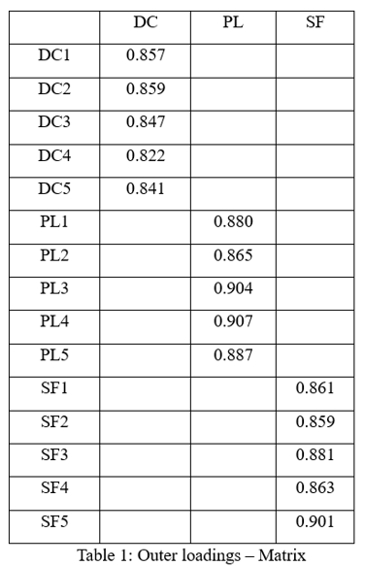
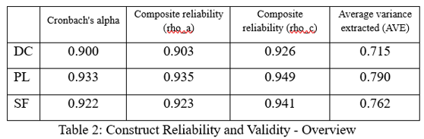
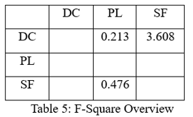
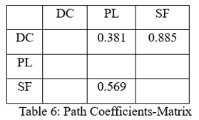
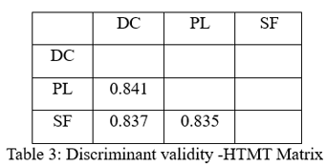
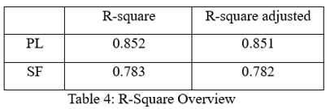
4. RESULTS

Slide 16
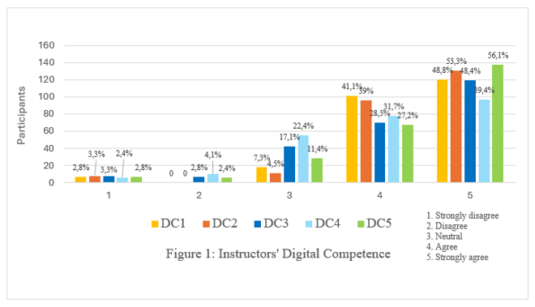

Slide 17
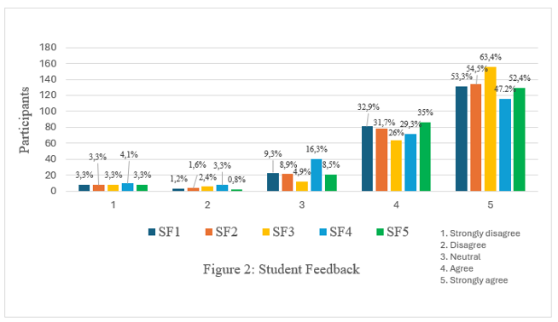

Slide 18
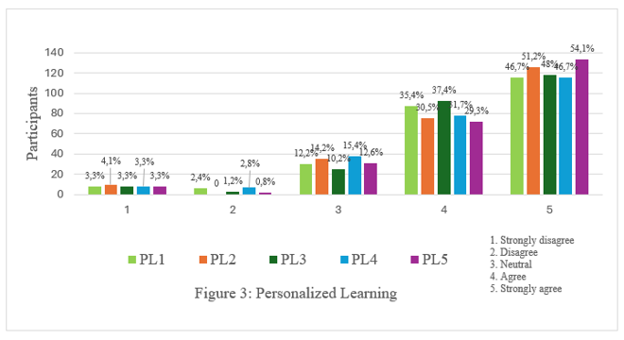

Slide 19

5. CONCLUSION
Key Findings
DC → Feedback (+)
DC → Personalized Learning (+)
Feedback → Personalized Learning (+)
Feedback mediates the DC–PL relationship
Recommendation: Strengthen lecturers' digital competence through professional development

Slide 20

REFERENCES
Betancur, C. V., & García, V. M. R. A. (2023). Microlearning for the development of teachers' digital competence related to feedback and decision making. Education Sciences, 13(7), 722. https://doi.org/10.3390/educsci13070722
Bond, M., Bedenlier, S., Marín, V. I., & Händel, M. (2024). Personalized learning in digital higher education: A systematic review. Computers & Education.
Carless, D., & Boud, D. (2018). The Development of Student Feedback Literacy. Assessment & Evaluation in Higher Education, 43(8), 1315–1325. https://doi.org/10.1080/02602938.2018.1463354
Chaw, L. Y., & Tang, C. M. (2024). Exploring the relationship between digital competence proficiency and student learning performance. European Journal of Education, 59, e12593. https://doi.org/10.1111/ejed.12593
Creswell, J. W., & Creswell, J. D. (2018). Research Design: Qualitative, Quantitative, and Mixed Methods Approach (5th ed.). SAGE Publications.
https://us.sagepub.com/en-us/nam/research-design/book255675
Dang, T. D., Phan, T. T., Vu, T. N. Q., La, T. D., & Pham, V. K. (2024). Digital competence of lecturers and its impact on student learning value in higher education. Heliyon, 10(17), e37318. https://doi.org/10.1016/j.heliyon.2024.e37318
Hair, J. F., Hult, G. T. M., Ringle, C. M., & Sarstedt, M. (2022). A Primer on Partial Least Squares Structural Equation Modeling (PLS-SEM) (3rd ed.). SAGE Publications.
https://us.sagepub.com/en-us/nam/a-primer-on-partial-least-squares-structural-equation-modeling-pls-sem/book277161
Hattie, J., & Timperley, H. (2007). The Power of Feedback. Review of Educational Research, 77(1), 81–112. https://doi.org/10.3102/003465430298487.
Holmes, W., Bialik, M., & Fadel, C. (2019). Artificial Intelligence in Education. Center for Curriculum Redesign. https://curriculumredesign.org/wp-content/uploads/AI-in-Education-Promises-and-Implications-for-Teaching-and-Learning.pdf
Hizam, S. M., Akter, H., Sentosa, I., & Ahmed, W. (2021). Digital competency of educators in the virtual learning environment: A structural equation modeling analysis. IOP Conference Series: Earth and Environmental Science, 704(1), 012023. https://doi.org/10.1088/1755-1315/704/1/012023
Instefjord, E. J., & Munthe, E. (2017). Preparing Pre-Service Teachers to Integrate Technology: An Analysis of the Emphasis on Digital Competence in Teacher Education Curricula. Teaching and Teacher Education, 67, 37–45.
https://doi.org/10.1016/j.tate.2017.05.016
Ilomäki, L., Paavola, S., Lakkala, M., & Kantosalo, A. (2016). Digital Competence—An Emergent Boundary Concept. Education and Information Technologies, 21(3), 655–679. https://doi.org/10.1007/s10639-014-9346-4
Nicol, D. J., & Macfarlane‐Dick, D. (2006). Formative Assessment and Self‐Regulated Learning. Studies in Higher Education, 31(2), 199–218.
https://doi.org/10.1080/03075070600572090.
Pane, J. F., Steiner, E. D., Baird, M. D., & Hamilton, L. S. (2017). Informing Progress: Insights on Personalized Learning Implementation. RAND Corporation.
https://doi.org/10.7249/RR2042.
Redecker, C. (2017). European Framework for the Digital Competence of Educators: DigCompEdu. European Commission. https://doi.org/10.2760/159770
Shute, V. J. (2008). Focus on Formative Feedback. Review of Educational Research, 78(1), 153–189. https://doi.org/10.3102/0034654307313795
Tondeur, J., Van Braak, J., Ertmer, P. A., & Ottenbreit-Leftwich, A. (2017). Understanding the Relationship Between Teachers’ Pedagogical Beliefs and Technology Use in Education: A Systematic Review. Educational Technology Research and Development, 65, 555–575.
https://doi.org/10.1007/s11423-016-9481-2
Walkington, C. (2013). Using Adaptive Learning Technologies to Personalize Instruction to Student Interests. Journal of Educational Psychology, 105(4), 932–945.
https://doi.org/10.1037/a0031882
Zimmerman, B. J. (2002). Becoming a Self-Regulated Learner: An overview. Theory Into Practice, 41(2), 64–70. https://doi.org/10.1207/s15430421tip4102_2

Slide 21


