Slide 1
AI-ASSISTED ESL LEARNING AND STUDENT MOTIVATION:
Challenges and Opportunities for Software Engineering Students
Đỗ Đức Bích Ngân
Faculty IT, HUFLIT
nganddb@huflit.edu.vn

Slide 2

AI tools are reshaping ESL learning through instant feedback and personalized support. Their impact on students' motivation remains underexplored within the context of SE students.
  This study investigate ESL learning supported by AI tools among SE students by examining their perceptions, usage experiences, and effects of AI tools on their learning motivation and autonomy
SE students are frequent AI users but may rely on AI for task completion.
  This study examines whether AI promotes genuine language learning.

Slide 3

Research Questions
What are SE students’ perceptions of AI-assisted tools in English learning?
How do SE students use AI tools for ESL learning, and what benefits and challenges do they experience?
How does the integration of AI into language learning affect SE students’ motivation and autonomy?

Slide 4
Hypotheses
Frequently using AI-based tools for learning English indicate high levels of motivation to learn English.
Benefits vs. drawbacks →SE students’ attitudes towards learning English.

Slide 5
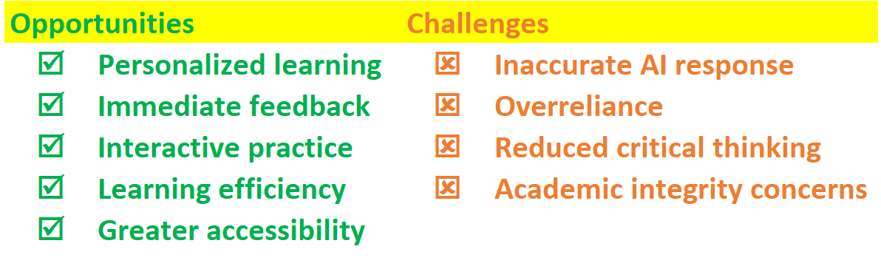
Literature review
Opportunities and Challenges AI-assisted ESL Learning

Slide 6
Literature review (cont)
AI-Assisted Learning
However...
The motivation impact of AI depends on:
▼
Low-anxiety
Greater confidence
More flexible learing
• learners' goals
• learning strategies
• how students use AI
▼
Higher engagement
and motivation

Slide 7
Literature review (cont)
RESEARCH GAPS
Existing studies mainly
focus on
▼
But they have rarely studied:
SE students, who have high digital competence and frequently use AI tools.
How AI use influences motivation and attitudes
How students balance AI's benefits and drawbacks in English learning
English majors
General university students
General benefits of AI

Slide 8
Methodology
Participants: The sample consisted of 134 undergraduate Software Engineering majors at Ho Chi Minh City University of Foreign Languages and Information Technology (HUFLIT). All the students were in their third or fourth year.
Instrument: The questionnaire consisted of both 3-point and 5-point Likert-scale items.
The quantitative data were analyzed using descriptive statistics and hypothesis testing.
Besides the quantitative items, the questionnaire also included several open-ended questions to gain deeper insights into students' experiences and opinions regarding AI-assisted English learning.

Slide 9
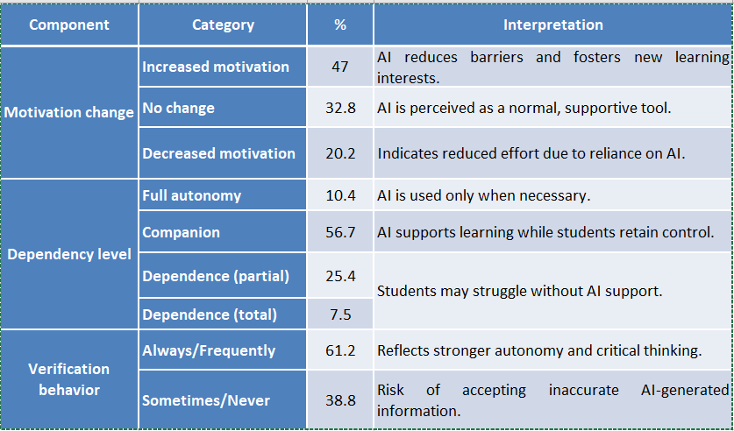
Findings

Slide 10
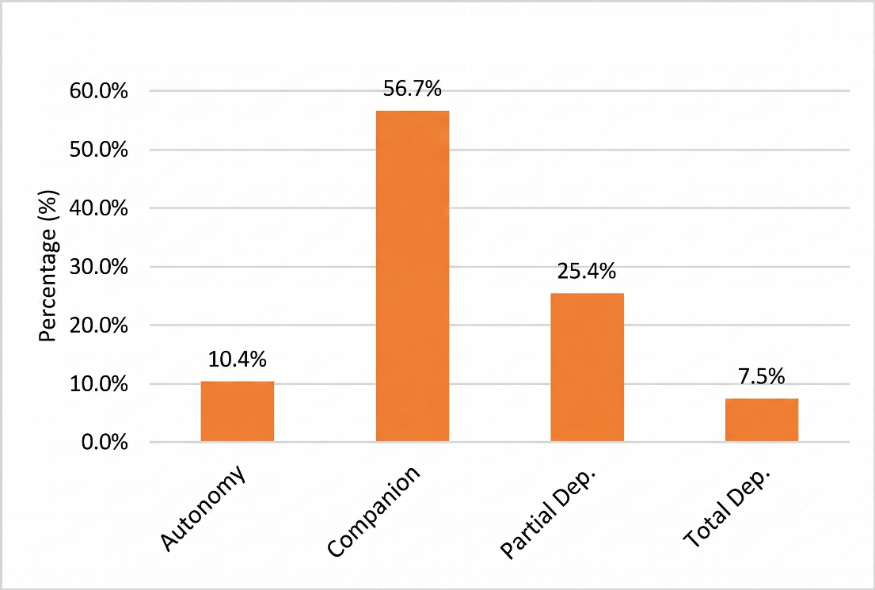
Findings (cont)

Slide 11
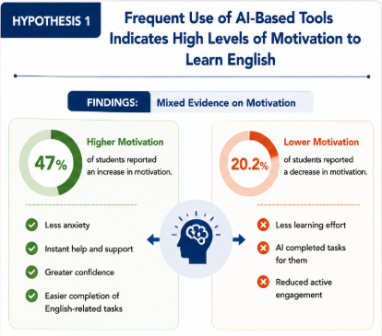

Slide 12
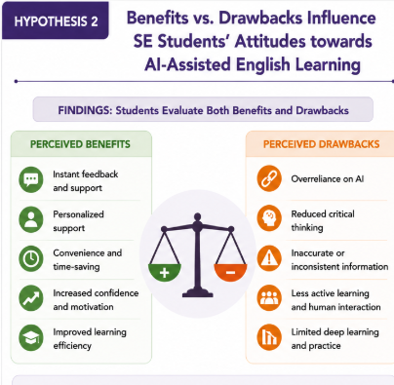

Slide 13
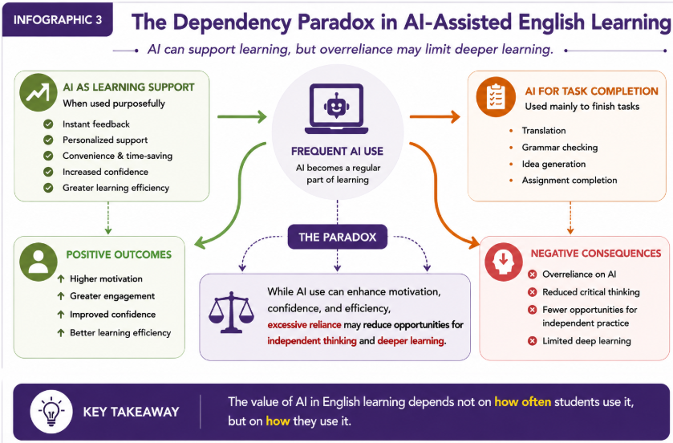

Slide 14
Conclusion
SE students recognize the value of English and view AI as a useful learning support, particularly for understanding technical content and completing academic tasks.
AI's impact on motivation is mixed: it can reduce anxiety and increase confidence-→ enhance ESL motivation and engagement.
However, excessive reliance may reduce learning effort and active engagement.
The value of AI in English learning depends not on how often students use it, but on how they use it.

Slide 15
Recommendations
For SE Students
Use AI as a learning partner, not just a task-completion tool.
Develop independent learning, critical thinking, and responsible AI use.
For English Lecturers
Design AI-supported activities that promote active learning, communication, and reflection.
Assess students' learning process and AI use, not only the final product.

Slide 16
Recommendations(cont)
For the SE Department
Align English courses with professional SE communication.
Provide training in prompt engineering and AI-assisted learning.
Encourage AI-based projects that integrate English and SE knowledge.
For Universities
Develop clear guidelines for ethical and responsible AI use.
Promote academic integrity in AI-supported learning.

Slide 17
Thank you for your listening!

