Slide 1
Unpacking the Barriers: Key Determinants of Public Speaking Anxiety Among English Major Undergraduates at HUFLIT
HUFLIT INTESOL CONFERENCE
Aug. 7th, 2026
Presenter: Vo Quoc Viet
Affiliation: HUFLIT

Slide 2
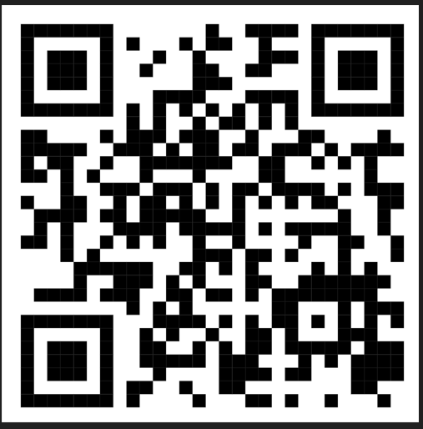
Access to the full paper:

Slide 3
Presentation outline
Problem Statement
Objective & Research Question
Literature Review & Research Gap
Methodology
Findings
Discussion
Conclusion
Recommendations

Slide 4
1. Problem Statement
Growing Issue:
    High occurrence of Public Speaking Anxiety (PSA) among HUFLIT English majors
Observed Reality:
    Significant portion of 2nd semester (2025–2026) students show medium-to-high PSA levels
Empirical Validation:
    Confirmed using McCroskey’s (1970) Personal Report of Public Speaking Anxiety (PRPSA)
Core Consequence:
    Acts as a major affective barrier, blocking effective oral performance

Slide 5
2. Objective & Research Question
Objective:
  Identify key determinants of Public Speaking Anxiety (PSA) among HUFLIT English majors
  Focus Areas: environmental, psychological, linguistic, and experiential barriers
  Goal: guide targeted pedagogical interventions
Research Question:
    "What are the primary environmental, psychological, linguistic, and experiential barriers contributing to public speaking anxiety among English major undergraduates at HUFLIT?"

Slide 6
3. Literature Review & Research Gap

Slide 7
Literature Review:
Primary Determinants of PSA
Environmental:
  Intimidating Learning Environment: created by negative evaluation and overly strict feedback + inflexible instructional and classroom management techniques
  Sources: Valdivieso Quinaluisa (2024); Monib (2025)
Psychological:
  Low Self-Confidence: Key driver of speaking hesitation (Le, 2024; Qayyum et al., 2024)
  Cognitive Anxiety: High stress during spontaneous, unscripted Q&A (Boonchuayrod, 2025)
  Fear of Negative Evaluation: Strong dread of making mistakes (Qayyum et al., 2024)

Slide 8
Linguistic:
  Linguistic Deficiencies: Vocabulary and grammar gaps hinder spoken fluency (Le, 2024; Monib, 2025; Qayyum et al., 2024)
  Excessive Self-Monitoring: Over-focusing on perfect grammar disrupts natural flow (Monib, 2025)
Experiential:
  Comparative Advantage: English majors exhibit lower performance anxiety than non-majors (Boonchuayrod, 2025)

Slide 9
Research Gap
Global Focus:
    Extensive existing literature on PSA across international contexts (e.g., (e.g., Thailand, South Korea, Brunei, Saudi Arabia, Indonesia, Ecuador, the Czech Republic, the Philippines, and Pakistan)
Vietnamese Context Gap:
    Limited empirical research on PSA among English major undergraduates in Vietnam
Under-Researched Dynamics:
    Lack of studies examining the combined, interrelated effects of all four barriers: environmental + psychological + linguistic + experiential

Slide 10
4. Methodology

Slide 11
Research Design & Participants
Research Design
  Framework: Mixed-methods study
  Approach: Convergent Parallel Design
    Quantitative & qualitative data collected concurrently
    Analyzed independently, then merged during interpretation
Population & Sampling
  Target Population: HUFLIT English majors with Public Speaking coursework experience
  Quantitative Sample: n = 133 students (Convenience Sampling)
  Qualitative Sample: n = 15 high-anxiety students (Purposeful Sampling based on PRPSA scores, developed by McCroskey (1970) )

Slide 12
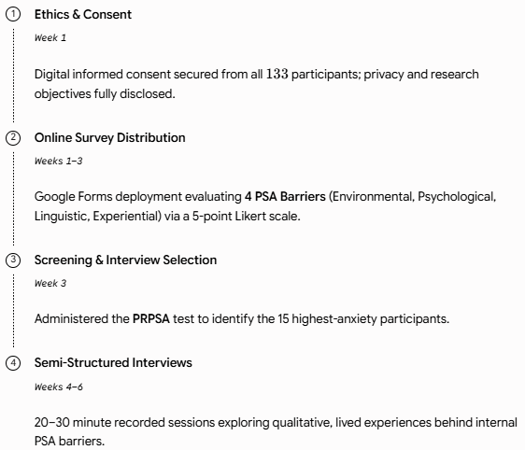
Data Collection Tools & Timeline

Slide 13
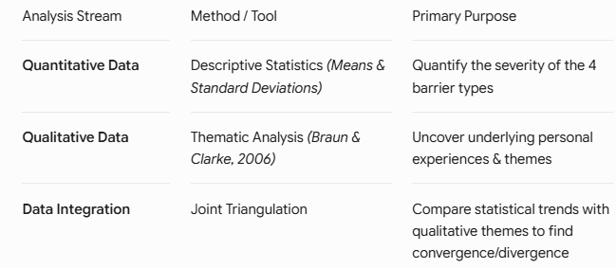
Data Analysis & Integration

Slide 14
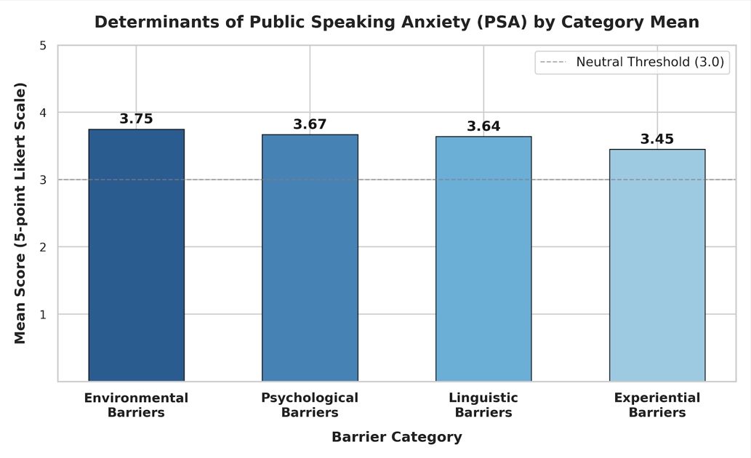
5. Findings

Slide 15
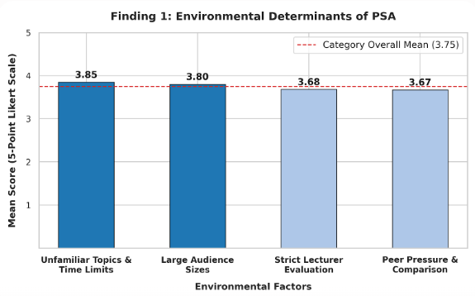
Qualitative Insight: Large crowds deepen feelings of isolation, while strict time limits exacerbate situational pressure.

Slide 16
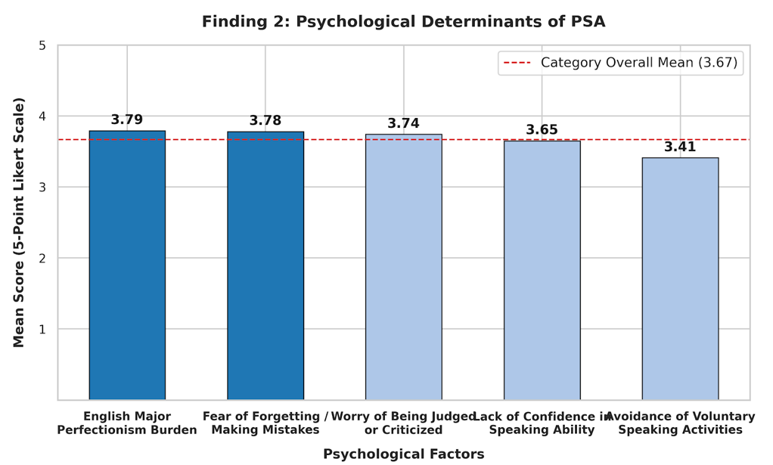
Qualitative Insight: Intrinsic pressure to perform flawlessly leads to high anxiety and fear of negative evaluation.

Slide 17
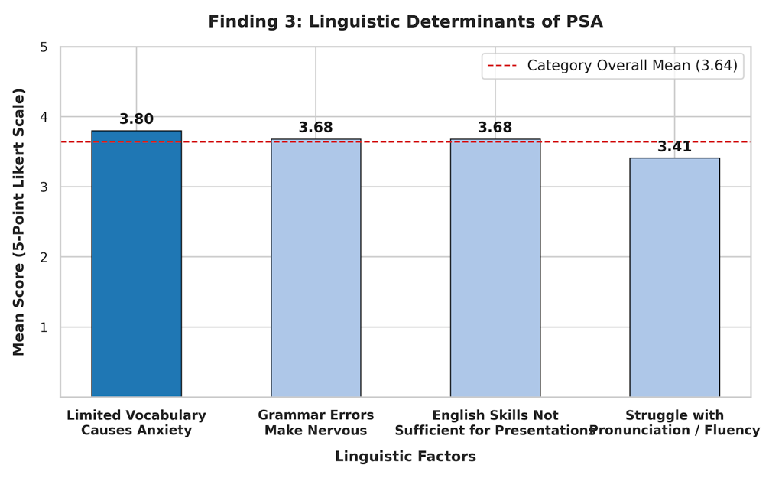
Qualitative Insight: Vocabulary limits and grammar errors trigger a self-monitoring state, forcing real-time editing and interrupting fluency.

Slide 18
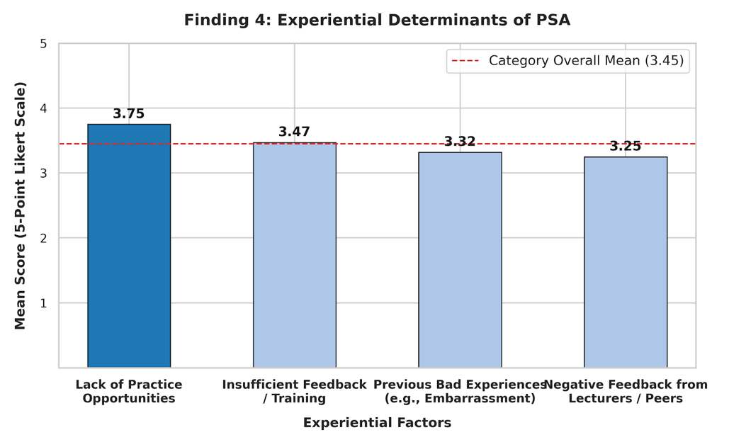
Qualitative Insight: Lack of practice leads to ineffective coping strategies (e.g., rote memorization, avoidance of public speaking practice).

Slide 19
6. Discussion
The Public Speaking Anxiety (PSA) Loop
The four barriers do not act in isolation; they form a self-reinforcing PSA loop.
  Linguistic Insecurity (Trigger): Grammatical focus and limited vocabulary create fear of negative evaluation.
  Environmental Amplification: Fear is intensified by large audiences, strict institutional expectations, and time constraints.
  Ineffective Coping Strategies: High performance stress leads to practice avoidance and rote memorization rather than skill building.
  Reinforcing Loop: Poor coping strategies fail to build competence, reinforcing original linguistic anxiety and perpetuating the loop.

Slide 20
7. Conclusion
  Public speaking anxiety at HUFLIT is driven by a network of interconnected factors.
  Primary Trigger: Environmental factors act as the strongest barrier.
  Psychological & Linguistic Load: Heightened by English major identity expectations and real-time self-monitoring state.
  Reinforcing PSA Loop: Practice avoidance leads to inadequate preparation, reinforces language anxiety and perpetuates the loop.

Slide 21
For Educators:
8. Key Recommendations
Scaffold presentation difficulty.
Foster collaborative interaction.
Reorient rubrics to prioritize communicative flow over grammatical perfection.
Discourage rote memorization; encourage outline-based impromptu speaking.

Slide 22
For the Institution (HUFLIT):
Safe Practice Environments: Non-graded speaking clubs & workshops
Psychological Support: Counseling to dismantle "flawless identity" expectations

Slide 23
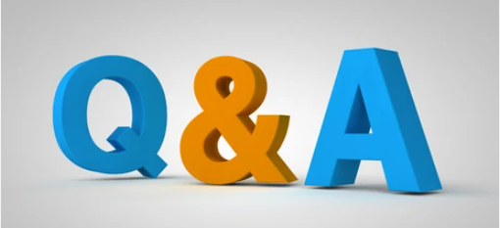
THANK YOU FOR YOUR ATTENTION.

Slide 24
References
Alamer, A., & Almulhim, F. (2021). The interrelation between language anxiety and self-determined motivation: A mixed methods approach. Frontiers in Education, 6, Article 618655. https://doi.org/10.3389/feduc.2021.618655
Boonchuayrod, P. (2025). Public speaking anxiety in higher education: A comparative analysis of English-major and non-English-major undergraduates. International Journal of Development Administration Research, 8(2), 153–172.
Braun, V., & Clarke, V. (2006). Using thematic analysis in psychology. Qualitative Research in Psychology, 3(2), 77–101. https://doi.org/10.1191/1478088706qp063oa
Karmida, K., Wariyati, W., Hasibuan, A. L., & Nurlaili, N. (2024). An analysis of students’ low confidence in speaking, as the attribute of pronunciation context. Journey: Journal of English Language and Pedagogy, 7(2), 331–336. https://doi.org/10.33503/journey.v7i2.845
Le, Y. (2024). Factors causing college students’ English speaking anxiety. Applied & Educational Psychology, 5(1), 159–164. https://doi.org/10.23977/appep.2024.050122

Slide 25
Le, Y. (2024). Factors causing college students’ English speaking anxiety. Applied & Educational Psychology, 5(1), 159–164. https://doi.org/10.23977/appep.2024.050122
Lintner, T., & Belovecová, B. (2024). Demographic predictors of public speaking anxiety among university students. Current Psychology, 43(30), 25215–25223. https://doi.org/10.1007/s12144-024-06216-w
McCroskey, J. C. (1970). Measures of communication-bound anxiety. Speech Monographs, 37(4), 269–277. https://doi.org/10.1080/03637757009375677
Monib, W. K. (2025). Determinant factors influencing English speaking skill among undergraduates: Challenges and remedial strategies. Acuity: Journal of English Language Pedagogy, Literature and Culture, 10(1), 72–85. https://doi.org/10.35974/acuity.v10i1.3351
Qayyum, N. U., Zahoor, N. I., & Bibi, N. M. (2024). Breaking the silence: Unveiling the hidden challenges to English speaking among undergraduates. Voyage Journal of Educational Studies, 4(3), 197–210. https://doi.org/10.58622/vjes.v4i3.197

Slide 26
Valdivieso Quinaluisa, M. G. (2024). Speaking anxiety in oral production of the English major undergraduate students (Undergraduate research report, Technical University of Cotopaxi, Pujilí Campus).
Viwattanabunchong, S. (2017). A survey of factors that cause public speaking anxiety for EFL learners [Master's thesis, Thammasat University]. Language Institute, Thammasat University.

Slide 27
Links to access data collection instruments and datasets
1. Quantitative survey (statements) :
https://docs.google.com/document/d/1TFabSWxGaboPr_JMATcK4kSf1KieKb74/edit?usp=sharing&ouid=106944625484452431759&rtpof=true&sd=true
2. Quantitative survey (responses) :
https://docs.google.com/spreadsheets/d/14GUvC8PSskI5Jlty8qYP6HJ9ntk9MyFD/edit?usp=sharing&ouid=106944625484452431759&rtpof=true&sd=true
3. Qualitative semi-structured interview questions:
https://docs.google.com/document/d/1_rIrX_U4rSd-ChoQtHEjToKRu95hZzdC/edit?usp=sharing&ouid=106944625484452431759&rtpof=true&sd=true
4. Qualitative semi-structured interview (responses):
https://docs.google.com/spreadsheets/d/144MSojPKwBVn5YmEIIceMCujnI_Qxmsh/edit?usp=sharing&ouid=106944625484452431759&rtpof=true&sd=true
5. The Personal Report of Public Speaking Anxiety (PRPSA)-Introversion Scale (statements):
https://docs.google.com/document/d/1drwqnVco5qZ3BTDHHI0Fnob_LUnpQ1Ev/edit?usp=sharing&ouid=106944625484452431759&rtpof=true&sd=true
6. The Personal Report of Public Speaking Anxiety (PRPSA)-Introversion Scale (responses):
https://docs.google.com/spreadsheets/d/19xrru1cKjMLD6BZhKrK2h3Znjz6_49PP/edit?usp=sharing&ouid=106944625484452431759&rtpof=true&sd=true

