Slide 1
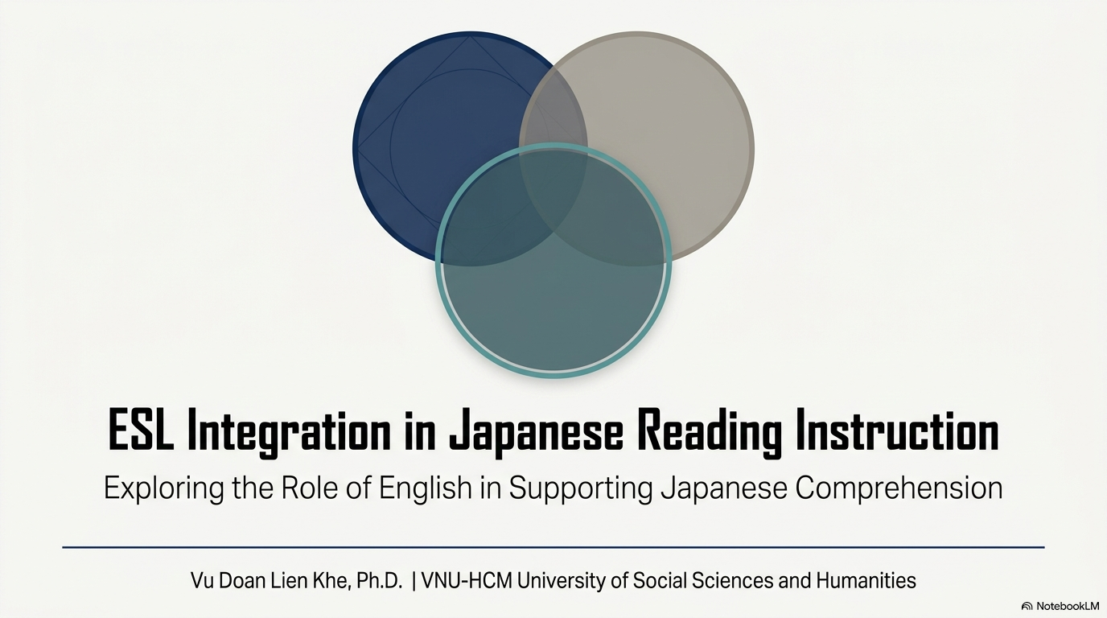
Notes:
Hello everyone.
My name is Vu Doan Lien Khe.
from the Faculty of Oriental Studies,
University of Social Sciences and Humanities,
Vietnam National University Ho Chi Minh City.
Thank you very much for joining my presentation today.
I would like to share a classroom practice that I have used with fourth-year Japanese-major students.
With the title
"ESL Integration in Japanese Reading Instruction:
Exploring the Role of English in Supporting Japanese Reading Comprehension."
In t twenty minutes, I will explain
why I conducted this study,
how I applied this teaching method,
and what I found from my students.

Slide 2
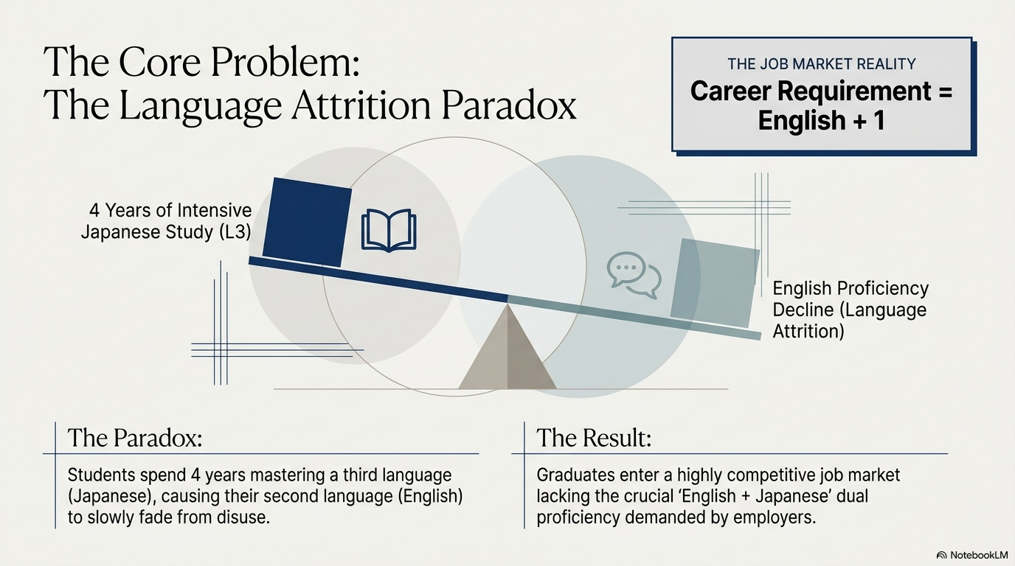
Notes:
Before talking about the teaching method,
I would like to explain the problem.
In Vietnam,
Japanese-major students usually study English for many years before entering university.
Then,
during four years at university,
they spend most of their time learning Japanese.
As a result,
Japanese becomes stronger,
but English becomes weaker.
This is called language attrition,
which means gradually forgetting or losing a language because we do not use it often.
This creates a paradox.
Students become very good at Japanese,but their English slowly declines.
However,
today's job market is different.
Many companies expect graduates to have
English plus one more foreign language.
So,
students need both Japanese and English.
If they lose their English, they may have fewer career opportunities.
Therefore,
I asked myself one question.
Can we keep students' English active while teaching Japanese?
That question became the starting point of this study.
Transition
To answer this question,
I developed my teaching model based on several language learning theories.

Slide 3
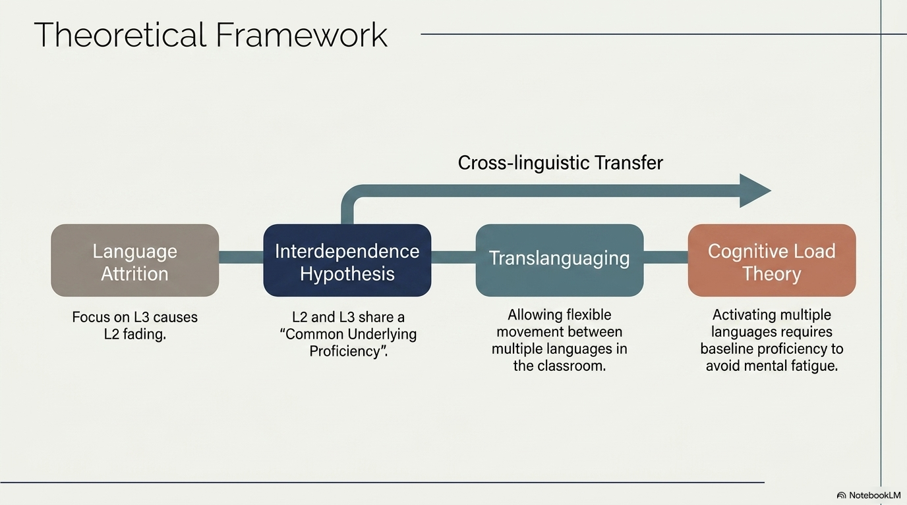
Notes:
This study is based on four main theories.
I will explain them briefly.
The first theory is Language Attrition.
It explains that if we stop using a language, our ability gradually becomes weaker.
This is exactly what happens to many Japanese-major students.
The second theory is Interdependence Hypothesis.
This theory says that different languages can support each other.
Learning one language can help us understand another language.
The third theory is Translanguaging. Instead of separating languages,
students can use all of their language knowledge together.
For example,
they can connect Japanese,English, and even Vietnamese during the learning process.
Finally, I use Cognitive Load Theory.
This theory reminds us that students cannot process too much information at the same time.
If English is too difficult, students may feel confused.
Therefore,
English should be used as a support, not as an additional burden.
These four theories together provide the foundation for my teaching model.
Transition
Now,
let me show you how I applied this idea in my classroom.

Slide 4
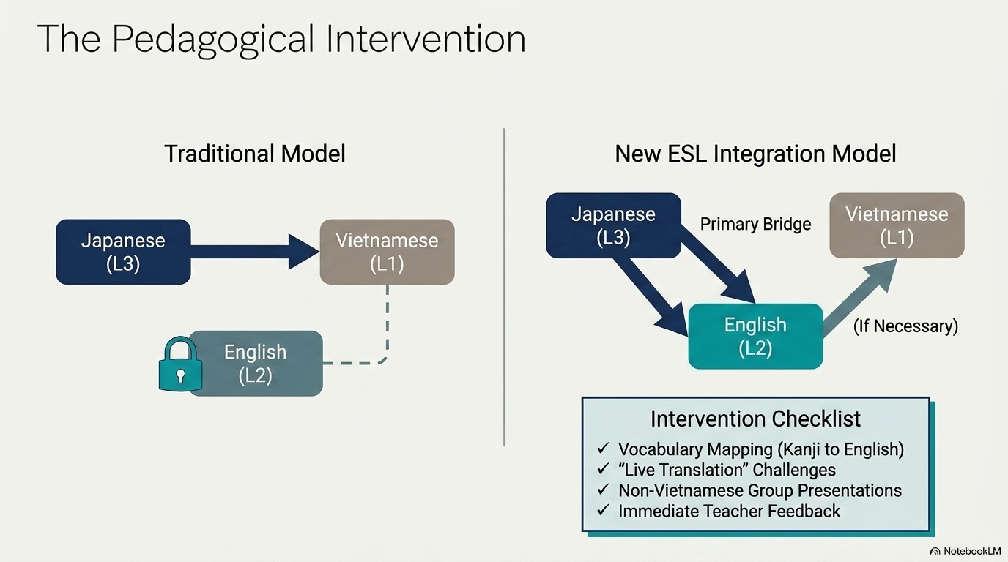
Notes:
This study uses a mixed-methods case study.
That means I collected both quantitative and qualitative data.
The participants were 51 fourth-year Japanese-major students
at the University of Social Sciences and Humanities.
They were chosen because they had already studied both English and Japanese for several years.
First,
I conducted a questionnaire using a five-point Likert scale.
The survey asked students about
their awareness of English attrition,
their opinions about the bilingual classroom,
and the benefits and challenges of using English during Japanese reading lessons.
Besides the questionnaire,
I also observed students during classroom activities.
I paid attention to
how quickly they responded,
how accurately they translated,
and how naturally they used English while reading Japanese.
Finally,
I analyzed the quantitative data with SPSS
and the qualitative responses using thematic analysis.
This combination helped me understand not only the numbers,
but also the students' real experiences.
Here you can see the participants and the research process.
Now,
I would like to introduce the classroom model.
This is actually the heart of my study.
Traditionally,
Japanese reading classes in Vietnam usually follow one direction.
Students translate directly from Japanese into Vietnamese.
However,
in my classroom,
I changed this process.
Instead of using only Vietnamese,
I encouraged students to use English as another bridge.
For example,
when students met a new Japanese word,
they first tried to explain it
in Japanese,
or in English,
before using Vietnamese.
Students also worked in small groups.
Each group prepared one reading passage.
During the presentation,
they explained vocabulary,
grammar,
and Kanji.
They could use
pictures,
gestures,
examples,
synonyms,
and English explanations.
Another important activity was
live translation.
Students immediately translated Japanese sentences,
usually into English,
without using dictionaries.
This activity encouraged students to think quickly
and connect Japanese with English naturally.
I would like to emphasize one point.
English was never compulsory.
Students were free to use it.
English was simply another learning tool,
not an examination.
My goal was not to replace Vietnamese.
My goal was to keep English alive
while students were learning Japanese.
English was a bridge. Not a burden.

Slide 5
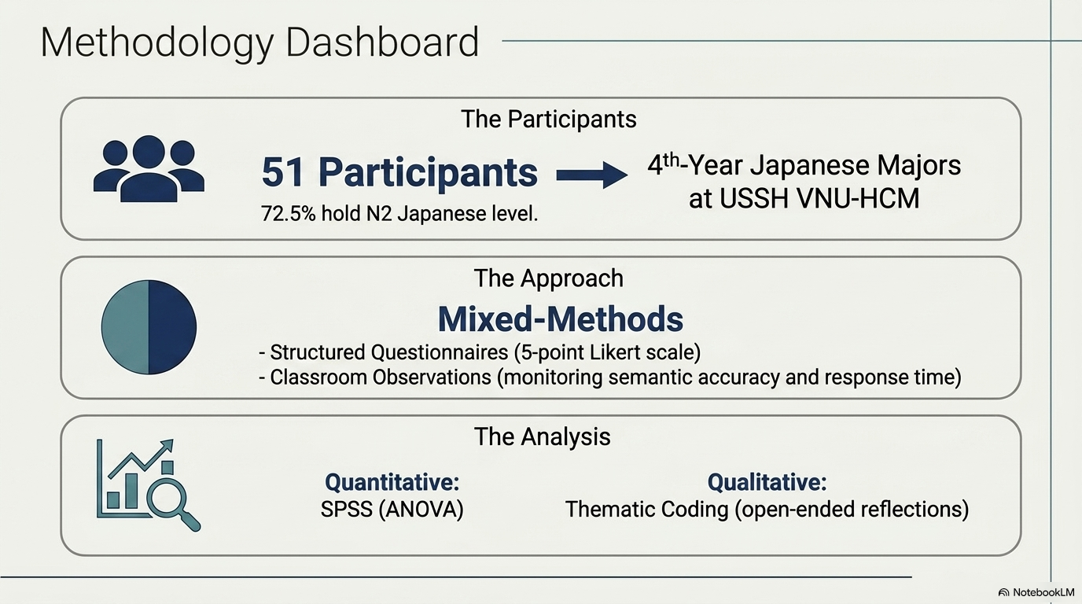
Notes:
We collected 51 valid responses,
representing about sixty percent of all fourth-year students.
One interesting finding is that
students had similar Japanese proficiency,
but very different English proficiency.
Most students had already reached
Japanese level N2.
However,
their English levels varied considerably.
Some students had good English,
while many students had only pre-intermediate English.
This difference is important.
It allowed us to examine whether English proficiency influences students' opinions about the bilingual model.
As you can see in this figure,
English proficiency was not the same for everyone.
Therefore,
students did not experience the classroom in exactly the same way.
Some students had stronger English, while others had weaker English.

Slide 6
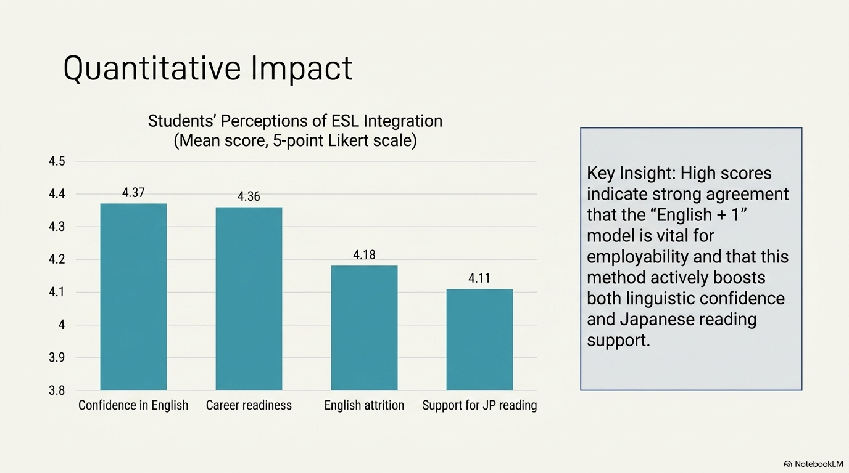
Notes:
Now I will present the main findings.
Overall,
students showed positive attitudes toward the bilingual classroom.
First, many students agreed that
their English was gradually becoming weaker
because they focused mainly on Japanese.
This confirms the problem of language attrition.
Second,
students believed that
English helped them remember Japanese vocabulary more effectively.
They also enjoyed discovering similarities between English and Japanese.
Another important finding concerns employability.
Students strongly agreed that
having both English and Japanese
would improve their future career opportunities.
Finally,
we compared students with different English proficiency levels.
The ANOVA analysis showed one interesting result.
Students with stronger English
enjoyed this teaching model more.
Students with weaker English
sometimes found it more difficult.
Therefore,
English proficiency influences students' perceptions of this bilingual classroom.
Overall,
the quantitative findings support my research hypotheses.

Slide 7
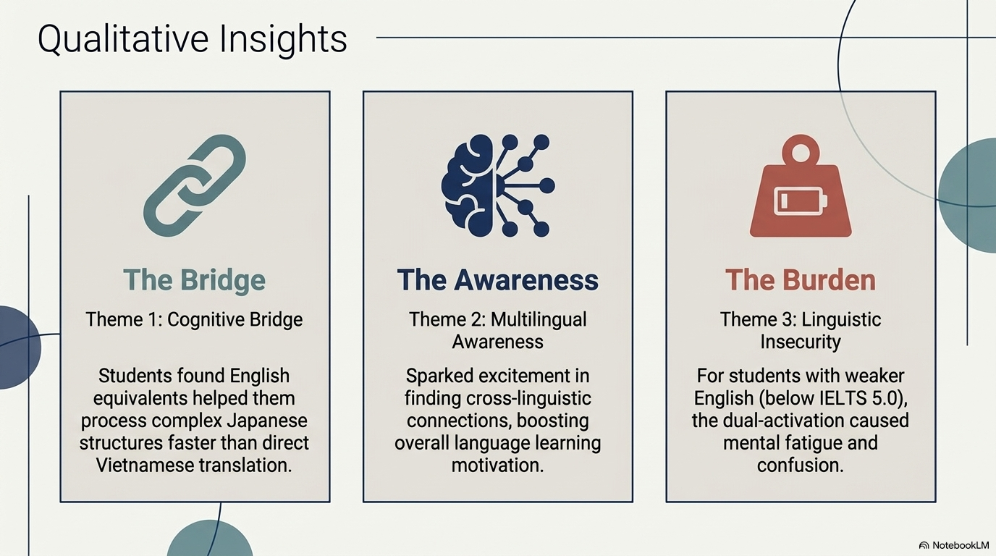
Notes:
Besides the survey,
students also shared their own experiences.
From their comments,
I found three major themes.
The first theme is
English as a cognitive bridge.
Many students said that
English helped them understand difficult Japanese words more easily.
Instead of translating directly into Vietnamese,
they connected Japanese with English first.
The second theme is
greater multilingual awareness.
Students became more aware
of the similarities between languages.
They also felt more confident using both English and Japanese.
The third theme is
cognitive burden.
Some students,
especially those with weaker English,
felt tired or confused.
They sometimes needed more time
to process two foreign languages together.
Therefore,
the classroom model works well,
but teachers should adapt it
according to students' English proficiency.

Slide 8
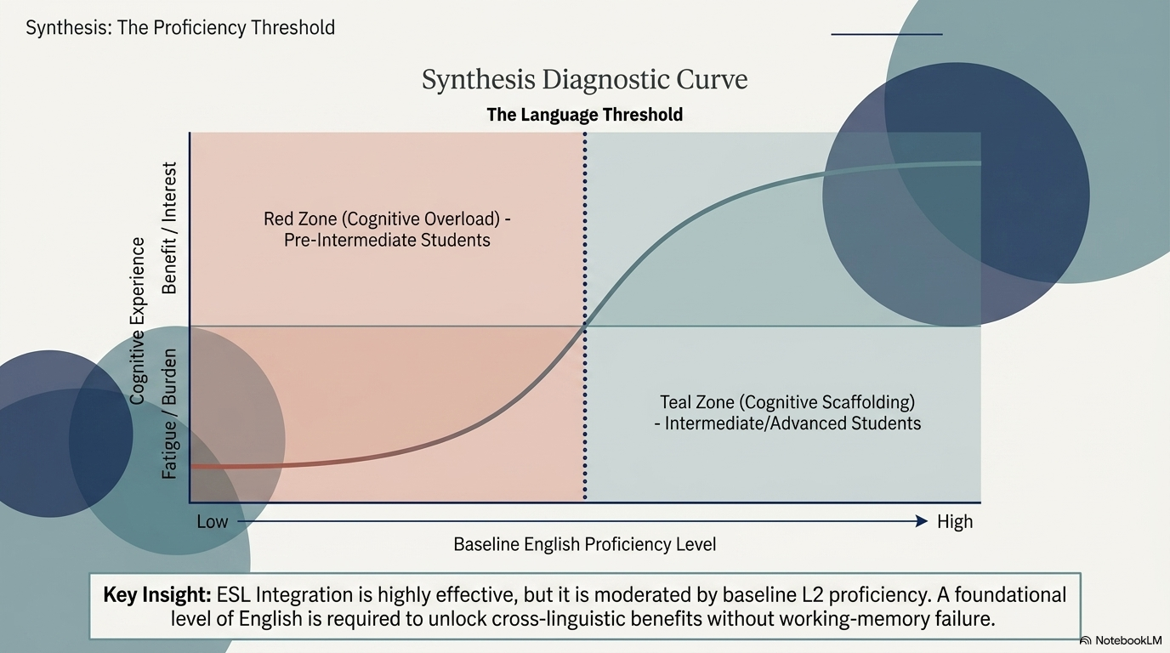
Notes:
Now I would like to summarize all the findings in one simple model.
This figure is my synthesis of the study.
On the horizontal axis,
we have students' English proficiency,
from low to high.
On the vertical axis,
we have students' learning experience,
from cognitive burden at the bottom
to learning benefits at the top.
Let's begin with the left side,
which is the red zone.
This area represents students with lower English proficiency,
especially those at the pre-intermediate level.
For these students,
using Japanese and English at the same time
may create cognitive overload.
They often feel confused,
mentally tired,
and less confident.
Therefore,
English does not always help them immediately.
In the middle,
we can see the dotted line.
This line represents
the language threshold.
It means that students need a minimum level of English
before they can benefit from this bilingual approach.
Once they reach this threshold,
the learning experience changes significantly.
On the right side,
we have the teal zone.
These are students with intermediate
or advanced English proficiency.
Instead of feeling overloaded,
they begin to use English as a learning tool.
English becomes a cognitive bridge
that supports Japanese reading.
They understand vocabulary more easily,
recognize language connections,
and become more confident in multilingual learning.
The curve shows this transition.
At first,
the benefits are quite limited.
But after students pass the language threshold,
the benefits increase rapidly.
Later,
the improvement becomes more stable.
This model also explains why our ANOVA results showed significant differences between English proficiency groups.
It also supports both
Language Threshold Theory
and
Cognitive Load Theory.
Therefore,
the quantitative findings,
the qualitative findings,
and the theoretical framework
all point to the same conclusion.

Slide 9
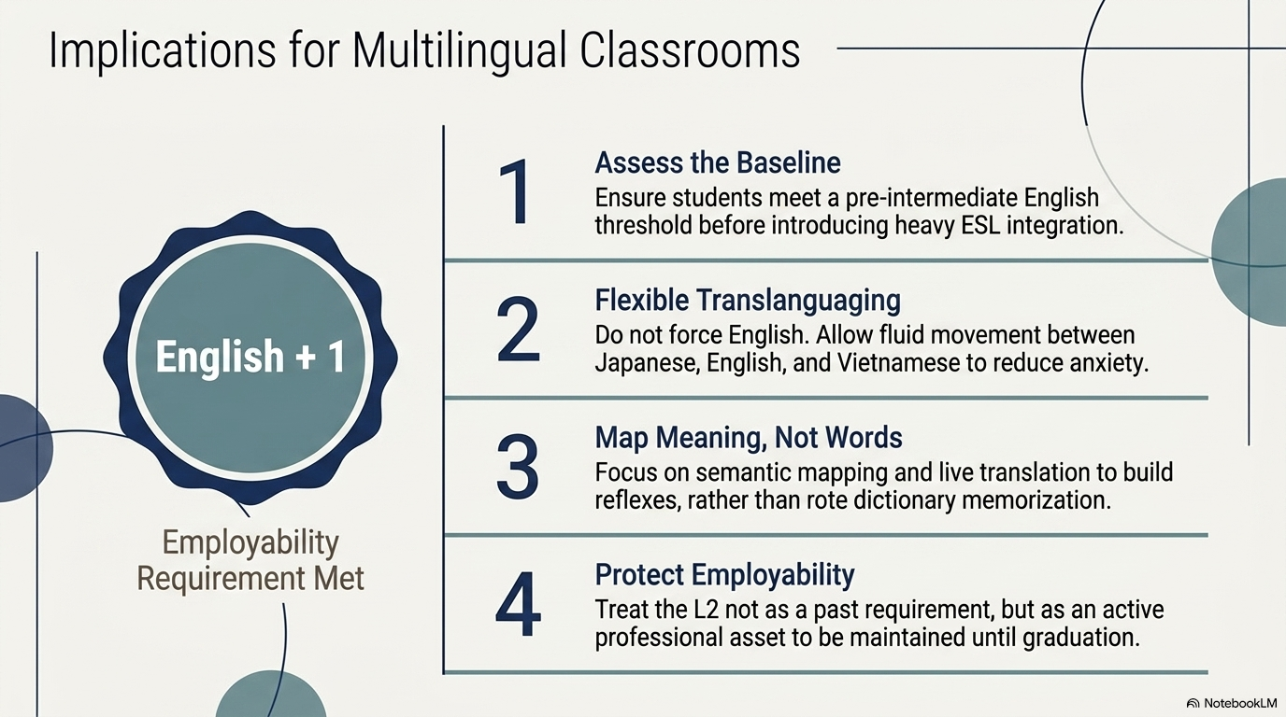
Notes:
Finally,
I would like to conclude my presentation.
This study suggests that
English can play an important supporting role
in Japanese reading instruction.
Rather than competing with Japanese,
English can help students understand Japanese more deeply.
At the same time,
students continue using English,
reducing the risk of language attrition.
However,
this approach should be flexible.
Students with lower English proficiency
may need additional support.
Overall,
I believe that multilingual classrooms
can better prepare students
for today's global job market.
I hope this teaching model
can also be adapted
to other foreign-language programs in the future.
Thank you very much for your attention.
I would be happy to answer your questions.

Slide 10
Thank you!

