Slide 1
EFL Teachers’ Perceptions of AI-Supported Technologies in IELTS Teaching
Focusing on High-quality academic programs in Vietnam
Ho Van Thai, M.A.
Faculty of Foreign Languages, College of Foreign Economic Relations

Slide 2


The Research Context & Gap
•
The Rise of AI: Generative AI and digital tools are reshaping EFL instruction globally.
•
High-Stakes Testing: Vietnamese "high-quality" programs demand rigorous IELTS scores (6.5 - 7.5) for graduation and global integration.
•
Teacher Burden: The responsibility of integrating complex AI ecosystems into strict IELTS rubrics falls heavily on tertiary lecturers.
•
The Gap: While general AI acceptance is studied, localized research on Vietnamese EFL teachers facing high-stakes prep for elite cohorts remains sparse.

Slide 3









Theoretical Perspectives
Teacher Cognition
TAM Model
TPACK Theory
Teachers' beliefs, perceptions, and prior experiences strongly influence classroom decision-making and instructional behavior.
Technology Acceptance Model suggests adoption is driven by perceived usefulness and perceived ease of use in high-stakes contexts.
Meaningful integration depends on aligning technological knowledge with pedagogical strategies and IELTS subject matter expertise.

Slide 4
Methodology
A Convergent Parallel Mixed-Methods Design

Slide 5


Study Design & Participants
Instruments
Participants & Context
Quantitative:
Closed-ended questionnaire (5-point Likert scale) mapping 5 core dimensions of technology adoption.
N = 50 tertiary EFL lecturers.
Teaching IELTS preparation in "high-quality" undergraduate tracks.
Located in Higher Education Institutions in Ho Chi Minh City.
Qualitative:
Semi-structured interviews with a subset of 10 participants (n=10) for nuanced insights.
All hold postgraduate degrees (Master’s or Ph.D.) with 2+ years of high-stakes prep experience.
Analysis: Descriptive statistics and inductive thematic analysis for triangulation.

Slide 6
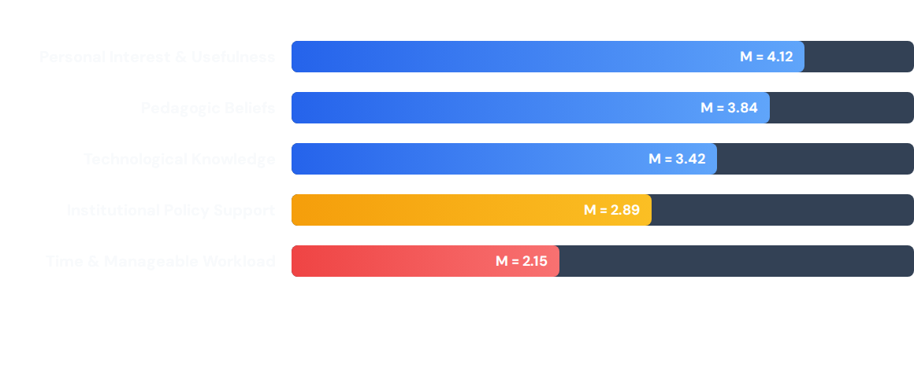
Quantitative Results (N=50)
Based on a 5-point Likert scale (1 = Strongly Disagree, 5 = Strongly Agree).

Slide 7
Key Qualitative Themes
Efficiency vs. Algorithmic Reliability
AI accelerates prep routines (vocabulary, initial grammar) but struggles with the rhetorical depth and logical progression required for advanced IELTS writing bands.
Student Dependence in Pragmatic Cohorts
Tech-savvy, non-language majors (e.g., logistics) use AI as an academic shortcut rather than a cognitive scaffold, threatening authentic communicative competence.
The Burden of Instructional Agency
Due to a "policy vacuum," the entire burden of regulating AI use and maintaining academic integrity falls on the individual teacher, leading to exhaustion.

Slide 8
Voice of the Educator
Instead of using ChatGPT to outline ideas for a manufacturing prompt, they ask it to write the whole essay, memorize it, and try to replicate it. They are submitting to the technology rather than learning from it...
"
"
— Participant 11 (Qualitative Interview)

Slide 9

The Operational Dissonance
4.12
High Optimism, Structural Bottleneck
Teachers recognize AI’s profound potential to revolutionize labor-intensive test preparation. However, this optimism is undercut by structural realities.
PERCEIVED USEFULNESS
Expecting educators to seamlessly absorb AI integration into their existing, heavy teaching schedules without adequate time to test reliability is an unsustainable strategy.
2.15
TIME CONSTRAINTS

Slide 10

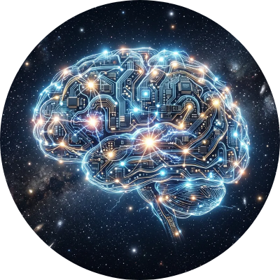
Discussion: Instructional Agency
The Teacher as a Digital Mediator
To counteract student over-reliance, teachers must exercise high Instructional Agency (IA).
This involves deliberately setting pedagogical boundaries, such as restricting AI use to brainstorming or requiring students to critically critique AI-generated essays against official IELTS rubrics.
Conclusion: AI cannot replace human contextual expertise; it demands teachers evolve into critical digital media mediators.

Slide 11

The Path Forward
1. Systematic Professional Development
Universities must transition from passive observation to active structural support. PD must move beyond basic software training to focus on AI literacy and digital pedagogy.
2. Transparent Ethical Guidelines
Establish clear, university-wide policies on AI use and academic integrity to relieve the regulatory burden on individual educators and prevent teacher burnout.

Slide 12
Q&A?
Thank you for your attention and participation.

