Slide 1


INTESOL INTERNATIONAL CONFERENCE 2025
Teaching English with INTESOL in an Artificial Intelligence World
EXPLORING FIRST-YEAR
ENGLISH-MAJORED STUDENTS’ PERCEPTIONS
OF PEDAGOGICAL TRANSLANGUAGING
IN AN EMI CONTEXT
Authors: Thinh Vu (International University)
Nhi Hoang (International University)
Date: 07/08/2026

Slide 2

Main Contents
1. Introduction
2. Literature Review
3. Methodology
4. Findings & Discussion
5. Conclusion

Slide 3

1
Introduction

Slide 4

Research problems
01 - INTRODUCTION
English: an unparalleled position in global internationalisation and the medium of instruction in educational settings (Liu, 2021)
English as a Medium of Instruction (EMI): an educational phenomenon, which increasingly attracting researchers' attention in applied linguistics (Macaro, 2020)
Principle: teachers should use only the target language (TL) and avoid the native language (L1) unless necessary (Littlewood & Yu, 2009)
→ A new and developing teaching and learning method: Translanguaging
⇒ Pedagogical Translanguaging
→ The use of L1 alongside the target language is considered a functional language practice (Sapitri et al., 2018).
⇒ Addressing challenges such as monolingual bias and the difficulties faced by learners with low English proficiency (Nguyen, 2022)

Slide 5
Research problems
01 - INTRODUCTION
Language barrier: significant factor in student failure (Zumor & Qasem, 2019)
Create an immediate academic crisis for Vietnamese first-year English-majored students (suddenly forced to shift to a completely English-speaking environment)
→ Pedagogical translanguaging: a supplementary tool for students with low-level language proficiency to understand the content of a text or lesson (Iversen, 2019)
Research gaps
Previous literature has focused primarily on teachers' perspectives
→ Neglecting quantitative data on the perceptions of first-year English-majored students regarding the use of pedagogical translanguaging in EMI environments within a Vietnamese context.

Slide 6
Research objectives
01 - INTRODUCTION
To explore first-year English-majored students’ perceptions of pedagogical translanguaging in an EMI context
To identify the practices most and least valued by students in EMI classrooms
Research questions
RQ1
How do first-year English-majored students perceive teachers’ pedagogical translanguaging practices in EMI classes?
RQ2
Which pedagogical translanguaging practices are most and least valued by first-year English-majored students in EMI classrooms?

Slide 7
Significance of the study
01 - INTRODUCTION
Theoretical Significance:
Contributes to the limited body of research on pedagogical translanguaging in teaching and learning within EMI environments, particularly shifts the focus from teachers to students
Practical significance:
offers a deeper understanding of learners’ experiences of pedagogical translanguaging in the EMI context.
→ Teachers and curriculum designers can know how students engage with translanguaging activities, thereby supporting more effective pedagogical decisions in EMI classrooms

Slide 8
2
Literature Review

Slide 9
Key issues
02 - LITERATURE REVIEW
EMI (English Medium of Instruction)
Perception
Translanguaging
Pedagogical Translanguaging
Translanguaging Practices
Benefits & Disadvantages
Previous studies

Slide 10
EMI Context
02 - LITERATURE REVIEW
EMI (English Medium of Instruction)
The provision of instruction in contexts where English is not the commonly used language (Macaro, 2020)
The implementation of using English to teach academic subjects in countries or jurisdictions where the mother tongue (L1) of most of the population is not English (Dearden, 2014)
⇒ The use of English to teach academic subjects in countries such as Vietnam, where the majority of the population speaks a language other than English.
Perception
→ The beliefs or opinions held by first-year English-majored students
Students' perceptions of actual classroom activities can be more important than what outsiders observe → students' perceptions guide their own learning behaviour, based on their own understanding (André et al., 2020)

Slide 11
Translanguaging
02 - LITERATURE REVIEW
Allowing students to draw on their native language repertoires to support learning in a target-language classroom (Khairunnisa & Lukmana, 2020)
Two perspectives (Nguyen, 2022):
Sociolinguistic: the fluid language practices of communities
Pedagogical: teachers and students collaboratively create spaces that embrace diverse language use to support creative and critical learning
Translanguaging and Code-Switching
Similarity (Sahib, 2019): the use of students’ first language to support second-language learning in the classroom
Differences (Cahyani et al., 2016):
Code-switching: a conversion between two separate monolingual languages
Translanguaging: combines the two languages into a unified whole to achieve effective communication

Slide 12
02 - LITERATURE REVIEW
Pedagogical Translanguaging
In this study, pedagogical translanguaging:
The intentional classroom practice in which a teacher actively values students' full linguistic repertoires as a fundamental right
Designs lessons that purposefully connect home languages to ensure complete comprehension
Flexibly utilises spontaneous language shifts during interactions to support meaningful learning
Translanguaging Practices
Five pedagogical purposes (Fang & Liu, 2020):
Explaining concepts
Checking comprehension
Localising content
Reinforcing instructions
Building relationships

Slide 13
Benefits
02 - LITERATURE REVIEW
Four educational advantages (Baker, 2011):
Help learners better understand the subject matter through interdependence and language transfer between their native language (L1) and the target language (TL)
L1 offer learners greater comfort and a sense of safety
Facilitate communication between school and family, especially when parents do not understand the target language their child is being taught
Allow learners to develop their second-language skills while learning the subject matter
Disadvantages
Distract and reduce students’ ability to absorb knowledge in the target language (Allard, 2017)
The overuse of the mother tongue in the classroom can hinder students' language development (Yuvayapan, 2019)

Slide 14
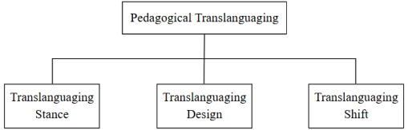

Conceptual framework
02 - LITERATURE REVIEW
Pedagogical Translanguaging framework by García et al. (2017)
Teacher’s belief that a bilingual student has one holistic language repertoire that he or she draws on at school
Deliberate integration of students' native and school languages into classroom activities
Unplanned, spontaneous translanguaging, with the teacher making immediate decisions that demonstrate flexibility and a willingness to support students' voices

Slide 15
Previous studies
02 - LITERATURE REVIEW
Romanowski (2020), Almatrafi (2023): highlighted the usefulness of pedagogical translanguaging, which helps lessons and activities less challenging and more comprehensible
Pham and Vu (2023): emphasized the role of pedagogical translanguaging in scaffolding students’ learning, particularly for cognitive functions such as explaining grammar and vocabulary, supporting translanguaging use in EFL classrooms
Ngo (2025): emphasized the useful medium, increased comprehension and created a supportive learning atmosphere → More appropriate for lower-proficiency classes

Slide 16
3
Methodology

Slide 17
3. METHODOLOGY
Approach
Quantitative research methods
Sampling
Purposive sampling
Participants
50 first-year English-majored students at an EMI university in Ho Chi Minh City.
The participants were recent high school graduates who were gradually adapting to a teaching and learning environment conducted entirely in English.
→ Many first-year students may feel overwhelmed by the amount of information they receive in English.

Slide 18
3. METHODOLOGY
Instruments
Questionnaire
5-point Likert scale questionnaire
→ Theoretical framework of pedagogical translanguaging proposed by García et al. (2017)
Google Form
Section A: Demographic Information - 2 questions
Section B: Perceived pedagogical translanguaging (Stace, Design, Shift) - 18 questions
Section C: Overall perceptions - 3 questions

Slide 19
3. METHODOLOGY
Data Collection
Questionnaire - Distribute Google Form (in-person)
Introduce & Instruct
Distribute questionnaire
Collect data
*All participants gave consent before data collection began.
Validity & Reliability
Validity
Develop on relevant theoretical framework
Have one expert in the field to review the items
Modify from feedbacks
Pilot test
16 participants
Collect feedbacks
Reliability
Calculating Cronbach’s Alpha coefficients.
+ Pilot study = .93

Slide 20
3. METHODOLOGY
Data Analysis
Quantitative data: Descriptive statistics (mean & SD)
Mean and SD of each item
Summary table of mean scores of all items in a construct

Slide 21
4
Results & Discussion

Slide 22
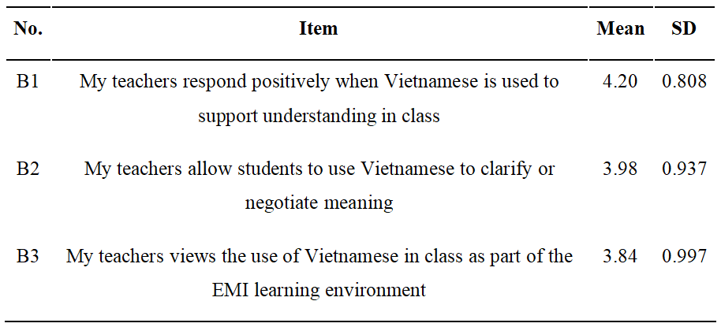


4. FINDINGS & DISCUSSION
RQ1: First-year English-majored students perceived teachers’ PT practices
Perceived Teacher’s Stance
Similar findings to Pantalleresco (2021), who emphasized that teachers' acknowledgement of learners' L1 facilitates understanding and fosters a comfortable classroom environment
Aligns with Liu (2021), who highlighted a shift toward the "meaning-making" process where L1 serves as a crucial tool for facilitating learning and understanding of the target language

Slide 23
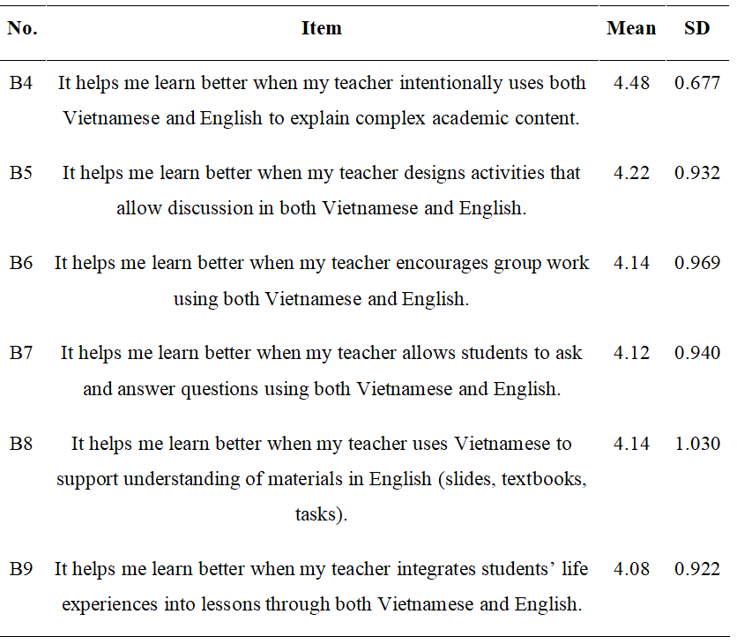
4. FINDINGS & DISCUSSION
RQ1: First-year English-majored students perceived teachers’ PT practices
Perceived Teacher’s Design
Aligns with Alasmari et al. (2022), who suggested that using the mother tongue reinforces learning by clarifying complex concepts and terminology
Phuong and Dang (2022) found that over-reliance on the mother tongue can reduce learners' motivation to learn

Slide 24
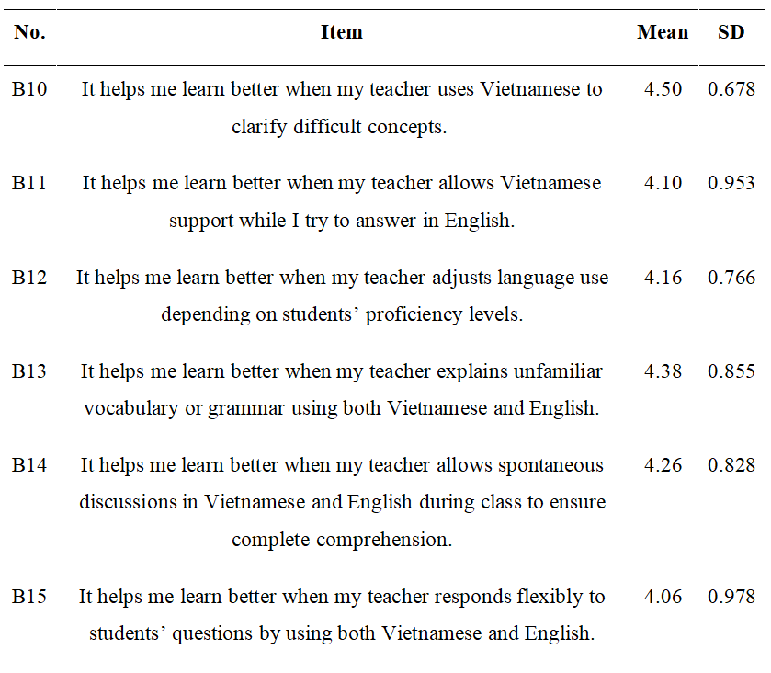
4. FINDINGS & DISCUSSION
RQ1: First-year English-majored students perceived teachers’ PT practices
Perceived Teacher’s Shift
Aligns with Liu et al. (2022), who found translanguaging activities help create a sense of “safety” in the classroom, reducing learner anxiety and promoting collaborative learning
Similar findings to Almatrafi (2023), who emphasized that translanguaging helps lower-level learners feel more confident in participating and fully utilising their language skills

Slide 25
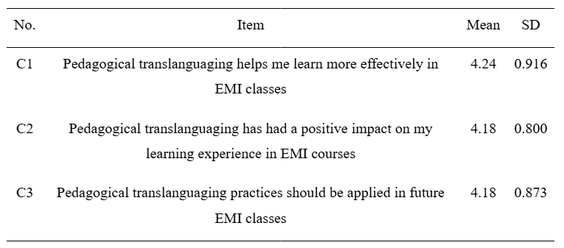
4. FINDINGS & DISCUSSION
RQ1: First-year English-majored students perceived teachers’ PT practices
Overview perceptions
Students responded positively to the implementation of pedagogical translanguaging in EMI classrooms
First-year students consider pedagogical translanguaging a helpful approach in EMI classrooms

Slide 26
4. FINDINGS & DISCUSSION
RQ2: Teachers’ PT practices are most frequently reported in EMI classes
Dimension | Item | Mean
Shift | It helps me learn better when my teacher uses Vietnamese to clarify difficult concepts | 4.50
Design | It helps me learn better when my teacher intentionally uses both Vietnamese and English to explain complex academic content | 4.48
Shift | It helps me learn better when my teacher explains unfamiliar vocabulary or grammar using both Vietnamese and English | 4.38
Cenoz and Etxague (2013): teachers' immediate use of Vietnamese serves as an essential scaffold to bridge the comprehension gap in real time
Yen and Danh (2021): incorporating the native language can shorten explanation time and create a safe learning environment for students

Slide 27
4. FINDINGS & DISCUSSION
RQ2: Teachers’ PT practices are least frequently reported in EMI classes
Dimension | Item | Mean
Stance | My teachers allow students to use Vietnamese to clarify or negotiate meaning | 3.98
Stance | My teachers views the use of Vietnamese in class as part of the EMI learning environment | 3.84
Surtees (2016): Some students associate EMI environment with a learning condition like English immersion or study abroad programs, which helps to boost their language competence
Breeze and Roothooft (2021): Some students might perceive the use of L1 as “dangerous territory”, reducing their exposure to English

Slide 28
5
Conclusion

Slide 29
5. CONCLUSION
Result Summary
First-year English-majored students perceived teachers’ PT practices | Teachers’ PT practices are most and least frequently reported in EMI classes
A useful tool to support comprehension Positive approach | Most: Clarify difficult concepts Explain complex academic content Explains unfamiliar vocabulary or grammar ⇒ Pedagogical purpose: explaining concepts Least: Teachers allow students to use Vietnamese to clarify or negotiate meaning Teachers views the use of Vietnamese in class as part of the EMI learning environment

Slide 30
5. CONCLUSION
Implications
Teachers | Know how to design and implement lesson plans and activities suitable for students at varying levels
Schools and educational institutions | Provide resources for the club to practice develop and deepen their understanding of pedagogical translanguaging

Slide 31
5. CONCLUSION
Limitations and Recommendations
Limitations | Recommendations
- Small sample size - Single context | - Longer periods - Diverse contexts
Quantitative design | - Mixed-methods approach
Focuses solely on English majors Neglecting the perspectives of non-English majors | - More varied participants

Slide 32
Thank you so much for your listening!

Slide 33
REFERENCES
Alasmari, M., Qasem, F., Ahmed, R., & Alrayes, M. (2022). Bilingual teachers’ translanguaging practices and ideologies in online classrooms in Saudi Arabia. Heliyon, 8 (9), e10537. https://doi.org/10.1016/j.heliyon.2022.e10537
Almatrafi, B. (2023). Saudi EFL Students’ Perceptions of Pedagogical Translanguaging in English Medium Instruction. International Journal of Language and Literary Studies, 5(4), 172-191. https://doi.org/10.36892/ijlls.v5i4.1460
André, S., Maulana, R., Helms-Lorenz, M., Telli, S., Chun, S., Fernández-García, C.-M., De Jager, T., Irnidayanti, Y., Inda-Caro, M., Lee, O., Safrina, R., Coetzee, T., & Jeon, M. (2020). Student Perceptions in Measuring Teaching Behavior Across Six Countries: A Multi-Group Confirmatory Factor Analysis Approach to Measurement Invariance. Frontiers in Psychology, 11, 1-19. https://doi.org/10.3389/fpsyg.2020.00273
Baker, C. (2011). Foundations of bilingual education and bilingualism. Multilingual matters.
Breeze, R., & Roothooft, H. (2021). Using the L1 in university-level EMI: Attitudes among lecturers in Spain. Language awareness, 30(2), 195-215. https://doi.org/10.1080/09658416.2021.1903911
Cahyani, H., De Courcy, M., & Barnett, J. (2016). Teachers’ code-switching in bilingual classrooms: Exploring pedagogical and sociocultural functions. International Journal of Bilingual Education and Bilingualism, 21(4), 465-479. https://doi.org/10.1080/13670050.2016.1189509
Cenoz, J., & Etxague, X. (2013). Spanish and English in Higher Education. Bilingual and multilingual education in the 21st century: Building on experience, 94, 85-106.
Dearden, J. (2014). English as a medium of instruction-a growing global phenomenon. British Council.
Fang, F., & Liu, Y. (2020). ‘Using all English is not always meaningful’: Stakeholders’ perspectives on the use of and attitudes towards translanguaging at a Chinese university. Lingua, 247, 102959. https://doi.org/10.1016/j.lingua.2020.102959
García, O., Ibarra-Johnson, S., & Seltzer, K. (2017). The translanguaging classroom: Leveraging student bilingualism for learning. Caslon.
Iversen, J. Y. (2019). Pre-service teachers’ translanguaging during field placement in multilingual, mainstream classrooms in Norway. Language and Education, 34(1), 51-65. https://doi.org/10.1080/09500782.2019.1682599
Khairunnisa, K., & Lukmana, I. (2020). Teachers’ Attitudes towards Translanguaging in Indonesian EFL Classrooms. Jurnal Penelitian Pendidikan, 20(2), 254-266. https://doi.org/10.17509/jpp.v20i2.27046
Kien, P. T., & Van, V. T. H. (2023). Vietnamese EFL secondary teachers’ translanguaging use and their perceptions. HO CHI MINH CITY OPEN UNIVERSITY JOURNAL OF SCIENCE - SOCIAL SCIENCES, 13(2), 35-52. https://doi.org/10.46223/hcmcoujs.soci.en.13.2.2608.2023
Liu, D. (2021). A study of graduate students’ perceptions towards pedagogical translanguaging at an international university in Bangkok. Language in India, 21(3), 1-36.
Liu, D., Deng, Y., & Wimpenny, K. (2022). Students’ perceptions and experiences of translanguaging pedagogy in teaching English for academic purposes in China. Teaching in Higher Education, 29(5), 1234-1252. https://doi.org/10.1080/13562517.2022.2129961

Slide 34
REFERENCES
Littlewood, W., & Yu, B. (2009). First language and target language in the foreign language classroom. Language Teaching, 44(1), 64-77. https://doi.org/10.1017/s0261444809990310
Macaro, E. (2020). Exploring the role of language in English medium instruction. International Journal of Bilingual Education and Bilingualism. https://doi.org/10.1080/13670050.2019.1620678
Ngo, K. T. (2025). EFL Learners’ Perceptions of Translanguaging in English classes at an HCM English Centre. International Journal of Language Instruction, 4(1), 50-64. https://doi.org/10.54855/ijli.25414
Nguyen, T. N. T. (2022). A Review of Studies on EFL Teachers’ and Students’ Perceptions of Tranglanguaging as a Pedagogical Approach. International Journal of TESOL & Education, 2(3), 324-331. https://doi.org/10.54855/ijte.222322
Pantalleresco, J. (2021). The teachers’ beliefs on translanguaging practices during speaking tasks in the Spanish as a foreign language classroom (Master’s dissertation, University of Malta). University of Malta Institutional Repository. https://www.um.edu.mt/library/oar/handle/123456789/102446
Phuong, H. Y., & Dang, T. D. (2022). English - majored students’ perceptions on teachers’ use of Vietnamese in EFL classrooms. Journal of English Education and Linguistics Studies (JEELS), 8(2), 371-391. https://doi.org/10.30762/jeels.v8i2.3379
Romanowski, P. (2020). Perceptions of translanguaging among the students and teachers of EMI classrooms in Poland. Lenguas Modernas, (55), 151-165.
Sahib, R. B. (2019). The use of translanguaging as a pedagogical strategy in efl classroom: A case study at bulukumba regency. LET: Linguistics, Literature and English Teaching Journal, 9(2), 154-180. https://doi.org/10.18592/let.v9i2.3124
Sapitri, N. M., Batan, I. G., & Myartawan, I. P. N. W. (2018). Functions of teachers’ translanguaging in the EFL classroom at two junior high schools in Singaraja. Jurnal Ilmiah Pendidikan dan Pembelajaran, 25(1). https://doi.org/10.23887/ls.v25i1.18821
Surtees, V. (2016). Beliefs about Language Learning in Study Abroad: Advocating for a Language Ideology Approach. Frontiers: The Interdisciplinary Journal of Study Abroad, 27, 85-103. https://doi.org/10.36366/frontiers.v27i1.376
Yen, P. H., & Danh, D. T. (2021). English – Majored Students’ Perceptions on Teachers’ Use Of Vietnamese In EFL Classrooms. JEELS (Journal of English Education and Linguistics Studies), 8(2), 371-391. https://doi.org/10.30762/jeels.v8i2.3379
Yuvayapan, F. (2019). Translanguaging in EFL classrooms: Teachers’ perceptions and practices. Dil Ve Dilbilimi Çalışmaları Dergisi, 15(2), 678-694. https://doi.org/10.17263/jlls.586811
Zumor, A., & Qasem, A. (2019). Challenges of using EMI in teaching and learning of university scientific disciplines: Student voice. International Journal of Language Education, 3(1), 74-90. https://doi.org/10.26858/ijole.v1i1.7510

Slide 35
Q&A Section!

