Slide 1
The Efficacy And Student Perceptions Of AI-generated Versus Teacher Feedback On University Students' L2 Writing Development: A Mixed-methods Study
Presented by Tran Duc Anh

Slide 2
i. Introduction

Slide 3
Writing – particularly challenging skill
Corrective written feedback – pinpoint errors – act as a powerful pedagogical tool for guidance (Perdana et al., 2025)
Difficulties:
High teacher-student ratio
Heterogenous distribution of proficiency levels
Overwhelming workload for teachers

Slide 4
AI-powered tool – a promising solution
Opinions are mixed:
Positive impact on writing performance: surface-level errors, promote peace of mind, instancy (Baz & Aksoy, 2025)
Issues: redundant details, confusion, lack of personalization (Lin & Crosthwaite, 2024)
Gap: Vietnamese university setting, feedback quality, learner trust

Slide 5

Research questions:
To what extent do AI-generated feedback and teacher-provided feedback improve students’ writing performance?
What are students’ perceptions regarding the usefulness of each feedback modality?
What is the student’s perceived motivational value of AI feedback, in contrast to teacher feedback?

Slide 6
II. Literature review

Slide 7

Teacher-led feedback
Provide personalized, contextualized remarks that account for specialized needs
Foster critical thinking with metalinguistic instruction
Limitation: fall short of immediate, extensive feedback
=> Delays in response rate and / or superficial comments

Slide 8

AI as a source of feedback
Large Language Models and Natural Language Processing
Generate formative feedback to clarify major points and positive reinforcement (Makwana, 2025)
Shortcomings:
Generate its own ideas
Fail to engage with learners emotionally
Fabricate inaccurate responses
Academic integrity

Slide 9
III. Methodology

Slide 10
54 Vietnamese English-major first-year students, aged from 18-21
Divided into 2 groups: teacher-feedback (33 students) & AI-feedback (21 students)
2 instructors
8 writing topics over 10 weeks
Marking rubric includes:
4 surface-level aspects (Grammar, Vocabulary, Mechanics, Sentence Structure)
3 meaning-level aspects (Content and Idea development, Coherence and Organization, Writing style)
Prompt
5-point Likert scale survey (with open-ended questions)
Semi-structured interview questions

Slide 11
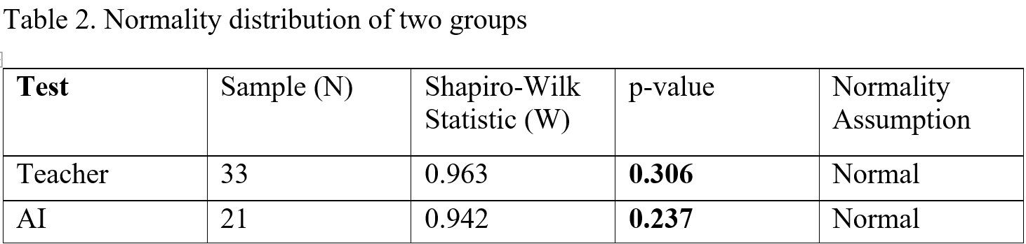
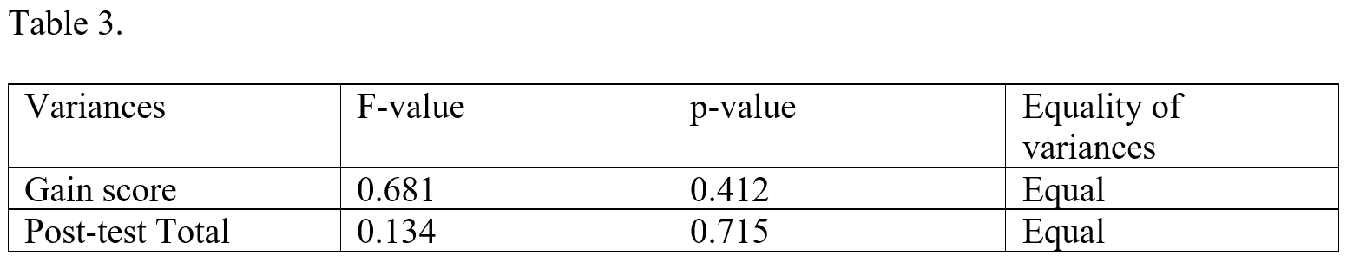
Necessary tests to ensure validity
Shapiro-Wilk test: ensure baseline equivalence
2. Levene’s test: equality of variances

Slide 12
IV. Data analysis and Findings

Slide 13
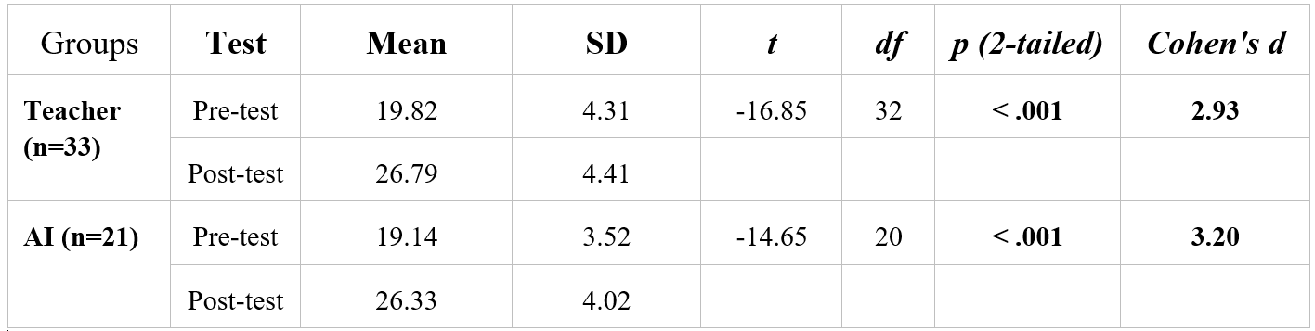
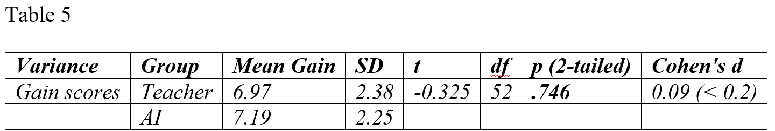
Paired-samples t-test: confirm statistically significant improvement of both groups
Independent-samples t-test: difference in effectiveness of two feedback sources is negligible (both groups improved)

Slide 14
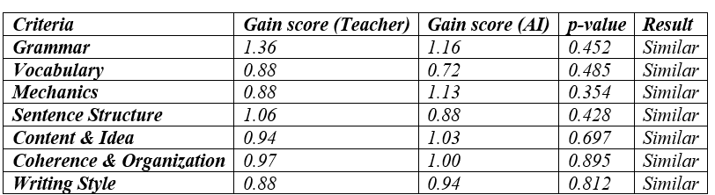
Independent-samples t-test: difference in effectiveness of two feedback sources is negligible

Slide 15
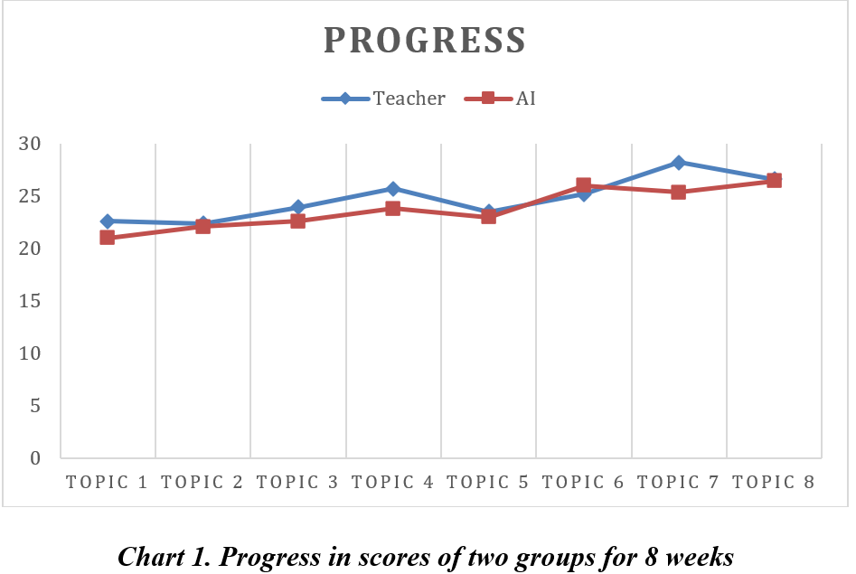

Slide 16
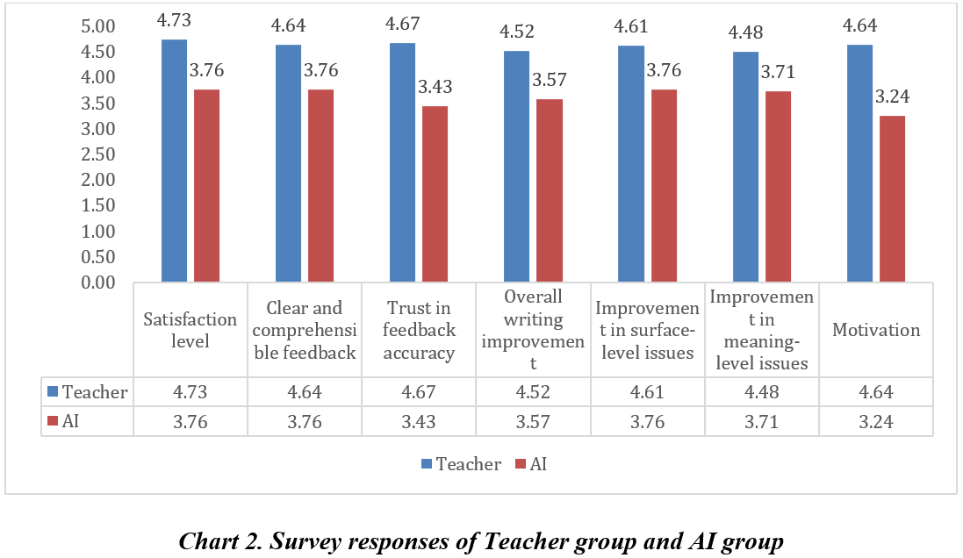

Slide 17
V. Discussion

Slide 18

To what extent do AI-generated feedback and teacher-provided
feedback improve students’ writing performance?
Both feedback modalities have a positive impact on
students’ writing performance. (T: 19.82 -> 26.79 / AI: 19.14 -> 26.33)
The effectiveness of teacher feedback and AI feedback is comparable within this sample.
Students require more time to adapt to and take advantage of AI feedback.
Surface-level: AI excels at addressing surface-level issues compared to human teachers (1.13 : 0.88). However, teacher-feedback students received a higher grammar score (1.356 : 1.16).
Meaning-level: AI feedback is just as effective as teacher feedback (1.03 : 1.00) (growing database & careful prompt engineering)

Slide 19

What are students’ perceptions regarding the usefulness of
each feedback modality?
Students value teacher feedback in all aspects. They have less trust in AI.

Slide 20
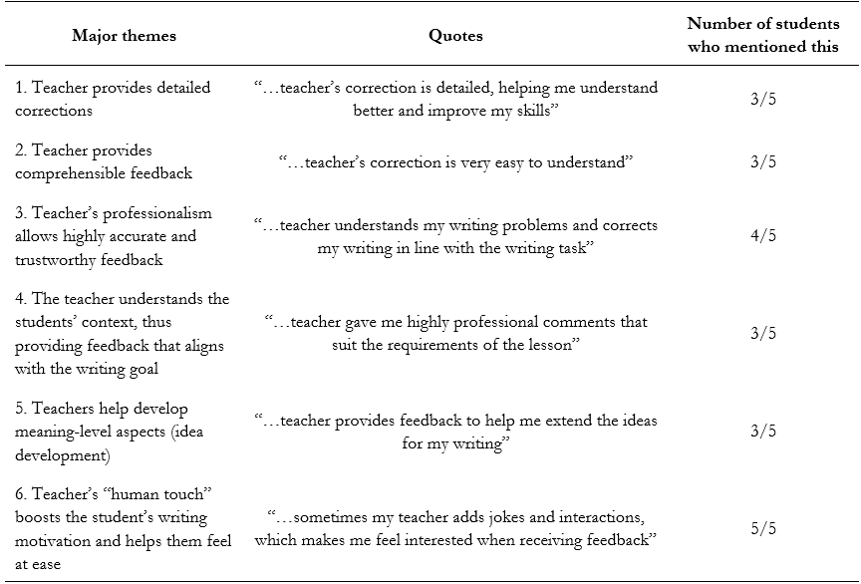

Slide 21
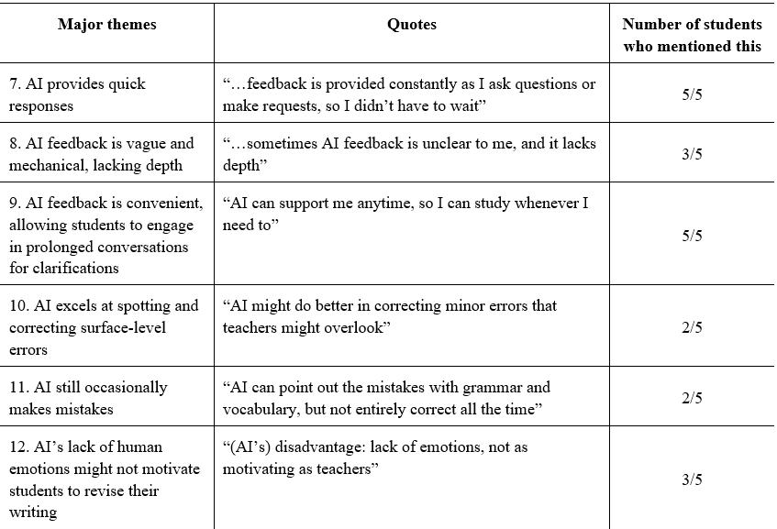

Slide 22

3. What is the student’s perceived motivational value of AI
feedback, in contrast to teacher feedback?
AI provides extensive and instant responses, suggests new
approaches, provides samples for students to refine their own writing. Students avoid long feedback delays and forgetting what they have written.
Generally, students still appreciate teacher feedback more, as this gives a “human” feel. Some admit they put in more effort in Draft 2 because they feel grateful for the teacher’s detailed corrections.
“I feel more motivated to think that my effort is recognized by my teacher, which encourages me to perform better as a way to repay for my teacher’s dedication.”

Slide 23
3. What is the student’s perceived motivational value of AI feedback,
in contrast to teacher feedback?
Two important factors at play:
1. The novelty effect: students feel a great sense of enthusiasm during
the first stage of learning.
Risk of blindly accepting quick AI corrections => loss of learner agency & over-reliance.
2. Familiarity: students too accustomed to the traditional way suffer from temporary anxiety and discomfort.
Success in AI use depends on students’ willingness to abandon old learning habits + greater contact with technology.

Slide 24
Vi. Conclusion

Slide 25
Traditional teacher-led feedback is highly effective, as it is well-adjusted to student’s background knowledge, language proficiency, and adhere to the writing goal. Feedback is personalized and focused to avoid straining the student’s cognitive capacity.
AI feedback can also be useful, with considerations:
Students interact with feedback with a critical mind.
Students put in effort to engage in extensive discussions with AI to clarify confusing points.
AI should only provide step-by-step guidance, rather than rewriting the whole writing.
Prompt must be rigorously and properly engineered to avoid redundancy and provide effective guidance during the writing process.

Slide 26
LIMITATIONS
Small sample size (54)
Self-selection bias
Short surveyed period (10 weeks), thus the long-term effect of each feedback type is not confirmed.
A need for future research:
Students with other levels of proficiency, and other types of writing (e.g. essays, creative writing).
Teacher’s feedback style could be another variable.
A blended approach (a group that receives feedback from both AI & teacher)

Slide 27
Bottom line
AI can be useful, but teacher guidance is still needed.
AI has yet to replace teachers, as students still highly value the emotional interactions with human teachers.

Slide 28
Prompt
You are my writing mentor. I will paste my paragraph draft below, based on the paragraph structure (topic sentence – supporting sentences – concluding sentence). Please give me feedback without rewriting the paragraph.
Follow these steps:
Start with strengths: Tell me what I did well in my paragraph.
Then, give me at least one suggestion for improvement for each aspect below:
Grammar (word form, article, tense)
Vocabulary / Word Choice (is the choice appropriate and natural?)
Mechanics (spelling, punctuation, capitalization)
Sentence Structure (variety and complexity)
Content and Idea Development (is the idea well-developed, with main points and supporting ideas?)
Coherence and Organization (is the ideas well-connected, with good use of linking words?)
Writing Style (is the style appropriate and natural?)
Give an overall comment: Summarize the main things I should focus on when revising.
Remember: Do not rewrite my paragraph — just guide me with feedback.

Slide 29
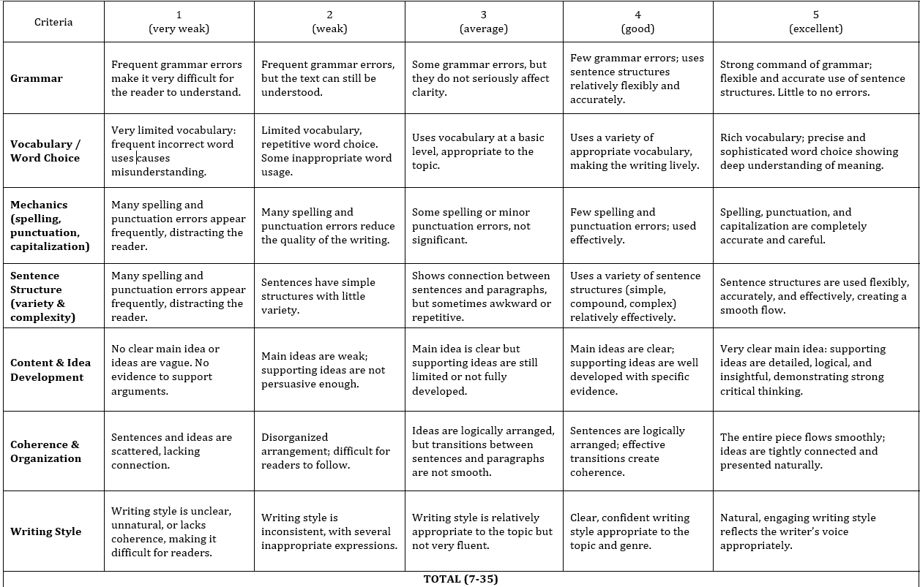
Marking rubrics

Slide 30
References
Alnemrat, A., Aldamen, H., Almashour, M., Al-Deaibes, M., & AlSharefeen, R. (2025). AI vs. teacher feedback on EFL argumentative writing: A quantitative study. Frontiers in Education, 10. https://doi.org/10.3389/feduc.2025.1546789
Bakla, A. (2020). A mixed methods study of feedback modes in L2 writing. Language Learning & Technology, 24(1), 143–161. https://doi.org/10.125/71192
Ballet, K., & Kelchtermans, G. (2009). Struggling with workload: Primary teachers’ experience of intensification. Teaching and Teacher Education, 25(8), 1150-1157. Retrieved from https://doi.org/10.1016/j.tate.2009.02.012
Bardwell, R. (1981). Feedback: How does it function? Journal of Experimental Education, 50(1), 4–9. https://doi.org/10.1080/00220973.1981.11011792
Baz, M. A., & Aksoy, S. H. (2025). The effect of feedback on informative text writing: AI or teacher? Open Praxis, 17(3), 611–631.
Bitchener, J., & Ferris, D. R. (2012). Written corrective feedback in second language acquisition and writing. Routledge.
Chen, C.-F. E., & Cheng, W.-Y. E. C. (2008). Beyond the design of automated writing evaluation: Pedagogical practices and perceived learning effectiveness in EFL writing classes. Language Learning & Technology, 12(2), 94–112.
…

Slide 31


