Slide 1

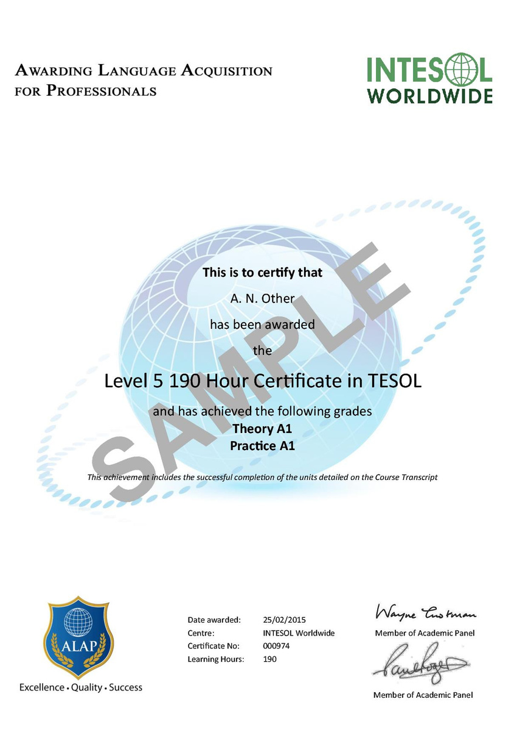

INTESOL INTERNATIONAL CONFERENCE 2026
Teaching English with INTESOL in an Artificial Intelligence World
RESEARCH PRESENTATION
THE PERCEIVED USE OF METACOGNITIVE ONLINE READING STRATEGIES AMONG STUDENTS AT AN EMI UNIVERSITY IN VIETNAM
Authors: Thinh Vu (International University – VNU HCMC)
Dung Dang (International University – VNU HCMC)

Slide 2
TABLE OF
CONTENTS
1. INTRODUCTION
2. LITERATURE REVIEW
3. METHODOLOGY
4. RESULTS & DISCUSSION
5. CONCLUSION

Slide 3
CHAPTER 1: INTRODUCTION
Background of the study
OFFLINE READING STRATEGIES
ONLINE READING STRATEGIES
- Reading: the involvement of acquiring information from texts (Amer et al., 2010; Pardede, 2022)
⟶ Effectively applying reading strategies is vital (Huang et al., 2009)
- COVID-19 outbreak: The Internet is a significant factor in foreign language learning (Pardede, 2022; Putera & Anggrainy, 2024)
- Online reading: a primary input for EFL/ESL learners (Amer et al., 2010)
==> Acquiring strategies for reading electronic texts, particularly metacognitive strategies (Amer et al., 2010)

Slide 4
CHAPTER 1: INTRODUCTION
Problem statement
Applying reading strategies in the EMI-university context (Nisrina, 2023)
The transfer of reading skills from offline to online texts (Amer et al., 2010)
Metacognitive online reading strategies (MORS): limited attention
Research objective
Research question
Explore students' online reading strategies at an EMI university in Vietnam through their perceptions
How do students at an EMI university use metacognitive online reading strategies?

Slide 5
CHAPTER 2: LITERATURE REVIEW
Reading strategies
Definition: Deliberate plans that readers use flexibly and adaptively to reconstruct texts (Par, 2020)
Offline reading strategies
Online reading strategies

Slide 6
CHAPTER 2: LITERATURE REVIEW
COGNITIVE READING STRATEGIES
- The actions or procedures used in the direct processing of text (Sheorey & Mokhtari, 2001)
- An internal process (Gagne, 1977)
Offline reading strategies
METACOGNITIVE READING STRATEGIES
- Higher-order executive skills that utilise learners’ knowledge of cognitive processes
- 3 sub-categories:
+ Global strategies: carefully and intentionally planned to monitor students’ independent reading.
+ Problem-solving strategies: actions/ procedures readers employ when reading the text directly.
+ Support strategies: actions employed to aid comprehension.

Slide 7
CHAPTER 2: LITERATURE REVIEW
Online reading strategies
Comparison between paper text and electronic text
- Online reading strategies: learners’ conscious, intentional actions and behaviours when working with electronic texts (Behalova, 2010).
- Electronic texts for learning purposes: e-books, online articles, journals, and related materials
- The richness and depth of online texts (Preece, 1993).
- Coiro (2003):
+ Printed text is structured by the author
+ Digital texts are multimodal
→ Non-sequential structures

Slide 8
CHAPTER 2: LITERATURE REVIEW
Online reading strategies
- Metacognitive online reading strategies (MORS): intentionally, carefully planned techniques used for online learning texts, including monitoring or managing the online reading process.
\

Slide 9
CHAPTER 1: INTRODUCTION
CHAPTER 2: LITERATURE REVIEW
Perception
- In the context of foreign language learning: How students interpret themselves.
- In this paper: The process or results of EMI students’ self-awareness regarding the use of MORS.

Slide 10
CHAPTER 1: INTRODUCTION
CHAPTER 2: LITERATURE REVIEW
The framework
Metacognitive Online Reading Strategies
Global Strategies
Problem-solving strategies
Support strategies
How learners read the text, aiming to plan, monitor, and evaluate their reading comprehension.
Providing readers with a specific plan to solve problems they may encounter while reading .
Involving localized techniques to aid reading comprehension
(Amer et al., 2010)

Slide 11
CHAPTER 1: INTRODUCTION
CHAPTER 2: LITERATURE REVIEW
Previous studies
Pookcharoen (2009), Anderson (2003), Omar (2014), Rianto (2022)
The most frequently used strategies: Problem-solving strategies
Amer et al. (2010), Harputra et al. (2023)
The most frequently used strategies: Global strategies
Most studies
The least frequently used strategies: Support strategies
The most frequently used strategies: Problem-solving strategies
The positive relationship between the use of global strategies and the predictor of reading performance
Vietnamese context: Do and Phan (2021)
The gap
EMI students who spend more time processing L2 texts
⟶ The investigation of MORS in an EMI context is underexplored

Slide 12
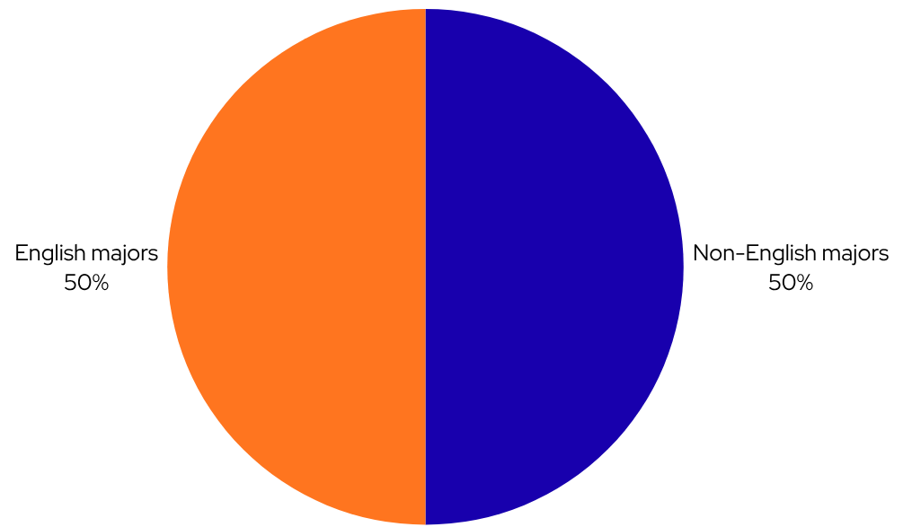
CHAPTER 3: METHODOLOGY
Study design & Participants
STUDY DESIGN
PARTICIPANTS
- Quantitative research design
⟶ Generate factual and reliable outcome data
- 124 students
- International University - VNU HCMC
- Convenience sampling method

Slide 13
CHAPTER 3: METHODOLOGY
Data Collection Instrument
- The Online Survey of Reading Strategies (OSORS) (Amer et al., 2010): adapted from the Survey of Reading Strategies (SORS) (Sheorey & Mokhtari, 2001):
+ Five-point Likert Scale via Google Form.
+ Sections:
  (A) Demographic information (5 items)
  (B) The perceived use of MORS among EMI students:
    - Global strategies (17 items)
    - Problem-solving strategies (8 items)
    - Support strategies (9 items)

Slide 14
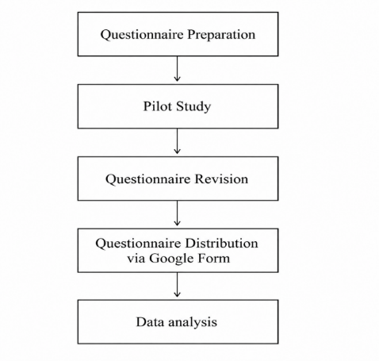
CHAPTER 3: METHODOLOGY
The procedure of the study
Figure 3.1
Data collection and analysis procedure
VALIDITY & RELIABILITY
Test | Cronbach’s Alpha
Pilot Test (N=20) | .80
Official Data (N=124) | .89
-> 2 items in the global strategies are revised
=> Strong reliability (Taber, 2018)
Figure 3.1
Data collection and analysis procedure

Slide 15
CHAPTER 3: METHODOLOGY
Data analysis
- Use SPSS Version 27
- Descriptive statistics:
+ Mean (M)
+ Standard Deviation (SD)
- Identify:
+ Most frequently used strategies
+ Least frequently used strategies
+ Strategy used in each MORS sub-category
⟶ Interpret the results

Slide 16
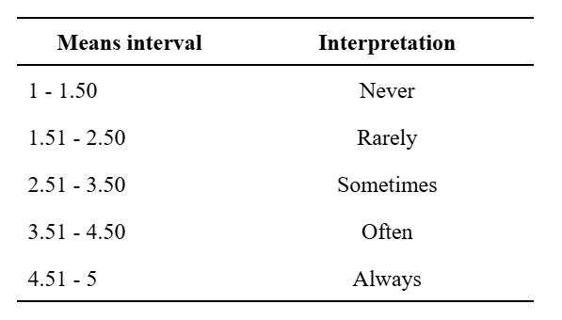
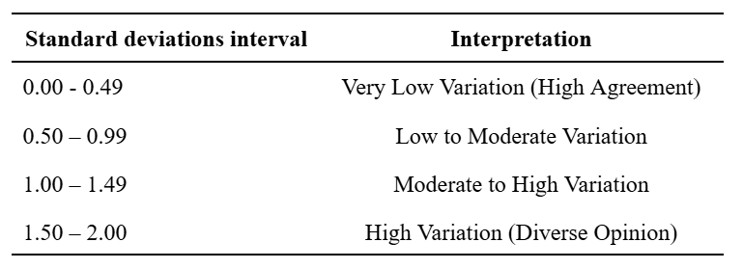
CHAPTER 1: INTRODUCTION
CHAPTER 4: RESULTS & DISCUSSION
Interpretation
Interpretation of the Mean Values
(Pimentel, 2010)
Interpretation of the Standard Deviation Values
(Creswell, 2014)

Slide 17
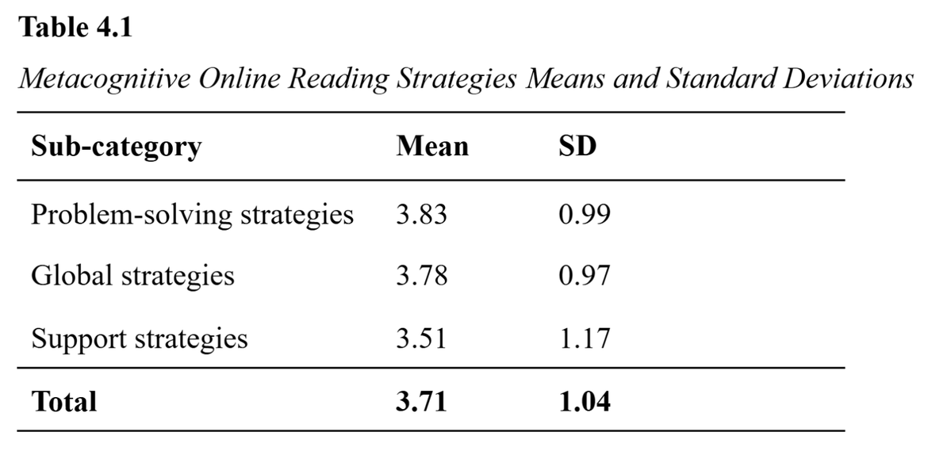
The perceived use of MORS
CHAPTER 1: INTRODUCTION
CHAPTER 4: RESULTS & DISCUSSION
Align with Do and Phan’s (2021) study
- EMI university: students are frequently exposed to global academic online coursebooks and learning materials
- Linguistic challenges students face when acquiring text (Meniado, 2016)
Most frequently used strategies: Problem-solving strategies

Slide 18
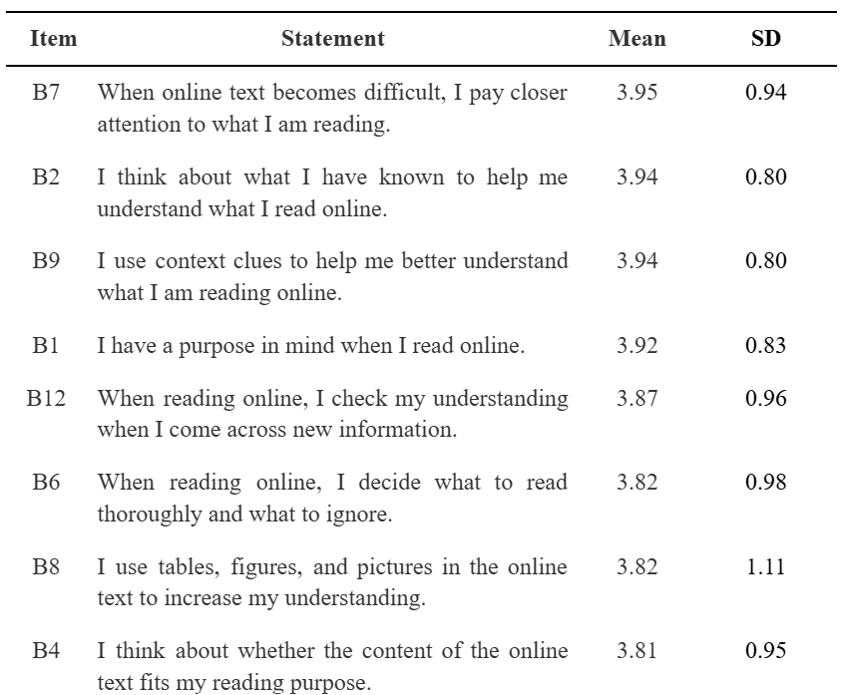
The perceived use of global strategies
CHAPTER 1: INTRODUCTION
CHAPTER 4: RESULTS & DISCUSSION
When online text becomes difficult, I pay closer attention to what I am reading.
Highest mean
- Students often adjust their attention to understand online readings better
- Attention adjustment significantly affects the reading process (Yildiz & Çetinkaya, 2017)
- Automatization theory (LaBerge & Samuels, 1974): attention is an important factor for reading comprehension

Slide 19
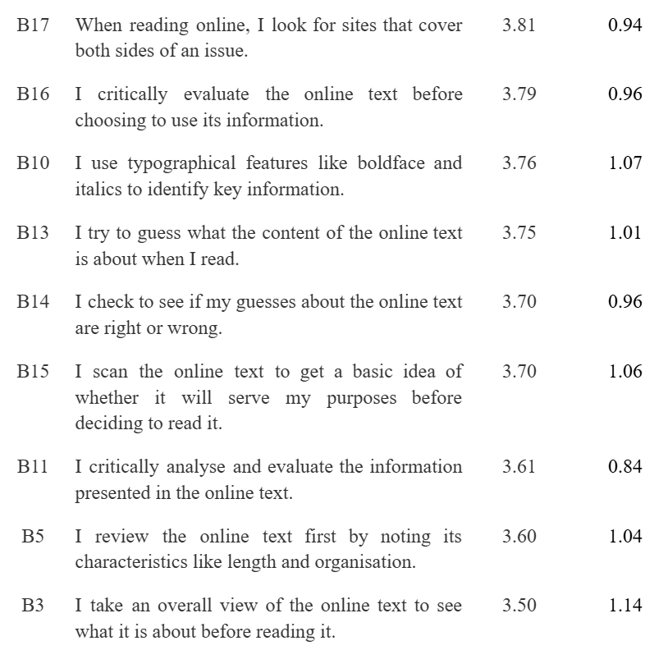
The perceived use of global strategies
CHAPTER 1: INTRODUCTION
CHAPTER 4: RESULTS & DISCUSSION
I take an overall view of the online text to see what it is about before reading it.
Lowest mean
- Sometimes preview online texts before reading
- Encounter unfamiliar academic vocabulary for the first time → Find it difficult to use it (Rukmini et al., 2014)
⟶ Discouragement and fear of its frequent use

Slide 20
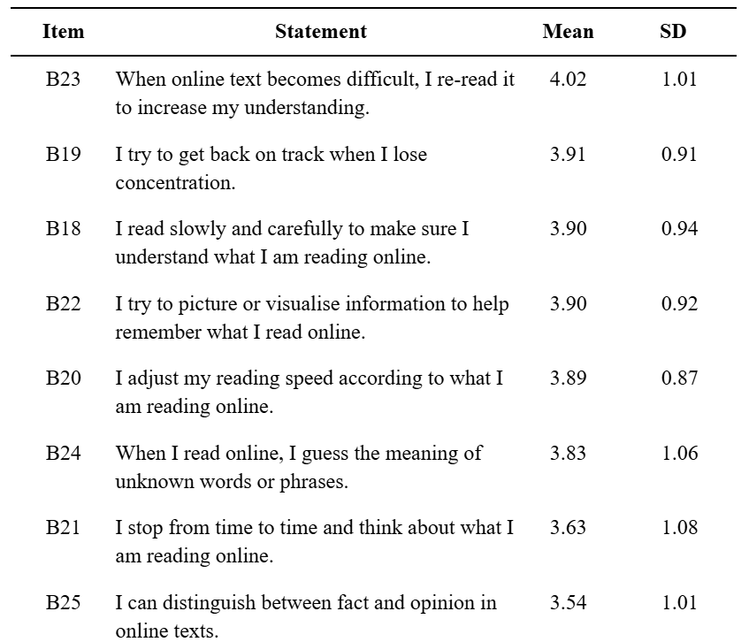
The perceived use of problem-solving strategies
CHAPTER 4: RESULTS & DISCUSSION
When online text becomes difficult, I pay closer attention to what I am reading.
Highest mean
- Frequent rereading for better comprehension
- One of the oldest and principal means to evaluate and regulate the reading process (Laverpool, 2008)
- One of the primary reading strategies taught to students (Laverpool, 2008)

Slide 21
The perceived use of problem-solving strategies
CHAPTER 4: RESULTS & DISCUSSION
Lowest mean
I can distinguish between fact and opinion in online texts.
- Determination between opinions and facts: a critical reading problem in text evaluation (Graney, 1990) → Recognise both explicit and implicit information (Brown & Yule, 1983)
- The richer, more complex components of online texts → Difficulty in distinguish between opinions and facts (Pardede, 2022)
⟶ Reduced confidence in applying this strategy

Slide 22
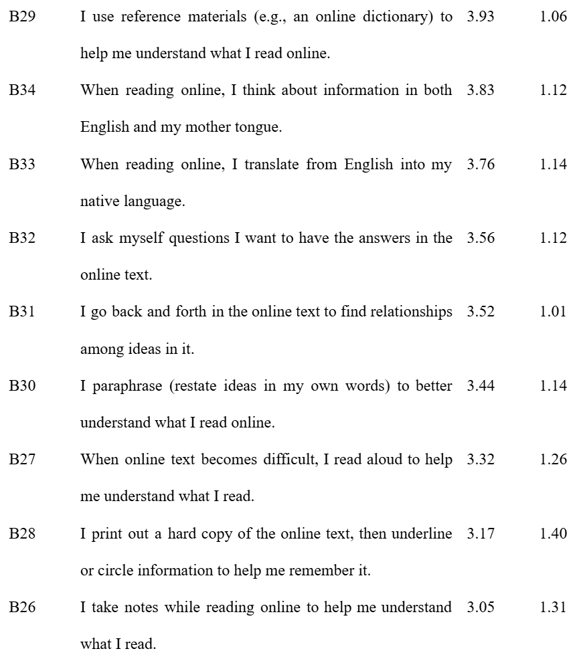
CHAPTER 1: INTRODUCTION
The perceived use of support strategies
CHAPTER 4: RESULTS & DISCUSSION
I use reference materials (e.g., an online dictionary) to help me understand what I read online
Highest mean
- Electronic dictionaries, a type of reference material: effective and motivating aids for successfully acquiring texts (Hamdi, 2015)
- One of the most frequently used strategies to address unfamiliar vocabulary or concepts (Pookcharoen, 2009)
- May be applied by:
+ Non-proficient readers: Check meanings
+ Proficient readers: Understand meanings

Slide 23
CHAPTER 1: INTRODUCTION
The perceived use of support strategies
CHAPTER 4: RESULTS & DISCUSSION
I take notes while reading online to help me understand what I read.
Lowest mean
- Consistent with Anderson (2003)
- EMI context: students must understand disciplinary concepts and process unfamiliar academic vocabulary
- Effective note-taking itself requires active selection and reformulation (Salame et al., 2024) → More complexity
⟶ A more demanding process

Slide 24
CHAPTER 1: INTRODUCTION
CHAPTER 5: CONCLUSION
Conclusion:
- Problem-solving strategies: most frequently used
- Support previous studies on students’ use of metacognitive online reading strategies.
Limitations:
- Small sample size (N = 124)
- OSORS is self-reported → Responses may be subjective (Jusoh & Abdullah, 2015)
Implications:
  Employ longitudinal designs or experimental methods for precise measurement
  Expand the sample size for generalizability enhancement

Slide 25
REFERENCES
  Amer, A., Al Barwani, T., & Ibrahim, M. (2010). Student teachers’ perceived use of online reading strategies. International Journal of Education and Development Using Information and Communication Technology, 6(4), 102–113. Retrieved from LearnTechLib
  Anderson, N. J. (2003). Scrolling, clicking, and reading English: Online reading strategies in a second/foreign language. The Reading Matrix, 3(3), 1–33. http://www.readingmatrix.com/articles/anderson/article.pdf
  Behalova, A. (2010). Exploring online reading strategies of American undergraduate students (Doctoral dissertation, Oklahoma State University).
  Brown, G., & Yule, G. (1983). Discourse analysis. Cambridge University Press.
  Coiro, J. (2003). Reading comprehension on the Internet: Expanding our understanding of reading comprehension to encompass new literacies. Reading Online. http://www.readingonline.org/electronic/elec_index.asp?HREF=/electronic/rt/203_Column/index.html
  Creswell, J. W. (2014). Research design: Qualitative, quantitative, and mixed methods approaches (4th ed.). SAGE Publications.
  Do, H. M., & Phan, H. L. T. (2021). Metacognitive awareness of reading strategies on second language Vietnamese undergraduates. Arab World English Journal, 12(1), 90–112. https://doi.org/10.24093/awej/vol12no1.7
  Gagne, R. M. (1977). The Condition of Learning. New York: Holt, Rinehart, and Winston.
  Graney, J. M. (1990). Determination of fact and opinion: A critical reading problem. Journal of Psycholinguistic Research, 19(2), 147–166. https://doi.org/10.1007/BF01077414
  Hamdi, C. (2015). The effects of electronic dictionary use on reading comprehension and vocabulary retention of EFL students. In Bejaia University International Conference Proceedings 2015. Arab World English Journal, 180–191. https://www.awej.org/images/conferences/BejaiaProceedings2015/16.pdf
  Harputra, Y., Rahmadani, Y. R., & Siregar, M. N. H. (2023). Identifying metacognitive online reading strategies of students Universitas Graha Nusantara. ETANIC Journal of English Language Teaching and Applied Linguistics, 1(1), 20–30. https://jurnal.radisi.or.id/index.php/JournalETANIC/article/view/257
  Huang, H. C., Chern, C. L., & Lin, C. C. (2009). EFL learners’ use of online reading strategies and comprehension of texts: An exploratory study. Computers & Education, 52(1), 13–26. https://doi.org/10.1016/j.compedu.2008.06.003
  Jusoh, Z., & Abdullah, L. (2015). Online survey of reading strategies (OSORS): Students’ online reading in academic context. Malaysian Journal of Distance Education, 17(2), 67–81. https://doi.org/10.21315/mjde2015.17.2.5
  LaBerge, D. & Samuels, S. J. (1974). Toward a theory of automatic information processing in reading. Cognitive Psychology, 6(2), 293–323. https://doi.org/10.1016/0010-0285(74)90015-2

Slide 26
REFERENCES
  Laverpool, A. (2008). The efficacy of rereading as a metacognitive tool for reading comprehension monitoring. Journal of College Reading and Learning, 38(2), 31–48. https://doi.org/10.1080/10790195.2008.10850307
  Meniado, J. C. (2016). Metacognitive reading strategies, motivation, and reading comprehension performance of Saudi EFL students. English Language Teaching, 9(3), 117-129. https://doi.org/10.5539/elt.v9n3p117
  Nisrina, N. (2023). Exploring reading strategies used by students based on metacognitive awareness. Ahmad Dahlan Journal of English Studies, 10(1), 1–11. https://doi.org/10.26555/adjes.v10i1.273
  Omar, N. A. (2014). Online metacognitive reading strategies use by postgraduate Libyan EFL students. World Academy of Science, Engineering and Technology International Journal of Humanities and Social Sciences, 8(7), 2285–2290.
  Par, L. (2020). The relationship between reading strategies and reading achievement of the EFL students. International Journal of Instruction, 13(2), 223–238. https://doi.org/10.29333/iji.2020.13216a
  Pardede, P. (2022). Online reading strategies in EFL: A review. JET (Journal of English Teaching), 8(2), 329–339. https://doi.org/10.33541/jet.v8i2.4130
  Pimentel, J. L. (2010). A note on the usage of Likert scaling for research data analysis. USM R&D Journal, 18(2), 109–112.
  Preece, J. (1993). Hypermedia, multimedia and human factors. In C. Latchem, J. Williamson, & L. Henderson-Lancett (Eds.), Interactive multimedia: Practice and promise (pp. 135–150). Kogan Page.
  Pookcharoen, S. (2009). Metacognitive online reading strategies among Thai EFL university students (Publication No. 3390322) [Doctoral dissertation, Indiana University]. ProQuest Dissertations & Theses Global.
  Putera, A. A., & Anggrainy, F. P. N. (2024). Online reading strategies to boost the students’ motivation. Journal of English Language Teaching and Learning (JETLE), 5(2), 173–184. https://doi.org/10.18860/jetle.v5i2.26522
  Rianto, A. (2022). Exploring correlation between metacognitive online reading strategy use and online reading comprehension of EFL students. Turkish Online Journal of Distance Education, 23(2), Article 14.
  Rukmini, N., Ohoiwutun, J. E. & Muhsin. (2014). Improving reading comprehension of the grade eight students by applying previewing and predicting technique. e-Journal of English Language Teaching Society (ELTS), 2(4), 1–11.
  Salame, I. I., Tuba, M. & Nujhat, M. (2024). Note-taking and its impact on learning, academic performance, and memory. International Journal of Instruction, 17(3), 599-616. https://doi.org/10.29333/iji.2024.17333a

Slide 27
REFERENCES
  Sheorey, R., & Mokhtari, K. (2001). Differences in the metacognitive awareness of reading strategies among native and non-native readers. System, 29(4), 431–449. https://doi.org/10.1016/S0346-251X(01)00039-2
  Taber, K. S. (2018). The use of Cronbach’s alpha when developing and reporting research instruments in science education. Research in Science Education, 48(6), 1273–1296. https://doi.org/10.1007/s11165-016-9602-2
  Yildiz, M. & Çetinkaya, E. (2017). The relationship between good readers’ attention, reading fluency and reading comprehension. Universal Journal of Educational Research, 5(3), 366–371. https://doi.org/10.13189/ujer.2017.050309

Slide 28
THANK YOU

