Slide 1
HUFLIT INTESOL INTERNATIONAL CONFERENCE 2026
Nguyen Thi Nuong
Academy of Policy and Development, Vietnam
Email: nuongnguyen@apd.edu.vn
Nguyen Thanh Dung
National University of Arts Education
Email: dungthanhnguyen1979@yahoo.com

Slide 2


ACADEMY OF POLICY AND DEVELOPMET
NATIONAL UNIVERSITY OF ARTS EDUCATION
WELCOME TO OUR RESEARCH
SHORT-FORM VIDEO PLATFORMS AS DIGITAL TOOLS FOR ESL VOCABULARY DEVELOPMENT: EVIDENCE FROM VIETNAMESE UNIVERSITY STUDENTS
Presented by Dr. Nuong Nguyen, Dr. Dung Thanh

Slide 3

1. INTRODUCTION
2. LITERATURE REVIEW
CONTENT
3. METHODOLOGY
4. RESULTS
5. DISCUSSION
6. CONCLUSION

Slide 4
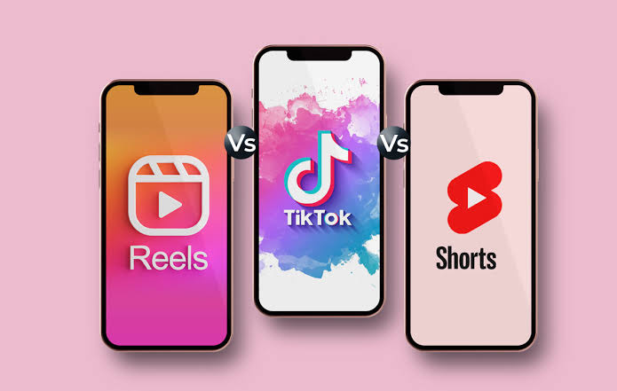
1. INTRODUCTION
Background
English vocabulary is fundamental to language proficiency.
Traditional vocabulary instruction often relies on memorization.
Short-form video platforms (TikTok, Instagram Reels) have become popular learning tools.
Their effectiveness for vocabulary learning remains unclear.
Research problem
Which characteristics of short-form videos actually facilitate vocabulary acquisition?

Slide 5

Research gap
Previous studies mainly focused on
learner motivation
attitudes
engagement
platform acceptance
However,
little empirical evidence explains how short-form videos improve vocabulary learning.
limited research has been conducted in Vietnam.
And very few studies examined
Engagement
Repetition
Multimedia elements
Distraction
within one integrated SEM model.

Slide 6
Research objectives
This study examines whether
Engagement
Repetition
Multimedia Elements
Distraction
Influence English Vocabulary Acquisition, using TikTok and Instagram Reels.
Research questions
RQ1: Which factors influence vocabulary acquisition?
RQ2: To what extent do these factors affect vocabulary acquisition?
RQ3: Which factor has the strongest influence?

Slide 7

2. LITERATURE REVIEW
Theoretical foundations
Cognitive Theory of Multimedia Learning (Mayer, 2009)
Cognitive Load Theory (Sweller, 1988)
Micro-learning Theory
Key variables
Engagement (ENG)
Repetition (REP)
Multimedia Elements (MUL)
Distraction (DIS)
Hypotheses
H1: ENG → VOC (+)
H2: REP → VOC (+)
H3: MUL → VOC (+)
H4: DIS → VOC (−)
Notes:
H1: Engagement (ENG) positively affects vocabulary acquisition (VOC).
H2: Repetition (REP) positively affects vocabulary acquisition (VOC).
H3: Multimedia elements (MUL) positively affect vocabulary acquisition (VOC).
H4: Distraction (DIS) negatively affects vocabulary acquisition (VOC).

Slide 8
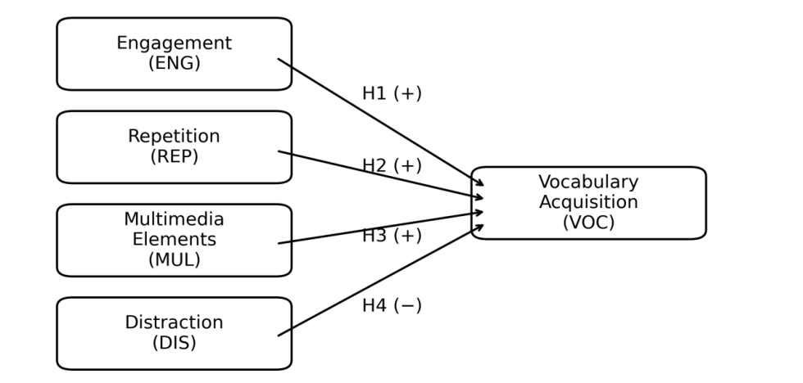
Research model
Figure 1. Research model and hypotheses

Slide 9
3. METHODOLOGY
Quantitative research design
Participants: 220 Vietnamese university students
Instruments: Online questionnaire (15 items)
Platforms: TikTok & Instagram Reels
Data analysis:
  Cronbach's Alpha
  EFA
  CFA
  SEM (AMOS 26)

Slide 10
Descriptive statistics
Table 1. Frequency distribution of the research sample (N=220)
4. RESULTS
Characteristic | Category | n | %
Gender | Male | 49 | 22.3
 | Female | 171 | 77.7
Age | Group 1 | 6 | 2.7
 | Group 2 | 206 | 93.6
 | Group 3 | 8 | 3.6
English proficiency | Level 1 | 55 | 25.0
 | Level 2 | 150 | 68.2
 | Level 3 | 15 | 6.8
English learning experience | Level 1 | 17 | 7.7
 | Level 2 | 28 | 12.7
 | Level 3 | 33 | 15.0
 | Level 4 | 142 | 64.5
Self-learning frequency | Level 1 | 13 | 5.9
 | Level 2 | 26 | 11.8
 | Level 3 | 136 | 61.8
 | Level 4 | 38 | 17.3
 | Level 5 | 7 | 3.2

Slide 11
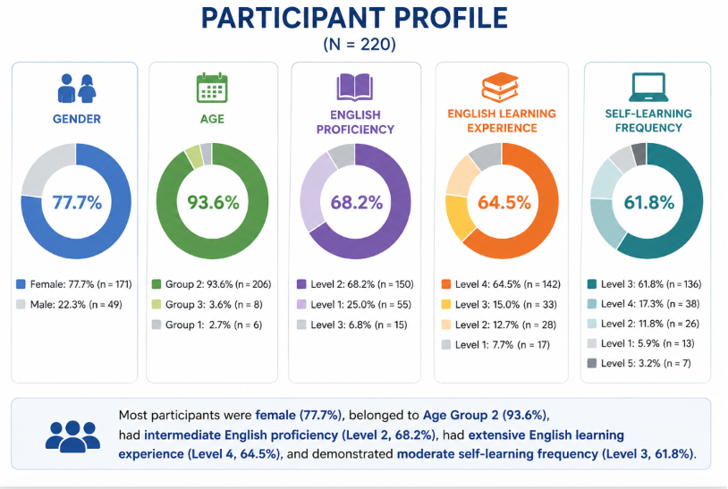

Slide 12
Reliability analysis
Table 2. Reliability analysis of measurement scales
Construct | Number of items | Cronbach’s Alpha | Reliability level
Engagement (ENG) | 2 | .819 | Good
Repetition (REP) | 2 | .815 | Good
Multimedia Elements (MUL) | 3 | .865 | Very Good
Distraction (DIS) | 2 | .878 | Excellent
Vocabulary Acquisition (VOC) | 3 | .830 | Good
All constructs demonstrated satisfactory internal consistency (α > .8

Slide 13
Exploratory Factor Analysis (EFA)
KMO = .928, indicating excellent sampling adequacy for factor analysis.
Bartlett’s Test: p < .001, confirming sufficient correlations among the observed variables.
Total Variance Explained = 66.451%, exceeding the recommended threshold of 50%.
Factor loadings were above the acceptable level, supporting construct validity and confirming that the observed variables appropriately represented the proposed latent constructs.
Table 3. Summary of Exploratory Factor Analysis (EFA)
Indicator | Result | Interpretation
KMO | .928 | Excellent
Bartlett's Test | p < .001 | Suitable for EFA
Total Variance Explained | 66.451% | Acceptable (>50%)
The EFA results confirmed the validity of the measurement model and supported the proposed theoretical framework.

Slide 14
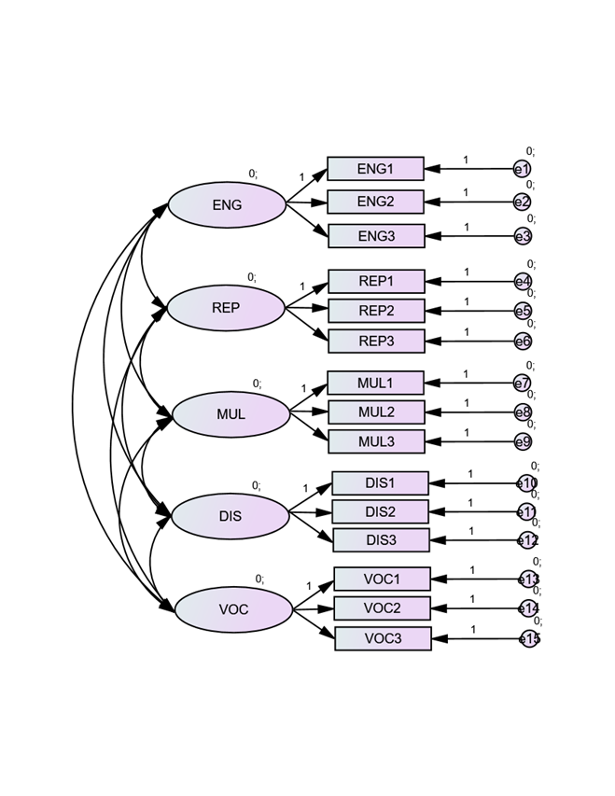
Table 4. CFA Model Fit Indices
Model Fit Indices | Value
χ²/df | 2.11
CFI | .931
TLI | .918
RMSEA | .061
Figure 2. Confirmatory factor analysis (CFA) measurement model
Key findings
Good model fit
Factor loadings: 0.718-0.884 (p < .001)
Convergent validity confirmed
Measurement model validated
Notes:
"The CFA results confirmed that the measurement model fit the data well. All fit indices met the recommended thresholds (χ²/df = 2.11, CFI = .931, TLI = .918, RMSEA = .061). In addition, all standardized factor loadings were significant and ranged from 0.718 to 0.884, supporting the convergent validity of the constructs. Therefore, the measurement model was considered appropriate for the subsequent SEM analysis."

Slide 15
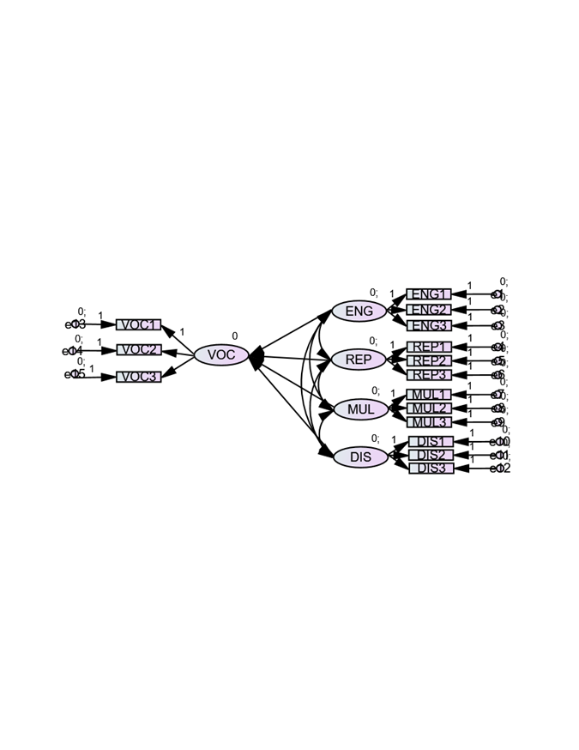
Structural Equation Modeling (SEM)
Table 5. SEM Path Analysis Results
Structural Path | β | p | Result
ENG → VOC | .118 | .231 | Not Supported
REP → VOC | .549 | .012 | Supported
MUL → VOC | .093 | .187 | Not Supported
DIS → VOC | –.074 | .294 | Not Supported
Key Findings
- Repetition (REP) was the only significant predictor of vocabulary acquisition (β = .549, p = .012).
- Engagement, Multimedia Elements, and Distraction did not show statistically significant effects (p > .05).
- These findings highlight the importance of repeated lexical exposure in supporting vocabulary learning through short-form video platforms.
Figure 3. Structural Equation Model with Standardized Estimates
Notes:
The SEM results showed that Repetition was the only significant predictor of vocabulary acquisition (β = .549, p = .012). In contrast, Engagement, Multimedia Elements, and Distraction did not have significant effects. This suggests that repeated exposure to vocabulary plays a more important role in vocabulary learning through short-form video platforms than learner engagement or multimedia features

Slide 16
Table 6. Regression and SEM summary
Regression and SEM Results
Indicator | Result
Adjusted R² | 0.649
Significant predictor | Repetition (REP)
Regression coefficient | β = .372, p < .001
SEM coefficient | β = .549, p = .012
Key findings
- The proposed model explained 64.9% of the variance in vocabulary acquisition (Adjusted R² = .649).
- Repetition (REP) was the strongest and only significant predictor, consistently supported by both Regression and SEM analyses.
- Engagement, Multimedia Elements, and Distraction did not have significant effects on vocabulary acquisition.
- These findings emphasize that repeated lexical exposure is more influential than multimedia features or learner engagement in promoting vocabulary learning through short-form video platforms.
Notes:
The regression model explained 64.9% of the variance in vocabulary acquisition. Consistent with the SEM findings, Repetition remained the strongest and only significant predictor, while Engagement, Multimedia Elements, and Distraction were not statistically significant. This confirms that repeated exposure to vocabulary is the key factor supporting vocabulary learning through short-form video platforms.

Slide 17
5. DISCUSSION
Key findings
Repetition was the only significant predictor of vocabulary acquisition, highlighting the importance of repeated lexical exposure in digital language learning.
Multimedia Elements and Engagement alone did not significantly improve vocabulary learning, suggesting that attractive content is insufficient without meaningful repetition.
Distraction showed no significant negative effect, indicating that learners may adapt to highly stimulating digital environments.
Overall, structured repetition, rather than entertainment value or multimedia complexity, is the key mechanism supporting vocabulary acquisition through short-form video platforms.

Slide 18
Theoretical and practical contributions
Theoretical contributions
Extends research on TikTok and Instagram Reels by identifying repetition as the primary mechanism underlying vocabulary acquisition.
Reinforces vocabulary acquisition theory by emphasizing the importance of repeated lexical exposure in digital learning environments.
Provides empirical evidence from the Vietnamese higher education context.
Practical contributions
Design vocabulary-focused short-form videos with repeated exposure, subtitles, and contextual recycling.
Integrate TikTok and Instagram Reels into supplementary vocabulary instruction to reinforce vocabulary learning beyond the classroom.
Notes:
The findings indicate that repetition is the key factor driving vocabulary acquisition through short-form video platforms. While multimedia features and learner engagement may attract attention, they do not necessarily lead to measurable vocabulary gains without repeated exposure. Interestingly, distraction was not found to significantly hinder learning, suggesting that students can adapt to dynamic digital environments. Therefore, educators and content creators should prioritize repeated lexical exposure and contextual recycling when designing educational short-form videos.

Slide 19
6. CONCLUSION
Key conclusions
Short-form video platforms (TikTok and Instagram Reels) can effectively support English vocabulary learning when they provide repeated lexical exposure.
Repetition was the only significant predictor of vocabulary acquisition, whereas Engagement, Multimedia Elements, and Distraction showed no significant effects.
Effective vocabulary learning depends more on structured repetition than on entertainment-oriented or multimedia-rich content.
Teachers and content creators should design short-form videos with subtitles, contextual recycling, thematic consistency, and repeated exposure to target vocabulary.

Slide 20
Limitations & Future Research
Limitations
Self-reported data from 220 Vietnamese university students.
Cross-sectional design and convenience sampling.
Focus on perceived rather than objective vocabulary gains.
Future Research
Conduct longitudinal or experimental studies.
Use objective vocabulary assessments.
Compare different social media platforms and learner populations.
Notes:
In conclusion, this study demonstrates that short-form video platforms can support English vocabulary learning when they provide repeated and meaningful lexical exposure. Among the four examined factors, repetition was the only significant predictor of vocabulary acquisition. These findings suggest that educators and content creators should prioritize repetition, subtitles, and contextual recycling rather than relying solely on multimedia features. Future research should adopt longitudinal or experimental designs, include objective vocabulary assessments, and investigate different learning contexts

Slide 21





Slide 22

Contact:
Ph.D. Nguyen Thi Nuong
Tel: 0912.833.525
Email: nuongnguyen@apd.edu.vn
Ph.D. Nguyen Thanh Dung
Tel: 0912.905.956
Email: dungthanhnguyen1979@yahoo.com

Slide 23
REFERENCES

