Slide 1

AN ANALYSIS ON EFL VIETNAMESE SOPHOMORES PRONUNCIATION IN A SPEAKING COURSE
Tran Thi Minh Thu
Email: thuttm@huflit.edu.vn
HUFLIT INTESOL 7th August

Slide 2


Table of content
Introduction
Literature review
Methodology
Analysis and discussion
Pedagogical implications
Conclusion

Slide 3

1. Introduction
the importance of English pronunciation in comprehension conversation
Vietnamese learners → difficulties in pronouncing English final consonants and consonant clusters due to substantial phonological differences between Vietnamese and English (Le, 2014; Nguyen, 2007; Bui et al., 2021)
Problems with word stress and intonation (Yates, 2017)
→ Aim to explore these aspects related to Vietnamese learners’ pronunciation and some appropriate recommendations for pronunciation teaching in Vietnam

Slide 4
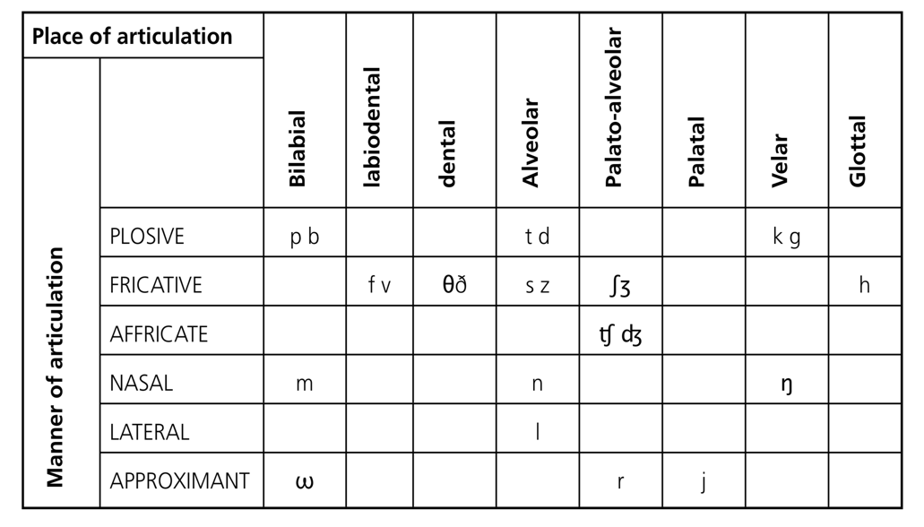
2. Literature review
2.1. Consonants
voiced group (/b/, /m/, /w/, /v/, /d/, /z/, /n/, /l/, /r/, /j/, /g/, /ʒ/, /dʒ/, /ŋ/, /ð/)
voiceless group (/p/, /f/, /t/, /s/, /k/, /h/, /ʃ/, /tʃ/, /θ/).
a crucial part in the syllable structure (Roach, 2009)

Slide 5
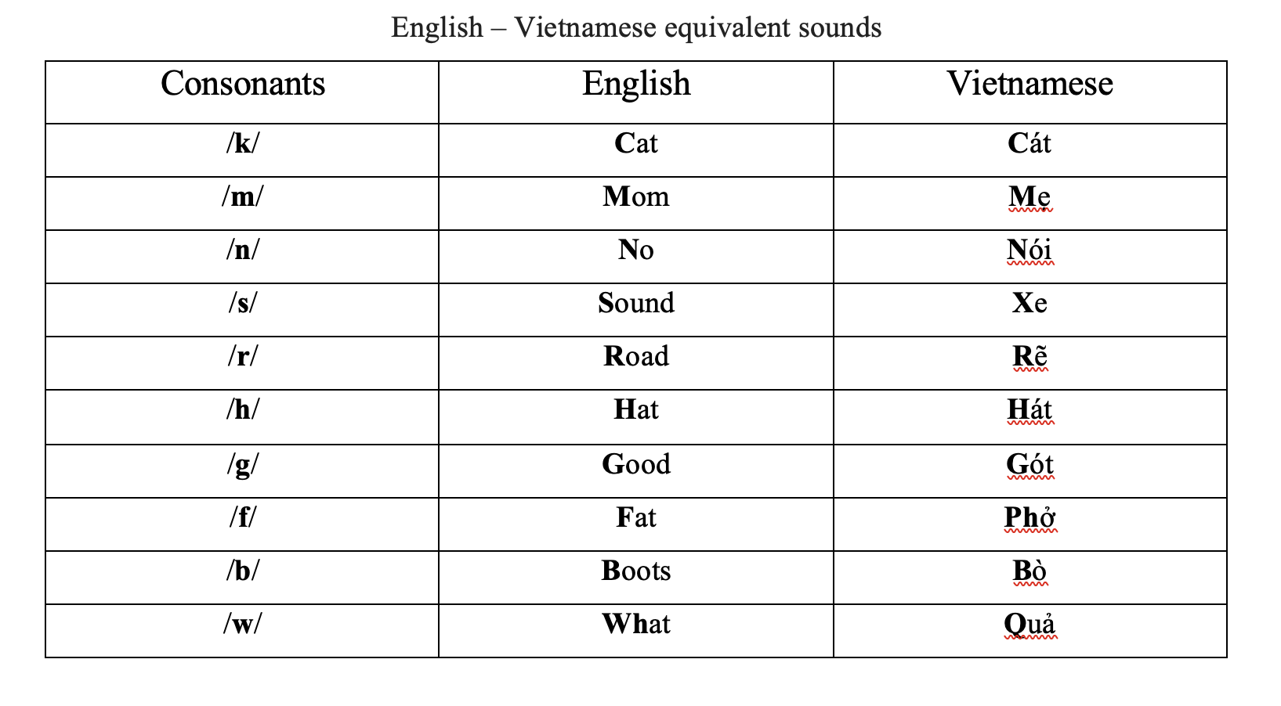

Slide 6
2. Literature review
2.2. Final consonants articulation among Vietnamese learners
Some shared consonants between Vietnamese and English /b, d, k, m, n, f, v, s, z, h, l/ (Pham & McLeod, 2016)
Vietnamese → no habits of pronouncing final sounds (Le, 2014) → challenges for Vietnamese learners
Two groups of final consonants: pre-final & post-final (Pre-final includes: /m/, /n/, /ŋ/, /l/, /s/ ; Post-final includes: /s/, /z/, /t/, /d/, /θ/ )

Slide 7

2. Literature review
2.2. Final consonants articulation among Vietnamese learners
Study of Bui et al. (2021) → mispronounced / omitted / substituted → common errors in pronouncing ending sounds among Vietnamese second language learners.
Study of Nguyen (2007) → differences between Vietnamese and English → errors in pronouncing English sounds
Ex: lives as /lɪvəz/ and leaves as /liːvəz/

Slide 8
2. Literature review
2.3. Word stress and intonation
2.3.1. Word stress
Four main factors: Loudness - Pitch change - Quality of sound - Length of sound(Rogerson-Revell, 2011)
The study of Yates (2017) → difficulties with English prosodic features because English stress patterns differ substantially from Vietnamese phonological organization

Slide 9
2. Literature review
2.3.2. Intonation
Framework for Intonation (Rogerson-Revell, 2011):
Thought groups/Tone units (the division of utterances into smaller chunks or meaningful units)
Nuclear stress placement/Tonicity (the accentual function of intonation)
Tone choice (Rise-Fall/pitch movement)

Slide 10
Research questions
What consonant difficulties do Vietnamese EFL sophomores encounter during both their read-a-loud and free speaking task?
What are some common mistakes do Vietnamese EFL sophomores make regarding English word stress and intonation?
What are the possible implications of these pronunciation difficulties for communicative effectiveness?

Slide 11
Methodology
Research design: qualitative descriptive case study
Participants: 2 Vietnamese EFL sophomores
Research tools: A free speaking task & reading passages (adopted from Fairbanks, 1960)
Analysis based on framework proposed by by Roach (2009), Rogerson-Revell (2011), and Cruttenden (2014)

Slide 12
Methodology
Procedures:
STEP 2:
A free speaking task and record
STEP 4:
Coding sheet and analysis
Within 2 weeks
STEP 1:
Read-a-loud reading passage and record
STEP 3:
Transcribe all the recordings for analysis
STEP 5:
Feedback and recommendations for the participants

Slide 13
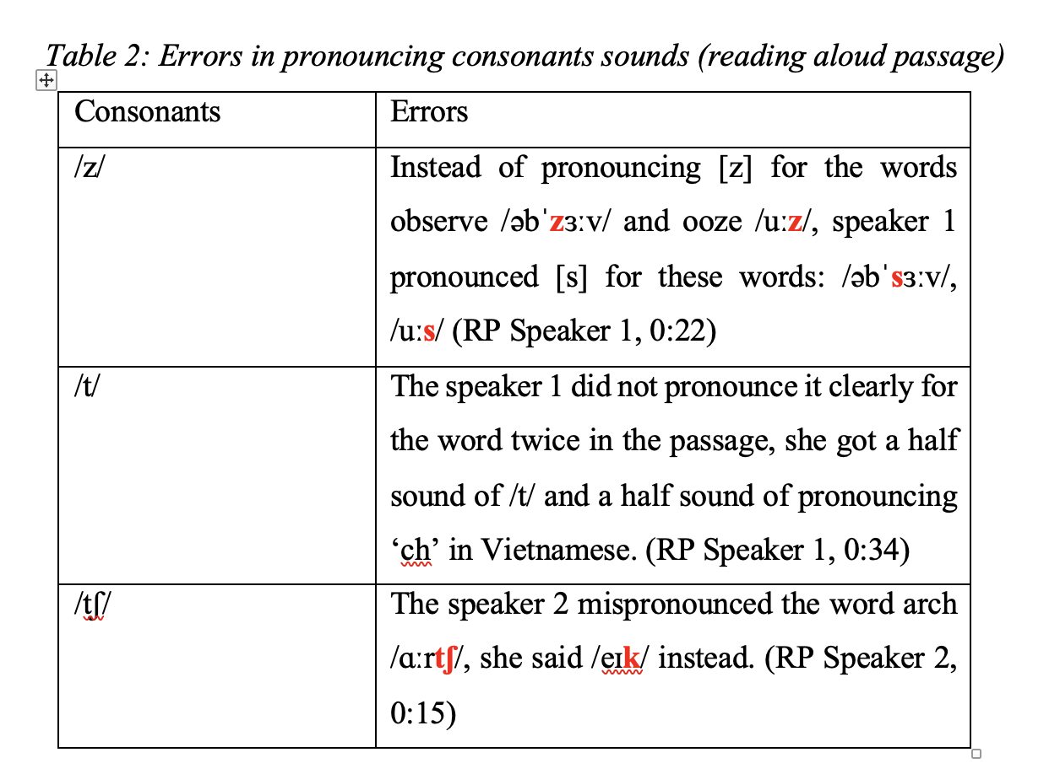
Analysis and discussion
4.1. consonants
no differences of final consonant sounds (/z/, /s/, /ɪz/) for words belonging to the s rules pronunciation.
did not produce correctly /t/, /d/ for the verbs in -ed form
/t/ was mostly unaspirated for words ending with ‘t’ & words engaging with -ed rule.

Slide 14
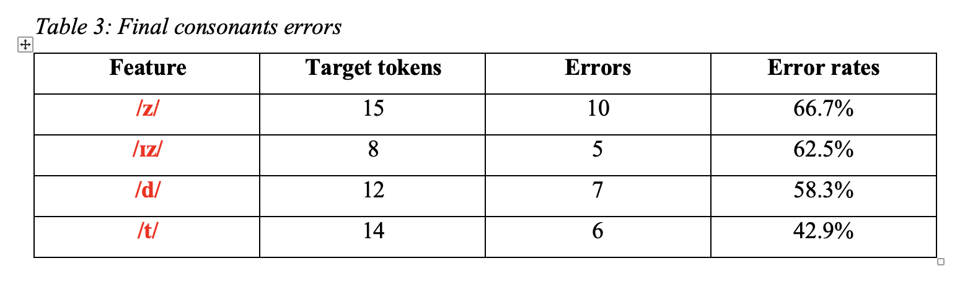
Analysis and discussion
4.1. consonants

Slide 15
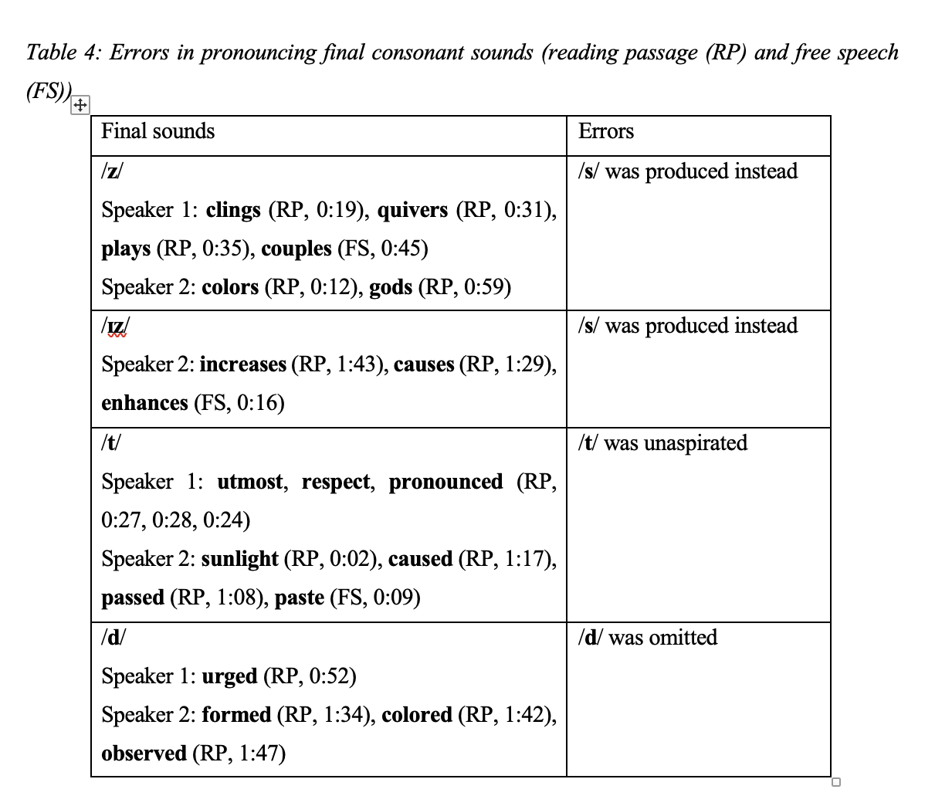
Analysis and discussion
4.1. consonants
→ Omitted
→ Substituted

Slide 16
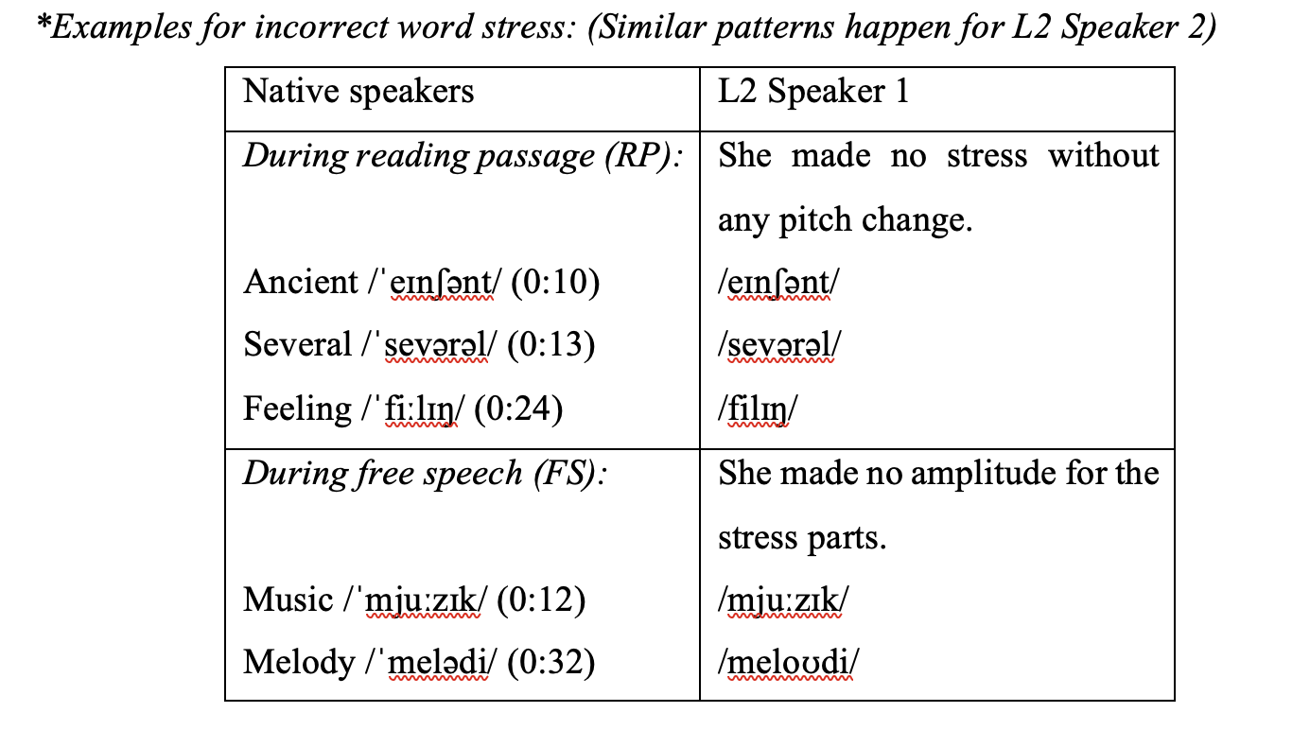
Analysis and discussion
4.2. Word stress and intonation

Slide 17
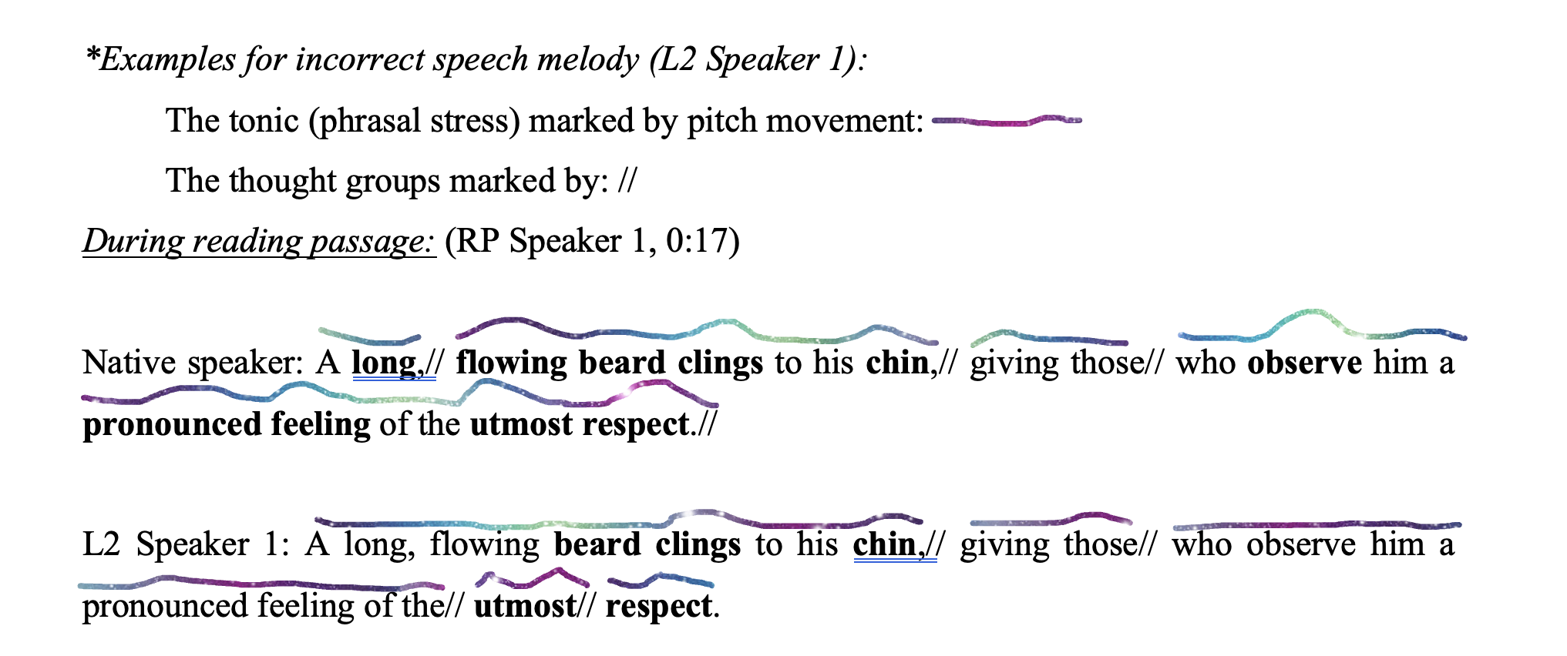
Analysis and discussion
4.2. Word stress and intonation

Slide 18
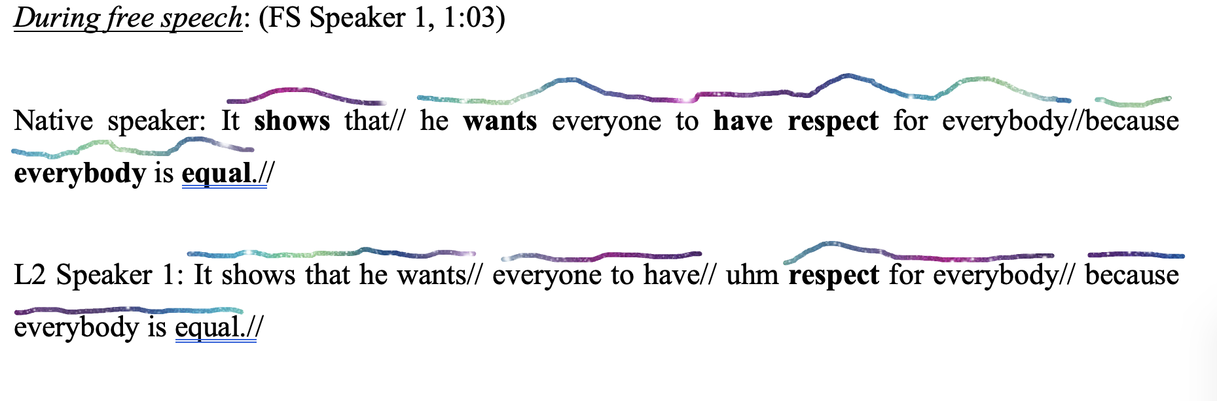
Analysis and discussion
4.2. Word stress and intonation

Slide 19
Analysis and discussion
the sound system of learners’ first language → influence their second language sounds (Nation & Newton, 2020)
cannot pronounce /tʃ/ correctly → same situation happens for producing final sounds of s rules and -ed rules
frequently omit or simplify word-final /s/ and /z/ → these sounds contribute little to lexical identification in Vietnamese → similar explanation for the omission of /d/
align with the study of Disney & Le ( 2024); Bui et al., (2021); Minh et al., (2024)
inaccurate English speech melody - omitted word stress, made wrong tone groups division and incorrect tonic placement during speech
the tendency to put their Vietnamese tones in speaking English words or producing English prosody

Slide 20
Limitations
Only two participants → limit the generalizability of this research
Lack of additional sources: interviews, classroom observations, listener judgements
Subjective description
Focus only on specific aspects: consonants, intonation
Not examine the effectiveness of any pronunciation intervention

Slide 21
Pedagogical Implications
explicit instruction regarding the pronunciation rules of /s/, /z/, /ɪz/, /t/, /d/, and /ɪd/, followed by extensive communicative practice
To raise learners’ awareness of these sounds → minimal-pair discrimination, information-gap tasks, dictation exercises, and peer correction
word stress and intonation improvements → suprasegmental instruction along with stress placement, tonic stress, and pitch movement tasks
Integrate pronunciation tasks into communicative activities

Slide 22
Conclusion
Vietnamese learners → the tendency of omitting final sounds or altering final sounds (e.g. plural, third-person singular, and past tense verbs)
Problems with intonation and word stress (e.g. pitch variation and inaccurate stress placement)
The impact on the communicative effectiveness
Call for further research in this field
The need for incorporating listeners judgement to measure communicative effectiveness level
→ The importance of learning and teaching pronunciation

Slide 23
Sample suggested activities
(celce-murcia et al., 2010)
Final sounds:
Activity: Work with your friends. Listen to your partner speaking a group of words and find out the word with different final sounds.
plays hands words peas buses hills
cats sleeps sits hats picks drops
You and your friends take turns, create a piece of paper with groups of words like this beforehand and keep practice together.

Slide 24
Sample suggested activities
(celce-murcia et al., 2010)
Word Stress:
Activity:
Listen to the following words and write the number of syllables in each word
Considerably ____ Social ____
Explanation ____ Understandable ____
Breakable ____ Expectancy ____
Immediately ____ Melody ____
Listen again and circle the stressed syllable in each word. Then practice saying these words to your partner. Check your partner’s stress.
This activity will help you to get used to making word stress. You and your friends should take turns and practice together.

Slide 25
Sample suggested activities
(celce-murcia et al., 2010)
Intonation:
Activity: You and your friend have been shopping. Make a conversation about what you purchased using the information given below:
A: What / you / got?
B: I / buy / shoes / two pairs / jeans / hat / T-shirt / this bag.
A: Quite a lot. I only / buy / couple / T-shirt / sneakers / my upcoming vacation.
B: You / buy / that jacket?
A: Which one? One / I / try on / Tommy’s?

Slide 26

References (please scan the QR code below to see the refences)

Slide 27


