Slide 1


TRƯỜNG ĐẠI HỌC NGOẠI NGỮ - TIN HỌC TP. HỒ CHÍ MINH
HO CHI MINH CITY UNIVERSITY OF FOREIGN LANGUAGES - INFORMATION TECHNOLOGY
The Pedagogical Impact of Artificial Intelligence Tools on English Majors' Writing Skills at HUFLIT
Presented by Nguyễn Minh Tuấn
https://canva.link/k4emiz027qjjd8y
www.huflit.edu.vn

Slide 2



Ho Chi Minh City University of Foreign Languages – Information Technology
Presentation Agenda
01 Introduction: Context & Objectives
02 Literature Review: Theory
03 Methodology: Research Design
04 Findings: Data & Themes
05 Discussion: Impacts & Implications
06 Conclusion & Recommendations
07 Limitations & Future Research

Slide 3
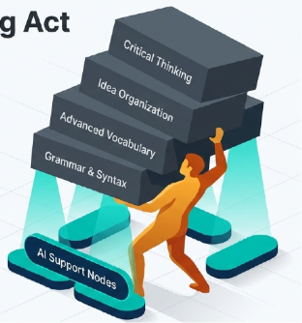
Ho Chi Minh City University of Foreign Languages – Information Technology
INTRODUCTION -
AI Tools in the Modern Writing Classroom
  Growing Presence
increasingly common in English language learning → ChatGPT, Gemini, Grammarly, and QuillBot to support their writing processes.
  Student Support Ecosystem
tasked with advanced academic assignments
  Valid concerns
writing abilities, independent thinking, and creativity.
.

Slide 4
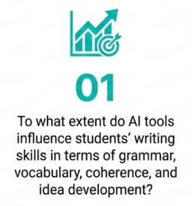
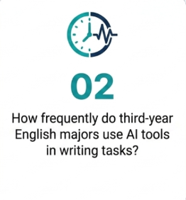
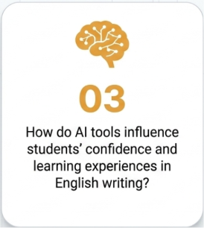
Ho Chi Minh City University of Foreign Languages – Information Technology
INTRODUCTION -
3 Core research questions

Slide 5
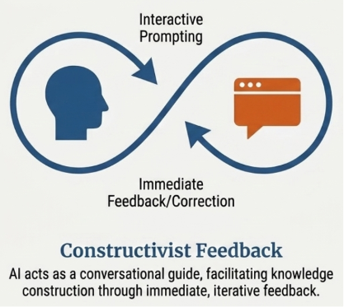
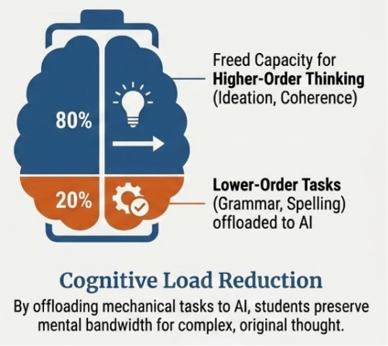
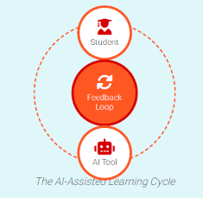
Ho Chi Minh City University of Foreign Languages – Information Technology
LITERATURE REVIEW -
Theoretical Foundations

Slide 6
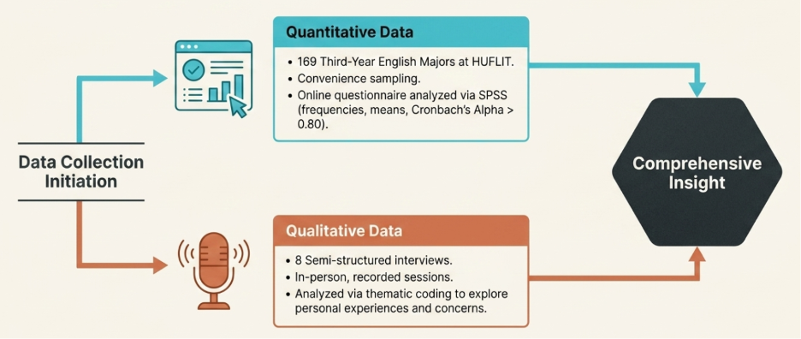
Ho Chi Minh City University of Foreign Languages – Information Technology
METHODOLOGY -
A mixed-methods approach

Slide 7
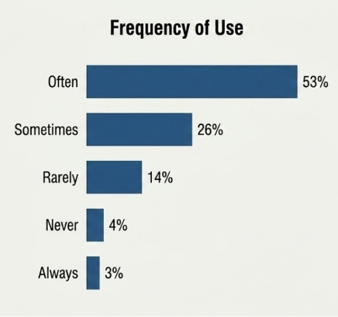
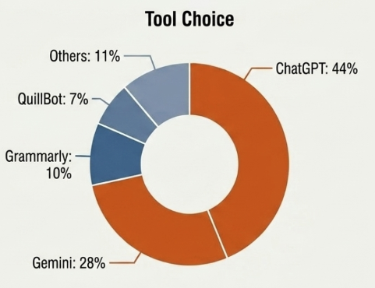
Ho Chi Minh City University of Foreign Languages – Information Technology
FINDINGS -
Quantitative & Qualitative findings

Slide 8
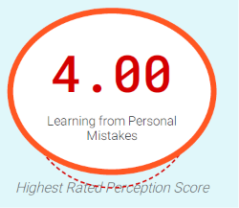
Ho Chi Minh City University of Foreign Languages – Information Technology
FINDINGS -
Positive Perceptions
  Idea Generation
  Clear Feedback
  Constructive Support

Slide 9
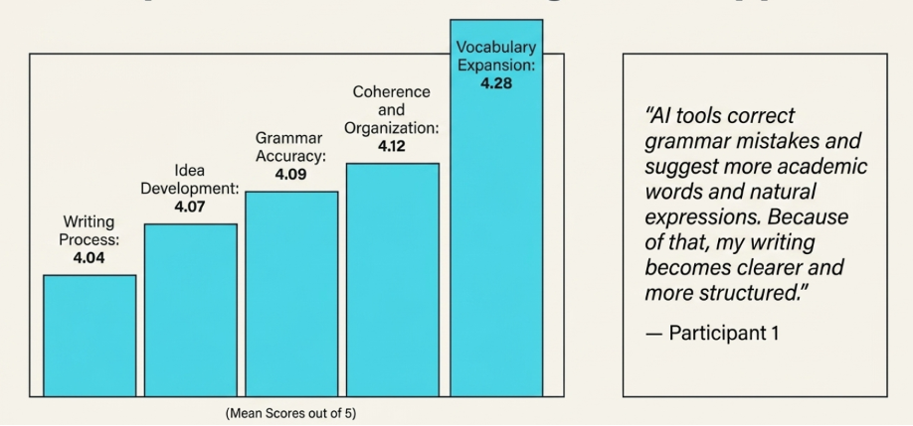
Ho Chi Minh City University of Foreign Languages – Information Technology
FINDINGS -
Writing Support

Slide 10
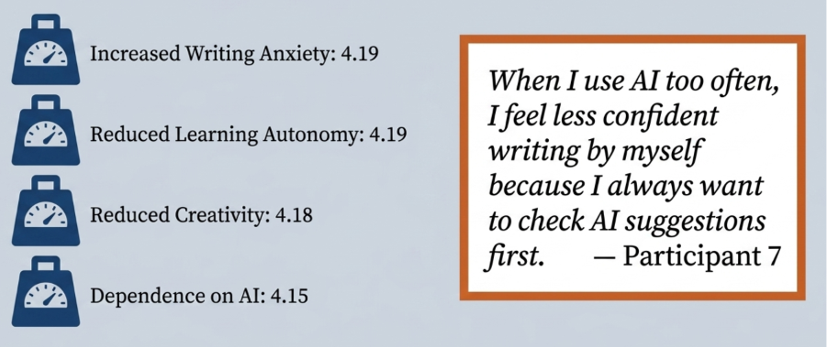
Ho Chi Minh City University of Foreign Languages – Information Technology
FINDINGS -
Student Concerns

Slide 11
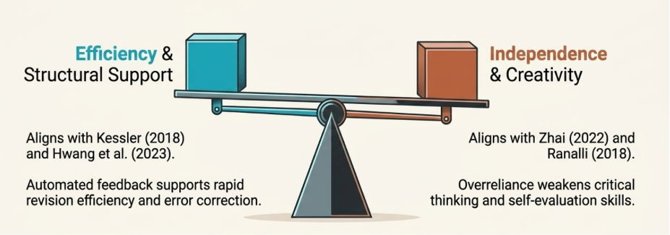
Ho Chi Minh City University of Foreign Languages – Information Technology
DISCUSSION -
Efficiency & Independence

Slide 12
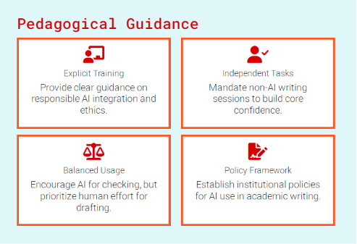
Ho Chi Minh City University of Foreign Languages – Information Technology
CONCLUSION & RECOMMENDATION
  widely adopted and positively perceived
  concerns persist
  a supportive resource, not a cognitive replacement

Slide 13
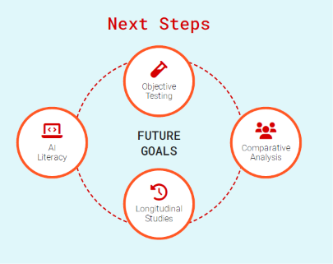
Ho Chi Minh City University of Foreign Languages – Information Technology
LIMITATIONS & FUTURE RESEARCH
  Subjective Data: self-reported perceptions
  Sample Scope: one institution (HUFLIT) and a small qualitative sample size
  Snapshot Analysis: specific moment in time

Slide 14
Ho Chi Minh City University of Foreign Languages – Information Technology
REFERENCE
Cung, L. T., Hoang, U. P. T., Dinh, A. N., & Bui, T. H. (2025). University Students’ perceptions of AI application in writing Skills in Vietnam: a Systematic review. Vietnam Journal of Education (Online)/Vietnam Journal of Education/GiáO DụC, 325–334. https://doi.org/10.52296/vje.2025.533
Hwang, Y., Lee, J. H., & Shin, D. (2023). What is prompt literacy? An exploratory study of language learners’ development of new literacy skill using generative AI. arXiv (Cornell University). https://doi.org/10.48550/arxiv.2311.05373
Kessler, G. (2018). Technology and the future of language teaching. Foreign Language Annals, 51(1), 205–218. https://doi.org/10.1111/flan.12318
Khan, A. L., Hasan, M. M., Islam, M. N., & Uddin, M. S. (2024). Artificial Intelligence Tools in Developing English Writing Skills: Bangladeshi University EFL Students’ Perceptions. English Education Jurnal Tadris Bahasa Inggris, 17(2), 345–371. https://doi.org/10.24042/ee-jtbi.v17i2.24369
Kukulska-Hulme, A., & Shield, L. (2008). An overview of mobile assisted language learning: From content delivery to supported collaboration and interaction. ReCALL, 20(3), 271–289. https://doi.org/10.1017/s0958344008000335
Nazari, N., Shabbir, M. S., & Setiawan, R. (2021). Application of Artificial Intelligence powered digital writing assistant in higher education: randomized controlled trial. Heliyon, 7(5), e07014. https://doi.org/10.1016/j.heliyon.2021.e07014
Ranalli, J. (2018). Automated written corrective feedback: how well can students make use of it? Computer Assisted Language Learning, 31(7), 653–674. https://doi.org/10.1080/09588221.2018.1428994
Seufert, S., Guggemos, J., & Sailer, M. (2020). Technology-related knowledge, skills, and attitudes of pre- and in-service teachers: The current situation and emerging trends. Computers in Human Behavior, 115, 106552. https://doi.org/10.1016/j.chb.2020.106552
Song, C., & Song, Y. (2023). Enhancing academic writing skills and motivation: assessing the efficacy of ChatGPT in AI-assisted language learning for EFL students. Frontiers in Psychology, 14, 1260843. https://doi.org/10.3389/fpsyg.2023.1260843
Sweller, J. (1988). Cognitive load during problem solving: Effects on learning. Cognitive Science, 12(2), 257–285. https://doi.org/10.1207/s15516709cog1202_4
Ta, T. T. H., Bo, T. L., Khuong, Q. N., & Nghiem, H. P. (2025). Impacts of artificial intelligence student guide on academic writing among third-year students at the faculty of international education, vnu university of languages and international studies. VNU Journal of Foreign Studies, 41(4), 40–53.https://doi.org/10.63023/2525-2445/jfs.ulis.5489
Tran, T. T. H. (2024). AI Tools in Teaching and Learning English Academic Writing Skills. Proceedings of the AsiaCALL International Conference, 4, 170–187. https://doi.org/10.54855/paic.23413
Utami, S. P. T., Andayani, A., Winarni, R., & Sumarwati, S. (2023). Utilization of artificial intelligence technology in an academic writing class: How do Indonesian students perceive? Contemporary Educational Technology, 15(4), ep450. https://doi.org/10.30935/cedtech/13419
Van, N. T. (2025). The impact of AI tools on English writing skills development. International Journal of Social Science Exceptional Research, 4(3), 01–06. https://doi.org/10.54660/ijsser.2025.4.3.01-06
Zhai, X., He, P., & Krajcik, J. (2022). Applying machine learning to automatically assess scientific models. Journal of Research in Science Teaching, 59(10), 1765–1794. https://doi.org/10.1002/tea.21773
Zhai, C., Wibowo, S., & Li, L. D. (2024). The effects of over-reliance on AI dialogue systems on students’ cognitive abilities: a systematic review. Smart Learning Environments, 11(1). https://doi.org/10.1186/s40561-024-00316-7

Slide 15

Ho Chi Minh City University of Foreign Languages – Information Technology
Thank You
The Pedagogical Impact of AI Tools on English Majors' Writing Skills
Contact: tuannm@huflit.edu.vn

