Slide 1

TRƯỜNG ĐẠI HỌC NGOẠI NGỮ - TIN HỌC TP. HỒ CHÍ MINH
HO CHI MINH CITY UNIVERSITY OF FOREIGN LANGUAGES - INFORMATION TECHNOLOGY
Exploring the Impacts of
Over-reliance on Generative AI Tools in Essay Writing: A Case Study of HUFLIT Sophomores

Slide 2
Table of content
1
2
3
INTRODUCTION
LITERATURE REVIEW
METHODOLOGY
1
1
1
4
5
FINDINGS & DISCUSSION
CONCLUSION & RECOMMENDATIONS
LE HOANG YEN VY

Slide 3




INTRODUCTION
Rapid growth of Generative AI in academic writing
Over-reliance on ChatGPT-Generated content
Decline in Independent idea generation and Arguement development
Cognitive load in Essay writing among
HUFLIT Sophomores
LE HOANG YEN VY

Slide 4
RESEARCH QUESTIONS
  To what extent does overuse of ChatGPT lead to students’ dependence on AI generated content in essay writing?
  How does the excessive use of ChatGPT influence HUFLIT sophomores’ ability to think independently when developing arguments in essays?
LE HOANG YEN VY

Slide 5

LITERATURE REVIEW
Cognitive Load Theory (CLT)
Second Language Acquisition (SLA)
Active language production through Writing
Limited working
memory capacity
Intrinsic, Extraneous,
and Germane Loads
Meaningful academic output creation
Managing Cognitive demands in Writing
Independent practice for language development
LE HOANG YEN VY

Slide 6
Primary Benefits Identified
Primary Risk Identified
PREVIOUS
RESEARCH
Author(s) & Year
Faster and coherent essay creation
Loss of student idea ownership
Bašić et al. (2023)
Improved grammar and vocabulary quality
Reduced independent critical thinking skills
Mahapatra (2024)
Reduced cognitive mental burden
Lowered creativity and passive participation
Boudouaia et al. (2024)
Increased student writing motivation
Weakened long-term writing abilities
Lai & Trinh (2025)
Lowered writing anxiety levels
Passive engagement during self-revision
Yuan & Dao (2026)
LE HOANG YEN VY

Slide 7




METHODOLOGY
  Mixed quantitative and qualititive methods
  Conducted at HUFLIT
  127 students
  Surveys and interviews
  Voluntary, confidential, and anonymous
  English-major sophomores
  Demographics plus perceptions
  Cross-sectional survey
  Survey (5-point Likert sclae)
  Academic essay writing courses
  Experienced GenAI users
  Data analyzed using SPSS
Research Design
Research context
Participants
Research Instrument
LE HOANG YEN VY

Slide 8
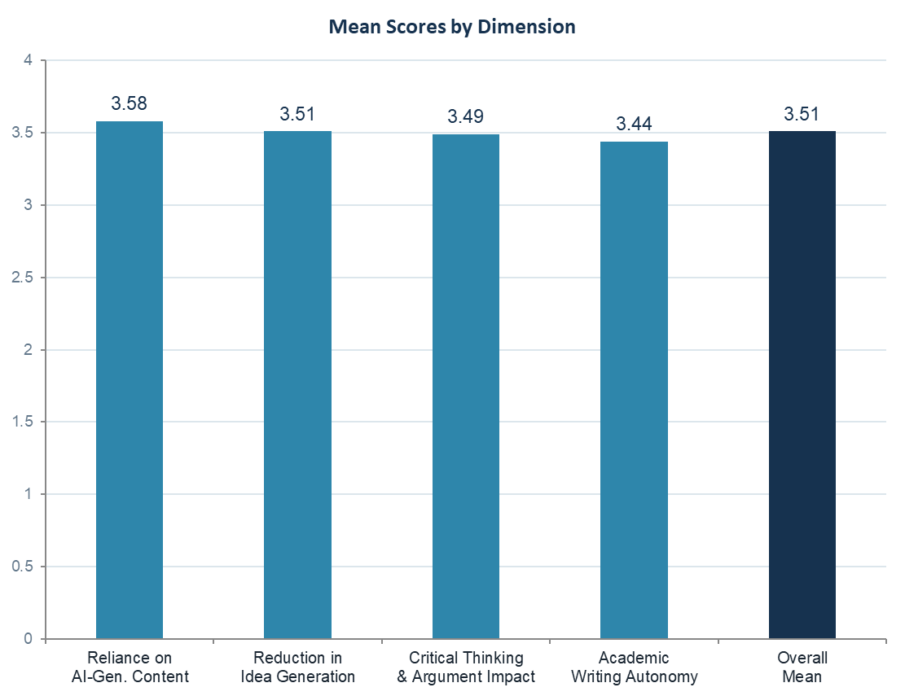
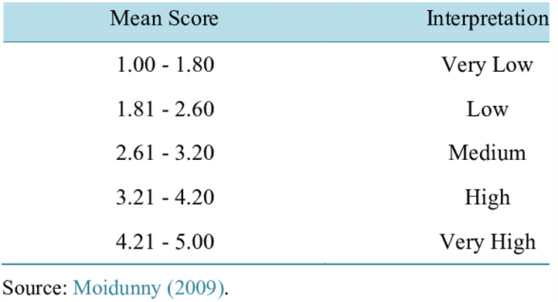
Findings and Discussions
PHAM KIM QUOC

Slide 9


DEPENDENCE ON AI-GENERATED CONTENT
ChatGPT-assisted structure planning
(M=3.64)
Difficulty writing without AI
(M=3.37)
Reliance on AI-generated ideas
(M=3.73)
PHAM KIM QUOC

Slide 10

REDUCTION IN INDEPENDENT IDEA GENERATION
Reliance on ChatGPT perspectives
(M=3.57)
Turn to ChatGPT for ideas
(M=3.41)
Decline in independent idea generation
(M=3.55)
PHAM KIM QUOC

Slide 11


IMPACT ON CRITICAL THINKING AND ARGUMENT DEVELOPMENT
ACADEMIC CONFIDENCE AND WRITING AUTONOMY
Weakened critical analysis skills
(M=3.60)
Lower writing self-confidence
(M=3.46)
Reduced independent
argument development
(M=3.40)
Reduced writer independence
(M = 3.37)
AI-supported essay reasoning
(M=3.47)
Fear of writing skill decline
(M=3.51)
PHAM KIM QUOC

Slide 12
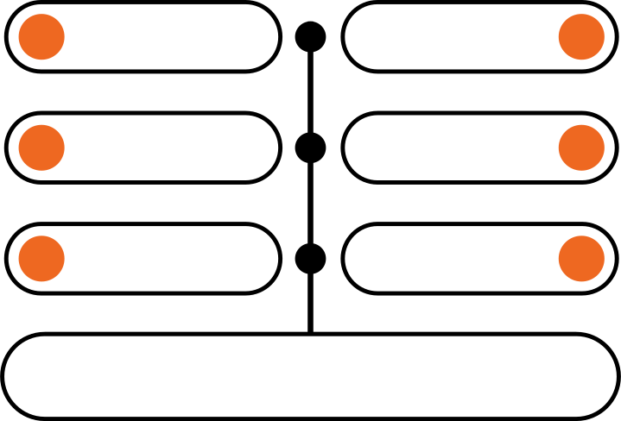
Role of AI
Active
Guidance
Student Ownership
Process-focused Teaching
Critical Engagement
Setting Boundaries
IMPLICATION

Slide 13
LIMITATIONS
Limited
Participant Sample
Self-reported Data
Small
Interview Sample
Modest
Scale Reliability

Slide 14

RECOMMENDATION
Educators & Universities
Assessment & Tasks
Structured educational frameworks &
process-oriented assignments
Mandatory drafts, notes &
self-reflection logs
Future Researchers
Long-term studies on how students learn to write on their own

Slide 15
REFERENCES
Alkamel, M. A. A., & Alwagieh, N. A. S. (2024). Utilizing an adaptable artificial intelligence writing tool (ChatGPT) to enhance academic writing skills among Yemeni university EFL students. Social Sciences & Humanities Open, 10, Article 101095.
https://doi.org/10.1016/j.ssaho.2024.101095
Bailey, S. (2025). Academic writing: A handbook for international students (6th ed.). Routledge. https://doi.org/10.4324/9781003509264
Banh, L., & Strobel, G. (2023). Generative artificial intelligence. Electronic Markets, 33, Article 63. https://doi.org/10.1007/s12525-023-00680-1
Bašić, Ž., Banovac, A., Kružić, I., & Jerković, I. (2023). ChatGPT-3.5 as writing assistance in students’ essays. Humanities and Social Sciences Communications, 10, Article 750.
https://doi.org/10.1057/s41599-023-02269-7
Boudouaia, A., Mouas, S., & Kouider, B. (2024). A study on ChatGPT-4 as an innovative approach to enhancing English as a foreign language writing learning. Journal of Educational Computing Research, 62(6), 1509–1537.
https://doi.org/10.1177/07356331241247465
Bryman, A. (2016). Social research methods (5th ed.). Oxford University Press.
Chen, B., Zhang, Z., Langrené, N., & Zhu, S. (2025). Unleashing the potential of prompt engineering for large language models. Patterns, 6(6), Article 101260.
https://doi.org/10.1016/j.patter.2025.101260

Slide 16
REFERENCES
Creswell, J. W., & Creswell, J. D. (2018). Research design: Qualitative, quantitative, and mixed methods approaches (5th ed.). SAGE Publications.
Creswell, J. W., & Plano Clark, V. L. (2018). Designing and conducting mixed methods research (3rd ed.). SAGE Publications.
Creswell, J. W., & Poth, C. N. (2018). Qualitative inquiry and research design: Choosing among five approaches (4th ed.). SAGE Publications.
Crosthwaite, P., & Sun, S. (2025). Generative AI and L2 written feedback studies: A scoping review. RELC Journal. Advance online publication.
https://doi.org/10.1177/00336882251386530
Ding, L., Zou, D., & Kohnke, L. (2026). Enhancing L2 writing with AI: Effects of ChatGPT feedback and the role of student engagement. Artificial Intelligence in Language Education, 2, Article 103356. https://doi.org/10.29140/aile.2026.103356
Field, A. (2018). Discovering statistics using IBM SPSS statistics (5th ed.). SAGE Publications.
Flower, L., & Hayes, J. R. (1981). A cognitive process theory of writing. College Composition and Communication, 32(4), 365–387.
https://doi.org/10.2307/356600
Hamp-Lyons, L., & Heasley, B. (2006). Study writing: A course in writing skills for academic purposes (2nd ed.). Cambridge University Press.

Slide 17
REFERENCES
He, R., Cao, J., & Tan, T. (2025). Generative artificial intelligence: A historical perspective. National Science Review, 12(5), Article nwaf050.
https://doi.org/10.1093/nsr/nwaf050
Hyland, K. (2003). Second language writing. Cambridge University Press. https://doi.org/10.1017/CBO9780511667251
Hyland, K. (2019). Second language writing (2nd ed.). Cambridge University Press.
Jiang, D., & Kalyuga, S. (2022). Learning English as a foreign language writing skills in collaborative settings: A cognitive load perspective. Frontiers in Psychology, 13, Article 932291. https://doi.org/10.3389/fpsyg.2022.932291
Jmaiel, H. A., Abukhait, R. O., Mohamed, A. M., Shaaban, T. S., Al-khresheh, M. H., & Al-Qadri, A. H. (2025). The role of ChatGPT in enhancing EFL students’ ESP writing skills: An experimental study of gender and major differences. Discover Education, 4, Article 240.
https://doi.org/10.1007/s44217-025-00700-6
Kallio, H., Pietilä, A.-M., Johnson, M., & Kangasniemi, M. (2016). Systematic methodological review: Developing a framework for a qualitative semi structured interview guide. Journal of Advanced Nursing, 72(12), 2954–2965.
https://doi.org/10.1111/jan.13031

Slide 18
REFERENCES
Kellogg, R. T. (2008). Training writing skills: A cognitive developmental perspective. Journal of Writing Research, 1(1), 1–26.
https://doi.org/10.17239/jowr 2008.01.01.1
Krashen, S. D. (1982). Principles and practice in second language acquisition. Pergamon Press.
Lai, T. K. L., & Trinh, H. L. (2025). The effects of ChatGPT on academic writing proficiency among English-majored undergraduates at a university. VNU Journal of Foreign Studies, 41(3), 92–109. https://doi.org/10.63023/2525 2445/jfs.ulis.5514
Lee, H.-P., Sarkar, A., Tankelevitch, L., Drosos, I., Rintel, S., Banks, R., & Wilson, N. (2025). The impact of generative AI on critical thinking: Self-reported reductions in cognitive effort and confidence effects from a survey of knowledge workers. In Proceedings of the 2025 CHI Conference on Human Factors in Computing Systems (pp. 1–22). ACM.
https://doi.org/10.1145/3706598.3713778
Mahapatra, S. (2024). Impact of ChatGPT on ESL students’ academic writing skills: A mixed methods intervention study. Smart Learning Environments, 11, Article 9.
https://doi.org/10.1186/s40561-024-00295-9
Nawal, A. F. (2018). Cognitive load theory in the context of second language academic writing. Higher Education Pedagogies, 3(1), 385–402.
https://doi.org/10.1080/23752696.2018.1513812

Slide 19
REFERENCES
Parasuraman, R., & Manzey, D. H. (2010). Complacency and bias in human use of automation: An attentional integration. Human Factors, 52(3), 381–410.
https://doi.org/10.1177/0018720810376055
Samir Passi, Shipi Dhanorkar, & Mihaela Vorvoreanu. 2024. Appropriate Reliance on Generative AI: Research Synthesis. Microsoft Technical Report MSR-TR-2024 7. Microsoft Corporation.
Patac, L. P., & Patac, A. V., Jr. (2025). Using ChatGPT for academic support: Managing cognitive load and enhancing learning efficiency—A phenomenological approach. Social Sciences & Humanities Open, 11, Article 101301
https://doi.org/10.1016/j.ssaho.2025.101301
Raza, M., Jahangir, Z., Riaz, M. B., Saeed, M. J., & Sattar, M. A. (2025). Industrial applications of large language models. Scientific Reports, 15, Article 13755.
https://doi.org/10.1038/s41598-025-98483-1
Setyowati, L., Sukmawan, S., & El-Sulukiyyah, A. A. (2020). Exploring the use of ESL Composition Profile for college writing in the Indonesian context. International Journal of Language Education, 4(2), 171–182.
https://doi.org/10.26858/ijole.v4i2.13662
Storey, V. C., Yue, W. T., Zhao, J. L., & Lukyanenko, R. (2025). Generative artificial intelligence: Evolving technology, growing societal impact, and opportunities for information systems research. Information Systems Frontiers, 27, 2081 2102.
https://doi.org/10.1007/s10796-025-10581-7

Slide 20
REFERENCES
Swain, M. (1985). Communicative competence: Some roles of comprehensible input and comprehensible output in its development. In S. M. Gass & C. G. Madden (Eds.), Input in second language acquisition (pp. 235–253). Newbury House.
Sweller, J. (1988). Cognitive load during problem solving: Effects on learning. Cognitive Science, 12(2), 257 285
https://doi.org/10.1207/s15516709cog1202_4
Sweller, J., Ayres, P., & Kalyuga, S. (2011). Cognitive load theory. Springer.
https://doi.org/10.1007/978-1-4419-8126-4 257–285.
Wang, C., Li, Z., & Bonk, C. J. (2024). Understanding self-directed learning in AI assisted writing: A mixed methods study of postsecondary learners. Computers and Education: Artificial Intelligence, 6, Article 100247.
https://doi.org/10.1016/j.caeai.2024.100247
Weigle, S. C. (2002). Assessing writing. Cambridge University Press. https://doi.org/10.1017/CBO9780511732997 Wingate, U. (2012). “Argument!” Helping students understand what essay writing is about. Journal of English for Academic Purposes, 11(2), 145–154.
https://doi.org/10.1016/j.jeap.2011.11.001
Xhaferi, A. (2024). The integration of ChatGPT in academic writing: Exploring perceptions and effectiveness of the students. International Journal of Multilingual Education, 25(2), 74–86.
https://doi.org/10.22333/ijme.2024.8997
Yuan, S., & Dao, P. (2026). ESL tertiary learners’ engagement in ChatGPT-assisted second language writing. Language Awareness. Advance online publication.
https://doi.org/10.1080/09658416.2026.2652333

Slide 21
REFERENCES
Zhai, C., Wibowo, S., & Li, L. D. (2024). The effects of over-reliance on AI dialogue systems on students’ cognitive abilities: A systematic review. Smart Learning Environments, 11, Article 28. https://doi.org/10.1186/s40561-024-00316-7
Zhang, S., Zhao, X., Zhou, T., & Kim, J. H. (2024). Do you have AI dependency? The roles of academic self-efficacy, academic stress, and performance expectations on problematic AI usage behavior. International Journal of Educational Technology in Higher Education, 21, Article 34.
https://doi.org/10.1186/s41239 024-00467-0

Slide 22

THANK YOU
FOR LISTENING!

