Slide 1

TESOL INTERNATIONAL CONFERENCE 2026
ARTIFICIAL INTELLIGENCE IN ENHANCING LISTENING AND NOTE-TAKING SKILLS:
EVIDENCE FROM FIRST-YEAR STUDENTS IN VIETNAM
Le Ngoc Anh Thu, Tran Tan Phat
Faculty of Foreign Languages, Ho Chi Minh City University of Foreign Languages and Information Technology
Faculty of Foreign Languages, Ho Chi Minh University of Banking

Slide 2
Presentation
Outline
1. Introduction
2. Literature Review
3. Methodology
4. Results and Discussion
5. Conclusion & Suggestions

Slide 3

1.
INTRODUCTION

Slide 4
Introduction
Research Background
Rapid transformation of higher education pedagogical practices.
HUFLIT’s focus on foreign languages and IT integration.
First-year students adapting from secondary to tertiary AI-enhanced learning paradigms.

Slide 5
Introduction
The Problem Statement
Discrepancy between students' self-reported AI competency and actual effective utilization for academic tasks
Note-taking Challenges: Simultaneous processing of oral input and writing remains a significant hurdle
Institutional Goal: Need for systematic investigation of AI tools in the Vietnamese EFL context
.

Slide 6
Introduction
Research Questions
1.What are HUFLIT first-year students’ perceptions of using AI in learning English?
2.How do AI tools impact HUFLIT first-year students’ English learning skills?
3.How did they apply note-taking skills in listening texts?

Slide 7

2.
LITERATURE REVIEW

Slide 8

Academic Listening as a Dual-Task
Simultaneous processing of oral input, content comprehension, and written record generation
Learners must split limited attention between speech and writing
First-year students often lack prior systematic note-taking training

Slide 9
Defining Effective Note-Taking
Quality vs. Quantity: Organization and inclusion of main ideas correlate more strongly with comprehension than word count
Metrics: Well-organized notes (hierarchical structures, symbols) are better predictors of performance
Reference: Shizuka & Ryan (2026) study with 195 EFL students
.

Slide 10
The Theoretical Framework: SOI Model
Selection: Identifying relevant information from oral input.
Organization: Structuring selected information coherently.
Integration: Connecting new information with prior knowledge.
AI Role: Scaffolding these processes through real-time aids.

Slide 11
AI Tools in Language Education
STT (Speech-to-Text): Immediate transcripts to facilitate noticing pronunciation and vocabulary.
Generative AI (e.g., NoteBookLM): Transforming written text into podcast-style dialogues to reduce cognitive load.
Personalization: 24/7 learning support and adjustable playback speeds.

Slide 12
Potential Benefits vs. Concerns
Benefits:
Personalized feedback
Vocabulary expansion
Reduced listening anxiety
Concerns:
Unnatural prosody (robotic voices)
Over-reliance
Loss of critical thinking

Slide 13

3.
METHODOLOGY

Slide 14
Instructional Strategies
Design: Mixed-methods sequential explanatory design.
Quantitative Strand: Quasi-experimental pretest-posttest control group design.
Qualitative Strand: Semi-structured reflective journals and open-ended questionnaires.
Rationale: Captures both statistical generalizability and contextual depth.

Slide 15
Research Participants
80 first-year EFL students at HUFLIT
  Experimental Group (n=40): AI-assisted instruction.
  Control Group (n=40): Conventional instruction.
  Proficiency Level: A2 to B1 CEFR levels
Instruments
Listening/Note-taking Tests: TOEFL ITP format (pre- and post-tests)
Perception questionnaire: 20-item Likert-scale (Perceived usefulness, engagement, etc.)
Reflective Journals: Documenting weekly strategies and challenges

Slide 16

Data collection
Data collection occurred over eight weeks during the first semester of the 2025 – 2026 academic year, following a structured timeline:
Week 1: Pretest (Standardized conditions)
Weeks 2-7: Intervention period (AI training for Experimental Group)
Week 8: Posttest and questionnaire.

Slide 17

4.
Results and Discussion

Slide 18
4.1. Analysis of Survey Results from 80 First-Year Students
Descriptive Statistics of Student Perceptions (Post-Intervention)
Perception Dimension | Experimental Group (n = 40) Mean (SD) | Control Group (n = 40) Mean (SD) | t-value | p-value
Perceived Usefulness | 4.28 (0.52) | 3.15 (0.68) | 8.34 | <.001
Ease of Use | 4.05 (0.61) | 3.30 (0.72) | 5.12 | <.001
Engagement | 4.18 (0.55) | 3.28 (0.69) | 6.45 | <.001
Reduced Listening Anxiety | 3.98 (0.70) | 3.22 (0.80) | 4.56 | <.001
Overall Perception | 4.12 (0.58) | 3.24 (0.71) | 6.14 | <.001

Slide 19
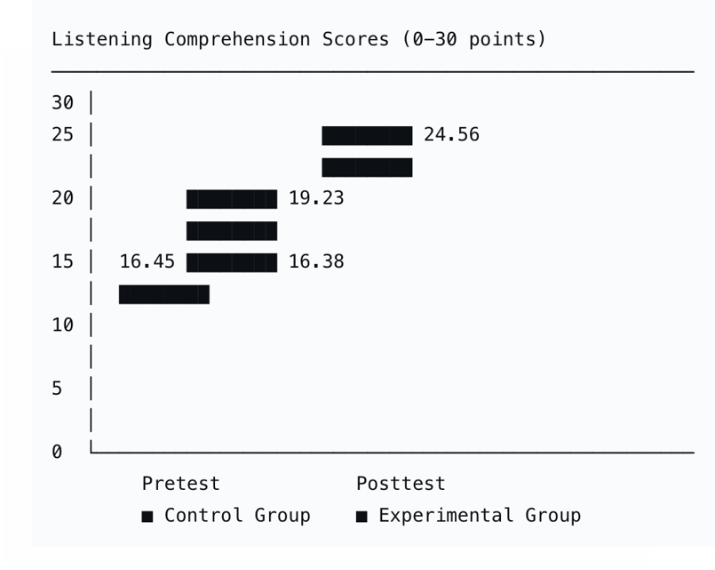
4.1. Analysis of Survey Results from 80 First-Year Students
Pre- and Post-Intervention Listening Comprehension Scores

Slide 20
4.1. Analysis of Survey Results from 80 First-Year Students
Note-Taking Quality Scores by Assessment and Group
Assessment Point | Control Group (n=40) Mean (SD) | Experimental Group (n=40) Mean (SD) | Mean Difference | % Improvement
Pretest (Week 1) | 5.28 (1.38) | 5.34 (1.42) | +0.06 | —
Posttest (Week 8) | 6.45 (1.67) | 8.67 (1.15) | +2.22 | —
Gain Score | +1.17 | +3.33 | +2.16 | —
% Improvement | 22.2% | 62.4% | — | 40.2% higher

Slide 21

4.2. Three Quantitative and Qualitative Models
Model 1: Perceived Usefulness-Actual Usage Correlation Model
Perception: 92.5% found AI useful.
Usage: Only 67.5% used it regularly beyond training.
Gap reason: Cognitive load involved in comparing personal notes with AI transcripts

Slide 22
4.2. Three Quantitative and Qualitative Models
Model 2: Note-Taking Quality Improvement Model
AI-Assisted Linear Notes
Adoption Rate: 42.5% of students.
Description: Using AI transcripts as the primary base text and annotating them manually.
Comparative Dual-Column Notes
Adoption Rate: 35% of students.
Description: Verifying personal notes alongside AI-generated summaries.
Outcome: Yielded the highest learning outcomes.
AI-Independent Strategic Notes
Adoption Rate: 22.5% of students.
Description: Deliberately avoiding AI for certain tasks to practice unaided listening.
Insight: Reflects high metacognitive awareness and resistance to over-reliance

Slide 23
4.2. Three Quantitative and Qualitative Models
Correlation Matrix of Key Variables (Experimental Group)
Variable | 1 | 2 | 3 | 4 | 5
1.Perceived Usefulness | 1.00
2. Frequency of AI Tool Use | 0.62** | 1.00
3. Note-Taking Quality (Posttest) | 0.58** | 0.71** | 1.00
4.Listening Comprehension (Posttest) | 0.53** | 0.67** | 0.79** | 1.00
5.Self-Reported Anxiety Reduction | 0.48* | 0.44* | 0.39* | 0.52** | 1.00
Note: *p < .05; **p < .01; n=40*

Slide 24
4.2. Three Quantitative and Qualitative Models
Comparison of Pre- and Post-Intervention Note-Taking Rubric Sub-Scores
Note: Rubric adapted from Jin & Webb (2024).
Rubric Component (Max Points) | Control Group (n=40) | Experimental Group (n=40)
 | Pretest | Posttest | Gain | Pretest | Posttest | Gain
Organization (3 pts) | 1.15 | 1.48 | +0.33 | 1.18 | 2.35 | +1.17
Main Ideas (3 pts) | 1.42 | 1.75 | +0.33 | 1.45 | 2.28 | +0.83
Supporting Details (3 pts) | 1.38 | 1.62 | +0.24 | 1.40 | 2.10 | +0.70
Abbreviations/ Symbols (3 pts) | 1.33 | 1.60 | +0.27 | 1.31 | 1.94 | +0.63
Total (12 pts) | 5.28 | 6.45 | +1.17 | 5.34 | 8.67 | +3.33

Slide 25
4.2. Three Quantitative and Qualitative Models
Thematic Analysis of Reflective Journals (Experimental Group)
Theme | Frequency | Example Quote | Representative Participant
AI as verification tool | 32 (80%) | “I listen first without AI, then check my notes against the transcript. This shows me what I missed.” | E08
Reduced listening anxiety | 28 (70%) | “Knowing I can see the transcript later makes me less nervous during first listening.” | E22
Concern about over-reliance | 26 (65%) | “Sometimes I just wait for AI instead of trying to listen. That’s a bad habit I’m fighting.” | E17
Improved vocabulary acquisition | 24 (60%) | “AI explains unknown words immediately. I learn more words per lecture now.” | E35
Need for instructor guidance | 22 (55%) | “AI is powerful, but I don’t always know how to use it best. Teacher shows us strategies.” | E12
Technical frustration | 18 (45%) | “Slow internet makes AI transcription lag. Very annoying during live listening.” | E03
Note: Multiple themes could be reported per participant; percentages reflect proportion of 40 participants mentioning each theme at least once.

Slide 26
Discussion
AI should be used to support, not replace, active listening.
Impact depends on strategic integration rather than mere access.
AI provides a safety net that lowers comprehension pressure.

Slide 27

5.
CONCLUSION

Slide 28
AI-enhanced instruction leads to significantly higher improvements in listening comprehension (50% gain) and note-taking quality (62.4% gain) compared to conventional methods.
The effectiveness of AI depends on pedagogical scaffolding; using AI as a verification tool (comparative dual-column approach) is superior to passive dependence.
Strategic deployment of AI tools fosters learner independence while reducing cognitive load and listening anxiety.
While perceptions are overwhelmingly positive, students remain aware of technical limitations like unnatural prosody and transcription inaccuracies

Slide 29
Suggestions for Future Research
Longitudinal designs are needed to examine whether AI-induced gains persist over time and whether over-reliance concerns materialize into long-term skill deficits.
Comparative studies across different AI tool types (e.g., generative AI vs. speech recognition alone) would clarify which features drive improvement.
Investigations with larger, more diverse samples across multiple Vietnamese universities would enhance generalizability.
Move from isolated interventions toward systematic, sustainable pedagogical models that officially integrate AI into the EFL curriculum

Slide 30
Thanks for listening.

