Slide 1


Slide 2
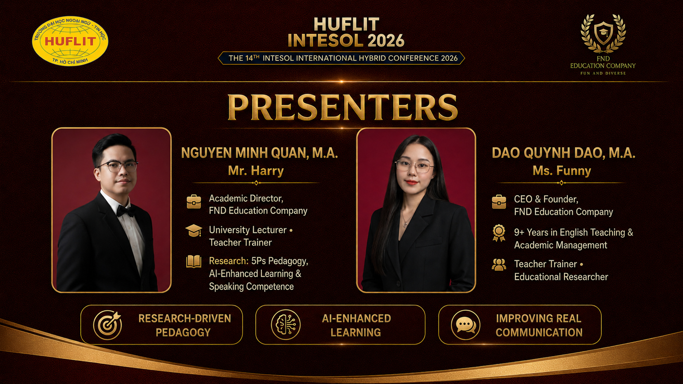

Slide 3


Slide 4
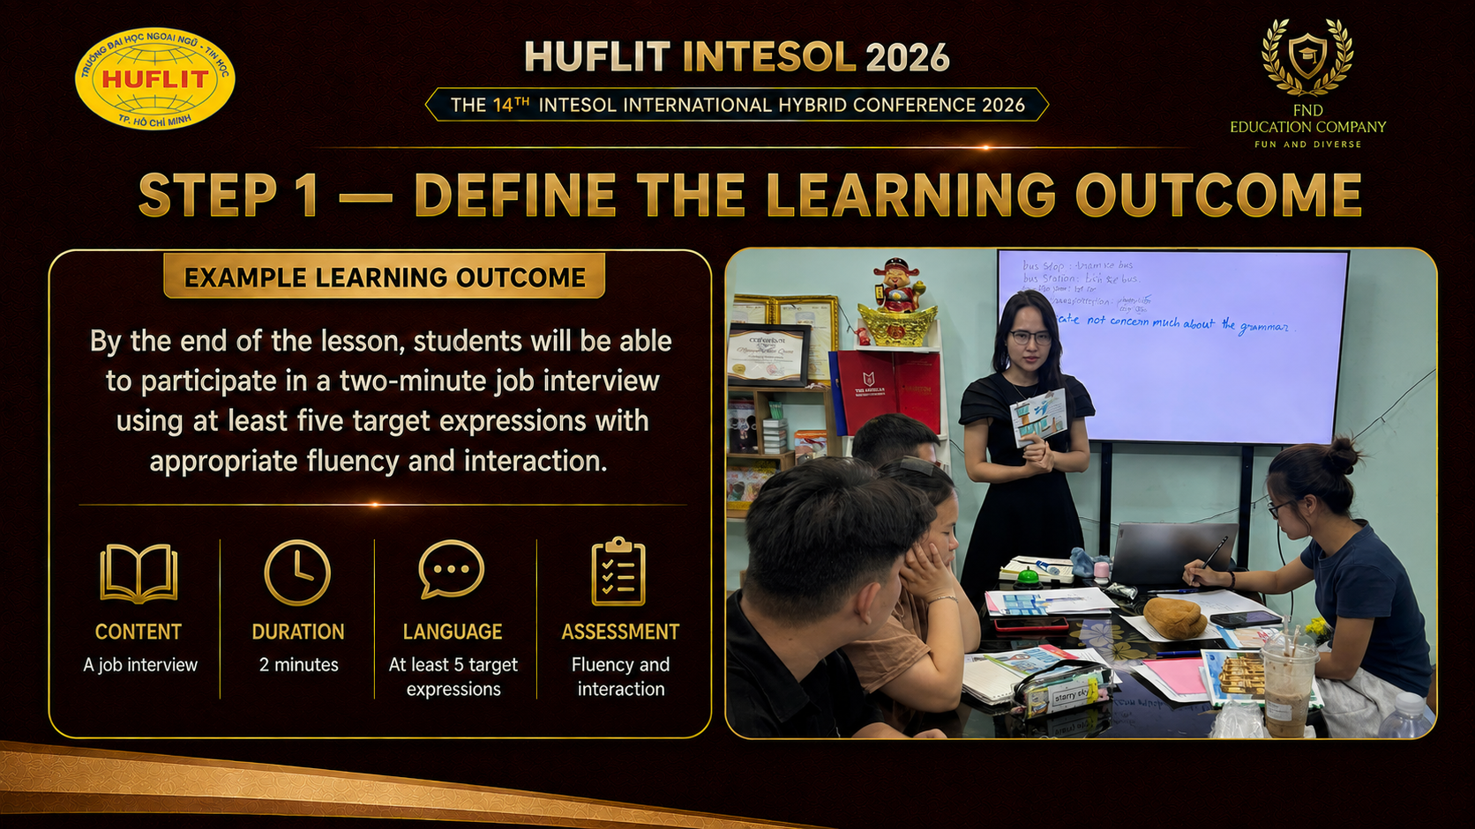

Slide 5
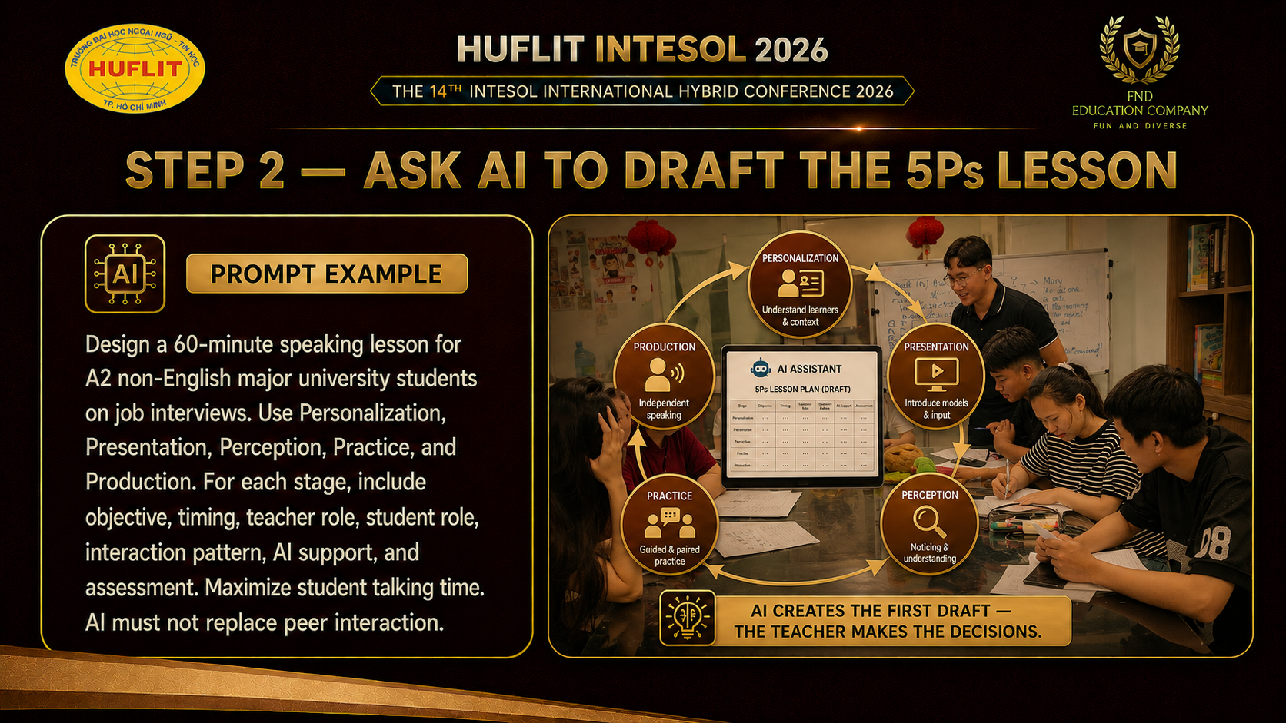

Slide 6
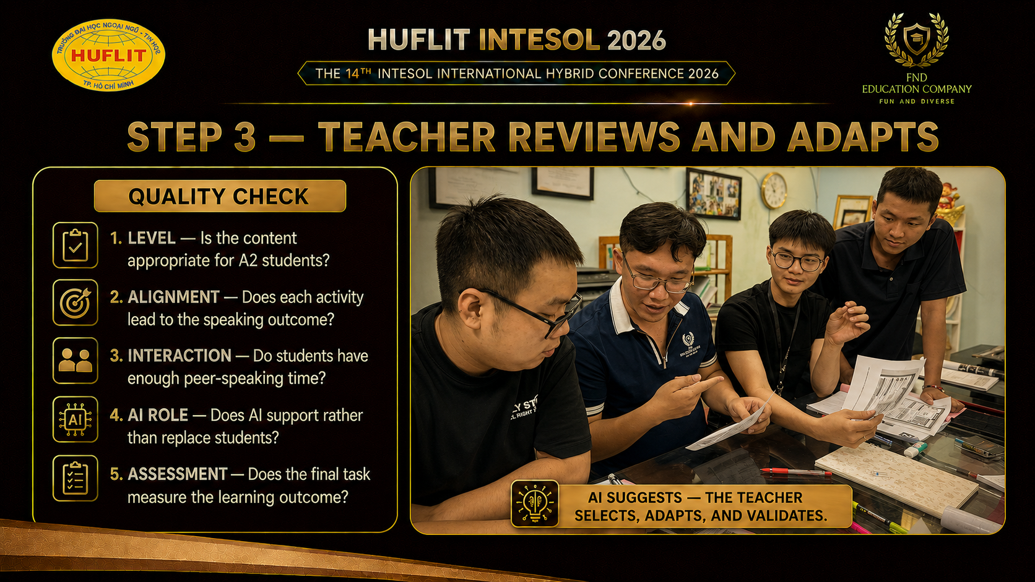

Slide 7


Slide 8
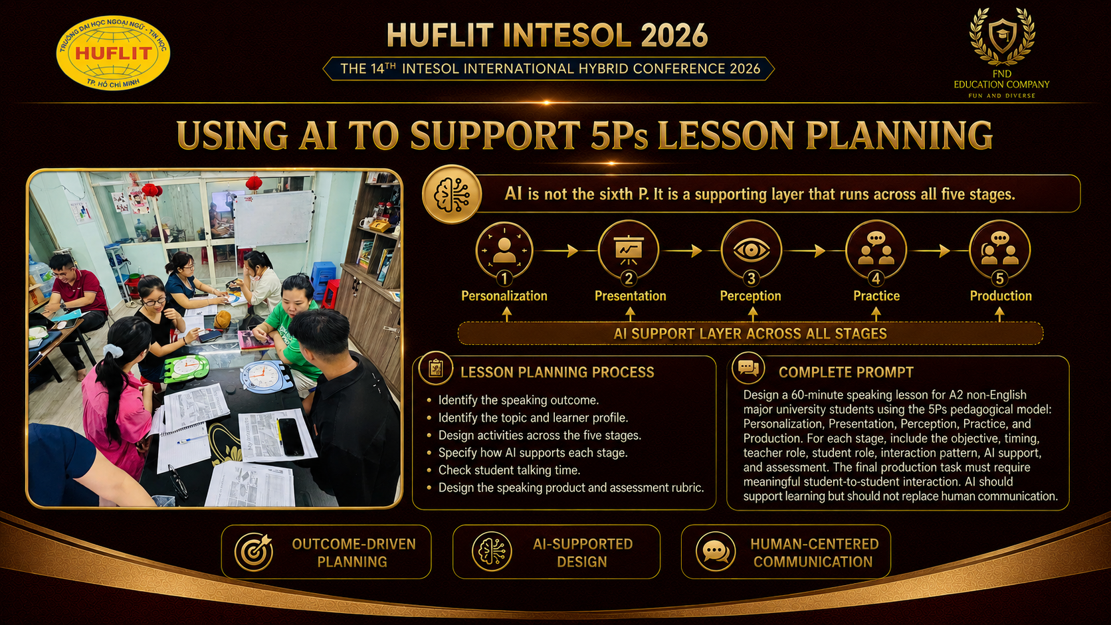

Slide 9
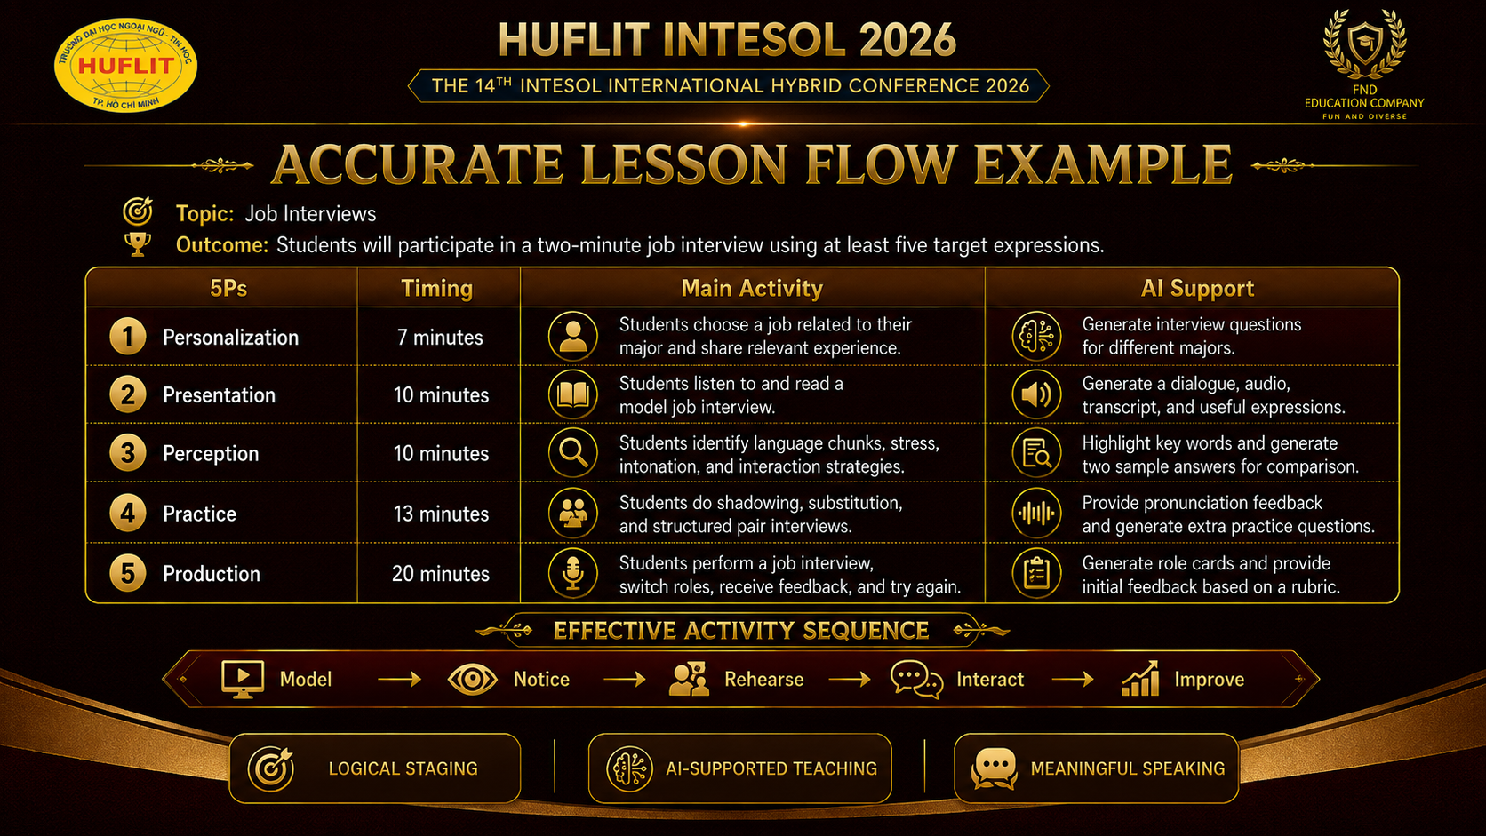

Slide 10
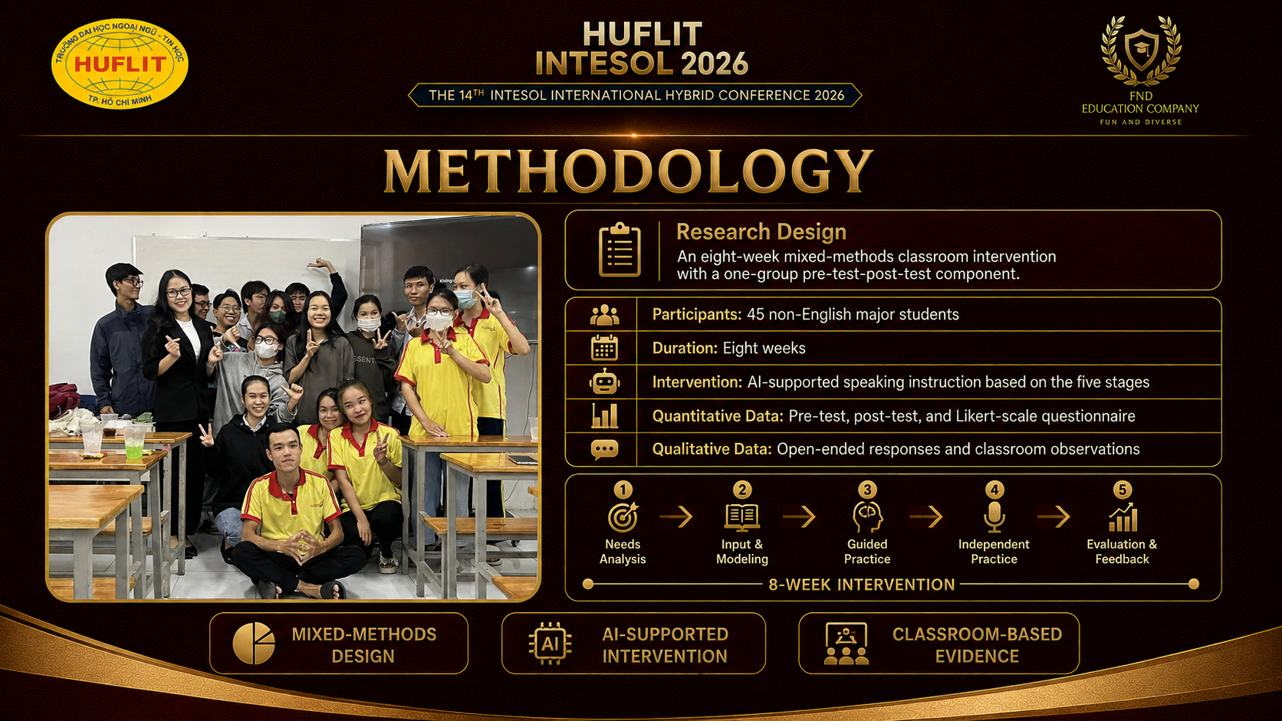

Slide 11
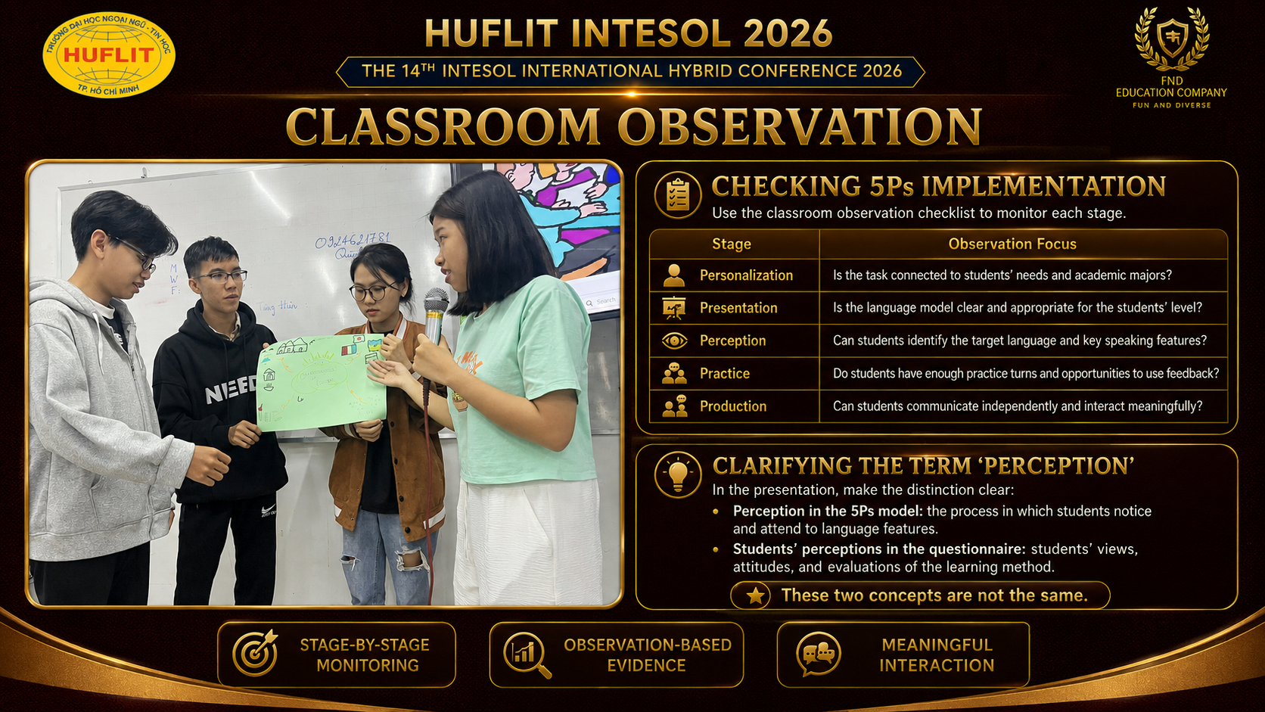

Slide 12
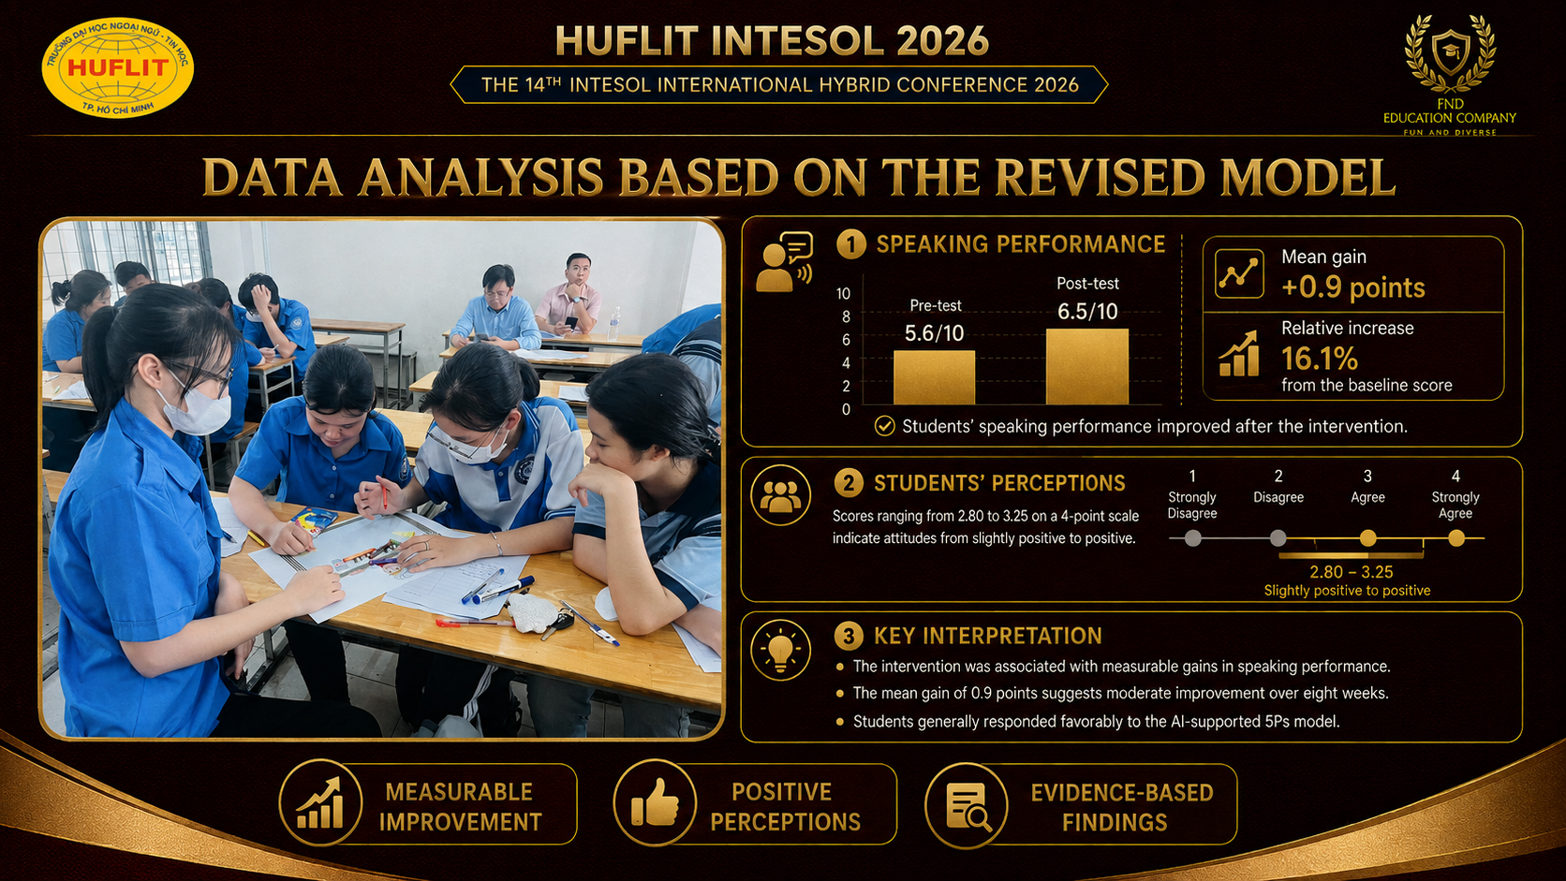
Notes:
Speaking performance: The score increase may reflect the structured progression of the 5Ps model. Personalization established relevance, Presentation provided language input, Perception encouraged noticing, Practice supported rehearsal, and Production created opportunities for independent speaking.
Students’ perceptions: Students generally responded positively to the approach, particularly its flexible practice opportunities and immediate feedback. However, the variation across questionnaire items indicates that students did not evaluate every aspect equally positively.

Slide 13
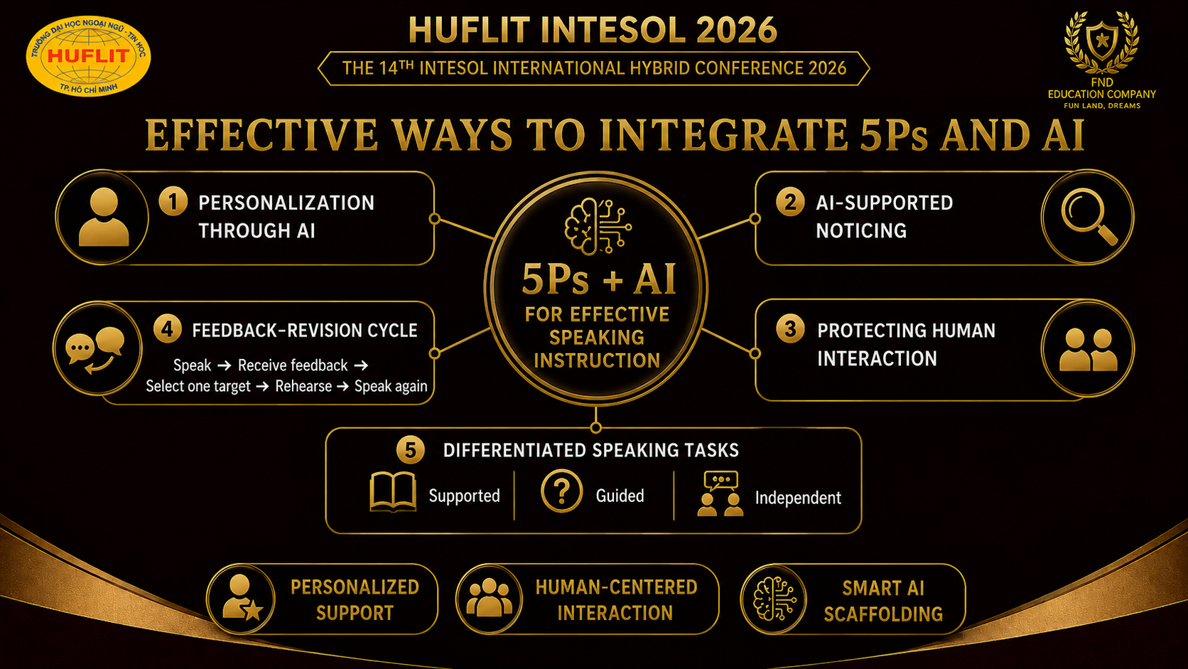
Notes:
1Personalization through AI: AI can create speaking situations based on students’ academic majors, language proficiency levels, personal interests, career goals, and specific difficulties faced by each group.
2AI-Supported Noticing: At the Perception stage, AI can highlight target expressions, mark word stress, compare two responses, generate transcripts from students’ spoken output, and help students identify errors before practising again.
3Feedback–Revision: CycleSpeak → Receive feedback → Select one target → Rehearse → Speak again. AI provides immediate feedback; teachers and peers verify the feedback; students then repeat and improve the speaking task.
4Protecting Human Interaction: At the Production stage, AI should only create communicative situations, generate role cards, support idea preparation, and provide feedback after the activity. The main communication must take place between students.
5Differentiated Speaking Tasks: AI can create three levels of speaking tasks: Supported—vocabulary banks and sentence frames; Guided—guiding questions and key expressions; Independent—open-ended communicative situations.

Slide 14
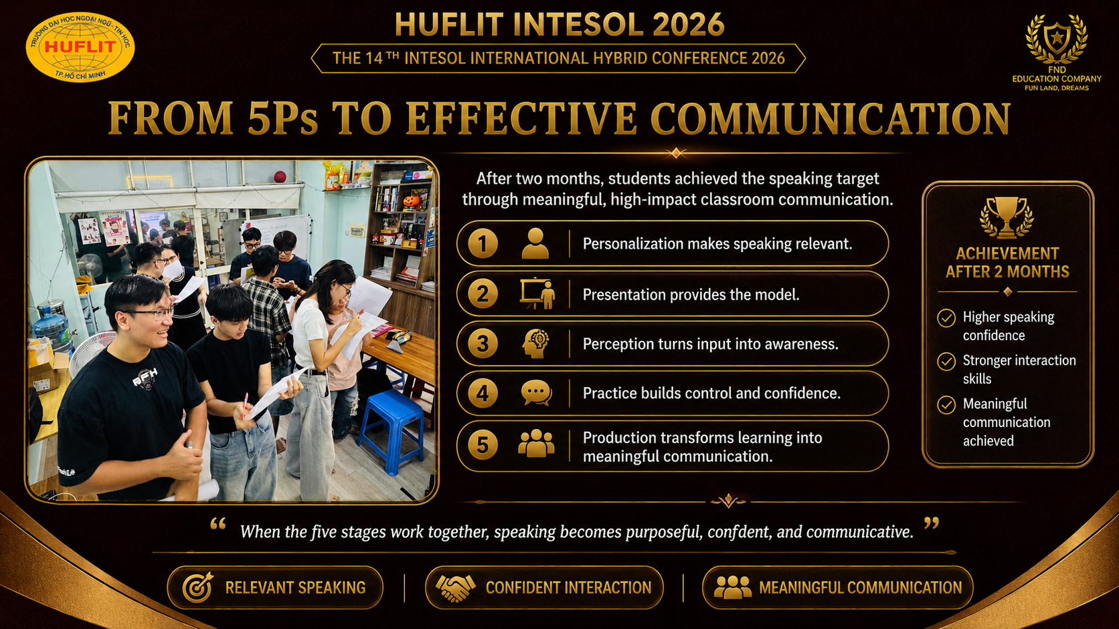
Notes:
The 5Ps model structures speaking development, while AI strengthens personalization, language awareness, practice, and feedback. However, meaningful human interaction remains the centre of speaking development.

Slide 15


Slide 16


