Slide 1




HUFLIT English Majors’ Perceptions of
AI-Supported Translation Learning in a Vietnamese EFL Context
Tran Nam Anh
Tran Thanh Tu
Faculty of Foreign Languages, HUFLIT
INTESOL 2026

Slide 2
Presentation Outline
1
Background, Research Problem & Objectives
2
Theoretical Framework & Methodology
3
Key Findings: Reliability & Factor Analysis
4
Discussion, Implications & Conclusion

Slide 3
Background of the Study
Generative AI (ChatGPT, Grammarly) is reshaping translation practice and education
Many translation programmes remain teacher-centred, with limited AI integration
Vietnamese EFL learners rely heavily on formal classroom instruction
HUFLIT students use AI in translation courses, but their perceptions remain unexamined

Slide 4
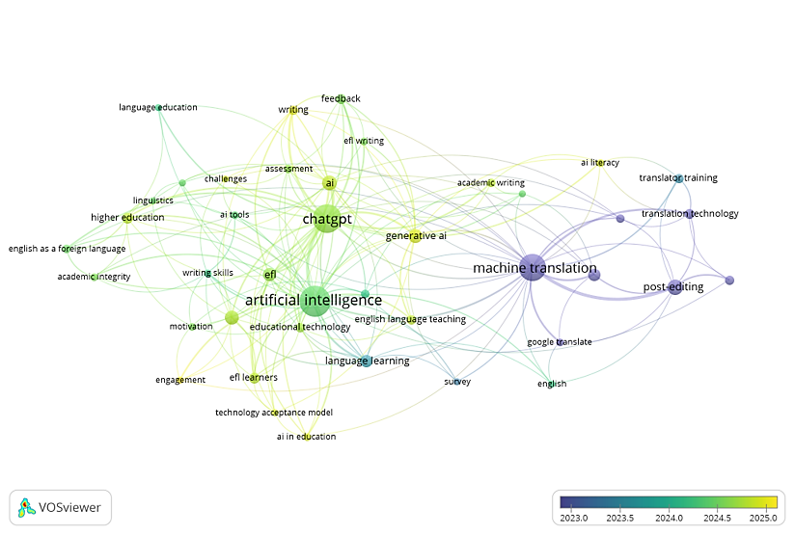
Research Problem & Gap
Most AI-in-education research targets general ESL/EFL, not translation-specific instruction
Empirical evidence from Vietnamese higher education remains limited
Prior studies rely on single theoretical lenses (TAM-only or TPACK-only)
Gap: no integrated framework linking perception, teaching, and self-regulation

Slide 5
Research Objectives & Questions
Objective: Investigate HUFLIT students' perceptions of AI-supported translation learning
RQ1: How do students perceive benefits and risks of AI-supported translation learning?
RQ2: What empirical factor structure emerges from students' perceptions?
RQ3: How do students perceive teacher AI integration and self-regulated engagement?

Slide 6
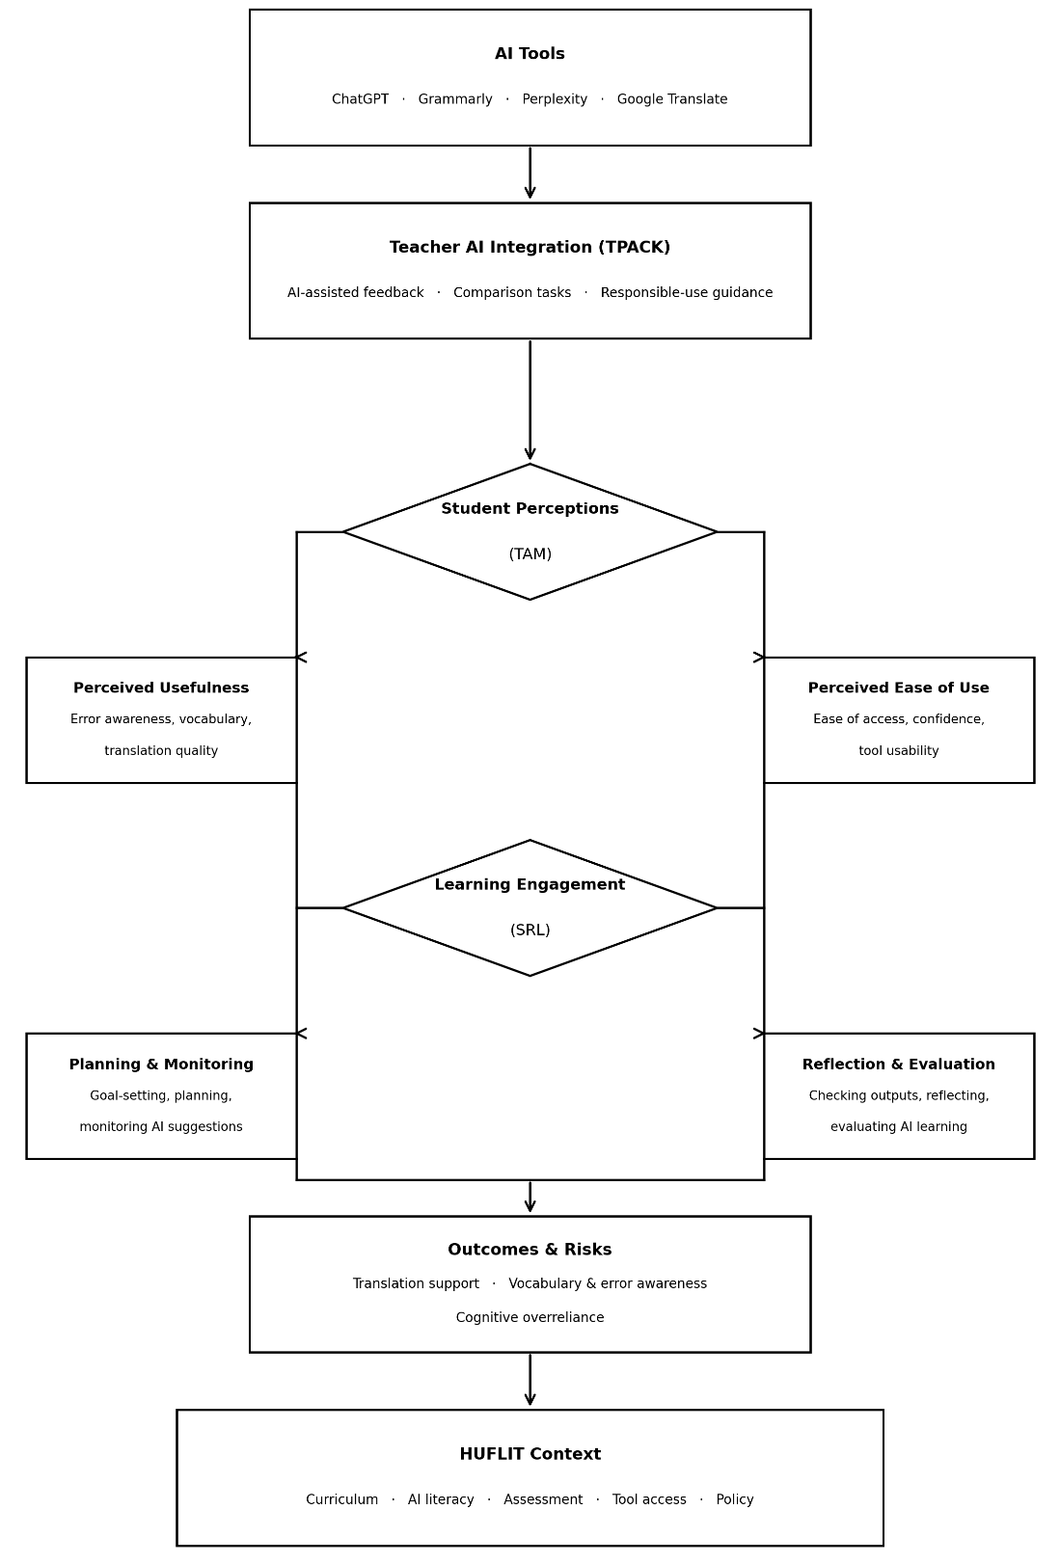
Integrated Theoretical Framework
TAM (Davis, 1989): perceived usefulness & ease of use drive AI adoption
TPACK (Mishra & Koehler, 2006): how teachers integrate AI into instruction
SRL (Zimmerman, 2000): planning, monitoring, and reflecting on AI use
Together: a multidimensional lens for AI-supported translation learning

Slide 7
Methodology
Quantitative survey design
Participants: HUFLIT English majors, Years 2–4, with translation coursework experience
Instrument: 23 Likert-scale items across 5 constructs (PU, PEOU, TAI, SRL, CO)
Analysis (SPSS): Descriptive statistics → Reliability (Cronbach's alpha) → EFA (PCA, Varimax)

Slide 8
Sample Profile & AI Usage
N = 219 English majors (78.5% female, 21.5% male; mostly 2nd-year students)
92.7% had already used AI in their translation courses
Mean AI-use frequency = 3.84/5; ChatGPT is the most-used tool (72.6%)
Main purposes: grammar checking (32.9%), vocabulary (24.2%), idea generation (23.7%)

Slide 9
Reliability Analysis
All 5 constructs show good-to-excellent internal consistency (α = 0.884–0.923)
Highest reliability: Self-Regulated Learning (α = 0.923)
Highest reliability: Teacher AI Integration (α = 0.917)
No items removed — all item-total correlations exceed 0.30

Slide 10
Students' Perceptions: Key Patterns
Perceived Usefulness: highest ratings overall (M = 4.15–4.16)
Top item: "Teacher helps decide when to rely on AI" (M = 4.33)
Self-Regulated Learning: consistently high (M = 3.90–4.17)
Concern: "I depend too much on AI" scored M = 4.03

Slide 11
Four-Factor Empirical Model (EFA)
KMO = 0.899; Bartlett's test significant — data suitable for factor analysis
4 factors extracted, explaining 73.53% of total variance
F1 AI Learning Engagement (26.4%) | F2 Teacher AI Integration (17.0%)
F3 Cognitive Overreliance (15.4%) | F4 Perceived Ease of Use (14.7%)

Slide 12
Key Finding: AI Learning Engagement
Perceived Usefulness and Self-Regulated Learning converged into ONE factor
Students see AI as useful precisely because it scaffolds their own learning
Planning, monitoring, and reflecting are inseparable from perceived usefulness
Contrasts with classical TAM, which treats these as separate constructs

Slide 13
Discussion: Teacher Guidance & Overreliance
Teacher AI Integration remained a distinct, independent factor (confirms TPACK)
Cognitive Overreliance also emerged as its own separate factor
Students are aware of overdependence, but awareness alone does not change behaviour
High ease of use, but confidence lags – critical AI literacy training still needed

Slide 14
Implications & Conclusion
/
Theoretical: TAM–TPACK–SRL integration reveals
a more nuanced perceptual structure
Practical: integrate AI into translation syllabi via comparison
and evaluation tasks
Practical: invest in teacher ai-literacy training
and clear institutional policies
AI's value ultimately depends on how it is taught, guided,
and critically framed

Slide 15
Thank You
Tran Nam Anh — anhtn@huflit.edu.vn
Tran Thanh Tu— tutt@huflit.edu.vn
Faculty of Foreign Languages, HUFLIT

